Slide 1

The Network Layer: Inter-Domain Routing
CS 352, Lecture 17, Spring 2020
http://www.cs.rutgers.edu/~sn624/352
Srinivas Narayana

Slide 2
Course announcements
Mid-term: Sakai scores you received were out of 30
We will grade the remaining 15 points manually
Project 2 due this Friday
Project 3 will go out this weekend
Small, but tricky. Start early.

Slide 3
Routing protocols
Link state protocols
e.g., OSPF, IS-IS
Path vector protocols
e.g., BGP
Distance vector protocols
e.g., RIP, IGRP
Intra-AS protocols
same protocol within an AS
different algorithms across ASes
Also called interior gateway protocols (IGP)
Inter-AS protocols
common across Ases
each AS knows little about the others
eBGP, iBGP, gateway routers

Slide 4
Border Gateway Protocol (BGP)
The glue that holds the Internet together

Slide 5
BGP basics
BGP session: two BGP routers (“peers”) exchange BGP messages over semi-permanent TCP connection:
advertising paths to different destination network prefixes
(compare to distance vectors and link state)
When AS3 gateway router 3a advertises path AS3,X to AS2 gateway router 2c,
AS3 promises to AS2 it will forward datagrams towards X
AS 3
3b
AS 1
1b
3a
3c
1a
1c
AS 2
2b
3d
X
1d
2a
2c
BGP advertisement:
AS3, X
2d

Slide 6
Path attributes and BGP routes
advertised prefix includes BGP attributes
Advertisement of a route = prefix + attributes
Two important attributes:
AS-PATH: list of ASes through which prefix advertisement has passed
NEXT-HOP: indicates specific internal-AS router to next-hop AS
Policy-based routing:
gateway receiving route advertisement uses import policy to accept/decline path (e.g., never route through AS Y).
AS export policy also determines whether to advertise a path to other other neighboring ASes

Slide 7
Policies in BGP

Slide 8
Policy comes from business relationships
Customer-provider relationships:
E.g., Rutgers is a customer of AT&T
Peer-peer relationships:
E.g., Verizon is a peer of AT&T
Business relationships depend on where connectivity occurs
“Where”, also called a “point of presence” (PoP)
E.g., customers at one PoP but peers at another
Sometimes, even when there is no direct connectivity
E.g., inteliquent (zoom/webex) traffic not to be charged, acc. to the FCC
Internet-eXchange Points (IXPs) are large PoPs where ISPs come together to connect with each other (often for free)

Slide 9
BGP Export Policy and Advertisements
legend:
provider
B
network
X
W
A
customer
C
network:
Y
Suppose an ISP only wants to route traffic to/from its customer networks (does not want to carry transit traffic between other ISPs)
A,B,C are provider networks
X,W,Y are customer (of provider networks)
X is dual-homed: attached to two networks
policy to enforce: X does not want to route from B to C via X
.. so X will not advertise to B a route to C

Slide 10
BGP Export Policy and Advertisements
legend:
provider
B
network
X
W
A
customer
C
network:
Y
Suppose an ISP only wants to route traffic to/from its customer networks (does not want to carry transit traffic between other ISPs)
A advertises path Aw to B and to C
B chooses not to advertise BAw to C:
B gets no “revenue” for routing CBAw, since none of C, A, w are B’s customers
C does not learn about CBAw path
C will route CAw (not using B) to get to w

Slide 11
Policies make BGP a complex protocol.
Advertise entire paths, not just local info (like link state or distance vectors).
Choose to advertise (export) only certain paths.
Choose to accept (import) only certain paths.
Complex decision process to prefer certain imported paths over others.

Slide 12
Poll #1
What may be a legitimate business policy used by a BGP-speaking AS?
(a) Don’t advertise to one provider paths to another provider
(b) Don’t advertise to a peer paths to another peer
(c) Do advertise to a customer paths to other customers
(d) Any of the above

Slide 13
BGP Routing

Slide 14
BGP path advertisement
AS3
3b
AS1
1b
3a
3c
1a
1c
AS2
2b
3d
X
1d
AS3,X
AS2,AS3,X
2a
2c
2d
AS2 router 2c receives path advertisement AS3,X (via eBGP) from AS3 router 3a
Based on AS2 policy, AS2 router 2c accepts path AS3,X, propagates (via iBGP) to all AS2 routers
Based on AS2 policy, AS2 router 2a advertises (via eBGP) path AS2, AS3, X to AS1 router 1c

Slide 15
BGP path advertisement
AS3
3b
AS1
1b
AS3,X
3a
3c
1a
1c
AS2
2b
3d
X
1d
AS3,X
AS2,AS3,X
2a
2c
2d
Gateway router may learn about multiple paths to destination:
AS1 gateway router 1c learns path AS2,AS3,X from 2a
AS1 gateway router 1c learns path AS3,X from 3a
Based on policy, AS1 gateway router 1c chooses path AS3,X, and advertises path within AS1 via iBGP

Slide 16
BGP messages
BGP messages exchanged between peers over TCP connection
In principle, can establish BGP session with any router
Common, but not necessary, that routers are physically adjacent
BGP messages:
OPEN: opens TCP connection to remote BGP peer and authenticates sending BGP peer
UPDATE: advertises new path (or withdraws old)
KEEPALIVE: keeps connection alive in absence of UPDATES; also ACKs OPEN request
NOTIFICATION: reports errors in previous msg; also used to close connection

Slide 17
BGP, OSPF, forwarding table entries
Q: how does router set forwarding table entry to distant prefix?
AS3
3b
AS1
1b
AS3,X
1
AS3,X
3a
3c
1a
2
1c
local link interfaces
at 1a, 1d
AS2
2b
3d
X
2
1d
1
AS3,X
AS2,AS3,X
2a
2c
physical link
2d
dest
NH
interface
recall: 1a, 1b, 1c learn about dest X via iBGP from 1c: “path to X goes through 1c”
Next-Hop
…
…
…
…
…
…
…
…
1d: OSPF intra-domain routing: to get to 1c, forward over outgoing local interface 1
X
1c
1c
1

Slide 18
BGP, OSPF, forwarding table entries
Q: how does router set forwarding table entry to distant prefix?
AS3
3b
AS1
1b
AS3,X
1
AS3,X
3a
3c
1a
2
1c
AS2
2b
3d
X
2
1d
1
AS3,X
AS2,AS3,X
2a
2c
physical link
2d
dest
NH
interface
recall: 1a, 1b, 1c learn about dest X via iBGP from 1c: “path to X goes through 1c”
Next-Hop
…
…
…
…
…
…
…
…
1d: OSPF intra-domain routing: to get to 1c, forward over outgoing local interface 1
X
1c
1c
2
1a: OSPF intra-domain routing: to get to 1c, forward over outgoing local interface 2

Slide 19
Poll #2
Suppose an AS uses OSPF as its intra-domain routing protocol.
Forwarding table entries on AS-internal routers towards destinations outside the AS are computed using information from
(a) iBGP
(b) OSPF
(c) both iBGP and OSPF
(d) None of the above

Slide 20
BGP route selection process
Router may learn about more than one route to destination AS, selects route based on:
local preference value attribute (policy decision)
shortest AS-PATH
closest NEXT-HOP router: “hot potato” routing
additional criteria
You can read up on the full, complex, list of criteria, e.g., at https://www.cisco.com/c/en/us/support/docs/ip/border-gateway-protocol-bgp/13753-25.html

Slide 21
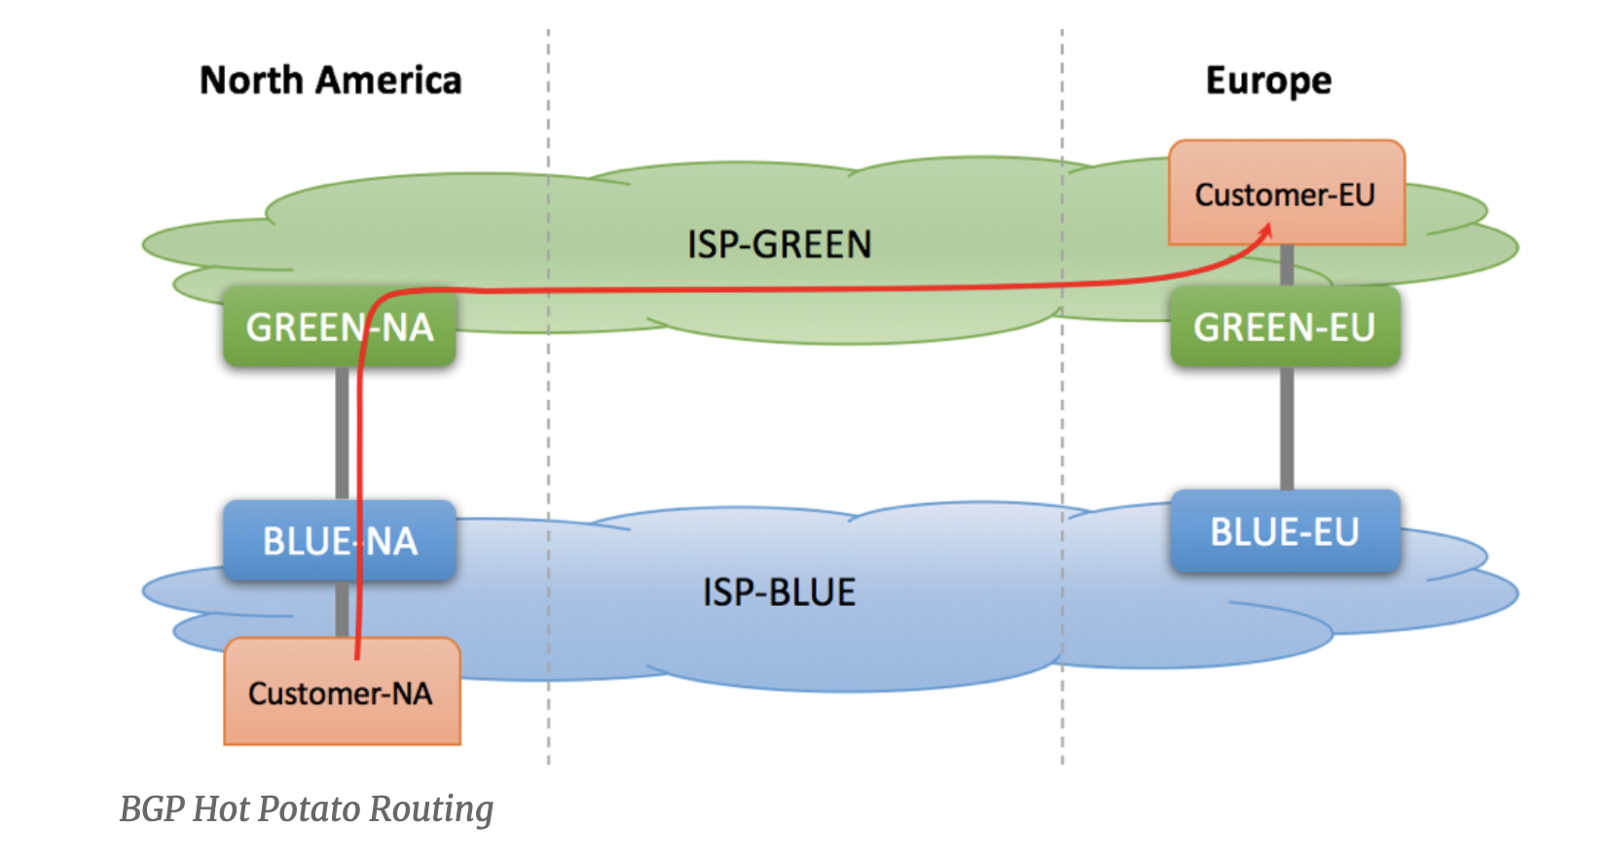

Hot-Potato Routing
Also called early-exit routing
Choose the “next-hop” router that is closest based on intra-AS routing
Reduces utilization on resources inside the AS
Source: http://bgphelp.com/2017/04/25/hot-potato-vs-cold-potato-routing/

Slide 22
Why different Intra-, Inter-AS routing?
policy:
inter-AS: admin wants control over how its traffic routed, who routes through its net.
intra-AS: single admin, so no policy decisions needed
scale:
hierarchical routing saves table size, reduced update traffic
performance:
intra-AS: can focus on performance
inter-AS: policy may dominate over performance

Slide 23
Quality of Service
How can the network make application performance better?

Slide 24
Network support for applications
A best effort Internet architecture does not offer any guarantees on delay, bandwidth, and loss
Network may drop, reorder, corrupt packets
Network may treat transfers randomly regardless of their “importance”
However, many apps require delay and loss bounds
E.g., voice over IP (phone calls) require strict delay guarantees
E.g., HD video requires a reasonable minimum bandwidth
E.g., remote surgery with 3D-vision requires strict sync & latency
How to provide quality of service (QoS) for apps?
Provision enough resources: make the best of best effort service
Mechanisms to handle traffic differently based on importance

Slide 25
How can networks improve the quality of service for applications?
Contention between different applications occurs often in the core of the network, not just at endpoints.
If contention isn’t resolved, performance of some apps may be severely affected.
e.g., zoom session affected by massive concurrent bittorrent downloads

Slide 26
One approach: “dimension” best effort networks well
deploy enough link capacity so that congestion doesn’t occur, multimedia traffic flows without delay or loss
low complexity of network mechanisms (use current “best effort” network)
high bandwidth costs
challenges:
network dimensioning: how much bandwidth is “enough?”
estimating network traffic demand: needed to determine how much bandwidth is “enough” (for that much traffic)
Network operators do this quite well, but there are exceptional circumstances.
Superbowl?
Pandemics?

Slide 27

Another approach: Multiple classes of service
Avoid “one-size fits all” service model
Use multiple classes of service
partition traffic into classes
network treats different classes of traffic differently (analogy: premium vs. economy lines at airports)
granularity: differential service among multiple classes, not among individual connections
history: ToS bits in IP hdr
0111

Slide 28

Multiple classes of service: scenario
H1
H3
R1
R2
H4
H2
R1 output
interface
queue
1.5 Mbps link

Slide 29
Scenario 1: mixed HTTP and VoIP
example: 1Mbps VoIP, HTTP share 1.5 Mbps link.
HTTP bursts can congest router, cause audio loss
want to give priority to audio over HTTP
R1
R2
Principle 1
packet marking needed for router to distinguish between different classes; and new router policy to treat packets accordingly

Slide 30
Principles for QOS guarantees (more)
what if applications misbehave (VoIP sends higher than declared rate)
policing: force source adherence to bandwidth allocations
marking, policing at network edge
1 Mbps
phone
R1
R2
1.5 Mbps link
packet marking and policing
Principle 2
provide protection (isolation) for one class from others

Slide 31
Principles for QoS guarantees (more)
allocating fixed (non-sharable) bandwidth to flow: inefficient use of bandwidth if flows doesn’t use its allocation
1 Mbps
phone
1 Mbps logical link
R1
R2
1.5 Mbps link
0.5 Mbps logical link
Principle 3
while providing isolation, it is desirable to use
resources as efficiently as possible
Work conservation

Slide 32
Poll #3
Where does contention between different traffic classes (e.g., resulting in long queues) typically occur within routers?
(a) switch fabric
(b) input line termination
(c) output port buffers
(d) forwarding table

Slide 33
Poll #4
What router mechanisms might you use to implement quality of service mechanisms?
(a) forwarding
(b) scheduling
(c) buffer management
(d) switching

