Slide 1

Transport
Part II
Lecture 6, Computer Networks (198:552)
Fall 2019

Slide 2
Two Main Transport Layers
User Datagram Protocol (UDP)
Abstraction of independent messages between endpoints
Just provides demultiplexing and error detection
Header fields: port numbers, checksum, and length
Low overhead, good for query/response and multimedia
Transmission Control Protocol (TCP)
Provides support for a stream of bytes abstraction

Slide 3
Transmission Control Protocol (TCP)
Multiplexing/demultiplexing
Determine which conversation a given packet belongs to
All transports need to do this
Reliability and flow control
Ensure that data sent is delivered to the receiver application
Ensure that receiver buffer doesn’t overflow
Ordered delivery
Ensure bits pushed by sender arrive at receiver app in order
Q: why would packets ever be received out of order?
Congestion control
Ensure that data sent doesn’t overwhelm network resources
Q: which network resource?

Slide 4
Ordered Delivery

Slide 5

Reordering packets at the receiver side
Let’s suppose receiver gets packets 1, 2, and 4, but not 3 (dropped)
Suppose you’re trying to download a Word document containing a report
What would happen if transport at the receiver directly presents packets 1, 2, and 4 to the Word application?
Sender
Receiver
1
2
3
4
1
2
4
5

Slide 6
Reordering at the receiver side
Reordering can also happen due to packets taking different paths through a network
Receiver needs a general strategy to ensure that data is presented to the application in the same order of sender side bytes pushed
Sender
Receiver
1
2
3
4
1
2
4
5
3

Slide 7
Buffering at the receiver side
Network writes here
Application can read up to here
1
2
1
2
4
1
2
3
4
Memory on the receiver machine

Slide 8
Buffering at the receiver side
The TCP receiver uses a memory buffer to hold packets until they can be read by the application in order
This process is known as TCP reassembly

Slide 9
Implications of ordered delivery
Packets cannot be delivered to the application if there is an in-order packet missing from the receiver’s buffer
The receiver can only buffer so much out-of-order data
Subsequent out-of-order packets dropped
It doesn’t matter that the packets successfully arrive at the receiver NIC from the sender over the network
TCP application throughput will suffer if there is too much packet “reordering” in the network

Slide 10
Implications of ordered delivery
A TCP sender can only send as much as the free receiver buffer space available before packets are dropped at the receiver
This number is called the receiver window size
TCP is said to implement flow control

Slide 11
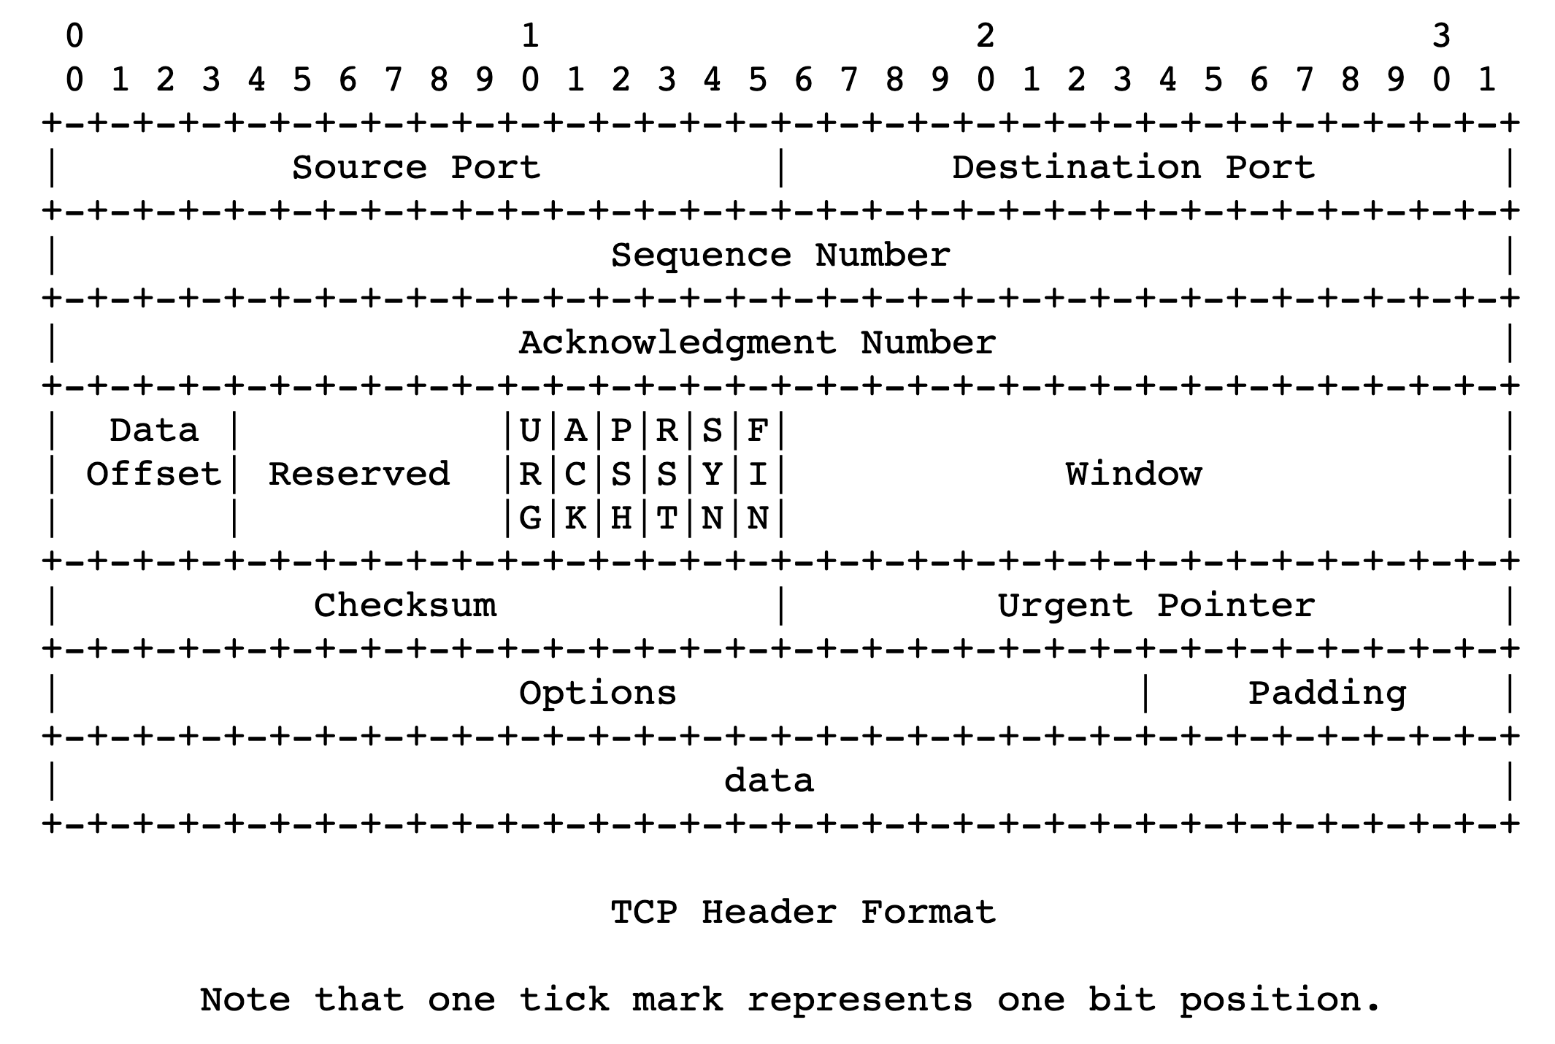
Flow control headers

Slide 12
Implications of buffering at receiver side
Flow control has implications for TCP data delivery, even when packets arrive in order
Typically TCP packets arrive in a burst
Why?
The receiver application won’t read this data in one shot
Q: What’s the size of the maximum burst?

Slide 13
Sizing the receiver window
Bandwidth-delay product: enough data to “fill the pipe”
Implications to achieve high throughput:
More memory required at high bandwidth
More memory required at high RTT
Consider 100 Gbit/s connection at 100 ms RTT
With this window size, can you guarantee that you will never “block” the connection due to a filled-up receiver buffer?
You can’t! If app never reads from receiver buffer, it will fill up and not allow any more data to come in.

Slide 14
Implications of ordered delivery
What if packets travel from sender to receiver over multiple paths?
Imagine a situation where one path is much faster than another
First (faster) path sends packets: 1, 3, 5, …
Second (slower) path sends packets: 2, 4, 6, …
Reassembly will require dropping the connection’s throughput to match the slower one

Slide 15
Implications of ordered delivery
Reordering and reassembly are bad for application throughput
Most network-level load balancing mechanisms avoid per-packet multi-path forwarding
Balance load at per-flow or per-flowlet (burst) granularity
Multi-path TCP variants exist, but all need to solve the path scheduling problem:
Schedule outgoing packet transmissions and adjust windows
… so that the packets arrive at the receiver (roughly) in order

Slide 16
Congestion control

Slide 17

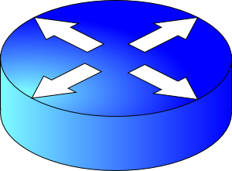
How should multiple endpoints share net?
It is difficult to know where the bottleneck link is
It is difficult to know how many other endpoints are using that link
Endpoints may join and leave at any time
Network paths may change over time, leading to different bottleneck links (with different link rates) over time

Slide 18
The approach that the Internet takes is to use a distributed algorithm to converge to an efficient and fair outcome.

Slide 19
The approach that the Internet takes is to use a distributed algorithm to converge to an efficient and fair outcome.
No one can centrally view or control all the endpoints and bottlenecks in the Internet.
Every endpoint must try to reach a globally good outcome by itself: i.e., in a distributed fashion.
This also puts a lot of trust in endpoints.

Slide 20
The approach that the Internet takes is to use a distributed algorithm to converge to an efficient and fair outcome.
If there is spare capacity in the bottleneck link, the endpoints should use it.

Slide 21
The approach that the Internet takes is to use a distributed algorithm to converge to an efficient and fair outcome.
If there are N endpoints sharing a bottleneck link, they should be able to get equitable shares of the link’s capacity.

Slide 22
The approach that the Internet takes is to use a distributed algorithm to converge to an efficient and fair outcome.
So, how to achieve this?

Slide 23
Feedback from network offers clues…
Signals
Packets being dropped (ex, RTO fires)
Packets being delayed
Rate of incoming ACKs
Knobs
What can you change to “probe” the sending rate?
Suppose receiver buffer is unbounded:
Let’s call the amount of in-flight data per RTT the congestion window
Increase congestion window: e.g., by x or by a factor of x
Decrease congestion window: e.g., by x or by a factor of x
“Implicit” feedback signals
(more on explicit signals later)

Slide 24
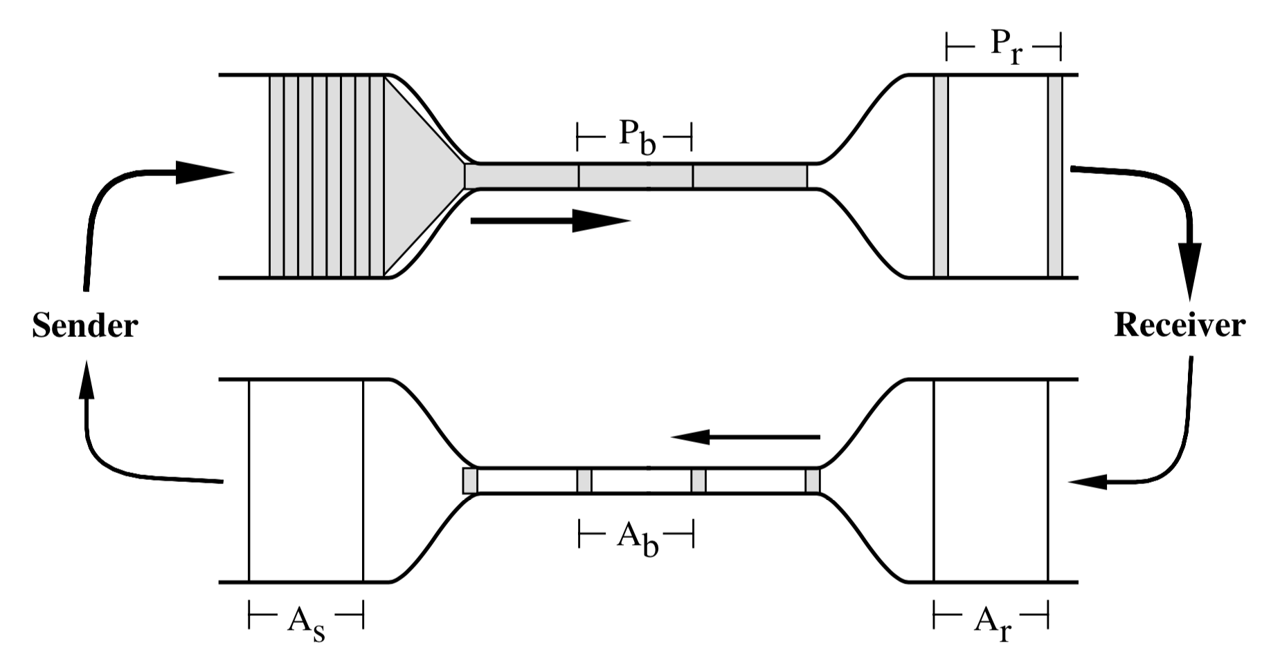
Steady state: ACK clocking

Slide 25
Time for an activity
Notes:
Make people guess a random number that you have in mind. See what strategies they come up with.

Slide 26
How to get to steady state?
Slow start
Congestion avoidance: Additive increase, multiplicative decrease (AIMD)
Loss
Congestion
Window
halved
time

Slide 27
How to get to steady state?
Upon a timeout, drop the window to a small fixed value (IW)
Upon idling, drop the window to a small fixed value (RW)
Loss
timeout
Congestion
Window
halved
IW
time

Slide 28
Why AIMD?
fairness
line
Converges to fairness
Converges to efficiency
Increments to rate smaller as fairness increases
(x₁,x₂)
(b_{D}x₁+a_{I}, b_{D}x₂+a_{I})
User 2: x₂
(b_{D}x₁,b_{D}x₂)
efficiency
line
User 1: x₁

Slide 29
TCP’s steady state is not static
As stated so far, TCP probes network capacity iteratively
… Until it induces a loss
… and then probes network capacity again
It is important to have efficient mechanisms to detect and recover from packet loss

Slide 30
Loss detection & recovery in TCP
Detecting loss before timeouts occur through fast retransmit
Basic idea:
if the receiver did not receive a segment
but did receive a subsequent few segments (duplicate ACKs)
… the unreceived packet must have been dropped.
Fast recovery: Don’t drop the window too much
If you’re receiving dup ACKs, packets are being delivered
Do congestion avoidance instead of slow start from IW
Many more details in RFC 2581 and follow-on work

Slide 31
Packet Scheduling

Slide 32

Are endpoint algorithms alone enough?
What if an endpoint is malicious or buggy?
Want the network core to do something more about resource allocation than best effort

Slide 33
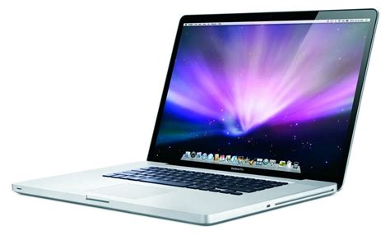

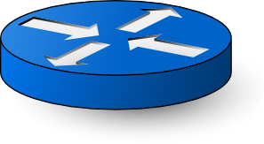
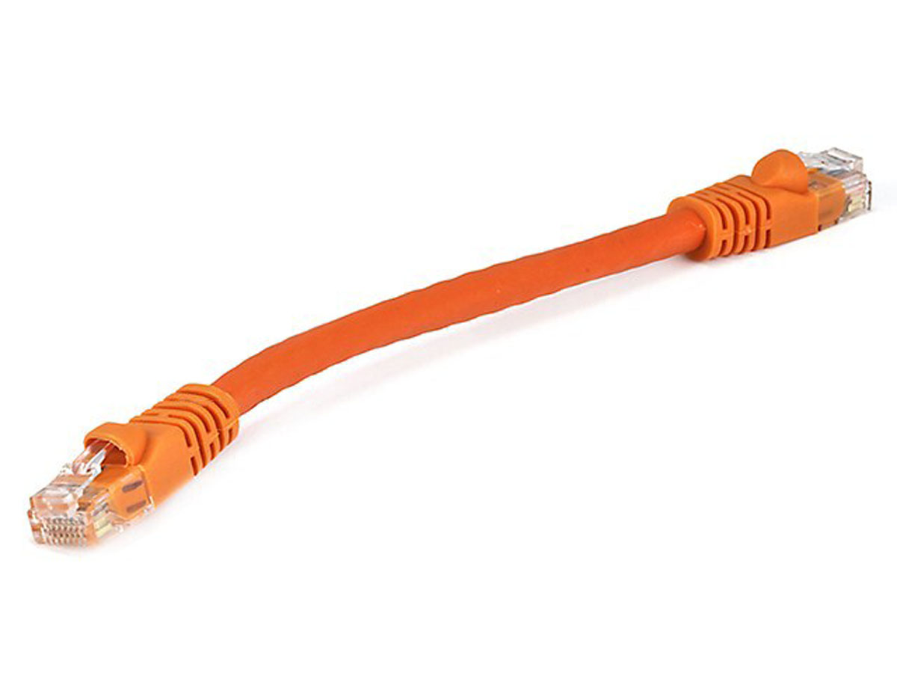
Network model
Queuing delay
Bottleneck queue
(max size B)
Link rate
Flows
Packet-switched core network

Slide 34

First-in first-out (FIFO) queue + tail-drop
Buffer size
2
1
b
2
a
1
a
b
Dropped packets

Slide 35
First-in first-out (FIFO) queue + tail-drop
6
Head of line blocking (HOL)
5
4
Buffer size
3
2
1
6
a
4
3
2
5
1
a
b
b
Can you guess what happens in the next round-trip time interval?
Dropped packets

Slide 36
ACK-clocking makes it worse: lucky case
13
12
11
10
Buffer size
9
8
7
12
11
10
9
8
b
7
b
13
c
Dropped packets

Slide 37
ACK-clocking makes it worse: unlucky case
13
12
11
10
Buffer size
9
8
7
13
12
11
10
9
8
7
b
b
c
Dropped packets

Slide 38
Network monopolized by “bad” endpoints
An ACK signals the source of a free router buffer slot
Further, ACK clocking means that the source transmits again
Contending packet arrivals may not be random enough
Blue flow can’t capture buffer space for a few round-trips
Sources which sent successfully earlier get to send again
A FIFO tail-drop queue incentivizes sources to misbehave!

Slide 39
Packet scheduling on routers
We will discuss packet scheduling algorithms implemented on routers in detail later in this course.
Goal: Achieve a predetermined resource allocation regardless of endpoint behavior
How to make such allocation “efficient”?
Implement on routers at high speeds and low cost
Achieve equitable sharing of network bandwidth & queues
Use available bandwidth effectively

