Slide 1

The Transport Layer: Reliability, Ordering, and Flow Control
CS 352, Lecture 8, Spring 2020
http://www.cs.rutgers.edu/~sn624/352
Srinivas Narayana

Slide 2
Course announcements
Mid-term 1 Friday in class
Closed book, calculators OK, no cell phones
Review has been released under Sakai resources section
Separate PDFs with questions and answers
Review worked in recitation
Mid-term may contain a few more questions, more challenging questions
Learning Assistant (LA) program: looking for 352 for next year

Slide 3
Review of concepts
Transport layer: User Datagram Protocol
Error detection using checksum
Reliable data delivery: stop and wait
ACKnowledgments (ACKs)
Retransmission TimeOut (RTO)
Sequence numbers
Main problem: low data rate/throughput
Reliable data delivery with pipelined data transmission
Key idea: increase the number of in-flight packets
Why does throughput increase?

Slide 4
Pipelined Reliability

Slide 5
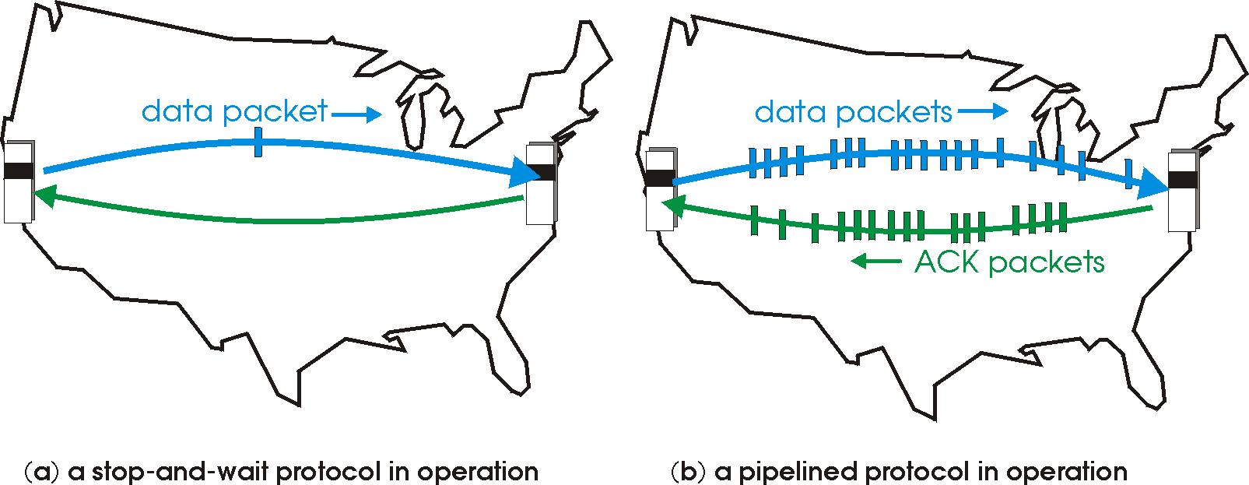
TCP is a pipelined transmission protocol
Sender allows multiple, “in-flight”, yet-to-be-acknowledged packets
A few packets on the way while, concurrently, new packets are transmitted

Slide 6
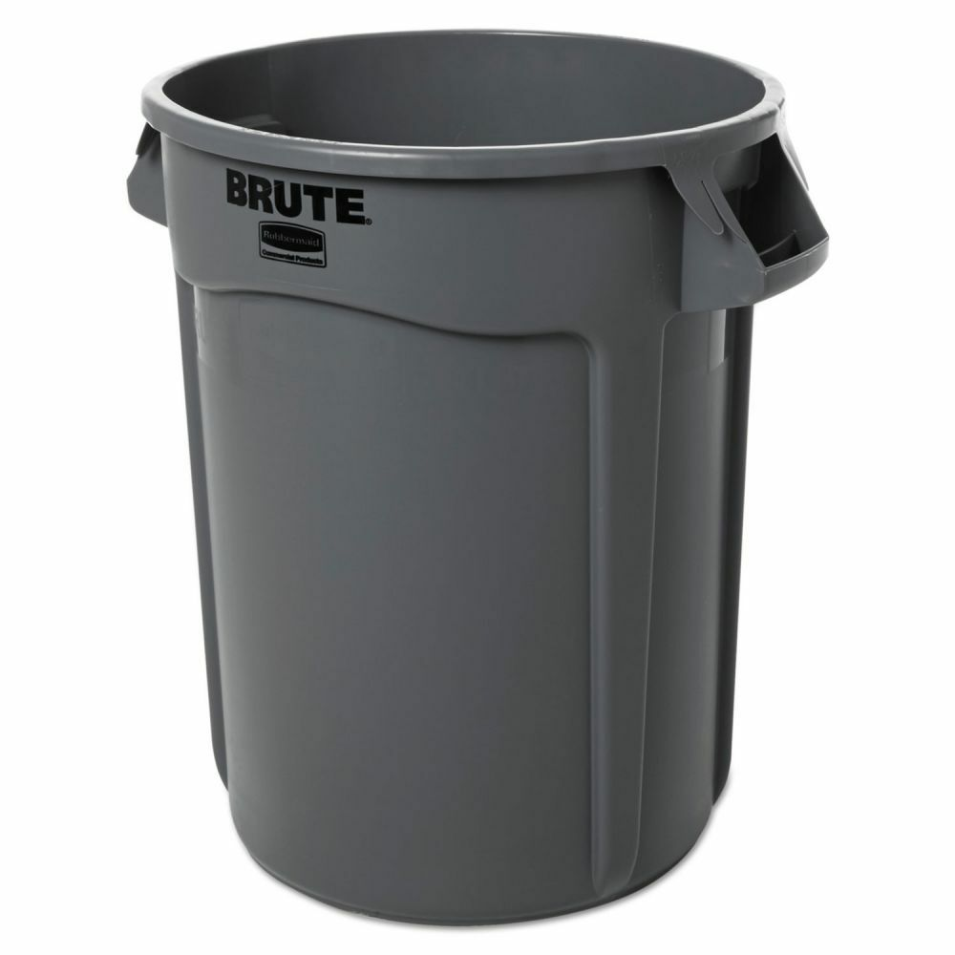
What if some packets/ACKs dropped?
Sequence numbers help associate an ACK with its packet
Note: In TCP, every byte has a sequence #
We will often simplify our examples by assuming each packet has a sequence #
In TCP, the ACK contains the sequence number of the next byte expected
Note: example uses packet seq #s
Q1: If a packet is dropped, should the receiver ACK subsequent packets?
Q2: If so, with what sequence number?
Sender
Receiver
1
2
3
4
2
3
4
5
5

Slide 7
Receiver strategies upon packet loss
Sender
Receiver
ACK subsequent pkts?
1
No
Yes
2
3
4
Selective Repeat
What seq # on ACK?
Go-back-N
5
Last pkt in order
Cumulative ACK
Seq # ranges received so far
Selective ACK
TCP’s default

Slide 8
Sliding Window with Go Back N
When the receiver notices a missing or erroneous frame:
It simply discards all frames with greater sequence numbers
The receiver will send no ACK
The sender will eventually time out and retransmit all the frames in its sending window

Slide 9
Go back N
RTO
Sender
0
1
2
3
4
2
3
4
5
6
Maximum
window size = 8
ACK 1
ACK 2
ACK 3
ACK 4
ACK 5
ACK 6
ACK 7
Receiver
0
1
E
D
D
2
3
4
5
6
Maximum
window size = 8
Discarded by
receiver
Frame with
error
Time

Slide 10
Go back N
Go Back N can recover from erroneous or missing frames
But…
It is wasteful. If there are errors, the sender will spend time retransmitting frames the receiver has already seen

Slide 11
Selective repeat with cumulative ACK
Idea: sender should only retransmit dropped/corrupted segments.
The receiver stores all the correct frames that arrive following the bad one. (Note that the receiver requires a memory buffer for each sequence number in its receiver window.)
When the receiver notices a skipped sequence number, it keeps acknowledging the last good sequence number,. i.e., cumulative ACK
When the sender times out waiting for an acknowledgement, it just retransmits the one unacknowledged frame, not all its successors.
Note that timeout applies independently for each sequence #

Slide 12
Selective repeat with cumulative ACK
Timeout interval
Sender
0
1
2
3
4
2
5
6
Maximum
window size = 8
ACK 2
ACK 2
ACK 1
ACK 2
ACK 5
ACK 6
ACK 7
Receiver
0
1
E
3
4
2
5
6
Maximum
window size = 8
Buffered by
receiver
Frame with
error
Time

Slide 13
Window
Window size: The amount of in-flight data (unACKed)
Window: Sequence numbers of in-flight data
Sequence numbers restart from 0 beyond a point (why?)
Window size = 3
Sender’s point of view:
0
1
2
3
4
5
6
7
0
1
0
7
1
6
2
Last acknowledged sequence #
Last sequence # sent
5
3
4
Increasing sequence numbers

Slide 14
Sliding window
Suppose sequence number 2 is acknowledged by the receiver
Sender can transmit sequence # 5
The window “slides” forward
Window size = 3
Sender’s point of view:
0
1
2
3
4
5
6
7
0
1
Last acknowledged sequence #
Last sequence # sent

Slide 15
Corresponding window on receiver side
Receiver only accepts sequence #s as allowed by the current receiver window
Receiver will not accept this sequence #. Packet dropped
Window size = 3
Receiver’s point of view:
0
1
2
3
4
5
6
7
0
1
Last acknowledged sequence #
Highest sequence # accepted

Slide 16
Ordered Delivery

Slide 17

Reordering packets at the receiver side
Let’s suppose receiver gets packets 1, 2, and 4, but not 3 (dropped)
Suppose you’re trying to download a Word document containing a report
What would happen if transport at the receiver directly presents packets 1, 2, and 4 to the Word application?
Sender
Receiver
1
2
3
4
1
2
4
5

Slide 18
Reordering at the receiver side
Reordering can also happen due to packets taking different paths through a network
Receiver needs a general strategy to ensure that data is presented to the application in the same order that the sender side pushed it
This is accomplished using a memory buffer at the receiver (also called receiver socket buffer)
We’ve already seen the use of memory buffer to have the sender avoid duplicate transmissions
Sender
Receiver
1
2
3
4
1
2
4
5
3

Slide 19

Interaction between apps and TCP
application
process
An app with a TCP socket reads from the TCP receive socket buffer
e.g., when you do data = sock.recv(10)
TCP receiver software only releases this data to the application if the data is in order relative to all other data already read by the application
TCP socket
receiver buffers
TCP
code
from sender
receiver protocol stack

Slide 20
Ordering at the receiver side
Network writes here
Application can read up to here
1
2
1
2
4
1
2
3
4
Socket buffer memory on the receiver

Slide 21
Ordering at the receiver side
The TCP software at the receiver uses socket buffers to hold packets until they can be read by an application in order
This process is known as TCP reassembly

Slide 22
Implications of ordered delivery
Packets cannot be delivered to the application if there is an in-order packet missing from the receiver’s buffer
The receiver can only buffer so much out-of-order data
Subsequent out-of-order packets dropped
It doesn’t matter that the packets successfully arrive at the receiver from the sender over the network
TCP application throughput will suffer if there is too much packet “reordering” in the network

Slide 23
Flow control

Slide 24
Implications of buffering at the receiver
application
process
Applications may read data slower than the sender is pushing data in
e.g., what if you never called recv()?
Hence, the permissible window size may vary over time.
TCP socket
receiver buffers
TCP
code
from sender
receiver protocol stack

Slide 25
Implications of buffering at the receiver
application
process
A TCP sender can only send as much as the free receiver buffer space available, before packets are dropped at the receiver
This number is called the receiver window size or advertised window size
TCP is said to implement flow control
Sender’s window size is bounded by the advertised window size.
TCP socket
receiver buffers
TCP
code
from sender
receiver protocol stack

Slide 26
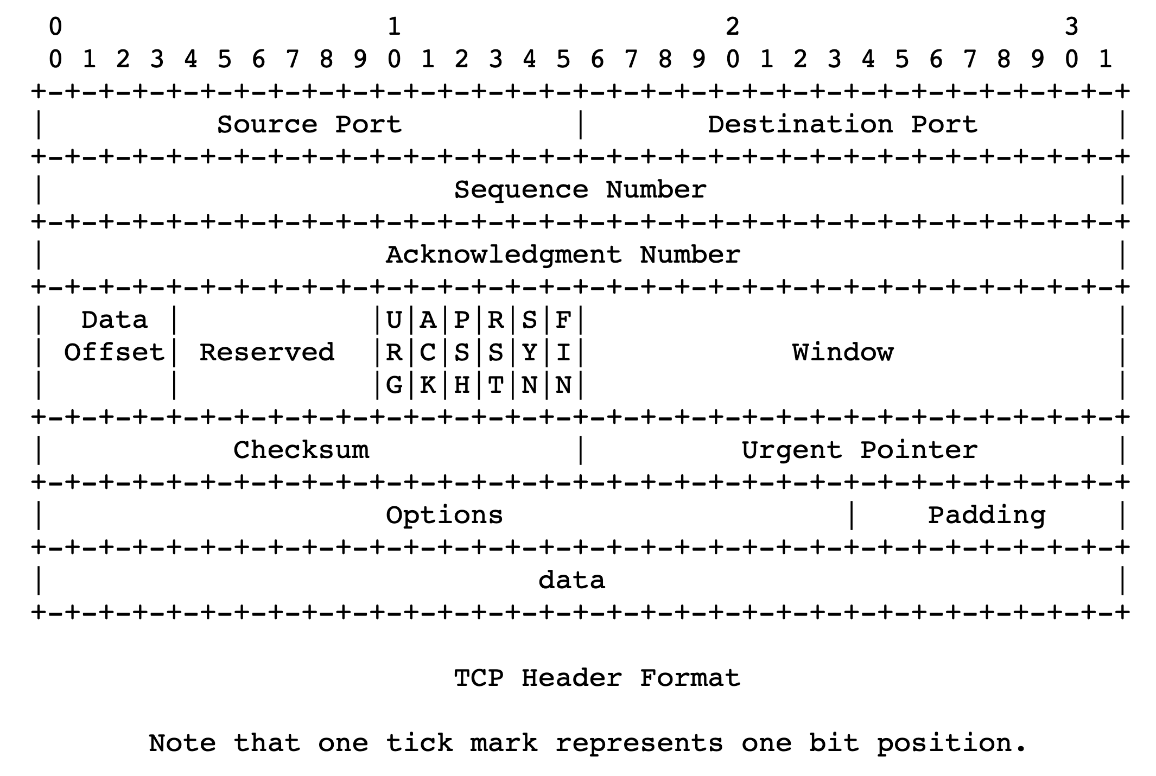
TCP headers

Slide 27
Sizing the receiver socket buffer
For each socket, there is a default size for the memory allocated to the receiving socket buffer
Unimaginatively called the receiver socket buffer size
If this number is too small, sender can’t keep too many packets in flight ➔ lower throughput
If too large, too much memory consumed
How big should the receiver socket buffer be?

