Slide 1
Administrivia
Review 1 paper assignments are out
See me after lecture if you haven’t yet received your assignment
MUD: Send me your top 1—3 questions on this lecture
Brainstorm project ideas (teams of 1—3)
Discuss with me during office hours or by appointment
Today: Some more examples of division of labor….

Slide 2
End-to-end arguments in system design
(ACM Trans. on Computer Systems, November 1984)
J. Saltzer, D. Reed, and D. Clark

Slide 3
End-to-end argument
Operations should occur only at the end points
… unless needed for performance optimization
2
4
3
1
5
Many things can go wrong: disk errors, software errors, hardware errors, communication errors, …

Slide 4
Trade-offs
Put functionality at each hop
All applications pay the price
End systems still need to check for errors
Place functionality only at the ends
Slower error detection
End-to-end retransmission wastes bandwidth
Compromise solution?
Reliable end-to-end transport protocol (TCP)
Plus file checksums to detect file-system errors
“Reasonably reliable” communication network

Slide 5

Control-Data Plane Separation
Lecture 3, Computer Networks (198:552)

Slide 6
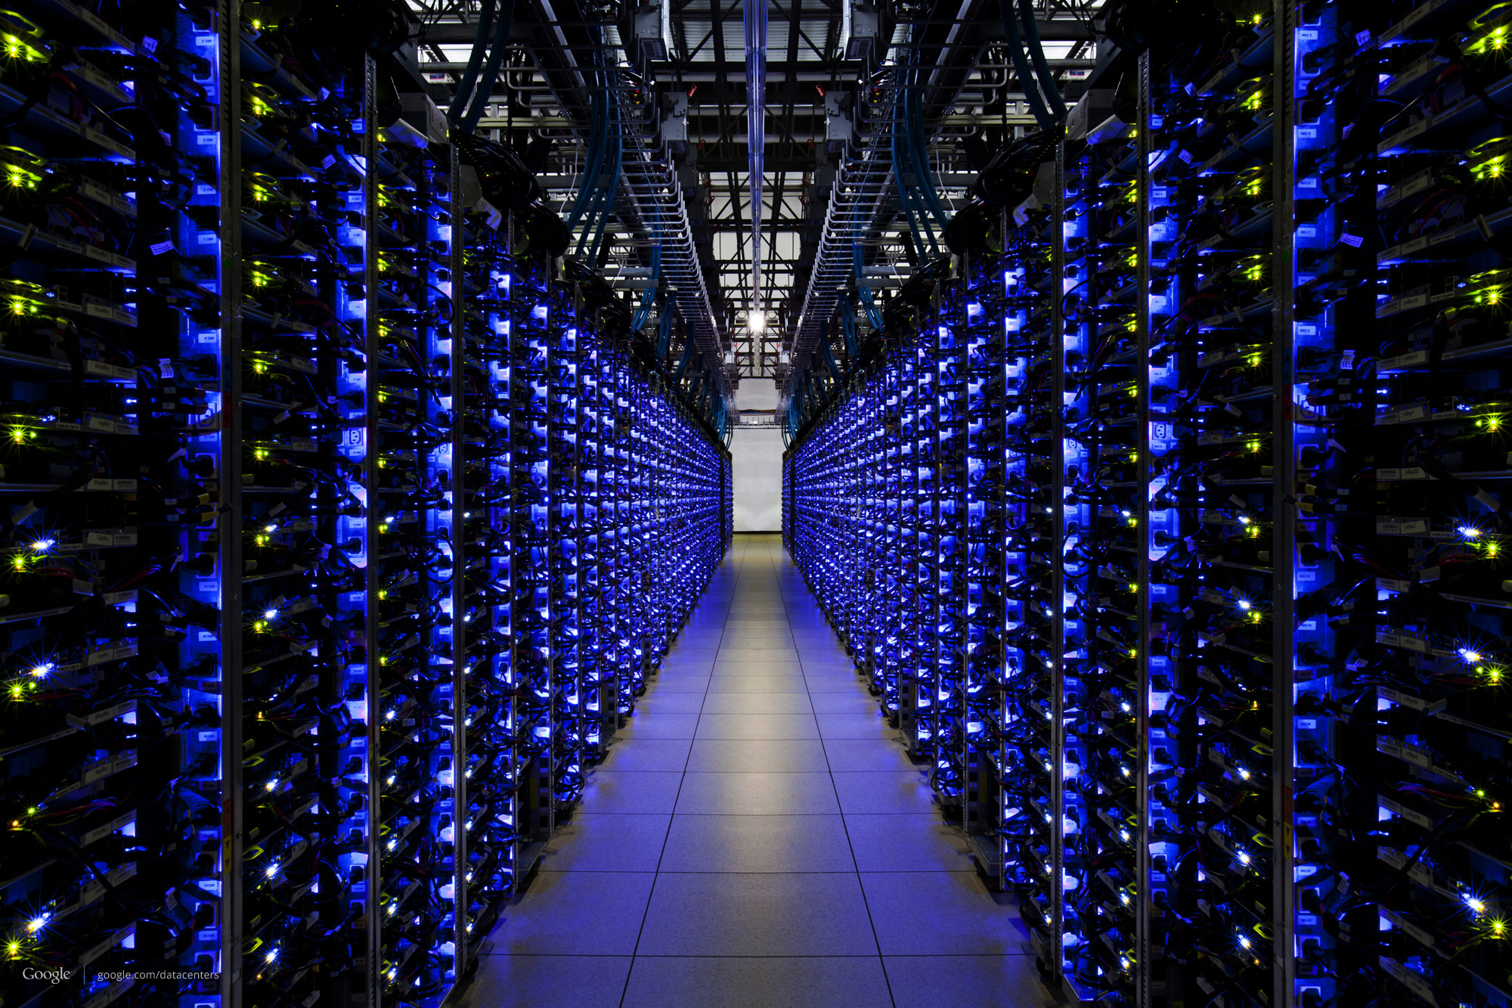

Edge vs. Core
Core: the network consisting of routers
Edge: the endpoints
What’s here?
The Core

Slide 7
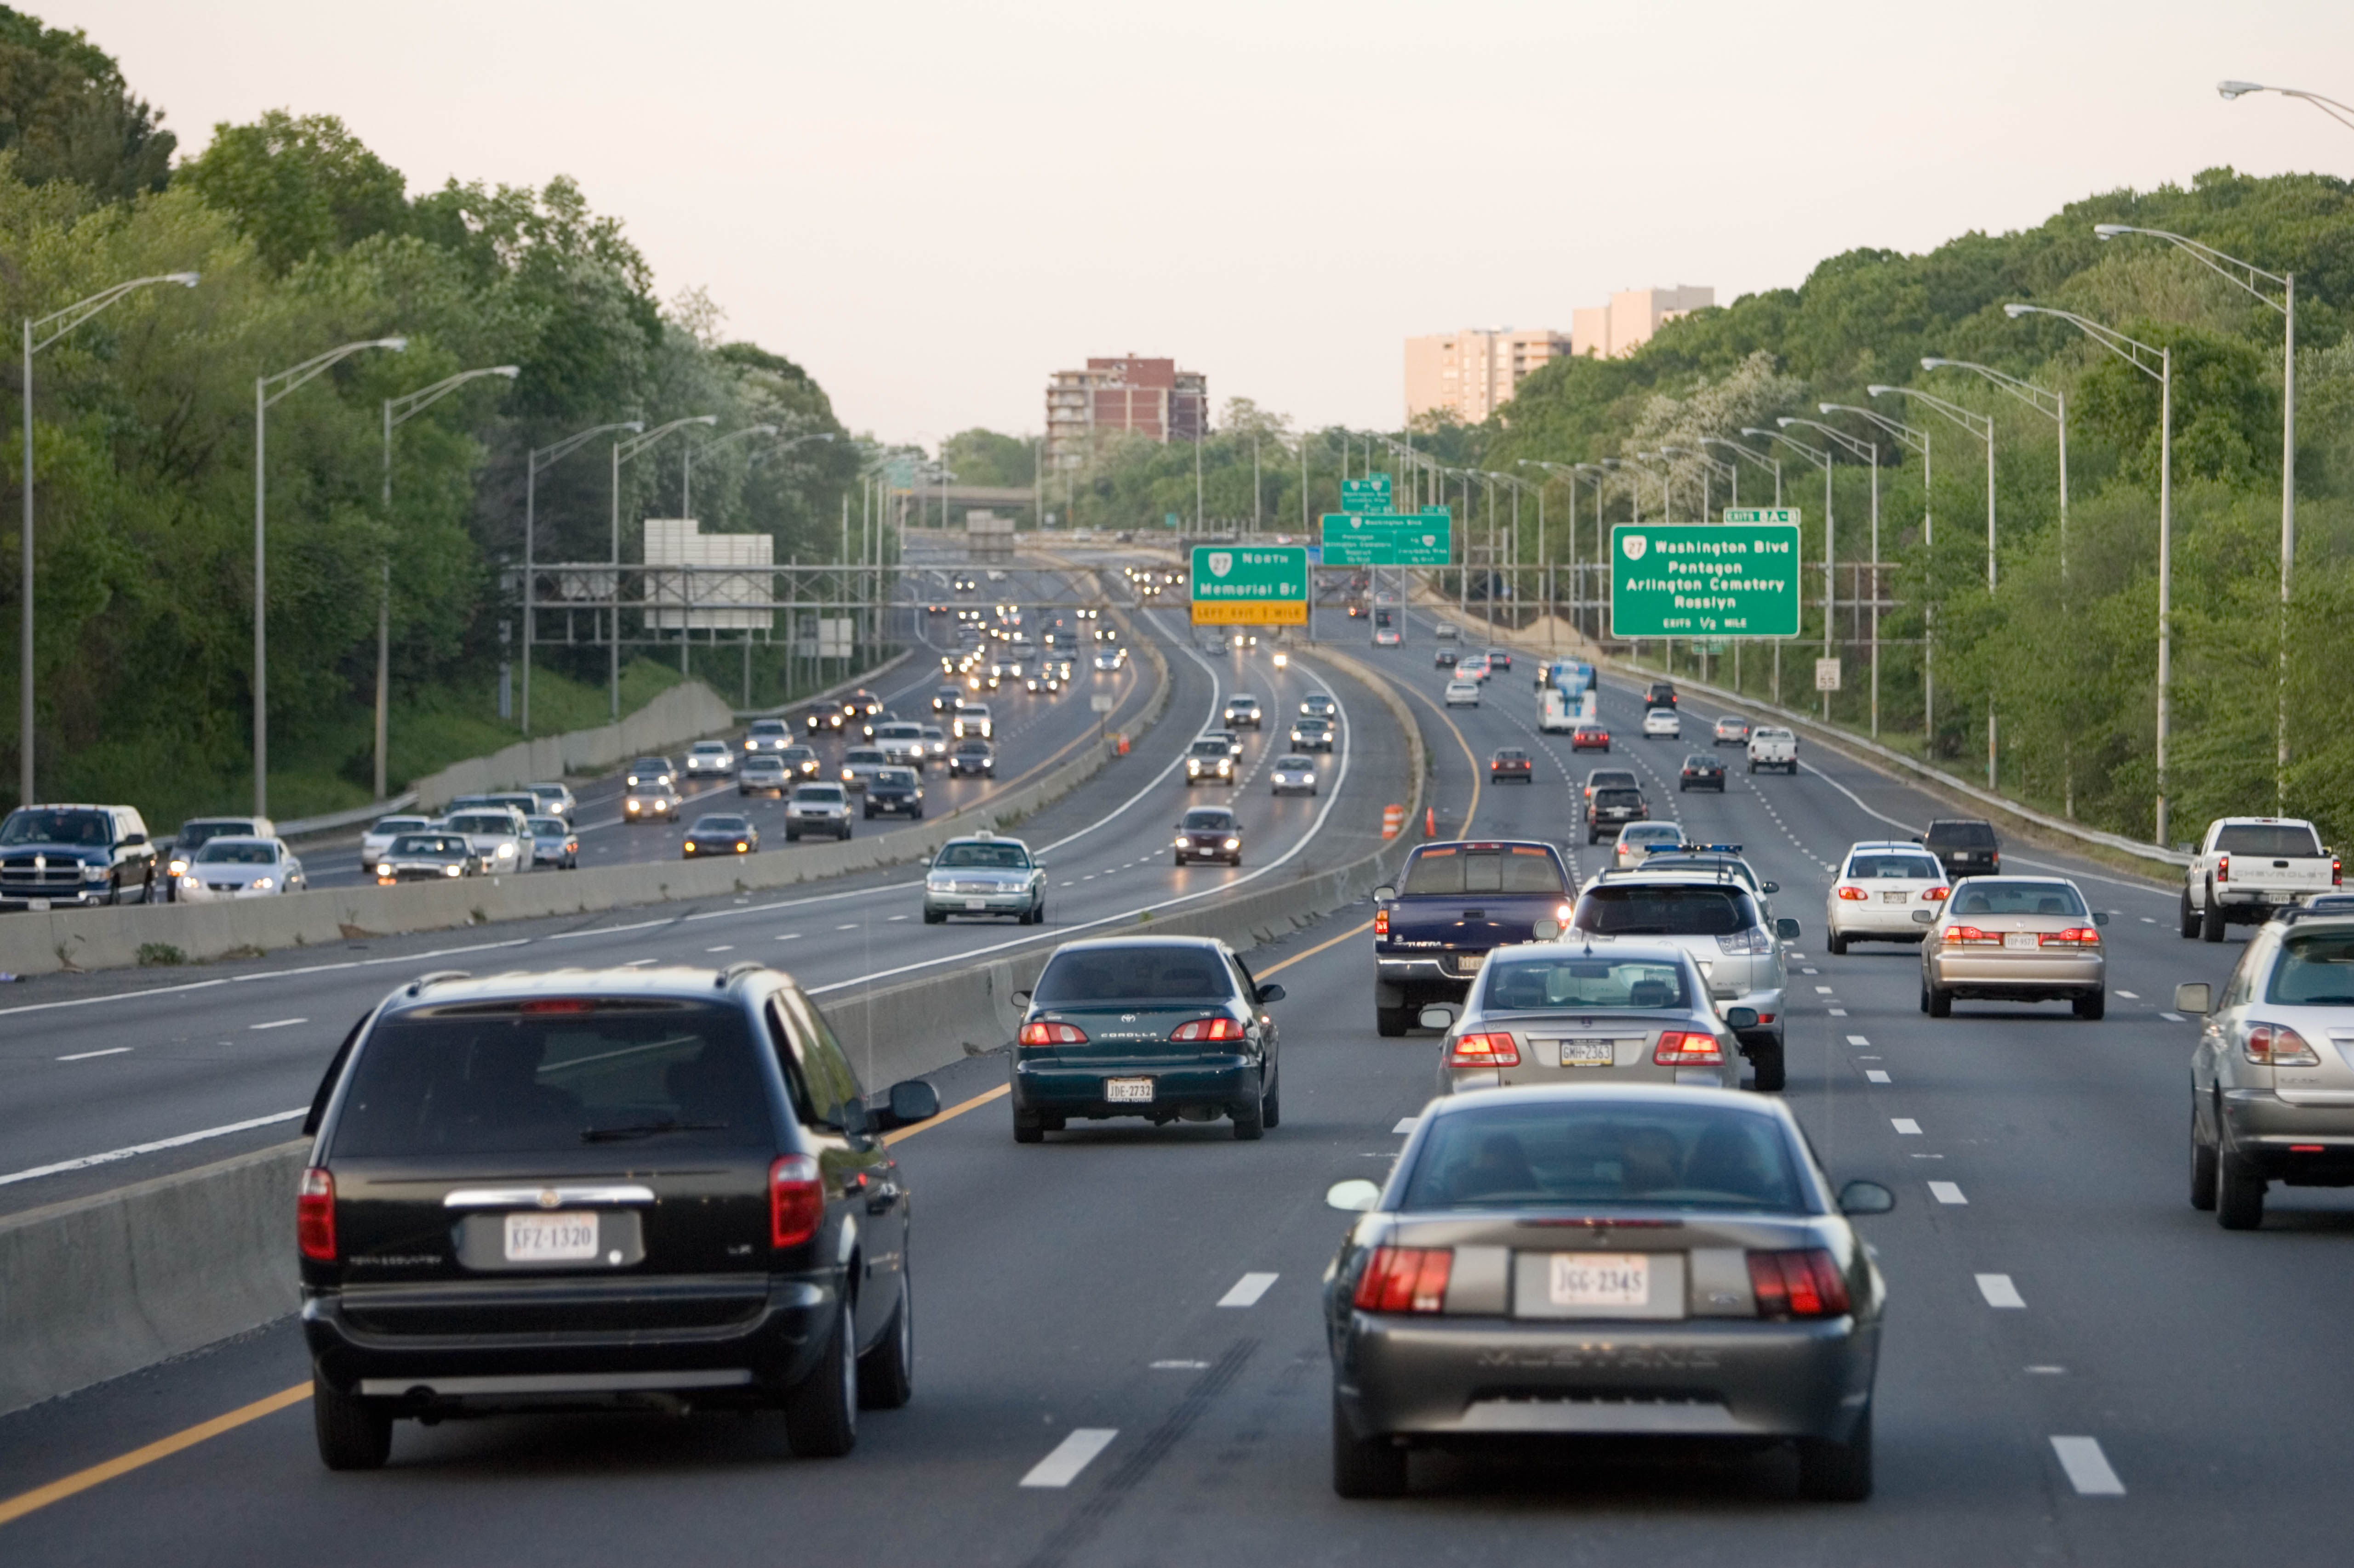
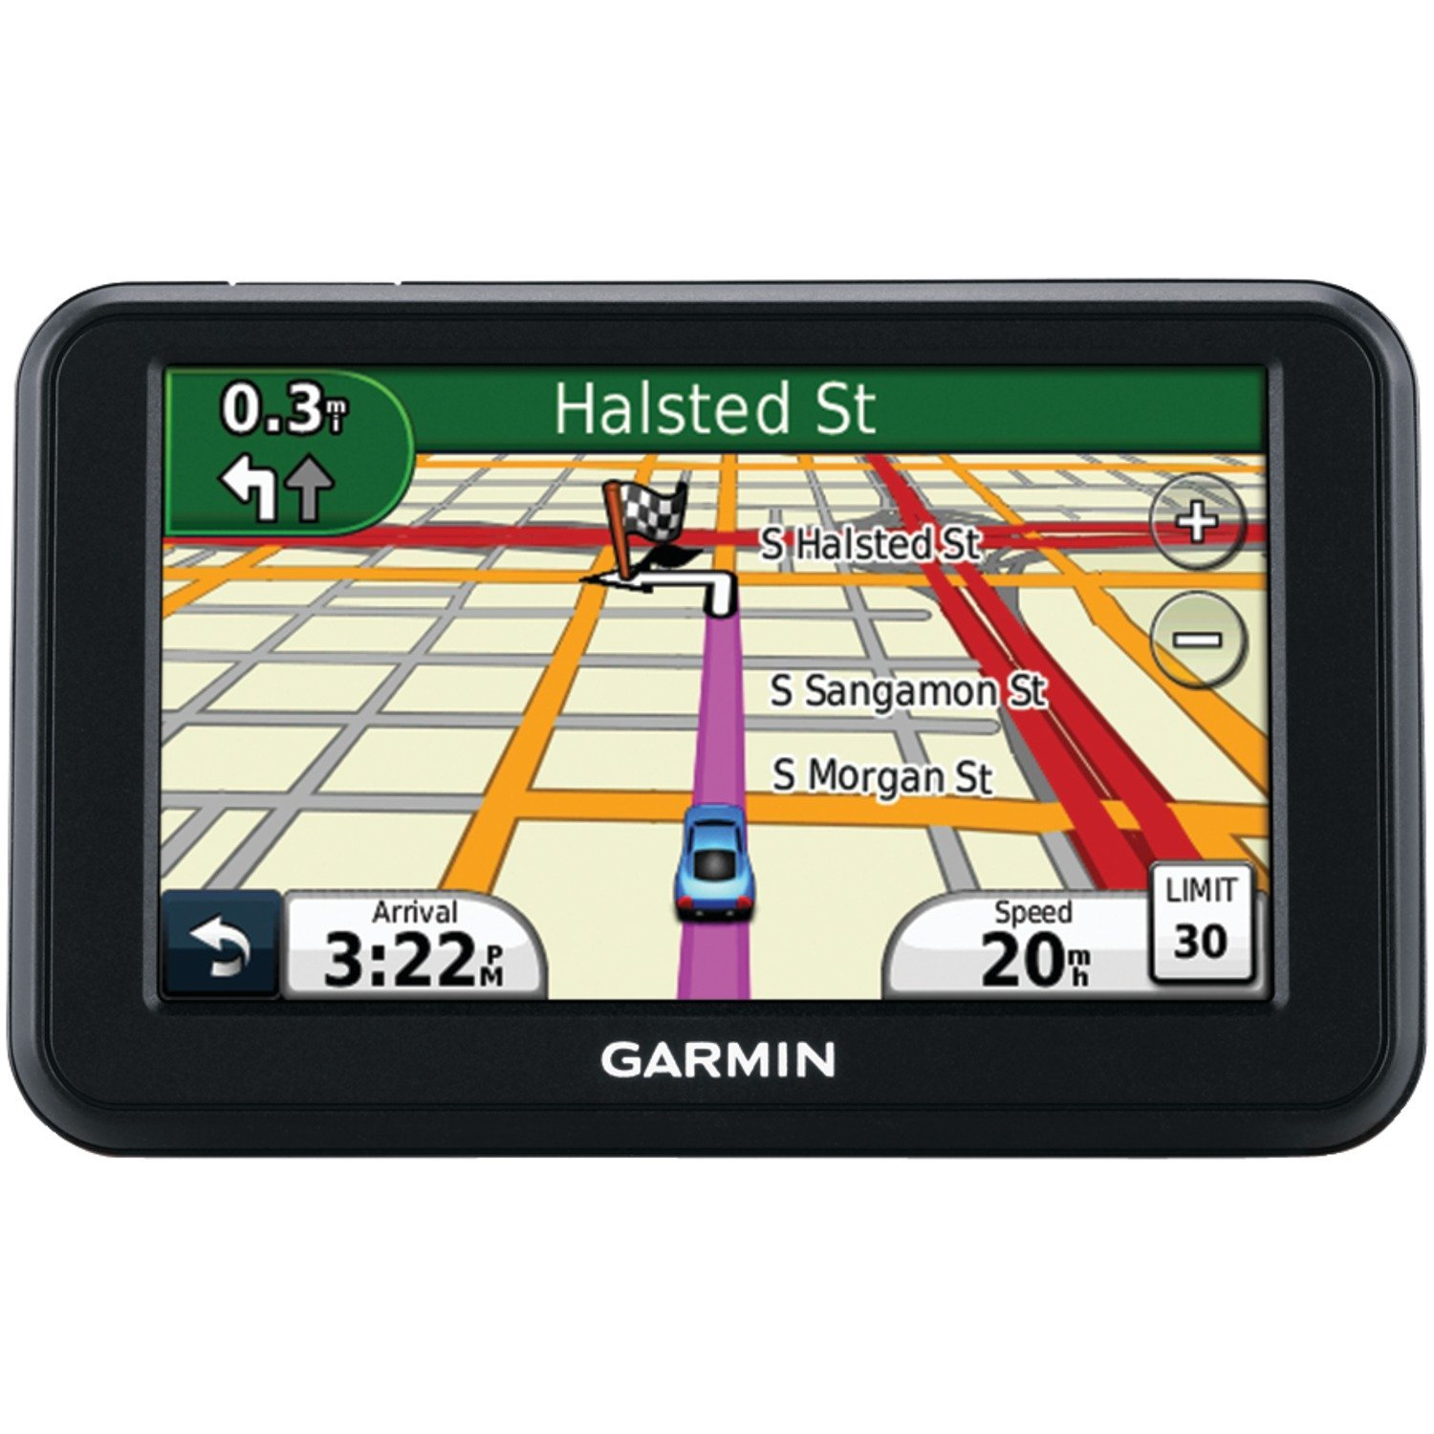
Core: Split into data and control planes
Data plane: handle packets
Handle individual packets as they arrive
Forward, drop, or buffer
Mark, schedule, measure, …
Control plane: handle events
Compute paths through the network
Track changes in network topology
Reserve resources along a path
Motivated by need for high-speed packet forwarding

Slide 8

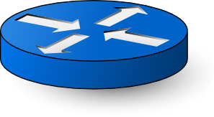
Adding the management plane
Make networks run well
The right traffic reaches the right destination
Traffic flows over short, uncongested paths
Failure recovery happens quickly
Routers don’t run out of resources
A control loop with the network
Measure (sense): topology, traffic, performance, …
Control (actuate): configure control and data planes

Slide 9
Data and Control Planes in a Router
Processor
control plane
data plane
Switching
fabric
Line card
Line card
Line card
Line card
Line card
Line card

Slide 10
Forwarding vs. Routing
Forwarding: data plane
Router directs packets to an output port
… by looking up a forwarding table
Routing: control plane
Routers talk amongst themselves
.. to compute the forwarding table
Destination IP | Subnet mask | Output port
10.0.0.0 | 255.255.255.0 | 4
8.4.5.3 | 255.0.0.0 | 1

Slide 11
Each router creates its own forwarding table … but the computation itself is distributed.

Slide 12
Routing protocols enable FT computation
What does the protocol compute?
Spanning tree, shortest path, local policy, arbitrary end-to-end paths
What algorithm does the protocol run?
Spanning-tree construction, distance vector, link-state routing, path-vector routing, source routing, end-to-end signaling
How do routers learn end-host locations?
Learning/flooding, injecting into the routing protocol, dissemination using a different protocol, and directory server

Slide 13
What does the protocol compute?
(the outcome, not the computation)

Slide 14
Different ways to represent paths
Trade-offs
State required to represent the paths
Efficiency of the resulting paths
Ability to support multiple paths
Complexity of computing the paths
Which nodes are in charge
Applied in different settings
LAN, intra-domain, inter-domain

Slide 15
Spanning tree (Ethernet)
One tree that reaches every node
Single path between each pair of nodes
No loops, so can support broadcast easily
Disadvantages
Paths are sometimes long
Some links are not used at all

Slide 16
Shortest paths (OSPF/IS-IS)
Set by network administrator
Shortest path(s) between each pair of nodes
Separate shortest-path tree rooted at each node
Minimum hop count or minimum sum of edge weights
Disadvantages
All nodes need to agree on the link metrics
Multipath routing is limited to Equal cost multiPath

Slide 17
Local policy at each hop (BGP)
Locally best path
Local policy: each node picks the path it likes best
… among the paths chosen by its neighbors
Disadvantages
More complicated to configure and model
2 1 d
2 d
3 2 d
3 4 d
2
2 1 d
2 d
3 2 d
3 4 d
2
3
1
1 d
1 2 d
3
1
1 d
1 2 d
4 d
4 d
5 4 d
4
5 4 d
4
5
5
6 4 d
6 5 4 d
d
6 4 d
6 5 4 d
d
6
6

Slide 18
End-to-end path selection (IP src route)
End-to-end path selection
Each node picks its own end to end paths
… independent of what other paths other nodes use
Disadvantages
More state and complexity in the nodes
Hop-by-hop destination-based forwarding is not enough

Slide 19
How to compute paths?

Slide 20
Spanning tree algorithm (Ethernet)
Elect a root
The switch with the smallest identifier
And form a tree from there
Algorithm
Repeatedly talk to neighbors
“I think node Y is the root”
“My distance from Y is d”
Update information based on neighbors
Smaller id as the root
Smaller distance d+1
Don’t use interfaces not in the path
root
One hop
Three hops

Slide 21
Spanning tree example: switch #4
Switch #4 thinks it is the root
Sends (4, 0) message to 2 and 7
Switch #4 hears from #2
Receives (2, 0) message from 2
… and thinks that #2 is the root
And realizes it is just one hop away
Switch #4 hears from #7
Receives (2, 1) from 7
And realizes this is a longer path
So, prefers its own one-hop path
And removes 4-7 link from the tree
1
3
5
2
4
6
7

Slide 22
Shortest-path problem
Compute: path costs to all nodes
From a given source u to all other nodes
Cost of the path through each outgoing link
Next hop along the least-cost path to s
2
3
1
1
4
u
2
1
5
4
3
6
s

Slide 23
Link-state: Dijkstra’s algorithm
Flood the topology information to all nodes
Each node computes shortest paths to other nodes
Initialization
Loop
S = {u}
for all nodes v
if (v is adjacent to u)
D(v) = c(u,v)
else D(v) = ∞
add w with smallest D(w) to S
update D(v) for all adjacent v:
D(v) = min{D(v), D(w) + c(w,v)}
until all nodes are in S

Slide 24
Link-state routing example (OSPF/IS-IS)
2
2
3
1
3
1
1
1
4
4
2
1
2
1
5
5
4
3
4
3
2
2
3
1
3
1
1
1
4
4
2
1
2
1
5
5
4
3
4
3

Slide 25
Link-state routing example (cont.)
2
2
3
1
3
1
1
1
4
4
2
1
2
1
5
5
4
3
4
3
2
2
3
1
3
1
1
1
4
4
2
1
2
1
5
5
4
3
4
3

Slide 26
Link-state: Shortest-path tree
Shortest-path tree from u
Forwarding table at u
v
2
y
link
3
1
1
x
4
v
(u,v)
u
z
2
1
w
(u,w)
5
t
x
(u,w)
w
4
3
y
(u,v)
s
z
(u,v)
Counter-intuitive: Operators may set the link metric to achieve certain shortest-path trees with the protocol
s
(u,w)
t
(u,w)

Slide 27

Path-vector routing (BGP)
Key idea: advertise the entire path
Distance vector: send distance metric per dest d
Path vector: send the entire path for each dest d
“d: path (2,1)”
“d: path (1)”
3
2
1
data traffic
data traffic
d

Slide 28
Path-vector: Fast loop detection
Node can easily detect a loop
Look for its own node identifier in the path
E.g., node 1 sees itself in the path “3, 2, 1”
Node can simply discard paths with loops
“d: path (2,1)”
“d: path (1)”
3
2
1
“d: path (3,2,1)”

Slide 29
Path-vector: Flexible policies
Each node can apply local policies
Path selection: Which path to use?
Path export: Which paths to advertise?
Examples
Node 2 may prefer the path “2, 3, 1” over “2, 1”
Node 1 may not let node 3 hear the path “1, 2”
2
3
2
3
1
1

Slide 30
Why are these algorithms distributed?

Slide 31
Learning the location of the endpoints

Slide 32


Finding the endpoints
Computing the forwarding table
Still must figure out where the endpoints are
How to find the endpoints?
Learning/flooding (Ethernet)
Injecting into the routing protocol
Dissemination using a different protocol
Central directory service
Ways to curb scaling challenges
E.g., spanning tree per VLAN for endpoint flooding

Slide 33
Ex: Disseminate with another protocol
One router learns the route
… and shares the information with other routers
disseminate route to other routers
learn a route to d
(e.g., via BGP)
Internal BGP (iBGP) used in backbone networks

Slide 34
Conclusion
Routing is a distributed computation
With challenges in scalability and handling dynamics
Different solutions for different environments
Ethernet LAN: spanning tree, MAC learning, flooding
Enterprise: link-state routing, injecting subnet addresses
Backbone: link-state routing inside, path-vector routing with neighboring domains, and iBGP dissemination
Data centers: many different solutions, still in flux
An active research area…

Slide 35
Clean-slate 4D architecture
ACM Computer Communications Review (CCR) 2005
Greenberg et al.

Slide 36
Three goals of 4D architecture
Network-level objectives
Configure the network globally; not each router
E.g., minimize the maximum link utilization
E.g., connectivity under all layer-two failures
Network-wide views
Complete visibility to drive decision-making
Traffic matrix, network topology, equipment
Direct control
Direct, complete control over data-plane configuration
Packet forwarding, filtering, marking, buffering…

Slide 37
4D: The four planes
Network-level objectives
Decision
Network-wide views
Dissemination
Direct control
Discovery
Data
Decision: all management and control logic
Dissemination: communication to/from the routers
Discovery: topology and traffic monitoring
Data: packet handling
routers

Slide 38
Decision plane
Network-level objectives
Decision
Network-wide views
Dissemination
Direct control
Discovery
Data
All mgmt logic implemented on “decision elements” (servers)
… which make all decisions for the network
Decision elements use network-wide views to compute data plane state that meets objectives
… then directly writes this state to routers!

Slide 39
Decision plane
Network-level objectives
Decision
Network-wide views
Dissemination
Direct control
Discovery
Data
All mgmt logic implemented on “decision elements” (servers)
… which make all decisions for the network
Decision elements use network-wide views to compute data plane state that meets objectives
… then directly writes this state to routers!

Slide 40
Dissemination plane
Network-level objectives
Decision
Network-wide views
Dissemination
Direct control
Discovery
Data
Provides a robust communication channel to each router
May run over same links as user data
However, logically separate and independently controlled

Slide 41
Discovery Plane
Network-level objectives
Decision
Network-wide views
Dissemination
Direct control
Discovery
Data
Each router discovers its own resources and its local environment
Each router propagates information (e.g., topology, traffic) to the decision elements via dissemination plane

Slide 42
Data Plane
Network-level objectives
Decision
Network-wide views
Dissemination
Direct control
Discovery
Data
Spatially distributed routers/switches
Forward, drop, buffer, shape, mark, rewrite, …
Can deploy with new or existing technology

Slide 43
Practical technical challenges
Scalability: Decision elements responsible for many routers
Response time: Delays between decision elements and routers
Reliability: Surviving failures of decision elements, routers, and the dissemination plane
Consistency: Ensuring multiple decision elements behave consistently
Security: Network vulnerable to attacks on decision elements
Interoperability: Legacy routers and neighboring domains
Networking meets Distributed Systems

Slide 44
Architectural considerations for new protocols
ACM SIGCOMM conference 1990
David Clark and David Tennenhouse

Slide 45
Endpoint transport
Router
control
plane
Processor
Transfer
control
control plane
data plane
data
plane
Switching
fabric
Data
manipulation
Line card
Line card
Line card
Line card
Line card
Line card

Slide 46
What limits performance of transport?
Transfer control: do infrequently over connection lifetime
Flow and congestion control
Loss and reordering, app multiplexing, …
Data manipulation: on every byte!
Moving data from network adapter to endpoint memory
Per-packet error correction
Presentation conversion
00-FA-4C-2D-…
(on the wire)
struct keyval {
key: #...;
val: #...;
location: …;
}

Slide 47
Two key ideas
App-level framing (ALF)
Transport knows little about what data loss means to the app
Transport should deliver data to app as App Data Units (ADUs)
Natural boundary for error correction and application processing
Integrated layer processing (ILP)
Process ADU to completion, including all data manipulation
Performance improvement:
Reduction in number of memory accesses
Remove indirect overheads due to cache misses and TLB flushes

Slide 48
Discussion
Does ALF support any functionality that TCP/UDP don’t?
Does ALF run contrary to layered design?
Pros and cons of these two implementations?
Is presentation conversion still the dominant bottleneck?
Why? Why not? If not, what has changed?
Why should we always run presentation conversion at its full rate?
What systems design principles did you derive from this paper?

Slide 49
Until next time…
MUD: Send me your top 1—3 questions on this lecture
Readings for next class: Jacobson’s TCP, XCP
Brainstorm project ideas (teams of 1—3)

Slide 52
Backup slides

Slide 53
Discussion questions for E2E argument
When should the network support a function anyway?
E.g., link-layer retransmission in wireless networks?
Whose interests are served by the e2e argument?
How does a network operator influence the network without violating the e2e argument?
Does the design of IP and TCP make it *hard* to violate the e2e argument?
E.g., middlebox functionality like NATs, firewalls, proxies
Should the e2e argument apply to routing?

Slide 54
Distance Vector: Bellman-Ford Algo
Define distances at each node x
d_{x}(y) = cost of least-cost path from x to y
Update distances based on neighbors
d_{x}(y) = min {c(x,v) + d_{v}(y)} over all neighbors v
v
2
y
3
1
1
x
4
u
z
2
1
5
t
d_{u}(z) = min{c(u,v) + d_{v}(z),
c(u,w) + d_{w}(z)}
w
4
3
s
Used in RIP and EIGRP

Slide 55
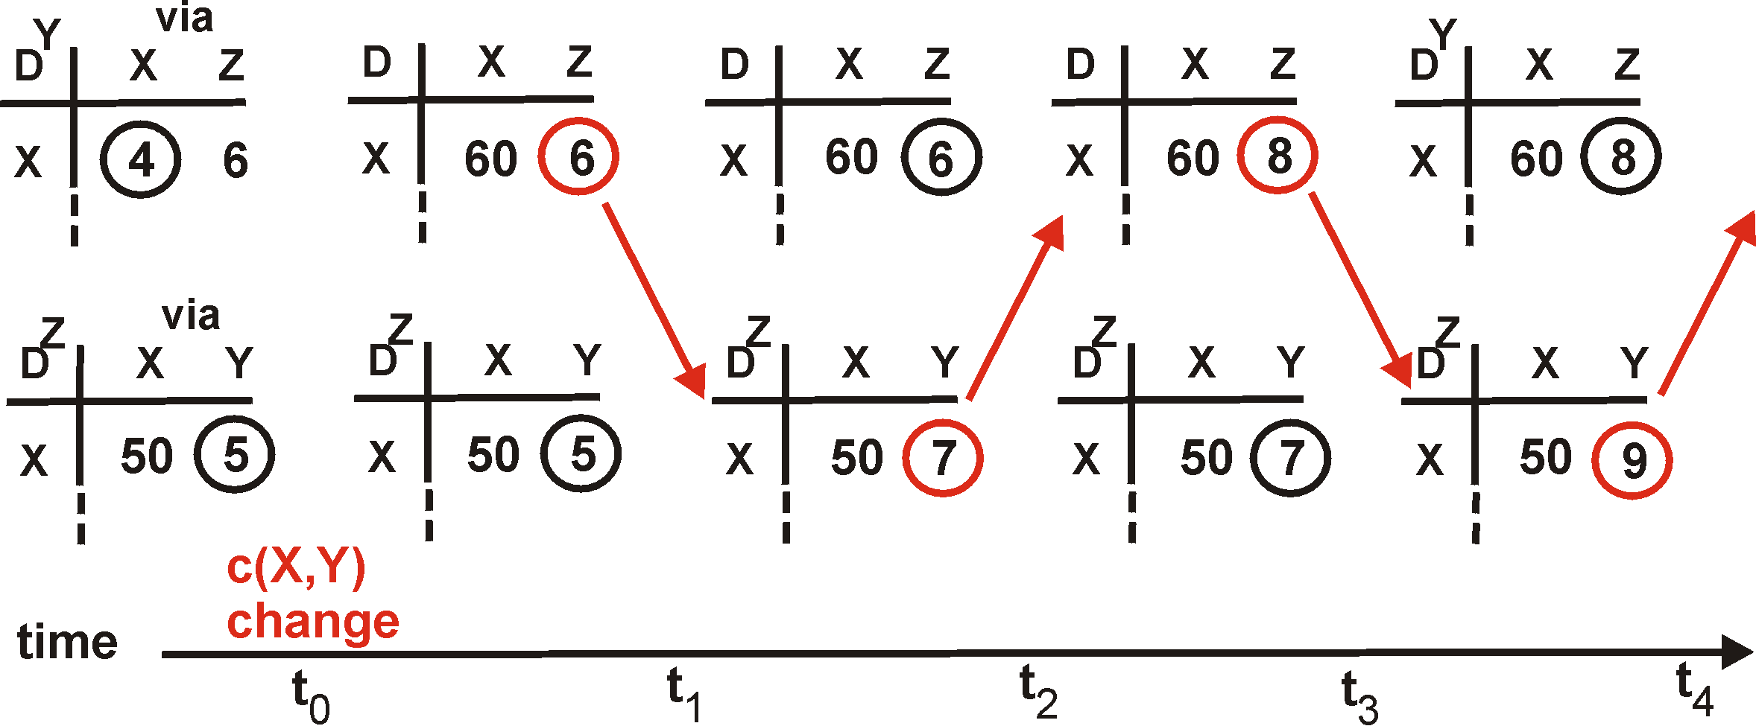
Distance Vector: Count to Infinity
Link cost changes:
Good news travels fast
Bad news travels slow - “count to infinity” problem!
60
Y
4
1
X
Z
50
algorithm
continues
on!

Slide 56
End-to-End Signaling
Establish end-to-end path in advance
Learn the topology (as in link-state routing)
End host or router computes and signals a path
Routers supports virtual circuits
Signaling: install entry for each circuit at each hop
Forwarding: look up the circuit id in the table
1: 7
2: 7
link 7
1: 14
2: 8
1
link 14
2
link 8
Used in MPLS with RSVP

Slide 57
Source Routing
Similar to end-to-end signaling
But the data packet carries the hops in the path
… rather than the routers storing big tables
End-host control
Tell the end host the topology
Let the end host select the end-to-end path
Variations of source routing
Strict: specify every hop
Loose: specify intermediate points
Used in IP source routing (but almost always disabled)

