Slide 1

Measurement
Lecture 8, Computer Networks (198:552)

Slide 2


Why measure networks?
Availability
Congestion/overload
Long-term demands
SLO violations
Application QoS
Throughput
Delay
Loss
Jitter
Application QoS
Problematic ISPs
Problematic CDNs
ISP
ISP
ISP

Slide 3
Measurements for ISP Network Operators

Slide 4
Example (1): Excess Traffic
Two large flows of traffic
New egress point for first flow
Multi-homed customer

Slide 5
Example (2): DoS Attack
Install packet
filter
Web server back to life…
Web server at its knees…

Slide 6
Example (3): Link Failure
Routing change alleviates congestion
Link failure
New route overloads a link

Slide 7

Measurements for ISP network operators
Route and schedule traffic
Filter traffic
Provision additional capacity
Control
Diagnose root cause
Determine how to route traffic
Measure
Detect link or path-level problems
Measure incoming traffic demands
“Measure” forwarding updates!

Slide 8
How do ISPs measure today?
Periodic link statistics
SNMP counters
Example: port1: 500 packets transmitted, 13 dropped
Periodic flow statistics
NetFlow, sFlow, IPFIX
Example: src: 10.0.0.1, dst:8.8.8.8, inport: 4, count: 45
Active end-to-end probes
Ping: 64 bytes from 128.6.68.140: icmp_seq=0 ttl=55 time=6.575 ms
Traceroute: more to come
User complaints!
Customer phone calls, NANOG posts

Slide 9
Diagnosis & Traffic engineering
Control plane issues
New routes
Link failures
Network upgrades!
Data plane issues
DoS attack
Flash crowds
Poor demand prediction, in general
“Decision plane” issues
Poor provisioning
Lack of peering
Lot of neat algorithms
& measurement systems
Quality of input data matters!
Scope to do a lot more…

Slide 10
Challenge: Measurement data reduction
A network can’t capture every packet with timestamps
Too much data!
Filter to restrict to data of interest
Ex: by source, by app, by (physical) port, …
Sample to thin the data stream for exact computations
Systematic, random, stratified
“Consistently” sample same/distinct packet at each hop
Aggregate (ex: by flow) to summarize data over many packets
One problem: too many flows
Sketches: aggregation that approximates with limited memory

Slide 11
Challenge: Joining traffic with forwarding
Where is DoS traffic entering the network?
How do I know which traffic is DoS traffic?
Are there other links that are affected?
Should you reroute other traffic that is affected?
Install packet
filter
Web server back to life…
Web server at its knees…

Slide 12
End-to-End Measurements

Slide 13
Why end-to-end measurements?
Endpoints could directly measure what matters to users
ISPs may not be willing to share data
Proprietary design, net neutrality, …
Data shared improperly may violate user privacy!
Indirect view: can’t say for sure why something happens
Hard to corroborate with ground truth
Possible to use multiple endpoints and span ISP boundaries!

Slide 14
Metrics and tools
Reachability: ping & its variants
Path: traceroute & its variants
Available bandwidth: speedtest, iperf, pathrate, …
Delays and loss rate: a selection of the above tools

Slide 15
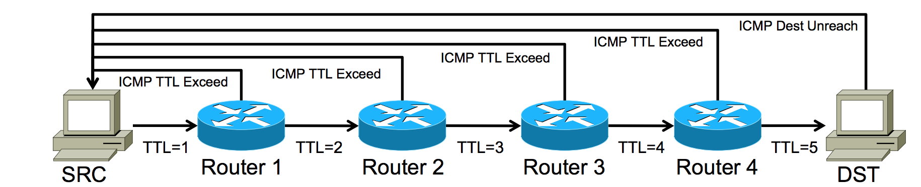
Traceroute
Launch a probe packet towards DST, with a TTL of 1
Each router hop decrements the TTL of the packet by 1
When TTL hits 0, router returns ICMP TTL Exceeded
SRC host receives this ICMP, displays a traceroute “hop”
Repeat from step 1, with TTL incremented by 1, until…
DST host receives probe returns ICMP Dest Unreach
Notes:
ACK https://www.nanog.org/meetings/nanog45/presentations/Sunday/RAS_traceroute_N45.pdf Richard Steenbergen NANOG 45

Slide 16
Traceroute: Example output (1/2)
[552]$ traceroute google.com
traceroute to google.com (172.217.10.78), 64 hops max, 52 byte packets
1 fios_quantum_gateway (192.168.1.1) 1.628 ms 1.537 ms 1.506 ms
2 lo0-100.nwrknj-vfttp-354.verizon-gni.net (74.102.79.1) 2.093 ms 2.486 ms 1.835 ms
3 b3354.nwrknj-lcr-21.verizon-gni.net (100.41.137.110) 4.962 ms 2.935 ms 3.985 ms
4 * * *
5 0.et-10-1-5.gw7.ewr6.alter.net (140.222.2.233) 3.864 ms
0.et-11-1-0.gw7.ewr6.alter.net (140.222.239.27) 3.503 ms
0.et-10-1-5.gw7.ewr6.alter.net (140.222.2.233) 3.581 ms
6 209.85.149.208 (209.85.149.208) 3.949 ms 4.222 ms 4.669 ms
7 * * *
8 108.170.226.198 (108.170.226.198) 9.154 ms
108.170.237.214 (108.170.237.214) 7.080 ms
72.14.234.64 (72.14.234.64) 10.782 ms
9 lga34s14-in-f14.1e100.net (172.217.10.78) 4.097 ms
108.170.248.66 (108.170.248.66) 5.462 ms
108.170.248.20 (108.170.248.20) 9.410 ms

Slide 17
Traceroute: Example output (2/2)
[552]$ traceroute rutgers.edu
traceroute to rutgers.edu (128.6.68.140), 64 hops max, 52 byte packets
1 fios_quantum_gateway (192.168.1.1) 1.536 ms 1.083 ms 1.098 ms
2 lo0-100.nwrknj-vfttp-354.verizon-gni.net (74.102.79.1) 2.343 ms 1.932 ms 1.948 ms
3 b3354.nwrknj-lcr-21.verizon-gni.net (100.41.137.110) 3.124 ms
b3354.nwrknj-lcr-22.verizon-gni.net (100.41.137.112) 4.026 ms 2.766 ms
4 * * *
5 * * *
6 0.ae1.gw1.phil.alter.net (140.222.0.221) 6.599 ms
0.ae6.gw1.phil.alter.net (140.222.0.223) 5.401 ms 5.670 ms
7 rutgers-gw.customer.alter.net (63.65.75.238) 5.061 ms 6.937 ms 6.205 ms
8 172.29.8.17 (172.29.8.17) 5.321 ms 5.475 ms 10.577 ms
9 172.29.6.63 (172.29.6.63) 6.500 ms 7.154 ms 7.254 ms
10 172.29.6.45 (172.29.6.45) 6.808 ms 6.799 ms 6.612 ms
11 172.28.193.138 (172.28.193.138) 8.201 ms 7.956 ms 8.180 ms
...
64 * * *

Slide 18
Some problems with traceroute
Control traffic (ICMP) and data traffic may see different behavior
Router CPU versus forwarding table
Probes load-balanced differently
A different packet observes each hop
Route changes while packet “in transit”
Not all routers may respond to ICMP messages
Hidden routers
Anonymous routers
Improper processing
One-way measurement

Slide 19
End-to-End Routing Behavior in the Internet
LBNL Technical Report (1996)
Vern Paxson

Slide 20
Methodology
Traceroute between NPDs distributed worldwide (add pic)
Exponential sampling/PASTA property
Why?
What might happen otherwise?
D1: unidirectional traceroutes
D2: “paired” traceroutes
Confidence intervals for probability that an event occurred
Measurements sample half of the Internet by AS weight

Slide 21
Pathologies in Internet routing
Forwarding loops!
Persistent and temporary
Circuitous routing
Routing transients
Recovery times are bimodal
Route fluttering
Partitioned network
Temporary outages, some > 30 seconds
Too many hops
Pathologies correlated with operator change and congestion

Slide 22
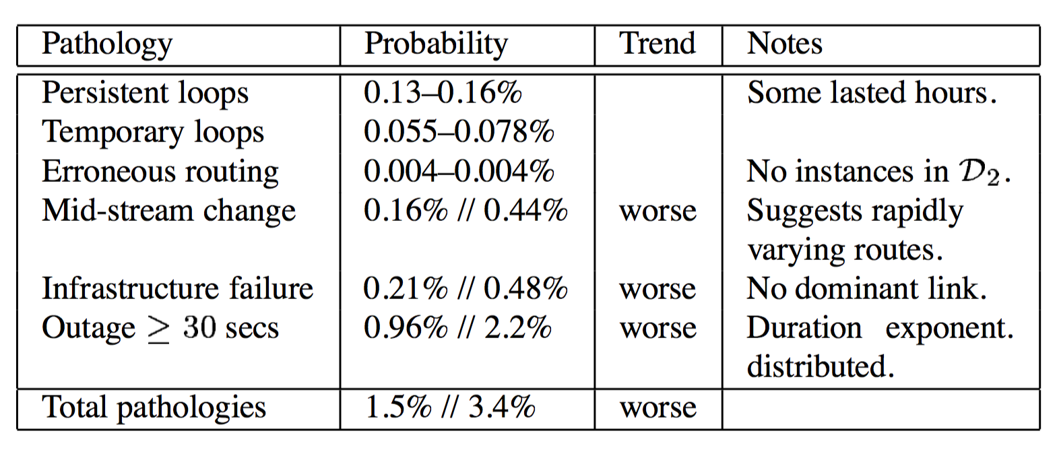
Summary of pathologies

Slide 23
Routing stability
Why does routing stability matter?
Prevalence: how frequently do you see a route?
PASTA ensures that samples see “true” stable behavior
Persistence: how long does a given route persist over time?
Challenging to measure!
Example: R1, R2, R1, but samples miss the intermediate R2

Slide 24
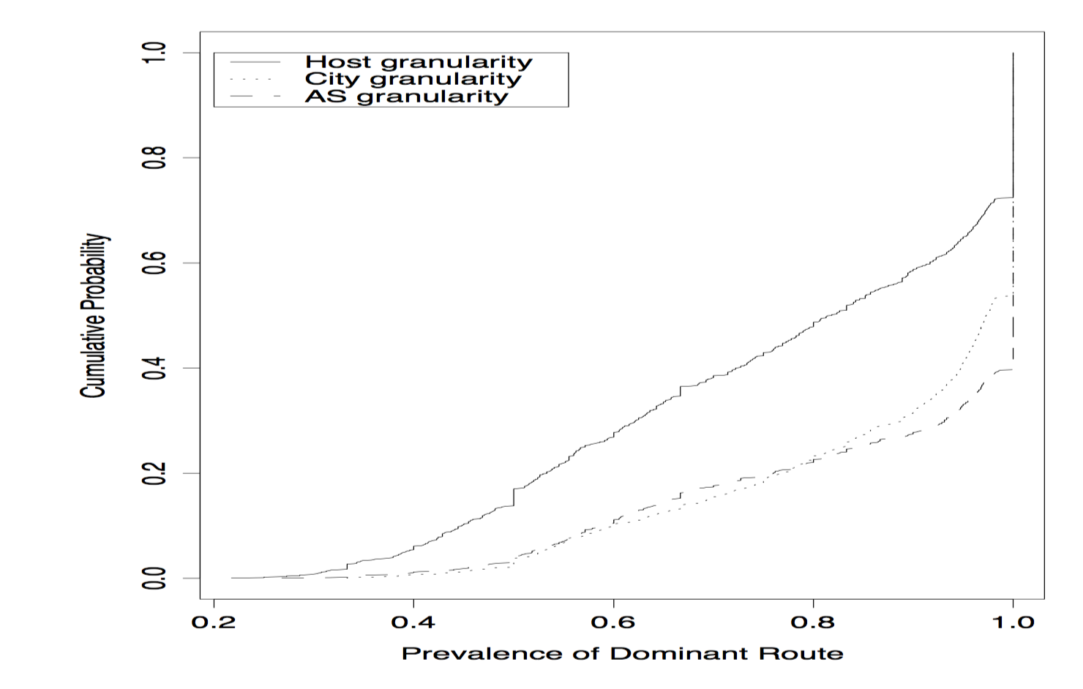
Routing prevalence

Slide 25
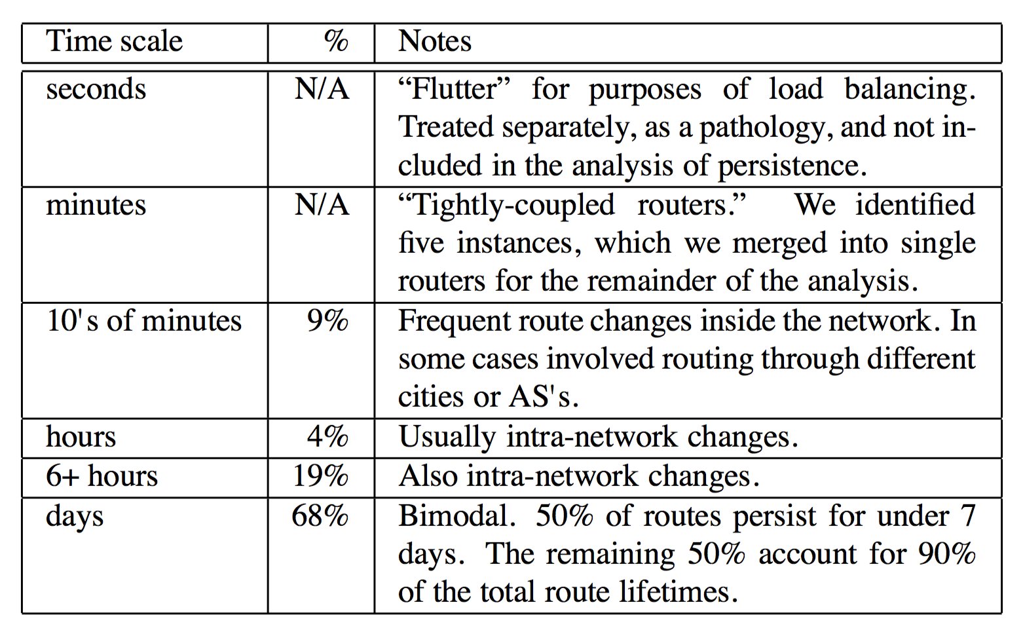
Routing persistence

Slide 26
Routing asymmetry
49% of D2 measurements saw asymmetric paths!
visiting a different city each way around
30% with a different AS!
Trend worsening over time

Slide 27
A summary
No guarantees on where your traffic might end up
A black-hole!
Somewhere unintended (US east→London goes through Israel)
Routes are dominated by single winner but can be quite flappy
Implications on what performance apps might expect
What measurement tools provide
Asymmetry makes a lot of things complex
Diagnosis: Assumptions about where problems lie
Flow state in the core: can’t assume you’ll see return traffic

Slide 28
Limitations of the study
Representativeness:
Routes within an AS may not have similar characteristics!
Sample a really small subset of actual Internet paths
Methodology:
PASTA doesn’t hold when the network is down
Hard to extrapolate trends in Internet evolution with just 2 points
E2E measurements:
Fundamentally hard to corroborate with ground truth

Slide 29
Reverse Traceroute
Usenix NSDI 2010
Ethan Katz-Bassett, Harsha V. Madhyastha, Vijay Kumar Adhikari, Colin Scott, Justine Sherry, Peter van Wesep, Thomas Anderson, and Arvind Krishnamurthy

Slide 30
Can we find the reverse path?
Routes aren’t always symmetric!
What are reverse routes useful for?

Slide 31
Main techniques
Distributed set of vantage points issuing forward traceroutes
Create an “atlas” of nodes and paths to the source
Incrementally stitch reverse path until you hit an atlas node
IP record route: grab first (few) router IP address(es) on return path
Recursively reverse traceroute from there!
Timestamp option: verify whether a router is on reverse path
Source spoofing: sample reverse path without forward path
Use prior mapping of vantage points “closest” to the destination
When all else fails, assume symmetric routing

Slide 32
How accurate is reverse traceroute?
Ground truth: actual traceroutes from D to S
Overlap in hops of reverse and (ground truth) traceroute
Close to 87% in the median
Why are there differences between the two?
Reverse paths used undiscovered peering links

Slide 33
(E2E) Measurement research challenges
Ground truth
Explaining empirical observations
Aliasing, router identification, AS identification, …
Representativeness
Measuring without bias
PASTA
Coordinating distributed vantage points
Probing overheads
Detailed knowhow of the Internet and its quirks!
Ex: IP timestamp marked only when router sees itself on top
How will the conclusions evolve over time?

