Slide 1

Congestion Control in
Data Centers
Lecture 16, Computer Networks (198:552)

Slide 2


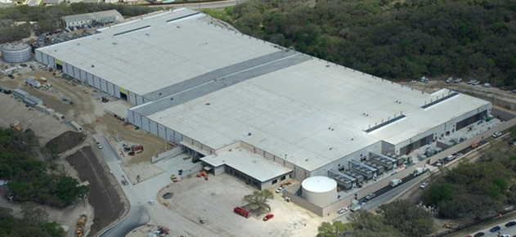


Transport inside the DC
100Kbps–100Mbps links
~100ms latency
INTERNET
Fabric
10–40Gbps links
~10–100μs latency
Servers

Slide 3
Transport inside the DC
INTERNET
Fabric
Interconnect for distributed compute workloads
Servers
web
app
cache
data-base
map-reduce
HPC
monitoring
Notes:
Specifically, while some of the traffic in data center networks is sent across the Internet, the majority of data center traffic is between the servers within the data center and never leaves the data center.

Slide 4
What’s different about DC transport?
Network characteristics
Very high link speeds (Gb/s); very low latency (microseconds)
Application characteristics
Large-scale distributed computation
Challenging traffic patterns
Diverse mix of mice & elephants
Incast
Cheap switches
Single-chip shared-memory devices; shallow buffers

Slide 5
Additional degrees of flexibility
Flow priorities and deadlines
Preemption and termination of flows
Coordination with switches
Packet header changes to propagate information

Slide 6


Data center workloads
Mice and Elephants!
Short messages
(e.g., query, coordination)
Large flows
(e.g., data update, backup)
Low Latency
High Throughput

Slide 7

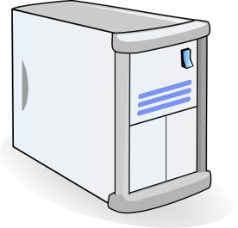
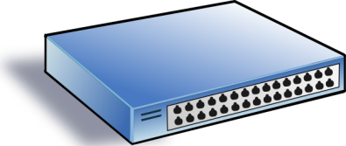
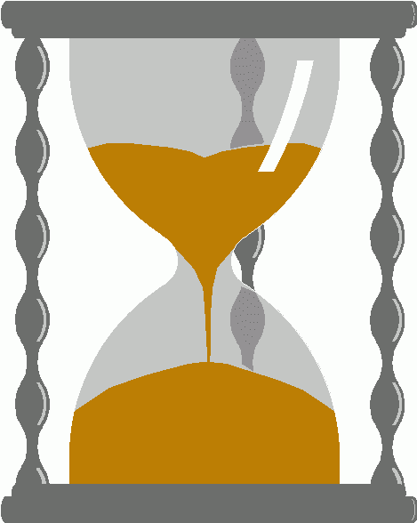
Incast
Synchronized fan-in congestion
Worker 1
Aggregator
Worker 2
Worker 3
RTO_{min} = 300 ms
Worker 4
TCP timeout
Vasudevan et al. (SIGCOMM’09)

Slide 8
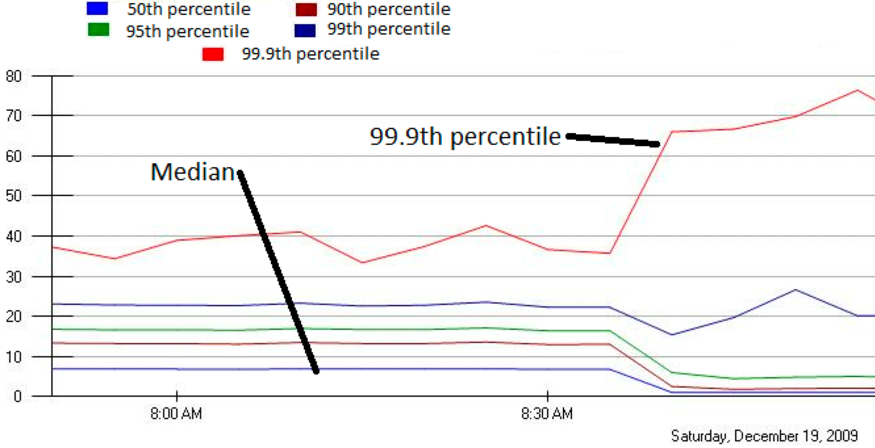
Incast in Microsoft Bing
MLA Query Completion Time (ms)
Jittering trades of median for high percentiles
Requests are jittered over 10ms window.
Jittering switched off around 8:30 am.
Notes:
1. Incast really happens – see this actual screenshot from production tool
2. People care, they’ve solved it at application by jittering.
3. They care about the 99.9th percentile, 1-1000 customers

Slide 9
DC transport requirements
Low Latency
Short messages, queries
High Throughput
Continuous data updates, backups
High Burst Tolerance
Incast
The challenge is to achieve these together

Slide 10
Data Center TCP
Mohammad Alizadeh et al., SIGCOMM’10

Slide 11
TCP widely used in the data center
Apps use familiar interfaces
TCP is deeply ingrained in the apps
... And developers’ minds
However, TCP not really designed for data center environments
Complex to work around TCP problems
Ad-hoc, inefficient, often expensive solutions
Practical deployment is hard
→ keep it simple!

Slide 12
Review: TCP algorithm
Sender 1
Additive Increase:
W → W+1 per round-trip time
Multiplicative Decrease:
W → W/2 per drop or ECN mark
ECN Mark (1 bit)
Receiver
Window Size (Rate)
Time
Sender 2
ECN = Explicit Congestion Notification
Notes:
DCTCP is based on the existing Explicit Congestion Notification framework in TCP.
----- Meeting Notes (3/7/12 12:24) -----
Remember to mention "SAWTOOTH"

Slide 13
TCP buffer requirement
Bandwidth-delay product rule of thumb:
A single flow needs C×RTT buffers for 100% Throughput.
B < C×RTT
B ≥ C×RTT
B
Buffer Size
B
100%
100%
Throughput
Notes:
Now in the case of TCP, the question of how much buffering is needed for high throughput has been studied and is known in the literature as the buffer sizing problem.
So if we can find a way to lower the variance of the sending rates, then we can reduce the buffering requirements and that’s exactly what DCTCP is designed to do”

Slide 14

Reducing buffer requirements
Appenzeller et al. (SIGCOMM ‘04):
Large # of flows: is enough.
Window Size
Buffer Size
Throughput
100%
Notes:
Now, there are previous results that show in some circumstances, we don't need big buffers.

Slide 15
Reducing buffer requirements
Appenzeller et al. (SIGCOMM ‘04):
Large # of flows: is enough.
Can’t rely on stat-mux benefit in the DC
Measurements show typically only 1-2 large flows at each server
Key observation:
Low variance in sending rate ➔ Small buffers suffice
Notes:
Now, there are previous results that show in some circumstances, we don't need big buffers.

Slide 16
DCTCP: Main idea
Extract multi-bit feedback from single-bit stream of ECN marks
Reduce window size based on fraction of marked packets

Slide 17
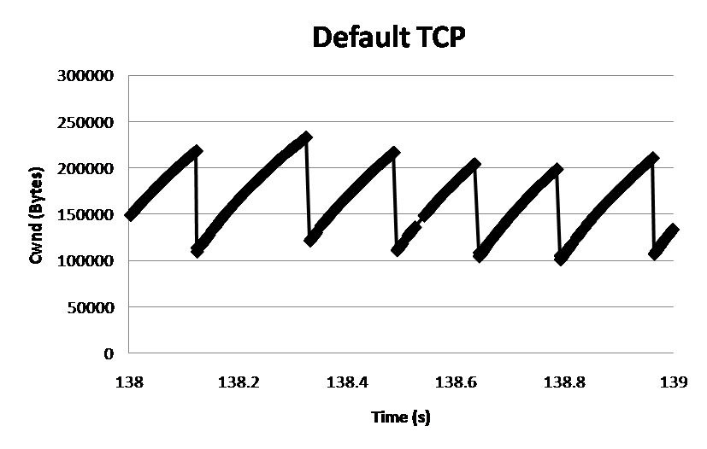
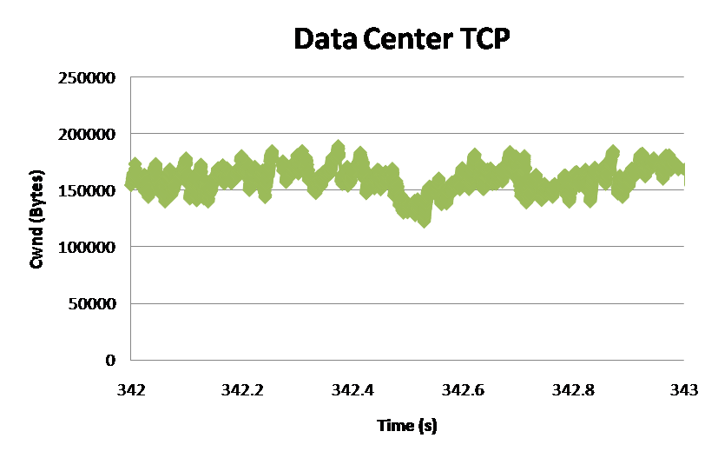
DCTCP: Main idea
ECN Marks | TCP | DCTCP
1 0 1 1 1 1 0 1 1 1 | Cut window by 50% | Cut window by 40%
0 0 0 0 0 0 0 0 0 1 | Cut window by 50% | Cut window by 5%
TCP
DCTCP
Window Size (Bytes)
Window Size (Bytes)
Time (sec)
Time (sec)
Notes:
Start with: “How can we extract multi-bit information from single-bit stream of ECN marks?”
- Standard deviation: TCP (33.6KB), DCTCP (11.5KB)

Slide 18
DCTCP algorithm
B
K
Don’t
Mark
Mark
Switch side:
Mark packets when Queue Length > K.
Sender side:
Maintain running average of fraction of packets marked (α).
Adaptive window decreases:
Note: decrease factor between 1 and 2.
Notes:
very simple marking mechanism
not all the tunings other aqms have
on the source side, the source is tryign to estimate the fraction of packets getting marked
using the obs that there is a stream of ecn marks coming back – more info in the stream than in any single bit
trying to maintain smooth rate variations to operate well even when using shallow buffers, and only a few flows (no stat mux)
F over the last RTT. In TCP there is always a way to get the next RTT from the window size. Comes from the self-clocking of TCP.
Only changing the decrease. Simplest version – makes a lot of sense. So generic could apply it to any algorithm – CTCP, CUBIC – how to cut its window leaving increase part to what it already does. Have to be careful here.

Slide 19
DCTCP vs TCP
Experiment: 2 flows (Win 7 stack), Broadcom 1Gbps Switch
Buffer is mostly empty
(KBytes)
DCTCP mitigates Incast by creating a
large buffer headroom
ECN Marking Thresh = 30KB

Slide 20
Why it works
Low Latency
Small buffer occupancies → low queuing delay
2. High Throughput
ECN averaging → smooth rate adjustments, low variance
3. High Burst Tolerance
Large buffer headroom → bursts fit
Aggressive marking → sources react before packets are dropped

Slide 21
Setting parameters: A bit of analysis
B
K
How much buffering does DCTCP need for 100% throughput?
Need to quantify queue size oscillations (Stability).
Packets sent in this
RTT are marked
Window Size
W*+1
W*
(W*+1)(1-α/2)
Time

Slide 22
Setting parameters: A bit of analysis
B
K
How small can queues be without loss of throughput?
Need to quantify queue size oscillations (Stability).
for TCP:
K > C x RTT
K > (1/7) C x RTT

Slide 23
Convergence time
DCTCP takes at most ~40% more RTTs than TCP
“Analysis of DCTCP”, SIGMETRICS 2011
Intuition: DCTCP makes smaller adjustments than TCP, but makes them much more frequently
TCP
DCTCP
Notes:
In the first part of the talk, we established that what we need from DCTCP is to maintain small queues, without loss of throughput
Now in the case of TCP, the question of how much buffering is needed for high throughput has been studied and is known in the literature as the buffer sizing problem.
… and I’ll show you how to get low var…

Slide 24
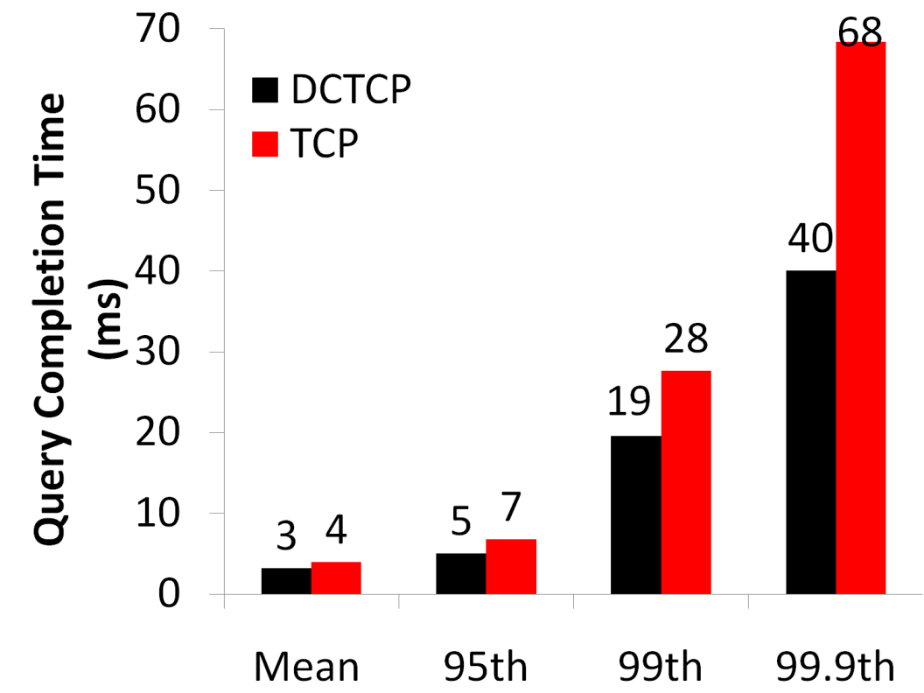
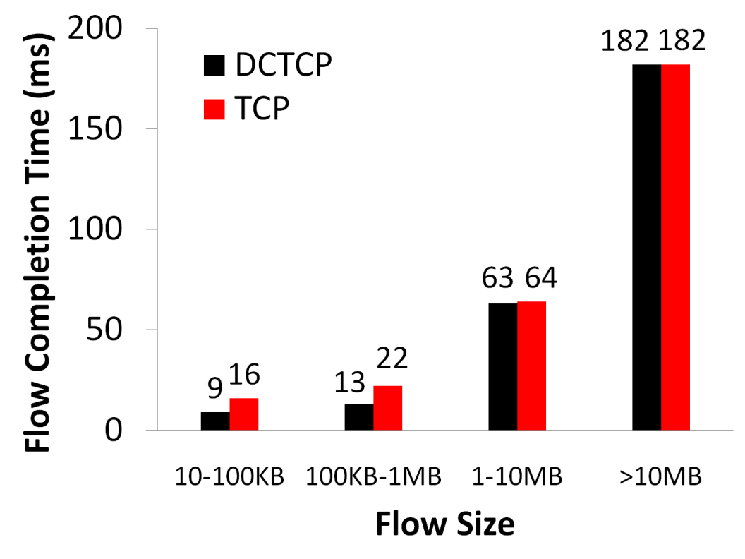
Bing benchmark (baseline)
Background Flows
Query Flows
Notes:
To transition to scaled traffic: people always want to get more out of their network.

Slide 25
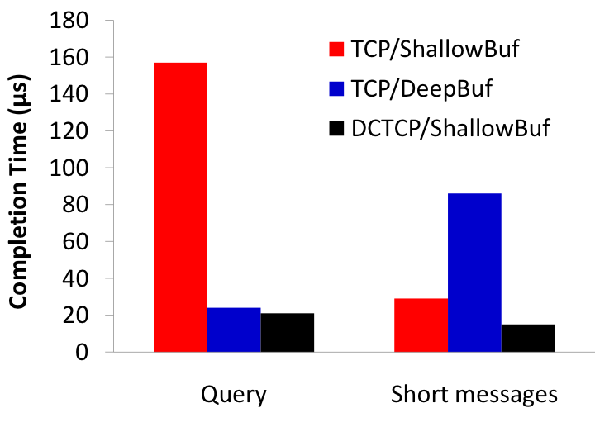
Bing benchmark (scaled 10x)
Incast
Deep buffers fix incast, but increase latency
DCTCP good for both incast & latency
Completion Time (ms)
Query Traffic
(Incast bursts)
Short messages
(Delay-sensitive)
Notes:
Emphasize that these are two traffic classes within same experiment

Slide 26
Discussion
Between throughput, delay, and convergence time, what metrics are you willing to give up? Why?
Are there other factors that may determine choice of K and B besides loss of throughput and max queue size?
How would you improve on DCTCP?
How could you add on flow prioritization over DCTCP?

Slide 27
Acknowledgment
Slides heavily adapted from material by Mohammad Alizadeh

