Slide 1

Middleboxes
Lecture 21, Computer Networks (198:552)

Slide 2
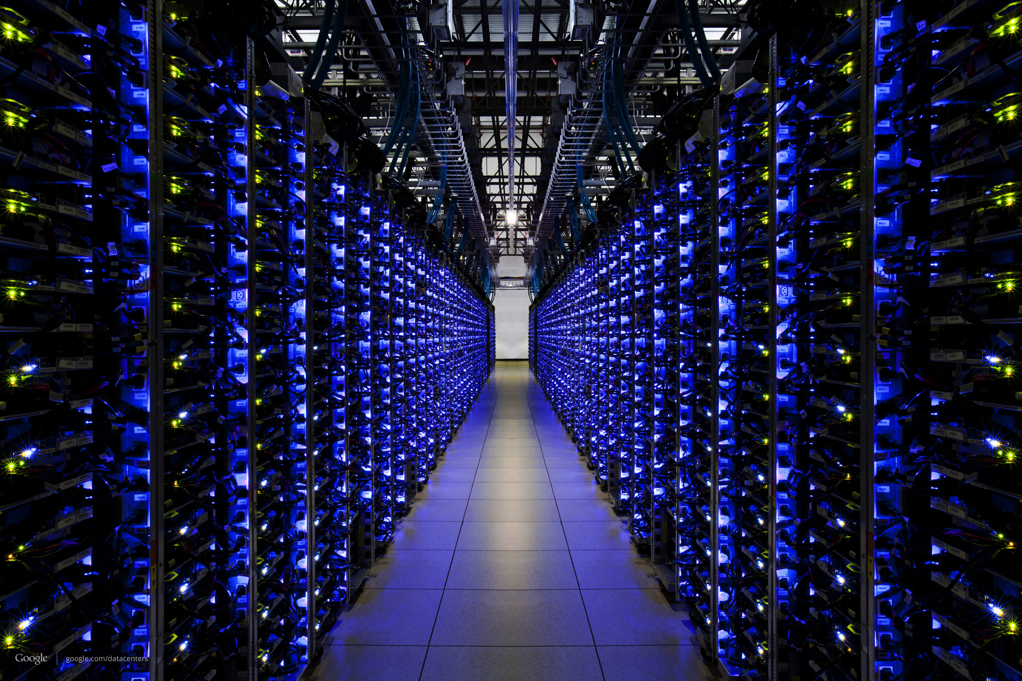

The Internet
Textbook view: A “smooth” pipe from source to destination
The Internet

Slide 3
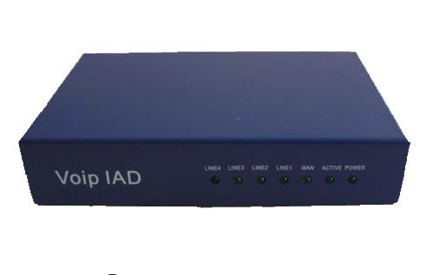
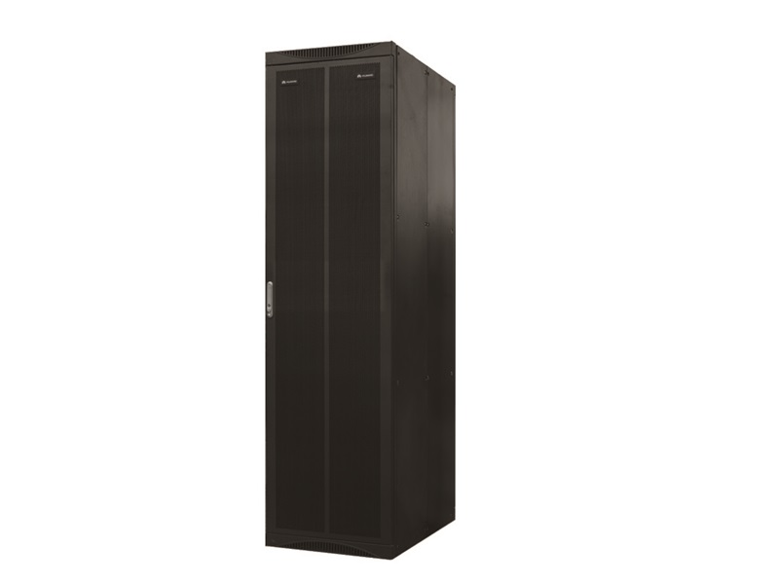


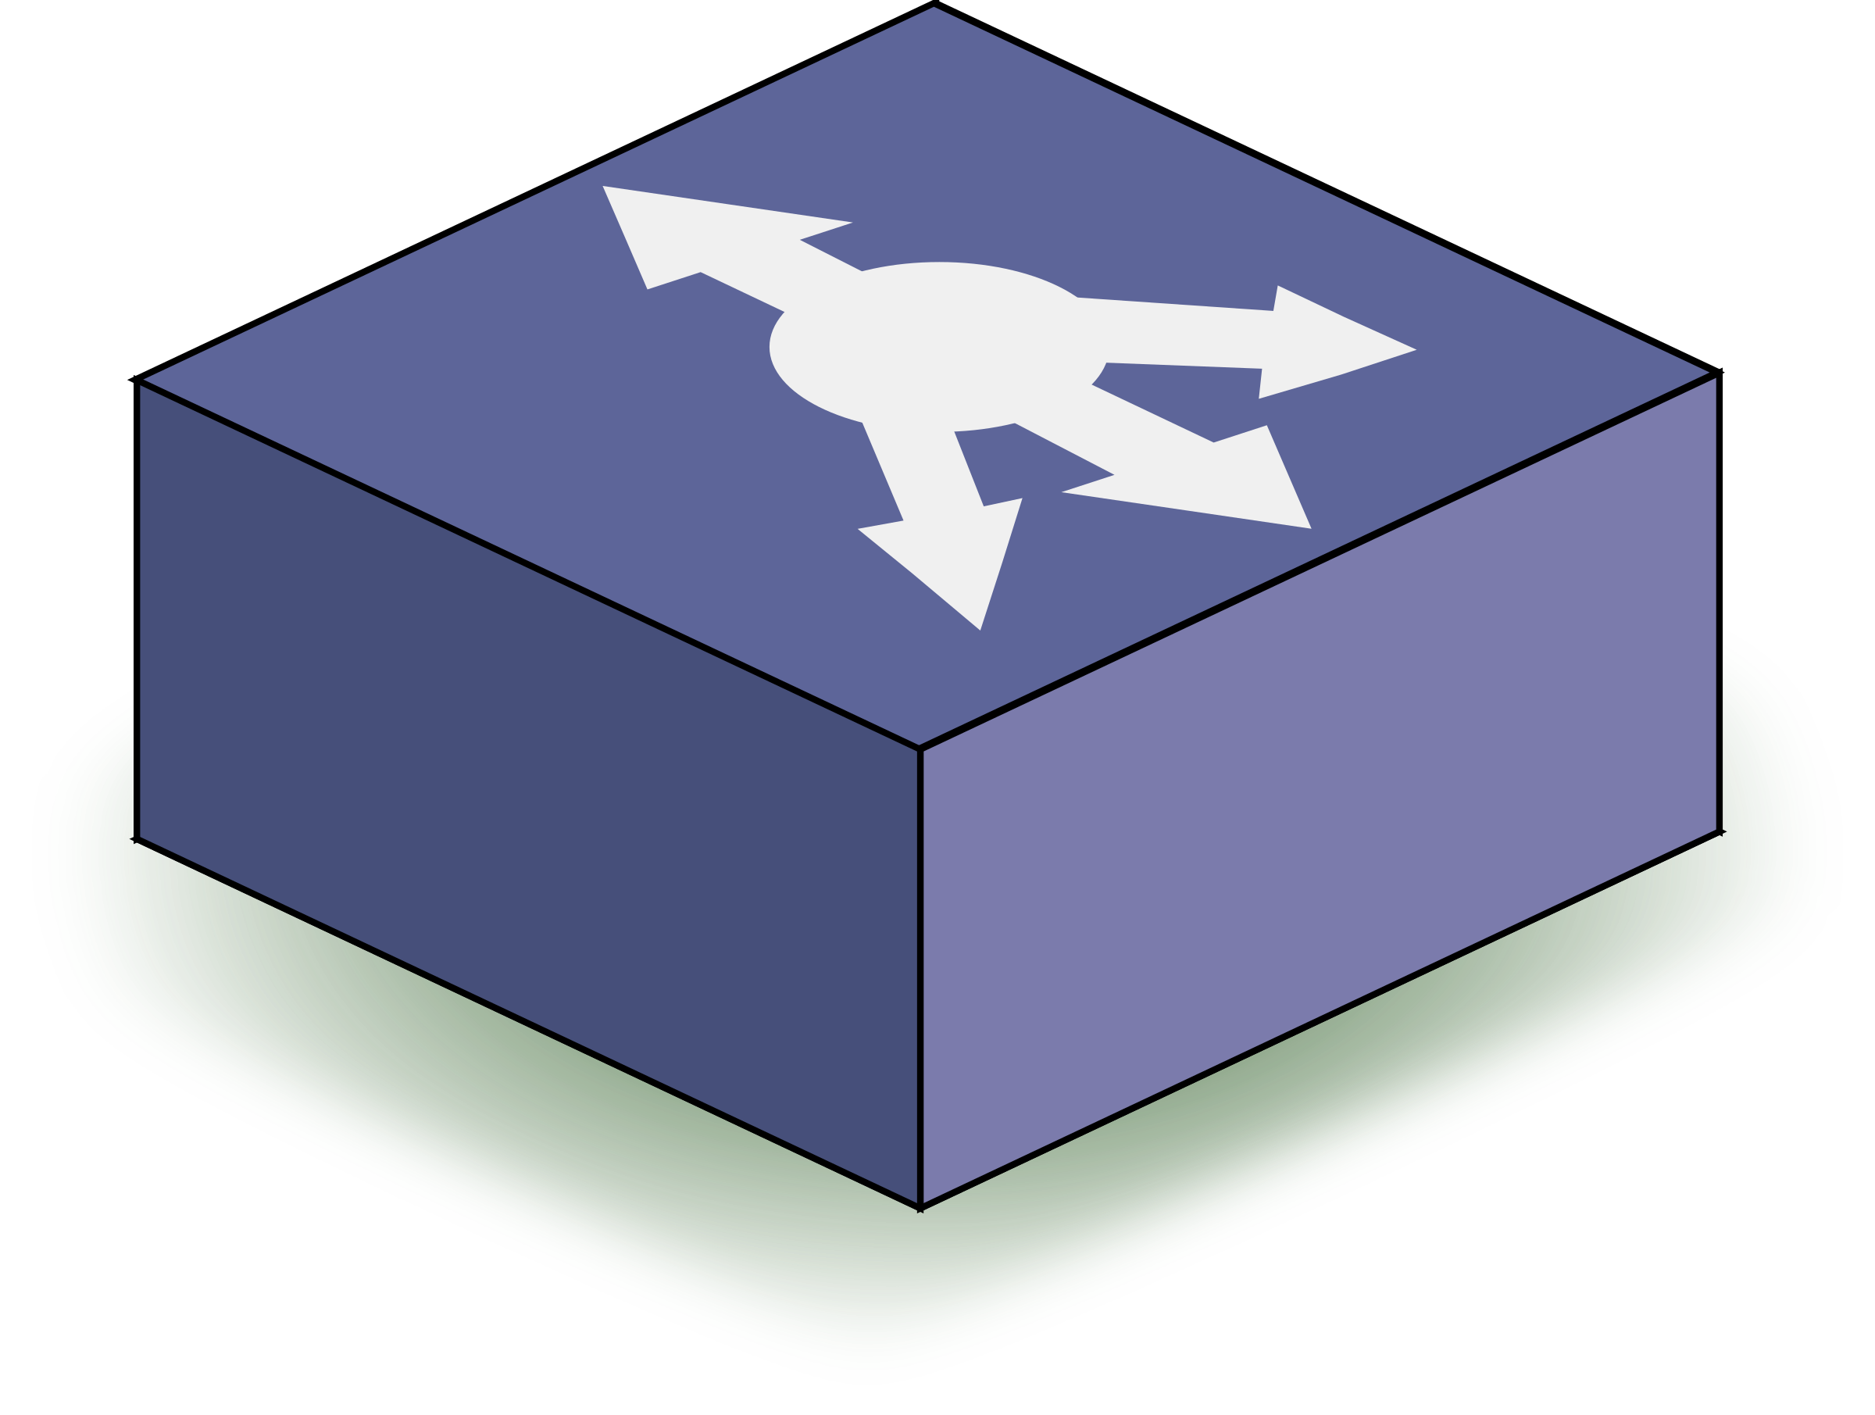





The Internet
Reality: Lots of “glue”
Middleboxes!
Notes:
DDoS, mobile packet gateway, VoIP gateway, load balancer, proxy, video transcoder, VPN gateway, WAN optimizer/cache, firewall, intrusion detection system.

Slide 4
What are middleboxes?
Specialized applications
Security, application optimization, network management
Specialized appliances
Hardware boxes with custom management interfaces
Thousands to millions of $$ in equipment
... and more to operate, upgrade, optimize their performance

Slide 5
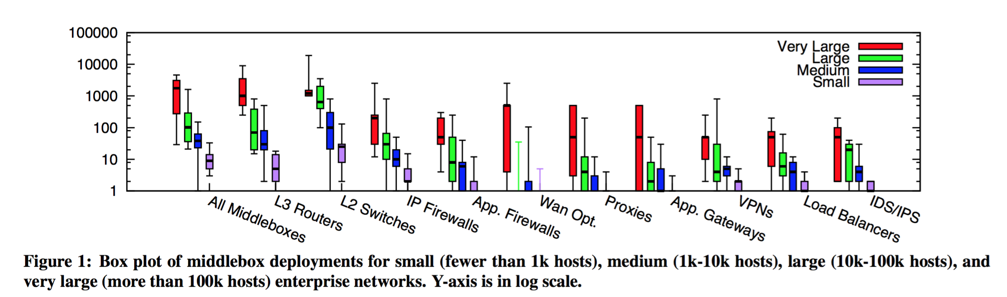
Significant deployments in enterprises!
Source: Aplomb, Justine Sherry et al., SIGCOMM ‘12

Slide 6
Some key concerns for operators
Upgradability: hardware vs. software
Expertise to operate: configure, optimize, …
Monitoring: Need visibility & diagnostics
Managing load: what if network traffic suddenly increases?
Could really use an elastic cloud + SDN-like approach ☺

Slide 7
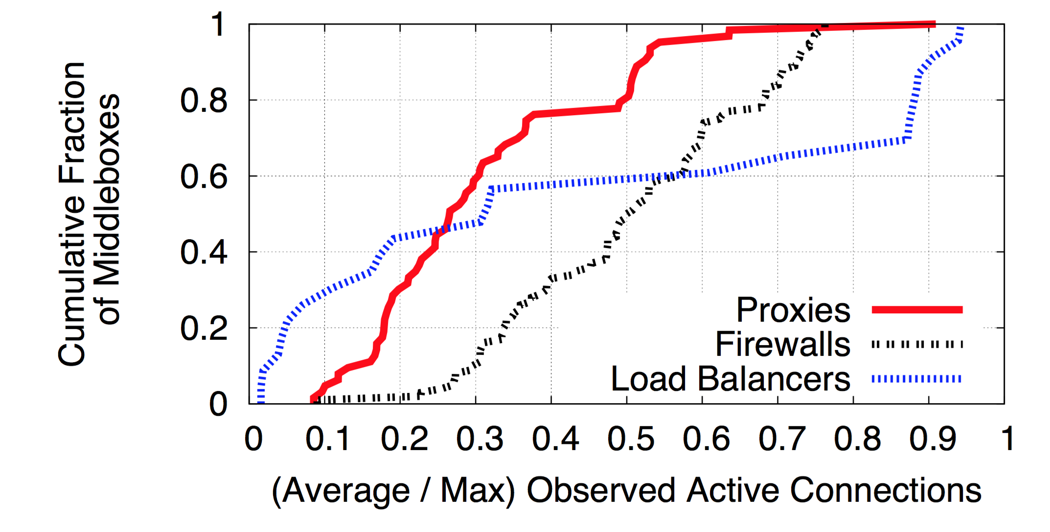
Example: Need for load management
Source: Aplomb, Justine Sherry et al., SIGCOMM ‘12

Slide 8
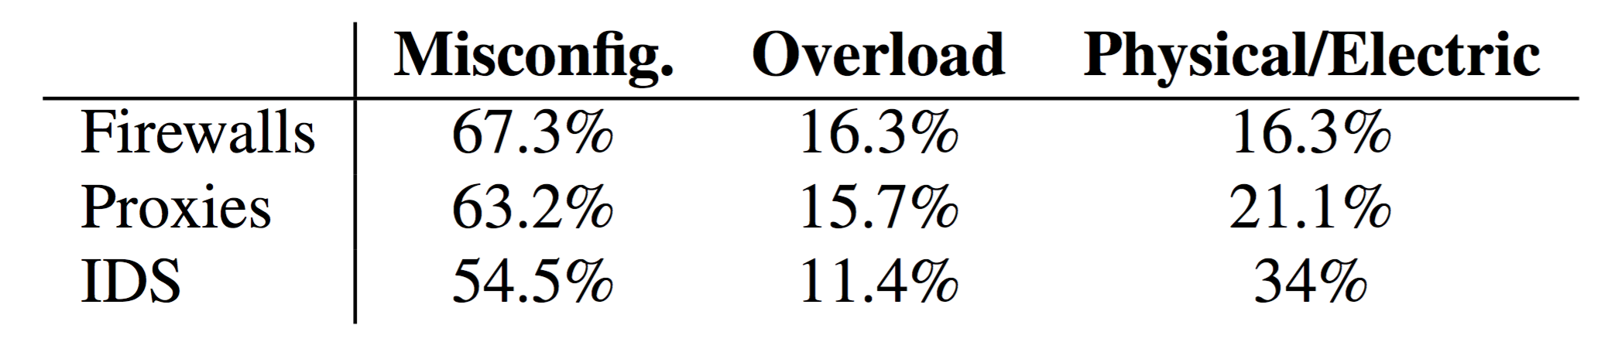
Example: Need for better ways to use
Most common causes of middlebox failure

Slide 9
Network Function Virtualization (NFV)
Encapsulate specialized app as software network functions
Run network functions inside VMs in a cluster

Slide 10
Benefits of NFV
Easier to upgrade
Regular software maintenance!
Easier to manage
Use server+VM management tools
Easier to develop
Write software instead of develop hardware
Reduce costs by consolidating VMs
And expand elastically as needed

Slide 11
NetBricks: Taking the V out of NFV
Aurojit Panda et al., OSDI ’16
(ACK: Material by Aurojit Panda)

