Slide 1

Router Design
Lecture 21
http://www.cs.rutgers.edu/~sn624/352-F24
Srinivas Narayana

Slide 2




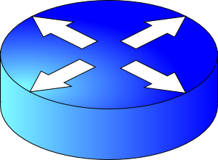
Review of concepts
Network layer’s main function: moving data from one endpoint to another
Analogy: postal system
Net layer
Addressing (IPv4)
Locate, not identify
endpoint
Network
layer
endpoint
Forwarding
Routing
10000000 11000011 00000001 01010000
Data plane
Control plane
.
.
128
195
1
.
80
Classless (CIDR)
IP prefixes
==
zip code
128.195.0.0/20

Slide 3
Advantages of prefix-based IP organization
Aggregate information across endpoints for forwarding & routing
Don’t reason about individual addresses; do prefixes instead
Reduce the sizes of information exchanged and router data structures
Prefixes (not individual IPs) are allocated to organizations by Internet registries
Each organization is delegated the work of assigning individual IPs
Facilitates movement of entire groups of hosts between organizations
(CIDR) IP address is decoupled from an explicit prefix length
Different routers can interpret an address with different prefix lengths
E.g., further away: more aggregated (shorter prefix); closer to destination: more granular (longer prefix)

Slide 4
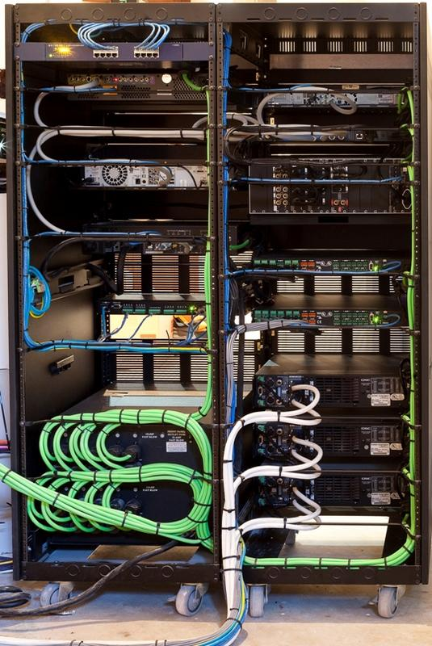
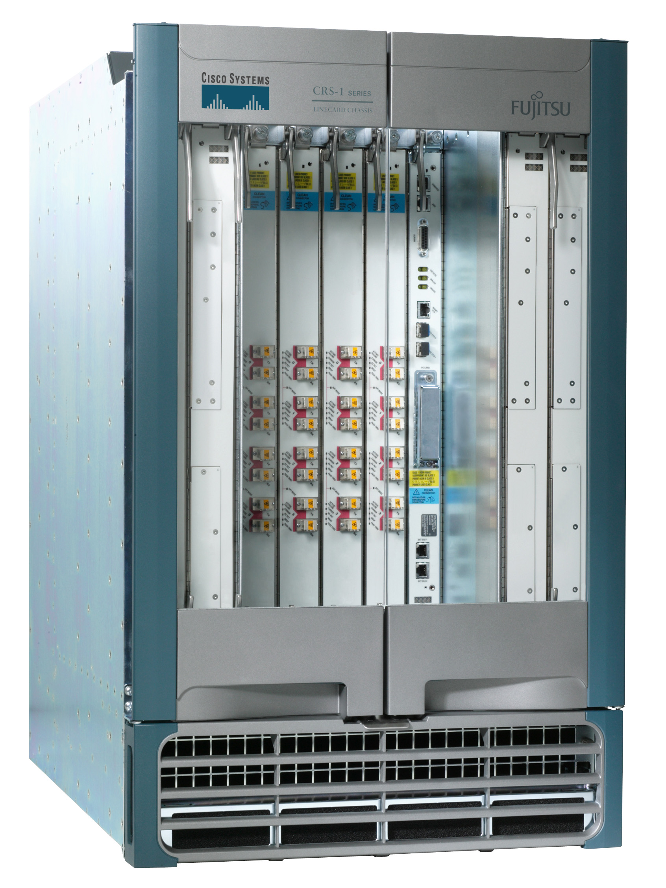
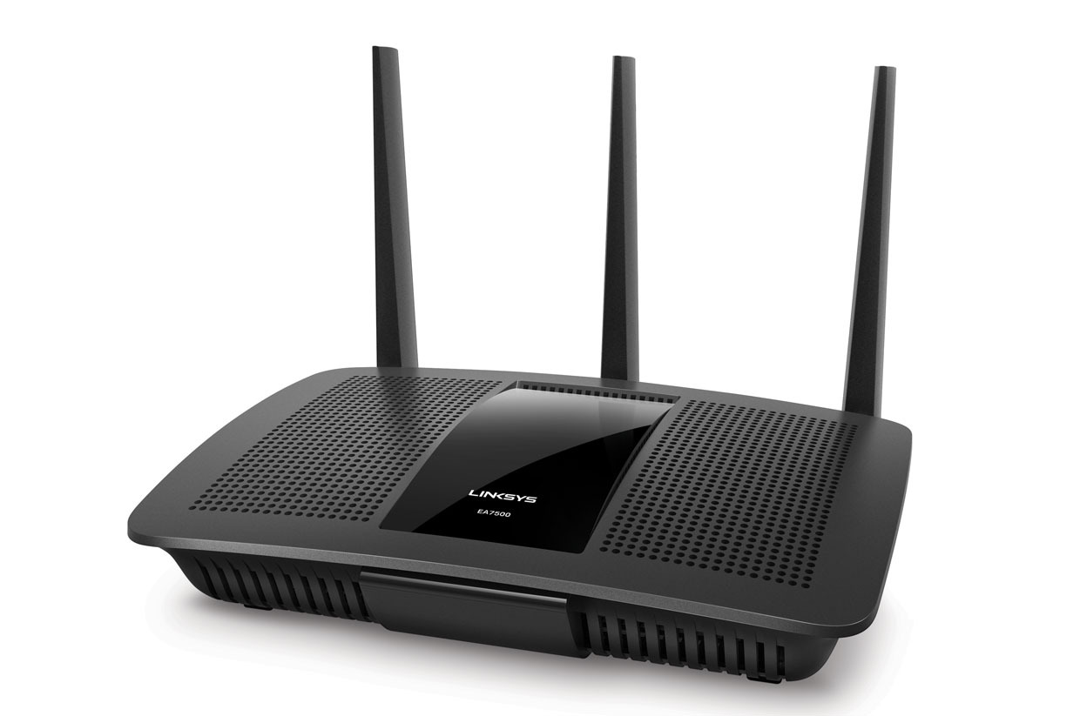
Next we’ll talk about routers
Access routers
Internet core router
Data center top-of-rack switch

Slide 5
What’s inside a router?

Slide 6
Router architecture overview
Review: assuming distributed routing, routing function: decide which ports packets need to exit
route
processor
Control plane
Data plane
Review: Forwarding function: move packets from one input port to another.
high-speed
switching
fabric
router input ports
router output ports

Slide 7
Different and evolving designs
There are different kinds of routers, with their own designs
Access routers (e.g., home WiFi), chassis/core routers, top-of-rack switches
Router designs have also evolved significantly over time
For simplicity and concreteness, we will learn about one high-speed router design from the early 2000s.
Called the MGR (multi-gigabit router). It could support an aggregate rate of 50 Gbit/s (1 G = 10⁹)
Today’s single-chip routers can support aggregate rates of ~10 Tbit/s (1 T = 10¹²)

Slide 8
Input port functions
Input port
Output port
Input port
Switching fabric
Output port
Line termination: receives physical (analog) signals and turns them into digital signals (physical layer)
Rate of link connecting to a single port termed line speed or line rate (modern routers: 100+ Gbit/s)
Link layer: performs medium access control functions (e.g., Ethernet)
…
…
Input port
Output port
Line
Term
Link
Layer
/ MAC
(receive)

Slide 9
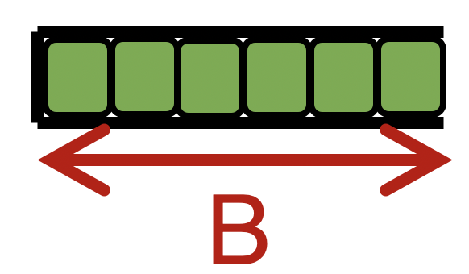

Input port functions
Input port
Output port
Input port
Switching fabric
Output port
Route lookup: high-speed lookup of which output port the packet is destined to
Goal: must complete this processing at the line rate
Queueing: packets may wait in per-output-port queues if packets are arriving too fast for the switching fabric to send them to the output port
…
…
Input port
Output port
Per-output
Queues
Line
Term
Link
Layer
/ MAC
(receive)
Route
lookup
switching
fabric

Slide 10

Route lookups
Route
lookup
Per-output
Queues
Line
Term
Link
Layer
Packet forwarding in the Internet is based on the destination IP address on the packet.
Example: if dst IP on packet is 65.45.145.34, it matches the prefix 65.0.0.0/8 (netmask 255.0.0.0) in table
(IP & netmask == prefix)
The packet is forwarded out port 3.
Example 2: what about dst IP 128.9.5.6?
Parse
Transport
Extract destination IP address
Network
Link layer
Route Lookup Data Structure
Outgoing Port
Forwarding Table
Dst-network
Port
65.0.0.0/8
3
128.9.0.0/16
1
149.12.0.0/19
7

Slide 11
Route lookups
Route
lookup
Per-output
Queues
Line
Term
Link
Layer
Number of entries in the forwarding table matters.
Fitting into router memory
Designing hardware and software for fast lookups
Parse
Transport
Extract destination IP address
Network
Link layer
Route Lookup Data Structure
Outgoing Port
Forwarding Table
Dst-network
Port
65.0.0.0/8
3
128.9.0.0/16
1
149.12.0.0/19
7

Slide 12
Route lookups
Route
lookup
Per-output
Queues
Line
Term
Link
Layer
Recall: IP addresses can be aggregated based on shared prefixes.
The number of table entries in a router is proportional to the number of prefixes, NOT the number of endpoints.
Today: ~ 1 million prefixes.
Parse
Transport
Extract destination IP address
Network
Link layer
Route Lookup Data Structure
Outgoing Port
Forwarding Table
Dst-network
Port
65.0.0.0/8
3
128.9.0.0/16
1
149.12.0.0/19
7

Slide 13
Route lookups
Route
lookup
Per-output
Queues
Line
Term
Link
Layer
Destination-IP-based forwarding has consequences.
Forwarding behavior is independent of the source: legitimate source vs. malicious attack traffic
Forwarding behavior is independent of the application: web traffic vs. file download vs. video
IP-based packet processing is “baked into” router hardware: evolving the IP protocol faces tall deployment hurdles
Parse
Transport
Extract destination IP address
Network
Link layer
Route Lookup Data Structure
Outgoing Port
Forwarding Table
Dst-network
Port
65.0.0.0/8
3
128.9.0.0/16
1
149.12.0.0/19
7

Slide 14
Output port functions
Input port
Output port
Input port
Switching fabric
Output port
Components in reverse order of those in the input port
This is where most routers have the bulk of their packet buffers
Recall discussions regarding router buffers from transport
MGR uses per-port output buffers, but modern routers have shared memory buffers
More efficient use of memory under varying demands
…
…
Input port
Output port
Queues
Link
Layer
/ MAC
(transmit)
Line
Termination
Switching
fabric
To output link

Slide 15
Output port functions
Input port
Output port
Input port
Switching fabric
Output port
Two important policy decisions
Scheduling: which among the waiting packets gets to be transmitted out the link?
Ex: First-In-First-Out (FIFO)
Buffer management: which among the packets arriving from the fabric get space in the packet buffer?
Ex: Tail drop: later packets dropped first
…
…
Input port
Output port
Queues
Link
Layer
/ MAC
(transmit)
Line
Termination
Switching
fabric
To output link

Slide 16
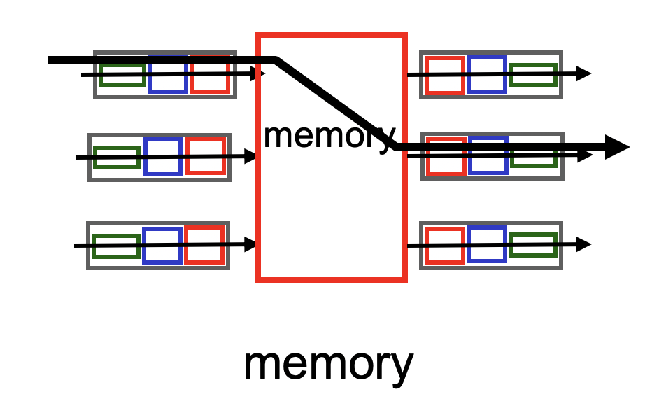
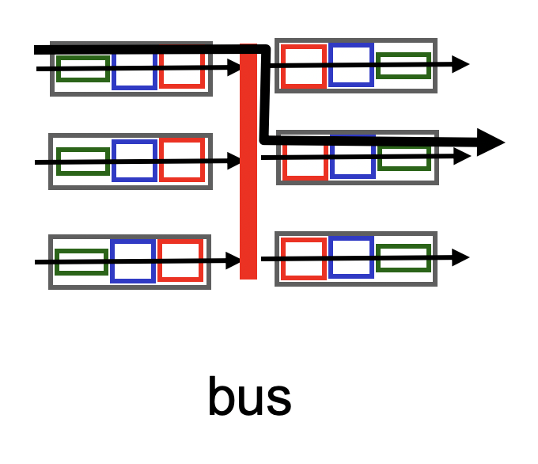
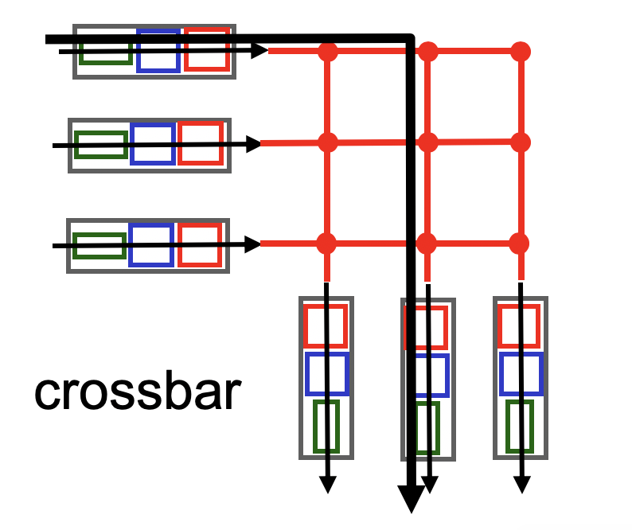
Fabrics: Types
Input port
Output port
Input port
Switching fabric
Output port
…
…
Fabric goal: Ferry as many packets as possible from input to output ports as quickly as possible.
Input port
Output port
Input port writes packets into shared memory.
Output port reads the packet when output link ready to transmit.
Single shared channel to move data from input to output port.
Easy to build buses; technology is quite mature.
Each input port has a physical data path to every output port.
Switch at the cross-over points turns on to connect pairs of ports.

Slide 17
Fabrics: Types
Input port
Output port
Input port
Switching fabric
Output port
…
…
Input port
Output port
Crossbars can get expensive as the number of ports grows (N² connections for N ports)
MGR uses a crossbar and schedules (in,out) port pairs.
Modern high-speed routers use highly optimized shared-memory-based interconnects.

Slide 18





Nonblocking fabrics
Input port
Output port
Input port
Switching fabric
Output port
…
…
Input port
Output port
High-speed switching fabrics designed to be nonblocking:
If an output port is “available”, an input port can always transmit to it without being blocked by the switching fabric itself
Nontrivial to achieve
Crossbars are nonblocking by design
Shared memory can be designed to be nonblocking if memory accesses can be made fast enough

Slide 19
Nonblocking fabrics
Input port
Output port
Input port
Switching fabric
Output port
…
…
Input port
Output port
With a nonblocking fabric, queues aren’t formed due to the switching fabric.
With a nonblocking fabric, there are no queues due to inefficiencies at the input port or the switching fabric
Queues only form due to contention for the output port
Fundamental, unavoidable, given the route

Slide 20
Nonblocking fabrics
Input port
Output port
Input port
Switching fabric
Output port
…
…
Input port
Output port
With a nonblocking fabric, queues aren’t formed due to the switching fabric.
With a nonblocking fabric, there are no queues due to inefficiencies at the input port or the switching fabric
Queues only form due to contention for the output port
Fundamental, unavoidable, given the route
Typically, these queues form on the output side
But can also “backpressure” to the input side if there is high contention for the output port
i.e.: can’t move pkts to output Qs since buffers full, so buffer @ input

Slide 21
Control (plane) processor
A general-purpose processor that “programs” the data plane:
Forwarding table
Scheduling and buffer management policy
Implements the routing algorithm by processing routing protocol messages
Mechanism by which routers collectively solve the Internet routing problem
More on this soon.
Control Processor
Input port
Output port
Input port
Switching fabric
Output port
…
…
Input port
Output port

Slide 22

Router design: the bigger picture
Control plane
Traditional distributed routing: per route-change processing
(~ a few tens of seconds)
Routing
Algorithm
control
plane
data
plane
Data plane
per-packet processing
(~ tens of nanoseconds)
0111
1
3
2
values in arriving
packet header, i.e, destination IP address

Slide 23
Longest Prefix Matching

Slide 24
Review: Route lookup
Table lookup matches a packet against an IP prefix
Ex: 65.12.45.2 matches 65.0.0.0/8
Prefixes are allocated to organizations by Internet registries
But organizations can reallocate a subset of their IP address allocation to other orgs
Parse
Transport
Extract destination IP address
Network
Link layer
Route Lookup Data Structure
Outgoing Port
Forwarding Table
Dst-network
Port
65.0.0.0/8
3
128.9.0.0/16
1
149.12.0.0/19
7

Slide 25
Example of IP block reallocation
ISP = Internet Service Provider
Dst IP Prefix | Output port
65.0.0.0/8 | 3
128.9.0.0/16 | 1
… | …
200.23.16.0/20 | 7 (towards A)
Suppose ISP A reallocates a part of its IP block to orgs 1… 8
ISP A owns the IP block 200.23.16.0/20.
Organization 1
200.23.16.0/23
Organization 2
200.23.18.0/23
[BGP] Send me pkts destined to
200.23.16.0/20
Organization 3
200.23.20.0/23
.
ISP A
.
.
.
.
Internet
.
Organization 8
200.23.30.0/23
There is an announcement mechanism (BGP) by which ISP A can inform the rest of the Internet about the prefixes it owns.
It is enough to announce a coarse-grained prefix 200.23.16.0/20 rather than 8 separate sub-prefixes.
Route Aggregation
Save forwarding table memory
Fewer routing protocol msgs

Slide 26
Example of IP block reallocation
Dst IP Prefix | Output port
65.0.0.0/8 | 3
128.9.0.0/16 | 1
… | …
200.23.16.0/20 | 7 (towards A)
Suppose ISP A reallocates a part of its IP block to orgs 1… 8
ISP A owns the IP block 200.23.16.0/20.
Organization 1
200.23.16.0/23
Organization 2
200.23.18.0/23
[BGP] Send me pkts destined to
200.23.16.0/20
Organization 3
200.23.20.0/23
.
ISP A
.
.
.
.
Internet
.
Organization 8
200.23.30.0/23
Now suppose one of these organizations adds another ISP for its Internet service and prefers using the new ISP.
Note: it’s possible for the organization to retain its assigned IP block.

Slide 27
Example of IP block reallocation
Dst IP Prefix | Output port
65.0.0.0/8 | 3
128.9.0.0/16 | 1
… | …
200.23.16.0/20 | 7 (towards A)
Suppose ISP A reallocates a part of its IP block to orgs 1… 8
ISP A owns the IP block 200.23.16.0/20.
Organization 1
200.23.16.0/23
Organization 2
200.23.18.0/23
[BGP] Send me pkts destined to
200.23.16.0/20
Organization 3
200.23.20.0/23
.
ISP A
.
.
.
.
Internet
.
Organization 8
200.23.30.0/23
[BGP] Announce 200.23.18.0/23
(besides other IP prefixes)
ISP B
Organization 2
200.23.18.0/23

Slide 28
Example of IP block reallocation
Dst IP Prefix | Output port
65.0.0.0/8 | 3
128.9.0.0/16 | 1
200.23.18.0/23 | 4 (towards B)
200.23.16.0/20 | 7 (towards A)
Suppose ISP A reallocates a part of its IP block to orgs 1… 8
ISP A owns the IP block 200.23.16.0/20.
Organization 1
200.23.16.0/23
Organization 2
200.23.18.0/23
[BGP] Send me pkts destined to
200.23.16.0/20
Organization 3
200.23.20.0/23
.
ISP A
.
.
.
.
Internet
.
Organization 8
200.23.30.0/23
[BGP] Announce 200.23.18.0/23
(besides other IP prefixes)
ISP B
Organization 2
200.23.18.0/23

Slide 29
A closer look at the forwarding table
200.23.18.0/23 is inside 200.23.16.0/20
A packet with destination IP address 200.23.18.xx is in both prefixes
i.e., both entries match
Q: How should the router choose to forward the packet?
Ideally: The org prefers B, so should choose B
Dst IP Prefix | Output port
65.0.0.0/8 | 3
128.9.0.0/16 | 1
200.23.18.0/23 | 4 (towards B)
200.23.16.0/20 | 7 (towards A)
200.23.16.0/20
The Internet uses a policy to prioritize: Longest Prefix Matching

Slide 30
Longest Prefix Matching (LPM)
Use the longest matching prefix, i.e., the most specific route, among all prefixes that match the packet.
Policy borne out of the Internet’s IP allocation model: prefixes and sub-prefixes are handed out
Internet routers use longest prefix matching.
How would you implement this in software?
Interesting algorithmic and design challenges in developing software and hardware
Dst IP Prefix | Output port
65.0.0.0/8 | 3
128.9.0.0/16 | 1
200.23.18.0/23 | 4 (towards B)
200.23.16.0/20 | 7 (towards A)
200.23.16.0/20

Slide 31
Internet routers perform longest-prefix matching on destination IP addresses of packets.

Slide 32
Why is LPM useful?
Help organizations move in one block to a different ISP while retaining their IP prefix assignment.
IPs unchanged: e.g., don’t have to update DNS for services in the org
Also enable an organization (e.g. Rutgers) to connect to two or more Internet Service Providers (ISPs) and express routing preferences
Announce longer prefixes to make the rest of the Internet prefer a certain path

Slide 33
Why is LPM useful?
Verizon
Agg. route
Rutgers
AT&T
Specific route
(longer prefix)
An ISP (e.g., Verizon) has allocated a sub-prefix (or “subnet”) of a larger prefix that the ISP owns to an organization (e.g., Rutgers)
Further, the ISP announces the aggregated prefix to the Internet to save on number of forwarding table memory and number of announcements
The organization (e.g., Rutgers) is reachable over multiple paths (e.g., through another ISP like AT&T)
The organization has a preference to use one path over another, and expresses this by announcing the longer (more specific) prefix
Routers in the Internet must route based on the longer prefix

