Slide 1

CS 352 Network: ICMP, NAT, Routing
Lecture 22
http://www.cs.rutgers.edu/~sn624/352-F22
Srinivas Narayana

Slide 2


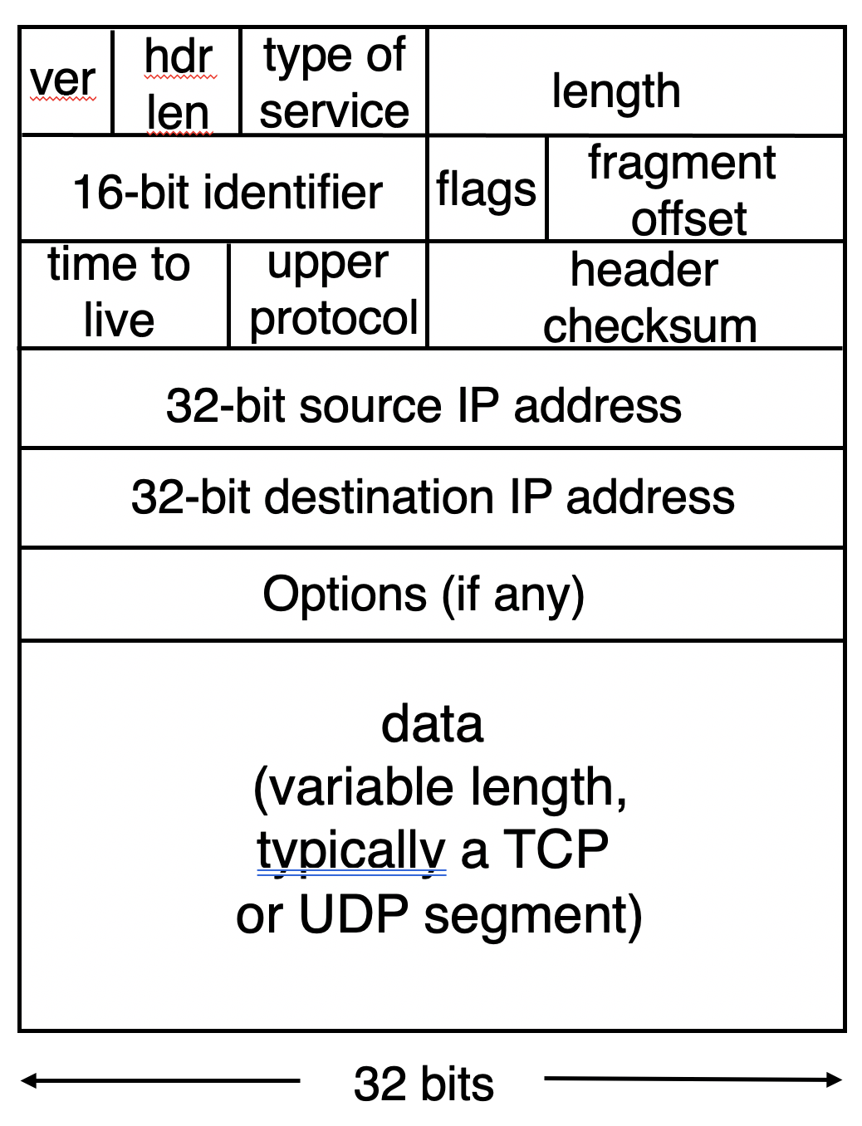

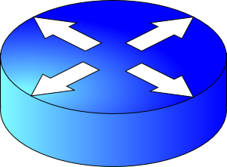
Review
Net layer
ICMP echo request and reply.
ping
IPv4 datagram
Dst IP Prefix | Output port
65.0.0.0/8 | 3
128.9.0.0/16 | 1
200.23.18.0/23 | 4 (towards B)
200.23.16.0/20 | 7 (towards A)
A
B
Echo
request
…
Time
Ping time
…
Echo
reply
200.23.16.0/20
Longest Prefix Matching

Slide 3
Traceroute
A tool that can record the router-level path taken by packets
A clever use of the IP time-to-live (TTL) field
In general, when a router receives an IP packet, it decrements the TTL field on the packet
A failsafe mechanism to ensure packets don’t keep taking up network resources for too long
If a router receives a packet with TTL=0, it sends an ICMP time exceeded message (type=11, code=0) to the source endpoint

Slide 4
Traceroute
Traceroute sends multiple packets to a destination endpoint
But it progressively increases the TTL on those packets: 1, 2, ...
Every time a time exceeded message is received, record the router’s IP address
Process repeated until the destination endpoint is reached
If the packet reaches the destination endpoint (i.e.: TTL is high enough), then the endpoint sends a port unreachable message (type=3, code=3)

Slide 5
Traceroute
A
R1
R2
R3
B
TTL=1, dest = B, dstport = invalid
Time
Time exceeded
Source: R1
TTL = 2
Similarly, capture IP addresses of routers at distance 3, 4, …
TE(R2)
Port un- reachable
Source: B
Have full router-level path until destination
A small demo…

Slide 6
Summary of ICMP
A protocol for network diagnostics and troubleshooting
Two useful tools: ping and traceroute
Ping: test connectivity to a machine totally outside your control
Use ICMP echo request and reply
Traceroute: determine router-level path to a remote endpoint
A smart use of the TTL field in the IP header

Slide 7
Network Address Translation (NAT)

Slide 8
Background: The Internet’s growing pains
Networks had incompatible addressing
IPv4 versus other network-layer protocols (X.25)
Routable address ranges different across networks
Entire networks were changing their Internet Service Providers
ISPs don’t want to route directly to internal endpoints
IPv4 address exhaustion
Insufficient large IP blocks even for large networks
Rutgers (AS46) has > 130,000 publicly routable IP addresses
IIT Madras (a well-known public university in India, AS141340) has 512
(Source: ipinfo.io)

Slide 9
Network Address Translation
When a router modifies fields in an IP packet to:
Enable communication across networks with different (network-layer) addressing formats and address ranges
Allow a network to change its connectivity to the Internet en masse by modifying the source IP to a (publicly-visible) gateway IP address
Masquerade as an entire network of endpoints using (say) one publicly visible IP address
Effect: use fewer IP addresses for more endpoints!
We’ll see a standard design: “Network address and port translation” (NAPT, RFC 2663)

Slide 10
Typical NAT setup (NAPT)
rest of
the Internet
local network
10.0.0/24
10.0.0.1
10.0.0.4
10.0.0.2
138.76.29.7
Gateway router
10.0.0.3
The gateway’s IP, 138.76.29.7 is publicly visible
The local endpoint IP addresses in 10.0.0/24 are private
All datagrams leaving local network have the same source IP as the gateway

Slide 11
Typical NAT setup (NAPT)
rest of
the Internet
local network
10.0.0/24
10.0.0.1
10.0.0.4
10.0.0.2
138.76.29.7
Gateway router
10.0.0.3
That is, for the rest of the Internet, the gateway masquerades as a single endpoint representing (hiding) all the private endpoints.
The entire network just needs one (or a few) public IP addresses.

Slide 12
Typical NAT setup (NAPT)
rest of
the Internet
local network
10.0.0/24
10.0.0.1
10.0.0.4
10.0.0.2
138.76.29.7
Gateway router
10.0.0.3
The NAT gateway router accomplishes this by using a different transport port for each distinct (transport-level) conversation between the local network and the Internet.

Slide 13
Typical NAT setup (NAPT)
1: host 10.0.0.1
sends datagram to
an external host,
128.119.40.186, at port 80
2: NAT router
changes datagram
src addr, port from
10.0.0.1, 3345 to
138.76.29.7, 5001,
Updates table
Translation table
Internet-side Local side
138.76.29.7, 5001 10.0.0.1, 3345
…… ……
4: Map back
S: 10.0.0.1, 3345
D: 128.119.40.186, 80
1
2
S: 138.76.29.7, 5001
D: 128.119.40.186, 80
10.0.0.1
S: 128.119.40.186, 80
D: 10.0.0.1, 3345
4
S: 128.119.40.186, 80
D: 138.76.29.7, 5001
3
10.0.0.2
4: NAT gateway
changes datagram
dest addr, port from
138.76.29.7, 5001 to
10.0.0.1, 3345
3: Reply arrives to
dst addr, port
138.76.29.7, 5001
138.76.29.7
10.0.0.3

Slide 14
Features of IP-masquerading NAT
Use one or a few public IPs: You don’t need a lot of addresses from your ISP
Change addresses of devices inside the local network freely, without notifying the rest of the Internet
Change the public IP address freely independent of network-local endpoints
Devices inside the local network are not publicly visible, routable, or accessible
Most IP masquerading NATs block incoming connections originating from the Internet
Only way to communicate is if the internal host initiates the conversation

Slide 15
If you’re home, you’re likely behind NAT
Most access routers (e.g., your home WiFi router) implement network address translation
You can check this by comparing your local address (visible from ifconfig) and your externally-visible IP address (e.g., type “what’s my IP address?” on your browser search bar)

Slide 16
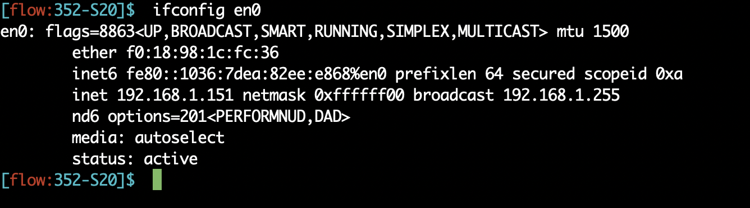
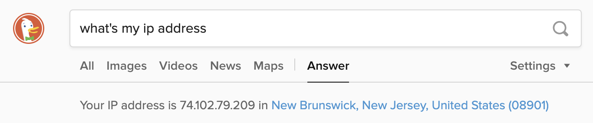
If you’re home, you’re likely behind NAT

Slide 17
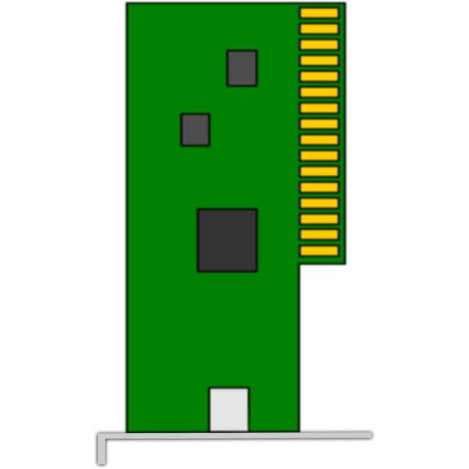
On public cloud, you’re behind NAT
VM
VM
Each VM believes it has its own IP address.
Each VM believes it has its own IP address.
Physical
addresses used
NAT
NAT
Physical Machine
Physical Machine

Slide 18
Limitations of IP-masquerading NATs
Connection limit due to 16-bit port-number field
~64K total simultaneous connections with a single public IP address
NAT can be controversial
“Routers should only manipulate headers up to the network layer, not modify headers at the transport layer!”
Application developers must take NAT into account
e.g., peer-to-peer applications like Skype
Internet “purists”: instead, solve address shortage with IPv6
32-bit IP addresses are just not enough
Esp. with more devices (your watch, your fridge, …) coming online

Slide 19
Routing Protocols

Slide 20


The network layer is all about reachability.
Every protocol below solves a sub-problem.
Net layer
How does an endpoint get an address?
Debugging
ICMP
How does an endpoint talk to another outside its network?
DHCP
ping
traceroute
Routing protocols
OSPF, RIP, BGP
How does an endpoint talk to another within the same network?
ARP
Gateways
NAT
IPv6

Slide 21
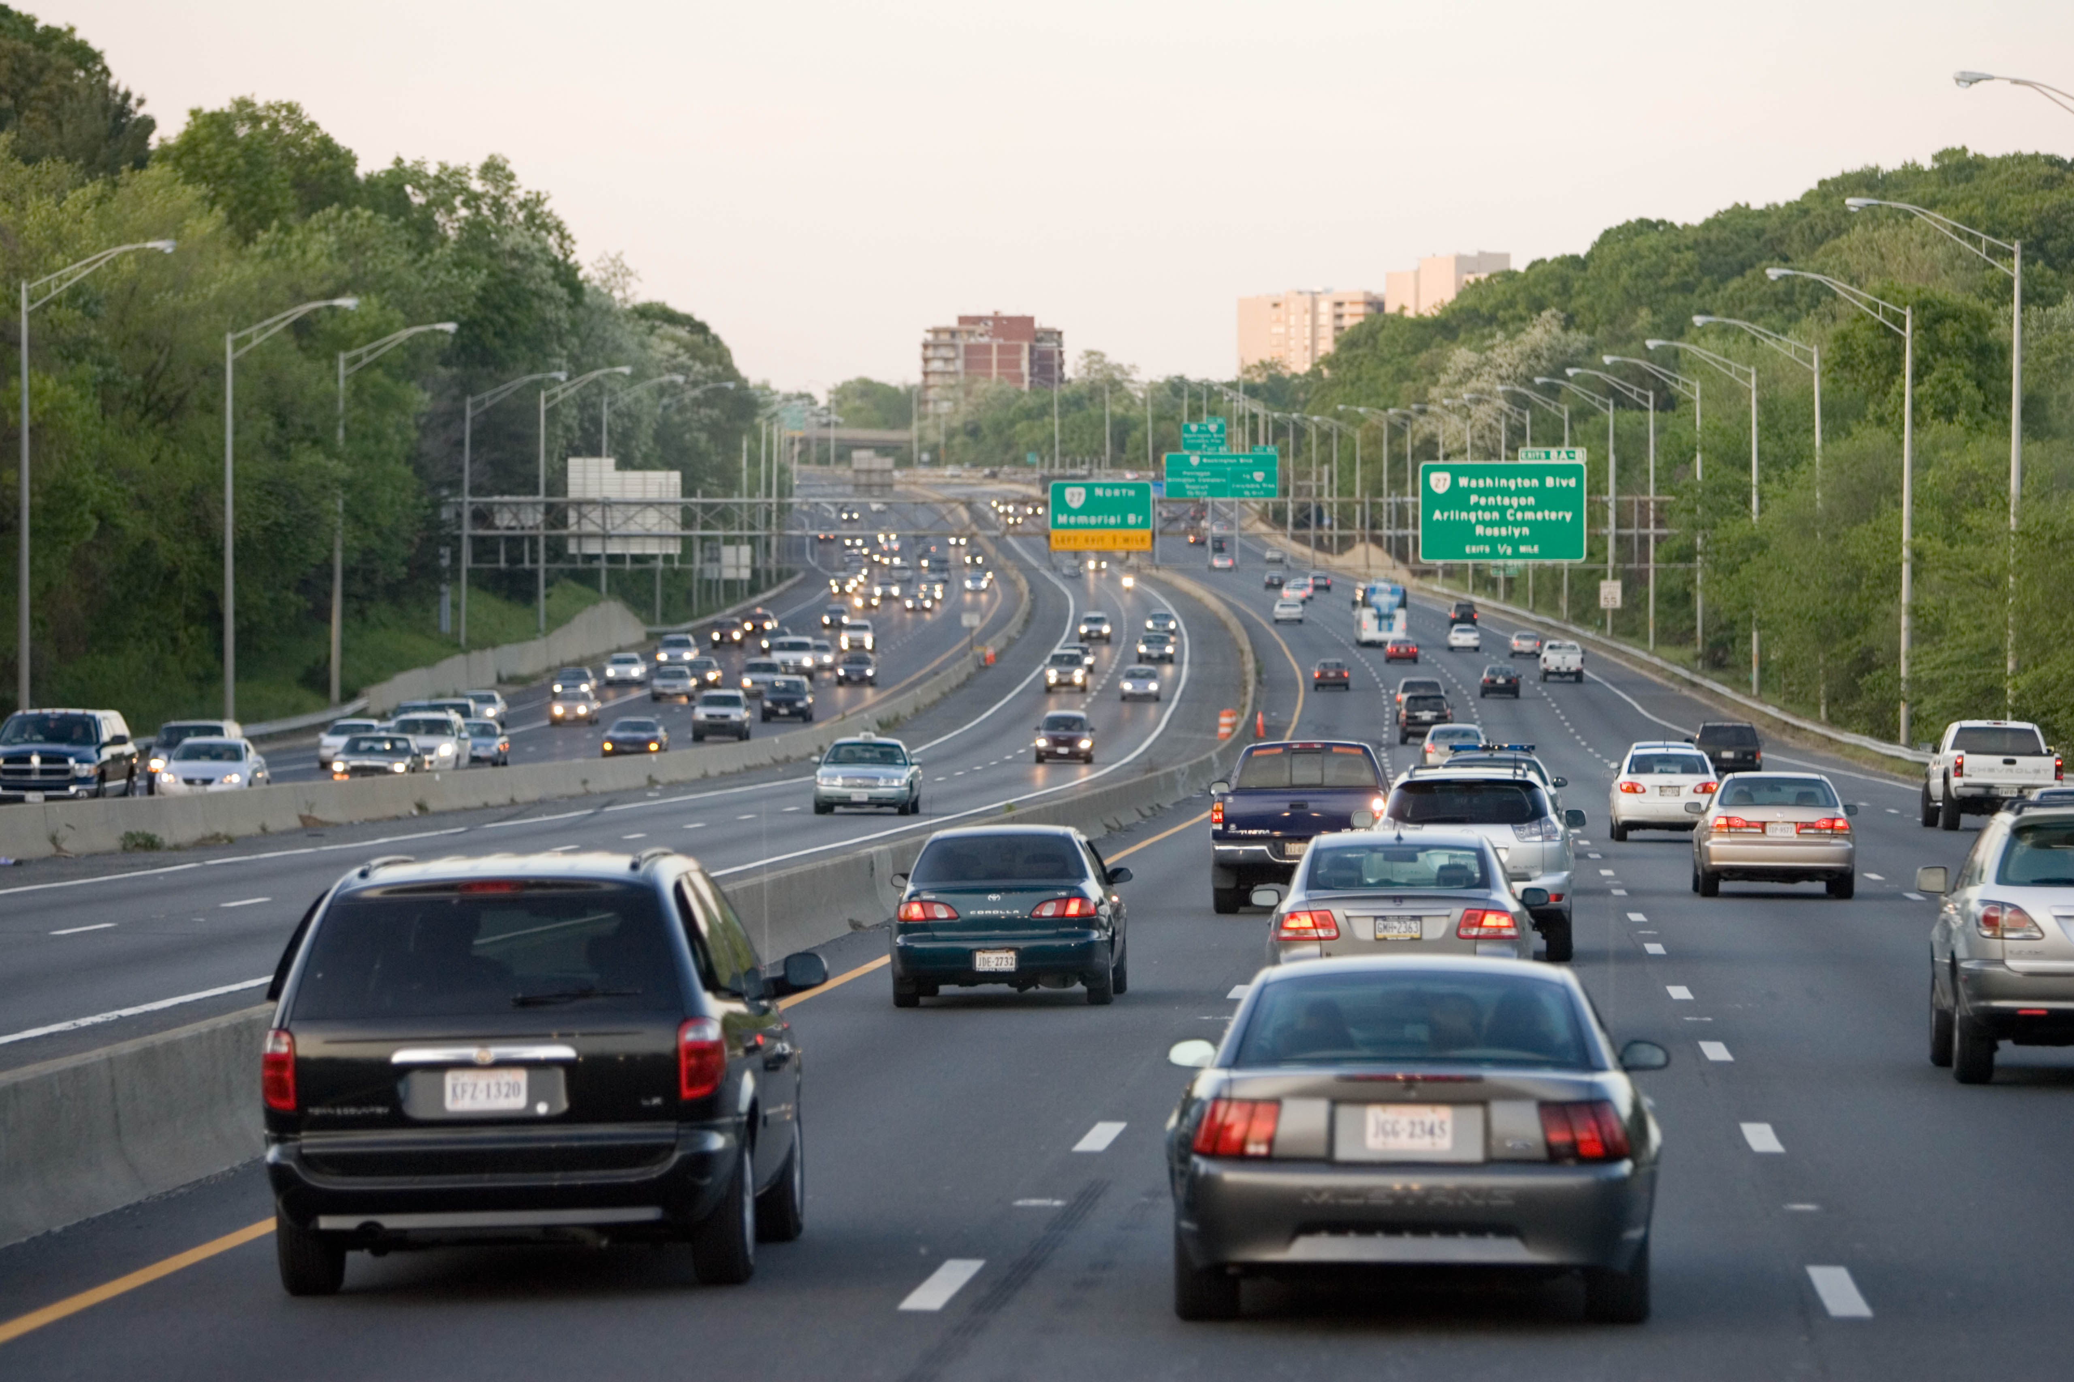
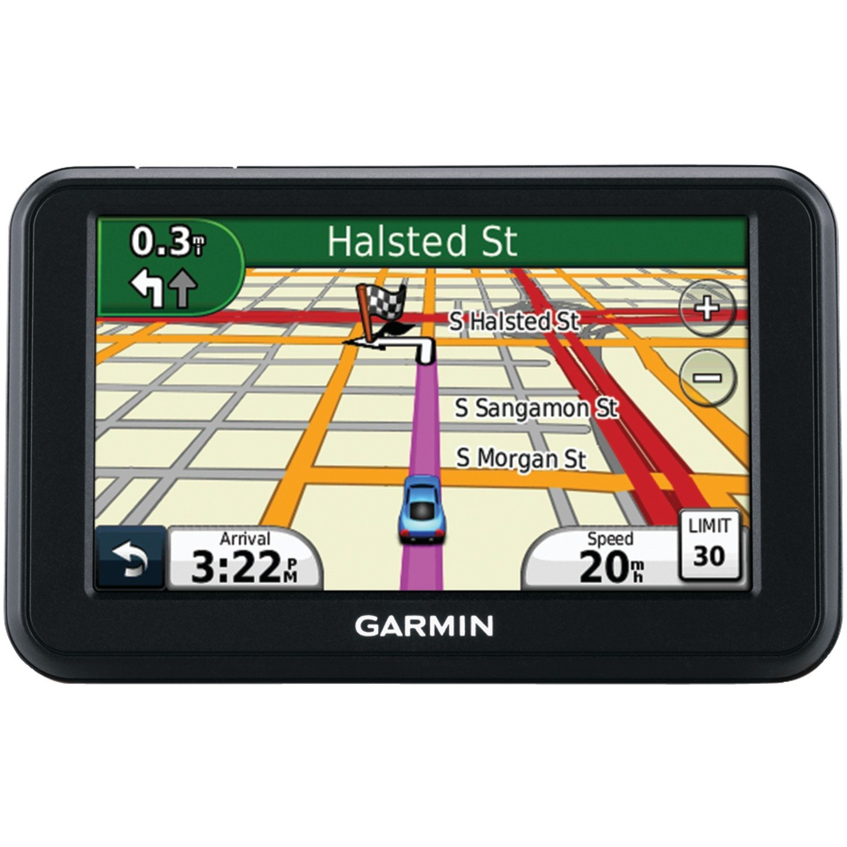
Review: Key network-layer functions
Forwarding (data plane): move packets from router’s input to appropriate router output
Routing (control plane): determine route taken by packets from source to destination
Analogy: taking a road trip
Forwarding: process of getting through single interchange
Routing: process of planning trip from source to destination
network
layer
runs
everywhere

Slide 22
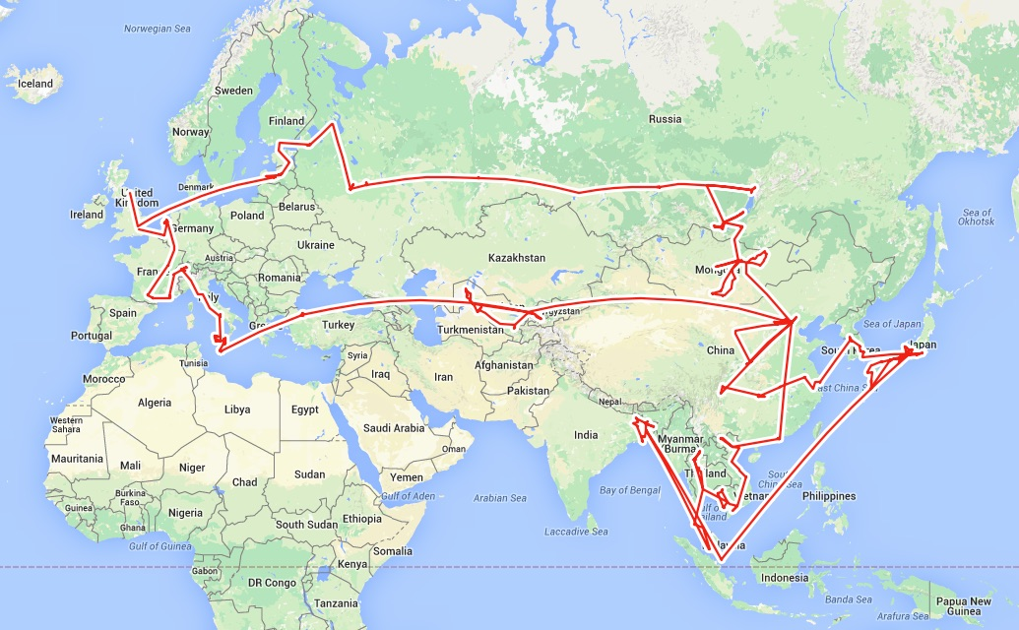
Routing is a fundamental problem in networking.
How would one design a “Google Maps”
to navigate the Internet?

Slide 23
Goals of Routing Protocols #1
Determine good paths from source to destination
“Good” = least cost
Least propagation delay
Least cost per unit bandwidth (e.g., $ per Gbit/s)
Least congested (workload-driven)
“Path” = a sequence of router ports (links)

Slide 24


Goals of Routing Protocols #2
Make networks resilient to failures
Routers & links can fail without taking down the entire network
Entire subsets can be unreachable; rest still reachable
Hence, the protocol must be distributed

Slide 25




Per-router control plane
Distributed control plane: Components in every router interact with other components to produce a routing outcome.
Routing
Algorithm
control
plane
data
plane
Routing protocol
Data plane
per-packet processing, moving packet from input port to output port
Q1. What info exchanged?
0111
1
3
2
values in arriving
packet header,
i.e, destination IP address
Q2. What computation?

Slide 26
The graph abstraction
Routing algorithms work over an abstract representation of a network: the graph abstraction
Each router is a node in a graph
Each link is an edge in the graph
Edges have weights (also called link metrics). Set by netadmin
Ex: Rutgers campus
u: Computer Science
v: School of Engineering
…
5
v
3
w
2
5
u
2
1
z
3
1
2
x
y
1

Slide 27
The graph abstraction
Routing algorithms work over an abstract representation of a network: the graph abstraction
G = (N, E)
N = {u, v, w, x, y, z}
E = { (u,v), (u,x), (v,x), (v,w), (x,w), (x,y), (w,y), (w,z), (y,z) }
Ex: Rutgers campus
u: Computer Science
v: School of Engineering
…
5
v
3
w
2
5
u
2
1
z
3
1
2
x
y
1

Slide 28
The graph abstraction
5
Cost of an edge: c(x, y)
Examples: c(u, v) = 2, c(u, w) = 5
Cost of a path = sum of edge costs
c(path x → w → y → z) = 3 + 1 + 2 = 6
Outcome of routing: each node should determine the least cost path to every other node
Q1: What information should nodes exchange with each other to enable this computation?
Q2: What algorithm should each node run to compute the least cost path to every node?
v
3
w
2
5
u
2
1
z
3
1
2
x
y
1

Slide 29
Coming up next
Routing protocols
Link state
protocols
Distance vector protocols
Each router has complete information of the graph
Messages exchanged by flooding all over the network
Communication expensive, but complete
Each router only maintains distances & next hop to others
Messages are exchanged over each link and stay within the link
Communication cheap, but incomplete

Slide 30
Link State Protocols

Slide 31
Link state protocol
Each router knows the state of all the links and routers in the network
Every router performs an independent computation on globally shared knowledge of network’s complete graph representation
Routing protocols
Link state
protocols
Distance vector protocols

Slide 32
Q1: Information exchange
Link state flooding: the process by which neighborhood information of each network router is transmitted to all other routers
Each router sends a link state advertisement (LSA) to each of its neighbors
LSA contains the router ID, the IP prefix owned by the router, the router’s neighbors, and link cost to those neighbors
Upon receiving an LSA, a router forwards it to each of its neighbors: flooding
5
v
3
w
2
5
u
2
1
z
3
1
2
x
y
1

Slide 33
Q1: Information exchange
Eventually, the entire network receives LSAs originated by each router
LSAs put into a link state database
LSAs occur periodically and whenever the graph changes
Example: if a link fails
Example: if a new link or router is added
The routing algorithm running at each router can use the entire network’s graph to compute least cost paths
5
v
3
w
2
5
u
2
1
z
3
1
2
x
y
1

Slide 34
Q2: The algorithm
Dijkstra’s algorithm
Given a network graph, the algorithm computes the least cost paths from one node (source) to all other nodes
This can then be used to compute the forwarding table at that node
Iterative algorithm: maintain estimates of least costs to reach every other node. After k iterations, each node definitively knows the least cost path to k destinations
Notation:
c(x,y): link cost from node x to y; = ∞ if not direct neighbors
D(v): current estimate of cost of path from source to destination v
p(v): (predecessor node) the last node before v on the path from source to v
N': set of nodes whose least cost path is definitively known

Slide 35
Dijsktra’s Algorithm
1 Initialization:
2 N' = {u}
3 for all nodes v
4 if v adjacent to u
5 then D(v) = c(u,v)
6 else D(v) = ∞
7
8 Loop
9 find w not in N' such that D(w) is a minimum
10 add w to N'
11 update D(v) for all v adjacent to w and not in N' :
12 D(v) = min( D(v), D(w) + c(w,v) )
13 /* new cost to v is either old cost to v or known
14 shortest path cost to w plus cost from w to v */
15 until all nodes in N'
Initial estimates of distances are just the link costs of neighbors.
Least cost node among all estimates. This cost cannot decrease further.
Relaxation

Slide 36
Visualization
min cost in N \ N’
N \ N’
Nodes with estimated least path costs, not definitively known to be smallest possible
N’
nodes whose least cost paths from u are definitively known
W should move to N’.
w
c(w, v)
D(w)
v
Relaxation: for each v in N \ N’, is the cost of the path via w smaller than known least cost path to v?
If so, update D(v)
Predecessor of v is w.
D(v)
v’
u
v’’
Cost of path via w: D(w) + c(w,v)
Cost of known best path: D(v)

Slide 37
Dijkstra’s algorithm: example
Step
0
1
2
3
4
5
N'
u
ux
uxy
uxyv
uxyvw
uxyvwz
D(v),p(v)
2,u
2,u
2,u
D(w),p(w)
5,u
4,x
3,y
3,y
D(x),p(x)
1,u
D(y),p(y)
∞
2,x
D(z),p(z)
∞
∞
4,y
4,y
4,y
5
v
3
w
2
5
u
2
1
z
3
1
2
x
y
1

Slide 38
Constructing the forwarding table
To find the router port to use for a given destination (router), find the predecessor of the node iteratively until reaching an immediate neighbor of the source u
The port connecting u to this neighbor is the output port for this destination

Slide 39
Constructing the forwarding table
5
Suppose we want forwarding entry for z.
v
3
w
2
5
u
2
1
z
3
1
2
x
y
1
D(v),p(v)
2,u
D(w),p(w)
3,y
D(x),p(x)
1,u
D(y),p(y)
2,x
D(z),p(z)
4,y
z: p(z) = y
y: p(y) = x
x: p(x) = u
x is an immediate
neighbor of u
Forwarding table at u:
destination
link
z
(u,x)

Slide 40
Summary of link state protocols
Each router announces link state to the entire network using flooding
Each node independently computes least cost paths to every other node using the full network graph
Dijkstra’s algorithm can efficiently compute these best paths
Easy to populate the forwarding table from predecessor information computed during the algorithm

