Slide 1

Data Centers
Part II
Lecture 8, Computer Networks (198:552)
Fall 2019
Notes:
Slide material heavily adapted courtesy of Albert Greenberg, Changhoon Kim, Mohammad Alizadeh.

Slide 2
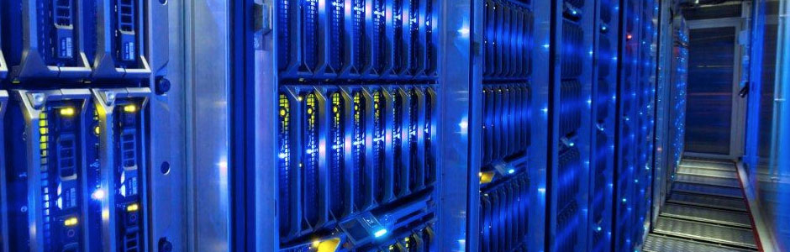
What are data centers?
Large facilities with 10s of thousands of networked servers
Compute, storage, and networking working in concert
“Warehouse-Scale Computers”

Slide 3
Cloud Computing: The View from Apps
On-demand
Use resources when you need it; pay-as-you-go
Elastic
Scale up & down based on demand
Multi-tenancy
Multiple independent users share infrastructure
Security and resource isolation
SLAs on performance & reliability
Dynamic Management
Resiliency: isolate failure of servers and storage
Workload movement: move work to other locations

Slide 4
What’s different about DCNs?
Single administrative domain
Change all endpoints and switches if you want
No need to be compatible with outside world
Unique network properties
Tiny round trip times (microseconds)
Massive multipath topologies
Shallow-buffered switches
Latency and tail-latency critical
Network is a backplane for large-scale parallel computation
Together, serious implications for the transport, network, link layer designs you can (and should) use

Slide 5
Challenges in DCNs

Slide 6
Data center costs
Amortized Cost* | Component | Sub-Components
~45% | Servers | CPU, memory, disk
~25% | Power infrastructure | UPS, cooling, power distribution
~15% | Power draw | Electrical utility costs
~15% | Network | Switches, links, transit
The Cost of a Cloud: Research Problems in Data Center Networks. Sigcomm CCR 2009. Greenberg, Hamilton, Maltz, Patel.
*3 yr amortization for servers, 15 yr for infrastructure; 5% cost of money
Notes:
Source: http://web.cse.ohio-state.edu/icdcs2009/Keynote_files/greenberg-keynote.pdf

Slide 7
Server costs
30% server utilization considered “good” in data centers
Application demands uneven across the resources
Each server has CPU, memory, disk: most applications exhaust one resource, stranding the others
Long provisioning timescales
New servers purchased quarterly at best
Uncertainty in demand
Demand for a new service can spike quickly
Risk management
Not having spare servers to meet demand brings failure just when success is at hand
Session state and storage constraints
If the world were stateless servers, life would be good
Notes:
Source: Albert Greenberg keynote, ICDCS 2009

Slide 8
Goal: Agility -- any service, any server
Turn the servers into a single large fungible pool
Dynamically expand and contract service footprint as needed
Place workloads where server resources are available
Easier to maintain availability
If one rack goes down, machines from another still available
Want to view DCN as a pool of compute connected by one big high-speed fabric

Slide 9

Steps to achieving Agility
Workload (compute) management
Means for rapidly installing a service’s code on a server
Virtual machines, disk images, containers
Storage management
Means for a server to access persistent data
Distributed filesystems (e.g., HDFS, blob stores)
Network and Routing management
Means for communicating with other servers, regardless of where they are in the data center
??

Slide 10
Agility means that the DCN needs…
Massive bisection bandwidth
Topologies
Routing (Multiple paths ➔ Load balancing)
Ultra-Low latency (<10 microseconds)
The right transport? Switch scheduling/buffer management?
Schedule packets or control transmission rates?
Centralized or distributed control?
Effective Resource Management (across servers & switches)
Multi-tenant performance isolation
App-aware network scheduling (e.g., for big data)
Support for next-generation hardware & apps
ML, RDMA, rack-scale computing, memory disaggregation

Slide 11
Conventional DC network
Internet
CR
CR
DC-Layer 3
. . .
AR
AR
AR
AR
DC-Layer 2
S
S
Key
CR = Core Router (L3)
AR = Access Router (L3)
S = Ethernet Switch (L2)
A = Rack of app. servers
S
S
S
S
. . .
A
A
…
A
A
A
…
A
~ 1,000 servers/pod == IP subnet
Source: “Data Center: Load balancing Data Center Services”, Cisco 2004

Slide 12
Layer 2 vs. Layer 3
Ethernet switching (layer 2)
Fixed IP addresses and auto-configuration (plug & play)
Seamless mobility, migration, and failover
Broadcast limits scale (ARP)
Spanning Tree Protocol: no multipath routing
IP routing (layer 3)
Scalability through hierarchical addressing
Multipath routing through equal-cost multipath
More complex configuration
Can’t migrate w/o changing IP address

Slide 13
Conventional DC Network Problems
CR
CR
~ 200:1
AR
AR
AR
AR
S
S
S
S
~ 40:1
S
S
S
S
. . .
S
S
S
S
~ 5:1
A
A
…
A
A
A
…
A
A
A
…
A
A
A
…
A
Dependence on high-cost proprietary routers
Extremely limited server-to-server capacity

Slide 14
Conventional DC Network Problems
CR
CR
~ 200:1
AR
AR
AR
AR
S
S
S
S
S
S
S
S
S
S
S
S
A
…
A
A
…
A
A
A
…
A
A
A
…
A
A
A
A
IP subnet (VLAN) #1
IP subnet (VLAN) #2
Resource fragmentation, significantly lowering cloud utilization (and cost-efficiency)
Notes:
Green host from the green IP subnet / VLAN#2 cannot respond to the request from the machine in the IP subnet / VLAN#1! This means that special rules must be installed on the switches to route VLAN 2 data within the sub-tree under the second pair of AR’s in this network.

Slide 15
Conventional DC Network Problems
CR
CR
~ 200:1
AR
AR
AR
AR
Complicated manual L2/L3 re-configuration
S
S
S
S
S
S
S
S
S
S
S
S
A
…
A
A
…
A
A
A
…
A
A
A
…
A
A
A
A
IP subnet (VLAN) #1
IP subnet (VLAN) #2
Resource fragmentation, significantly lowering cloud utilization (and cost-efficiency)

Slide 16
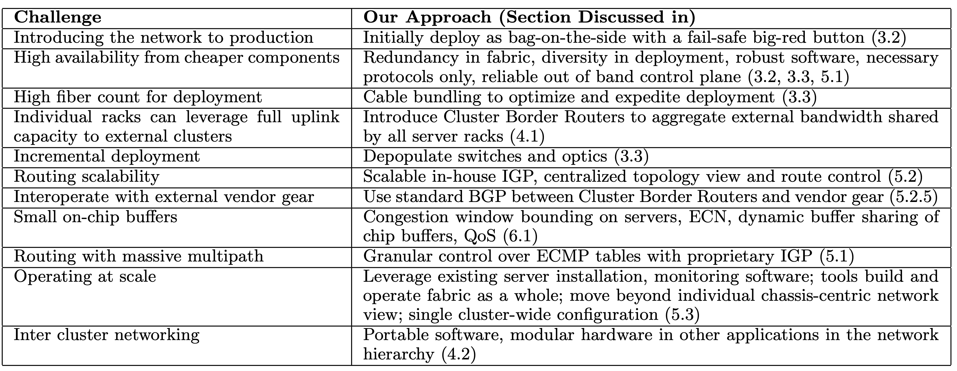
Google’s DCN Challenges & Approaches
Source: Jupiter rising: a decade of Clos topologies and centralized control in Google’s data center network. SIGCOMM’15

Slide 17
Building a high-speed
switching fabric

Slide 18
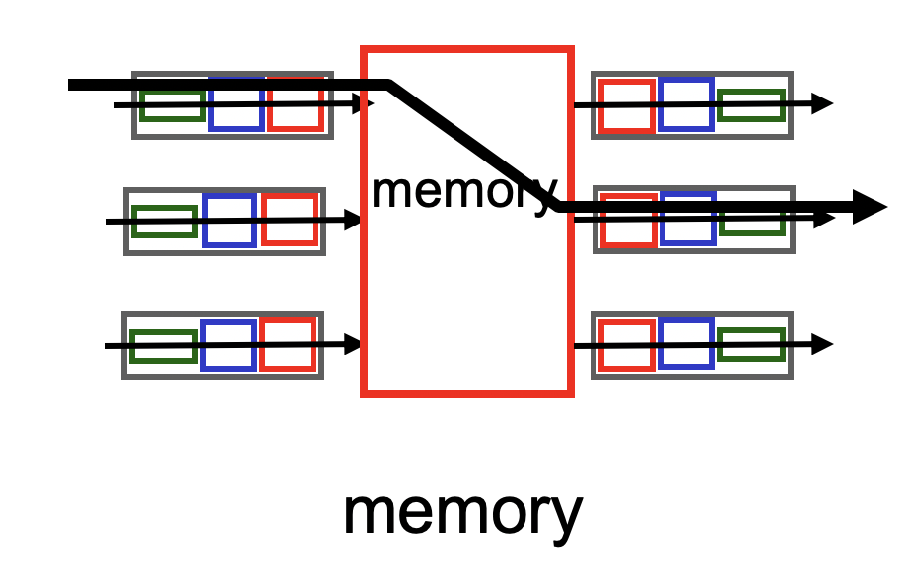
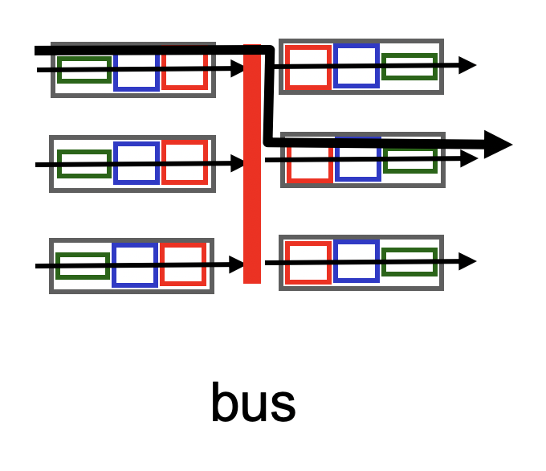
A single (n X m)-port switching fabric
Different designs of switching fabric possible
Assume n ingress ports and m egress ports, half duplex links

Slide 19
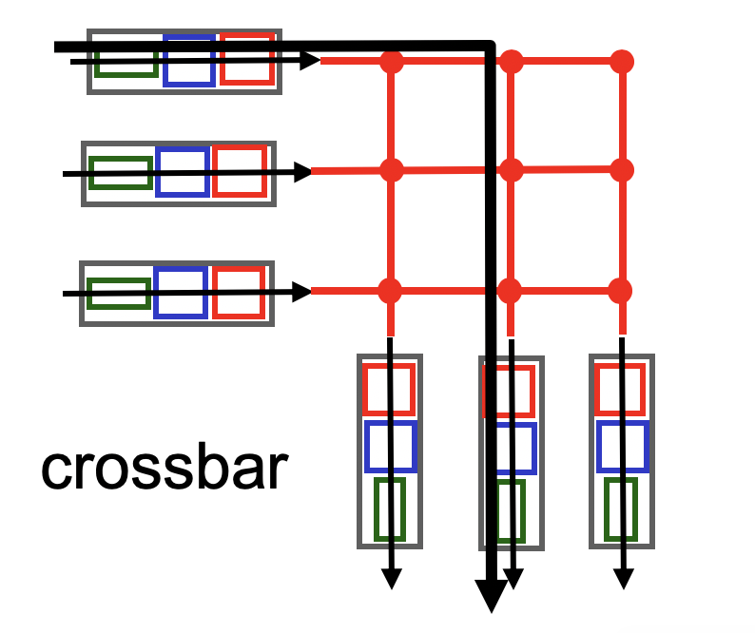
A single (n X m)-port switching fabric
Electrical/mechanical/electronic crossover
We are OK with any design such that:
Any port can connect to any other directly if all other ports free
Nonblocking: if input port x and output port y are both free, they should be able to connect
Regardless of other ports being connected.
If not satisfied, switch is blocking.

Slide 20
High port density + nonblocking == hard!
Low-cost nonblocking crossbars are feasible for small # ports
However, it is costly to be nonblocking with a large number of ports
If each crossover is as fast as each input port,
Number of crossover points == n * m
Cost grows quadratically on the number of input ports
Else, crossover must transition faster than the port
… so that you can keep the number of crossovers small
Q: How is this relevant to the data center network fabric?

