Slide 1

Software Switches
Lecture 10, Computer Networks (198:552)
Fall 2019
Notes:
Slide material heavily adapted courtesy of Albert Greenberg, Changhoon Kim, Mohammad Alizadeh.

Slide 2
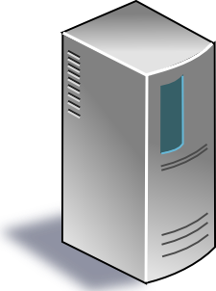



Software-Defined Network (SDN)
Centralized control plane
Data plane
Data plane
Data plane
Data plane

Slide 3
Why software switches?
Early roots in networking: first switches were fully in software
Until high link speeds forced everyone to make ASICs
As a tool for experimentation with new protocols (eg: Openflow)
Advent of virtualization
Need flexible policies (ie: flow rules) inside endpoints!
What policies?

Slide 4
Policies in virtualized switches
Tenant policies
Network virtualization: I want the physical network to look like my own, and nobody else is on it
Provider policies
Traffic must follow the ACLs and paths set by the provider
Topology “traversal”
Use the core of the DCN as a mesh of point to point tunnels

Slide 5
Where should policies be implemented?
App
App
App
App
Virtual machine
Container
Lambda
Hypervisor (OR) orchestrator

Slide 6
OpenVSwitch: Requirements
Support large and complex policies
Support updates in such policies
Q: why?
Allow the hypervisor/orchestrator to support user workloads
Don’t take up too much resources
Process packets with high performance
Provide high throughput and low delay

Slide 7
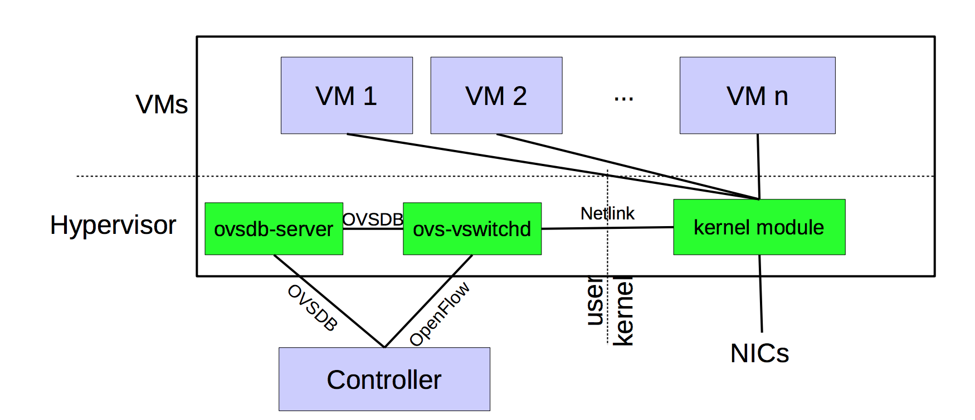
OVS design

Slide 8
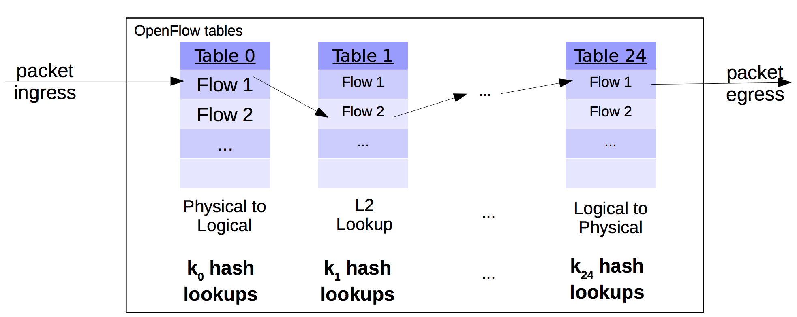
First design: put OF tables in the kernel
Large policies: Low performance with 100+ lookups per packet
Merging policies is problematic: cross-product explosion
Complex logic in kernel: rules with wildcards require complex algos

Slide 9
Idea 1: Microflow cache
Microflow: complete set of OF packet headers and metadata
Example: srcIP, dstIP, IP TTL, srcMAC, dstMAC
Use tuple space search to do one lookup per packet
Hit
Microflow cache in the kernel
Use a large hash table
Openflow table in user space
Miss

Slide 10
Problems with micro-flows
Too many micro-flows: e.g., each TCP port
Many micro-flows may be short lived!
Poor cache-hit rate
Can we cache the outcome of rule lookup directly?
Naive approach: Cross-product explosion!
Example: Table 1 on source IP, table 2 on destination IP
Recurring theme in this paper: avoid up-front (proactive) costs

Slide 11
Idea 2: Mega-flow cache
Build the cache of rules lazily using just the fields accessed
Ex: contain just src/dst IP combinations that appeared in packets
Hit
Megaflow cache in the kernel
Use tuple space search
Miss
Openflow table in user space

Slide 12
Improvements to mega-flow caching
You have an OF table. What happens if you populate the mega-flow blindly by concatenating the fields accessed on lookup?
Hint 1: consider flow tables that match on highly variable fields
Hint 2: consider priorities of rules with overlapping matches
Hint 3: consider the number of lookups vs. microflow cache
OVS introduced a series of algorithmic improvements
Priority sorting of mega-flow tables
Staged lookups starting with more static sets of fields
Prefix trie to detect non-overlapping longest-prefix matches
Combine with micro-flow cache!

Slide 13
Discussion of OVS

Slide 14
What you said

Slide 15
FAQs
#1 How do megaflows handle wildcards in OpenFlow rules?

Slide 16
FAQs
#2.1 What are the actual sizes of the microflow and megaflow caches?
#2.2 Do the caches overlap with the L1, L2, … caches of the machine?

Slide 17
FAQs
#3.1 What exactly is the overhead of passing a packet between the kernel and the user space process?
#3.2 (How) Do the benefits of OVS caching carry over to user space networking?

Slide 18
FAQs
#4.1 With OVS, are we limited to Openflow? Can we use more flexible protocols?
#4.2 How flexible and perf-critical is OVSDB?

Slide 19
Missing details in perf evaluation
if the paper gave more information on how often in their benchmark
system the real locations of virtual switches or their hypervisors were
moved. This is because moving very often would inevitably incur overheads due to memory copying and cache misses.
Michael Wu

Slide 20
Missing details in perf evaluation
The author just experimented the effect for each optimization only
and the whole combination. They did not take the combination effect of two optimization or three optimization into consideration. I think some combination of two optimizations may achieve better performance and throughput.
Weizhi Wang

Slide 21
Missing details in perf evaluation
Is there any downside on moving the IP tunneled packets
transportation virtual? Namely, will the possibility of losing packets increase? [...] Wouldn't connecting to virtual datacenters cost more time, or can it be overlooked?
Xiaochang Chen

Slide 22
Deeper design issues
I feel it possible for one VM to use some techniques of reverse engineering like measuring the time of connection setup to sniff the connections of other vms, similar to Phantom and Sphere's hack to CPU caching. Though I am not quite sure, since Open Vswitch is fully open-sourced, its hash function, seeds are open to all people, it's totally possible to monitor the activities of other VMs in one VM.
Siwei Feng

Slide 23
Improving performance
Another improvement that could be made would be specifying
this idea for specific data centers and hardware. While OVS is made to serve data centers in general, research should be done to see how caches should be implemented on a hardware level to best serve the processes outlined in this paper.
Richard Fernandes
Is it possible to offload the flow table search and flow computation
to some special hardware, e.g., FPGA?
Qiongwen Xu

Slide 24
Improving performance
staged lookup [...] statically divides field into four groups. A
better choice is to refer to importance of different headers in different scenes adaptively.
Huixiong Qin

