Slide 1

Router Design: An Overview
Lecture 15, Computer Networks (198:552)
Fall 2019
Notes:
Slide material heavily adapted courtesy of Albert Greenberg, Changhoon Kim, Mohammad Alizadeh.

Slide 2

The router data plane
Management plane
(part of)
control
plane
Data plane implements per-packet decisions
On behalf of control & management planes
Forward packets at high speed
Manage contention for switch/link resources
Processor
data plane
Switching
fabric
Net intf
Net intf
Net intf
Net intf

Slide 3
Requirements on router data planes
Speed!
Inherently
parallel workload
➔ Leverage hardware parallelism!

Slide 4
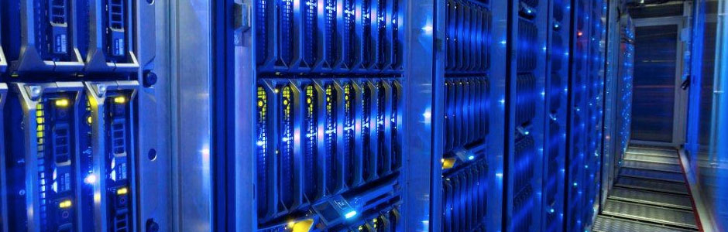
Requirements for router data planes
Speed
Chip area ➔ size
Power
Port density
Programmability

Slide 5
Overview of router functionality
Historically evolving, multiple concurrent router designs
Many commonalities
Today: broad look at two router designs
MGR: router from the late 1990s
RMT: router from the late 2010s
Mechanisms implemented:
Packet receive/transmit from/to physical interfaces
Packet and header parsing
Packet lookup and modification: ingress & egress processing
High-speed switching fabric to connect different interfaces
Traffic management: fair sharing, rate limiting, prioritization
Buffer management: admission into switch memory

Slide 6
Life of a packet

Slide 7
(1) Receive data at line cards
Circuitry to interface with physical medium: CoAx, optical
SerDes/IO modules: serialize/deserialize data from the wire
Network interfaces keep getting faster: more parallelism
but stay the same size (Moore’s law is alive here, for now)
Multiple network interfaces on a single line card
Component detachable from the rest of the switch
Ex: upgrade multiple 10 Gbit/s interfaces to 40 Gbit/s in one shot
Preliminary header processing possible
MGR: convert link-layer headers to standard format

Slide 8
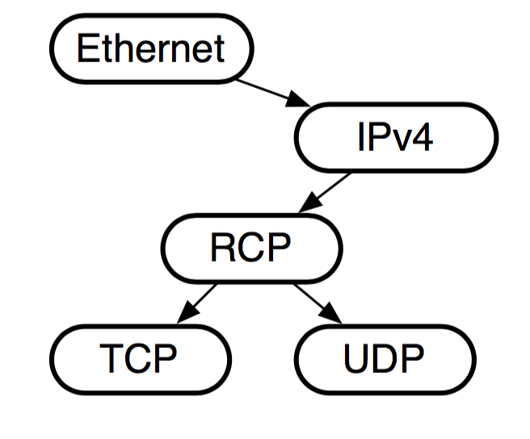
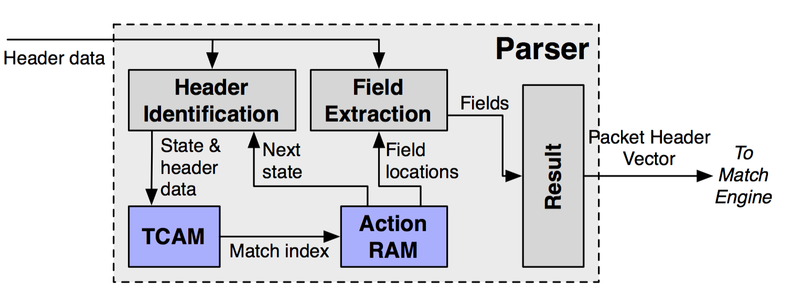
(2) Packet parsing
Extract header fields: branching, looped processing
Ex: Determine transport-level protocol based on IP protocol type
Ex: Multiple encapsulations of VLAN or MPLS headers
Outcome: parse graph and data in the parsed regions
MGR: done in software using bit slicing of header memory
RMT: programmable packet parsing in hardware

Slide 9
(2) Packet parsing
Key principle: Separate the packet header and payload
Conserve bandwidth for data read/written inside switch!
Header continues on to packet lookup/modification
Payload sits on a buffer until router knows what to do with the packet
Buffer could be on the ingress line card (MGR)
But more commonly a buffer shared between line cards (RMT)

Slide 10
Things that routers are expected to do…
RFC 1812: Forward pkts using route lookup, but also …
Update TTL: ttl -= 1
Update IP checksum (Q: why?)
IP to link layer mappings across networks (why?)
Rewrite link layer source address
Special processing (IP options): source route, record route, …
Fragmentation of packets
Multicast
Handle QoS assurances, if any

Slide 11
(3) Packet lookup
Typical structure: Sequence of tables (Ex: L2, L3, ACL tables)
Exact match lookup
Longest prefix match
Wildcard lookups
Outcome: a (set of) output ports, possible header rewrites
Wide range of table sizes (# entries) and widths (headers)
Header modifications possible (we saw examples earlier)
TTL decrements, IP checksum re-computation
Encapsulate/decapsulate tunneling headers (MPLS, NV-GRE, …)
MAC source address rewrite
Interesting algorithmic problems!

Slide 12
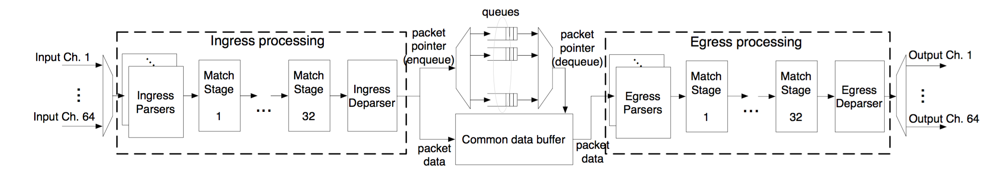
(3) Packet lookup in RMT: Pipelined parallelism
Different functionalities (ex: L2, L3) in different table stages
Highly parallel over packets (1 packet/stage): high throughput
Pipeline circuitry clocked at a high rate: ex: RMT@1 GHz
MGR: software with memory access non-determinism
RMT: deterministic hardware pipeline stages

Slide 13
(3) Packet lookup in MGR
A forwarding engine card separate from line cards
Scale forwarding and interface capacity separately
Use Alpha 21164 (a 415MHz generic processor)
Programmed in assembly

Slide 14
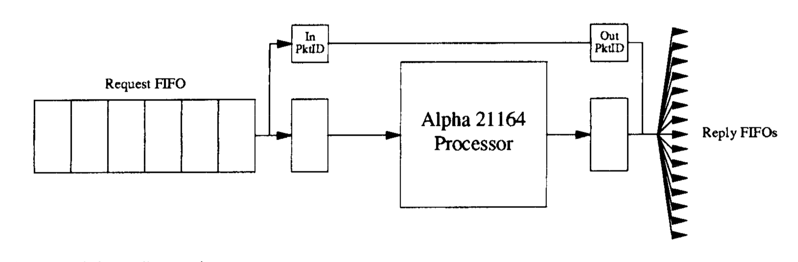
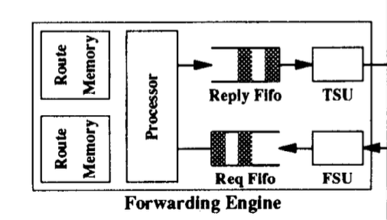
(3) MGR: Memory layout matters
Try to fit all code into local instruction cache
Local cache of routes for fast route lookup
Why might route caches work in the Internet?
Far-away external memory stores full forwarding table
Accessed through a dedicated bus

Slide 15
(3) Packet lookup in MGR
Many micro-optimizations to improve performance
Separate fast path from slow path (optimize the common case)
ARP lookup
Fragmentation
Error handling
Separate packet classification from QoS
Reduce data flowing through the processor memory bus
Packet headers separated from payload
Packet IDs not normally read from/written to in the normal case
Two copies of table in ext memory to support seamless updates

Slide 16
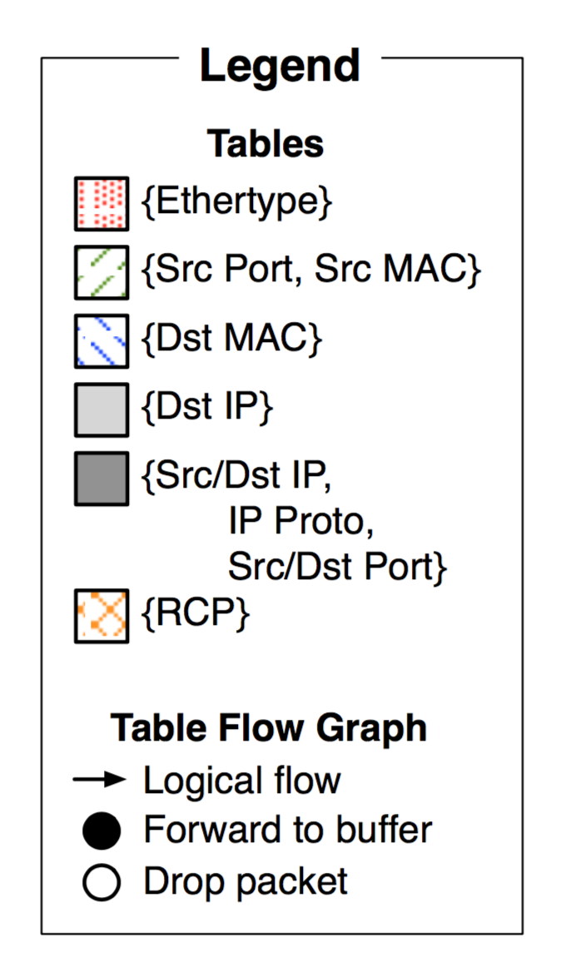
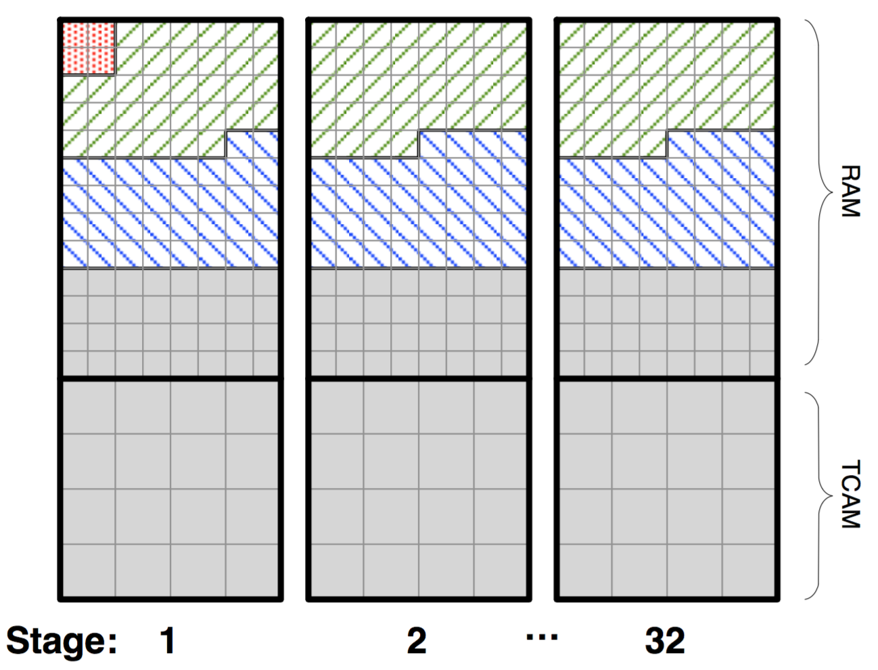
(3) RMT: Memory layout matters
RMT: flexible partitioning of memory across SRAM and TCAM
Numerous fixed size memory blocks
Circuitry for independent block-level access
Deterministic access times
All of it is SRAM or TCAM
Interesting compiler issues
“Packing” tables

Slide 17
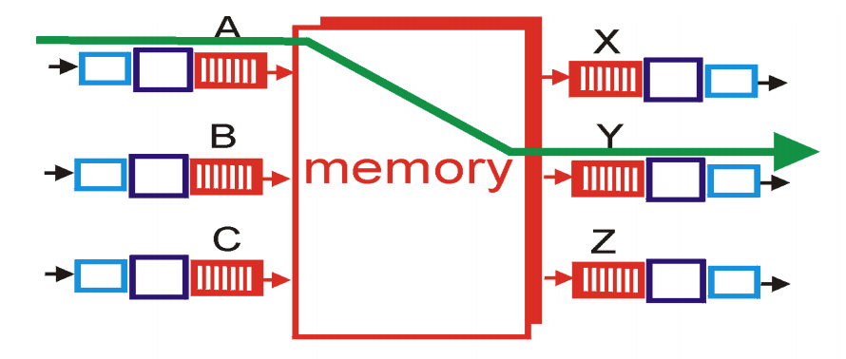
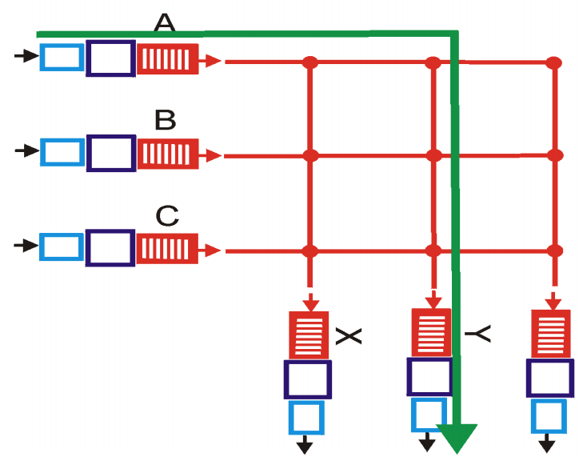
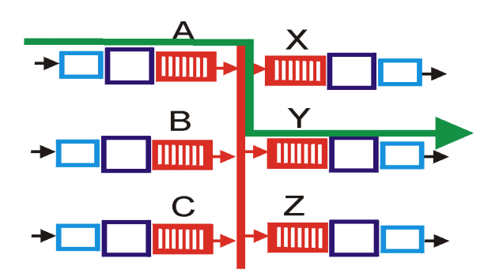
(4) Interconnect/Switching Fabric
Move headers and packet from one interface to another
Kinds of fabrics: memory, bus, crossbar

Slide 18
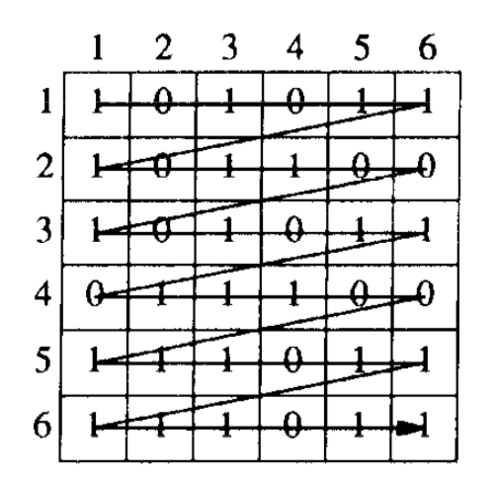
(4) Crossbars: The scheduling problem
Demands from port i to port j
Can one utilize fabric capacity regardless of demand pattern?
Blocking vs. nonblocking
MGR considers strategies:
Greedy, wavefront, block wavefront
Need to address fairness issues

Slide 19
(4) RMT switching fabric
RMT uses shared memory as the fabric to hold packet headers and payloads between any two interfaces
Tradeoff
More wires and power
But implement traffic and buffer management in one place

Slide 20
(5) Queueing: Traffic management
Where should the packets not currently serviced wait?
Input-queued vs. output-queued
HOL blocking? Suppose port 1 wants to send to both 2 and 3
But port 2 is clogged
Port 1’s packets towards port 3 should not be delayed

Slide 21
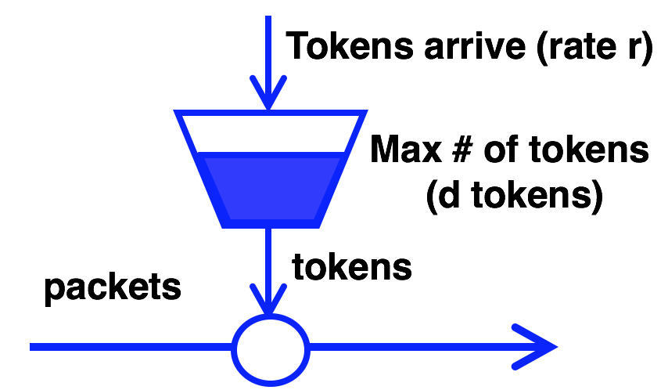
(5) Queueing: Traffic Management
Better to have queues represent output port contention
Scheduling policies:
Fair queueing across ports
Strict prioritization of some ports over others
Rate limiting per port!

Slide 22

(5) Queueing: Buffer Management
Typical buffer management: Tail-drop
How should buffer memory be partitioned across ports?
Static partitioning: if port 1 has no packets, don’t drop port 2
Shared memory with dynamic partitioning
However, need to share fairly:
If output port 1 is congested, why should port 2 traffic suffer?
Algorithmic problems in dynamic memory sizing across ports

Slide 23
(6) Egress processing
Combine headers with payload for transmission
Need to incorporate header modifications
… also called “deparsing”
Multicast: egress-specific packet processing
Ex: source MAC address
Multicast makes almost everything inside the switch (interconnect, queueing, lookups) more complex

Slide 24
Fixed function pipeline
L2 Table
IPv4 Table
IPv6 Table
ACL Table
L2 Hdr Actions
v4 Hdr Actions
v6 Hdr Actions
ACL Actions
Fixed Parser
Fixed Header Processing Pipeline

Slide 25
Protocol Independent Switch Arch. (PISA)
Match+Action Stage
Memory
ALU
Programmable Parser
Programmable Match-Action Pipeline

