Slide 1

Congestion Control for
Data Centers
Lecture 21, Computer Networks (198:552)
Fall 2019
Material adapted from slides by Mohammad Alizadeh

Slide 2
Review: TCP congestion control
Keep some in-flight (un-ACK’ed) packets: congestion window
Adjust window based on several algorithms:
Startup: slow start
Steady state: AIMD
Loss: fast retransmission, fast recovery
Main question for this lecture:
(How) should this design change for data centers?

Slide 3
DC Transport Requirements
High throughput, low latency, burst tolerance

Slide 4


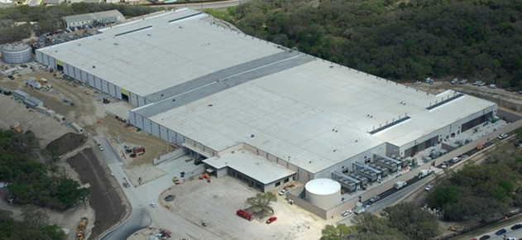


Transport inside the DC
100Kbps–100Mbps links
~100ms latency
INTERNET
Fabric
10–40Gbps links
~10–100μs latency
Servers

Slide 5
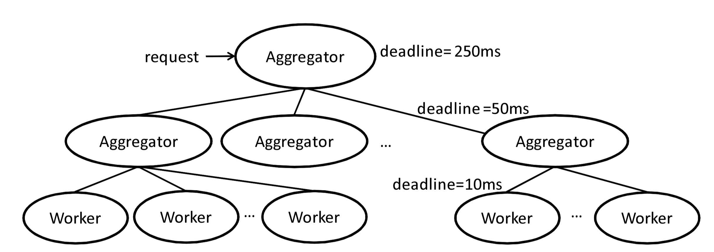
Transport inside the DC
INTERNET
Fabric
Interconnect for distributed compute workloads
Servers
web
app
cache
data-base
map-reduce
HPC
monitoring
Notes:
Specifically, while some of the traffic in data center networks is sent across the Internet, the majority of data center traffic is between the servers within the data center and never leaves the data center.

Slide 6


Data center workloads
Mice and Elephants
Short messages
(e.g., query, coordination)
Large flows
(e.g., data update, backup)
Low Latency
High Throughput

Slide 7


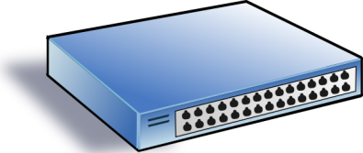

Incast
Synchronized fan-in congestion
Worker 1
Aggregator
Worker 2
Worker 3
RTO_{min} = 300 ms
Worker 4
TCP timeout
Vasudevan et al. (SIGCOMM’09)

Slide 8
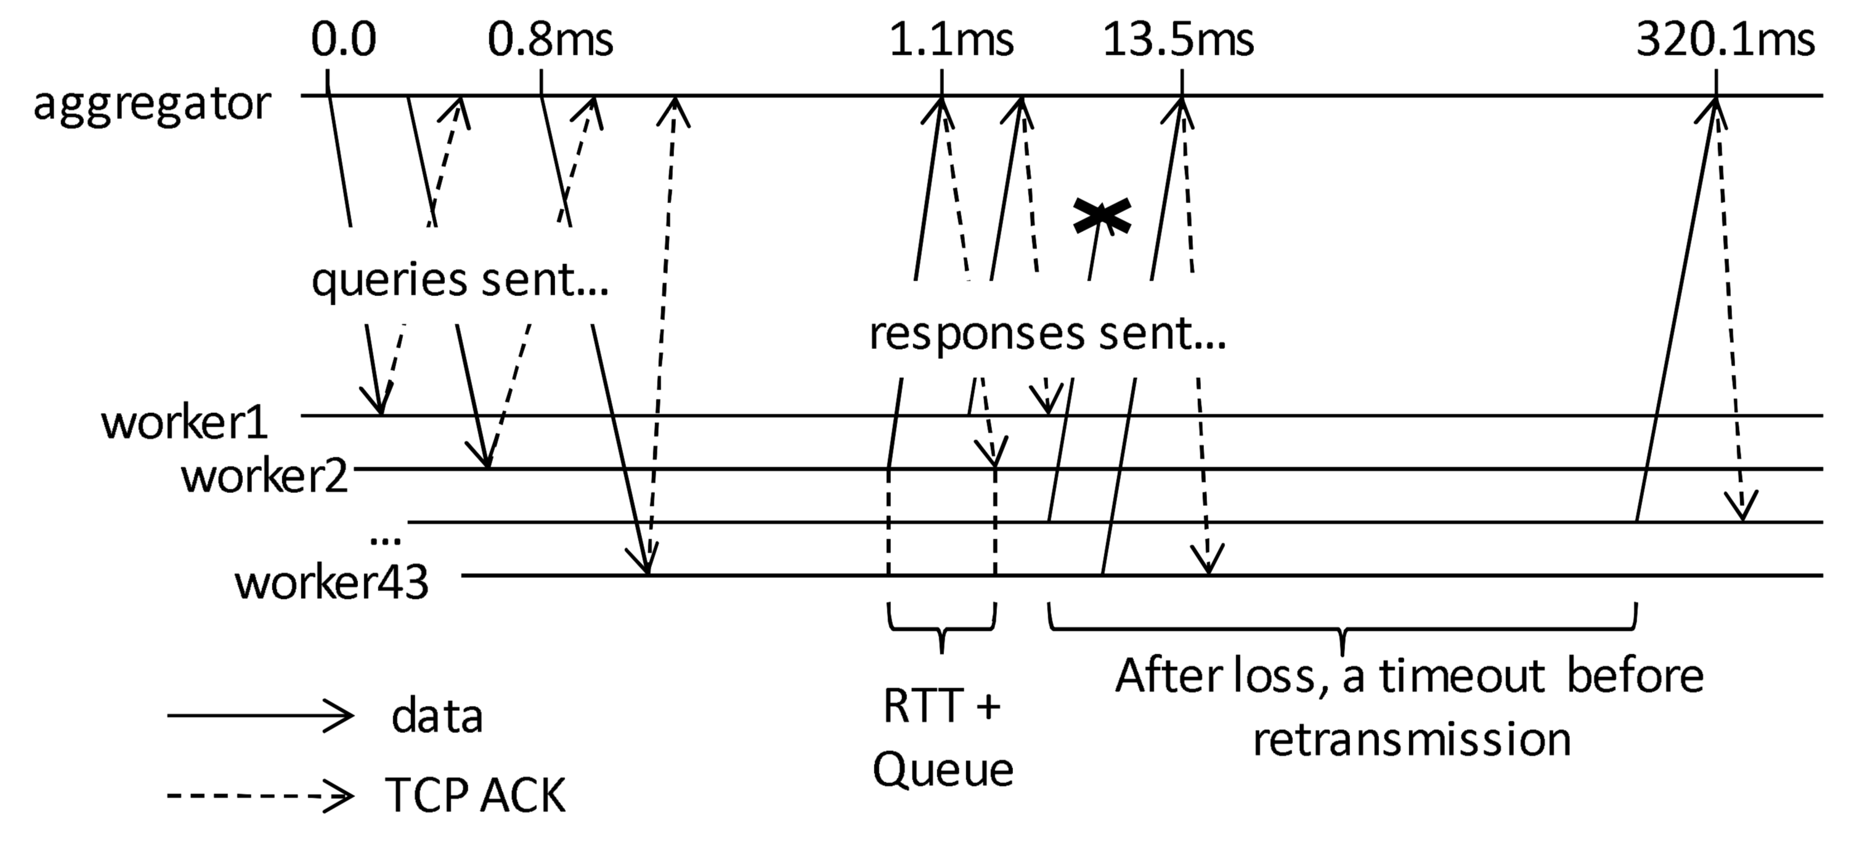
Trace of a real incast event
Maybe, reduce RTO to mitigate this

Slide 9
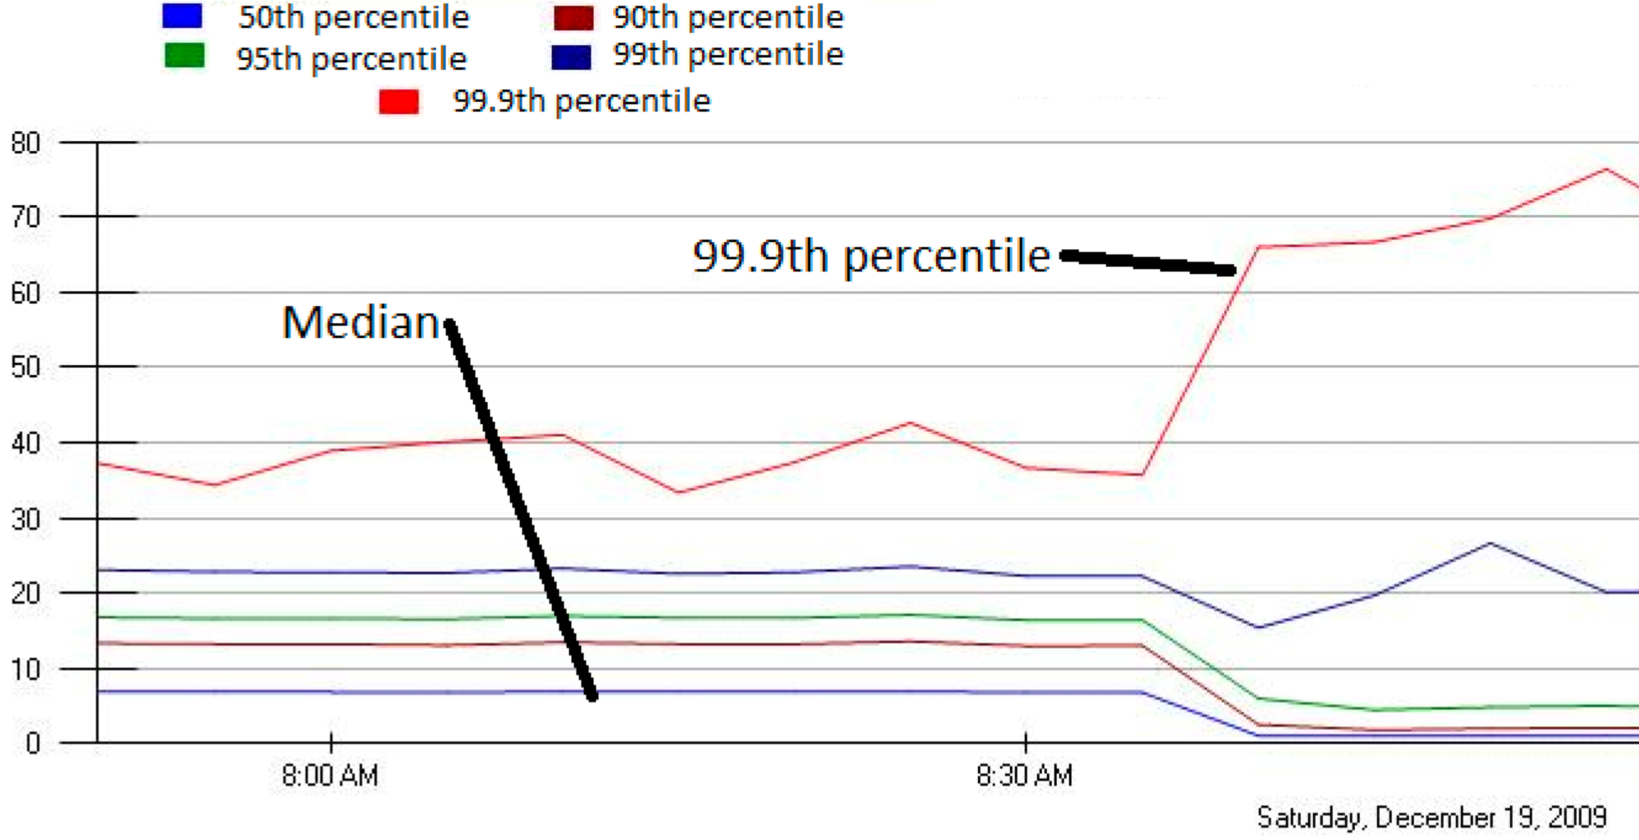
Jittering to mitigate incast
MLA Query Completion Time (ms)
Requests are jittered over 10ms window.
Jittering switched off around 8:30 am.
Jittering trades of median for high percentiles
Notes:
1. Incast really happens – see this actual screenshot from production tool
2. People care, they’ve solved it at application by jittering.
3. They care about the 99.9th percentile, 1-1000 customers

Slide 10
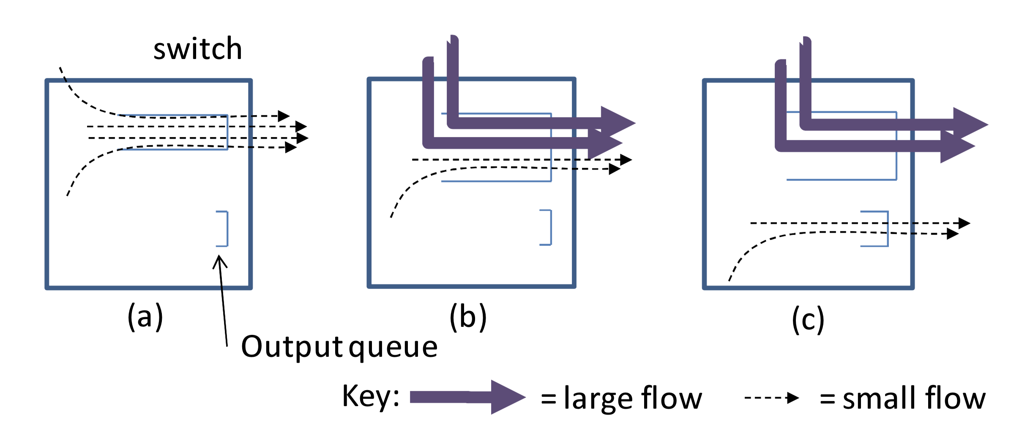
HOL Blocking and Buffer Pressure
Queue buildup increases latency for everyone
(Reducing RTO doesn’t help latency)

Slide 11
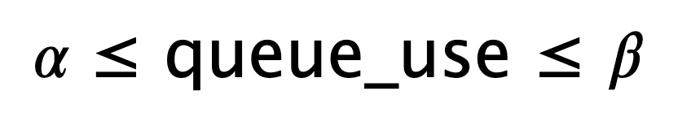
Another possibility: Delay-based CC
Keep just a few packets in queues by observing delays
Adjust window such that only a few packets are in queue
RTT estimates need to be very accurate and precise
Can be challenging in low-RTT data centers

Slide 12
Data Center TCP (DCTCP)
Design of the congestion control algorithm

Slide 13
Review: TCP algorithm
Sender 1
Additive Increase:
W → W+1 per round-trip time
Multiplicative Decrease:
W → W/2 per drop or ECN mark
ECN Mark (1 bit)
Receiver
Window Size (Rate)
Time
Sender 2
ECN = Explicit Congestion Notification
Notes:
DCTCP is based on the existing Explicit Congestion Notification framework in TCP.
----- Meeting Notes (3/7/12 12:24) -----
Remember to mention "SAWTOOTH"

Slide 14
DCTCP: Main idea
Extract multi-bit feedback from single-bit stream of ECN marks
Reduce window size based on fraction of marked packets

Slide 15
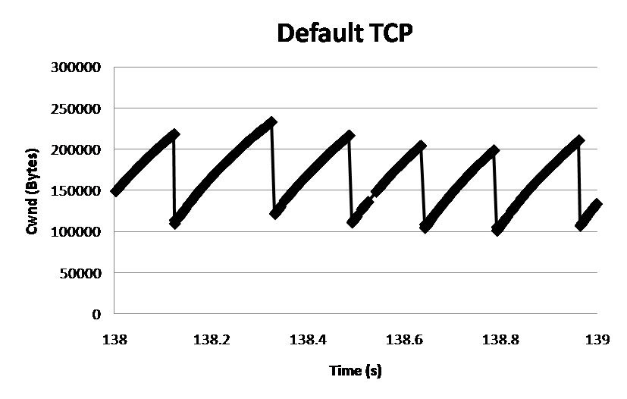
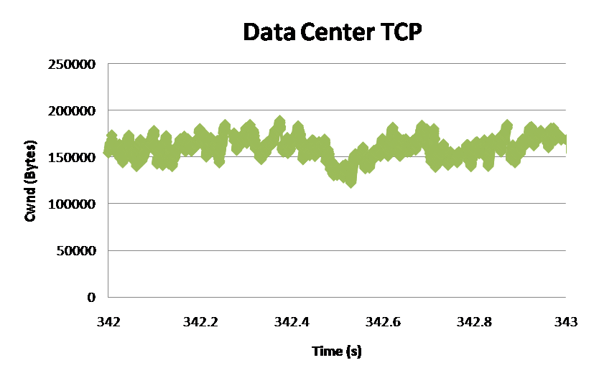
DCTCP: Main idea
ECN Marks | TCP | DCTCP
1 0 1 1 1 1 0 1 1 1 | Cut window by 50% | Cut window by 40%
0 0 0 0 0 0 0 0 0 1 | Cut window by 50% | Cut window by 5%
TCP
DCTCP
Window Size (Bytes)
Window Size (Bytes)
Time (sec)
Time (sec)
Notes:
Start with: “How can we extract multi-bit information from single-bit stream of ECN marks?”
- Standard deviation: TCP (33.6KB), DCTCP (11.5KB)

Slide 16
DCTCP algorithm
B
K
Don’t
Mark
Mark
Switch side:
Mark packets when Queue Length > K.
Sender side:
Maintain running average of fraction of packets marked (α).
Adaptive window decreases:
Note: decrease factor between 1 and 2.
Notes:
very simple marking mechanism
not all the tunings other aqms have
on the source side, the source is tryign to estimate the fraction of packets getting marked
using the obs that there is a stream of ecn marks coming back – more info in the stream than in any single bit
trying to maintain smooth rate variations to operate well even when using shallow buffers, and only a few flows (no stat mux)
F over the last RTT. In TCP there is always a way to get the next RTT from the window size. Comes from the self-clocking of TCP.
Only changing the decrease. Simplest version – makes a lot of sense. So generic could apply it to any algorithm – CTCP, CUBIC – how to cut its window leaving increase part to what it already does. Have to be careful here.

Slide 17
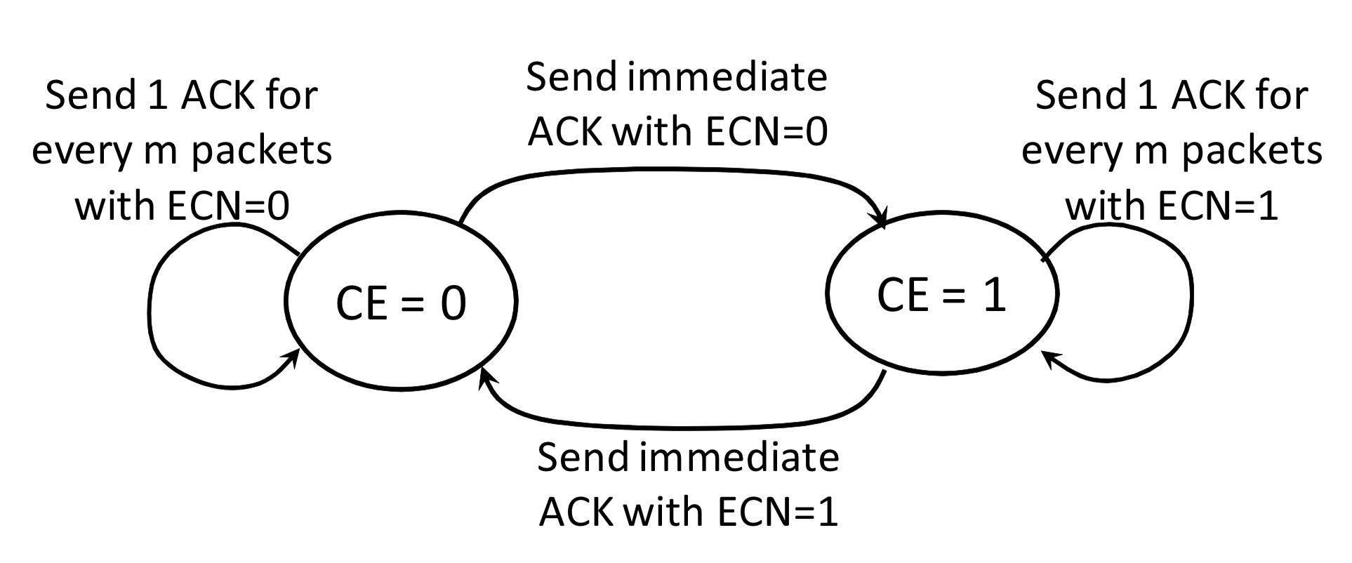
Efficient and “lossless” ACK generation

Slide 18
DCTCP vs TCP
Experiment: 2 flows (Win 7 stack), Broadcom 1Gbps Switch
Buffer is mostly empty
(KBytes)
DCTCP mitigates Incast by creating a
large buffer headroom
ECN Marking Thresh = 30KB

Slide 19
Why it works
Low Latency
Small buffer occupancies → low queuing delay
2. High Throughput
ECN averaging → smooth rate adjustments, low variance
3. High Burst Tolerance
Large buffer headroom → bursts fit
Aggressive marking → sources react before packets are dropped

Slide 20
Setting parameters: A bit of analysis
B
K
How much buffering does DCTCP need for 100% throughput?
Need to quantify queue size oscillations (stability).
Packets sent in this
RTT are marked
Window Size
W*+1
W*
(W*+1)(1-α/2)
Time

Slide 21
Setting parameters: A bit of analysis
B
K
How small can queues be without loss of throughput?
Need to quantify queue size oscillations (Stability).
for TCP:
K > C x RTT
K > (1/7) C x RTT

Slide 22
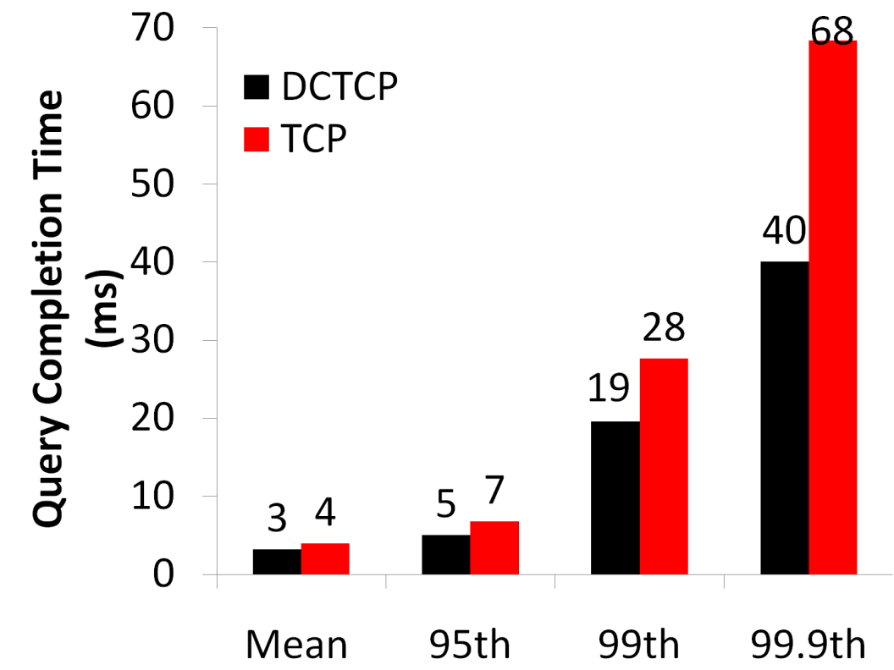
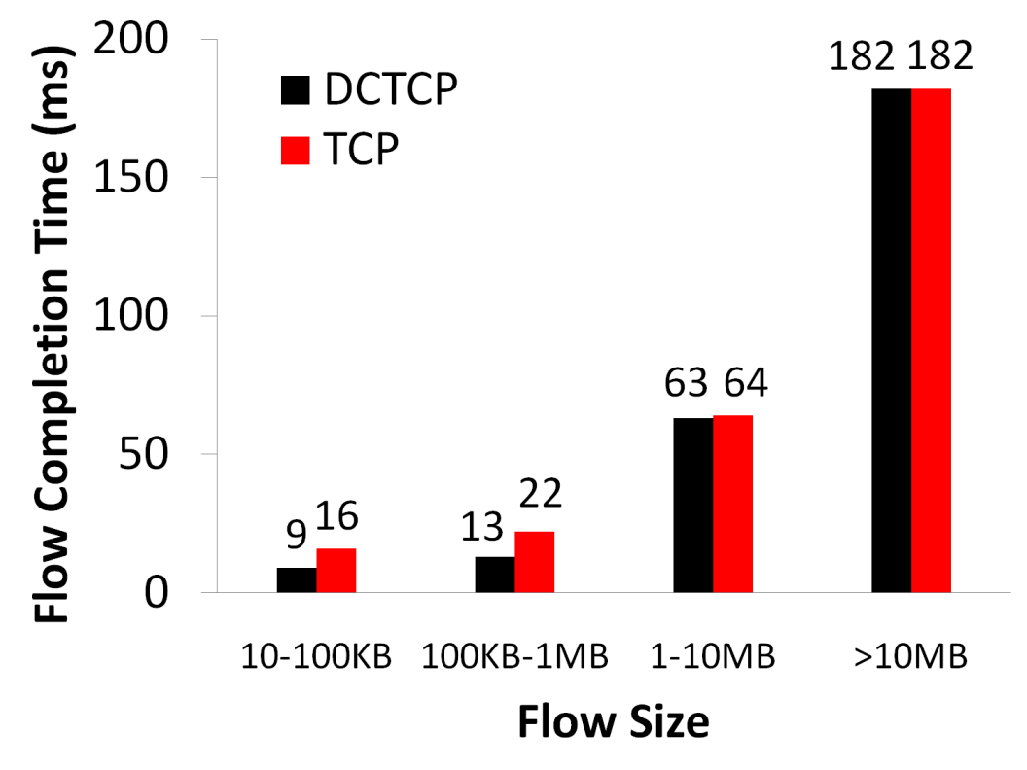
Bing benchmark (baseline)
Background Flows
Query Flows
Notes:
To transition to scaled traffic: people always want to get more out of their network.

Slide 23
Convergence time
DCTCP takes at most ~40% more RTTs than TCP
“Analysis of DCTCP”, SIGMETRICS 2011
Intuition: DCTCP makes smaller adjustments than TCP, but makes them much more frequently
TCP
DCTCP
Notes:
In the first part of the talk, we established that what we need from DCTCP is to maintain small queues, without loss of throughput
Now in the case of TCP, the question of how much buffering is needed for high throughput has been studied and is known in the literature as the buffer sizing problem.
… and I’ll show you how to get low var…

Slide 24
CC evaluation: several aspects!
Throughput, delays, flow completion times
Fairness, convergence times
Specific impairments:
incast (many to one, all to all)
collateral damage from incast
buffer pressure
Impact on background traffic
Multi-hop versus single-hop bottlenecks

Slide 25
CC Deployment Concerns
Life ain’t easy in the fast lane

Slide 26
Practical deployment concerns in DCs
Coexistence with legacy protocols like TCP Cubic
Application code can’t be upgraded in one shot
Minimum window size matters during heavy incast events
e.g., 2 packets versus 1 packet!
Setting pkt flags appropriately at senders, receivers, and routers
Non “ECN-capable” flagged packets will be dropped when Q > K
… including the SYN packets of any connection
Receive-buffer tuning
Receive buffer must be at least BDP, but what is the BDP?

