Slide 1

Static Network Verification
Lecture 22, Computer Networks (198:552)
Fall 2019

Slide 2

Review: Control/data plane separation
Traditionally:
Individual routing algorithm components in each and every router interact in the control plane
Control plane
per route-change processing
(~ a few seconds)
Routing
Algorithm
control
plane
data
plane
Data plane
per-packet processing
(~ tens of nanoseconds)
0111
1
3
2
values in arriving
packet header

Slide 3
Networks are complex
Numerous control plane protocols
RFCs numbering in the thousands
Protocols interact in complex ways
Concerns of complexity extend to SDNs as well
Protocols must often work across administrative boundaries
Significant outages often due to avoidable reasons
Human errors cause >50% of outages
Network is in a constant state of change

Slide 4
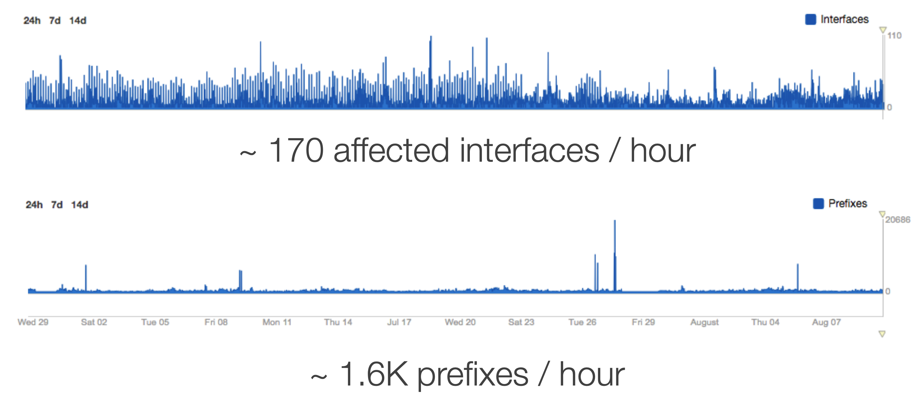
Outages happen all the time
Source: https://blog.thousandeyes.com/nanog-68-decoding-performance-data-internet-outages/
Notes:
Source: https://blog.thousandeyes.com/nanog-68-decoding-performance-data-internet-outages/ https://ripe73.ripe.net/presentations/9-RIPE-73-Decoding-Performance-Data-from-Large-Scale-Internet-Outages.pdf

Slide 5
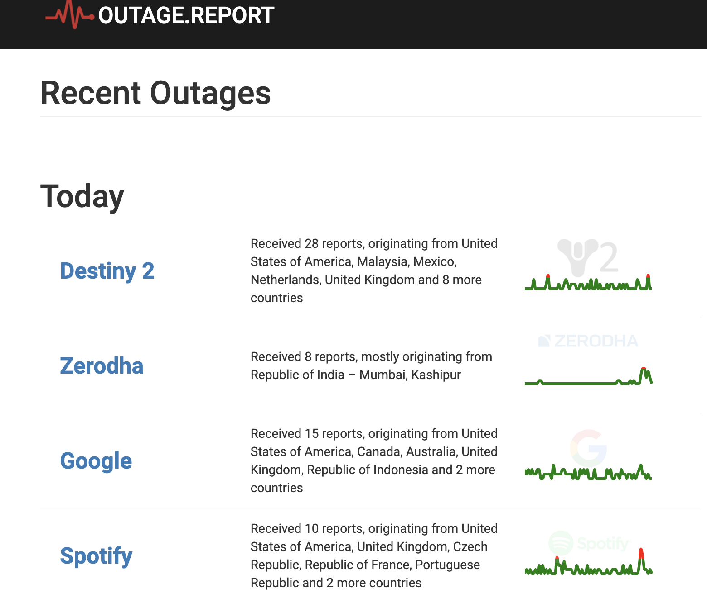
Outages happen all the time
Notes:
Source: https://outage.report/

Slide 6
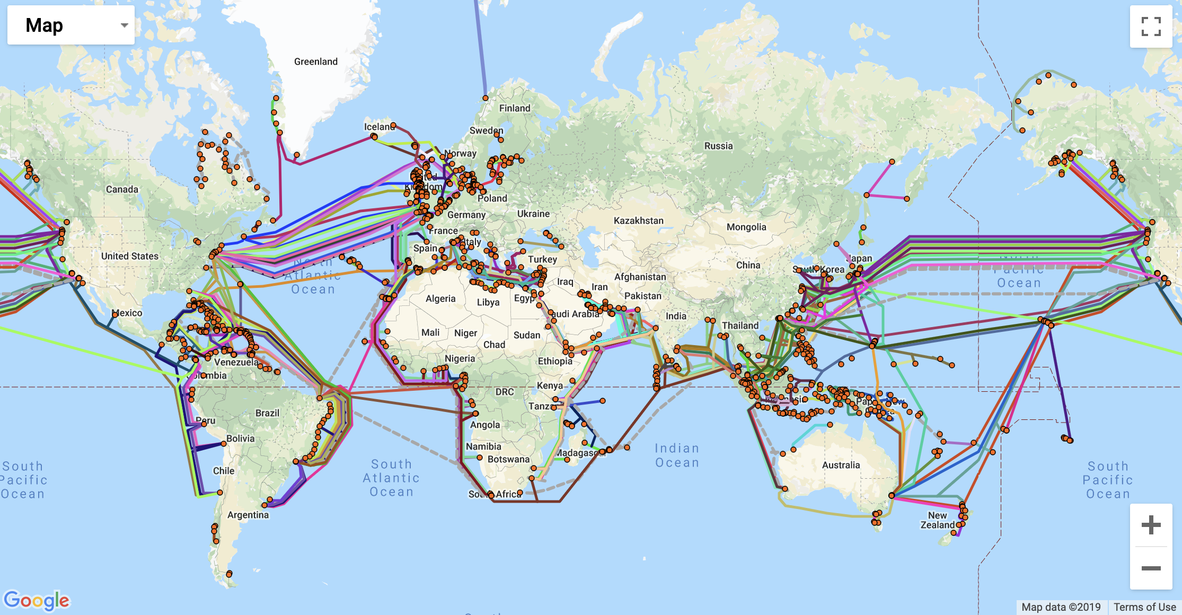
Root causes: Physical connectivity
Cable faults
Notes:
Source: http://www.fiberatlantic.com/submarinecablemap/

Slide 7
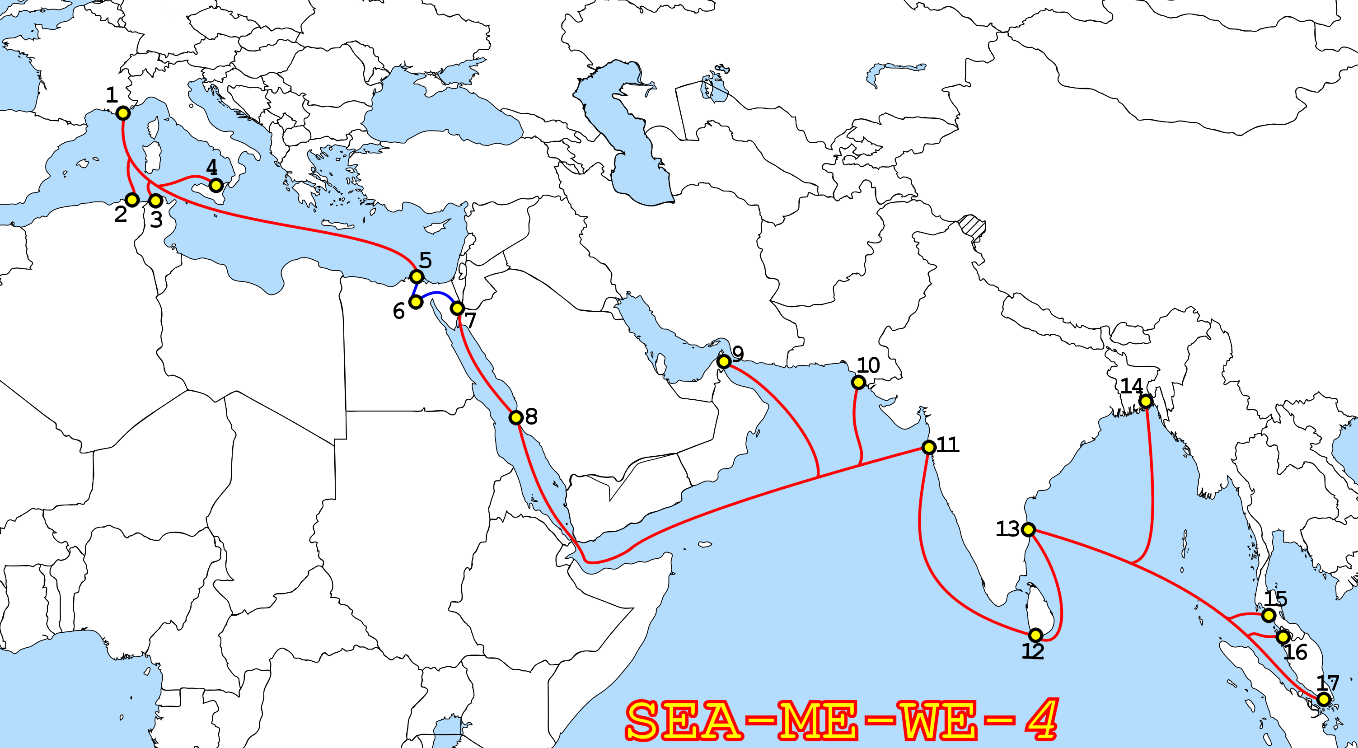
Root causes: Physical connectivity
Single cable fault or break can take out multiple ISP paths
Tata, Telecon Italia
Cascading effects due to load on other links
New inter-dom paths taken
PoPs overloaded
Drop traffic worldwide
Notes:
Source: Wikipedia SEA-ME-WE-4 https://en.wikipedia.org/wiki/SEA-ME-WE_4#/media/File:SEA-ME-WE-4-Route.png

Slide 8
Root causes: Physical connectivity
Network interfaces can become faulty too
Widespread intra-domain, or even inter-domain outages
Notes:
Source: Wikipedia SEA-ME-WE-4 https://en.wikipedia.org/wiki/SEA-ME-WE_4#/media/File:SEA-ME-WE-4-Route.png

Slide 9
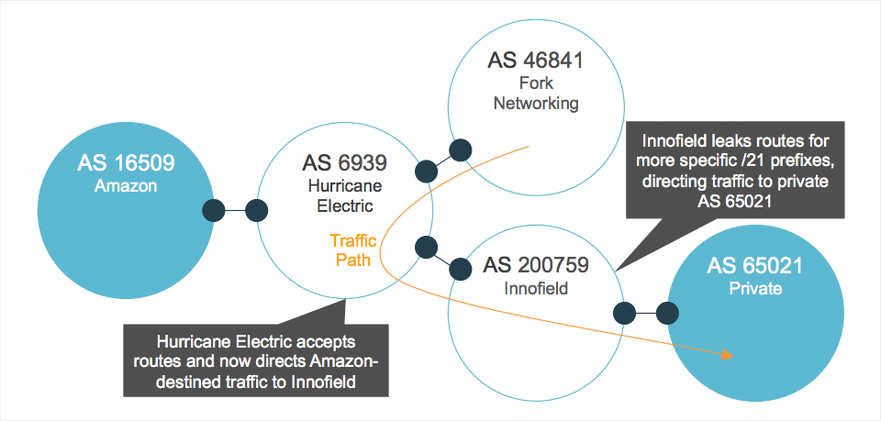
Root causes: Route misconfiguration
Leaks: e.g., ISP announces more specific routes to a destination
Prefix “hijacking”
Flaps
Likely to be misconfigurations
e.g., Youtube08
But can also be deliberate: MITM
E.g., Belarus
Notes:
Source: https://blog.thousandeyes.com/nanog-68-decoding-performance-data-internet-outages/

Slide 10
Root causes
Discussion so far about inter-domain failures
But many intra-domain failures possible too
Information leaks between tenants on a public cloud
e.g., HIPAA compliance
e.g., Banking regulations
Loops in intra-domain routing
Transient loops due to convergence delay
Permanent loops due to misconfigurations
Blackholes

Slide 11
A manifesto of operator requirements
Know the answers to simple questions
Can A talk to B?
Reachability
A and B can be hosts, IP prefixes, “slices”
Are there loops, blackholes, …
Know the effects of a change, preferably before it happens
What-if analyses
Link failures, protocol messages accepted from peers, …
Answer these Qs fast to keep up with change in the network

Slide 12
An Abstract Problem Statement
Formalizing verification as a mathematical problem

Slide 13
for all M, does N satisfy P?
Decision Procedure: An algorithm that answers yes/no
Ask the question under assumptions about network change:
static, incremental, or dynamic
Property of interest:
Loop freedom
Blackholes
Equivalence
Many complex props…
Sequence of messages:
Packets,
Routing protocol
Link failures
Network representation:
Data plane
Control plane

Slide 14
A simple example: Modeling firewall rules
Assume packets just have 2 bits; there are only 2 ports
Firewall config: 10 -> fwd(2); *1 -> fwd(1). All others dropped
Boolean representation of the network:
N: (d1 & ~d0) | ((d1 | ~d1) & d0)
Property: only the packets from 00 are dropped
P: (~d1 & ~d0)
Messages (M): all combinations of Boolean variables d0, d1
Verification question: for all d0, d1, is formula N | P valid? i.e.,
Is ((d1 & ~d0) | ((d1 | ~d1) & d0)) | (~d1 & ~d0) a tautology?
Decision procedure: SAT solver

Slide 15
Typical considerations for verification
Size of network representations
O(# rules)? # packets? Some product of these things?
Speed of decision procedure, e.g., SAT solving
Typically NP-hard or worse in the worst case
Verification: leveraging average-case complexity
Coverage of possible network events
Does property hold under firewall rule changes? New protocol messages? Link failures?
Strength of properties and counter-examples
Does P hold for all packets? Are we looking for one counterexample, or the whole set of violating packets?

Slide 16
Verification, testing, synthesis, eq checks
Verification: for all M, does N satisfy P?
Testing: For the given M, does N satisfy P?
Synthesis: Given P, can you produce an N that satisfies it
For a given set of M? (including for all M)
Let N’ be another network representation
Equivalence checking: For all M, do N and N’ behave in the same way with respect to P?, i.e.,
i.e., either both satisfy P or both violate it

Slide 17
Properties to verify
Reachability, isolation, loop freedom
Equivalence between data plane rules
Replicated configurations (for availability or performance)
Reducing to simpler configurations
Waypoint properties
e.g., does traffic always go through a monitoring node?
Ordering constraints on processing: e.g., DPI must follow ACLs
Temporal properties, e.g.:
After first message from a source, don’t broadcast traffic destined to it
Performance properties: e.g., arrival distributions & congestion

Slide 18
Header Space Analysis

Slide 19
Header Space Analysis: Discussion
Compact Boolean representation of router: union of wildcards
Example? (say IP router)
Operations on header spaces
e.g, Why is an inverse always well-defined?
cross-product issue and the linear fragmentation assumption
Representation matters! difference of two unions
Properties: reachability, generic loops, infinite loops
Loop detection: per-port vs. per-switch, any port vs. init port
What else could you run on the HS “propagation tree”?

Slide 23
Scaling challenges with verification
Too many messages and events
Packet headers
Link failures
Protocol messages
Orderings between events matters
Too many network rules
Too large a network

Slide 24
10,000 ft overview of the broad literature
Data plane verification
Static: header space analysis
Incremental: Veriflow
Dynamic: NICE
Control and data plane verification
Static: p4v
Incremental: Batfish
Dynamic: Minesweeper

