Slide 1

CS 352 Circuit & Packet Switching, Measurement & Layering
Lecture 2
http://www.cs.rutgers.edu/~sn624/352-F22
Srinivas Narayana

Slide 2


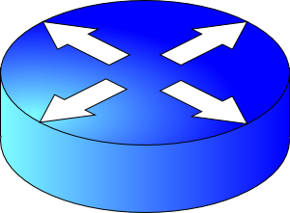

Review of definitions
packet
link
link
link
host/
endpoint
host/
endpoint
router
router
Endpoint or Host: Machine running user application
Packet: a unit of data transmission (ex: 1500 bytes)
Link: a physical communication channel between two or more machines
Router: A machine that processes packets moving them from one link to another towards a destination
Network: Collection of interconnected machines
Address: a unique name given to a machine (more later)

Slide 3
Today’s lecture
Dive a bit deeper into how Internet communication works
Links: how does communication work physically?
Routers: how do they move data between links?
Endpoints: how is networking organized at endpoints?
Understand how to measure the Internet

Slide 4
How do machines talk?

Slide 5
How do machines communicate?
With 1s and 0s
Computers only deal with 1s and 0s
How do we transmit 1s and 0s in a network?
Encoding and Decoding problem.

Slide 6
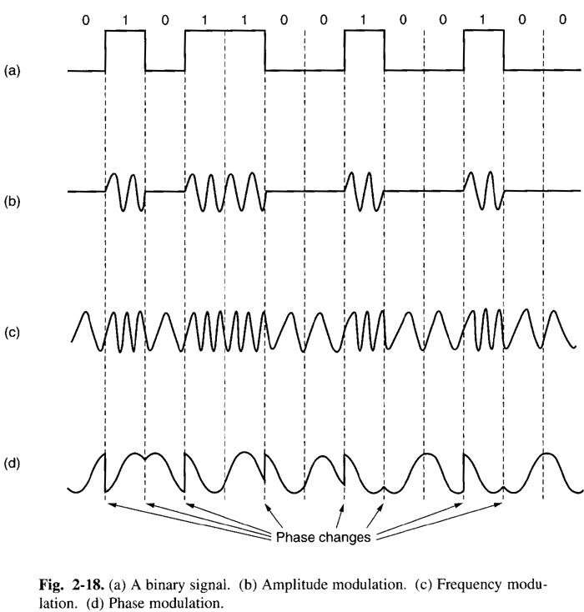
Physical transmission on a single link
Physical signaling (light, AC voltages, etc.) are often analog
Convert bits to signals through modulation of the physical characteristics of signals: encoding
Convert signals back to digital by decoding physical signals

Slide 7

Routers and Multi-link networks
Routers need a way to move data across links
We use the term switching to denote physically moving data from one link to another
There are different possibilities to switch data between links…
Router
Router

Slide 8
Switching schemes
Host applications transfer data containing many messages.
(1) Circuit Switching
(2) Message Switching
(3) Packet Switching

Slide 9

Circuit switching
Provides service by setting up the full path of connected links from the origin to the destination
Example: Telephone network
Dedicated path with dedicated resources

Slide 10
Circuit switching
Call request signal
1. Setup: Control message sets up a path from origin to destination
2. Accept signal informs source that data transmission may proceed
3. Data transmission begins
4. Entire path remains allocated to the transmission (whether used or not)
5. When transmission is complete, source releases the circuit
Propagation
Delay
Resource reservation
delay
Time
Call accept signal
Data
Transmission
Time
Data
A
B
C
D

Slide 11


Message switching
Each message is addressed to a destination
Header: metadata that denotes how to process a message
Typically includes a destination address
The message “hops” from node to node through a network while allocating only one link at a time
(Compare to circuit switching, where all links are reserved at the same time, regardless of use.)
Analogy: Postal service

Slide 12
Message switching
When the entire message is received at a router, the next step and link in its journey are selected (routing)
If this selected link is busy, the message waits in a queue until the link becomes free
Store and forward switching
Router waits for all bits of a message to arrive on incoming link before sending the first bit of the message on the outgoing link
Alternative: cut–through switching sends bits as they arrive

Slide 13
Message Switching
Header
Msg
Time
Total transfer time
Msg
Store and forward
delay
Queueing
Delay
Msg
A
B
C
D

Slide 14
Packet switching
Messages are split into smaller pieces called packets
Packets have a maximum length
Packets are numbered and addressed
Packets are sent through the network one at a time
Pipelining: different parts of a message concurrently transmitted over different links
Provides higher utilization of link resources

Slide 15
Packet switching
Header
Pkt 1
Pkt 2
Pkt 1
Store and forward
delay
Total transfer time
Time
Pkt 3
Queueing
Delay
Pkt 2
Pkt 3
Pkt 1
Pkt 2
Pkt 3
A
B
C
D

Slide 16
The Internet uses store-and-forward packet switching.

Slide 17
Comparisons across switching tech
Circuit switching incurs an initial delay to set up the path
Packet (and message) switching can start transmitting data right away
Packet switching doesn’t reserve resources for the conversation
Circuit switching does. Needs admission control
Packet switching makes resource reservation decisions per packet
Fewer or no guarantees ➔ easier to build
Telephone networks are more reliable and harder to build

Slide 18
Comparisons across switching tech
(1) Total Delay to transfer a message
Short Bursty Messages:
Packet < Circuit
Long Continuous Messages:
Circuit < Packet
(2) Header overhead (what % of bits on the wire is metadata?)
If typical messages are larger than typical packets:
Packet > Message

Slide 19


Switching
host/
endpoint
host/
endpoint
link
link
link
router
router
Many layers…
Encoding and decoding

Slide 20
Layering and Protocols

Slide 21
Software/hardware organization at hosts
Application: useful user-level functions
Communication functions broken up and “stacked”
Transport: provide guarantees to apps
Each layer depends on the one below it.
Each layer supports the one above it.
The interfaces between layers are well-defined and standardized.
Network: best-effort global pkt delivery
Link: best-effort local pkt delivery

Slide 22

Internet software and hardware
are arranged in layers.
Layering provides modularity
Each layer: well-defined function
& interfaces to layers above & below it.
Functionality is implemented in protocols.

Slide 23
Protocols: The “rules” of networking
Protocols consist of two things
Message format
structure of messages exchanged with an endpoint
Actions
operations upon receiving, or not receiving, messages
Example of a Zoom conversation:
Message format: English words and sentences
Actions: when a word is heard, say “yes”; when nothing is heard for more than 3 seconds, say “can you hear me?”

Slide 24
The protocols of the Internet
Standardized by the Internet Engineering Task Force (IETF)
through documents called RFCs (“Request For Comments”)
Layering of protocols
HTTP
FTP
NV
TFTP
HTTPS
FTP
HTTP
SIP
RTSP
TCP
UDP
TCP
UDP
IP
IP
Ether
ATM
…
WiFi
X.25
…
802.11
ATM

Slide 25

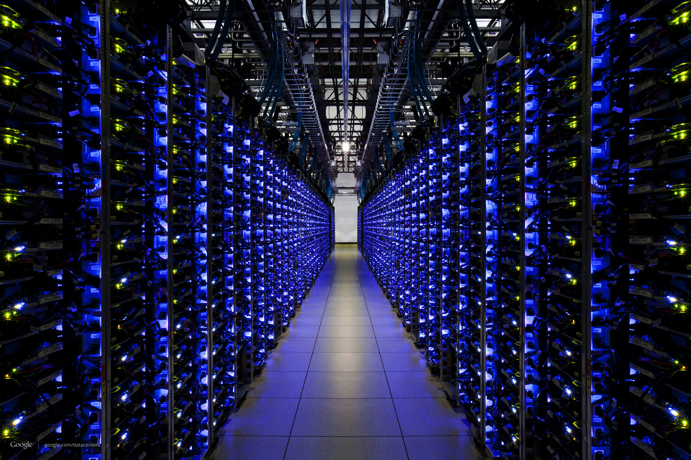


The Internet
Applications
Applications
Packet starts as an
app “payload”
Transport
Packet takes on headers at each layer
Transport
Network
Network
Link layer
Link layer
The Internet

Slide 26

Applications
Applications
Transport
Transport
Network
Network
Network
Network
Link layer
Link layer
Link layer
Link layer

Slide 27
Applications
Applications
Routers have network and link layers too!
Transport
Transport
Network
Network
Network
Network
Link layer
Link layer
Link layer
Link layer

Slide 28



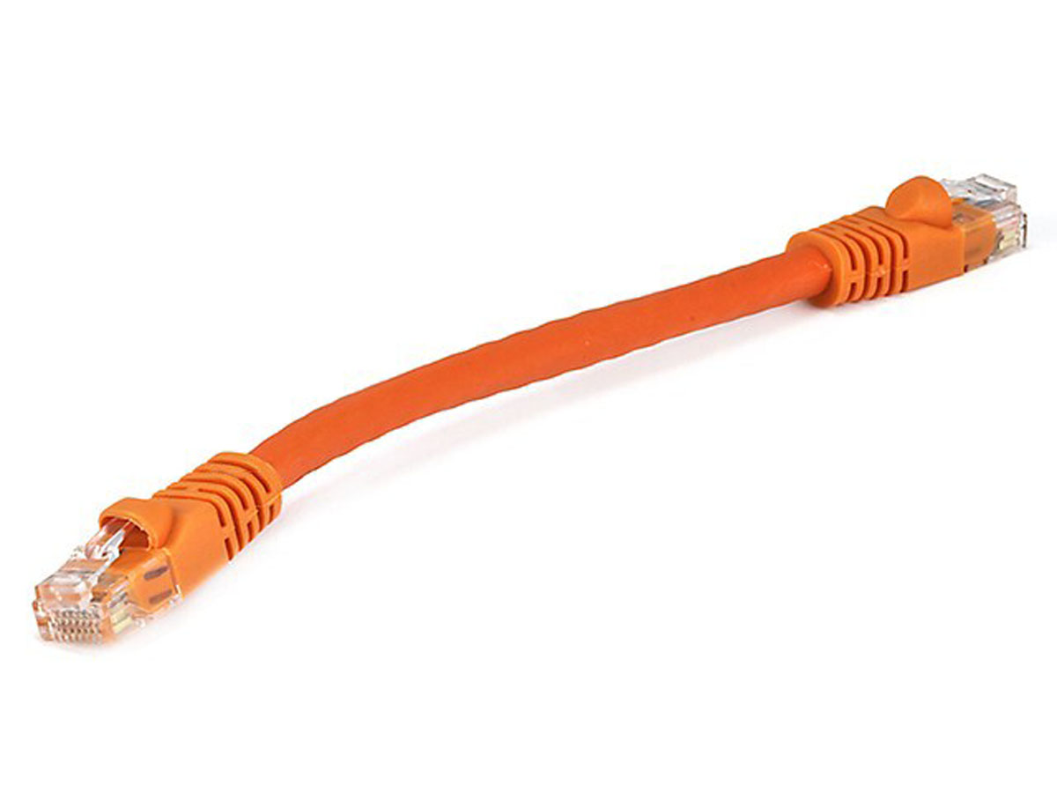
Rutgers campus network
The Internet
Transport address (port)
Ex: 64058
With which app is this conversation associated?
Network address (IP address)
Ex: 192.168.1.4
Whose network am I attached to?
Hardware address (MAC address)
Ex: 00-15-C5-49-04-A9
How do I identify my network interface (device)?

Slide 29
The Internet
Google’s network
Application address (URL)
Ex: mail.google.com
Transport address (port)
Ex: 4096
Network address (IP address)
Ex: 10.1.1.104
Hardware address (MAC address)
Ex: 00-15-C5-49-04-A7

Slide 30
Layering
Communication over the Internet is a complex problem.
Layering simplifies understanding, testing, maintaining
Easy to improve or replace protocol at one layer without affecting others

Slide 31

This course has layers
Application
HTTPS
FTP
HTTP
SIP
RTSP
Transport
TCP
UDP
Network
IP
Host-to-Net
X.25
…
802.11
ATM

Slide 32
Measuring Networks (including the Internet)

Slide 33
Some definitions
Packet size: length of a packet (bits or bytes), incl. header and data
Bandwidth: For a single link, amount of data it can transmit per unit time (bits/second or Bytes/second or packets/second)
Propagation delay: Time needed to move one bit across (second)
Imposed by the communication medium; depends on the link “length”
Transmission delay: Time from first bit@sender to last bit@sender
Determined by link bandwidth and packet size
Queueing delay: Time that a packet waits for transmission
Determined by contention for the link
Total packet delay: time from first bit@sender to last bit@receiver
propagation delay + queueing delay + transmission delay for a single packet

Slide 34

An analogy: Conveyor belt
Propagation delay
Bandwidth
Propagation delay = time for first box to travel the length of the belt
Bandwidth = the number of boxes put on the belt per minute (“rate”)
Suppose we have N boxes in one shipment
Shipment transmission time = N / rate
The next box is put on the belt (1/rate) minutes after the last
Total transfer time = transmission time + propagation delay

Slide 35
Visualizing the components of delay
Transmission delay at the first link
Propagation delay of first link
Queueing at the router
Increasing time
Transmission delay at the second link
Propagation delay of second link

Slide 36
Bandwidth and delay demo
Throughput (related to bandwidth)
iperf –s # at the destination
iperf –c <destination> # at the source,
e.g., iperf –c localhost
(total) delay
ping <destination>
e.g., ping google.com
(Don’t just watch; you can try it!)

