Slide 1

CS 352 Sockets, App Layer, DNS
Lecture 3
http://www.cs.rutgers.edu/~sn624/352-F22
Srinivas Narayana

Slide 2
Review of concepts
Switching: Circuit, Message, Packet
Layering: Modularity
Application: useful user-level functions
User space
Transport: provide guarantees to apps
Kernel space
Network: best-effort global pkt delivery
Protocol: Message format and actions
Link: best-effort local pkt delivery
Protocols can be public domain (RFCs) or proprietary.

Slide 3
Today’s lecture
Understand how to measure the Internet
Learn how application software accesses the Internet
Dive into our first app-layer protocol

Slide 4
Measuring Networks (including the Internet)

Slide 5
Some definitions
Packet size: length of a packet (bits or bytes), incl. header and data
Bandwidth: For a single link, amount of data it can transmit per unit time (bits/second or Bytes/second or packets/second)
Propagation delay: Time needed to move one bit across (second)
Imposed by the communication medium; depends on the link “length”
Transmission delay: Time from first bit@sender to last bit@sender
Determined by link bandwidth and packet size
Queueing delay: Time that a packet waits for transmission
Determined by contention for the link
Total packet delay: time from first bit@sender to last bit@receiver
propagation delay + queueing delay + transmission delay for a single packet

Slide 6

An analogy: Conveyor belt
Propagation delay
Bandwidth
Propagation delay = time for first box to travel the length of the belt
Bandwidth = the number of boxes put on the belt per minute (“rate”)
Suppose we have N boxes in one shipment
Shipment transmission time = N / rate
The next box is put on the belt (1/rate) minutes after the last
Total transfer time = transmission time + propagation delay

Slide 7

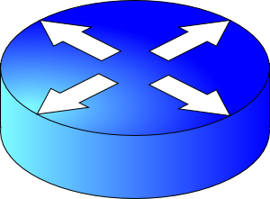
Visualizing the components of delay
Transmission delay at the first link
Propagation delay of first link
Queueing at the router
Increasing time
Transmission delay at the second link
Propagation delay of second link

Slide 8
Bandwidth and delay demo
Throughput (related to bandwidth)
iperf –s # at the destination
iperf –c <destination> # at the source,
e.g., iperf –c localhost
(total) delay
ping <destination>
e.g., ping google.com
(Don’t just watch; you can try it!)

Slide 9
Application Layer

Slide 10




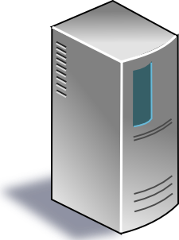





App-layer communication
Internet applications reside on multiple endpoints
Need addresses to identify the communicating endpoints
E.g., Telephone network: xxx-yyy-zzzz
Internet: Internet Protocol (IP) addresses
IPv4 (32 bits) 128.6.24.78
IPv6 (128 bits) 2001:4000:A000:C000:6000:B001:412A:8000
Which app on each endpoint? Port number
IP addr
IP addr
Internet
port
port

Slide 11
How are addresses used?
Socket: abstraction (API) of the Internet for applications
IP_{A}
IP_{B}
Internet
port_{B}
port_{A}
App process
App process
User space
User space
Socket
Socket
Kernel space
Kernel space
Operating system’s network stack
Operating system’s network stack
Internet
App-layer connection is a 4-tuple: (IP_{A}, port_{A}, IP_{B}, port_{B})

Slide 12




Socket system calls
Process A
(client)
connect(
IP_{B}, port_{B})
send()
Process B
(server)
bind(IPaddr_{B}, port_{B})
listen()
accept()
recv()
process
process
IP_{B} + port_{B}
socket
socket
IP_{A} + port_{A}

Slide 13
Seeing app-layer connections
netstat
ss

Slide 14
Common Architectures of Applications

Slide 15
Client-server architecture
client
Server:
Always-on endpoint
Provides a “service” to the world
Typically, a permanent IP address
Compute clusters to scale to many users
Clients:
A “customer” of the server
May be intermittently connected
May have dynamic IP addresses
Typically, do not communicate directly with other clients
The web and most mobile apps use a client-server architecture
server
client

Slide 16
Peer-to-peer (P2P) architecture
peer
Peers:
Intermittently connected hosts
Directly talking to each other
Little to no reliance on always-up servers
Examples: BitTorrent
Today, many applications use a hybrid model
Example: (webRTC) Google meet, FB messenger, …
peer

Slide 17
Going forward: A few app-layer protocols
Domain Name System
The web
Mail
Streaming video

Slide 18
Domain Name System

Slide 19
You have my name. Can you lookup my address?

Slide 20
Domain Name System (DNS)
Problem statement:
Average brain can easily remember 7 digits for a few names
On average, IP addresses have 12 digits
We need an easier way to remember IP addresses
Solution:
Use alphanumeric names to refer to hosts.
Called host names or domain names (e.g.: cs.rutgers.edu)
We need a directory (address book)
A service to map alphanumeric host names to binary IP addresses
We call this process Address Resolution

Slide 21

Types of Directories
Directories map a name to an address
Simplistic designs
Central directory
Ask everyone (e.g., flooding)
Tell everyone (e.g., push to a file like /etc/hosts)
Scalable distributed designs
Hierarchical namespace (e.g., Domain Name System (DNS))
Flat name space (e.g., Distributed Hash Table)

Slide 22
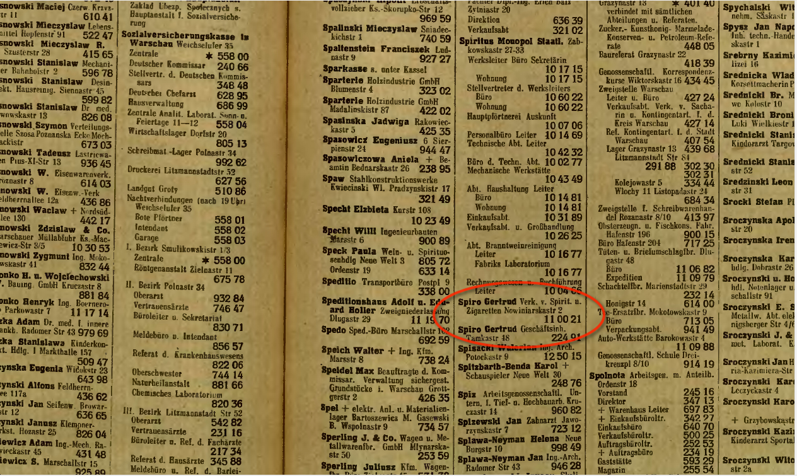
Simple DNS
What if every endpoint has a local directory?
/etc/hosts.txt
How things worked in the early days of the Internet!
What if endpoints changed addresses? How do you keep this up to date?

Slide 23
Simple DNS
DOMAIN NAME | IP ADDRESS
spotify.com | 98.138.253.109
cs.rutgers.edu | 128.6.4.2
www.google.com | 74.125.225.243
www.princeton.edu | 128.112.132.86
<Client IP, CPort, DNS server IP, 53>
QUERY cs.rutgers.edu
<DNS server, 53, Client IP, Cport>
RESPONSE 128.6.4.2
Key idea: Implement a server that looks up a table.
Will this scale?
Every new (changed) host needs to be entered in this table
Performance: can the server serve billions of Internet users
Failure: what if the server or the database crashes?
How to secure this server?

Slide 24
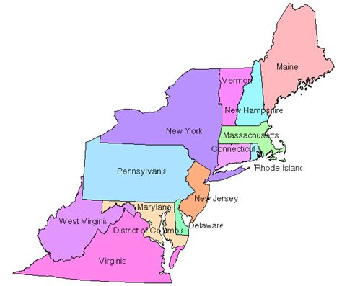

Distributed and hierarchical database
Root DNS Servers
Top-level domain (TLD) servers
com DNS servers
org DNS servers
edu DNS servers
google.com
DNS servers
wnyc.org
DNS servers
rutgers.edu
DNS servers
umass.edu
DNS servers
amazon.com
DNS servers
cs.rutgers.edu DNS server
Authoritative name server
RFC 1034: Distribution through hierarchy enables scaling

Slide 25
DNS Protocol
Client-server application
Client connects to (known) port 53 on server
Assume DNS server IP known
Two types of messages
Queries
Responses
Type of Query (OPCODE)
Standard query (0x0)
e.g., Request IP address for a given domain name
Updates (0x5)
Provide a binding of IP address to domain name
Each type has a common message format that follows the header

Slide 26
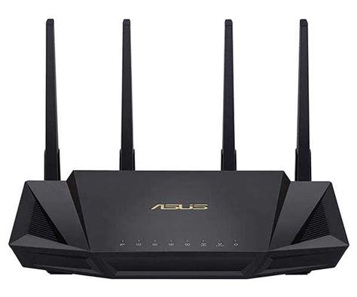
DNS Protocol
When client wants to know an IP address for a host name
Client sends a DNS query to the “local” name server in its network
If name server contains the mapping, it returns the IP address to the client
Otherwise, the name server forwards the request to the root name server
The request works its way down the tree toward the host until it reaches a name server with the correct mapping

Slide 27
Example
root DNS server
2
Host at cs.rutgers.edu wants IP address for gaia.cs.umass.edu
Local DNS server
Root DNS server
TLD DNS server
Authoritative DNS server
3
.edu DNS server
4
5
local DNS server
dns.rutgers.edu
7
6
1
8
umass.edu DNS server
dns.umass.edu
requesting host
cs.rutgers.edu
gaia.cs.umass.edu

Slide 28
Query type
root DNS server
2
Iterative query
Contacted server replies with name of server to contact
“I don’t know this name, but ask this other server”
Queries are iterative from POV of the local DNS server
3
.edu DNS server
4
5
local DNS server
dns.rutgers.edu
7
6
1
8
umass.edu DNS server
dns.umass.edu
requesting host
cs.rutgers.edu
gaia.cs.umass.edu

Slide 29
Query type
root DNS server
Recursive query:
Puts burden of name resolution on the contacted (e.g., root) name server
Problem: think about load on the root DNS server.
Must it answer every DNS query?
2
3
7
6
.edu DNS server
local DNS server
dns.rutgers.edu
5
4
1
8
umass.edu DNS server
dns.umass.edu
requesting host
cs.rutgers.edu
gaia.cs.umass.edu

Slide 30
DNS caching
Once (any) name server learns a name to IP address mapping, it caches the mapping
Cache entries timeout (disappear) after some time
TLD servers typically cached in local name servers
In practice, root name servers aren’t visited often!
Caching is pervasive in DNS

Slide 31
DNS in action
dig <domain-name>
dig +trace <domain-name>
dig @<dns-server> <domain-name>

Slide 32
Bootstrapping DNS
How does a host contact the name server if all it has is the domain name and no (name server) IP address?
IP address of at least 1 nameserver (usually, a local resolver) must be known a priori
The name server may be bootstrapped “statically”, e.g.,
File /etc/resolv.conf in unix
Start -> settings-> control panel-> network ->TCP/IP -> properties in windows
… or with another protocol!
DHCP: Dynamic Host Configuration Protocol (more on this later)

Slide 33
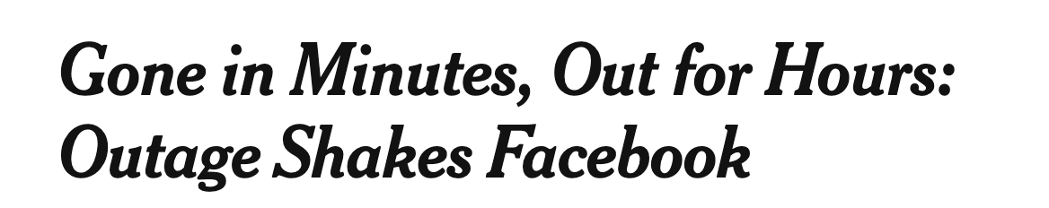



DNS may seem simple, but …

