Slide 1

CS 352 Name Resolution
Lecture 4
http://www.cs.rutgers.edu/~sn624/352-F22
Srinivas Narayana

Slide 2



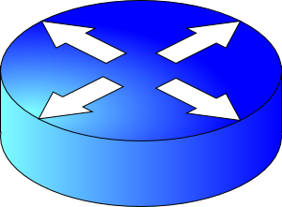

Review of concepts
Connection 4-tuple
DNS: turn human-readable addresses into IP addresses.
IP_{A}
IP_{B}
port_{A}
port_{B}
Propagation
Application process
Application process
Transmission
gethostbyname()
bind(IP_{B}, port_{B})
listen()
accept()
recv(data)
Bandwidth
connect(IP_{B}, port_{B})
send(data)
Queueing
User space
Socket
Socket
Client-server architecture
Peer to peer architecture
Kernel space
OS network stack layers
OS network stack layers
Internet

Slide 3
Simple DNS
DOMAIN NAME | IP ADDRESS
spotify.com | 98.138.253.109
cs.rutgers.edu | 128.6.4.2
www.google.com | 74.125.225.243
www.princeton.edu | 128.112.132.86
<Client IP, CPort, DNS server IP, 53>
QUERY cs.rutgers.edu
<DNS server, 53, Client IP, Cport>
RESPONSE 128.6.4.2
Key idea: Implement a server that looks up a table.
Will this scale?
Every new (changed) host needs to be (re)entered in this table
Performance: can the server serve billions of Internet users?
Failure: what if the server or the database crashes?
Security: What if someone “takes over” this server?

Slide 4
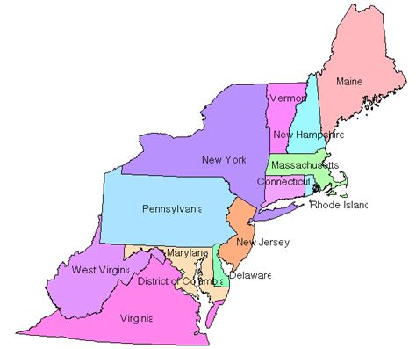
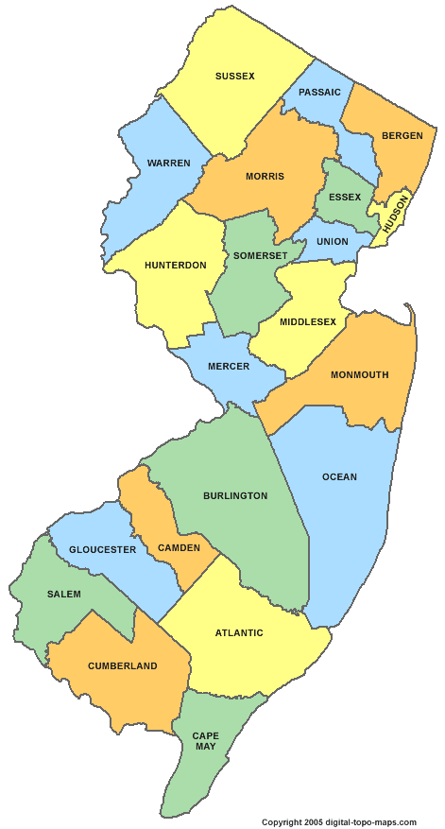

Distributed and hierarchical database
Root DNS Servers
Top-level domain (TLD) servers
com DNS servers
org DNS servers
edu DNS servers
google.com
DNS servers
wnyc.org
DNS servers
rutgers.edu
DNS servers
umass.edu
DNS servers
amazon.com
DNS servers
cs.rutgers.edu DNS server
Authoritative name server
RFC 1034
Hierarchy
Replication

Slide 5
DNS Protocol
Client-server application
Client connects to (known) port 53 on server
For now, assume DNS server IP known
Two types of messages
Queries
Responses
Type of Query (OPCODE)
Standard query (0x0)
e.g., Request IP address for a given domain name
Updates (0x5)
Provide a binding of IP address to domain name
Each type has a common message format that follows the header

Slide 6
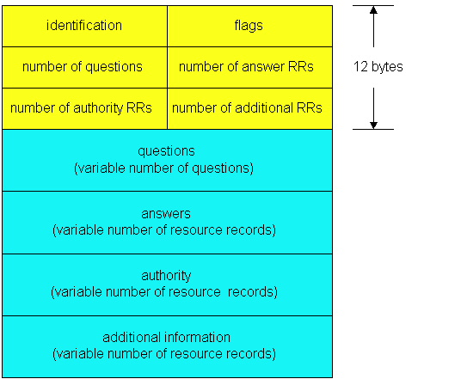
DNS protocol: Message format
DNS protocol : query and reply messages, both with same message format
QR
Opcode
Message header
QR = 0 for Query, 1 for response
Opcode= 0 standard
identification: 16 bit # for query, reply to query uses same #
flags:
Authoritative answer
recursion desired
recursion available
reply is authoritative

Slide 7
DNS protocol: Message format
QR
OPCODE
Name, type fields
for a query
Resource records in response to query
records for
authoritative servers
Information about nameserver
additional “helpful”
info that may be used

Slide 8

DNS Protocol: Actions
When client wants to know an IP address for a host name
Client sends a DNS query to the “local” name server in its network
If name server contains the mapping, it returns the IP address to the client
Otherwise, the name server forwards the request to the root name server
The request works its way down the DNS hierarchy until it reaches a name server with a mapping for the requested name

Slide 9
Example
root DNS server
2
Host at cs.rutgers.edu wants IP address for gaia.cs.umass.edu
Local DNS server
Root DNS server
TLD DNS server
Authoritative DNS server
3
.edu DNS server
4
5
local DNS server
dns.rutgers.edu
7
6
1
8
umass.edu DNS server
dns.umass.edu
requesting host
cs.rutgers.edu
gaia.cs.umass.edu

Slide 10
Query type
root DNS server
2
Iterative query
Contacted server replies with name of server to contact
“I don’t know this name, but ask this other server”
Queries are iterative from POV of the local DNS server
3
.edu DNS server
4
5
local DNS server
dns.rutgers.edu
7
6
1
8
umass.edu DNS server
dns.umass.edu
requesting host
cs.rutgers.edu
gaia.cs.umass.edu

Slide 11
Query type
root DNS server
Recursive query:
Puts burden of name resolution on the contacted (e.g., root) name server
Query to root DNS server is recursive from POV of local
Problem: think about load on the root DNS server.
Must it answer every DNS query?
2
3
7
6
.edu DNS server
local DNS server
dns.rutgers.edu
5
4
1
8
umass.edu DNS server
dns.umass.edu
requesting host
cs.rutgers.edu
gaia.cs.umass.edu

Slide 12
DNS caching
Once (any) name server learns a name to IP address mapping, it caches the mapping
Cache entries timeout (disappear) after some time
TLD servers typically cached in local name servers
In practice, root name servers aren’t visited often!
Caching is pervasive in DNS

Slide 13
DNS in action
dig <domain-name>
dig +trace <domain-name>
dig @<dns-server> <domain-name>
Don’t just watch; try it!

Slide 14
Bootstrapping DNS
How does a host contact the name server if all it has is the domain name and no (name server) IP address?
IP address of at least 1 nameserver (usually, a local resolver) must be known a priori
The name server may be bootstrapped “statically”, e.g.,
File /etc/resolv.conf in unix
Start -> settings-> control panel-> network ->TCP/IP -> properties in windows
… or with another protocol!
DHCP: Dynamic Host Configuration Protocol (more on this later)

Slide 15




DNS may seem “basic”, low level, but …

Slide 16
DNS Resource Records

Slide 17
DNS is a distributed database
DNS stores resource records (RRs)
(Incomplete) message format for each resource record (RR):
Class, type, name, value, TTL
You can read all the gory details of the message format at https://www.iana.org/assignments/dns-parameters/dns-parameters.xhtml

Slide 18
DNS records
Type=A
name is hostname
value is IPv4 address
Type=CNAME
name is alias name for some “canonical” (the real) name
e.g., www.ibm.com is really
servereast.backup2.ibm.com
value is canonical name
Type=AAAA
name is hostname
value is IPv6 address
Type=NS
name is domain (e.g. foo.com)
value is hostname of authoritative name server for this domain
Type=MX
value is name of mailserver associated with name
More complete info at https://www.iana.org/assignments/dns-parameters/dns-parameters.xhtml

Slide 19
DNS record example
NAME | Design.cs.rutgers.edu
TYPE | A
CLASS | IN
TTL | 1 day(86400)
ADDRESS | 192.26.92.30
RRs in response
to query
records for
authoritative servers
Information about nameserver
NAME | Cs.rutgers.edu
TYPE | NS
CLASS | IN
TTL | 1 day(86400)
NSDNAME | Ns-lcsr.rutgers.edu
DNS serves as a general repository of information for the Internet!

Slide 20
DNS record types
dig –t <type> <domain-name>

Slide 21
Summary of DNS
Hostname to IP address translation via a global network of servers
Embodies several scaling principles
Partition through a hierarchy to silo query load
Replication to scale out at each level of hierarchy
Caching to reduce query load
Once you have a reliable DB, can implement many useful things on top!
Example 1: Scaling large web services, e.g., google search, by redirecting different clients to different servers (IP addresses)
Reliability, load balancing, performance optimization
Example 2: Associating certificates, keys (security info) with domain names
https://www.rfc-editor.org/rfc/rfc8162.html
https://datatracker.ietf.org/doc/draft-ietf-dnsop-svcb-https/00/

