Slide 1

CS 352 Congestion Control (Part 1)
Lecture 16
http://www.cs.rutgers.edu/~sn624/352-F22
Srinivas Narayana

Slide 2



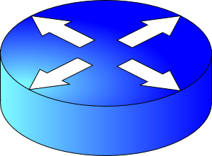
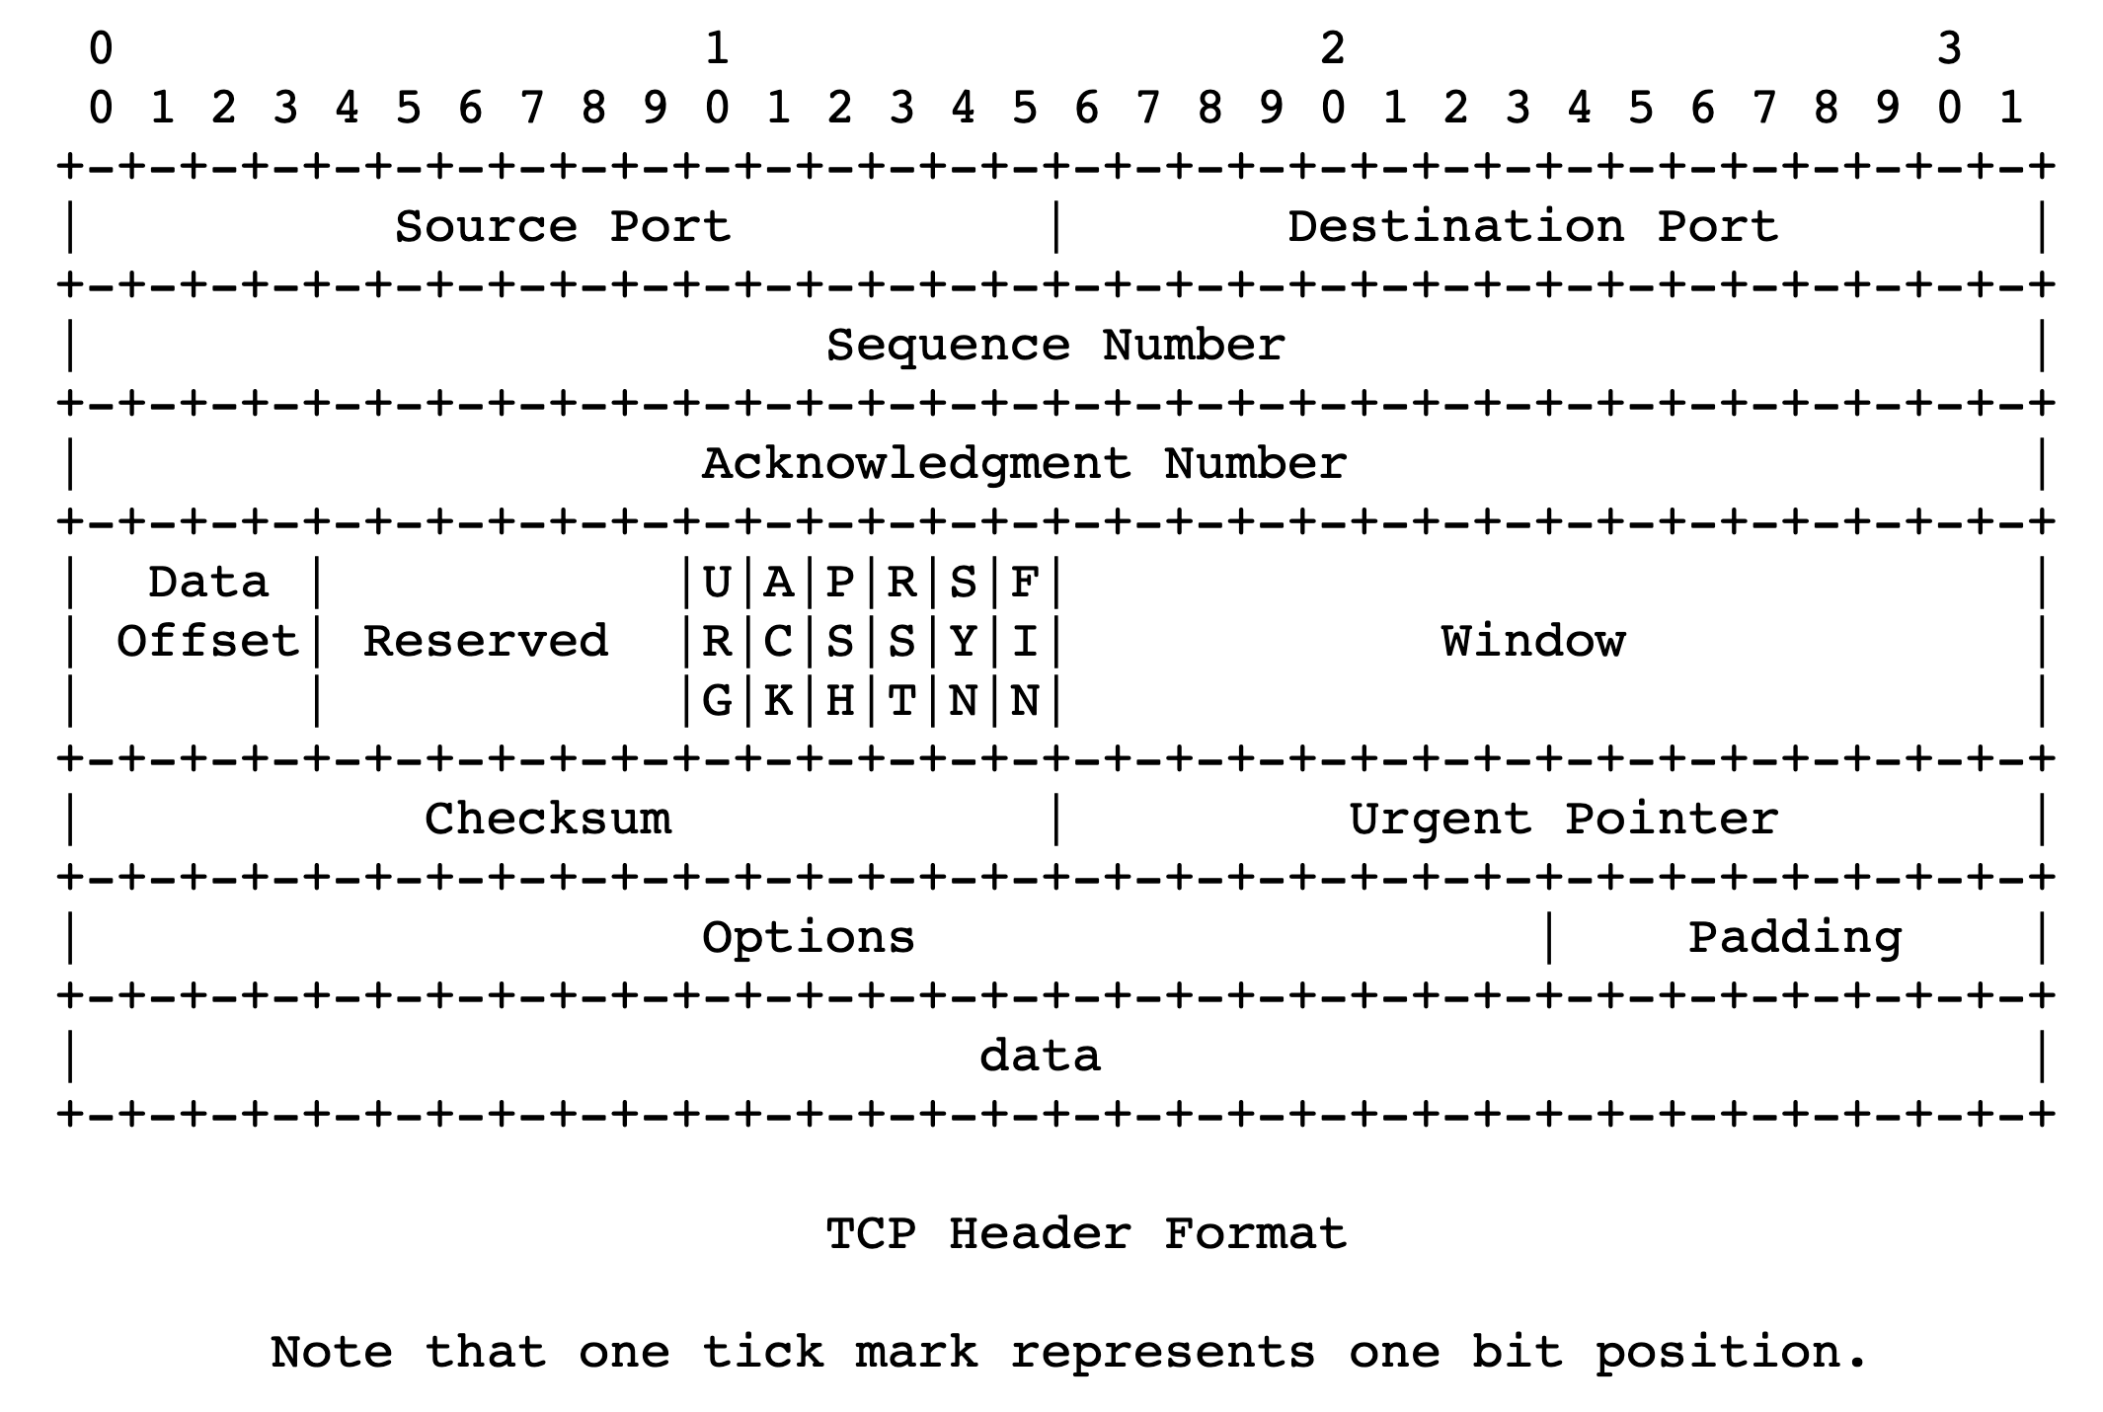
sender
Multiple locations for bottlenecks
application
process
recv()
Congestion Control
TCP socket
receiver buffers
Flow Control
What’s the bottleneck? How to adapt how much data to keep in flight?
TCP
code
from sender
Flow Control: Receiver informs sender free buffer over time
Last transmitted
seq #
receiver
Last cumulative
ACK’ed seq #
Buffer >= desired W
Sender’s view:
0
1
2
3
4
5
6
7
0
1
Low socket buffering
==
Poor TCP throughput
Window <= Advertised window

Slide 3

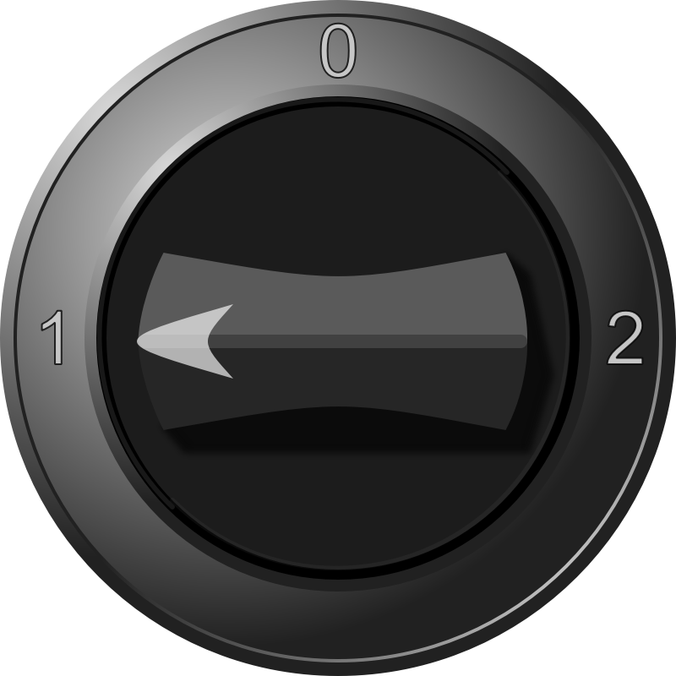

Congestion control
The approach that the Internet takes is to use a distributed algorithm to converge to an efficient and fair outcome.
Each endpoint acts by itself. No central vantage point or control.
Use whatever bottleneck capacity available, even with a single TCP connection.
Share bottleneck capacity equitably
H
C
Sense and React

Slide 4
Signals and Knobs in Congestion Control
Signals
Packets being ACK’ed
Packets being dropped (e.g. RTO fires)
Packets being delayed (RTT)
Rate of incoming ACKs
Knobs
What can you change to “probe” the available bottleneck capacity?
Suppose receiver buffer is unbounded:
Increase window/sending rate: e.g., add x or multiply by a factor of x
Decrease window/sending rate: e.g., subtract x or reduce by a factor of x
Implicit feedback signals measured directly at sender.
(There are also explicit signals that the network might provide.)

Slide 5
Sense and react, sure…but how?
H
Where do you want to be?
The steady state
How do you get there?
Congestion control algorithms
Sense accurately
React proportionately
C

Slide 6
The Steady State
Efficiency of a single TCP conversation

Slide 7

What does efficiency look like?
Suppose we want to achieve an efficient outcome for one TCP conversation by observing network signals from the endpoint
Q: How should the endpoint behave at steady state?
Challenge: bottleneck link is remotely located

Slide 8
Steady state: Ideal goal
High sending rate: Use the full capacity of the bottleneck link
Low delay: Minimize the overall delay of packets to get to the receiver
Overall delay = propagation + queueing + transmission
Assume propagation and transmission components fixed
“Low delay” reduces to low queueing delay
i.e., don’t push so much data into the network that packets have to wait in queues
Key question: When to send the next packet?

Slide 9
When to send the next packet?
T
Fast link
Bottleneck link
1. Send packet burst (as allowed by window)
Inter-packet delay T
2. Receive data packet
5. Send data packet on ACK
Data
Sender
T
T
Receiver
T
4. Receive ACK
3. Send ACK
ACKs

Slide 10
Rationale
When the sender receives an ACK, that’s a signal that the previous packet has left the bottleneck link (and the rest of the network)
Hence, it must be safe to send another packet without congesting the bottleneck link
Such transmissions are said to follow packet conservation
ACK clocking: “Clock” of ACKs governs packet transmissions

Slide 11
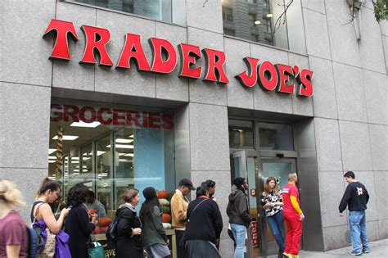
ACK clocking: analogy
How to avoid crowding a grocery store?
Strategy: Send the next waiting customer exactly when a customer exits the store
However, this strategy alone can lead to inefficient use of resources…

Slide 12
ACK clocking alone can be inefficient
Sender pushing data slowly
T
Large delay T
Send data packet on ACK
Data
Sender
T
T
Receiver
T
ACKs

Slide 13
ACK clocking alone can be inefficient
Sender pushing data slowly
T
Large delay T
Send data packet on ACK
Data
Sender
Receiver
The sending rate should be high enough to keep the “pipe” full
Analogy: a grocery store with only 1 customer in entire store
If the store isn’t “full”, you’re using store space inefficiently

Slide 14
Steady State of Congestion Control
Send at the highest rate possible (to keep the pipe full)
while being ACK-clocked (to avoid congesting the pipe)
So, how to get to steady state?

Slide 15
Finding the Right Congestion Window

Slide 16
Let’s play a game
Suppose I’m thinking of a positive integer. You need to guess the number I have in mind.
Each time you guess, I will tell you whether your number is smaller or larger than (or the same as) the one I’m thinking of
Note that my number can be very large
How would you go about guessing the number?

Slide 17
Finding the right congestion window
TCP congestion control algorithms solve a similar problem!
There is an unknown bottleneck link rate that the sender must match
If sender sends more than the bottleneck link rate:
packet loss, delays, etc.
If sender sends less than the bottleneck link rate:
all packets get through; successful ACKs

Slide 18
Quickly finding a rate: TCP slow start
L
N
T
Payload
Initially cwnd = 1 MSS
MSS is “maximum segment size”
Upon receiving an ACK of each MSS, increase the cwnd by 1 MSS
Effectively, double cwnd every RTT
Initial rate is slow but ramps up exponentially fast
On loss (RTO), restart from cwnd := 1 MSS
Host A
Host B
MSS
one segment
RTT
two segments
four segments
time

Slide 19
Behavior of slow start
Packet drops/
RTO
Congestion Window
Slow start
Slow start
Slow start
1 MSS
Time

Slide 20
Slow start has problems
Congestion window increases too rapidly
Example: suppose the “right” window size cwnd is 17
cwnd would go from 16 to 32 and then dropping down to 1
Result: massive packet drops
Congestion window decreases too rapidly
Suppose the right cwnd is 31, and there is a loss when cwnd is 32
Slow start will resume all the way back from cwnd 1
Result: unnecessarily low throughput
Instead, perform finer adjustments of cwnd based on signals

Slide 21
Use slow start mainly at the beginning
You might accelerate your car a lot when you start, but you want to make only small adjustments after.
Want a smooth ride, not a jerky one!
Slow start is a good algorithm to get close to the bottleneck link rate when there is little info available about the bottleneck, e.g., starting of a connection
Once close enough to the bottleneck link rate, use a different set of strategies to perform smaller adjustments to cwnd
Called TCP congestion avoidance

Slide 22
TCP Congestion Avoidance

Slide 23
Two congestion control algorithms
TCP New Reno
The most studied, classic “textbook” TCP algorithm
The primary knob is congestion window
The primary signal is packet loss (RTO)
Adjustment using additive increase
TCP BBR
Recent algorithm developed & deployed by Google
The primary knob is sending rate
The primary signal is rate of incoming ACKs
Adjustment using gain cycling and filters

Slide 24
TCP New Reno: Additive Increase
Remember the recent past to find a good estimate of link rate
The last good cwnd without packet drop is a good indicator
TCP New Reno calls this the slow start threshold (ssthresh)
Increase cwnd by 1 MSS every RTT after cwnd hits ssthresh
Effect: increase window additively per RTT
Host A
Host B
say ssthresh=4
four segments
RTT
five segments
RTT
six segments
RTT
seven segments
…
time

Slide 25
TCP New Reno: Additive increase
Start with ssthresh = 64K bytes (TCP default)
Do slow start until ssthresh
Once the threshold is passed, do additive increase
Add one MSS to cwnd for each cwnd worth data ACK’ed
For each MSS ACK’ed, cwnd = cwnd + (MSS * MSS) / cwnd
Upon a TCP timeout (RTO),
Set cwnd = 1 MSS
Set ssthresh = max(2 * MSS, 0.5 * cwnd)
i.e., the next linear increase will start at half the current cwnd

Slide 26
Behavior of Additive Increase
Say MSS = 1 KByte
Default ssthresh = 64KB = 64 MSS
Packet drops/
RTO
Loss occurs at cwnd = 54K
Loss occurs at cwnd = 40K
54 MSS
Additive increase
Set ssthresh to
27 MSS
Additive increase
Congestion Window
Set ssthresh to
20 MSS
Slow start
Slow start
Slow
start
1K
Time

Slide 27
TCP BBR: finding the bottleneck link rate
1. Send data at a specific rate
Data gets across the bottleneck at the bottleneck link rate.
2. Receive data packet
Use ACK receive rate to determine sending rate
Data
Sender
Receiver
4. Measure rate of incoming ACKs
3. Send ACK
ACKs

Slide 28
TCP BBR: finding the bottleneck link rate
Assuming that the link rate of the bottleneck
== the rate of data getting across the bottleneck link
== the rate of data getting to the receiver
== the rate at which ACKs are generated by the receiver
== the rate at which ACKs reach the sender
Measuring ACK rate provides an estimate of bottleneck link rate
BBR: Send at the maximum ACK rate measured in the recent past
Update max with new bottleneck rate estimates, i.e., larger ACK rate
Forget estimates last measured a long time ago
Incorporated into a rate filter

Slide 29
TCP BBR: Adjustments by gain cycling
BBR periodically increases its sending rate by a gain factor to see if the link rate has increased (e.g., due to a path change)
Steady state operation: constant sending rate
Last max ACK rate was measured a while ago. Forget it & use a more recent max ACK rate
…
Gain cycle
Sending rate
…
No change
in ACK rate
Detect higher ACK rate:
Update sending rate
Bottleneck link rate increase
Time
Bottleneck link rate decrease

Slide 30
Summary: Getting to Steady State
Want to get to highest sending rate that doesn’t congest the bottleneck link
Slow start: Exponential increase towards a reasonable estimate of link rate
Congestion avoidance: milder adjustments to get close to correct link rate estimate.
TCP New Reno: additive increase
TCP BBR: gain cycling and filters

