Slide 1

CS 352 Network: LPM, Protocols
Lecture 21
http://www.cs.rutgers.edu/~sn624/352-F22
Srinivas Narayana

Slide 2




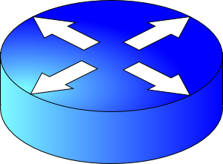
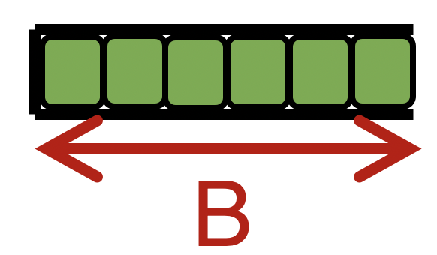

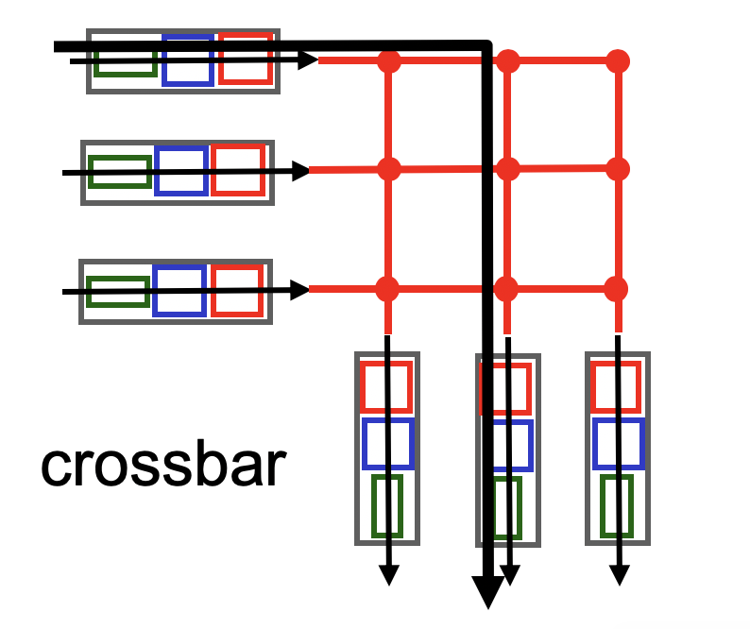

Quick recap of concepts
The Internet uses destination IP based forwarding.
route
processor
Parse
Net layer
Transport
high-speed
switching
fabric
Network
router input ports
router output ports
Link layer
Extract destination IP address
In nonblocking fabrics, queues form only due to contention for output port.
Forwarding Table
Nonblocking
Blocking
Dst-network
Lookup forwarding table
Port
Output port contention is fundamental; unavoidable.
65.0.0.0/8
3
128.9.0.0/16
1
Scheduling and buffer management crucial.
149.12.0.0/19
7

Slide 3
Control (plane) processor
A general-purpose processor that “programs” the data plane:
Forwarding table
Scheduling and buffer management policy
Implements the routing algorithm by processing routing protocol messages
Mechanism by which routers collectively solve the Internet routing problem
More on this soon.
Control Processor
Input port
Output port
Input port
Switching fabric
Output port
…
…
Input port
Output port

Slide 4

Router design: the bigger picture
Control plane
Traditional distributed routing: per route-change processing
(~ a few tens of seconds)
Routing
Algorithm
control
plane
data
plane
Data plane
per-packet processing
(~ tens of nanoseconds)
0111
1
3
2
values in arriving
packet header, i.e, destination IP address

Slide 5
Longest Prefix Matching

Slide 6
Review: Route lookup
Table lookup matches a packet against an IP prefix
Ex: 65.12.45.2 matches 65.0.0.0/8
Prefixes are allocated to organizations by Internet registries
But organizations can reallocate a subset of their IP address allocation to other orgs
Parse
Transport
Extract destination IP address
Network
Link layer
Route Lookup Data Structure
Outgoing Port
Forwarding Table
Dst-network
Port
65.0.0.0/8
3
128.9.0.0/16
1
149.12.0.0/19
7

Slide 7
Example of IP block reallocation
Dst IP Prefix | Output port
65.0.0.0/8 | 3
128.9.0.0/16 | 1
… | …
200.23.16.0/20 | 7 (towards A)
Suppose ISP A reallocates a part of its IP block to orgs 1… 8
ISP A owns the IP block 200.23.16.0/20.
Organization 1
200.23.16.0/23
Organization 2
200.23.18.0/23
[BGP] Send me pkts destined to
200.23.16.0/20
Organization 3
200.23.20.0/23
.
ISP A
.
.
.
.
Internet
.
Organization 8
200.23.30.0/23
There is an announcement mechanism (BGP) by which ISP A can inform the rest of the Internet about the prefixes it owns.
It is enough to announce a coarse-grained prefix 200.23.16.0/20 rather than 8 separate sub-prefixes.
Route Aggregation
Save forwarding table memory
Fewer routing protocol msgs

Slide 8
Example of IP block reallocation
Dst IP Prefix | Output port
65.0.0.0/8 | 3
128.9.0.0/16 | 1
… | …
200.23.16.0/20 | 7 (towards A)
Suppose ISP A reallocates a part of its IP block to orgs 1… 8
ISP A owns the IP block 200.23.16.0/20.
Organization 1
200.23.16.0/23
Organization 2
200.23.18.0/23
[BGP] Send me pkts destined to
200.23.16.0/20
Organization 3
200.23.20.0/23
.
ISP A
.
.
.
.
Internet
.
Organization 8
200.23.30.0/23
Now suppose one of these organizations adds another ISP for its Internet service and prefers using the new ISP.
Note: it’s possible for the organization to retain its assigned IP block.

Slide 9
Example of IP block reallocation
Dst IP Prefix | Output port
65.0.0.0/8 | 3
128.9.0.0/16 | 1
… | …
200.23.16.0/20 | 7 (towards A)
Suppose ISP A reallocates a part of its IP block to orgs 1… 8
ISP A owns the IP block 200.23.16.0/20.
Organization 1
200.23.16.0/23
Organization 2
200.23.18.0/23
[BGP] Send me pkts destined to
200.23.16.0/20
Organization 3
200.23.20.0/23
.
ISP A
.
.
.
.
Internet
.
Organization 8
200.23.30.0/23
[BGP] Announce 200.23.18.0/23
(besides other IP prefixes)
ISP B
Organization 2
200.23.18.0/23

Slide 10
Example of IP block reallocation
Dst IP Prefix | Output port
65.0.0.0/8 | 3
128.9.0.0/16 | 1
200.23.18.0/23 | 4 (towards B)
200.23.16.0/20 | 7 (towards A)
Suppose ISP A reallocates a part of its IP block to orgs 1… 8
ISP A owns the IP block 200.23.16.0/20.
Organization 1
200.23.16.0/23
Organization 2
200.23.18.0/23
[BGP] Send me pkts destined to
200.23.16.0/20
Organization 3
200.23.20.0/23
.
ISP A
.
.
.
.
Internet
.
Organization 8
200.23.30.0/23
[BGP] Announce 200.23.18.0/23
(besides other IP prefixes)
ISP B
Organization 2
200.23.18.0/23

Slide 11
A closer look at the forwarding table
200.23.18.0/23 is inside 200.23.16.0/20
A packet with destination IP address 200.23.18.xx is in both prefixes
i.e., both entries match
Q: How should the router choose to forward the packet?
The org prefers B, so should choose B
Dst IP Prefix | Output port
65.0.0.0/8 | 3
128.9.0.0/16 | 1
200.23.18.0/23 | 4 (towards B)
200.23.16.0/20 | 7 (towards A)
200.23.16.0/20
The Internet uses a policy to prioritize: Longest Prefix Matching

Slide 12
Longest Prefix Matching (LPM)
Use the longest matching prefix, i.e., the most specific route, among all prefixes that match the packet.
Policy borne out of the Internet’s IP allocation model: prefixes and sub-prefixes are handed out
Internet routers use longest prefix matching.
Very interesting algorithmic problems
Challenges in designing efficient software and hardware data structures
Dst IP Prefix | Output port
65.0.0.0/8 | 3
128.9.0.0/16 | 1
200.23.18.0/23 | 4 (towards B)
200.23.16.0/20 | 7 (towards A)
200.23.16.0/20

Slide 13
Internet routers perform longest-prefix matching on destination IP addresses of packets.

Slide 14
Why is LPM prevalent?
Verizon
Agg. route
Rutgers
AT&T
Specific route
(longer prefix)
An ISP (e.g., Verizon) has allocated a sub-prefix (or “subnet”) of a larger prefix that the ISP owns to an organization (e.g., Rutgers)
Further, the ISP announces the aggregated prefix to the Internet to save on number of forwarding table memory and number of announcements
The organization (e.g., Rutgers) is reachable over multiple paths (e.g., through another ISP like AT&T)
The organization has a preference to use one path over another, and expresses this by announcing the longer (more specific) prefix
Routers in the Internet must route based on the longer prefix

Slide 15
IPv4 Datagram Format

Slide 16
Transport
Network
total datagram
length (bytes)
Link layer
IP protocol version
number
32 bits
header length
(bytes)
ver
hdr
len
type of
service
Bits for
traffic differentiation
e.g., audio, web, bulk
(more on this later)
length
for
fragmentation/
reassembly
flags
fragment
offset
16-bit identifier
max number
remaining hops
(decremented at
each router)
time to
live
upper
protocol
header
checksum
32-bit source IP address
upper layer protocol to deliver payload to, e.g., TCP, UDP
32-bit destination IP address
Options (if any)
E.g. timestamp,
record the route
taken, specify
list of routers
to visit (“source routing”)
How much header overhead?
Suppose 20 bytes of TCP
20 bytes of IP
= 40 bytes
data
(variable length,
typically a TCP
or UDP segment)

Slide 17
Rest of this lecture
Discuss support protocols and mechanisms for the network layer
Protocols: DHCP, ICMP, ARP, IPv6, …
Mechanisms: NAT
Some of these protocols use an IP header underneath their own header (ICMP) or replace the IP header with their own (ARP)
But these shouldn’t be construed as transport/network protocols
They are fundamental to supporting IP/network layer functionality
More appropriately discussed as support protocols for the network layer

Slide 18


The network layer is all about reachability.
Every protocol we’ll see solves a sub-problem.
How does an endpoint get an address?
How does an endpoint talk to another outside its network?
Debugging?
ICMP
Routing protocols
OSPF, RIP, BGP
DHCP
How does an endpoint talk to another within the same network?
ARP
Gateways
NAT & IPv6

Slide 19
Internet Control Message Protocol (ICMP)

Slide 20
Internet Control Message Protocol
A protocol for troubleshooting and diagnostics
Works over IP: unreliable delivery of packets
Some functions of ICMP:
Determine reachability and network errors
Specify that packets have been in the network for too long

Slide 21
ICMP message format (informal)
ICMP header
Message type, Code, Checksum,
ICMP data
IP header
https://en.wikipedia.org/wiki/Internet_Control_Message_Protocol#Control_messages

Slide 22
Specific uses of ICMP
Echo request reply
Check remotely if an endpoint is alive and connected
Without running an app remotely or controlling that endpoint
An unreachable destination
Invalid address and/or port
Knowing if packet’s IP time-to-live expired
Example, due to routing loops
Look at two tools built using ICMP: ping and traceroute

Slide 23
Ping
Uses ICMP echo request (type=8, code=0) and reply (type=0, code=0)
Source sends ICMP echo request message to dst address
Destination network stack replies with an ICMP echo reply message
Source can calculate round trip time (RTT) of packets
If no echo reply comes back, then the destination is unreachable
Don’t need to have a server program running on the other side
In general, the remote endpoint can be completely outside your control

Slide 24
Ping
A
R1
R2
R3
B
Echo
request
Time
Ping time
Echo reply
A small demo…

Slide 25
Traceroute
A tool that can record the router-level path taken by packets
A clever use of the IP time-to-live (TTL) field
In general, when a router receives an IP packet, it decrements the TTL field on the packet
A failsafe mechanism to ensure packets don’t keep taking up network resources for too long
If a router receives a packet with TTL=0, it sends an ICMP time exceeded message (type=11, code=0) to the source endpoint

Slide 26
Traceroute
Traceroute sends multiple packets to a destination endpoint
But it progressively increases the TTL on those packets: 1, 2, ...
Every time a time exceeded message is received, record the router’s IP address
Process repeated until the destination endpoint is reached
If the packet reaches the destination endpoint (i.e.: TTL is high enough), then the endpoint sends a port unreachable message (type=3, code=3)

Slide 27
Traceroute
A
R1
R2
R3
B
TTL=1, dest = B, dstport = invalid
Time
Time exceeded
Source: R1
TTL = 2
Similarly, capture IP addresses of routers at distance 3, 4, …
TE(R2)
Port un- reachable
Source: B
Have full router-level path until destination
A small demo…

Slide 28
Summary of ICMP
A protocol for network diagnostics and troubleshooting
Two useful tools: ping and traceroute
Ping: test connectivity to a machine totally outside your control
Use ICMP echo request and reply
Traceroute: determine router-level path to a remote endpoint
A smart use of the TTL field in the IP header

Slide 29
Network Address Translation (NAT)

Slide 30
Background: The Internet’s growing pains
Networks had incompatible addressing
IPv4 versus other network-layer protocols (X.25)
Routable address ranges different across networks
Entire networks were changing their Internet Service Providers
ISPs don’t want to route directly to internal endpoints, just to the gateway
IPv4 address exhaustion
Insufficient large IP blocks even for large networks
Rutgers (AS46) has > 130,000 publicly routable IP addresses
IIT Madras (a well-known public university in India, AS141340) has 512
(Source: ipinfo.io)

Slide 31
Network Address Translation
When a router modifies fields in an IP packet to:
Enable communication across networks with different (network-layer) addressing formats and address ranges
Allow a network to change its connectivity to the Internet en masse by modifying the source IP to a (publicly-visible) gateway IP address
Masquerade as an entire network of endpoints using (say) one publicly visible IP address
Effect: use fewer IP addresses for more endpoints!
We’ll see a standard design: “Network address and port translation” (NAPT)

Slide 32
Typical NAT setup (NAPT)
rest of
the Internet
local network
10.0.0/24
10.0.0.1
10.0.0.4
10.0.0.2
138.76.29.7
Gateway router
10.0.0.3
The gateway’s IP, 138.76.29.7 is publicly visible
The local endpoint IP addresses in 10.0.0/24 are private
All datagrams leaving local network have the same source IP as the gateway

Slide 33
Typical NAT setup (NAPT)
rest of
the Internet
local network
10.0.0/24
10.0.0.1
10.0.0.4
10.0.0.2
138.76.29.7
Gateway router
10.0.0.3
That is, for the rest of the Internet, the gateway masquerades as a single endpoint representing (hiding) all the private endpoints.
The entire network just needs one (or a few) public IP addresses.

Slide 34
Typical NAT setup (NAPT)
rest of
the Internet
local network
10.0.0/24
10.0.0.1
10.0.0.4
10.0.0.2
138.76.29.7
Gateway router
10.0.0.3
The NAT gateway router accomplishes this by using a different transport port for each distinct (transport-level) conversation between the local network and the Internet.

Slide 35
Typical NAT setup (NAPT)
1: host 10.0.0.1
sends datagram to
an external host,
128.119.40.186, at port 80
2: NAT router
changes datagram
src addr, port from
10.0.0.1, 3345 to
138.76.29.7, 5001,
Updates table
Translation table
Internet-side Local side
138.76.29.7, 5001 10.0.0.1, 3345
…… ……
4: Map back
S: 10.0.0.1, 3345
D: 128.119.40.186, 80
1
2
S: 138.76.29.7, 5001
D: 128.119.40.186, 80
10.0.0.1
S: 128.119.40.186, 80
D: 10.0.0.1, 3345
4
S: 128.119.40.186, 80
D: 138.76.29.7, 5001
3
10.0.0.2
4: NAT gateway
changes datagram
dest addr, port from
138.76.29.7, 5001 to
10.0.0.1, 3345
3: Reply arrives to
dst addr, port
138.76.29.7, 5001
138.76.29.7
10.0.0.3

Slide 36
Features of IP-masquerading NAT
Use one or a few public IPs: You don’t need a lot of addresses from your ISP
Change addresses of devices inside the local network freely, without notifying the rest of the Internet
Change the public IP address freely independent of network-local endpoints
Devices inside the local network are not publicly visible, routable, or accessible
Most IP masquerading NATs block incoming connections originating from the Internet
Only way to communicate is if the internal host initiates the conversation

Slide 37
If you’re home, you’re likely behind NAT
Most access routers (e.g., your home WiFi router) implement network address translation
You can check this by comparing your local address (visible from ifconfig) and your externally-visible IP address (e.g., type “what’s my IP address?” on your browser search bar)

Slide 38
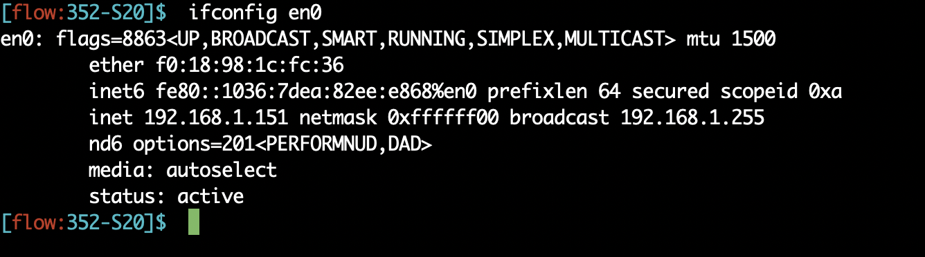
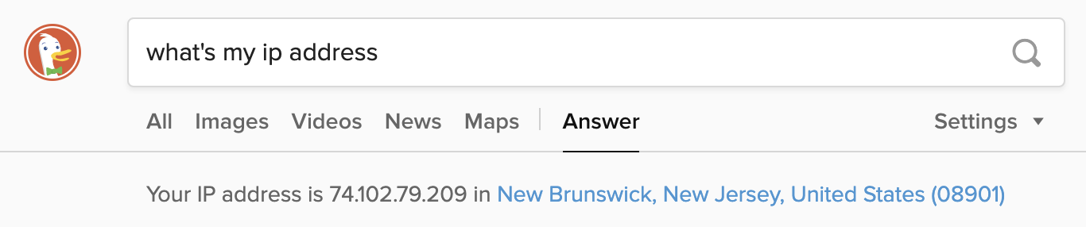
If you’re home, you’re likely behind NAT

Slide 39
Limitations of IP-masquerading NATs
Connection limit due to 16-bit port-number field
~64K total simultaneous connections with a single public IP address
NAT can be controversial
“Routers should only manipulate headers up to the network layer, not modify headers at the transport layer!”
Application developers must take NAT into account
e.g., peer-to-peer applications like Skype
Internet “purists”: instead, solve address shortage with IPv6
32-bit IP addresses are just not enough
Esp. with more devices (your watch, your fridge, …) coming online

