Slide 1

Anonymous Communication
Lecture 25, Computer Networks (198:552)

Slide 2
Why anonymous communication?
Most common security: prevent eavesdropping by encryption
But encryption can still reveal who talks to who
Inter-organization collaborations
Censorship circumvention
Anonymous payments
Browsing publicly available content
Notes:
Analysis: attackers want to reveal which points in a network may be attacked
Confirmation: attackers want to reveal who is talking to who

Slide 3


Key approach: Relay-based routing
Encryption of payload
Intermediate nodes can’t learn the (src,dst)

Slide 4
Important requirements
Key-sharing: symmetric key or public key
Incentives for routers: rate-limiting, easy deployment
Deployment: Easy to deploy on the user side
Usable: minimal performance impact on applications
Flexibility: no app modification, different transports, …

Slide 5
Adversaries
May have visibility into raw traffic everywhere
… but this is too strong
Instead, consider adversaries with partial traffic visibility
Can see selected links/points of the network
Including compromised relay nodes
Example: timing attacks
Adversary may inject traffic to force timing or attack relays

Slide 6
Two broad kinds of anonymity networks
High-latency networks
Introduce random and arbitrary delays
Even a strong adversary will find it challenging to learn correspondence
Too unusable for real apps
Low-latency networks
Minimize path stretch
Focus on performance: but still vulnerable to timing attacks

Slide 7
Tor: the low-latency anonymity network
Usable as a browser-based extension & SOCKS proxy
Originally based on the notion of onion routing
Encryption layered successively at different routers
Move data in fixed-size segments called cells
Circuits: paths of onion routers

Slide 8
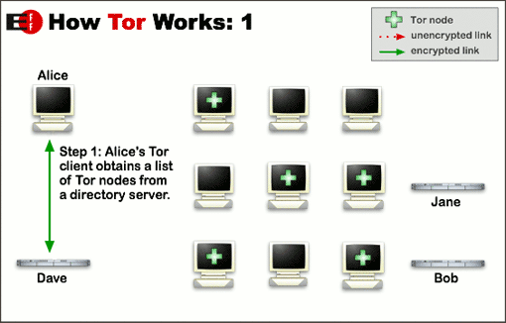
How Tor works (1/3)

Slide 9
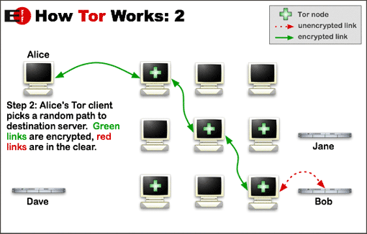
How Tor works (2/3)

Slide 10
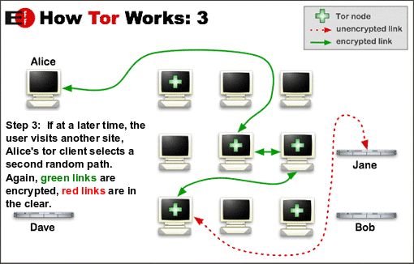
How Tor works (3/3)

Slide 11
Backpressure-Based Transport Protocol for the ToR Network
Florian Tschorsch and Björn Scheuermann, Usenix NSDI‘16

