Slide 1

Future Directions
Lecture 26, Computer Networks (198:552)

Slide 2
A 10,000-foot recap of the class
Foundational: layering, congestion control, scheduling
Inter and intra-domain networks
Software-defined networking
Data center networking
Co-designing networks with applications

Slide 3
The times they are a-changin’…
Technological constraints
Demise of Moore’s law, memory wall
Tools
Machine learning
Industrial trends
Consolidation, disaggregation, net neutrality
Unconventional networks
Blockchain networks, edge networks
Today: some examples of recent work along these directions

Slide 4
Machine learning
Algorithmic techniques to learn functions from inputs to outputs
Chief distinction among approaches: kinds of functions that can be learned
Examples: mapping images to labels, predicting next match score from historical scores, etc.

Slide 5
Neural networks
Neuron (perceptron): tries to approximate a function f*
… internally using a (parameterized) function f
ie: y = f(x; p)
Learning: Choose parameter p to “best approximate” f*
Example representational functions:
Linear function on inputs
Sigmoid over linear combination of inputs
Layers: can compose these functions with each other
Structure of composition forms the “network” of neural networks

Slide 6
Expressiveness of neural networks
Universal approximation theorem
Any “reasonable” function can be represented to within arbitrary error over all inputs
Doesn’t mean any function can be learned, however
The size of the network isn’t bounded

Slide 7
Applications in networking
“ML for systems”: good to apply ML when
Optimal solutions are hard to compute
State of the art mostly constitutes heuristics
Existing solutions use a “model” of the system
Some examples…

Slide 8
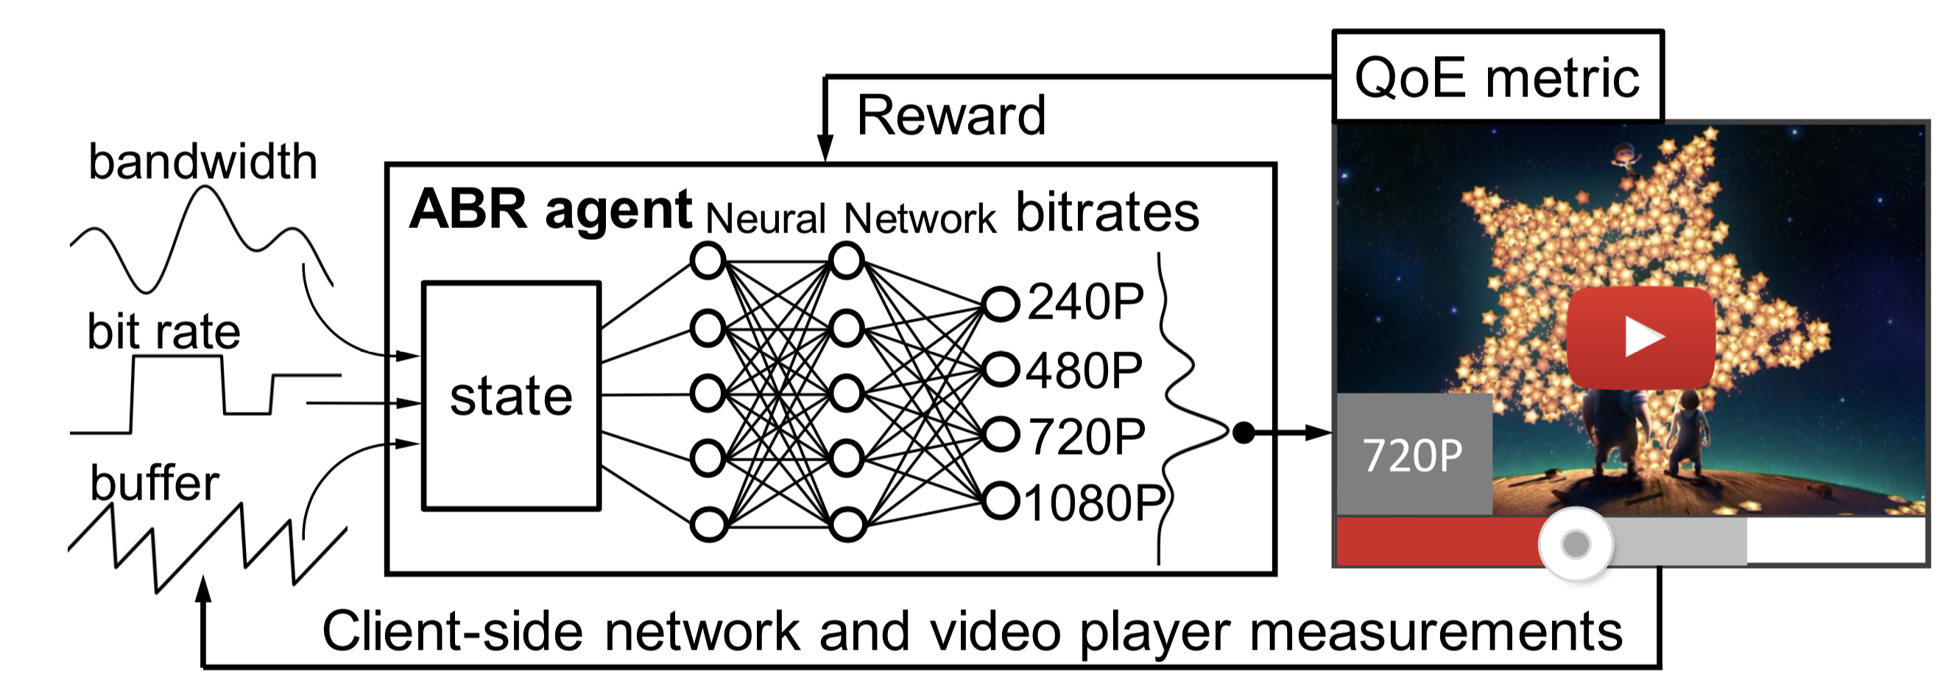
Pensieve: Video bit-rate adaptation
[Neural adaptive video streaming with Pensieve
Hongzi Mao et al, SIGCOMM’17]

Slide 9
Pensieve: Video bit-rate adaptation
State:
Past chunk throughput
Past chunk download time
Next chunk sizes (at varying bitrates)
Current buffer size
Number of chunks left
Last chunk bit-rate
Use raw observation signals; no network “model”
Function learned: map state to requested bit-rate

Slide 10
Remy: Congestion control
State:
Interarrival time between ACKs (EWMA)
Time between TCP sender timestamps (EWMA)
Ratio between most recent RTT and minimum RTT
Action:
A multiple to the current congestion window
Increment or decrement to the congestion window
A lower bound on time between successive packet transmissions
Simulate multiple senders & choosing best rule given the state
Subdivide the state space used in the most used rule

Slide 11
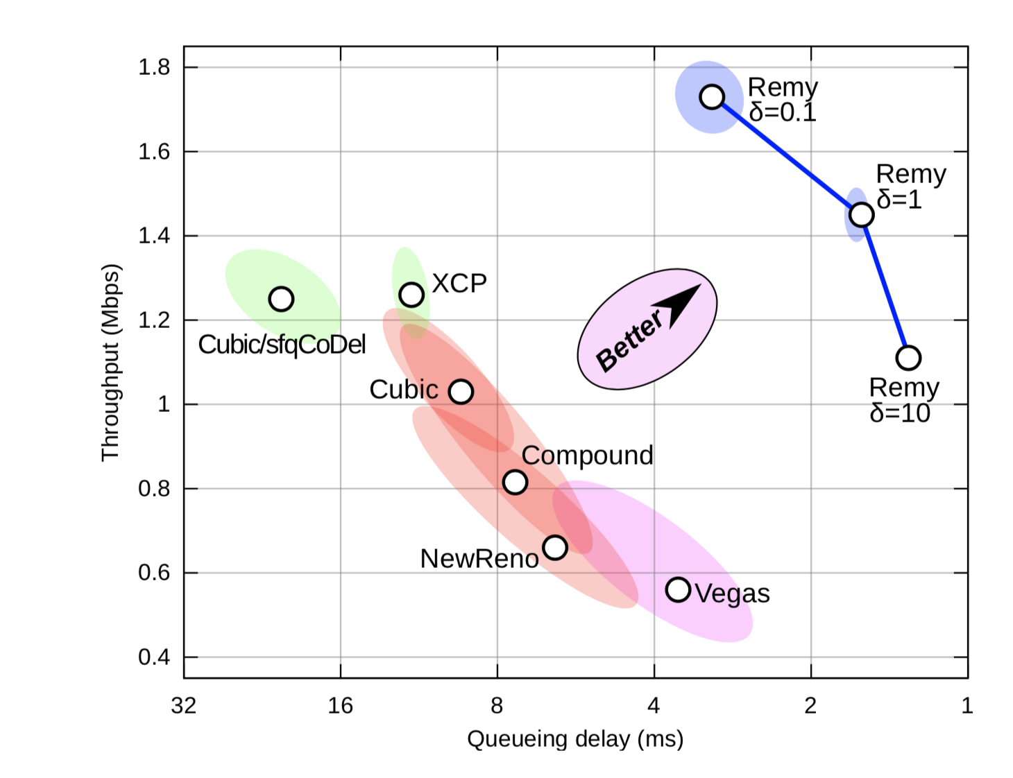
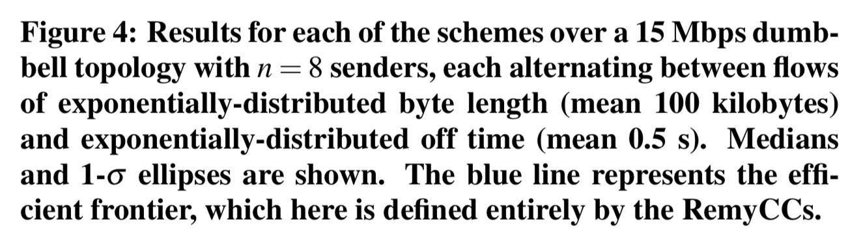
Remy: Congestion control
[Computer-generated congestion control, Winstein and Balakrishnan, SIGCOMM’13]

Slide 12
Building Systems for ML
Data center architectures for ML
How to train really large networks?
Can we make apps using ML really fast?
What programmatic frameworks can make developing ML apps really easy?
“Edge” video analytics

Slide 13
Living on the edge…
“IoTs”
mobile phones
Cameras: street intersections, shopfront, car dashcam
Sensors
Constraint: significantly less powerful than compute clusters
Power, compute, bandwidth
But want to implement sensor data processing
Ex: Video analytics using neural networks

Slide 14
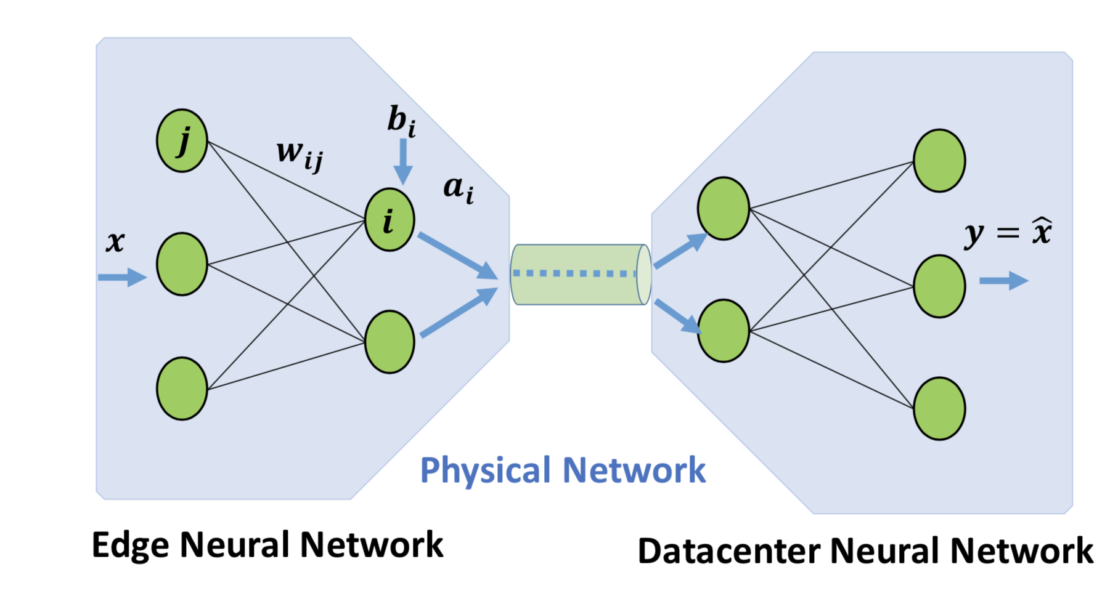
Partitioning edge video analytics

Slide 15
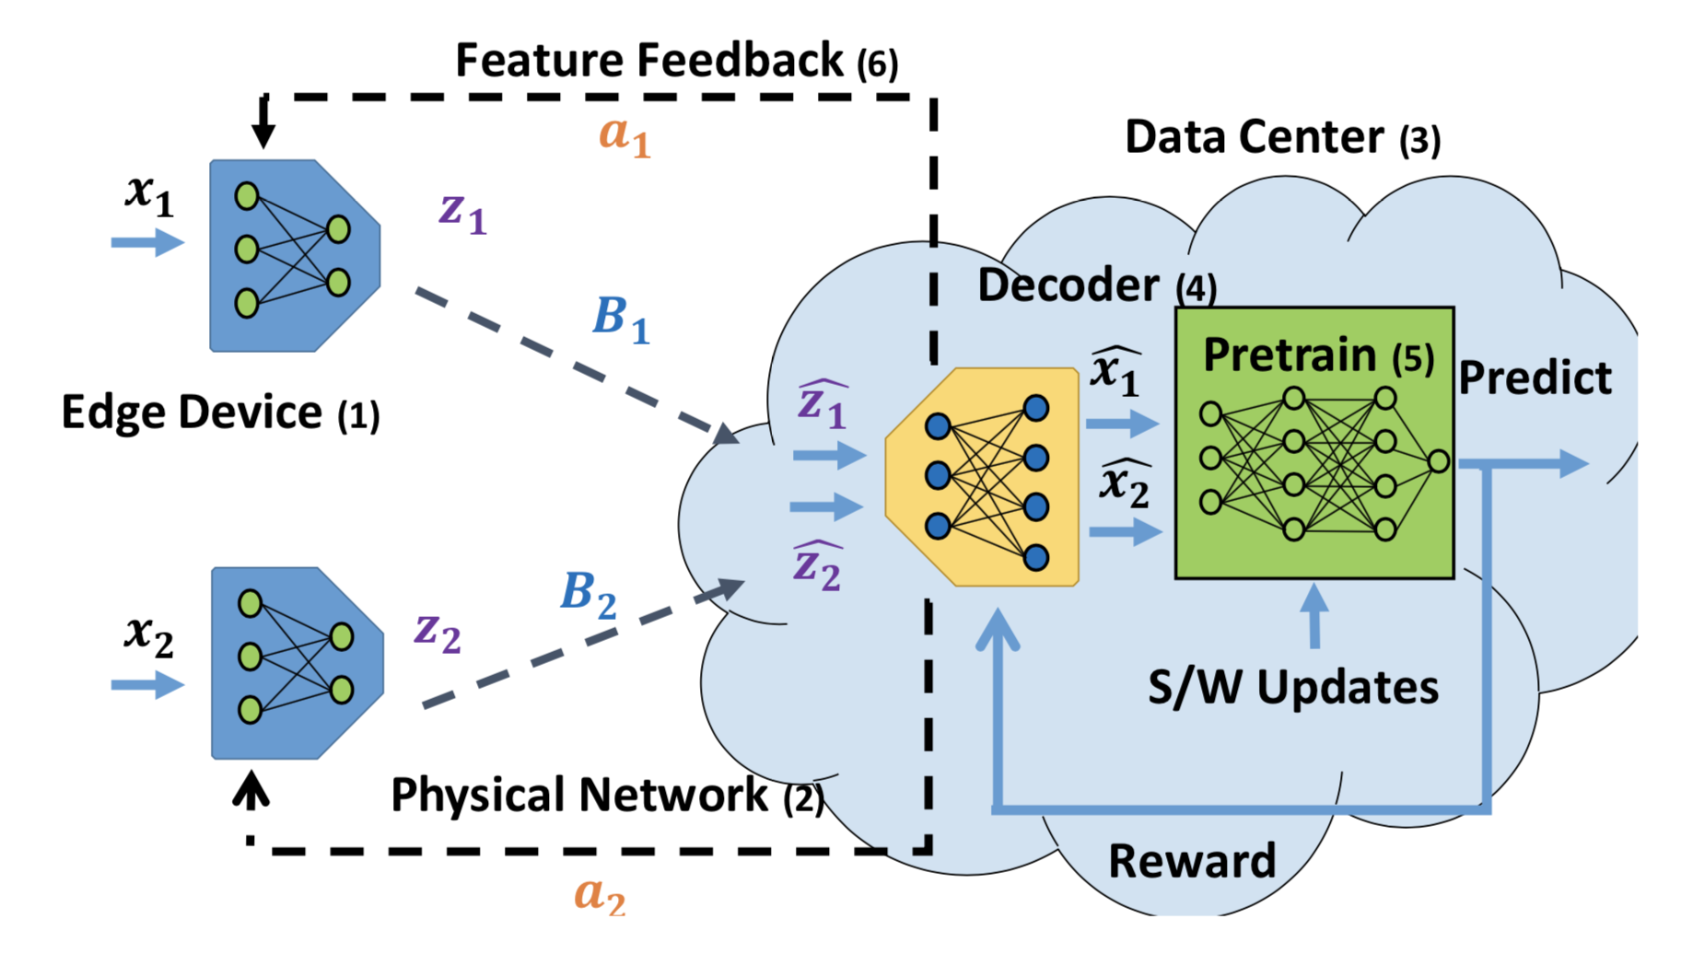
Flexible auto-encoding of features
“Neural networks meet physical networks”, Chinchali et al., HotNets 2018

Slide 16
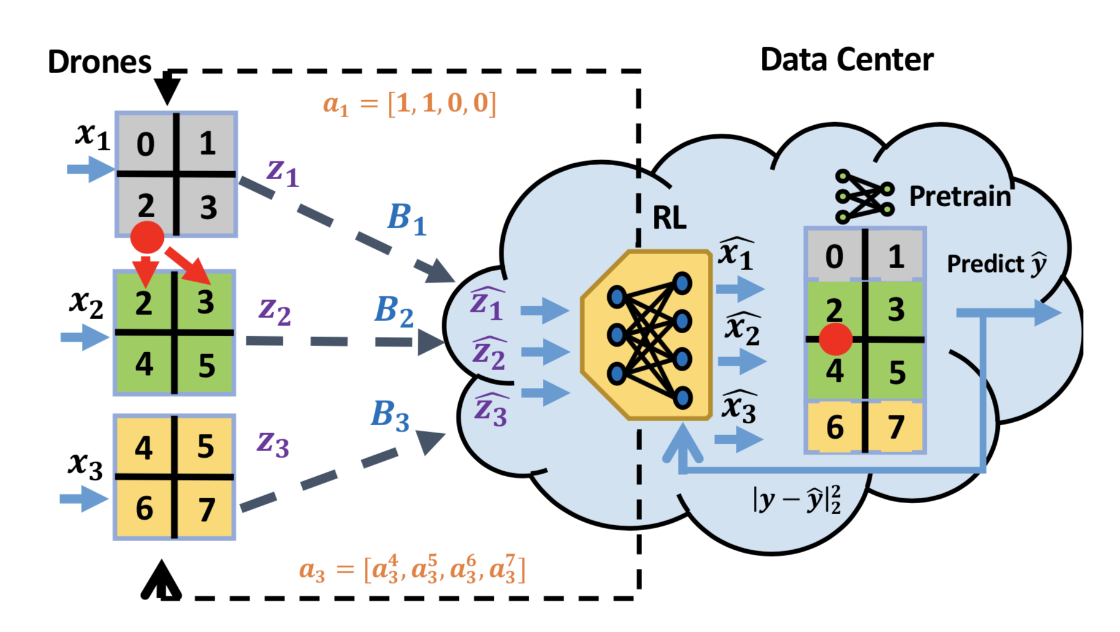
Example: Drone-video-based tracking

Slide 17
Technological constraints: Moore’s law
Processors aren’t clocked faster any more (Dennard scaling)
Soon, can no longer pack more transistors in the same area (feature size limits)
Implication (1): Application code won’t automatically get faster
Implication (2): Need to re-design applications or the hardware from the ground up

Slide 18
Trend: compute offloads to accelerators
Example: smartNICs (e.g., Azure NIC)
Hardware runs (part of) the network stack’s processing
Other accelerators:
GPUs
TPUs
Matrix computation accelerators in the research realm

Slide 19
Disaggregation of resources
Typical server: compute cores, memory, storage. Problems:
Memory wall: not enough bandwidth between compute & mem
Provisioning for evolution in storage and mem technologies
Inefficient usage of per-server statically allocated resources

Slide 20
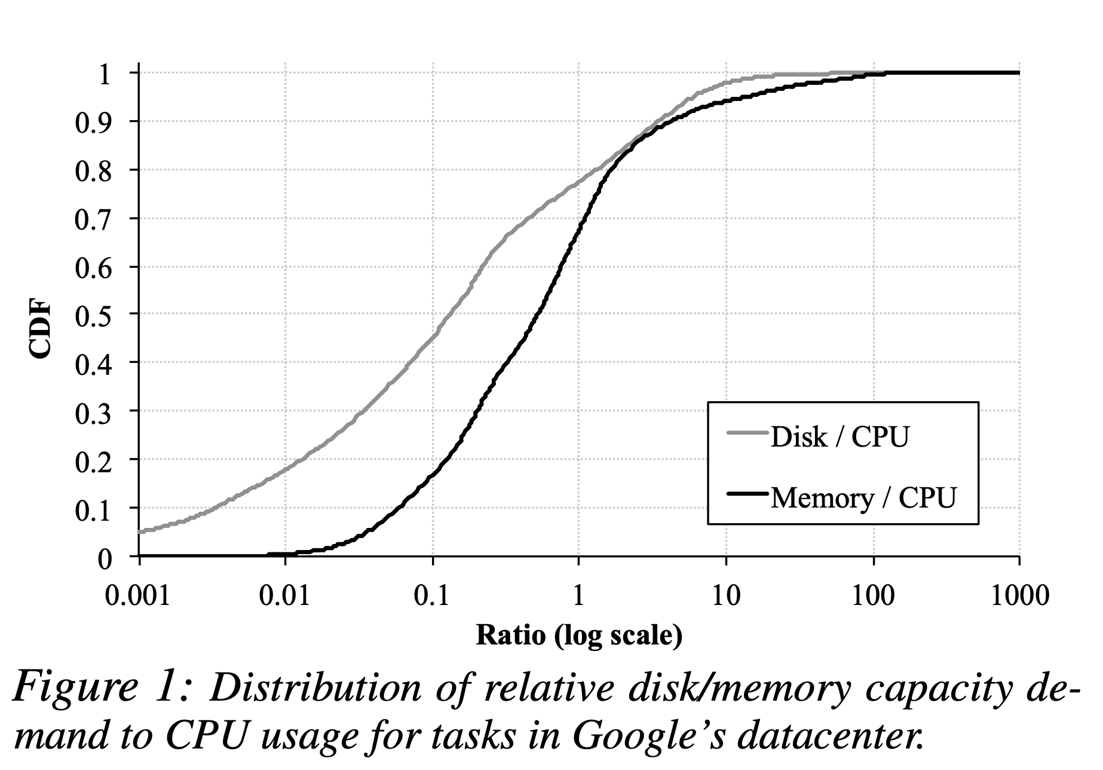
The need for disaggregation

Slide 21
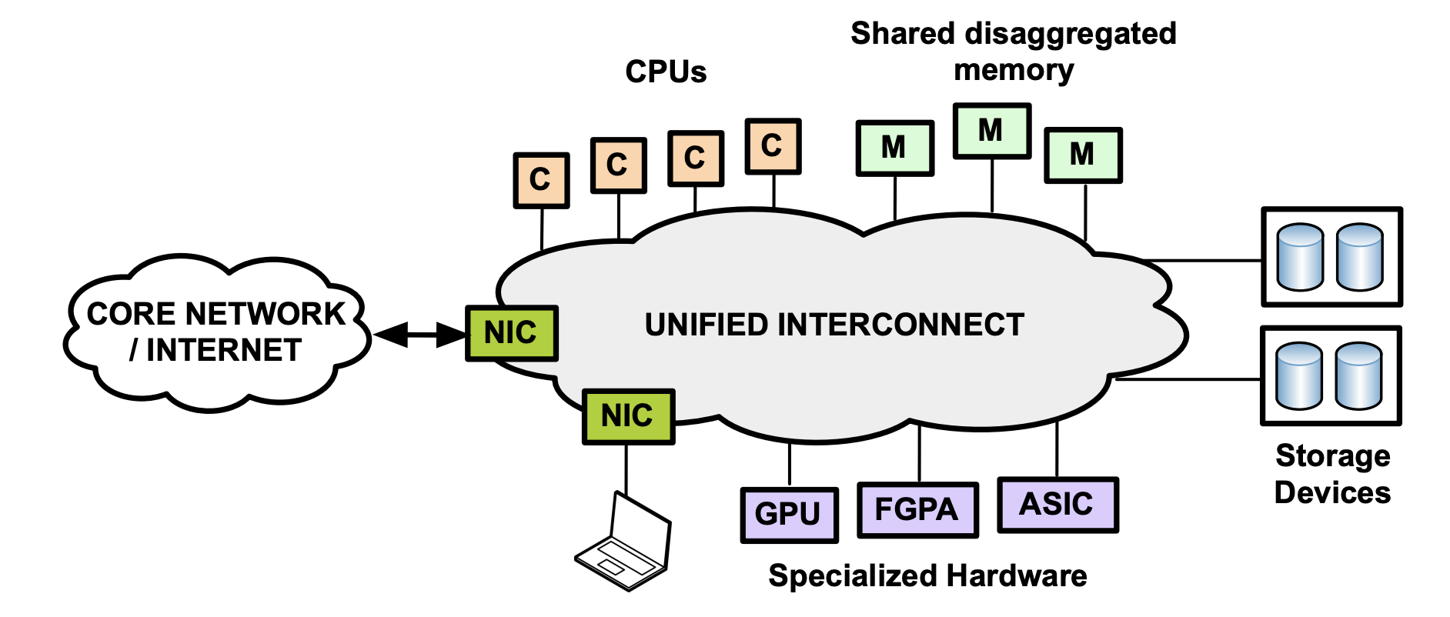
Disaggregation
[Network requirements for resource disaggregation, OSDI’16]

Slide 22
Research questions
Want to build resource blades: separate compute, mem, storage
Can we provide a high bandwidth low latency fabric to interconnect the different components?
Should communication be reliable? Packet or circuit switched?
Resource allocation for different applications?
Application abstractions: move away from VMs?
How should the new OS look like? Failure models? Abstractions of memory? Storage?

Slide 23
The times they are a-changin’…
Technological constraints
Demise of Moore’s law, memory wall
Tools
Machine learning
Industrial trends
Consolidation, disaggregation, net neutrality
Unconventional networks
Blockchain networks, edge networks

Slide 24
Your thoughts?
What are you excited about? What would you like to work on?

Slide 25
Course presentation
10 mins per group + 2 mins for questions
Describe the problem
Your solution approach
Existing approaches and if/how your approach is different
Report on your progress:
What have you built?
Can you show a demonstration?
Can you show preliminary evaluation results?
What lessons have you learned from this exercise?

Slide 26
Course feedback

