Slide 1

Programmable Switches
Lecture 13, Computer Networks (198:552)

Slide 2

SDN router data plane
Part of the control plane
(part of)
control
plane
Data plane implements per-packet decisions
On behalf of control & management planes
Forward packets at high speed
Manage contention for switch/link resources
Processor
data plane
Switching
fabric
Net intf
Net intf
Net intf
Net intf

Slide 3
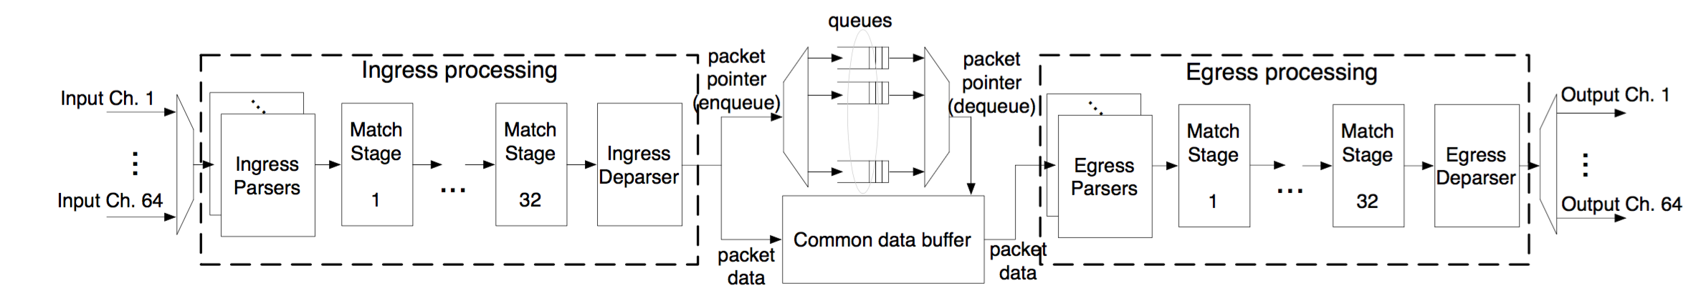
Life of a packet: RMT architecture
Many modern switches share similar architecture
FlexPipe, Xpliant, Tofino, …
Pipelined packet processing with a 1 GHz clock

Slide 4
What data plane policies might we need?
Parsing
Ex: Turn raw bits 0x0a000104fe into IP header 10.0.1.4 and proto 254
Stateless lookups
Ex: Send all packets with protocol 254 through port 5
Stateful processing
Ex: If # packets sent from any IP in 10.0/16 exceeds 500, drop
Traffic management
Ex: Packets from 10.0/16 have high priority unless rate > 10 Kb/s
Buffer management
Ex: restrict all traffic outside of 10.0/16 to 80% of the switch buffer

Slide 5
Programmability
Allow network designers/operators to specify all of the above
Needs hardware design and language design
Software pkt processing could incorporate all of these features
However: limited throughput, low port density, high power
Key Q: Can we achieve programmability with high performance?

Slide 6
Programmability: Topics today
1: Packet parsing
2: Flexible stateless processing
3: Flexible stateful processing
4, if we have time: complex policies without perf penalties

Slide 7
(1) Packet parsing: Need to generalize
In the beginning, OpenFlow was simple: Match-Action
Single rule table on a fixed set of fields (12 fields in OF 1.0)
Needed new encapsulation formats, different versions of protocols, additional measurement-related headers
Number of headers ballooned to 41 in OF 1.4 specification!
With multiple stages of heterogenous tables

Slide 8
(1) Parsing abstractions
Goal: can we make transforming bits to headers more flexible?
A parser state machine where each state may emit headers
IP
TCP
Ethernet
UDP
Payload
Custom protocol

Slide 9
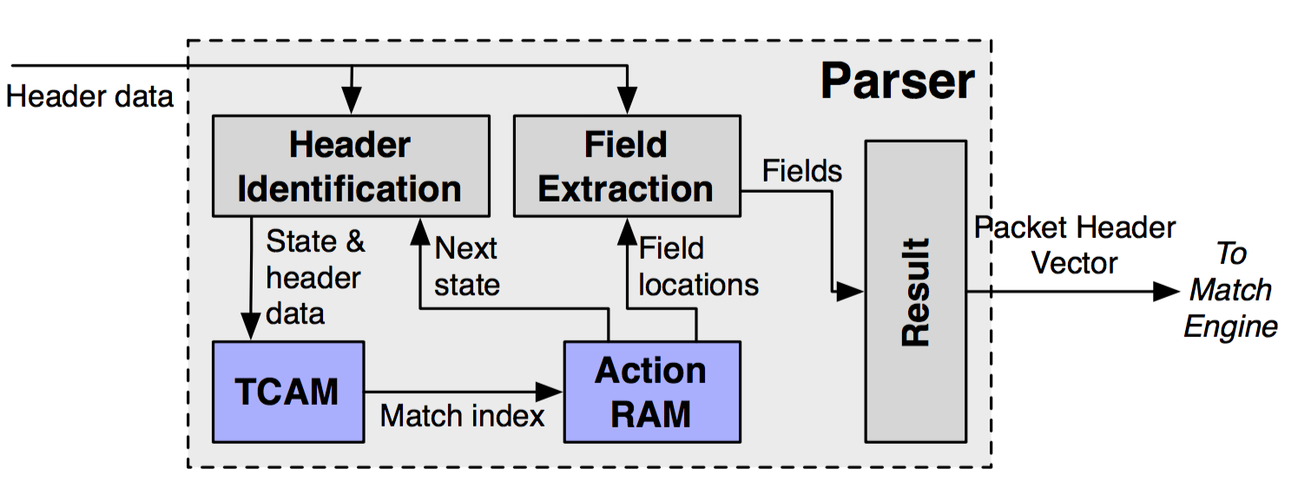
(1) Parsing implementation in hardware
Use TCAM to store state machine transitions & hdr bit locations
Extract fields into packet header vector in a separate action RAM

Slide 10
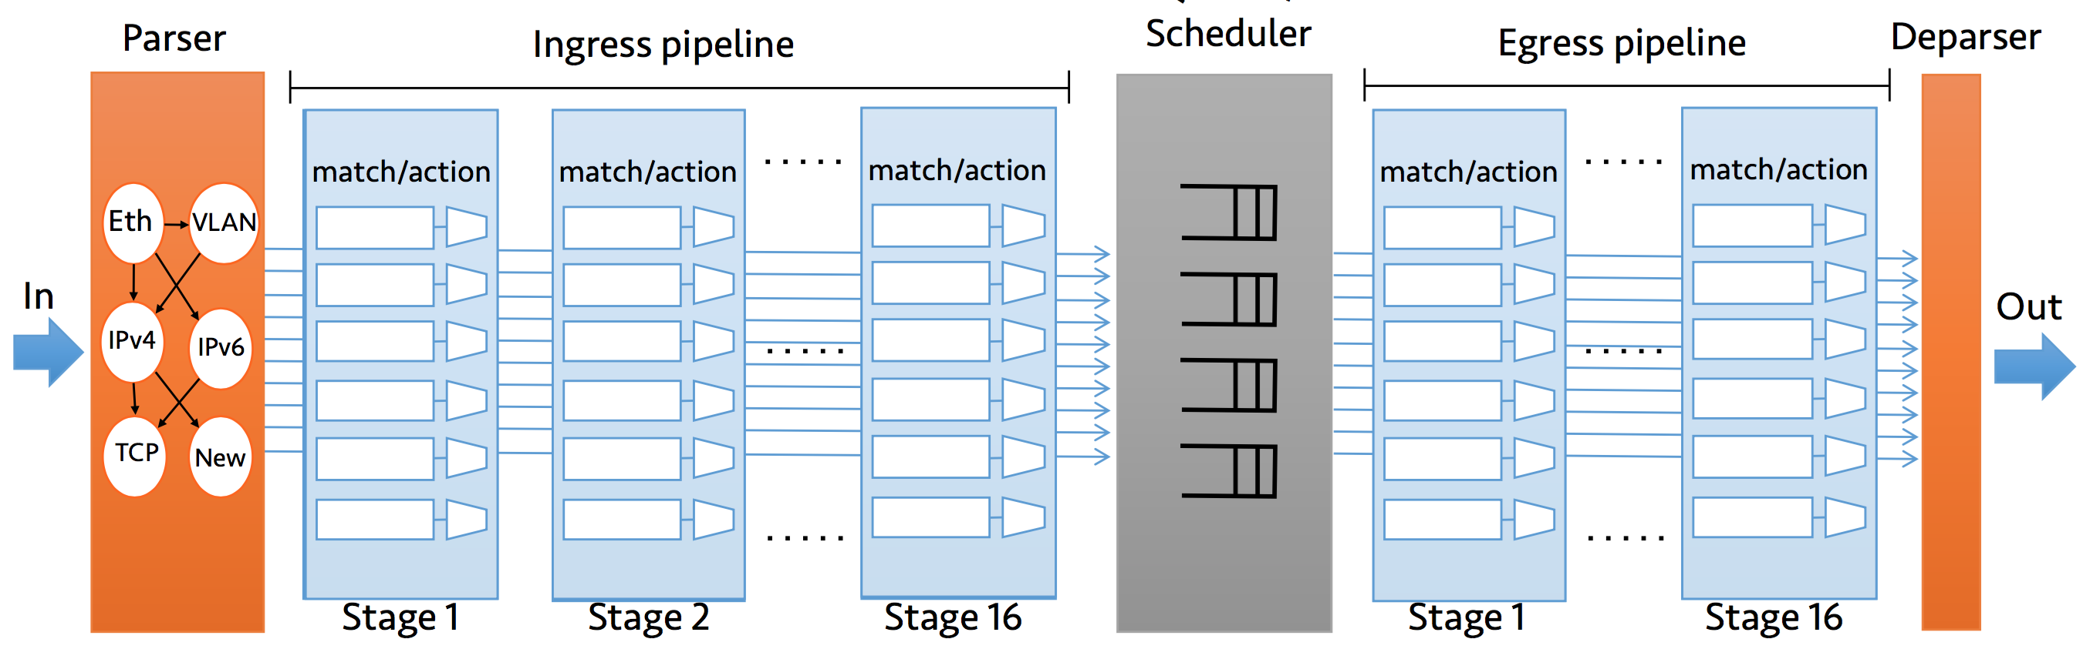
(2) How are the parsed headers used?
Headers carried through the rest of the pipeline
To be used in general-purpose match-action tables
Headers

Slide 11
(2) Abstractions for stateless processing
Goal: specify a set of tables & control flow between them
Actions: more general than OpenFlow 1.0 forward/drop/count
Copy, add, remove headers
Arithmetic, logical, and bit-vector operations!
Set metadata on packet header for control flow between tables

Slide 12
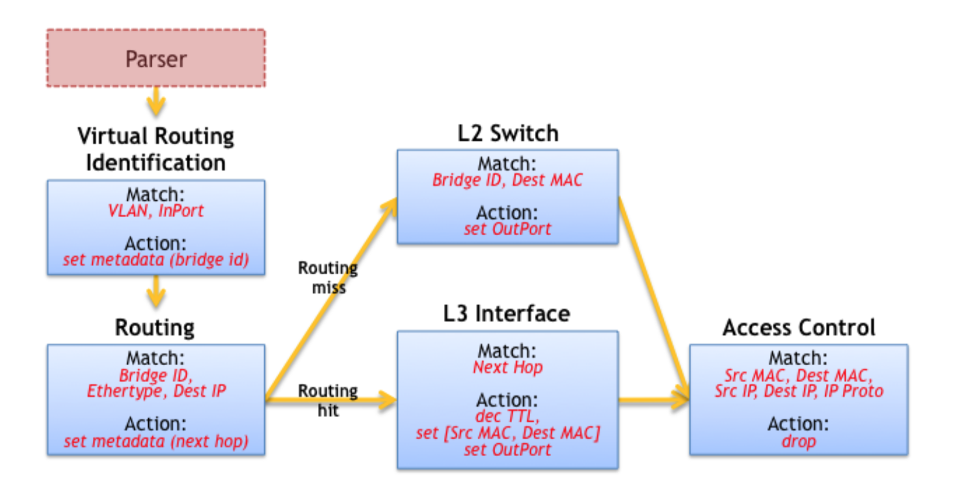
(2) Table dependency graph (TDG)

Slide 13
(2) Match-action table implementation
Mental model:
Match and Action units supplied with the Packet Header Vector
Each pipeline stage accesses its own local memory
PHV

Slide 14
(2) Match-action table implementation
Hardware realization: separately configurable memory blocks
SRAM
Exact match
Action memory
Statistics!
PHV
PHV
TCAM
ternary match

Slide 15
(2) Match-action table implementation
Hardware realization: separately configurable memory blocks
SRAM
Exact match
Action memory
Statistics!
PHV
Match RAM blocks also contain
pointers to action memory and instructions
PHV
TCAM
ternary match

Slide 16

(1,2) Parse & pipeline specification with
High-level goals
Allow reconfiguring packet processing in the field
Protocol independent
Target independent
Declarative: specify parse graph and TDG
Headers, parsing, metadata
Tables, actions, control flow
P4 separates table configuration from table population

Slide 17
(1,2) Parse & pipeline specification with
Header and state machine spec
header_type ethernet_t {
fields {
dstMac : 48;
srcMac : 48;
ethType : 16;
}
}
header ethernet_t ethernet;
parser start {
extract(ethernet);
return ingress;
}

Slide 18
(1,2) Parse & pipeline specification with
Actions
Rule Table
action _drop() {
drop();
}
action fwd(dport) {
modify_field(standard_metadata.
egress_spec, dport);
}
table forward {
reads {
ethernet.dstMac: exact;
}
actions {
fwd;
_drop;
}
size: 200;
}
Control Flow
control ingress {
apply(forward);
}

Slide 19
(3) Flexible stateful processing
What if the action depends on previously seen (other) packets?
Example: send every 100th packet to a measurement server
Other examples: Flowlet switching, DNS TTL change tracking, XCP, …
Actions in a single match-action table aren’t expressive enough
Example: if (pkt.field1 + pkt.field2 == 10) { counter++; }

Slide 20
(3) An example: “Flowlet” load balancing
Consider the time of arrival of the current packet and the last packet of the same flow
If current packet arrives 1 ms later than the last packet did, consider rerouting the packet to balance load
Else, keep the packet on the same route as the last packet
Q: why might you want to do this?

Slide 21
(3) Abstraction: Packet transaction
A piece of code along with state that runs to completion on each packet before processing the next [Domino’16]
Why is this challenging to implement on switch hardware?
Hint: Switch is clocked at 1 GHz!

Slide 22
(3) Abstraction: Packet transaction
A piece of code along with state that runs to completion on each packet before processing the next [Domino’16]
Why is this challenging to implement on switch hardware?
Hint: Switch is clocked at 1 GHz!
(1) Switch must process a new packet every 1 ns
Transaction code may not run completely in one pipeline stage

Slide 23
(3) Abstraction: Packet transaction
A piece of code along with state that runs to completion on each packet before processing the next [Domino’16]
Why is this challenging to implement on switch hardware?
Hint: Switch is clocked at 1 GHz!
(1) Switch must process a new packet every 1 ns
Transaction code may not run completely in one pipeline stage
(2) Read and write to state must happen in the same pipeline stage
Need atomic operation in hardware

Slide 24
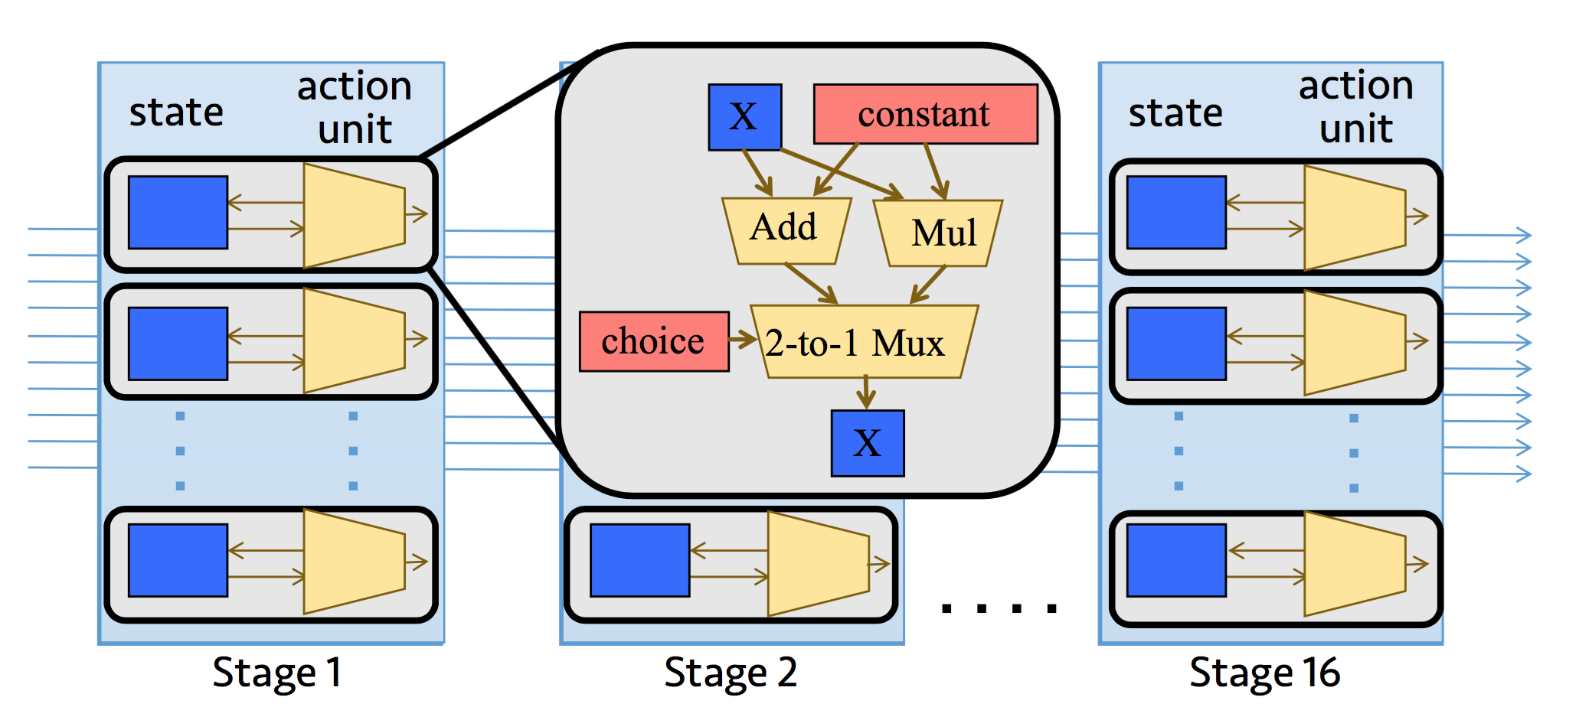
(3) Insight #1: Stateful atoms
The atoms constitute the switch’s action instruction set: run under 1 ns

Slide 25
(3) Insight #2: Pipeline the stateless actions
if (pkt.field1 + pkt.field2 == 10) { counter ++; }
Have a compiler do this analysis for us ☺
Stateless operations (whose results depend only on the current packet) can execute over multiple stages
Only the stateful operation must run atomically in one pipeline stage

Slide 26
(4) Implementing complex policies
What if you have a very large P4 (or Domino) program?
Ex: too many logical tables in TDG
Ex: logical table keys are too wide
Sharing memory across stages leads to paucity in physical tables
Ex: too many (stateless) actions per logical table
Sharing compute across stages leads to paucity in physical tables
Solution in RMT architecture: Re-circulation

Slide 27
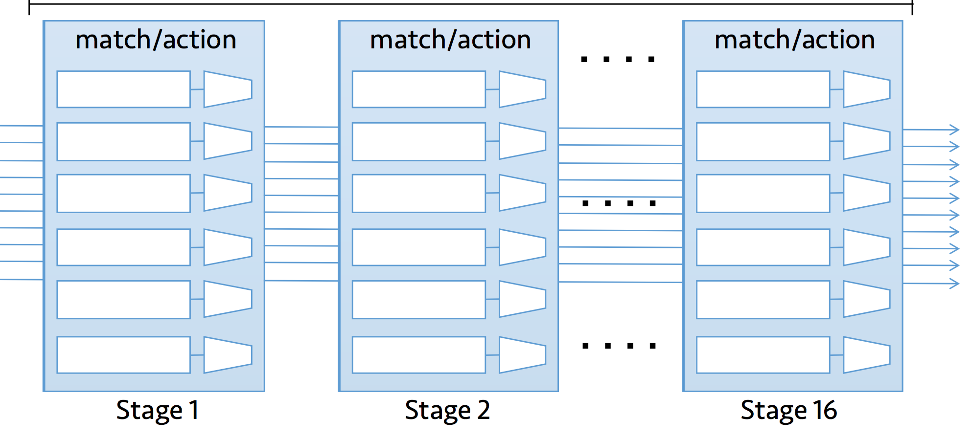
(4) Re-circulation “extends” the pipeline
Recirculate to ingress
But throughput drops by 2x!

Slide 28
(4) Decouple pkt compute & mem access!
Allow packet processing to run to completion on separate physical processors [dRMT’17]
Aggregate per-stage memory clusters into a shared memory pool
Crossbar enables all processors to access each memory
Schedule instructions on each core to avoid contention

Slide 29
(4) RMT: compute and memory access
Stage 1
Stage 2
Stage N
Parser
Deparser
Pkt Header
Queues
Match
Match
Match
In
Action
Action
Action
Out
keys
results
Memory Cluster 1
Memory Cluster 2
Memory Cluster N
Notes:
As background, I’ll briefly review how programmable switches are architected in hardware. For concreteness, I’ll focus on the RMT architecture because it is representative of many commercial products today.
In the RMT architecture, a parser turns bytes from the wire into a bag of packet headers. In each pipeline stage, a programmable match unit extracts the relevant part of the packet header as a key to look up in the match-action table. It then sends this to the memory cluster, which performs the lookup and returns a result. This result is used by a programmable action unit to transform the packet headers appropriately.
This process then repeats itself.

Slide 30
(4) dRMT: Memory disaggregation
Stage 1
Stage 2
Stage N
Queues
Parser
Deparser
In
Match
Match
Match
Out
Action
Action
Action
Memory Cluster 1
Memory Cluster 2
Memory Cluster N
Notes:
First, we disagg. memory. We replace the stage-local memory in the pipeline with a shared array of memory clusters accessible from any stage through a crossbar. Now, the stages in aggregate have access to all the memory in the system, because the memory doesn’t belong to any one stage in particular.

Slide 31
(4) dRMT: Compute disaggregation
Queues
Parser
In
Deparser
Distributor
Out
Proc. 1
Proc. 2
Proc. N
Match
Pkt 1
Match
Pkt 2
Match
Pkt N
Action
Action
Action
Memory Cluster 1
Memory Cluster 2
Memory Cluster N
Notes:
Next, we disaggregate compute. We replace each of the pipeline stages that is rigidly forced to always execute matches followed by actions with a match-action processor that can execute matches and actions in any order that respects program dependencies. Now, once packets have been parsed, they are distributed by a distributor to one of the processors in round-robin order. So the first packet goes to processor 1, the second to processor 2, and so on.
Once a processor receives a packet, it is responsible for carrying out all operations on that packet. Unlike the pipeline, packets don’t move around between processors. Let’s look at pkt 2 on proc 2. Over the duration of this packet, the proc might access tables in different memory clusters.

