Slide 1

Congestion Control II
Lecture 18
http://www.cs.rutgers.edu/~sn624/352-F24
Srinivas Narayana

Slide 2



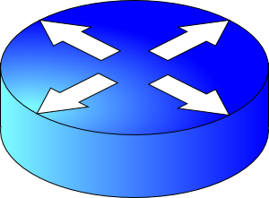


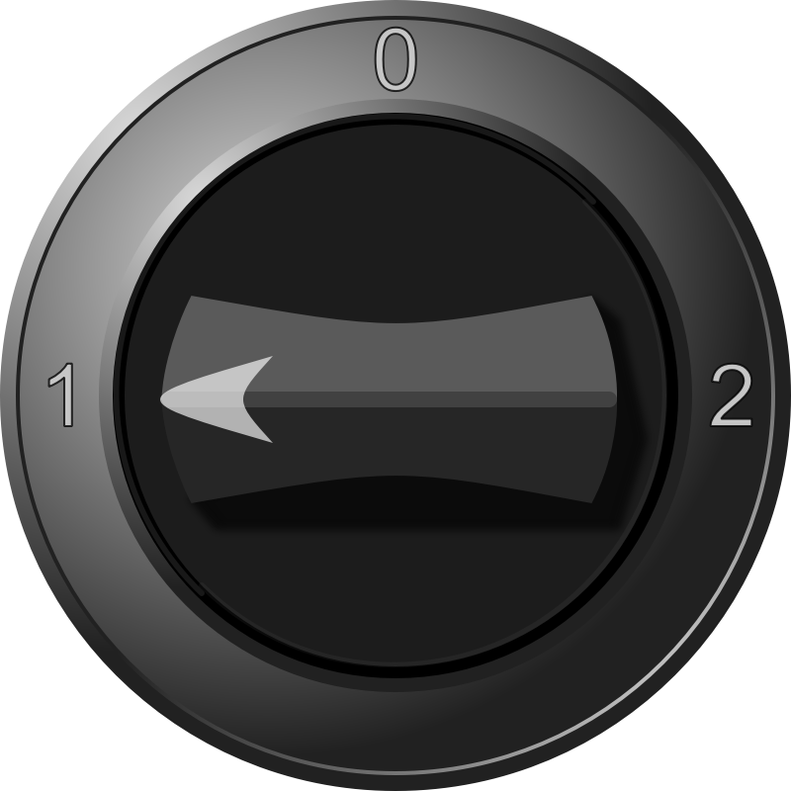
sender
Multiple locations for bottlenecks
application
process
recv()
TCP socket
receiver buffers
Congestion Control
Flow Control
What’s the bottleneck? How to adapt how much data to keep in flight?
TCP
code
from sender
Distributed algorithm converging to an efficient and fair outcome
Sense and React
receiver
TCP congestion control algorithm
Steady state?
How to get to steady state?
Loss, ACKs, etc.
Congestion window, sending rate
H
C
Bottleneck link
Signals
Knobs

Slide 3
Congestion window
The sender maintains an estimate of the amount of in-flight data needed to keep the link fully busy without congesting it
This estimate is called the congestion window (cwnd)
Recall: There is a relationship between the sending rate (throughput) and the sender’s window: sender transmits a window’s worth of data over an RTT duration
Rate = window / RTT

Slide 4
Interaction b/w flow & congestion control
Use window = min(congestion window, receiver advertised window)
Overwhelm neither the receiver nor network links & routers
Window <= Congestion window (congestion control)
Window <= Advertised window (flow control)
Sender’s view:
0
1
2
3
4
5
6
7
0
1
Last cumulative
ACK’ed seq #
Last transmitted
seq #

Slide 5

Review: Steady state operation
(2) Keep transmissions over the bottleneck link back to back
Send packet burst (as allowed by window)
Data
Receive data packet
(1) Keep transmissions ACK-clocked: Send new data on ACK
Sender
Receiver
Receive ACK
Send ACK
ACKs

Slide 6
Review: Slow start
Problems:
Congestion window grows too fast!
Congestion window drops too fast!
Need gentler adaptation of cwnd closer to steady state
Q: How to get to steady state?
Packet drops/
RTO
Congestion Window
Slow start
Slow start
Slow start
1 MSS
Time

Slide 7
TCP Congestion Avoidance

Slide 8
Two congestion control algorithms
TCP New Reno
The most studied, classic “textbook” TCP algorithm
The primary knob is congestion window
The primary signal is packet loss (RTO)
Adjustment using additive increase
TCP BBR
Recent algorithm developed & deployed by Google
The primary knob is sending rate
The primary signal is rate of incoming ACKs
Adjustment using gain cycling and filters

Slide 9
TCP New Reno: Additive Increase
Remember the recent past to find a good estimate of link rate
The last good cwnd without packet drop is a good indicator
TCP New Reno calls this the slow start threshold (ssthresh)
Increase cwnd by 1 MSS every RTT after cwnd hits ssthresh
Effect: increase window additively per RTT
Host A
Host B
say ssthresh=4
four segments
RTT
five segments
RTT
six segments
RTT
seven segments
…
time

Slide 10
TCP New Reno: Additive increase
Start with ssthresh = 64K bytes (TCP default)
Do slow start until ssthresh
Once the threshold is passed, do additive increase
Add one MSS to cwnd for each cwnd worth data ACK’ed
For each MSS ACK’ed, cwnd = cwnd + (MSS/cwnd) * MSS
Upon a TCP timeout (RTO),
Set cwnd = 1 MSS
Set ssthresh = max(2 * MSS, 0.5 * cwnd)
i.e., the next linear increase will start at half the current cwnd

Slide 11
Behavior of Additive Increase
Say MSS = 1 KByte
Default ssthresh = 64KB = 64 MSS
Packet drops/
RTO
Loss occurs at cwnd = 54K
Loss occurs at cwnd = 40K
54 MSS
Additive increase
Set ssthresh to
27 MSS
Additive increase
Congestion Window
Set ssthresh to
20 MSS
Slow start
Slow start
Slow
start
1K
Time

Slide 12
TCP BBR: finding the bottleneck link rate
1. Send data at a specific rate
Data gets across the bottleneck at the bottleneck link rate.
2. Receive data packet
Use ACK receive rate to determine sending rate
Data
Sender
Receiver
4. Measure rate of incoming ACKs
3. Send ACK
ACKs

Slide 13
TCP BBR: finding the bottleneck link rate
Assuming that the link rate of the bottleneck
== the rate of data getting across the bottleneck link
== the rate of data getting to the receiver
== the rate at which ACKs are generated by the receiver
== the rate at which ACKs reach the sender
Measuring ACK rate provides an estimate of bottleneck link rate
BBR: Send at the maximum ACK rate measured in the recent past
Update max with new bottleneck rate estimates, i.e., larger ACK rate
Forget estimates last measured a long time ago
Incorporated into a rate filter

Slide 14
TCP BBR: Adjustments by gain cycling
BBR periodically increases its sending rate by a gain factor to see if the link rate has increased (e.g., due to a path change)
Steady state operation: constant sending rate
Last max ACK rate was measured a while ago. Forget it & use a more recent max ACK rate
…
Gain cycle
Sending rate
…
Filter
No change
in ACK rate
Detect higher ACK rate:
Update sending rate
Bottleneck link rate increase
Time
Bottleneck link rate decrease

Slide 15
Bandwidth-Delay Product

Slide 16
Steady state cwnd for a single flow
Suppose the bottleneck link has rate C
Suppose the propagation round-trip delay (propRTT) between sender and receiver is T
Ignore transmission delays for this example;
Assume steady state: highest sending rate with no bottleneck congestion; back-to-back packets over bottleneck link
Q: how much data is in flight over a single RTT?
C * T data i.e., amount of data unACKed at any point in time
ACKs take time T to arrive (without any queueing). In the meantime, sender is transmitting at rate C

Slide 17
The Bandwidth-Delay Product
C * T = bandwidth-delay product:
The amount of data in flight for a sender transmitting at the ideal rate during the ideal round-trip delay of a packet
Note: this is just the amount of data “on the pipes”
Data
C * T

