Slide 1

Congestion Control III
Lecture 19
http://www.cs.rutgers.edu/~sn624/352-F24
Srinivas Narayana

Slide 2


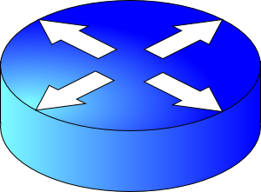
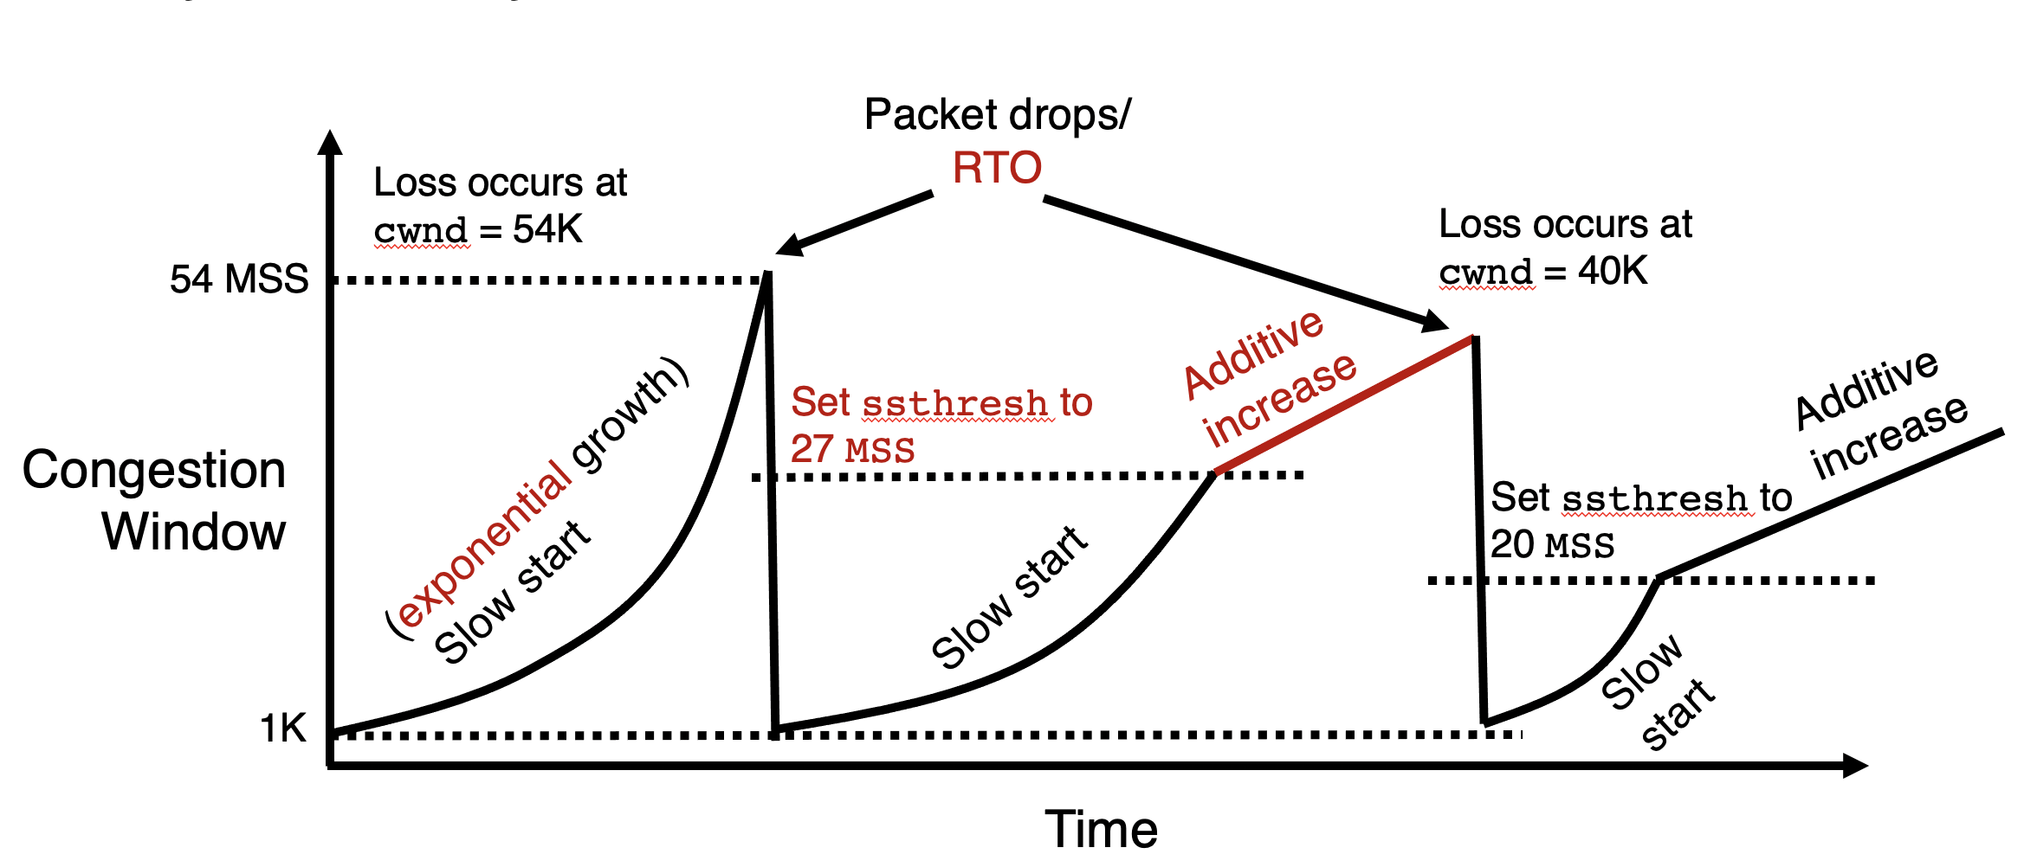
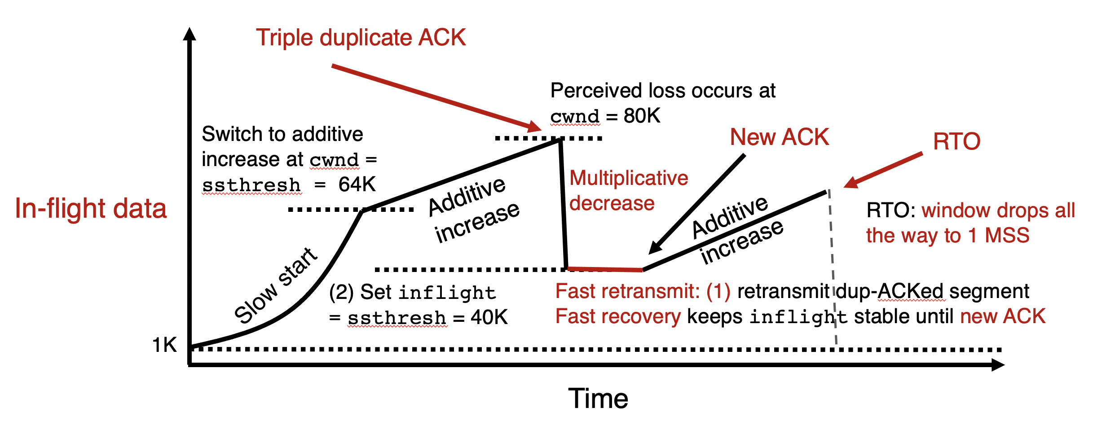


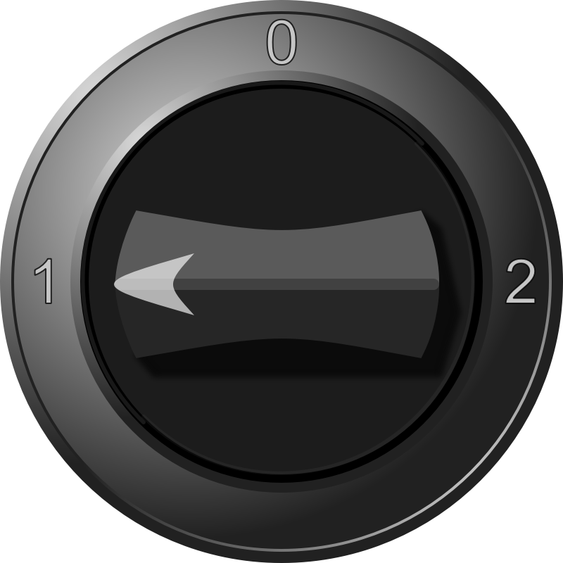
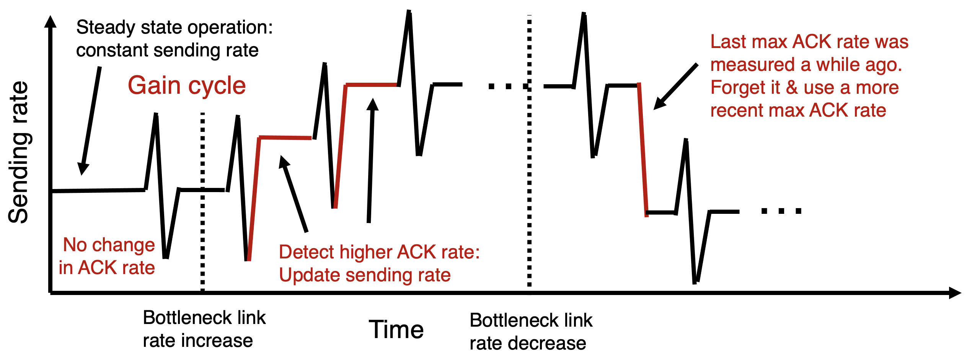
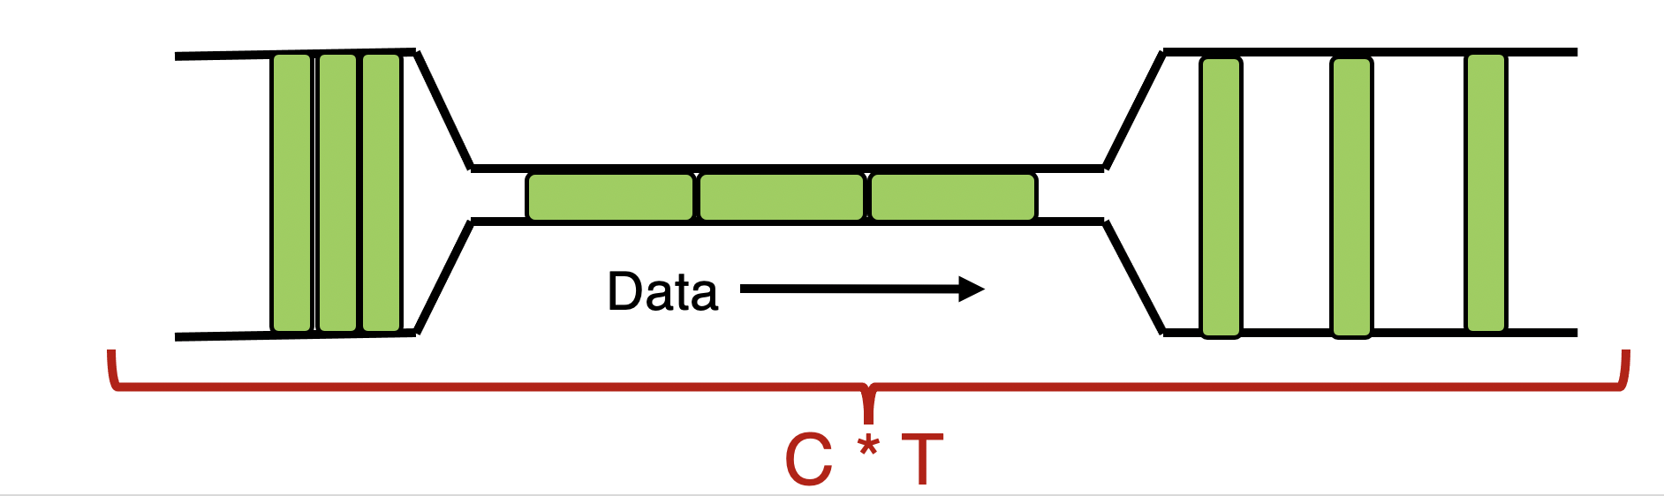
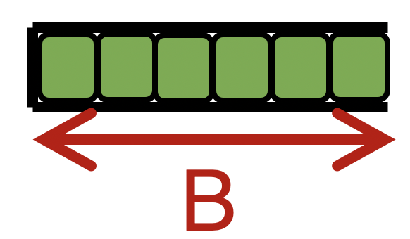

TCP New Reno
= slow start
+ congestion avoidance (AI)
+ fast retransmit & recovery (MD)
Congestion Control
Sense and React
H
C
TCP BBR: Gain cycling
Signals
Knobs
Bandwidth-Delay Product
cwnd < BDP: sender under-uses the link
BDP = cwnd: 100% link use, zero queues (ideal)
BDP < cwnd < BDP + B: persistent queue @ router
BDP + B < cwnd: packet drops

Slide 3
The Bandwidth-Delay Product
C * T = bandwidth-delay product:
The amount of data in flight for a sender transmitting at the ideal rate during the ideal round-trip delay of a packet. (Assumed sole user of the link)
Note: this is just the amount of data “on the pipes”
Data
C * T

Slide 4
The Bandwidth-Delay Product
Q: What happens if cwnd < C * T?
A: Not sending back to back packets, link underused
Data

Slide 5
The Bandwidth-Delay Product
Q: What happens if cwnd > C * T?
i.e., where are the rest of the in-flight packets?
A: Waiting at the bottleneck router queues
Data
C * T

Slide 6
Router buffers and the max cwnd
Router buffer memory is finite: queues can only be so long
If the router buffer size is B, there is at most B data waiting in the queue
If cwnd increases beyond C * T + B, data is dropped!
B
Data
C * T

Slide 7
Summary
Bandwidth-Delay Product (BDP) governs the window size of a single connection at steady state
The bottleneck router buffer size governs how much the cwnd can exceed the BDP before packet drops occur
BDP is the ideal desired window size to use the full bottleneck link, without any queueing.
Accommodating flow control, BDP is also the min socket buffer size to use the bottleneck link fully:
Important to set socket buffer sizes appropriately for high BDP paths

Slide 8
Detecting and Reacting to Packet Loss

Slide 9
Detecting packet loss
Congestion Window
Grow too fast
Drop too fast
1 MSS
Time
So far, all the algorithms we’ve studied have a coarse loss detection mechanism: RTO timer expiration
Let the RTO expire, drop cwnd all the way to 1 MSS
Analogy: you’re driving a car
You accelerate until the next car in front is super close to you (RTO) and then hit the brakes hard (cwnd := 1)
Q: Can you see obstacles from afar and slow down proportionately?
That is, can the sender see packet loss coming in advance?
And reduce cwnd more gently?

Slide 10
Can we detect loss earlier than RTO?
Key idea: use the information in the ACKs. How?
Suppose successive (cumulative) ACKs contain the same ACK#
Also called duplicate ACKs
Occur when network is reordering packets, or one (but not most) packets in the window were lost
Reduce cwnd when you see many duplicate ACKs
Consider many dup ACKs a strong indication that packet was lost
Default threshold: 3 dup ACKs, i.e., triple duplicate ACK
Make cwnd reduction gentler than setting cwnd = 1; recover faster

Slide 11
Fast Retransmit & Fast Recovery

Slide 12
Distinction: In-flight versus window
So far, window and in-flight referred to the same data
Fast retransmit/recovery differentiate the two notions
cwnd = 6
inflight = 3
Sender’s view:
0
1
2
3
4
5
6
7
0
1
0
1
2
3
4
5
6
7
0
1
Triple duplicate ACKs
(assume subsequent 3 pieces of data were successfully received)
Last cumulative
ACK’ed seq #
Last transmitted
seq #
cwnd is the interval between the last cumulatively ACK’ed seq# and the last transmitted seq#
inflight is the data currently believed to be in flight.

Slide 13
TCP fast retransmit (RFC 2581)
The fact that ACKs are coming means that data is getting delivered to the receiver, although with some loss.
Before the dup ACKs arrive, we assume inflight = cwnd
TCP sender performs two actions with fast retransmit

Slide 14
TCP fast retransmit (RFC 2581)
(1) Reduce the cwnd and in-flight gently
Don’t drop cwnd all the way down to 1 MSS
Reduce the amount of in-flight data multiplicatively
Set inflight → inflight / 2
That is, set cwnd = (inflight / 2) + 3MSS
This step is called multiplicative decrease
Algorithm also sets ssthresh to inflight / 2

Slide 15
TCP fast retransmit (RFC 2581)
Example: Suppose cwnd and inflight (before triple dup ACK) were both 8 MSS.
After triple dup ACK, reduce inflight to 4 MSS
Assume 3 of those 8 MSS no longer in flight; set cwnd = 7 MSS
Updated to
inflight = 4
cwnd = 7
cwnd = inflight = 8
0
1
2
3
4
5
6
7
0
1
2
3
4
5
6
7
0
1
5
Last cumulative
ACK’ed seq #
Assumed not in flight (dup ACK)

Slide 16
TCP fast retransmit (RFC 2581)
(2) The seq# from dup ACKs is immediately retransmitted
That is, don’t wait for an RTO if there is sufficiently strong evidence that a packet was lost

Slide 17
TCP fast recovery (RFC 2581)
Sender keeps the reduced inflight until a new ACK arrives
New ACK: an ACK for the seq# that was just retransmitted
Cumulative ACK may also indicate the (three or more) pieces of data that were previously delivered to generate the duplicate ACKs
Conserve packets in flight: transmit some data over lossy periods (rather than almost no data, if cwnd := 1)

Slide 18
TCP fast recovery (RFC 2581)
Keep incrementing cwnd by 1 MSS for each dup ACK
cwnd = 6
inflight = 3
0
1
2
3
4
5
6
7
0
1
2
3
4
5
6
7
0
1
5
Last cumulative
ACK’ed seq #
Assumed not in flight (dup ACK)

Slide 19
TCP fast recovery (RFC 2581)
Keep incrementing cwnd by 1 MSS for each dup ACK
cwnd = 7
inflight = 3
0
1
2
3
4
5
6
7
0
1
2
3
4
5
6
7
0
1
Last cumulative
ACK’ed seq #
Assumed not in flight (dup ACK)

Slide 20
TCP fast recovery (RFC 2581)
Keep incrementing cwnd by 1 MSS for each dup ACK
cwnd = 8
inflight = 3
0
1
2
3
4
5
6
7
0
1
2
3
4
5
6
7
0
1
Last cumulative
ACK’ed seq #
Assumed not in flight (dup ACK)

Slide 21
TCP fast recovery (RFC 2581)
Eventually a new ACK arrives, acknowledging the retransmitted data and all data in between
Deflate cwnd to half of cwnd before fast retransmit.
cwnd and inflight are aligned and equal once again
Perform additive increase from this point!
cwnd = 6/2 = 3
inflight = cwnd = 3
0
1
2
3
4
5
6
7
0
1
2
3
4
5
6
7
0
1
Last cumulative
ACK’ed seq #
New ACK acknowledged this data

Slide 22
Additive Increase/Multiplicative Decrease
Say MSS = 1 KByte
Default ssthresh = 64KB = 64 MSS
Triple duplicate ACK
Fast retransmit: (1) retransmit dup-ACKed segment
Perceived loss occurs at cwnd = 80K
Switch to additive increase at cwnd = ssthresh = 64K
New ACK
RTO
(2) Multiplicative decrease
In-flight data
Additive increase
Additive increase
RTO: window drops all the way to 1 MSS
Slow start
(2) Set inflight = ssthresh = 40K
Fast recovery keeps inflight stable until new ACK
1K
Time

Slide 23
TCP New Reno performs additive increase and multiplicative decrease of congestion window.
In short, we often refer to this as AIMD.
Multiplicative decrease is a part of all TCP algorithms, including BBR.
[We didn’t cover this, but MD is necessary for fairness across TCP flows.]

Slide 24
Summary: TCP loss detection & reaction
Don’t wait for an RTO and then set the cwnd to 1 MSS
Instead, react proportionately by sensing pkt loss in advance
Fast Retransmit
Triple dup ACK: sufficiently strong signal that network has dropped data, before RTO
Immediately retransmit data
Multiplicatively decrease in-flight data to half of its value
Fast Recovery
Maintain this reduced amount of in-flight data as long as dup ACKs arrive
Data is successfully getting delivered
When new ACK arrives, do additive increase from there on

Slide 25
Connection Management
How does a TCP connection start?

Slide 26



Starting a TCP connection
TCP requires sender/receiver to set up some context
Sequence numbers, window size, buffers, OS table entries
Let’s talk. Here’s my request.
Provision enough socket buffers.
Sender
e.g., browser
Attack by resource exhaustion at server
(SYN flood)
Receiver
e.g., web server
OK. Here’s my response.
Entries in operating system tables (connection lookup), choose sequence #, etc.

Slide 27
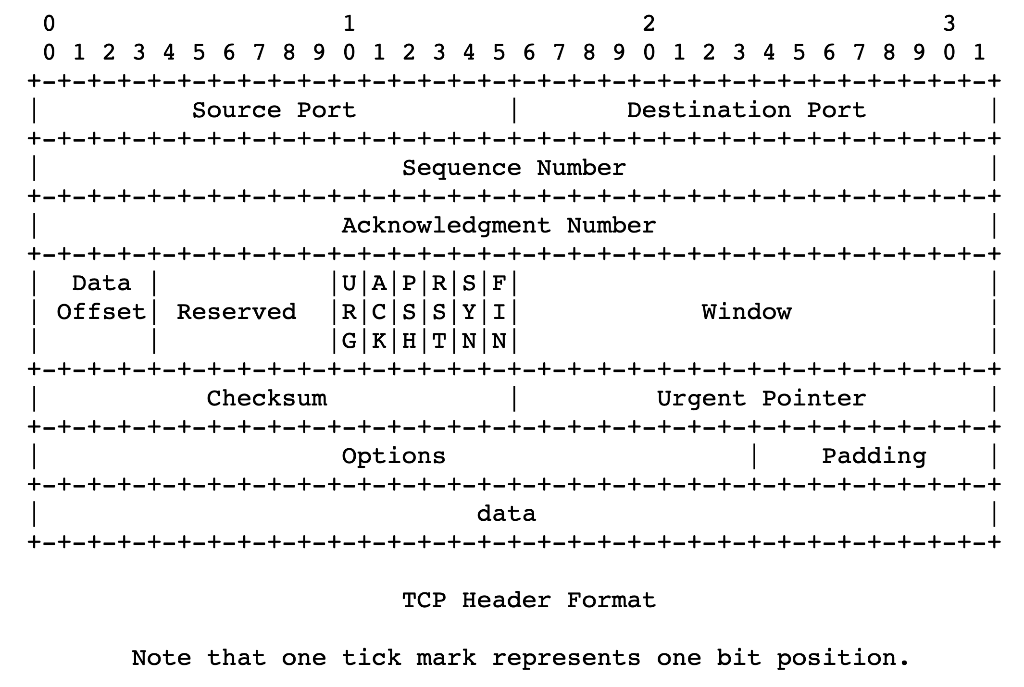
TCP 3-way handshake
Server state
ss = socket(AF_INET,SOCK_STREAM)
ss.bind((‘’,server_port))
ss.listen(1)
csockid, addr = ss.accept()
Client state
cs = socket(AF_INET, SOCK_STREAM)
LISTEN
cs.connect((host,server_port))
LISTEN
choose init seq num, x
send TCP SYN msg
No app data
SYNbit=1, Seq=x
SYNSENT
choose init seq num, y
send TCP SYNACK
msg, acking SYN
SYN RCVD
SYNbit=1, Seq=y
ACKbit=1; ACKnum=x+1
received SYNACK(x)
indicates server is live;
send ACK for SYNACK;
this segment may contain
client-to-server data
received ACK(y)
indicates client is live
ESTAB
ACKbit=1, ACKnum=y+1
Provision resources
ESTAB
Notes:
TCP’s three way handshake, that operates as follows
Let’s say the client and server both create a TCP socket as we learned about in Chapter 2 and enter the LISTEN state
The client then connects to the server sending a SYN message with a sequence number x (SYN Message is an TCP Segment with SYN but set in the header – you might want to go back and review the TCP segment format!)
The server is waiting for a connection, and receives the SYN message enters the SYN received state (NOT the established state and sends a SYN ACK message back.
Finally the client sends an ACK message to the server, and when the server receiver this enters the ESTABLished state. This is when the application process would see the return from the wait on the socket accept() call

Slide 28
Implications of 3-way handshake
Any application data can only be sent an RTT after
Fresh connection: at least 2 RTTs to get a response
Often fruitful to use persistent connections
“Recent” measures to address the startup delay
TCP fast open
QUIC

