Slide 1
Administrivia
Review 1
Specific instructions to structure review in lecture 1 slides 26/27
Office hours moving to Thursday 10—12
MUD: Send me your top 1—3 questions on this lecture
Think about use cases and directions for your project!

Slide 2

Congestion Control
Lecture 4, Computer Networks (198:552)

Slide 3


Edge vs. core division of labor
Core: best-effort packet delivery
Edge: end-to-end guarantees to applications
Transport should figure out how to use the core effectively
The Internet

Slide 4
The role of the endpoint
Network discovery and bootstrapping
How does the endpoint join the network?
How does the endpoint get an address?
Interface to networked applications
What interface to higher-level applications?
How does the host realize that abstraction?
Distributed resource sharing
What roles does the host play in network resource allocation decisions?

Slide 5


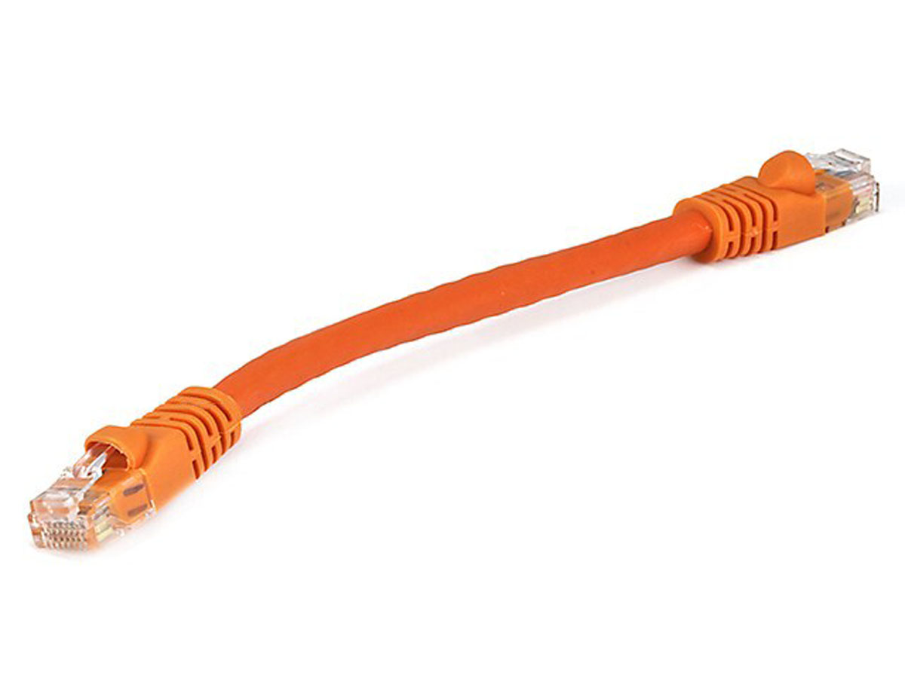
Network model
Queuing delay
Bottleneck queue
(max size B)
Link rate
(capacity)
Flows
Packet-switched core network

Slide 6

TCP: Reliable & ordered transport
Reliable delivery using ACKs
Data ordered using sequence numbers
Receiver assembles data in order
before sending to the application
Data
Transmit buffer
Receive buffer
ACKs

Slide 7
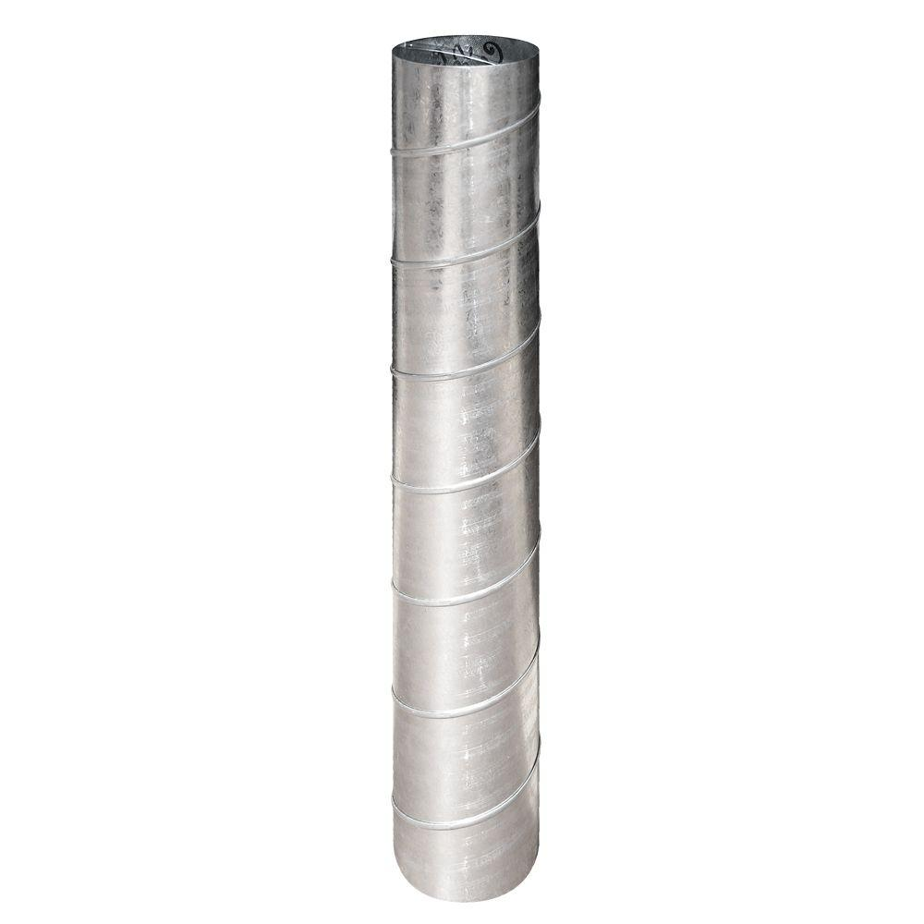
But what about performance?
Throughput: the width of the pipe (MBytes/sec)
Delay: the length of the pipe (milliseconds)
Packet drop: leaks from the pipe (percentage of packets)

Slide 8
What happens at a queue?
Persistent queue buildup
packet
loss
knee
cliff
Knee – point after which
Throughput increases very slowly
Delay increases fast
Cliff – point after which
Throughput starts to decrease very fast to zero
Delay approaches infinity
For an M/M/1 queue
Delay = 1/(1 – utilization)
Throughput
congestion
collapse
Load
Delay
Load

Slide 9
Flow ctrl vs. Cong ctrl vs. Cong avoidance
Flow control:
Receiver tells sender how much it can accept in its buffer
Congestion avoidance:
Trying to stay to the left of the knee
Congestion control:
Trying to stay to the left of the cliff
Final window == min (receiver window, congestion window)

Slide 10
How should an endpoint transmit data … and not overwhelm queues?

Slide 11

Control loop
Data
ACKs
Congestion window: transmitted yet unACKed data
How should an endpoint adapt its congestion window
… based on congestion signals provided by the network?

Slide 12
Congestion signals
Explicit network signals
Send packet back to source (e.g., ICMP source quench)
Set bit in header (e.g., ECN)
Send direct feedback (e.g., sending rate)
Unless on every router, still need end-to-end signal
Implicit network signals
Loss (e.g. TCP New Reno, SACK)
Delay (e.g. TCP Vegas)
Easily deployable
Robustness?
Wireless?

Slide 13
Exercise
Buffer size B at the bottleneck queue
Link capacity C
Propagation delay T
What’s the congestion window for a flow at the knee? Cliff?
Is there a network buffer size that’s always sufficient?
Is there a receiver buffer size that’s always sufficient?

Slide 14
Congestion Avoidance and Control
ACM SIGCOMM ‘88
Van Jacobson and Michael Karels

Slide 15
One possible set of goals
Persistent queue buildup
packet
loss
knee
cliff
Equilibrium: stay close to the “cliff”
At equilibrium:
Don’t send a new packet
... until current one leaves the network
Return to equilibrium if you go “over” the cliff
Try to approach the cliff if below it
Share bandwidth ‘fairly’ across flows
Throughput
congestion
collapse
Load

Slide 16
TCP New Reno: Mechanisms
Packet conservation
Reacting to loss: multiplicative decrease
Probing for more throughput: additive increase
Getting started: slow start
A better retransmission timeout
Fast retransmit
Fast recovery

Slide 17
TCP congestion control
Additive increase, multiplicative decrease (AIMD)
On packet loss, divide congestion window in half
On success for last window, increase window linearly
Window
Loss
halved
t
Mechanisms not shown: slow start, fast retransmit, recovery, timeout loss, etc.

Slide 18
Discussion of Jacobson’s paper
Is loss always congestive?
Wireless networks
Errors and corruption?
Is loss the best congestion signal?
How about delays?
Explicit congestion notifications from the network?
Is packet conservation always a good thing?
Differences in flow propagation delays?
Detect incipient congestion?
Why AIMD?

Slide 19
Why AIMD?
Some thoughts from Chiu and Jain’s ‘89 paper,
[CJ89]: “An Analysis of the Increase and Decrease Algorithms for Congestion Avoidance in Computer Networks”

Slide 20
Efficient allocation
Too slow?
Underutilize the network
Too fast?
High delays, lose packets
Every endpoint is doing it
May all under/over shoot
Large oscillations
Optimal:
Σx_{i}=X_{goal}, e.g., link capacity
Efficiency = 1 - distance from efficiency line
2 user example
overload
User 2: x₂
underload
Efficiency
line
User 1: x₁

Slide 21
Fair allocation
Max-min fairness
Flows which share the same bottleneck get the same amount of bandwidth
Assumes no knowledge of priorities
Fairness = 1 - distance from fairness line
2 user example
2 getting
too much
fairness
line
User 2: x₂
1 getting
too much
User 1: x₁

Slide 22
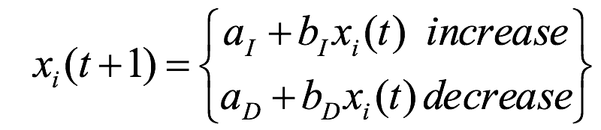
Linear window adaptation rules
x_{i}(t): window or rate of the i^{th} user at time t
a_{I}, a_{D}, b_{I}, b_{D}: constant increase/decrease coefficients
All users receive same network feedback
Binary feedback: sense congestion or available capacity
All users increase or decrease simultaneously

Slide 23
Multiplicative increase, additive decrease
fairness
line
Does not converge to fairness
Not stable at all
Does not converge to efficiency
Stable iff
(b_{I}(x₁+a_{D}), b_{I}(x₂+a_{D}))
(x₁,x₂)
User 2: x₂
(x₁+a_{D},x₂+a_{D})
efficiency
line
User 1: x₁

Slide 24
Additive increase, additive decrease
(x₁+a_{D}+a_{I}), x₂+a_{D}+a_{I}))
fairness
line
Does not converge to fairness
Stable
Does not converge to efficiency
Stable iff
(x₁,x₂)
User 2: x₂
(x₁+a_{D},x₂+a_{D})
efficiency
line
User 1: x₁

Slide 25
Multiplicative increase, mult. decrease
fairness
line
Does not converge to fairness
Stable
Converges to efficiency iff
(x₁,x₂)
(b_{I}b_{D}x₁, b_{I}b_{D}x₂)
User 2: x₂
(b_{d}x₁,b_{d}x₂)
efficiency
line
User 1: x₁

Slide 26
Additive increase, multiplicative decrease
fairness
line
Converges to fairness
Converges to efficiency
Increments smaller as fairness increases
Effect on metrics?
(x₁,x₂)
(b_{D}x₁+a_{I}, b_{D}x₂+a_{I})
User 2: x₂
(b_{D}x₁,b_{D}x₂)
efficiency
line
User 1: x₁

Slide 27
Significance of AIMD/CJ89
Characteristics
Converges to efficiency, fairness
Easily deployable: feedback is binary
Fully distributed
No need to know the full state of the system (e.g., # users, link rates)
[CJ89] result that enabled the Internet to grow beyond the ‘80s
A scalable Internet required a fully distributed congestion control
Formed the basis of TCP as we know it

Slide 28
Modeling
Critical to understanding complex systems
[CJ89] model relevant even today (since ‘89!)
10⁶ increase of bandwidth, 1000x increase in number of users
Criteria for good models
Realistic
Simple
Easy to work with
Easy for others to understand
Realistic, complex model → useless
Unrealistic, simple model → may teach something!

Slide 29
Congestion Control for High Bandwidth-Delay Product Networks
ACM SIGCOMM ‘02
Dina Katabi, Mark Handley, and Charlie Rohrs

Slide 30
Key ideas
Use window X.
I will use window X.
X
ACK
An explicit control system running in the network
Give direct, multi-bit feedback on transmission windows/rates to endpoints
Separate efficiency control from fairness

Slide 31
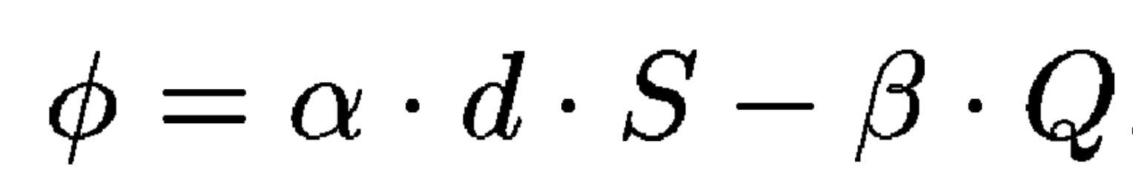
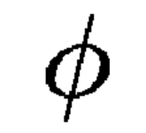
XCP efficiency control loop
Spare bandwidth
Persistent queue
Sender (roughly): cwnd = cwnd +
Why do you need both terms of this equation?

Slide 32
XCP fairness rules
If > 0, increase in throughput of all flows must be the same
If < 0, decrease in throughput must be proportional to a flow’s current throughput
Bandwidth shuffling: if too close to convergence, perturb by adding a small window to over-utilize the link

Slide 33
Discussion of XCP
What window increase/decrease rules are used by XCP?
Is it fair?
Why couldn’t you separate efficiency & fairness in TCP New Reno?
Is generating multi-bit feedback harder than binary?
What about the end-to-end argument?
Deployment concerns?
Ensuring control loop runs at every bottleneck router?
Selfish or rogue endpoints?
Should you necessarily push queue size to zero?
Is it always possible to keep the pipe full?
How to accommodate noise in measurements or window sizes?

Slide 34
Some questions to think about…
What should networks provide as feedback for endpoints?
Should the network operate at the cliff, the knee, or elsewhere?
What is a good definition of fairness? Take into account:
Demands? Usage of multiple resources? App goals?
What about hosts who cheat to hog resources?
How to detect cheating? How to prevent/punish?
What about wireless networks?
Loss caused by interference, not just congestion
Difficulty of detecting collisions (due to fading)

Slide 36
Backup slides

Slide 37
Proposition 1 from [Chiu and Jain ’89]
In order to satisfy the requirements of distributed convergence to efficiency and fairness without truncation,
the linear decrease policy should be multiplicative, and
the linear increase policy should always have an additive component, and
optionally it may have a multiplicative component with the coefficient no less than one.

Slide 38
Fast Retransmit
Don’t wait for window to drain
Resend a segment after 3 duplicate ACKs
remember a duplicate ACK means that an out-of sequence segment was received
Notes:
duplicate ACKs due to packet reordering
why reordering?
iwindow may be too small to get duplicate ACKs
cwnd = 1
segment 1
ACK 2
cwnd = 2
segment 2
segment 3
ACK 3
ACK 4
cwnd = 4
segment 4
segment 5
segment 6
ACK 4
segment 7
ACK 4
3 duplicate
ACKs
ACK 4

Slide 39
Fast Recovery
After a fast-retransmit set cwnd to ssthresh/2
i.e., don’t reset cwnd to 1
But when RTO expires still do cwnd = 1
Fast Retransmit and Fast Recovery → implemented by TCP Reno; most widely used version of TCP today

Slide 40
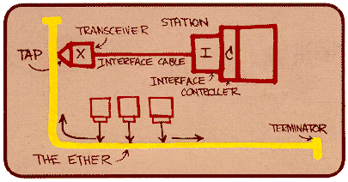
Ethernet back-off mechanism
Carrier sense: wait for link to be idle
If idle, start sending; if not, wait until idle
Collision detection: listen while transmitting
If collision: abort transmission, and send jam signal
Exponential back-off: wait before retransmitting
Wait random time, exponentially larger on each retry

