Slide 1

Router Design
Lecture 21
http://www.cs.rutgers.edu/~sn624/352-F24
Srinivas Narayana

Slide 2




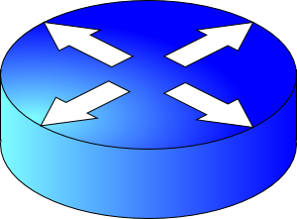
Review of concepts
Network layer’s main function: moving data from one endpoint to another
Analogy: postal system
Net layer
Addressing (IPv4)
Locate, not identify
endpoint
Network
layer
endpoint
Forwarding
Routing
10000000 11000011 00000001 01010000
Data plane
Control plane
.
.
128
195
1
.
80
Classless (CIDR)
IP prefixes
==
zip code
128.195.0.0/20

Slide 3
Advantages of prefix-based IP organization
Aggregate information across endpoints for forwarding & routing
Don’t reason about individual addresses; do prefixes instead
Reduce the sizes of information exchanged and router data structures
Prefixes (not individual IPs) are allocated to organizations by Internet registries
Each organization is delegated the work of assigning individual IPs
Facilitates movement of entire groups of hosts between organizations
(CIDR) IP address is decoupled from an explicit prefix length
Different routers can interpret an address with different prefix lengths
E.g., further away: more aggregated (shorter prefix); closer to destination: more granular (longer prefix)

Slide 4
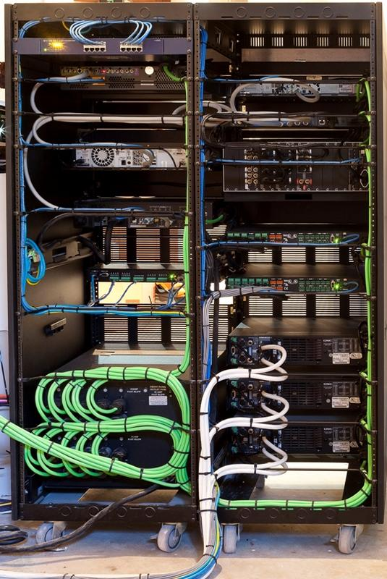
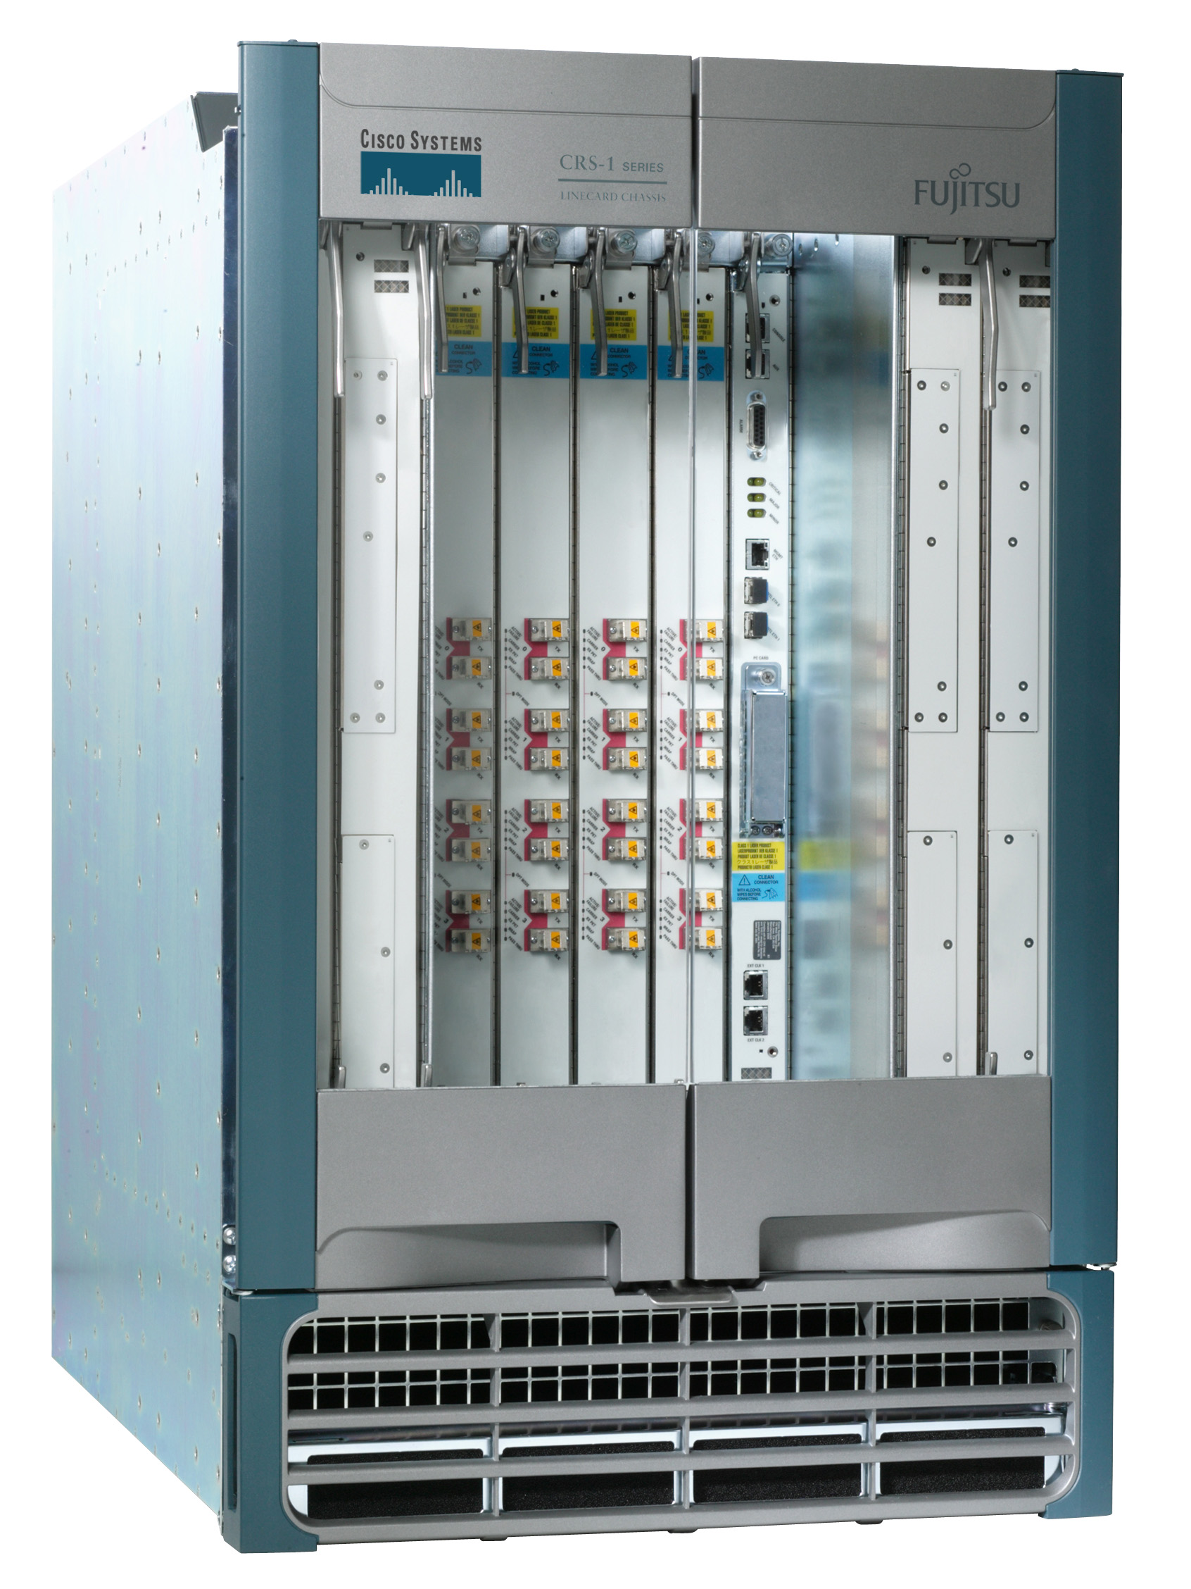
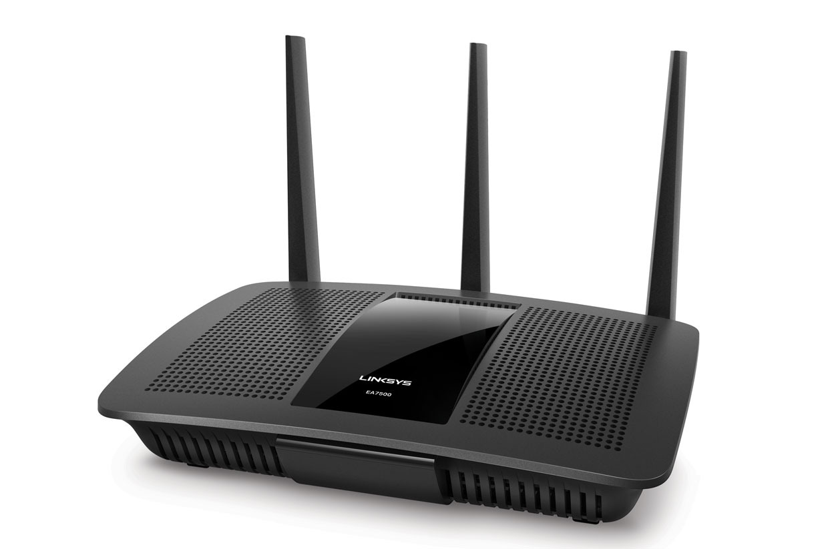
Next we’ll talk about routers
Access routers
Internet core router
Data center top-of-rack switch

Slide 5
What’s inside a router?

Slide 6
Router architecture overview
Review: assuming distributed routing, routing function: decide which ports packets need to exit
route
processor
Control plane
Data plane
Review: Forwarding function: move packets from one input port to another.
high-speed
switching
fabric
router input ports
router output ports

Slide 7
Different and evolving designs
There are different kinds of routers, with their own designs
Access routers (e.g., home WiFi), chassis/core routers, top-of-rack switches
Router designs have also evolved significantly over time
For simplicity and concreteness, we will learn about one high-speed router design from the early 2000s.
Called the MGR (multi-gigabit router). It could support an aggregate rate of 50 Gbit/s (1 G = 10⁹)
Today’s single-chip routers can support aggregate rates of ~10 Tbit/s (1 T = 10¹²)

Slide 8
Input port functions
Input port
Output port
Input port
Switching fabric
Output port
Line termination: receives physical (analog) signals and turns them into digital signals (physical layer)
Rate of link connecting to a single port termed line speed or line rate (modern routers: 100+ Gbit/s)
Link layer: performs medium access control functions (e.g., Ethernet)
…
…
Input port
Output port
Line
Term
Link
Layer
/ MAC
(receive)

Slide 9
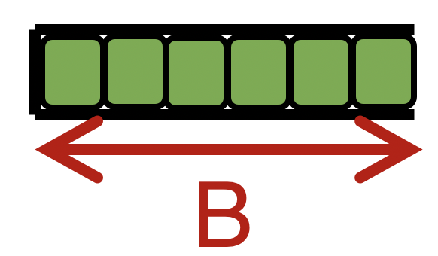

Input port functions
Input port
Output port
Input port
Switching fabric
Output port
Route lookup: high-speed lookup of which output port the packet is destined to
Goal: must complete this processing at the line rate
Queueing: packets may wait in per-output-port queues if packets are arriving too fast for the switching fabric to send them to the output port
…
…
Input port
Output port
Per-output
Queues
Line
Term
Link
Layer
/ MAC
(receive)
Route
lookup
switching
fabric

Slide 10

Route lookups
Route
lookup
Per-output
Queues
Line
Term
Link
Layer
Packet forwarding in the Internet is based on the destination IP address on the packet.
Example: if dst IP on packet is 65.45.145.34, it matches the prefix 65.0.0.0/8 (netmask 255.0.0.0) in table
(IP & netmask == prefix)
The packet is forwarded out port 3.
Example 2: what about dst IP 128.9.5.6?
Parse
Transport
Extract destination IP address
Network
Link layer
Route Lookup Data Structure
Outgoing Port
Forwarding Table
Dst-network
Port
65.0.0.0/8
3
128.9.0.0/16
1
149.12.0.0/19
7

Slide 11
Route lookups
Route
lookup
Per-output
Queues
Line
Term
Link
Layer
Number of entries in the forwarding table matters.
Fitting into router memory
Designing hardware and software for fast lookups
Parse
Transport
Extract destination IP address
Network
Link layer
Route Lookup Data Structure
Outgoing Port
Forwarding Table
Dst-network
Port
65.0.0.0/8
3
128.9.0.0/16
1
149.12.0.0/19
7

Slide 12
Route lookups
Route
lookup
Per-output
Queues
Line
Term
Link
Layer
Recall: IP addresses can be aggregated based on shared prefixes.
The number of table entries in a router is proportional to the number of prefixes, NOT the number of endpoints.
Today: ~ 1 million prefixes.
Parse
Transport
Extract destination IP address
Network
Link layer
Route Lookup Data Structure
Outgoing Port
Forwarding Table
Dst-network
Port
65.0.0.0/8
3
128.9.0.0/16
1
149.12.0.0/19
7

Slide 13
Route lookups
Route
lookup
Per-output
Queues
Line
Term
Link
Layer
Destination-IP-based forwarding has consequences.
Forwarding behavior is independent of the source: legitimate source vs. malicious attack traffic
Forwarding behavior is independent of the application: web traffic vs. file download vs. video
IP-based packet processing is “baked into” router hardware: evolving the IP protocol faces tall deployment hurdles
Parse
Transport
Extract destination IP address
Network
Link layer
Route Lookup Data Structure
Outgoing Port
Forwarding Table
Dst-network
Port
65.0.0.0/8
3
128.9.0.0/16
1
149.12.0.0/19
7

Slide 14
Output port functions
Input port
Output port
Input port
Switching fabric
Output port
Components in reverse order of those in the input port
This is where most routers have the bulk of their packet buffers
Recall discussions regarding router buffers from transport
MGR uses per-port output buffers, but modern routers have shared memory buffers
More efficient use of memory under varying demands
…
…
Input port
Output port
Queues
Link
Layer
/ MAC
(transmit)
Line
Termination
Switching
fabric
To output link

Slide 15
Output port functions
Input port
Output port
Input port
Switching fabric
Output port
Two important policy decisions
Scheduling: which among the waiting packets gets to be transmitted out the link?
Ex: First-In-First-Out (FIFO)
Buffer management: which among the packets arriving from the fabric get space in the packet buffer?
Ex: Tail drop: later packets dropped first
…
…
Input port
Output port
Queues
Link
Layer
/ MAC
(transmit)
Line
Termination
Switching
fabric
To output link

