Slide 1

Routers; LPM; Protocols
Lecture 22
http://www.cs.rutgers.edu/~sn624/352-F24
Srinivas Narayana

Slide 2
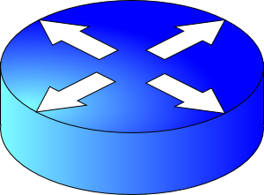
Review: Router architecture
assuming distributed routing, routing function: decide which ports packets need to exit
route
processor
Control plane
Data plane
Forwarding function: move packets from one input port to another.
high-speed
switching
fabric
router input ports
router output ports

Slide 3
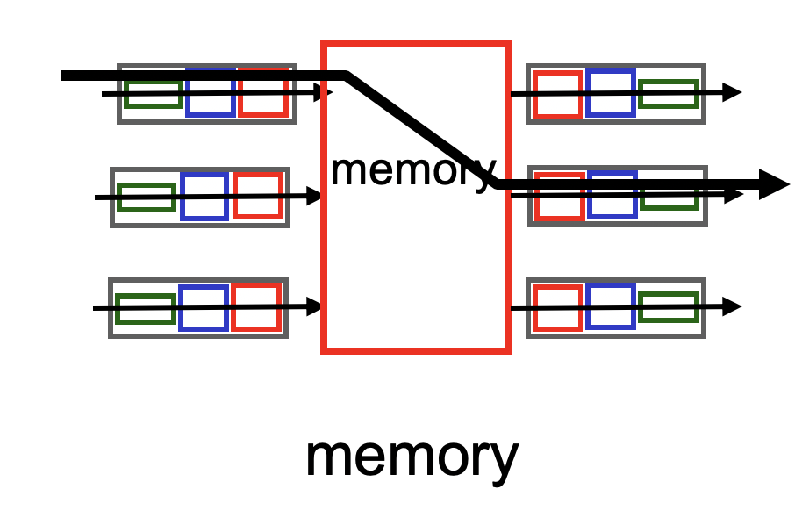
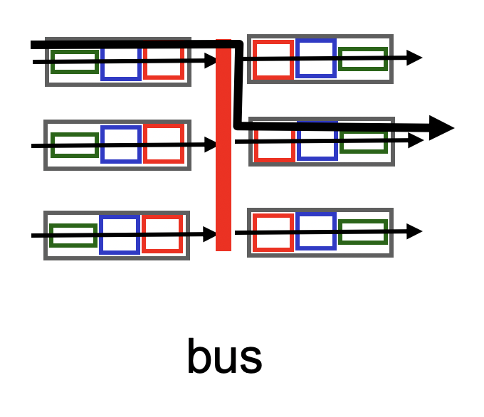
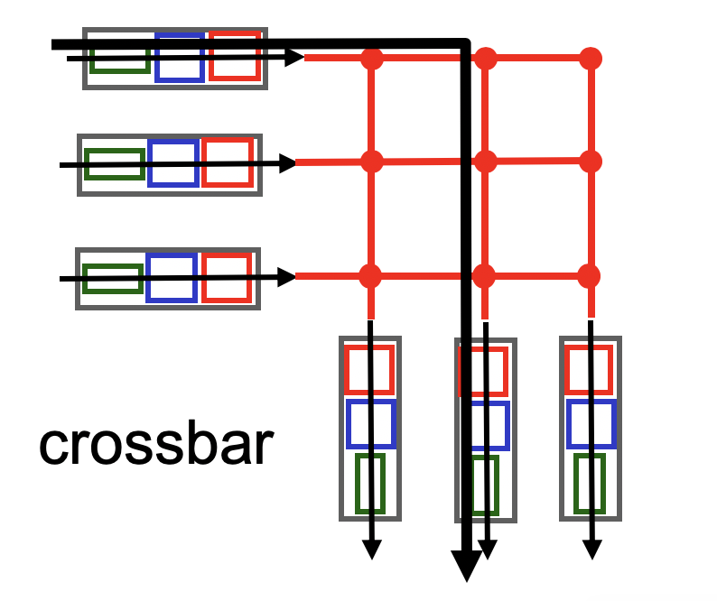
Fabrics: Types
Input port
Output port
Input port
Switching fabric
Output port
…
…
Fabric goal: Ferry as many packets as possible from input to output ports as quickly as possible.
Input port
Output port
Input port writes packets into shared memory.
Output port reads the packet when output link ready to transmit.
Single shared channel to move data from input to output port.
Easy to build buses; technology is quite mature.
Each input port has a physical data path to every output port.
Switch at the cross-over points turns on to connect pairs of ports.

Slide 4
Fabrics: Types
Input port
Output port
Input port
Switching fabric
Output port
…
…
Input port
Output port
Crossbars can get expensive as the number of ports grows (N² connections for N ports)
MGR uses a crossbar and schedules (in,out) port pairs.
Modern high-speed routers use highly optimized shared-memory-based interconnects.

Slide 5





Nonblocking fabrics
Input port
Output port
Input port
Switching fabric
Output port
…
…
Input port
Output port
High-speed switching fabrics designed to be nonblocking:
If an output port is “available”, an input port can always transmit to it without being blocked by the switching fabric itself
Nontrivial to achieve
Crossbars are nonblocking by design
Shared memory can be designed to be nonblocking if memory accesses can be made fast enough

Slide 6
Nonblocking fabrics
Input port
Output port
Input port
Switching fabric
Output port
…
…
Input port
Output port
With a nonblocking fabric, queues aren’t formed due to the switching fabric.
With a nonblocking fabric, there are no queues due to inefficiencies at the input port or the switching fabric
Queues only form due to contention for the output port
Fundamental, unavoidable, given the route

Slide 7
Nonblocking fabrics
Input port
Output port
Input port
Switching fabric
Output port
…
…
Input port
Output port
With a nonblocking fabric, queues aren’t formed due to the switching fabric.
With a nonblocking fabric, there are no queues due to inefficiencies at the input port or the switching fabric
Queues only form due to contention for the output port
Fundamental, unavoidable, given the route
Typically, these queues form on the output side
But can also “backpressure” to the input side if there is high contention for the output port
i.e.: can’t move pkts to output Qs since buffers full, so buffer @ input

Slide 8
Control (plane) processor
A general-purpose processor that “programs” the data plane:
Forwarding table
Scheduling and buffer management policy
Implements the routing algorithm by processing routing protocol messages
Mechanism by which routers collectively solve the Internet routing problem
More on this soon.
Control Processor
Input port
Output port
Input port
Switching fabric
Output port
…
…
Input port
Output port

Slide 9

Router design: the bigger picture
Control plane
Traditional distributed routing: per route-change processing
(~ a few tens of seconds)
Routing
Algorithm
control
plane
data
plane
Data plane
per-packet processing
(~ tens of nanoseconds)
0111
1
3
2
values in arriving
packet header, i.e, destination IP address

Slide 10
Longest Prefix Matching

Slide 11

Review: Route lookup
Table lookup matches a packet against an IP prefix
Ex: 65.12.45.2 matches 65.0.0.0/8
Prefixes are allocated to organizations by Internet registries
But organizations can reallocate a subset of their IP address allocation to other orgs
Parse
Transport
Extract destination IP address
Network
Link layer
Route Lookup Data Structure
Outgoing Port
Forwarding Table
Dst-network
Port
65.0.0.0/8
3
128.9.0.0/16
1
149.12.0.0/19
7

Slide 12
Example of IP block reallocation
ISP = Internet Service Provider
Dst IP Prefix | Output port
65.0.0.0/8 | 3
128.9.0.0/16 | 1
… | …
200.23.16.0/20 | 7 (towards A)
Suppose ISP A reallocates a part of its IP block to orgs 1… 8
ISP A owns the IP block 200.23.16.0/20.
Organization 1
200.23.16.0/23
Organization 2
200.23.18.0/23
[BGP] Send me pkts destined to
200.23.16.0/20
Organization 3
200.23.20.0/23
.
ISP A
.
.
.
.
Internet
.
Organization 8
200.23.30.0/23
There is an announcement mechanism (BGP) by which ISP A can inform the rest of the Internet about the prefixes it owns.
It is enough to announce a coarse-grained prefix 200.23.16.0/20 rather than 8 separate sub-prefixes.
Route Aggregation
Save forwarding table memory
Fewer routing protocol msgs

Slide 13
Example of IP block reallocation
Dst IP Prefix | Output port
65.0.0.0/8 | 3
128.9.0.0/16 | 1
… | …
200.23.16.0/20 | 7 (towards A)
Suppose ISP A reallocates a part of its IP block to orgs 1… 8
ISP A owns the IP block 200.23.16.0/20.
Organization 1
200.23.16.0/23
Organization 2
200.23.18.0/23
[BGP] Send me pkts destined to
200.23.16.0/20
Organization 3
200.23.20.0/23
.
ISP A
.
.
.
.
Internet
.
Organization 8
200.23.30.0/23
Now suppose one of these organizations adds another ISP for its Internet service and prefers using the new ISP.
Note: it’s possible for the organization to retain its assigned IP block.

Slide 14
Example of IP block reallocation
Dst IP Prefix | Output port
65.0.0.0/8 | 3
128.9.0.0/16 | 1
… | …
200.23.16.0/20 | 7 (towards A)
Suppose ISP A reallocates a part of its IP block to orgs 1… 8
ISP A owns the IP block 200.23.16.0/20.
Organization 1
200.23.16.0/23
Organization 2
200.23.18.0/23
[BGP] Send me pkts destined to
200.23.16.0/20
Organization 3
200.23.20.0/23
.
ISP A
.
.
.
.
Internet
.
Organization 8
200.23.30.0/23
[BGP] Announce 200.23.18.0/23
(besides other IP prefixes)
ISP B
Organization 2
200.23.18.0/23

Slide 15
Example of IP block reallocation
Dst IP Prefix | Output port
65.0.0.0/8 | 3
128.9.0.0/16 | 1
200.23.18.0/23 | 4 (towards B)
200.23.16.0/20 | 7 (towards A)
Suppose ISP A reallocates a part of its IP block to orgs 1… 8
ISP A owns the IP block 200.23.16.0/20.
Organization 1
200.23.16.0/23
Organization 2
200.23.18.0/23
[BGP] Send me pkts destined to
200.23.16.0/20
Organization 3
200.23.20.0/23
.
ISP A
.
.
.
.
Internet
.
Organization 8
200.23.30.0/23
[BGP] Announce 200.23.18.0/23
(besides other IP prefixes)
ISP B
Organization 2
200.23.18.0/23

Slide 16
A closer look at the forwarding table
200.23.18.0/23 is inside 200.23.16.0/20
A packet with destination IP address 200.23.18.xx is in both prefixes
i.e., both entries match
Q: How should the router choose to forward the packet?
Ideally: The org prefers B, so should choose B
Dst IP Prefix | Output port
65.0.0.0/8 | 3
128.9.0.0/16 | 1
200.23.18.0/23 | 4 (towards B)
200.23.16.0/20 | 7 (towards A)
200.23.16.0/20
The Internet uses a policy to prioritize: Longest Prefix Matching

Slide 17
Longest Prefix Matching (LPM)
Use the longest matching prefix, i.e., the most specific route, among all prefixes that match the packet.
Policy borne out of the Internet’s IP allocation model: prefixes and sub-prefixes are handed out
Internet routers use longest prefix matching.
How would you implement this in software?
Interesting algorithmic and design challenges in developing software and hardware
Dst IP Prefix | Output port
65.0.0.0/8 | 3
128.9.0.0/16 | 1
200.23.18.0/23 | 4 (towards B)
200.23.16.0/20 | 7 (towards A)
200.23.16.0/20

Slide 18
Internet routers perform longest-prefix matching on destination IP addresses of packets.

Slide 19
Why is LPM useful?
Help organizations move in one block to a different ISP while retaining their IP prefix assignment.
IPs unchanged: e.g., don’t have to update DNS for services in the org
Also enable an organization (e.g. Rutgers) to connect to two or more Internet Service Providers (ISPs) and express routing preferences
Announce longer prefixes to make the rest of the Internet prefer a certain path

Slide 20
Why is LPM useful?
Verizon
Agg. route
Rutgers
AT&T
Specific route
(longer prefix)
An ISP (e.g., Verizon) has allocated a sub-prefix (or “subnet”) of a larger prefix that the ISP owns to an organization (e.g., Rutgers)
Further, the ISP announces the aggregated prefix to the Internet to save on number of forwarding table memory and number of announcements
The organization (e.g., Rutgers) is reachable over multiple paths (e.g., through another ISP like AT&T)
The organization has a preference to use one path over another, and expresses this by announcing the longer (more specific) prefix
Routers in the Internet must route based on the longer prefix

Slide 21
IPv4 Datagram Format

Slide 22
Transport
Network
total datagram
length (bytes)
Link layer
IP protocol version
number
32 bits
header length
(bytes)
ver
hdr
len
type of
service
Bits for
traffic differentiation
e.g., audio, web, bulk
length
for
fragmentation/
reassembly
flags
fragment
offset
16-bit identifier
max number
remaining hops
(decremented at
each router)
time to
live
upper
protocol
header
checksum
32-bit source IP address
upper layer protocol to deliver payload to, e.g., TCP, UDP
32-bit destination IP address
Options (if any)
E.g. timestamp,
record the route
taken, specify
list of routers
to visit (“source routing”)
How much header overhead?
(default) 20 bytes of TCP
(default) 20 bytes of IP
= 40 bytes
data
(variable length,
typically a TCP
or UDP segment)

Slide 23



The network layer is all about reachability.
We’ll see protocols that solve subproblems.
How does an endpoint get an address?
How does an endpoint talk to another outside its network?
Debugging?
ICMP
Routing protocols
OSPF, RIP, BGP
DHCP
How does an endpoint talk to another within the same network?
ARP
Gateways
NAT & IPv6

Slide 24
IP Support Protocols
Many support protocols and mechanisms for the network layer
Protocols: DHCP, ICMP, ARP, IPv6, …
Mechanisms: NAT
Some of these protocols use an IP header underneath their own header (ICMP) or replace the IP header with their own (ARP)
But these shouldn’t be construed as transport/network protocols
They are fundamental to supporting IP/network layer functionality
More appropriately discussed as support protocols for the network layer

Slide 25
Internet Control Message Protocol (ICMP)

Slide 26
Internet Control Message Protocol
A protocol for troubleshooting and diagnostics
Works over IP: unreliable delivery of packets
Some functions of ICMP:
Determine reachability and network errors
Specify that packets have been in the network for too long

Slide 27
ICMP message format (informal)
ICMP header
Message type, Code, Checksum,
ICMP data
IP header
https://en.wikipedia.org/wiki/Internet_Control_Message_Protocol#Control_messages

Slide 28
Specific uses of ICMP
Echo request reply
Check remotely if an endpoint is alive and connected
Without running an app remotely or controlling that endpoint
An unreachable destination
Invalid address and/or port
Knowing if packet’s IP time-to-live expired
Example, due to routing loops
Look at two tools built using ICMP: ping and traceroute

Slide 29
Ping
Uses ICMP echo request (type=8, code=0) and reply (type=0, code=0)
Source sends ICMP echo request message to dst address
Destination network stack replies with an ICMP echo reply message
Source can calculate round trip time (RTT) of packets
If no echo reply comes back, then the destination is unreachable
Don’t need to have a server program running on the other side
In general, the remote endpoint can be completely outside your control

Slide 30
Ping
A
R1
R2
R3
B
Echo
request
Time
Ping time
Echo reply
A small demo…

Slide 31
Traceroute
A tool that can record the router-level path taken by packets
A clever use of the IP time-to-live (TTL) field
In general, when a router receives an IP packet, it decrements the TTL field on the packet
A failsafe mechanism to ensure packets don’t keep taking up network resources for too long
If a router receives a packet with TTL=0, it sends an ICMP time exceeded message (type=11, code=0) to the source endpoint

Slide 32
Traceroute
Traceroute sends multiple packets to a destination endpoint
But it progressively increases the TTL on those packets: 1, 2, ...
Every time a time exceeded message is received, record the router’s IP address
Process repeated until the destination endpoint is reached
If the packet reaches the destination endpoint (i.e.: TTL is high enough), then the endpoint sends a port unreachable message (type=3, code=3)

Slide 33
Traceroute
A
R1
R2
R3
B
TTL=1, dest = B, dstport = invalid
Time
Time exceeded
Source: R1
TTL = 2
Similarly, capture IP addresses of routers at distance 3, 4, …
TE(R2)
Port un- reachable
Source: B
Have full router-level path until destination
A small demo…

Slide 34
Summary of ICMP
A protocol for network diagnostics and troubleshooting
Two useful tools: ping and traceroute
Ping: test connectivity to a machine totally outside your control
Use ICMP echo request and reply
Traceroute: determine router-level path to a remote endpoint
A smart use of the TTL field in the IP header

