Slide 1

The Link Layer: Medium Access Control
CS 352, Lecture 20, Spring 2020
http://www.cs.rutgers.edu/~sn624/352
Srinivas Narayana

Slide 2
Course announcements
Quiz 7 will go online later today
Due Tuesday
Get started on project 3
Round trip time on this is short

Slide 3


Review of concepts
Link layer: on every host and router
Application
HTTPS
FTP
HTTP
SMTP
DNS
Transport
TCP
UDP
Network
IP
Link layer
802.3
…
802.11
ATM
Ethernet

Slide 4
Review of concepts
Link layer: on every host and router, hardware and software
Link layer deals with communication to physically adjacent node
Encoding: NRZ, Manchester
Error detection and correction
1-dimensional parity: detect a 1-bit error, but can’t correct it
2-dimensional parity: detect and correct a 1-bit error
Cyclic Redundancy Check (CRC): detect up to r bits of bursty error with just r extra bits
ARP: lookup network-layer address to get link-layer address
Network addresses => routing, Hardware address ~=> identity
Medium access control: today’s lecture

Slide 5





Multiple access
two types of “links”:
point-to-point
PPP for dial-up access
point-to-point link between Ethernet switch, host
broadcast (shared wire or medium)
old-fashioned Ethernet
802.11 wireless LAN
shared wire (e.g.,
cabled Ethernet)
shared RF
(e.g., 802.11 WiFi)
shared RF
(satellite)
humans at a
cocktail party
(shared air, acoustical)

Slide 6
Multiple access protocols
single shared broadcast channel
two or more simultaneous transmissions by nodes: interference
collision if node receives two or more signals at the same time
multiple access protocol
distributed algorithm that determines how nodes share channel, i.e., determine when node can transmit
communication about channel sharing must use channel itself!
no separate (out-of-band) channel for coordination
Multiple access protocols solve the Medium Access Control problem

Slide 7
An ideal multiple access protocol
given: broadcast channel of rate R bps
Goals:
1. when one node wants to transmit, it can send at rate R.
2. when M nodes want to transmit, each can send at average rate R/M
3. fully decentralized:
no special node to coordinate transmissions
no synchronization of clocks, slots
4. simple

Slide 8
MAC protocols: Taxonomy
three broad classes:
channel partitioning
divide channel into smaller “pieces” (time slots, frequency, code)
allocate piece to node for exclusive use
random access
channel not divided, allow collisions
“recover” from collisions
“taking turns”
nodes take turns, but nodes with more to send can take more or longer turns

Slide 9
(1) Channel partitioning MAC protocols: TDMA
TDMA: time division multiple access
access to channel in "rounds"
each station gets fixed length slot (length = packet transmission time) in each round
unused slots go idle
example: 6-station LAN, 1,3,4 have packets to send, slots 2,5,6 idle
6-slot
frame
6-slot
frame
1
3
4
1
3
4

Slide 10
Channel partitioning MAC protocols: FDMA
FDMA: frequency division multiple access
channel spectrum divided into frequency bands
each station assigned fixed frequency band
unused transmission time in frequency bands go idle
example: 6-station LAN, 1,3,4 have packet to send, frequency bands 2,5,6 idle
time
frequency bands
FDM cable

Slide 11
(2) Random access protocols
when node has packet to send
transmit at full channel data rate R.
no a priori coordination among nodes
Collision possible when two or more transmitting nodes choose to send simultaneously
A random access MAC protocol specifies:
how to detect collisions
how to recover from collisions (e.g., via delayed retransmissions)
examples of random access MAC protocols:
slotted ALOHA, ALOHA
CSMA, CSMA/CD, CSMA/CA

Slide 12

Slotted ALOHA
assumptions:
all frames same size
time divided into equal size slots (time to transmit 1 frame)
nodes start to transmit only slot beginning
nodes are synchronized
if 2 or more nodes transmit in slot, all nodes detect collision
operation:
when node obtains fresh frame, transmits in next slot
if no collision: node can send new frame in next slot
if collision: node retransmits frame in each subsequent slot with prob. p until success

Slide 13
Slotted ALOHA
node 1
1
1
1
1
node 2
2
2
2
node 3
3
3
3
C
I
C
S
I
C
I
S
S
Pros:
single active node can continuously transmit at full rate of channel
highly decentralized (each node operates on its own) simple
Cons:
collisions, wasting slots
idle slots
clock synchronization: nodes must sync on slot start times
Ensure detect collision within a frame; even if detection is fast, whole frame time still wasted

Slide 14
Slotted ALOHA: efficiency
efficiency: long-run fraction of successful slots (many nodes, all with many frames to send)
max efficiency: find p* that maximizes Np(1-p)^{N-1}
for many nodes, take limit of Np*(1-p*)^{N-1} as N goes to infinity, gives:
max efficiency = 1/e = .37
suppose: N nodes with many frames to send, each transmits in slot with probability p
prob that given node has success in a slot = p(1-p)^{N-1}
prob that any node has a success = Np(1-p)^{N-1}
at best: channel
used for useful
transmissions 37%
of time!
!

Slide 15
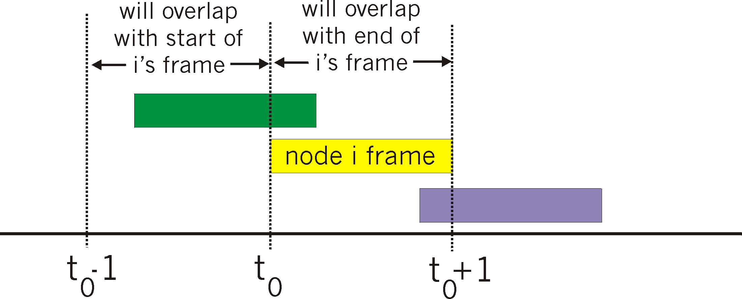
Pure (unslotted) ALOHA
unslotted Aloha: simpler, no synchronization
when frame first arrives
transmit immediately
collision probability increases:
frame sent at t₀ collides with other frames sent in [t₀-1,t₀+1]

Slide 16
Pure ALOHA efficiency
P(success by given node) = P(node transmits) .
P(no other node transmits in [t₀-1,t₀] .
P(no other node transmits in [t₀,t₀+1]
= p . (1-p)^{N-1 .} (1-p)^{N-1}
= p . (1-p)^{2(N-1)}
… choosing optimum p and then letting n
= 1/(2e) = .18
Worse than slotted Aloha!

Slide 17
Are there better strategies to transmit rather than independently and randomly?

Slide 18
CSMA (carrier sense multiple access)
CSMA: listen before transmit:
if channel sensed idle: transmit entire frame
if channel sensed busy, defer transmission
human analogy: don’t interrupt others!

Slide 19
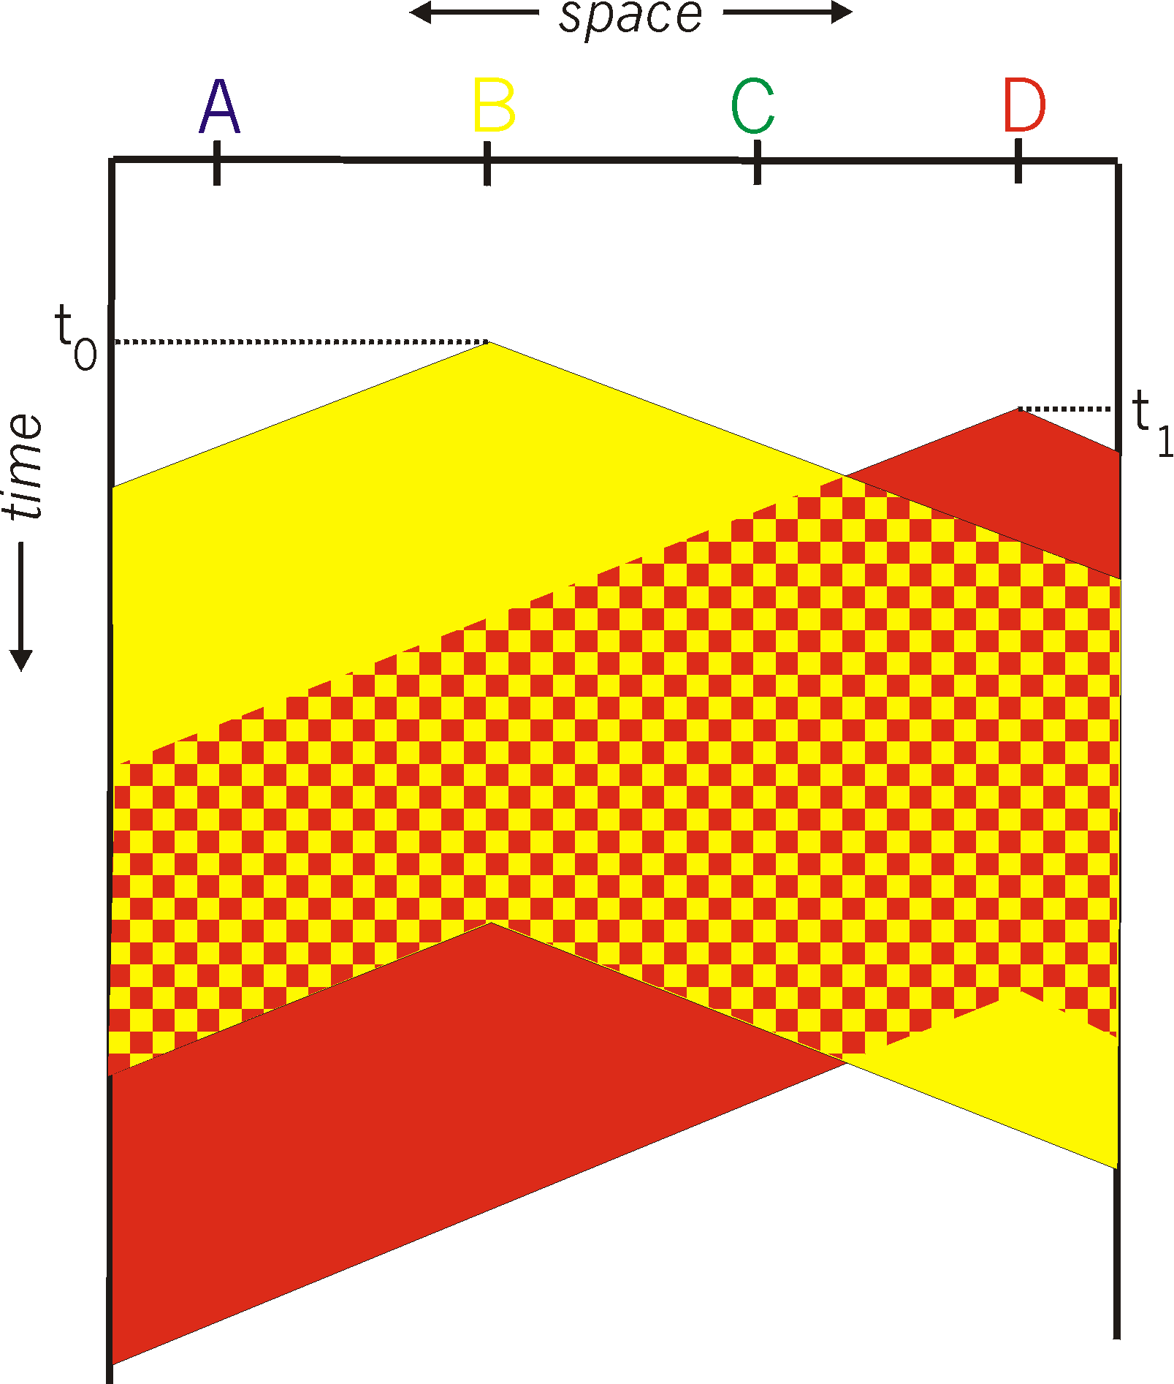
CSMA collisions
spatial layout of nodes
collisions can still occur: propagation delay means two nodes may not hear each other’s transmission
collision: entire packet transmission time wasted
distance & propagation delay play role in in determining collision probability

Slide 20
CSMA/CD (collision detection)
CSMA/CD: carrier sensing, deferral as in CSMA
collisions detected within short time
colliding transmissions aborted, reducing channel wastage
collision detection:
easy in wired LANs: measure signal strengths, compare transmitted, received signals
difficult in wireless LANs: received signal strength overwhelmed by local transmission strength
human analogy: the polite conversationalist

Slide 21
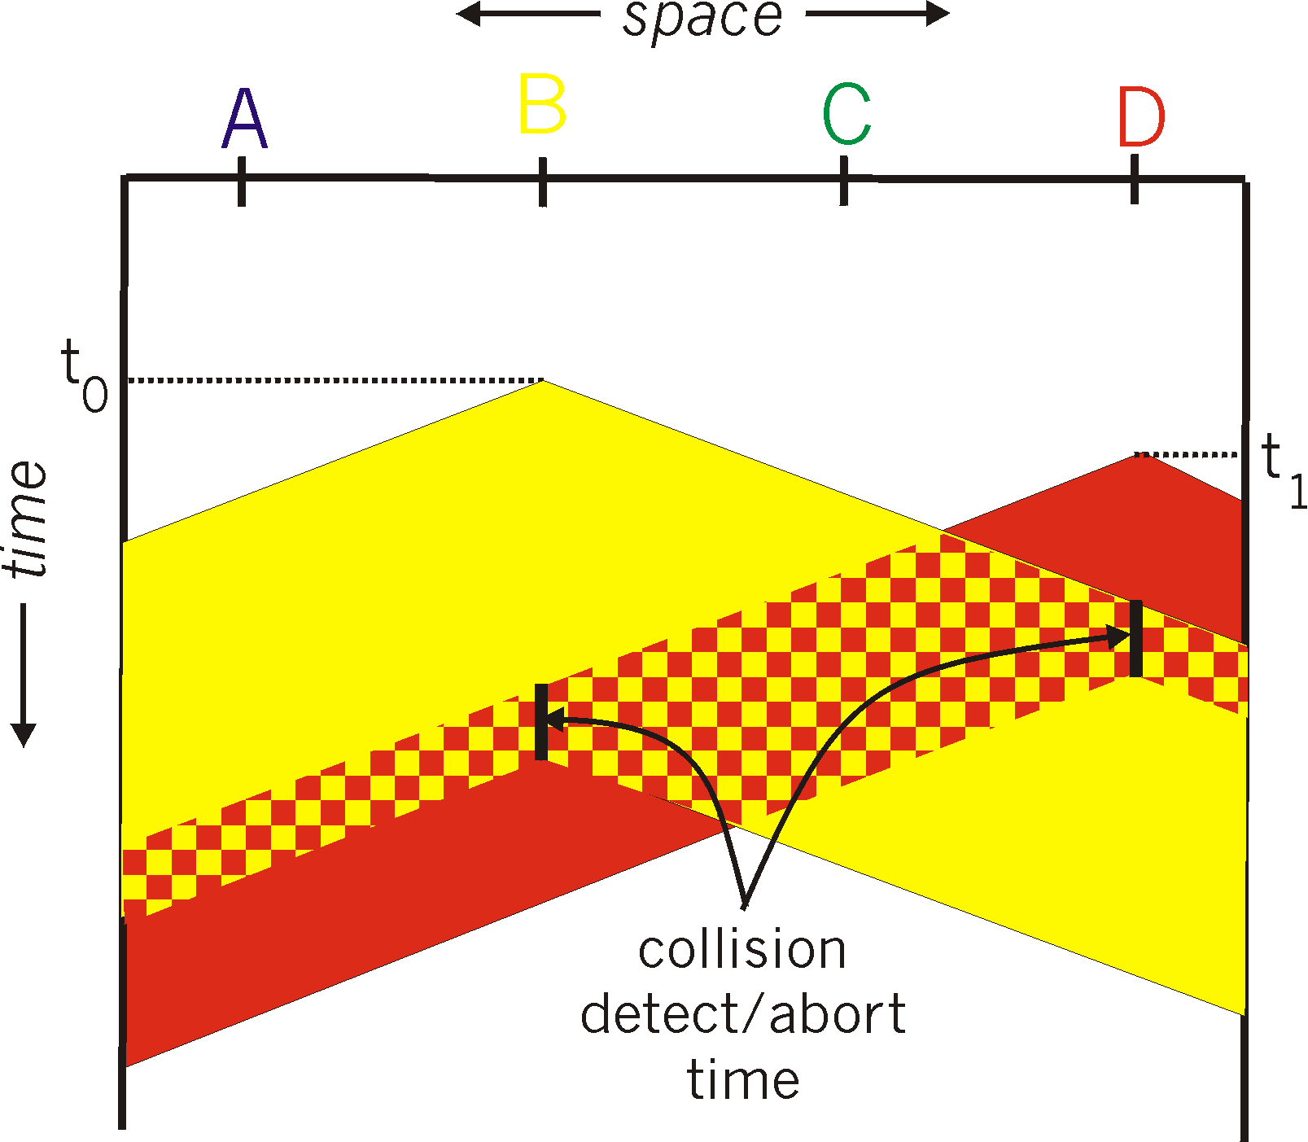
CSMA/CD (collision detection)
spatial layout of nodes

Slide 22
Ethernet CSMA/CD algorithm
1. NIC receives datagram from network layer, creates frame
2. If NIC senses channel idle, starts frame transmission. If NIC senses channel busy, waits until channel idle, then transmits.
3. If NIC transmits entire frame without detecting another transmission, NIC is done with frame !
4. If NIC detects another transmission while transmitting, aborts and sends jam signal
How long should the NIC wait to retransmit after aborting due to a collision?

Slide 23
Ethernet CSMA/CD algorithm
1. NIC receives datagram from network layer, creates frame
2. If NIC senses channel idle, starts frame transmission. If NIC senses channel busy, waits until channel idle, then transmits.
3. If NIC transmits entire frame without detecting another transmission, NIC is done with frame !
4. If NIC detects another transmission while transmitting, aborts and sends jam signal
5. After aborting, NIC enters binary (exponential) backoff:
after mth collision, NIC chooses K at random from {0,1,2, …, 2^{m}-1}. NIC waits K·512 bit times, returns to Step 2
longer backoff interval with more collisions

Slide 24
CSMA/CD efficiency
T_{prop} = max prop delay between 2 nodes in LAN
t_{trans} = time to transmit max-size frame
efficiency goes to 1
as t_{prop} goes to 0
as t_{trans} goes to infinity
better performance than ALOHA: and simple, cheap, decentralized!

Slide 25
(3) “Taking turns” MAC protocols
channel partitioning MAC protocols:
share channel efficiently and fairly at high load
inefficient at low load: delay in channel access, 1/N bandwidth allocated even if only 1 active node!
random access MAC protocols
efficient at low load: single node can fully utilize channel
high load: collision overhead
“taking turns” protocols
look for efficiency both at low and high load

Slide 26

“Taking turns” MAC protocols
polling:
orchestrator node “invites” sender nodes to transmit in turn
typically used with simple sender devices
concerns:
polling overhead
latency
single point of failure (orchestrator)
data
poll
orchestrator
data
senders

Slide 27
“Taking turns” MAC protocols
token passing:
control token passed from one node to next sequentially.
token message
concerns:
latency
single point of failure (node holding the token)
T
(nothing
to send)
T
data

Slide 28
Summary of multiple access protocols
channel partitioning
Time Division, Frequency Division
Code (next lectures)
random access
ALOHA, Slotted ALOHA, CSMA, CSMA/CD
carrier sensing: easy in some technologies (wire), hard in others (wireless)
CSMA/CD used in Ethernet
CSMA/CA used in 802.11
taking turns
polling from central site, token passing
Bluetooth, FDDI, token ring

