Slide 1

Application Architecture
Lecture 7
Srinivas Narayana
http://www.cs.rutgers.edu/~sn624/553-S25

Slide 2
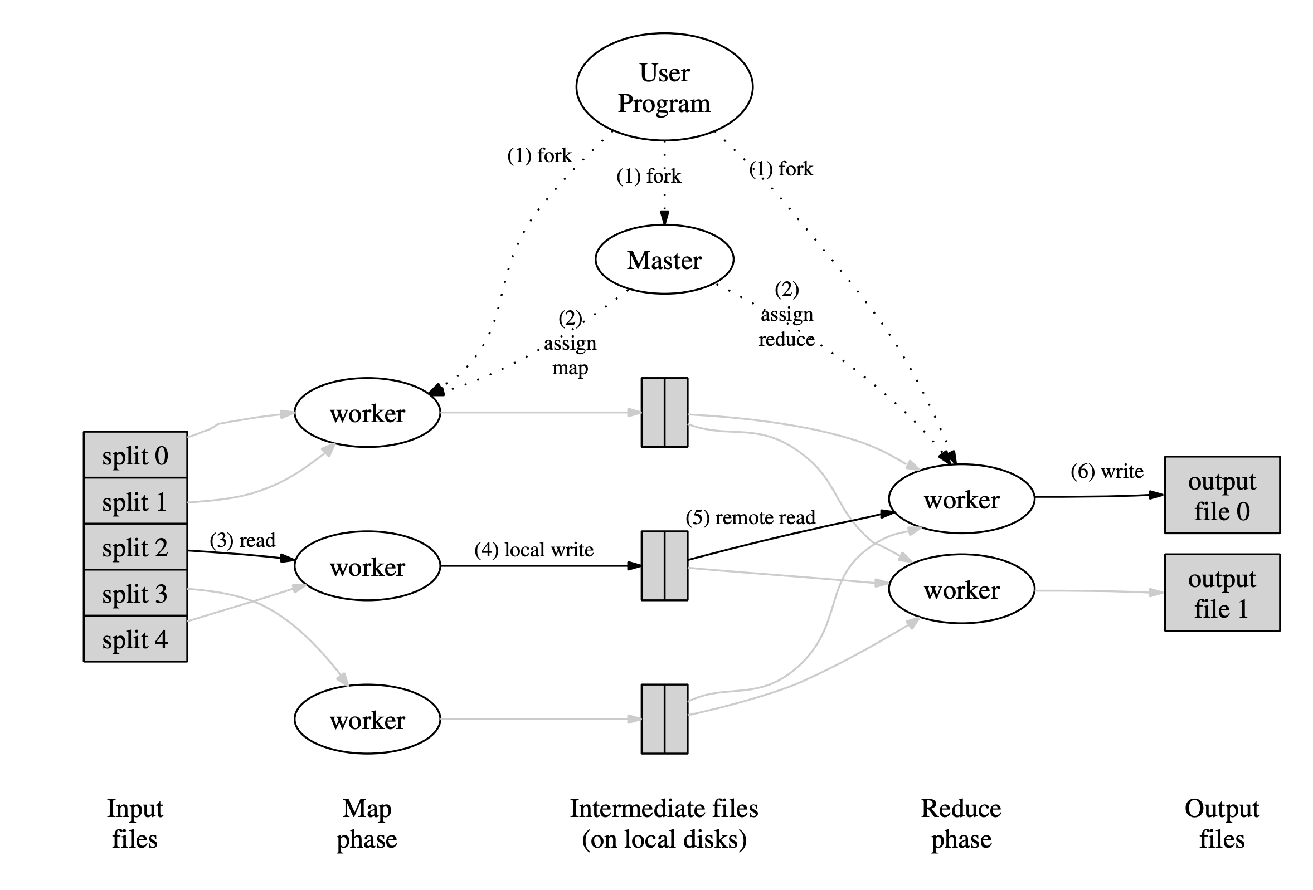
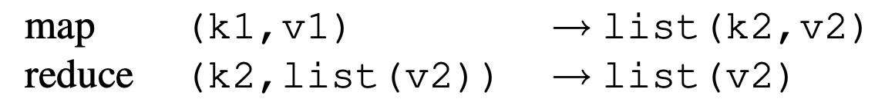
Review: Map-Reduce
Different (intermediate) key space
Same key space

Slide 3
Processing steps in MapReduce
Input data consumed from a distributed filesystem
Master ships code to the worker node closest to data, if possible (CPU, memory constraints permitting)
Each mapper partitions its input data by the reducer key
Typically through a hash function, e.g., hash (key) mod R == r
Sort output data (per partition) by the key; run map function
Reducers are informed of partial result at each mapper
Reducer pulls files from mappers through RPC
Output persisted to distributed filesystem (typically involves replication)
Result: R output files in the DFS (one per reducer partition)

Slide 4
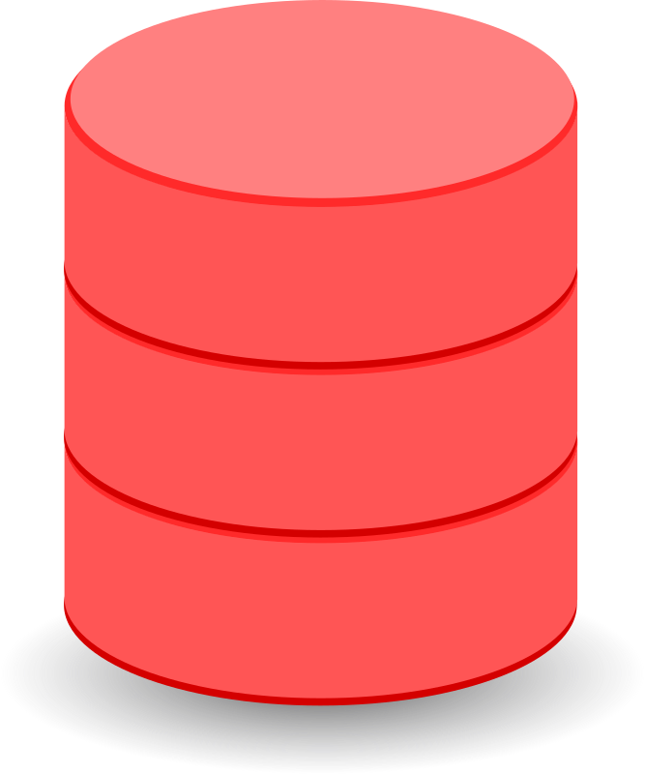
Implementation Key Principles
Data locality
Reduce network bandwidth: ship code to data
Locally persist (not DFS) intermediate results
Handle failures by re-doing compute
No fancy hardware fault tolerance (e.g., RAID)
Mapper failure: restart map job
Assume deterministic operations
Reducer failure (after completion): no problem (DFS)
Identify and skip shards with deterministic faults
Mitigate stragglers through eager replication of compute close to job completion
Combiners at mapper: preliminary reduce for associative and commutative functions

Slide 5
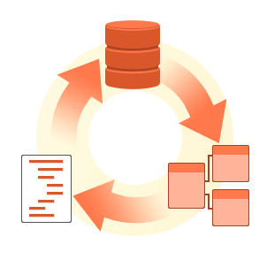
More examples of using map-reduce
Database Joins
Example: user activity (e.g. URLs) with user information (e.g. age)
Grouping (GROUPBY) aggregations:
Count, sum, etc
Creating the sequence of events in a user session, determining whether e.g. a new version of a web page resulted in better sales
Large distributed sorting
Output sorting after mapper: important!

Slide 6
Building on Map-Reduce: (1) Workflows
One Map-Reduce job isn’t usually enough
Google web search index: pipeline of 10 jobs; recommendation systems: 50—100
Workflows: Chains of map-reduce jobs
E.g., one MR for counting requests by URL; another to sort count
Explicit output files from each?
Like writing to file at the end of each tool in Unix pipeline
Materialization of the intermediate results needed?
Stragglers make workflows slower
Separate systems needed just to orchestrate the workflows correctly

Slide 7
Building on Map-Reduce: (2) Dataflow
Dataflow engines: handle the entire workflow
“Operators”: chain map-reduce functions
Only persist intermediate outputs to DFS when necessary
Chain reducers (no explicit mappers) when the key is the same
Don’t wait for stragglers of the previous job
Stream Processing
Incremental execution of batch jobs when new data arrives
Selectively materialize or recompute intermediate results
Lineages (RDD/Spark) or checkpoint

Slide 8
Serverless

Slide 9
What is serverless?
Programming model / abstraction
Stateless functions. Computation decoupled from where it is going to run
Event triggered
Auto scaling, fault tolerant. No need to manage anything
Charging for execution time rather than allocated resources (as a service model for customers). Request count, request exec time. Scale to zero
Servers definitely required. But user can execute code without managing any resources explicitly
Unfamiliar with cloud res management? can still run cloud code
Often only provide source code for the framework/runtime (e.g. python)
Many commercial offerings today (AWS, Microsoft, Azure)

Slide 10
Example
https://github.com/serverless/examples/blob/v4/aws-python-alexa-skill/handler.py
https://github.com/serverless/examples/blob/v4/aws-python-http-api/handler.py
https://github.com/serverless/examples/blob/v4/aws-python-line-echo-bot/handler.py
https://github.com/serverless/examples

Slide 11
What (kinds of) apps can be built?
Bursty compute-intensive workloads are best
Event processing: quintessential example of thumbnail creation for image upload by a user
Offloading API calls (e.g., mobile app to backend)
As a coordination service between services which have different characteristics (e.g. users upload service feedback with high volumes; process slowly & sift to then add issues at lower volume) – create a level of indirection
Edge computation (e.g. IoT/greengrass), CDN points of presence (e.g. cloudFlare)
Chatbots

Slide 12
Consequences of serverless abstraction
Stateless:
Database/storage integration becomes necessary
Storage options aren’t necessarily ideal (ephemeral? Long-term? High IOPS? Low latency?)
Ecosystem of other tools:
manage state, record logs, send alerts, perform authentication and authorization, messaging queues, cloud based storage
Prone to vendor lock-in
Relinquish control of resource provisioning, monitoring, maintenance, scalability, fault tolerance, placement, logging, …
Cost-driven decision making
Only pay for what you use rather than allocated
Billing tier depends on memory provisioned; request exec time/count
Packages and software libraries that inflate memory size
Long polling, web sockets? …

Slide 13
Consequences of serverless abstraction
Supporting stateful interactions (HTTP cookies, sessions)
Retrieve session state from storage across several connections/requests
Dedicated proxy to supply the session state
How to compose multiple serverless functions
Coordination server (always on, itself not serverless)
Use a messaging queue (message router/broker)
Need frameworks and tools to turn existing high-level language code (e.g. legacy applications) into serverless functions
E.g. python decorator app.route(…) web-hook into a serverless function
Unpredictable performance
Functions may run on different kinds of machines

Slide 14
How is serverless run?
We’ll talk more about the basic support you need in the infrastructure module (next)
Evolution of infrastructure and lightweightedness leading to it
Bare metal, VMs, containers.
Sitting between IAAS and SAAS
Servers are very much necessary, just not managed by the developer

Slide 15
What should the hosting platform do?
Architecture/workflow of the platform managing your functions
Get picture from baldini et al’s paper
Platform manages a set of user-defined functions
Take an event sent over http or received from an event source
Determine which function(s) to which to dispatch the event
Send event to a function instance
Wait for a response, make it available to user
Gather execution logs
Stop the function when no longer needed
Isolate functions of tenants from each other
Need to quickly start functions when requests arrive (bursty)
And also stop when functions no longer in use

Slide 16
Platform perspective
Promise for the cloud provider to manage resources more efficiently
Startup time could be substantial for sandboxing environment
Load balancing for code, data, package locality
Use existing hardware more efficiently, e.g. older server hardware
Balancing load across instances requires info provider may not have
Package, code, data, session locality

