Slide 1

Routing (part 2)
Lecture 24
http://www.cs.rutgers.edu/~sn624/352-F24
Srinivas Narayana

Slide 2

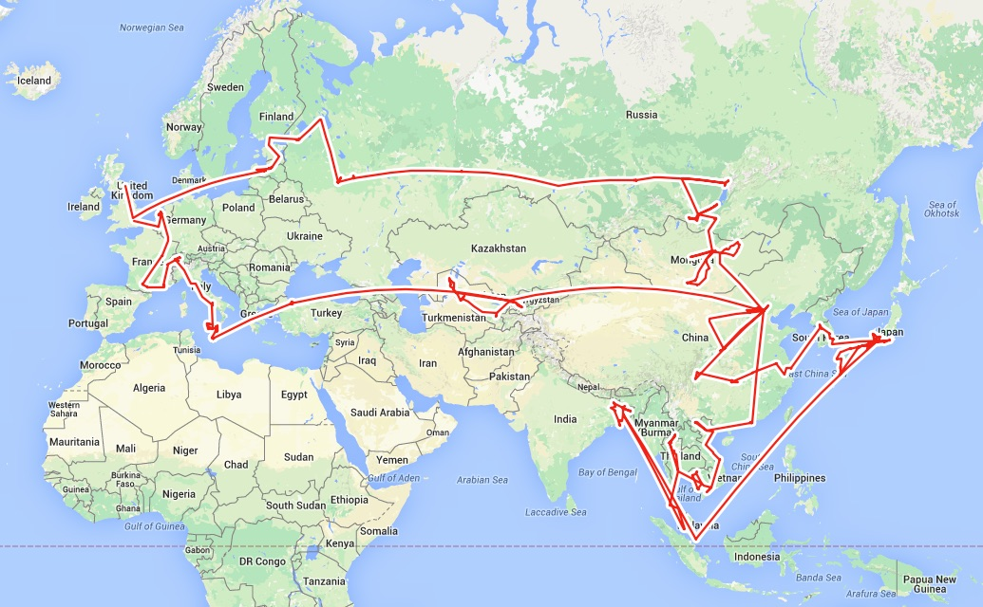

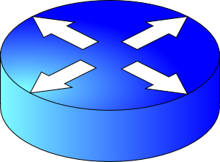


Goals of routing:
#1 Good paths
#2 Failure resilience
Routing: Google Maps for the Internet?
Routing protocols
Flooding
Dijkstra’s algorithm
Relaxation
5
Link state
protocols
Distance vector protocols
3
w
c(w, v)
v
w
D(w),
known least
2
5
Q1. What info exchanged?
u
2
1
z
v
3
1
2
x
y
D(v),
estimate
Q2. What computation?
1
u

Slide 3
Distance Vector Protocols

Slide 4
Distance Vector Protocol
Each router only exchanges a distance vector with its neighbors
Distance: how far the destination is
Vector: a value for each destination
DVs are only exchanged between neighbors; not flooded
Use incomplete view of graph derived from neighbors’ distance vectors to compute the shortest paths
Routing protocols
Q1. What info exchanged?
Q2. What computation?
Link state
protocols
Distance vector protocols

Slide 5
Q1: Distance Vectors
D_{x}(y) = estimate of least cost from x to y
Distance vector: D_{x} = [D_{x}(y): y є N ]
Node x knows cost of edge to each neighbor v: c(x,v)
Node x maintains D_{x}
Node x also maintains its neighbors’ distance vectors
For each neighbor v, x maintains D_{v} = [D_{v}(y): y є N ]
Nodes exchange distance vector periodically and whenever the local distance vector changes (e.g., link failure, cost changes)
Notes:
At each node we need
- an array (known as DV) that lists the current least costs to reach all known destinations
- also need to maintain the next-hop along the least cost path
- the DV’s from all neighbors

Slide 6
Q2: Algorithm
Bellman-Ford algorithm
Each node initializes its own distance vector (DV) to edge costs
Each node sends its DVs to its neighbors
When a node x receives new DV from a neighbor v, it updates its own DV using the Bellman-Ford equation:
Given d_{x}(y) := estimated cost of the least-cost path from x to y
Update d_{x}(y) = min_{v} {c(x,v) + d_{v}(y) }
cost of path from neighbor v to destination y
minimum taken over
all neighbors v of x
cost to reach neighbor v directly from x

Slide 7
Visualization
Neighbor v sends its distance vector to x.
Which neighbor v offers the current best path from x to y?
Path through neighbor v has cost c(x,v) + d_{v}(y)
Choose min-cost neighbor
Remember min-cost neighbor as the one used to reach node y
This neighbor determines the output port!
v
c(x,v)
v’
x
d_{v}(y)
v’’
y
v’’’
Use v’’ and link (x,v’’) to reach y.

Slide 8
D_{x}(y) = min{c(x,y) + D_{y}(y), c(x,z) + D_{z}(y)} = min{2+0 , 7+1} = 2
D_{x}(z) = min{c(x,y) + D_{y}(z),
c(x,z) + D_{z}(z)}
= min{2+1 , 7+0} = 3
node x table
cost to
cost to
cost to
x y z
x y z
x y z
x
0 2 7
x
0 2 3
x
0 2 3
from
y
∞
∞
∞
from
y
2 0 1
from
y
2 0 1
z
∞
∞
∞
z
7 1 0
z
3 1 0
node y table
cost to
cost to
cost to
x y z
x y z
x y z
y
x
∞
∞
∞
x
0 2 7
2
1
2 0 1
x
0 2 3
x
z
from
y
from
y
2 0 1
from
y
2 0 1
7
z
∞
∞
∞
z
7 1 0
z
3 1 0
node z table
cost to
cost to
cost to
x y z
x y z
x y z
x
∞ ∞ ∞
x
0 2 7
x
0 2 3
from
y
from
y
2 0 1
from
y
2 0 1
∞
∞
∞
z
z
3 1 0
z
3 1 0
7
1
0
time
Notes:
This example assumes that nodes are computing routes in a lock-step fashion.

Slide 9
Good news travels fast
Suppose the link cost reduces or a new better path becomes available in a network.
The immediate neighbors of the change detect the better path immediately
Since their DV changed, these nodes notify their neighbors immediately.
And those neighbors notify still more neighbors
… until the entire network knows to use the better path
Good news travels fast through the network
This is despite messages only being exchanged among neighbors
1
y
4
1
x
z
2

Slide 10

Bad news travels slowly
If router goes down, could be a while before network realizes it.
B still thinks it can reach A through C… bad!
A
B
C
D
E
1
2
3
4
Initially
C thinks it can reach A through B… worse!
3
2
3
4
After 1 exchange
3
4
3
4
After 2 exchanges
B, D think they can reach A through C… ugly!
5
4
5
4
After 3 exchanges
5
6
5
6
After 4 exchanges
Count to infinity problem
7
6
7
6
After 5 exchanges
etc… to infinity

Slide 11
Bad news travels slowly
Reacting appropriately to bad news requires information that only other routers have. DV does not exchange sufficient info.
B needs to know that C has no other path to A other than via B.
DV does not exchange paths; just distances!
Poisoned reverse: if X gets its route to Y via Z, then X will announce d_{X}(Y) = ∞ in its message to Z
Effect: Z won’t use X to route to Y
However, this won’t solve the problem in general (think why.)
A
B
C
D
E

Slide 12
Summary: Comparison of LS and DV
Link State Algorithms
Distance Vector Algorithms
Nodes have full visibility into the network’s graph
Copious message exchange: each LSA is flooded over the whole network
Robust to network changes and failures
Only distances and neighbors are visible
Sparse message exchange: DVs are exchanged among neighbors only
Brittle to router failures. Incorrect info may propagate all over net
OSPF
Open Shortest Path First
(v2 RFC 2328)
EIGRP
Enhanced Interior Gateway Routing Protocol
(RFC 7868)

Slide 13
Routing protocols
Link state
protocols
Distance vector protocols
Every router is aware of the existence of every other router.
Messages reveal information on the full network (graph) structure.
Message exchange and forwarding tables scale with network size.
These assumptions/settings cannot work on the Internet.

Slide 14
Internet Routing

Slide 15





The Internet is a large federated network
AT&T
Comcast
Verizon

Slide 16
The Internet is a large federated network
Several autonomously run organizations: No one “boss”
Organizations cooperate, but also compete
AT&T
Comcast
e.g., AT&T has little commercial interest in revealing its internal network structure to Verizon.
Verizon

Slide 17
The Internet is a large federated network
Several autonomously run organizations: No one “boss”
Organizations cooperate, but also compete
AT&T
Message exchanges must
not reveal internal network details.
Comcast
Verizon
Algorithm must work with “incomplete” information about its neighbors’ internal topology.

Slide 18
The Internet is a large federated network
Internet today: > 70,000 unique autonomous networks
Internet routers: > 800,000 forwarding table entries
AT&T
Keep messages & tables as small as possible. Don’t flood
Comcast
Verizon
Algorithm must be incremental: don’t recompute the whole table on every message exchanged.

Slide 19
Inter-domain Routing
Routing approaches so far (LS + DV) are applicable within one autonomous system (AS), e.g., Rutgers
Called intra-domain routing protocols
The Internet uses Border Gateway Protocol (BGP)
All AS’es speak BGP. It is the glue that holds the Internet together
BGP is a path vector protocol
Routing protocols
Link state
protocols
Distance vector protocols
Path vector protocols
Messages?
Algorithm?

Slide 20
Q1. BGP Messages
Loop detection is easy
(no “count to infinity”)
Exchange paths: path vector
Routing Announcements or Advertisements
“I am here” or “I can reach here”
Occur over a TCP connection (BGP session) between routers
Route announcement = destination + attributes
Destination: IP prefix
Route Attributes:
AS-level path
Next hop
Several others: origin, MED, community, etc.
An AS promises to use advertised path to reach destination
Only route changes are advertised after BGP session established
No link metrics, distances!
“I am here.”
Dst: 128.1.2.0/24
AS path: X
1b
“I can reach X”
Dst: 128.1.2.0/24
AS path: AS2, X
AS 2
1a
1c
2b
1d
2a
2c
X
2d

Slide 21
Q1. Next Hop
Next hop conceptually denotes the first router interface that begins the AS-level path
The meaning of this attribute is context-dependent
In an announcement arriving from a different AS (eBGP), next hop is the router in the next AS which sent the announcement
Example: Next Hop of the eBGP announcement reaching 1c is 2a
1b
2b
1a
1c
2a
2c
X
1d
2d
AS 1
eBGP announcement:
AS2, X
AS 2

Slide 22
Q1. Next Hop
Suppose router 1c imports the path (more on this soon)
Router 1c will propagate the announcement inside the AS using iBGP
The next hop of this (iBGP) announcement is set to 1c
In particular, the next hop is an AS1 internal address
1b
2b
1a
1c
2a
2c
X
1d
2d
AS 1
eBGP announcement:
AS2, X
AS 2

Slide 23
Q2. The algorithm
A BGP router does not consider every routing advertisement it receives by default to make routing decisions!
An import policy determines whether a route is even considered a candidate
Once imported, the router performs route selection
A BGP router does not propagate its chosen path to a destination to all other AS’es by default!
An export policy determines whether a (chosen) path can be advertised to other AS’es and routers
Programmed by network operator
Policy considerations make BGP very different from intra-domain (LS / DV) protocols

Slide 24
Policies in BGP

Slide 25
Policy arises from business relationships
Customer-provider relationships:
E.g., Rutgers is a customer of AT&T
Peer-peer relationships:
E.g., Verizon is a peer of AT&T
Business relationships depend on where connectivity occurs
“Where”, also called a “point of presence” (PoP)
e.g., customers at one PoP but peers at another
Internet-eXchange Points (IXPs) are large PoPs where ISPs come together to connect with each other (often for free)

Slide 26
BGP Export Policy
legend:
provider
B
network
X
W
A
customer
C
network:
Y
Suppose an ISP only wants to route traffic to/from its customer networks (does not want to carry transit traffic between other ISPs)
A,B,C are provider networks
X,W,Y are customers (of provider networks)
X is dual-homed: attached to two networks
policy to enforce: X does not want to route from B to C via X
So, X will not announce to B a route to C

Slide 27
BGP Export Policy
legend:
provider
B
network
X
W
A
customer
C
network:
Y
Suppose an ISP only wants to route traffic to/from its customer networks (does not want to carry transit traffic between other ISPs)
A announces path Aw to B and to C
B will not announce BAw to C:
B gets no “revenue” for routing CBAw, since none of C, A, w are B’s customers
C will route CAw (not using B) to get to w

Slide 28
BGP Import Policy
legend:
provider
B
network
X
W
A
customer
C
network:
Y
Suppose an ISP wants to minimize costs by avoiding routing through its providers when possible.
Suppose C announces path Cy to x
Further, y announces a direct path (“y”) to x
Then x may choose not to import the path Cy to y since it has a peer path (“y”) towards y

Slide 29
Q2. BGP Route Selection
When a router imports more than one route to a destination IP prefix, it selects route based on:
local preference value attribute (import policy decision -- set by network admin)
shortest AS-PATH
closest NEXT-HOP router
Several additional criteria: You can read up on the full, complex, list of criteria, e.g., at https://www.cisco.com/c/en/us/support/docs/ip/border-gateway-protocol-bgp/13753-25.html

Slide 30

Example of route selection
NA
EU
Suppose AS A and B are connected to each other both in North America (NA) and in Europe (EU)
A source in NA wants to reach a destination in EU
There are two paths available
Assume same local preference
Same AS path length
Closest next hop-router: choose path via B1 rather than B2
Dst-EU
A1
A2
AS A
B1
B2
Src-NA
AS B

Slide 31

Example of route selection
NA
EU
Choosing closest next-hop results in early exit routing
Try to exit the local AS as early as possible
Also called hot potato routing
Reduce resource use within local AS
potentially at the expense of another AS
Dst-EU
A1
A2
AS A
B1
B2
Src-NA
AS B

Slide 32
Computing the forwarding table
AS3
3b
AS1
1b
3a
3c
1a
1c
AS2
2b
3d
X
1d
2a
2c
2d
Suppose a router in AS1 wants to forward a packet destined to external prefix X.
How is the forwarding table entry for X at 1d computed?
How is the forwarding table entry for X at 1c computed?

Slide 33
eBGP and iBGP announcements
AS3
3b
AS1
1b
3a
3c
1a
1c
AS2
2b
3d
X
1d
AS3,X
AS2,AS3,X
2a
2c
2d
AS2 router 2c receives path announcement AS3,X (via eBGP) from AS3 router 3a
Based on AS2 import policy, AS2 router 2c imports and selects path AS3,X, propagates (via iBGP) to all AS2 routers
Based on AS2 export policy, AS2 router 2a announces (via eBGP) path AS2, AS3, X to AS1 router 1c

Slide 34
eBGP and iBGP announcements
AS3
3b
AS1
1b
AS3,X
3a
3c
1a
1c
AS2
2b
3d
X
1d
AS3,X
AS2,AS3,X
2a
2c
2d
A given router may learn about multiple paths to destination:
AS1 gateway router 1c learns path AS2,AS3,X from 2a (next hop 2a)
AS1 gateway router 1c learns path AS3,X from 3a (next hop 3a)
Through BGP route selection process, AS1 gateway router 1c chooses path AS3,X, and announces path within AS1 via iBGP (next hop 1c)

Slide 35
Setting forwarding table entries
AS3
3b
AS1
1b
AS3,X
3a
3c
1a
1c
2
AS2
2b
1
3d
X
3
1d
AS3,X
AS2,AS3,X
2a
2c
2d
recall: 1a, 1b, 1d learn about dest X via iBGP from next-hop 1c: “path to X goes through 1c”
1d: intra-domain routing: to get to 1c, forward over outgoing local interface 1
dest
Next-Hop
NH
interface
…
…
…
…
…
…
…
…
X
1c
1c
1
IP Dst
Out port
Forwarding table
X
1

Slide 36
Setting forwarding table entries
AS3
3b
AS1
1b
AS3,X
1
2
3a
3c
1a
1c
3
AS2
2b
3d
X
1d
AS3,X
AS2,AS3,X
2a
2c
2d
dest
Next-Hop
NH
interface
recall: 1c learns about dest X via eBGP from next-hop 3a: “path to X goes through 3a”
1c: to get to link-local neighbor 3a, forward out interface 2
…
…
…
…
…
…
…
…
X
3a
3a
2
IP Dst
Out port
Forwarding table
X
2

Slide 37
Summary: Inter-domain routing
Federation and scale introduce new requirements for routing on the Internet
BGP is the protocol that handles Internet routing
Path vector: exchange paths to a destination with attributes
Policy-based import of routes, route selection, and export

Slide 38
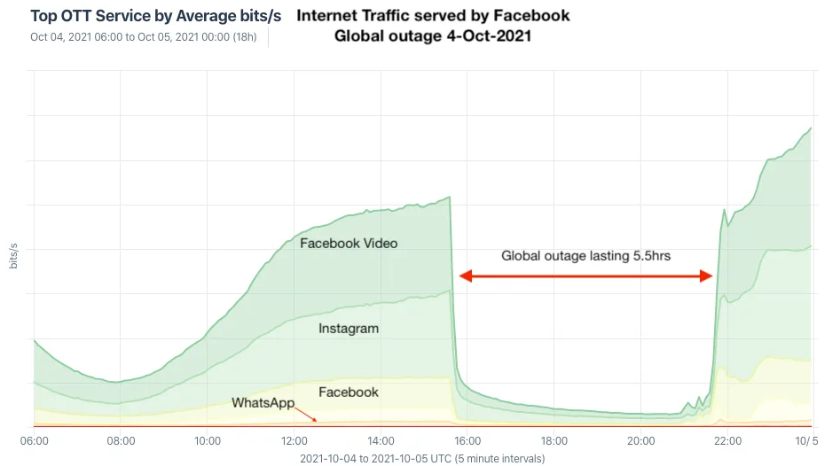
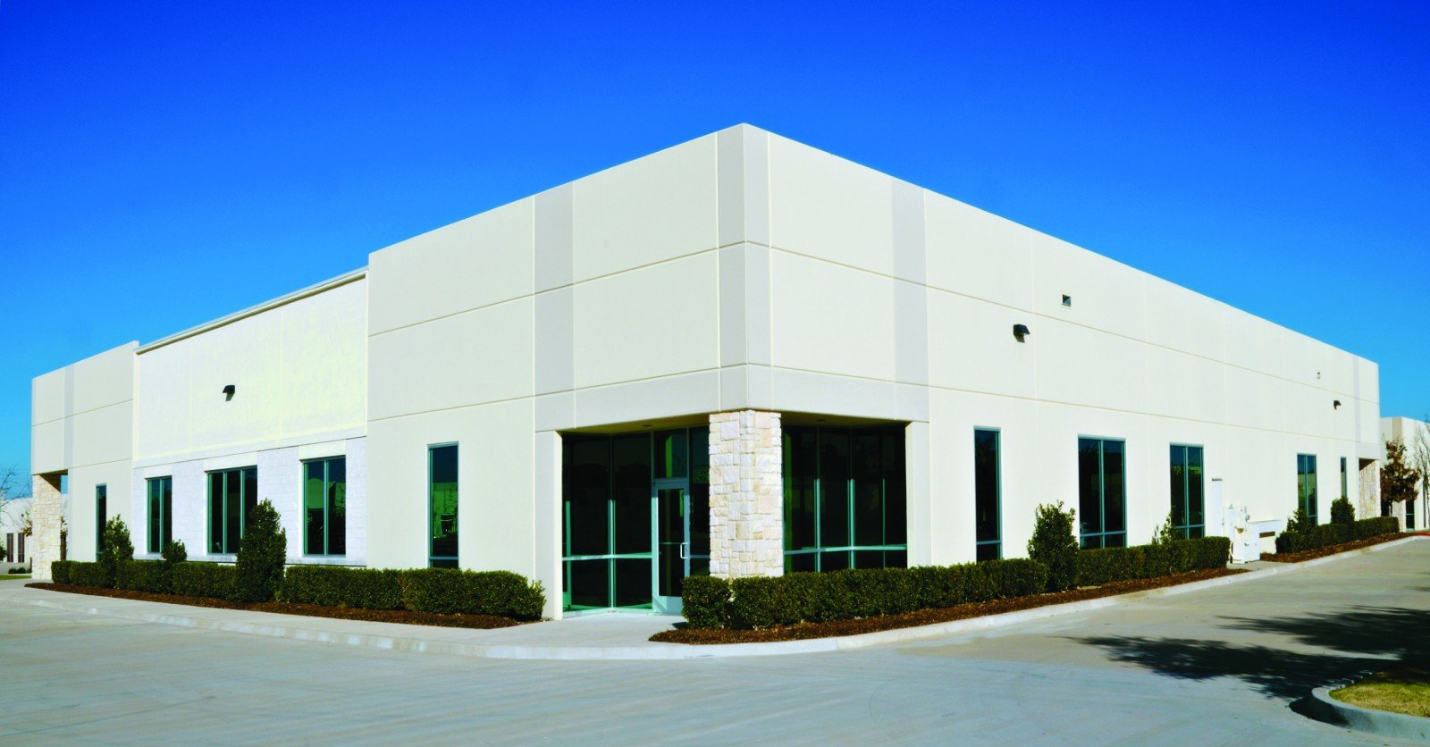

BGP’s impact: October ’21 FB++ outage
BGP route withdrawal:
“I can’t reach FB anymore”
FB network
Rest of the Internet
BGP route withdrawal: don’t use me to get to FB
FB’s DNS servers
No remote access (no more reachability due to BGP withdrawal of DC and DNS servers)
Restricted physical access (prox can’t verify, can’t access prox server)
https://engineering.fb.com/2021/10/05/networking-traffic/outage-details/
By Doug Madory - https://www.kentik.com/blog/facebooks-historic-outage-explained/, CC BY 4.0, https://commons.wikimedia.org/w/index.php?curid=110816752

