Slide 1

Network Layer: Control/data plane, addressing, routers
CS 352, Lecture 10
http://www.cs.rutgers.edu/~sn624/352-S19
Srinivas Narayana
(heavily adapted from slides by Prof. Badri Nath and the textbook authors)

Slide 2
Next: Network layer
Application
HTTPS
FTP
HTTP
SMTP
DNS
Transport
TCP
UDP
Network
IP
Host-to-Net
X.25
…
802.11
ATM

Slide 3
















Network layer
application
transport
network
data link
physical
transport segment from sending to receiving host
on sending side encapsulates segments into datagrams
on receiving side, delivers segments to transport layer
network layer protocols in every host, router
router examines header fields in all IP datagrams passing through it
network
data link
physical
network
data link
physical
network
data link
physical
network
data link
physical
network
data link
physical
network
data link
physical
network
data link
physical
network
data link
physical
network
data link
physical
application
transport
network
data link
physical
network
data link
physical
network
data link
physical

Slide 4
Two key network-layer functions
network-layer functions:
forwarding: move packets from router’s input to appropriate router output
routing: determine route taken by packets from source to destination
routing algorithms
analogy: taking a trip
forwarding: process of getting through single interchange
routing: process of planning trip from source to destination

Slide 5
Network layer: data plane, control plane
Data plane
local, per-router function
determines how datagram arriving on router input port is forwarded to router output port
forwarding function
Control plane
network-wide logic
determines how datagram is routed among routers along end-end path from source host to destination host
two control-plane approaches:
traditional routing algorithms: implemented in routers
software-defined networking (SDN): implemented in (remote) servers
values in arriving
packet header
0111
1
3
2

Slide 6
IP Addressing

Slide 7
IPv4 Addresses
32 bits long
Identifier for host, router interface
Notation:
Each byte is written in decimal in MSB order, separated by dots
Example: 128.195.1.80 stands for the 32-bit IP address
10000000 11000011 00000001 01010000

Slide 8
Types of IPv4 Addresses
Unicast Address
Destination is a single host
Multicast address
Destination is a group of hosts
Broadcast address
255.255.255.255
Destination is all hosts

Slide 9
IPv4 Address Classes (old)
Class
32 bits
0
Net
Type of Serv.
A
Host
B
10
Net
Host
C
110
Net
Host
D
1110
Multicast address
E
1111
Reserved

Slide 10
IP Address Classes
Class A:
For very large organizations
16 million hosts allowed
Class B:
For large organizations
65 thousand hosts allowed
Class C
For small organizations
255 hosts allowed
Class D
Multicast addresses
No network/host hierarchy

Slide 11
Problems with Class-based Routing
Too many small networks requiring multiple class C addresses
Running out of class B addresses, not enough nets in class A
Addressing strategy must allow for greater diversity of network sizes

Slide 12
IP addressing: CIDR
CIDR: Classless InterDomain Routing
subnet portion of address of arbitrary length
address format: a.b.c.d/x, where x is # bits in subnet portion of address
subnet
part
host
part
11001000 00010111 00010000 00000000
200.23.16.0/23

Slide 13
CIDR
An ISP can obtain a block of addresses and partition this further to its customers
Say an ISP has 200.8.0.0/16 address (65K addresses).
He has another customer who needs only 64 addresses starting from 200.8.4.128
Then that block can be specified as 200.8.4.128/26
Notes:
Instead of announcing all routes individually ...

Slide 14
Subnetting
Example: Class B address with 8-bit subnetting
16 bits
8 bits
8 bits
Network id
Subnet id
Host id
Example
Address:
165.230
.24
.8

Slide 15
Subnet Masks
Subnet masks allow hosts to determine if another IP address is on the same subnet or the same network
16 bits
8 bits
8 bits
Network id
Subnet id
Host id
Mask:
1111111111111111
11111111
00000000
255.255
.255
.0

Slide 16
Subnet Masks (cont’d)
Assume IP addresses A and B share subnet mask M.
Are IP addresses A and B on the same subnet?
1. Compute logical AND (A & M).
2. Compute logical AND (B & M).
3. If (A & M) == (B & M) then A and B are
on the same subnet.
Example: A and B are class B addresses
A = 165.230.82.52
B = 165.230.24.93
M = 255.255.255.0
Same (classful) network?
Same subnet?

Slide 17
Example of IP Addressing in a network
223.1.1.1
223.1.2.1
223.1.1.2
223.1.1.4
223.1.2.9
223.1.2.2
223.1.1.3
223.1.3.27
223.1.3.1
223.1.3.2

Slide 18
What’s inside a router?

Slide 19
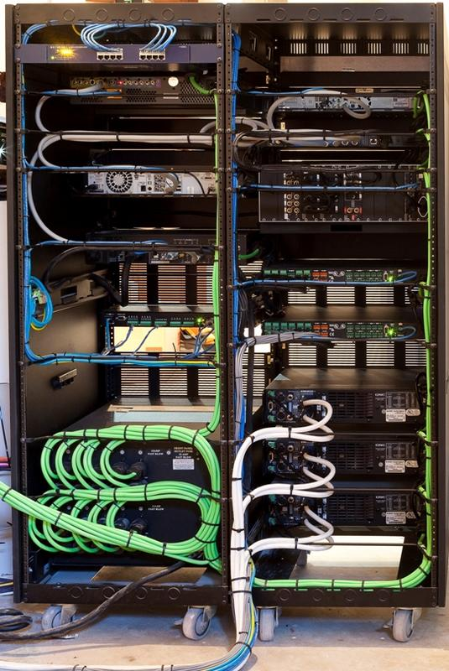
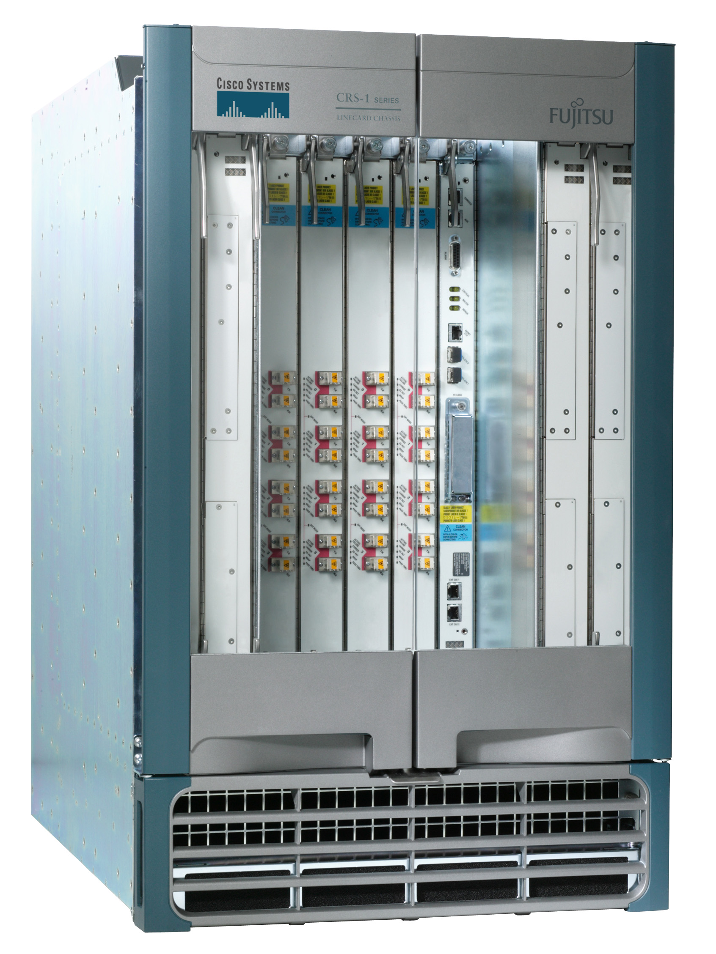
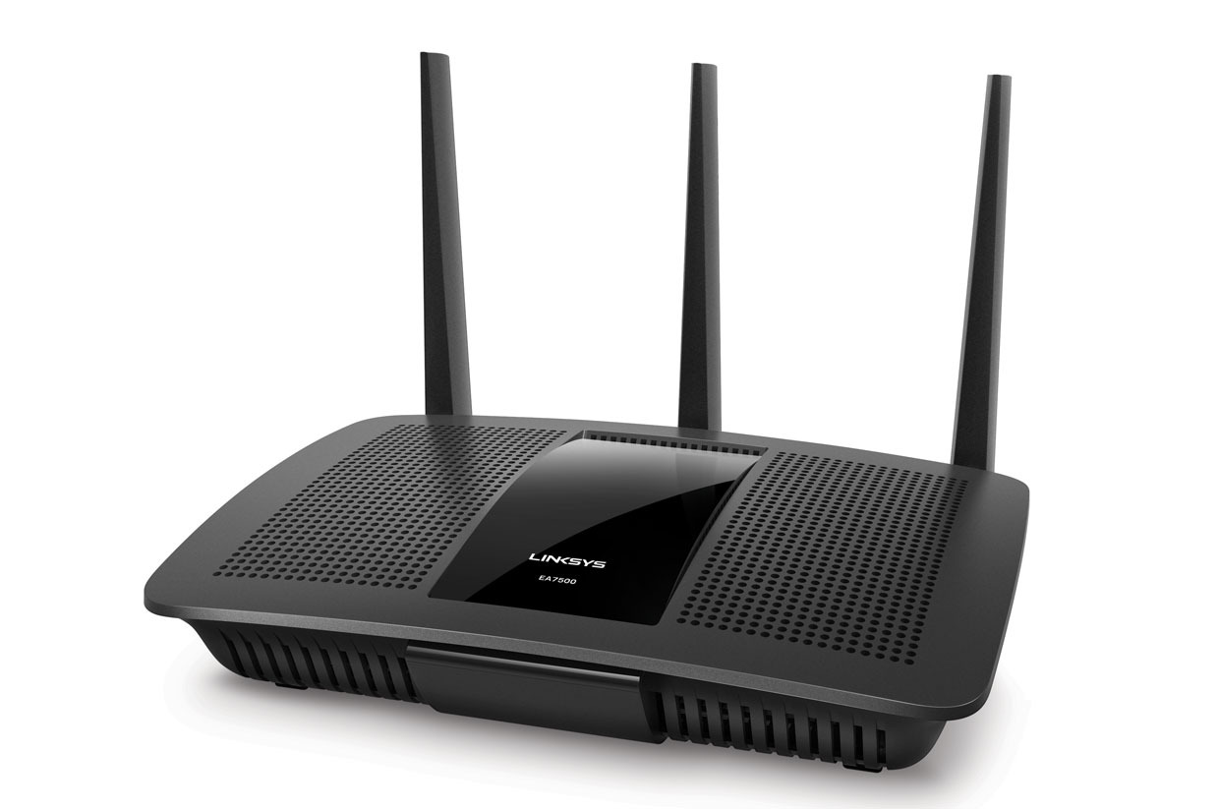

What do routers look like?
Access routers
Core router
Data center top-of-rack switch

Slide 20

Basic components: Control & Data Planes
Traditionally:
Individual routing algorithm components in each and every router interact in the control plane
Control plane
per route-change processing
(~ a few seconds)
Routing
Algorithm
control
plane
data
plane
Data plane
per-packet processing
(~ tens of nanoseconds)
0111
1
3
2
values in arriving
packet header

Slide 21
Router architecture overview
routing
processor
Control plane
Data plane
high-speed
switching
fabric
router input ports
router output ports

Slide 22
Input port functions
lookup,
forwarding
queueing
line
termination
link
layer
protocol
(receive)
switch
fabric
physical layer:
bit-level reception
Switching:
using header field values, lookup output port using forwarding table in input port memory (“match plus action”)
goal: complete input port processing at ‘line speed’
queuing: if datagrams arrive faster than forwarding rate into switch fabric
data link layer:
e.g., Ethernet
(We’ll see this later in the course)

Slide 23
Destination-based Forwarding in the Internet
Packet
payload
header
Router
Destination Address
Routing Lookup Data Structure
Outgoing Port
Forwarding Table
Dest-network
Port
65.0.0.0/8
3
128.9.0.0/16
1
149.12.0.0/19
7

Slide 24
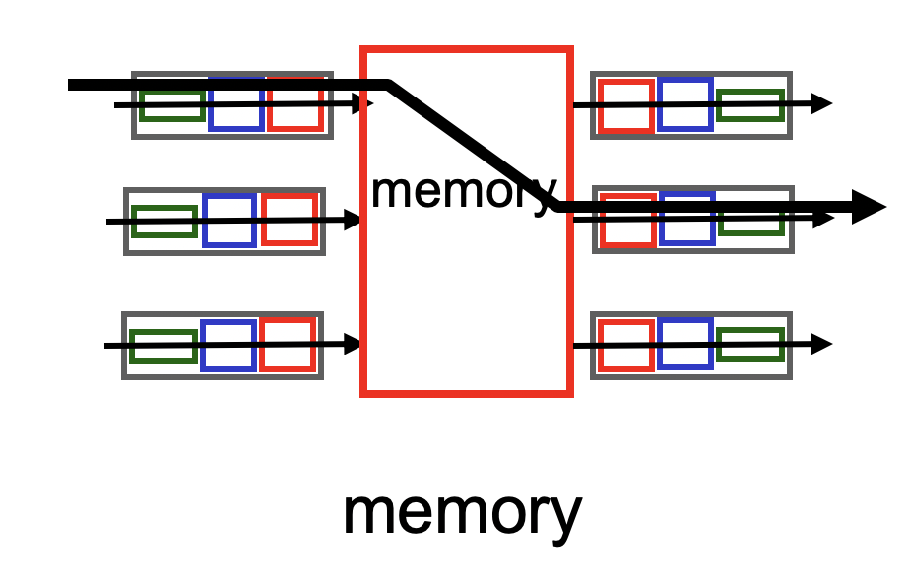
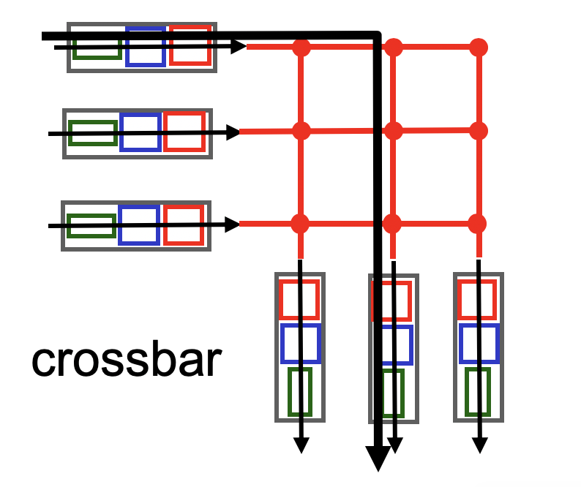
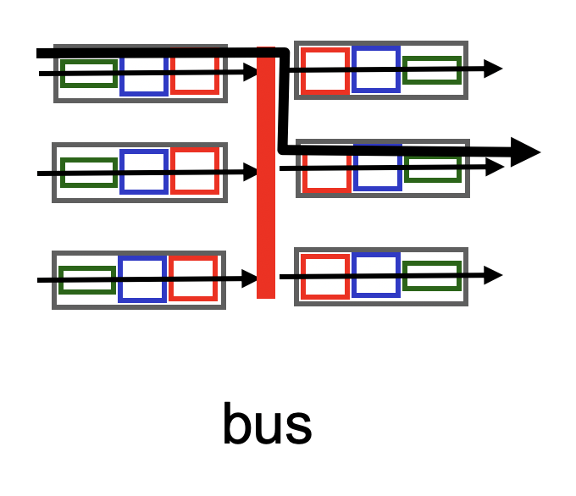
Three types of switching fabrics

Slide 25
Output Ports
datagram
buffer
queueing
switch
fabric
link
layer
protocol
(send)
line
termination
Buffering required when datagrams arrive from fabric faster than the transmission rate
Important implication: if buffers filled up, packets are dropped!
Scheduling discipline chooses among queued datagrams for transmission
Important implication: Who gets priority is chosen by the scheduler

Slide 26
Prefixes and IP lookup

Slide 27
Example Forwarding Table
Destination IP Prefix | Outgoing Port
65.0.0.0/8 | 3
128.9.0.0/16 | 1
65.0.0.128/25 | 4
142.12.0.0/19 | 7
Prefix length
IP prefix: 0-32 bits
Longest prefix match
142.12.0.0/19
128.9.0.0/16
65.0.0.0/8
0
2²⁴
128.9.16.14
2³²-1
65.0.0.0
65.255.255.255

Slide 28
Prefixes can Overlap
Longest matching prefix
128.9.176.0/24
128.9.16.0/24
65.0.0.0/8
142.12.0.0/19
128.9.0.0/16
0
128.9.16.14
2³²-1
Routing lookup: Find the longest matching prefix (the most specific route) among all prefixes that match the destination address.

Slide 29
Reducing Routing Table Size
Without CIDR:
200.71.0.0
200.71.1.0
200.71.2.0
…..
200.71.255.0
200.71.0.0
200.71.1.0
200.71.2.0
…..
200.71.255.0
service
provider
Routing
table
With CIDR:
200.71.0.0
200.71.1.0
200.71.2.0
…..
200.71.255.0
service
provider
200.71.0.0/16
Routing
table

Slide 30
Hierarchical addressing: Route aggregation
Efficient advertisement of routing information!
Organization 0
200.23.16.0/23
Organization 1
200.23.18.0/23
“Send me anything
with addresses
beginning
200.23.16.0/20”
Organization 2
200.23.20.0/23
.
Fly-By-Night-ISP
.
.
.
.
Internet
Organization 7
.
200.23.30.0/23
ISPs-R-Us
“Send me anything
with addresses
beginning
199.31.0.0/16”

Slide 31
LPM: Announcing more specific routes
ISPs-R-Us has a more specific route to Organization 1
Longest prefix match will be used to route IP packets
Organization 0
200.23.16.0/23
“Send me anything
with addresses
beginning
200.23.16.0/20”
Organization 2
200.23.20.0/23
.
Fly-By-Night-ISP
.
.
.
.
Internet
Organization 7
.
200.23.30.0/23
ISPs-R-Us
“Send me anything
with addresses
beginning 199.31.0.0/16
or 200.23.18.0/23”
Organization 1
200.23.18.0/23

Slide 32
The Internet Protocol (IP)

Slide 33
IP datagram format
IP protocol version
number
32 bits
total datagram
length (bytes)
header length
(bytes)
head.
len
type of
service
ver
length
for
fragmentation/
reassembly
“type” of data
flgs
fragment
offset
16-bit identifier
max number
remaining hops
(decremented at
each router)
time to
live
upper
layer
header
checksum
32 bit source IP address
upper layer protocol
to deliver payload to
32 bit destination IP address
Options (if any)
E.g. timestamp,
record route
taken, specify
list of routers
to visit.
how much overhead with TCP?
20 bytes of TCP
20 bytes of IP
= 40 bytes + app layer overhead
data
(variable length,
typically a TCP
or UDP segment)

Slide 34
IP Fragmentation & Reassembly
network links have MTU (max.transfer size) - largest possible link-level frame.
different link types, different MTUs
large IP datagram divided (“fragmented”) within net
one datagram becomes several datagrams
“reassembled” only at final destination
IP header bits used to identify, order related fragments
fragmentation:
in: one large datagram
out: 3 smaller datagrams
reassembly

Slide 35
IP Fragmentation and Reassembly
length
=4000
ID
=x
fragflag
=0
offset
=0
Example
4000 byte datagram
MTU = 1500 bytes
One large datagram becomes
several smaller datagrams
length
=1500
ID
=x
fragflag
=1
offset
=0
1480 bytes in data field
length
=1500
ID
=x
fragflag
=1
offset
=185
offset =
1480/8
length
=1040
ID
=x
fragflag
=0
offset
=370

Slide 38
IP Address Hierarchy
Class A, B, C addresses support two levels of hierarchy
However, the host portion can be further split into “subnets” by the address class owner
more than 2 levels of hierarchy

Slide 39
Basic Components
Routing
Protocols
Control Plane
Routing
Table
Data plane
per-packet processing
Forwarding
Table
Switching

Slide 40
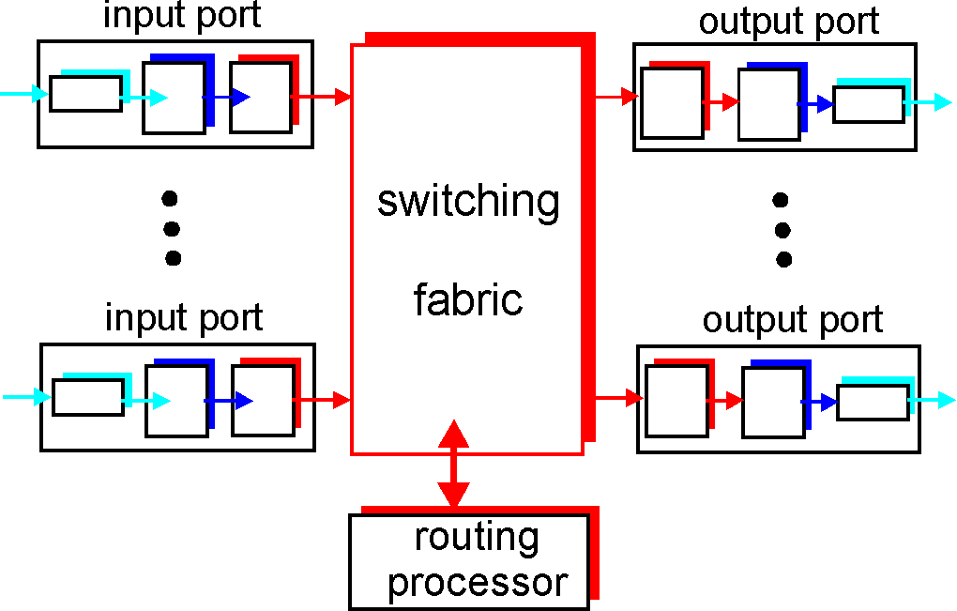
Router Architecture Overview

Slide 41
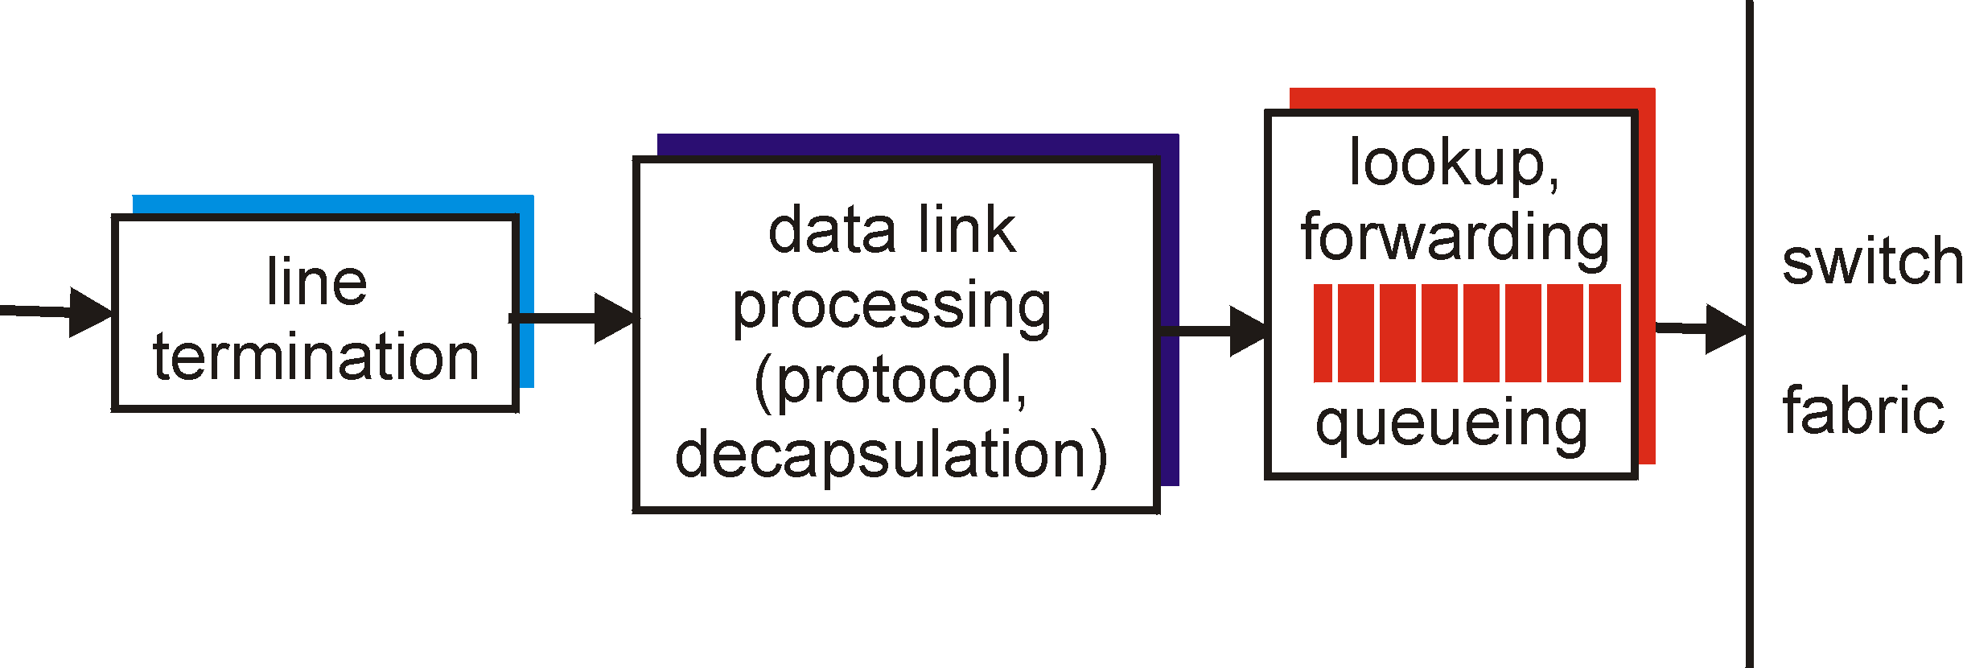
Input Port Functions
Physical layer:
bit-level reception
Data link layer:
e.g., Ethernet
see chapter 5
Decentralized switching:
queuing: if datagrams arrive faster than forwarding rate into switch fabric

Slide 42
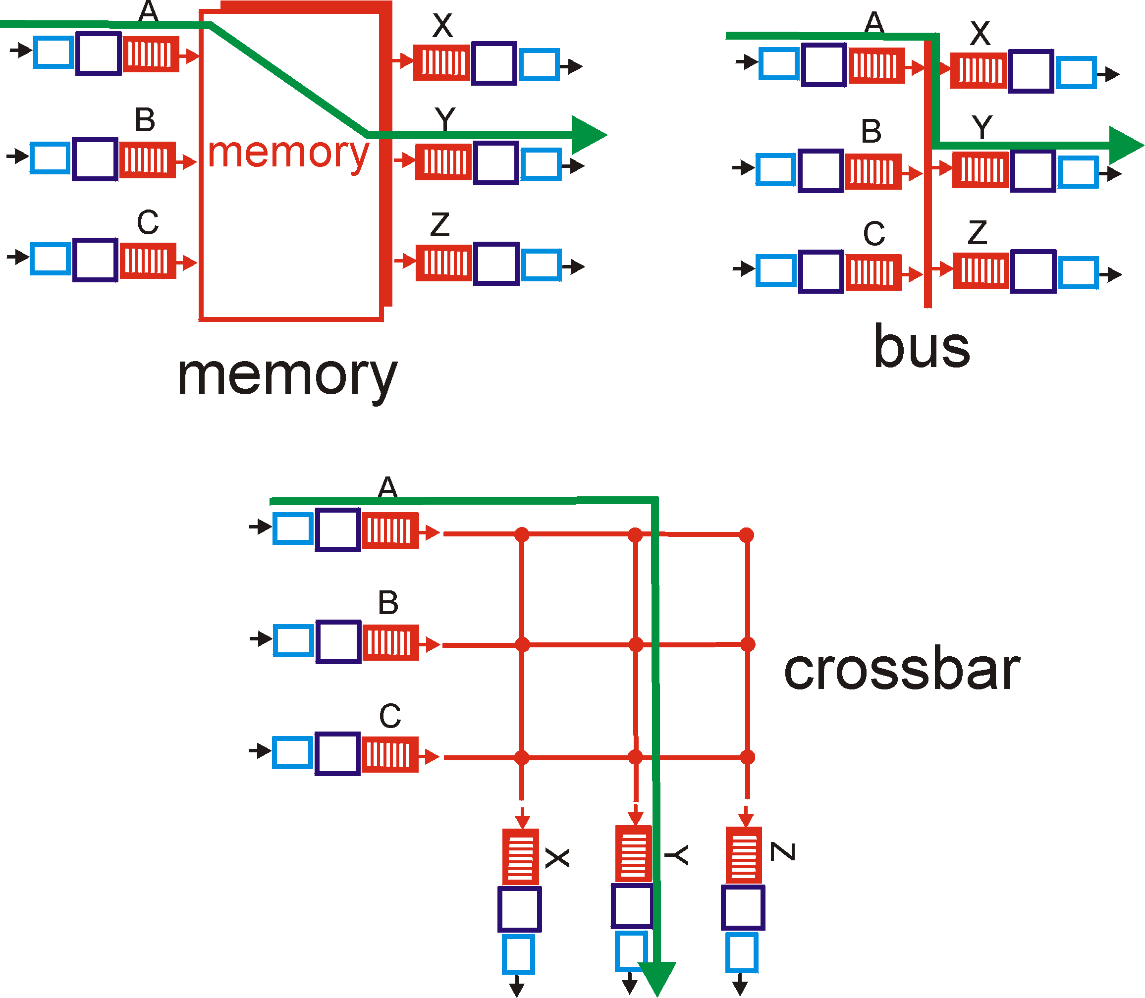
Three types of switching fabrics

Slide 43
Longest prefix match
With CIDR, route entries are prefixes <prefix, CIDR mask>
Can be aggregated
We need to find the longest matching prefix that matches the destination address
Need to search all prefixes of all length (in order) and among prefixes of the same length
128.8.2/24
128.8.0/16
192.2.0/16
128.8.2.128
128.8.0.24
192.2.2.128

Slide 44
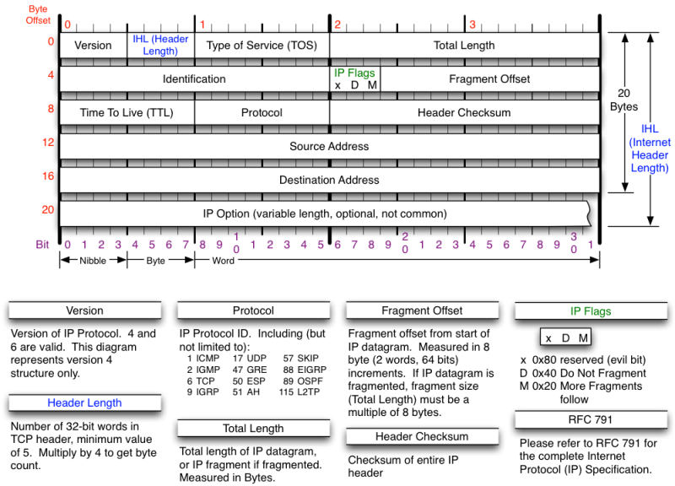

Slide 45
The Internet Protocol (IP)
Provides delivery of packets from one host to any other host in the Internet
Internet packets are called “datagrams” and may be up to 64 kilobytes in length
although they are typically much smaller

