Slide 1

Domain Name System
Lecture 5
http://www.cs.rutgers.edu/~sn624/352-F24
Srinivas Narayana

Slide 2

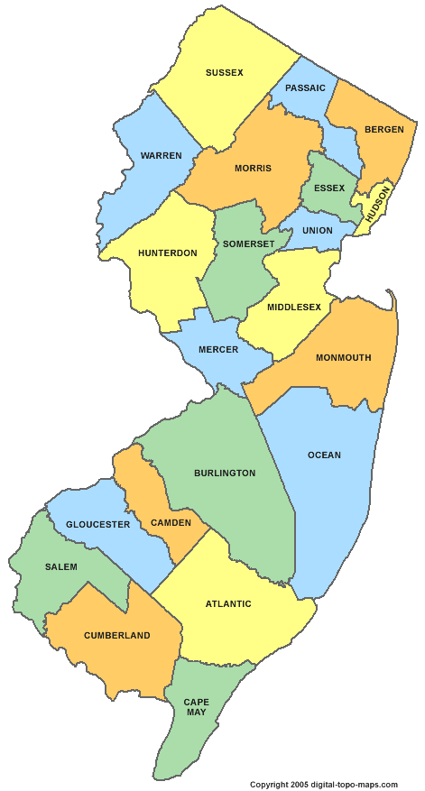
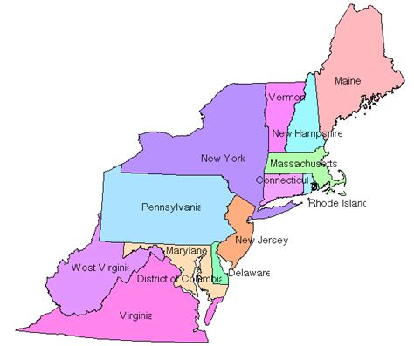
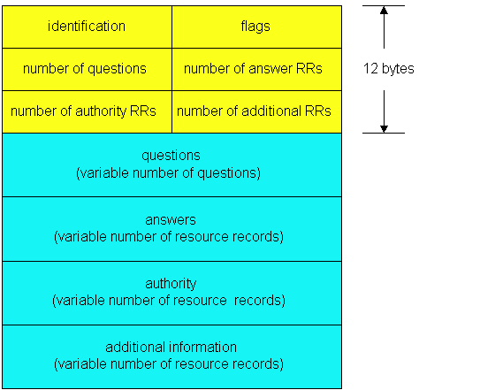

Review
Domain Name System
Human readable → IP addresses
Hierarchical, distributed database
Root server, TLD server, Authoritative name server
Client-server
QR
OPCODE
Peer to peer
Iterative queries

Slide 3
Example
root DNS server
2
Host at cs.rutgers.edu wants IP address for gaia.cs.umass.edu
Local DNS server
Root DNS server
TLD DNS server
Authoritative DNS server
3
.edu DNS server
4
5
local DNS server
dns.rutgers.edu
7
6
1
8
umass.edu DNS server
dns.umass.edu
requesting host
cs.rutgers.edu
gaia.cs.umass.edu

Slide 4
Query type
root DNS server
2
Iterative query
Contacted server replies with name of server to contact
“I don’t know this name, but ask this other server”
Queries 2,4,6 are iterative from point of view of the local DNS server
3
.edu DNS server
4
5
local DNS server
dns.rutgers.edu
7
6
1
8
umass.edu DNS server
dns.umass.edu
requesting host
cs.rutgers.edu
gaia.cs.umass.edu

Slide 5
Query type
root DNS server
Recursive query:
Puts burden of name resolution on the contacted (e.g., root) name server
Query 2 (to root DNS server) is recursive from the local server
In general, recursive is not preferred for higher levels of the DNS hierarchy
2
3
7
6
.edu DNS server
local DNS server
dns.rutgers.edu
5
4
1
8
umass.edu DNS server
dns.umass.edu
requesting host
cs.rutgers.edu
gaia.cs.umass.edu

Slide 6
Problem: Load on Higher Levels of DNS
Think about the query load on the root DNS server (regardless of recursive/iterative)
Must root server answer every DNS query?

Slide 7
DNS caching
Once (any) name server learns a name to IP address mapping, it caches the mapping
Cache entries timeout (disappear) after some time
TLD servers typically cached in local name servers
In practice, root name servers aren’t visited often!
Caching is pervasive in DNS

Slide 8
Bootstrapping DNS
How does a host contact the name server if all it has is the domain name and no (name server) IP address?
IP address of at least 1 nameserver (usually, a local name server) must be known a priori
The local name server may be bootstrapped “statically”, e.g.,
File /etc/resolv.conf in unix
Start -> settings-> control panel-> network ->TCP/IP -> properties in windows
The local DNS server or with another protocol!
DHCP: Dynamic Host Configuration Protocol
The local DNS server must know the root servers

Slide 9




DNS may seem “basic”, low level, but …

Slide 10
DNS Resource Records

Slide 11
DNS is a distributed database
DNS stores resource records (RRs)
(Incomplete) message format for each resource record (RR):
Class, type, name, value, TTL
You can read all the gory details of the message format at https://www.iana.org/assignments/dns-parameters/dns-parameters.xhtml

Slide 12
DNS records
Type=A
name is hostname
value is IPv4 address
Type=CNAME
name is alias name for some “canonical” (the real) name
e.g., www.ibm.com is really
servereast.backup2.ibm.com
value is canonical name
Type=AAAA
name is hostname
value is IPv6 address
Type=NS
name is domain (e.g. foo.com)
value is hostname of authoritative name server for this domain
Type=MX
value is name of mailserver associated with name
More complete info at https://www.iana.org/assignments/dns-parameters/dns-parameters.xhtml

Slide 13
DNS record example
NAME | Design.cs.rutgers.edu
TYPE | A
CLASS | IN
TTL | 1 day(86400)
ADDRESS | 192.26.92.30
RRs in response
to query
records for
authoritative servers
Information about nameserver
NAME | Cs.rutgers.edu
TYPE | NS
CLASS | IN
TTL | 1 day(86400)
NSDNAME | Ns-lcsr.rutgers.edu
DNS serves as a general repository of information for the Internet!

Slide 14
DNS record types
dig –t <type> <domain-name>

Slide 15
Summary of DNS
Hostname to IP address translation via a global network of servers
Embodies several scaling principles
Partition through a hierarchy to silo query load
Replication to scale out at each level of hierarchy
Caching to reduce query load
Once you have a reliable DB, can implement many useful things on top!
Example 1: Scaling large web services, e.g., google search, by redirecting different clients to different servers (IP addresses)
Reliability, load balancing, performance optimization
Example 2: Associating certificates, keys (security info) with domain names
https://www.rfc-editor.org/rfc/rfc8162.html
https://datatracker.ietf.org/doc/draft-ietf-dnsop-svcb-https/00/

Slide 16
The Web (HTTP)

Slide 17
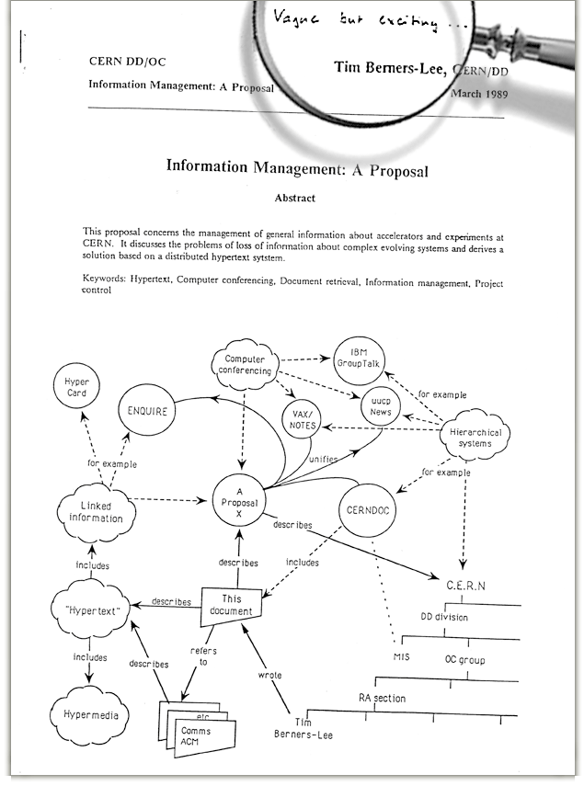
The Web: Humble origins
Tim Berners-Lee: a way to manage and access documents at CERN research lab
Info containing links to other info, accessible remotely through a standardized mechanism independent of the heterogeneity of the underlying machines
“Hypertext”

