Slide 1

Memory Virtualization

Slide 2
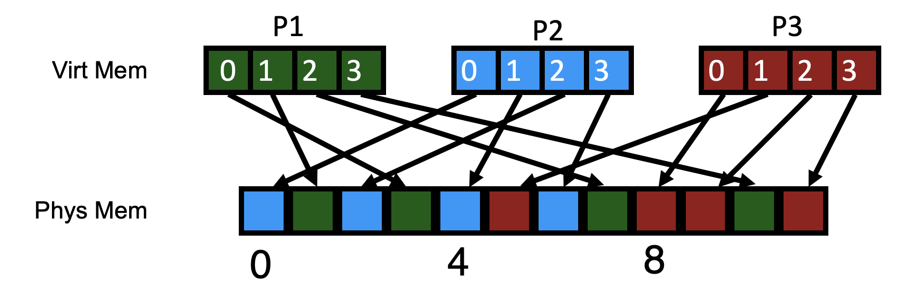
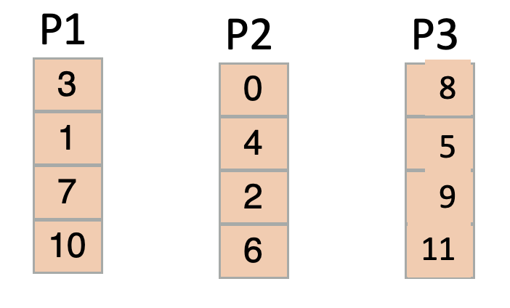
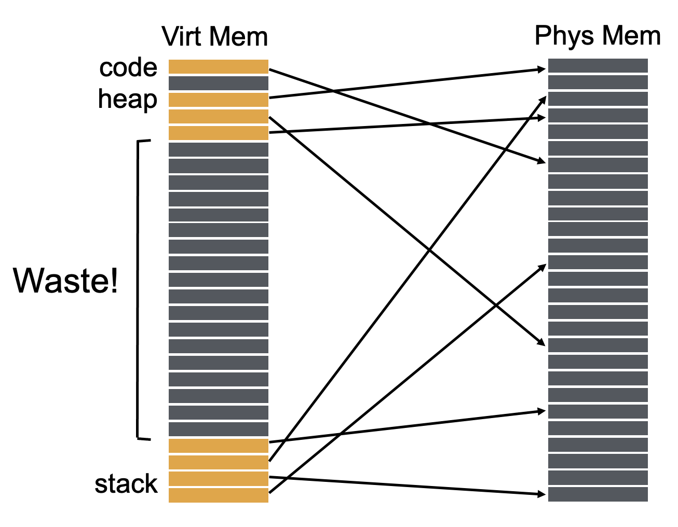
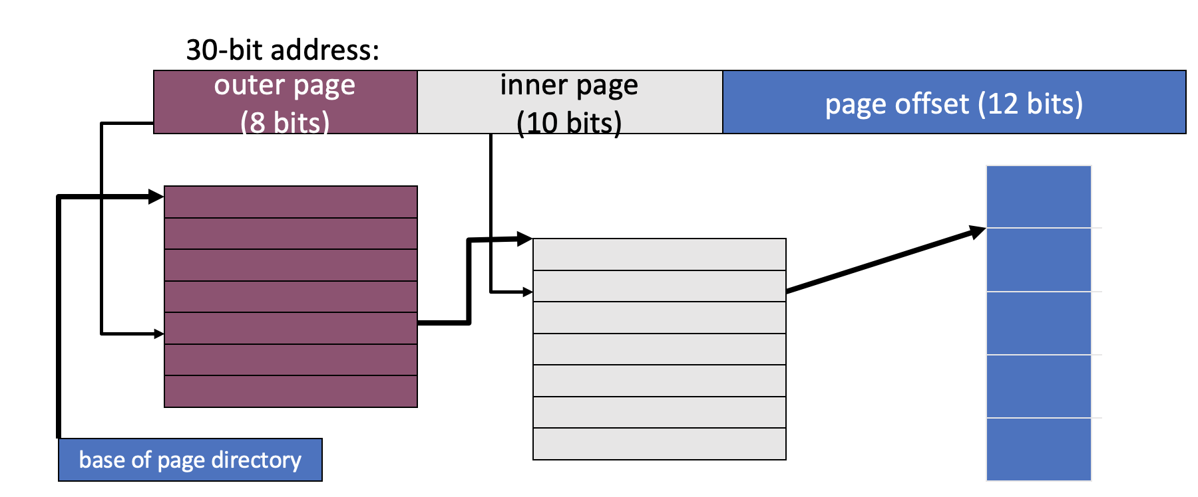
Use of a page table doubles memory references
Sparse PTEs
Valid PTEs are continuous

Slide 3
Address format for Multilevel Paging
30-bit address:
outer page
inner page
page offset (12 bits)
How should logical address be structured?
How many bits for each paging level?
Goal?
Each page table fits within a page
PTE size * number PTE = page size
Assume PTE size = 4 bytes
Page size = 2^12 bytes = 4KB
number PTE per page = (2^12 bytes per page) / (4 bytes per PTE)
→ number PTE = 2^10
→ # bits for selecting inner page = 10
Remaining bits for outer page:
30 – 10 – 12 = 8 bits

Slide 4
Problem with 2 levels?
Problem: page directory (outer level) may not fit in a page!
Solution:
Split page directories into pieces
Use another page dir to refer to the pieces of the page directory
64-bit address:
outer page? (N bits)
inner page
(10 bits)
page offset (12 bits)
VPN
PD idx 0
PD idx 1
PT idx
OFFSET
How large is virtual address space with 4 KB pages, 4 byte PTEs, each page table fits in page, given 1, 2, 3 levels?
4KB / 4 bytes → 1K entries per level
1 level: 1K * 4K = 2^22 = 4 MB
2 levels: 1K * 1K * 4K = 2^32 ≈ 4 GB
3 levels: 1K * 1K * 1K * 4K = 2^42 ≈ 4 TB

Slide 5
Review: Paging pros and cons
Advantages
No external fragmentation
don’t need to find contiguous RAM
All free pages are equivalent
Easy to manage, allocate, and free pages
Disadvantages
Page tables can get big
Must have one entry for every page of address space
Accessing page tables is too slow [address this shortly]
Doubles the number of memory references per instruction

Slide 6
Translation Steps
H/W: for each mem reference: 1. extract VPN (virt page num) from VA (virt addr) 2. calculate addr of PTE (page table entry) 3. read PTE from memory 4. extract PFN (page frame num) 5. build PA (phys addr) 6. read contents of PA from memory into register
(cheap)
(cheap)
(expensive)
(cheap)
(cheap)
(expensive)
Which steps are expensive?
Which expensive step(s) can we (not) avoid?
3) Let’s try to avoid having to read PTE from memory!

Slide 7
Translation Lookaside Buffers
How can page translations be made faster?
What is the basic idea of a TLB (Translation Lookaside Buffer)?
What types of workloads perform well with TLBs?
How do TLBs interact with context-switches?

Slide 8
Example: Array Iterator
int sum = 0;
for (i=0; i<N; i++){ sum += a[i];
}
Assume ‘a’ starts at 0x3000
Ignore instruction fetches
What virtual addresses?
What physical addresses?
load 0x3000
load 0x3004
load 0x3008
load 0x300C …
load 0x100C load 0x7000 load 0x100C load 0x7004 load 0x100C load 0x7008 load 0x100C load 0x700C
Observation: Repeatedly access same PTE because program repeatedly accesses same virtual page

Slide 9
Strategy: Cache Page Translations
We couldn’t store entire page table in MMU, but we can store a fast cache
CPU MMU
RAM
PT
Translation Cache
Some popular entries
memory interconnect
TLB: Translation Lookaside Buffer

Slide 10
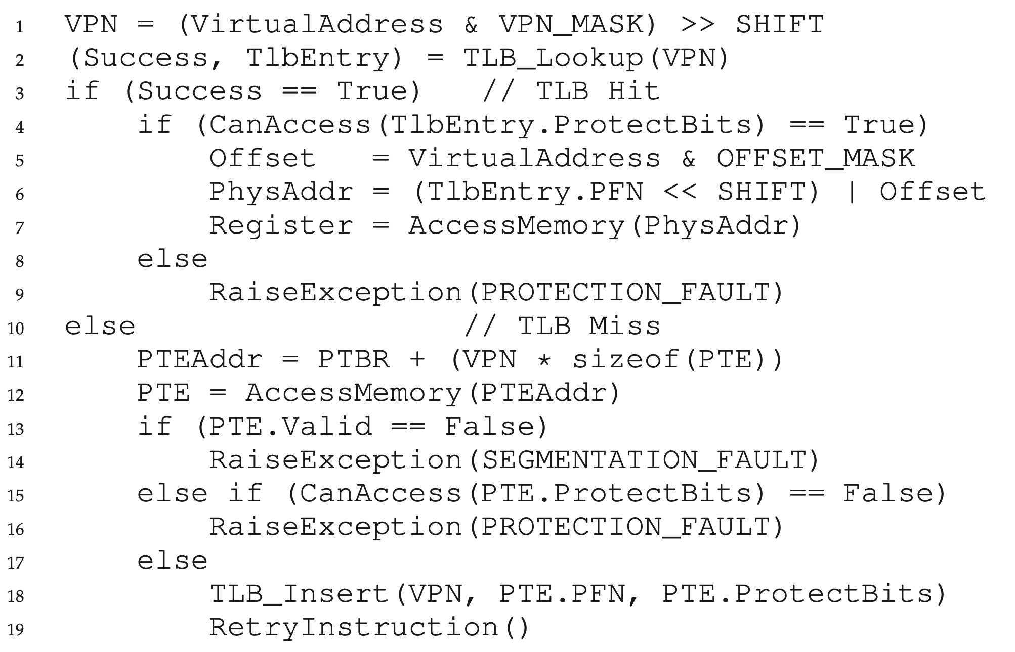
TLB Control Flow
// assume simple linear page table

Slide 11
TLB Control Flow
// assume simple linear page table

Slide 12
TLB Control Flow
// assume simple linear page table

Slide 13
TLB Control Flow
// assume simple linear page table

Slide 14
TLB Control Flow
// assume simple linear page table

Slide 15
TLB Control Flow
// assume simple linear page table

Slide 16
TLB Organization
TLB Entry
Tag (virtual page number)
Physical page number (page table entry)
A
0
1
2
3
4
5
6
7
8
9
10
11
12
13
14
15
Lookup
Calculate set (tag % num_sets)
Search for tag within resulting set
Where is VPN (tag) 18 located?
2
Direct mapped (num sets = 16)

Slide 17
TLB Organization
TLB Entry
Tag (virtual page number)
Physical page number (page table entry)
A
0
1
2
3
4
5
6
7
8
9
10
11
12
13
14
15
A
B
C
D
0
1
2
3
Index
Four-way set associative
Set
More in Computer Architecture Class
Two-way set associative
A
B
C
D
E
L
M
N
O
P
Direct mapped
Fully associative

Slide 18
TLB Associativity Trade-offs
Higher associativity
+ Better utilization, fewer collisions
Slower
More hardware
Lower associativity
+ Fast
+ Simple, less hardware
Greater chance of collisions
TLBs are usually fully associative

Slide 19
Array Iterator (with TLB)
int sum = 0;
for (i = 0; i < 2048; i++){ sum += a[i];
}
Assume following virtual address stream:
load 0x1000 load 0x1004 load 0x1008 load 0x100C …
What will TLB behavior look like?

Slide 20
TLB Accesses: Sequential Example
Virtual
Physical
0 KB
PTBR
load 0x1000
load 0x1004
load 0x1008
load 0x100c
…
load 0x2000
load 0x2004
load 0x0004
load 0x5000
(TLB hit)
load 0x5004
(TLB hit)
load 0x5008
(TLB hit)
load 0x500C …
load 0x0008
load 0x4000
(TLB hit)
load 0x4004
Page Table
4 KB
P1
P1 pagetable
8 KB
1
5
4
…
P2
0
1
2
3
12 KB
P2
CPU’s TLB
16 KB
P1
Valid | VPN | PPN
20 KB
P1
1
1
5
24 KB
1
2
4
P2
28 KB

Slide 21
Performance Of TLB?
int sum = 0; for (i=0; i<2048; i++) { sum += a[i]; }
Miss rate?
2/2048 = 0.1%
Hit rate? (1 – miss rate)
99.9%
Would hit rate get better or worse with smaller pages?
Worse
Calculate miss rate of TLB for data:
# TLB misses / # TLB lookups
# TLB lookups?
= number of accesses to a = 2048
# TLB misses?
= number of unique pages accessed
= 2048 / (elements of ‘a’ per 4K page)
= 2K / (4K / sizeof(int)) = 2K / 1K = 2

Slide 22
TLB Performance
How can system improve TLB performance (hit rate) given fixed number of TLB entries?
Increase page size
Fewer unique page translations needed to access same amount of memory
TLB “reach” in terms of physical memory size:
Number of TLB entries * Page Size
“Huge pages” used in many real systems.

Slide 23
TLB Performance with Workloads
Sequential array accesses almost always hit in TLB
Very fast!
What access pattern will be slow?
Highly random, with no repeat accesses

Slide 24
Workload Access Patterns
Workload A
Workload B
int sum = 0;
for (i=0; i<2048; i++) { sum += a[i];
}
int sum = 0; srand(1234); for (i=0; i<1000; i++) { sum += a[rand() % N]; } srand(1234); for (i=0; i<1000; i++) { sum += a[rand() % N]; }

Slide 25
Workload Access Patterns
Spatial Locality
Workload A
Sequential Accesses
int sum = 0;
for (i=0; i<2048; i++) { sum += a[i];
}
address
…
time

Slide 26
Workload Access Patterns
Temporal Locality
Workload B
Repeated Accesses (even if random locations)
int sum = 0; srand(1234); for (i=0; i<1000; i++) { sum += a[rand() % N]; } srand(1234); for (i=0; i<1000; i++) { sum += a[rand() % N]; }
address
…
time

Slide 27
Workload Locality
Spatial Locality: future access will be to nearby addresses
Temporal Locality: future access will be repeats to the same data
What TLB characteristics are best for each type?
Spatial:
Access same page repeatedly; need same VPN → PFN translation
Same TLB entry re-used
Temporal:
Access same address near in future
Same TLB entry re-used in near future
How near in future? How many TLB entries are there?

Slide 28
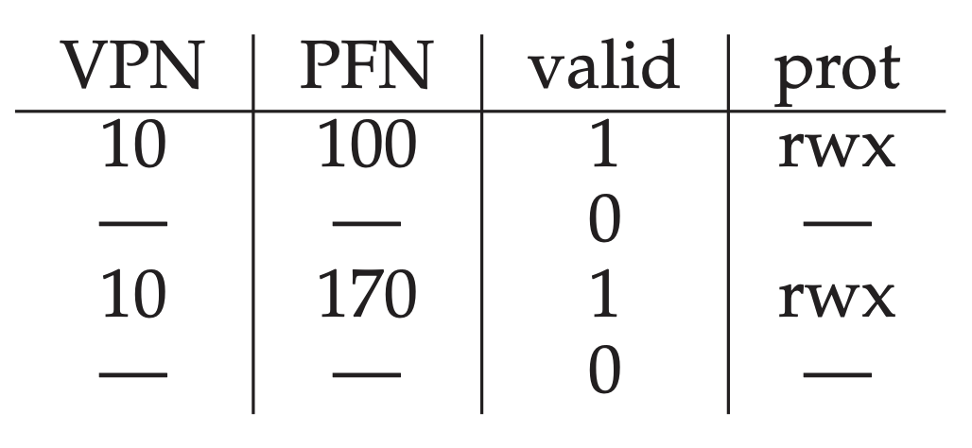
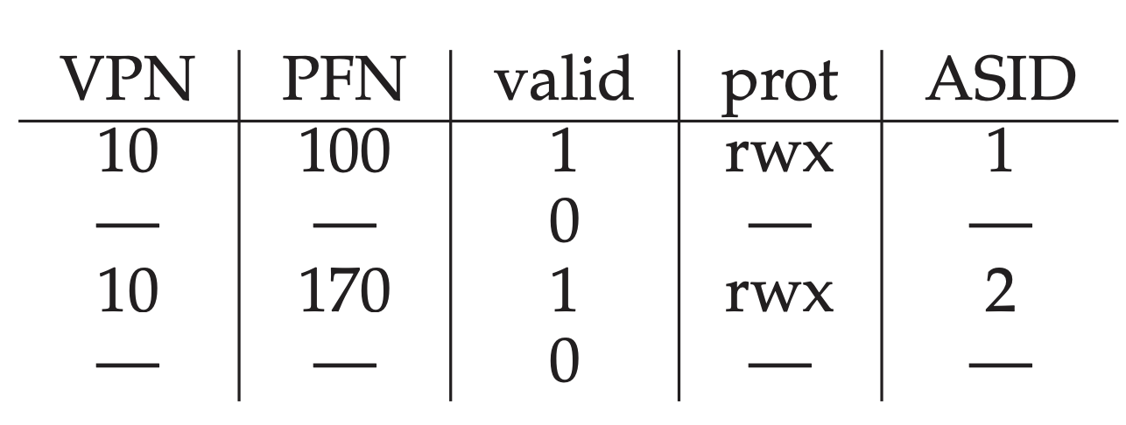
Differentiating processes
So far, we assumed VPNs are unique. They are not (across multiple processes)!
Option 1: Flush TLBs upon every context switch (valid = 0)
Problem: poor performance after each context switch
Option 2: Attach “address space identifier” to TLB entry

Slide 29
A full system with TLBs
On TLB miss: lookups with more paging levels more expensive
How much does a miss cost?
ASID | VPN | PFN | Valid
211 | 0xbb | 0x91 | 1
211 | 0xff | 0x23 | 1
122 | 0x05 | 0x91 | 1
211 | 0x05 | 0x12 | 0
Assume 3-level page table, 256-byte pages, 16-bit addresses
Assume ASID of current process is 211
How many physical accesses for each instruction?
^{(a) 0xAA10: movl 0x1111, %edi}
^{(b) 0xBB13: addl $0x3, %edi}
^{(c) 0x0519: movl %edi, 0xFF10}
0xaa: (TLB miss -> 3 for addr trans) + 1 instr fetch
Total: 8
0x11: (TLB miss -> 3 for addr trans) + 1 movl
0xbb: (TLB hit -> 0 for addr trans) + 1 instr fetch from 0x9113
Total: 1
0x05: (TLB miss -> 3 for addr trans) + 1 instr fetch
Total: 5
0xff: (TLB hit -> 0 for addr trans) + 1 movl into 0x2310

Slide 30
Summary: Better page tables
Problem: Simple linear page tables require too much contiguous memory
Many options for efficiently organizing page tables
If OS traps on TLB miss, OS can use any data structure
e.g., inverted page tables
If Hardware handles TLB miss, page tables must follow specific data structure that hardware knows how to “walk”
Multi-level page tables used in x86 architecture
Each page table must fit within a page
Next Topic: What if desired address spaces do not fit in physical memory?

Slide 31
Virtual Memory
RUTGERS UNIVERSITY Computer Sciences Department
Sudarsun Kannan
CS 416 + 518 Operating Systems Design
Questions answered:
How to run process when not enough physical memory?
When should a page be moved from disk to memory?
What page in memory should be replaced?
How can the LRU page be approximated efficiently?

Slide 32
Motivation
OS goal: Support processes when not enough physical memory
Single process with very large address space
Multiple processes with combined address spaces
User code should be independent of amount of physical memory
Correctness, if not performance
Virtual memory: OS provides illusion of more physical memory
How could we make such an illusion work?
We rely on key properties of user processes (workload) and machine architecture (hardware)

Slide 33
code
data
Program
Virtual Memory

Slide 34
Virtual Memory
code
data
Program
create
code data
heap
stack
Process 1

Slide 35
Virtual Memory
code
data
Program
create
code data
heap
stack
Process 1
what’s in code?

Slide 36
Virtual Memory
data
Program
create
LibA
LibB
LibA
LibB
data
heap
stack
Process 1
LibC
Prog
LibC
Prog
many large libraries, some
of which are rarely/never used
How to avoid wasting physical pages to back rarely used virtual pages?

Slide 37
Virtual Memory
LibA
LibB
data
heap
stack
Process 1
data
Program
Disk
LibA
LibB
LibC
Prog
LibC
Prog
Phys Memory
LibC
Prog

Slide 38
Virtual Memory
LibA
LibB
data
heap
stack
Process 1
data
Program
Disk
LibA
LibB
LibC
Prog
LibC
Prog
LibC
Prog
Phys Memory

Slide 39
Virtual Memory
LibA
LibB
data
heap
stack
Process 1
data
Program
Disk
LibA
LibB
LibC
Prog
LibC
Prog
access LibB
LibC
Prog
Phys Memory

Slide 40
Virtual Memory
LibA
LibB
data
heap
stack
Process 1
data
Program
Disk
LibA
LibB
copy (or move)
to main memory
LibC
Prog
LibC
Prog
LibC
Prog
LibB
Phys Memory

Slide 41
Virtual Memory
LibA
LibB
data
heap
stack
Process 1
data
Program
Disk
LibA
LibB
LibC
Prog
Called “paging” in
LibC
Prog
LibC
Prog
LibB
Phys Memory

Slide 42
Locality of Reference
Effectively: Using main memory as a cache of process virtual memory contents located on disk
Leverage locality of reference within processes
Spatial: reference memory addresses near previously referenced addresses
Temporal: reference memory addresses that have referenced in the past
Processes spend majority of time in small portion of code
For example: 90% of time in 10% of code
Implication:
Process only uses small amount of address space at any moment
Only small amount of address space must be resident in physical memory

Slide 43
Memory Hierarchy
Leverage memory hierarchy of machine architecture
Each layer acts as “backing store” for layer above
size
speed
cost
registers
caches
main memory
disk storage

Slide 44
Virtual Memory Intuition
Idea: OS keeps unreferenced pages on disk
Slower, cheaper backing store than memory
Process can run when not all pages are loaded into main memory
OS and hardware cooperate to provide illusion of large disk as fast as main memory
Same behavior as if all of address space in main memory
Hopefully have similar performance
Requirements:
OS must have mechanism to identify location of each page in address space either in memory or on disk
OS must have policy for determining which pages live in memory and which on disk

Slide 45
Virtual Address Space Mechanisms
Each page in virtual address space maps to one of three locations:
Physical main memory: Small, fast, expensive
Disk (backing store): Large, slow, cheap
Nothing (error): Free
Extend page tables with an extra bit: present
permissions (r/w), valid, present
Page in memory: present bit set in PTE
Page on disk: present bit cleared
PTE with cleared present bit points to block on disk
Causes trap into OS when page is referenced
Trap: page fault

Slide 46
Present Bit
Disk
PFN valid prot present
10 1 r-x 1
- 0 - -
23 1 rw- 0
- 0 - -
- 0 - -
- 0 - -
Phys Memory
- 0 - -
- 0 - -
- 0 - -
- 0 - -
- 0 - -
16 1 rw- 1
28 1 rw- 0
// VPN 0xb
4 1 rw- 1
What if access vpn 0xb?

Slide 47
Virtual Memory Mechanisms
Hardware and OS cooperate to translate addresses
First, hardware checks TLB for virtual address
if TLB hit, address translation is done; page in physical memory
If TLB miss...
Hardware or OS walk page tables
If PTE designates page is present, then page in physical memory

Slide 48
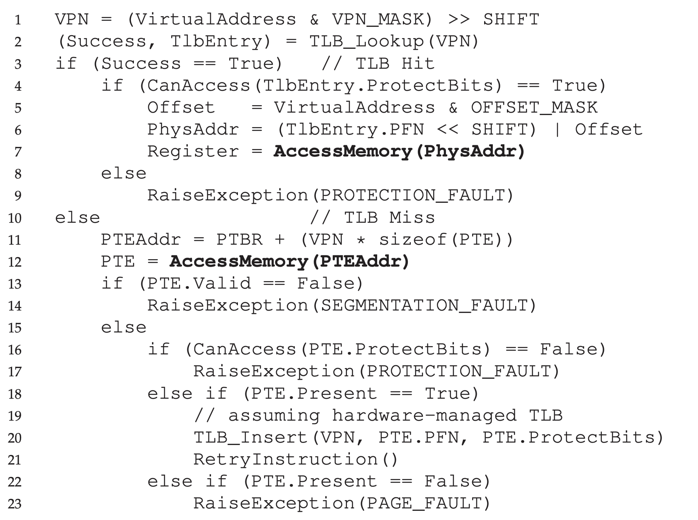
Hardware memory access: Control flow

Slide 49
Hardware memory access: Control flow

Slide 50
Hardware memory access: Control flow

Slide 51
Virtual Memory Mechanisms
If page fault (i.e., present bit is cleared)
Trap into OS (not handled by hardware. Why?)
OS selects victim page in memory to replace
Write victim page out to disk if modified. Add modified (“dirty”) bit to PTE
OS reads referenced page from disk into memory
Page table is updated, present bit is set
Process continues execution
What should scheduler do?

Slide 52
Mechanism for Continuing a Process
Continuing a process after a page fault is tricky
Want page fault to be transparent to user
Page fault may have occurred in middle of instruction
When instruction is being fetched
When data is being loaded or stored
Requires hardware support
precise interrupts: stop CPU pipeline such that instructions before faulting instruction have completed, and those after can be restarted
Complexity depends upon instruction set
Can faulting instruction be restarted from beginning?
Example: move +(SP), R2
Must track side effects so hardware can roll them back if needed

Slide 53
Virtual Memory Policies
Goal: Minimize number of page faults
Page faults require milliseconds to handle (reading from disk)
Implication: Plenty of time for OS to make good decision
OS has two decisions
Page selection
When should a page (or pages) on disk be brought into memory?
Page replacement
Which resident page (or pages) in memory should be thrown out to disk?

Slide 54
Average Memory Access Time (AMAT)
Hit% = portion of accesses that go straight to RAM
Miss% = portion of accesses that go to disk first
Tm = time for memory access
Td = time for disk access
AMAT = (Tm) + (Miss% * Td)

Slide 55
Page Selection
When should a page be brought from disk into memory?
Demand paging: Load page only when page fault occurs
Intuition: Wait until page must absolutely be in memory
When process starts: No pages are loaded in memory
Problems: Pay the cost of a page fault for every newly accessed page

Slide 56
Page Selection
When should a page be brought from disk into memory?
Pre-paging (anticipatory, prefetching): Load page before referenced
OS predicts future accesses (oracle) and brings pages into memory early
Works well for some access patterns (e.g., sequential)
Problems?

Slide 57
Page Selection
When should a page be brought from disk into memory?
Hints: Combine above with user-supplied hints about page references
User specifies: may need page in future, don’t need this page anymore, or sequential access pattern, ...
Example: madvise() in Unix

Slide 58
Page Replacement
Which page in main memory should selected as victim?
Write out victim page to disk if modified (“dirty” bit set)
If victim page is not modified (clean), just discard
OPT: Replace page not used for longest time in future
Advantages: Guaranteed to minimize number of page faults
Disadvantages: Requires that OS predict the future; Not practical, but good for comparison

Slide 59
OPT Replacement Example
Page reference string: 1,2,3,1,2,4,1,4,2,3, 2
Three pages of physical memory
OPT
Miss: 1,2,3
Metric: Miss count

Slide 60
OPT Replacement Example
Page reference string: 1,2,3,1,2,4,1,4,2,3, 2
Three pages of physical memory
OPT
Miss: 1,2,3
Metric: Miss count : 3
1
2
3

Slide 61
OPT Replacement Example
Page reference string: 1,2,3,1,2,4,1,4,2,3, 2
Three pages of physical memory
OPT
Miss: 1,2,3
Metric: Miss count : 3
1
2
3
Compulsory misses
Hit 1
1
2
3
Hit 2
1
2
3

Slide 62
OPT Replacement Example
Page reference string: 1,2,3,1,2,4,1,4,2,3, 2
Three pages of physical memory
OPT
Miss: 1,2,3
Metric: Miss count: 4
1
2
3
capacity miss
Hit 1
1
2
3
Hit 2
1
2
3
Miss:4, Replace: 3
1
2
4
Hit 1
1
2
4

Slide 63
OPT Replacement Example
Page reference string: 1,2,3,1,2,4,1,4,2,3, 2
Three pages of physical memory
OPT
Miss: 1,2,3
Metric: Miss count: 4
1
2
3
Hit 1
1
2
3
Hit 2
1
2
3
Miss:4, Replace: 3
1
2
4
Hit 1
1
2
4
Hit: 4
1
2
4
Hit: 2
1
2
4

Slide 64
OPT Replacement Example
Page reference string: 1,2,3,1,2,4,1,4,2,3, 2
Three pages of physical memory
OPT
Miss: 1,2,3
Metric: AMAT? Miss count : 5
1
2
3
Hit 1
1
2
3
5 misses, 4 compulsory misses
Hit 2
1
2
3
Miss:4, Replace: 3
1
2
4
AMAT = (Tm) + (Miss% * Td)
Assume Tm = 100ns
Assume Td = 1000000 ns (1millisec)
AMAT = ?
Hit 1
1
2
4
Hit: 4
1
2
4
Hit: 2
1
2
4
Miss:3, Replace: 1
2
3
4
Hit: 2
2
3
4

Slide 65
FIFO
FIFO: Replace page that has been in memory the longest
Intuition: First referenced long time ago, done with it now
Advantages: Fair: All pages receive equal residency; Easy to implement (circular buffer)
Disadvantage: Some pages may always be needed

Slide 66
FIFO Example
Page reference string: 1,2,3,1,2,4,1,4,2,3,2
Three pages of physical memory
OPT
Miss: 1,2,3
Metric: Miss count: 3
1
2
3

Slide 67
FIFO Example
Page reference string: 1,2,3,1,2,4,1,4,2,3,2
Three pages of physical memory
OPT
Miss: 1,2,3
Metric: Miss count: 4
1
2
3
Hit: 1
1
2
3
Hit: 2
1
2
3
Miss:4, Replace:1
2
3
4

Slide 68
FIFO Example
Page reference string: 1,2,3,1,2,4,1,4,2,3,2
Three pages of physical memory
OPT
Miss: 1,2,3
Metric: Miss count: 5
1
2
3
Hit: 1
1
2
3
Hit: 2
1
2
3
Miss:4, Replace:1
2
3
4
Miss:1, Replace:2
3
4
1
Hit: 4
3
4
1

Slide 69
FIFO Example
Page reference string: 1,2,3,1,2,4,1,4,2,3,2
Three pages of physical memory
OPT
Miss: 1,2,3
Metric: Miss count : 7
1
2
3
Hit: 1
1
2
3
Hit: 2
1
2
3
Miss:4, Replace:1
2
3
4
Miss:1, Replace:2
3
4
1
Hit: 4
3
4
1
Miss:2, Replace:3
4
1
2
Miss:3, Replace:4
1
2
3

Slide 70
FIFO Example
Page reference string: 1,2,3,1,2,4,1,4,2,3,2
Three pages of physical memory
OPT
Miss: 1,2,3
Metric: Miss count : 7
1
2
3
Hit: 1
1
2
3
Hit: 2
1
2
3
Miss:4, Replace:1
2
3
4
Miss:1, Replace:2
3
4
1
Hit: 4
3
4
1
Miss:2, Replace:3
4
1
2
Miss:3, Replace:4
1
2
3
Hit: 2
1
2
3

Slide 71
FIFO Example
Page reference string: 1,2,3,1,2,4,1,4,2,3,2
Three pages of physical memory
OPT
Miss: 1,2,3
1
2
3
Hit: 1
1
2
3
7 total misses, 4 compulsory misses
Hit: 2
1
2
3
Miss:4, Replace:1
2
3
4
AMAT = (Tm) + (Miss% * Td)
Assume Tm = 100ns
Assume Td = 1000000 ns (1millisec)
AMAT = ?
Miss:1, Replace:2
3
4
1
Hit: 4
3
4
1
Miss:2, Replace:3
4
1
2
Miss:3, Replace:4
1
2
3
Hit: 2
1
2
3

Slide 72
LRU Example – Replace Least Recently Used
Page reference string: 1,2,3,1,2,4,1,4,2,3,2
Three pages of physical memory
OPT
Miss: 1,2,3
Metric: Miss count
5 total misses
4 compulsory misses
In this example, same as OPT!
1
2
3
Hit: 1
1
2
3
Hit: 2
1
2
3
Miss:4, Replace:3
1
2
4
Hit: 1
1
2
4
Hit: 4
1
2
4
Hit: 2
1
2
4
Miss:3, Replace:1
2
4
3
Hit: 2
2
4
3

Slide 73
Page Replacement Comparison
Add more physical memory, what happens to performance?
LRU, OPT: Add more memory, guaranteed to have fewer (or same number of) page faults
Smaller memory sizes are guaranteed to contain a subset of larger memory sizes
Stack property: smaller cache a subset of bigger cache
FIFO: Add more memory, usually have fewer page faults
Belady’s anomaly: but there are cases where we have more page faults!

Slide 74
Fifo Performance may Decrease!
Consider access stream: 1, 2, 3, 4, 1, 2, 5, 1, 2, 3, 4, 5
Consider physical memory size: 3 pages vs. 4 pages
How many misses with FIFO?
3 pages: 9 misses
4 pages: 10 misses

Slide 75
Problems with LRU-based Replacement
LRU does not consider frequency of accesses
Is a page accessed once in the past equal to one accessed N times?
Common workload problem:
Scan (sequential read, never used again) one large data region flushes memory
Solution: Track frequency of accesses to page
Pure LFU (Least-frequently-used) replacement
Problem: LFU can never forget pages from the far past

Slide 76
Implementing LRU
Perfect LRU on Software
OS maintains ordered list of physical pages by reference time
When page is referenced: Move page to front of list
When need victim: Pick page at back of list
Trade-off: Slow on memory reference, fast on replacement
Perfect LRU on Hardware
Associate timestamp with each page (e.g., PTE)
When page is referenced: Associate current system timestamp with page
When need victim: Scan through registers to find oldest timestamp
Trade-off: Fast on memory reference, slow on replacement (especially as size of memory grows)
In practice, do not implement Perfect LRU
LRU is an approximation anyway, so approximate more
Goal: Find an old page, but not necessarily the oldest

Slide 77
Clock Algorithm
Hardware
Keep use (or reference) bit for each page frame
When page is referenced: set use bit
Operating System
Page replacement: Look for page with use bit cleared (has not been referenced for a while)
Implementation:
Keep pointer to last examined page frame (“clock hand”)
Traverse pages in circular fashion (like a clock)
Clear use bits as you search
Stop when find page with already cleared use bit, replace this page

Slide 78
Clock: Look For a Page
use=1
use=1
use=0
use=1
0
1
2
3
…
Physical Mem:
clock hand

Slide 79
Clock: Look For a Page
use=0
use=1
use=0
use=1
0
1
2
3
…
Physical Mem:
clock hand

Slide 80
Clock: Look For a Page
use=0
use=0
use=0
use=1
0
1
2
3
…
Physical Mem:
clock hand

Slide 81
Clock: Look For a Page
use=0
use=0
use=0
use=1
0
1
2
3
…
Physical Mem:
clock hand
evict page 2 because it has not been recently used

Slide 82
Clock: Look For a Page
use=0
use=0
use=0
use=1
0
1
2
3
…
Physical Mem:
clock hand
page 0 is accessed…

Slide 83
Clock: Look For a Page
use=1
use=0
use=0
use=1
0
1
2
3
…
Physical Mem:
clock hand

Slide 84
Clock: Look For a Page
use=1
use=0
use=0
use=1
0
1
2
3
…
Physical Mem:
clock hand

Slide 85
Clock: Look For a Page
use=1
use=0
use=0
use=1
0
1
2
3
…
Physical Mem:
clock hand

Slide 86
Clock: Look For a Page
use=1
use=0
use=0
use=0
0
1
2
3
…
Physical Mem:
clock hand

Slide 87
Clock: Look For a Page
use=0
use=0
use=0
use=0
0
1
2
3
…
Physical Mem:
clock hand

Slide 88
Clock: Look For a Page
use=0
use=0
use=0
use=0
0
1
2
3
…
Physical Mem:
clock hand
evict page 1 because it has not been recently used

Slide 89
Clock Extensions
Use modified (“dirty”) bit to prefer to retain modified pages in memory
Intuition: More expensive to replace dirty pages
Modified pages must be written to disk, clean pages do not have to be
First replace pages that have use bit and modified bit cleared
Replace multiple pages at once
Intuition: Expensive to run replacement algorithm and to write single block to disk
Find multiple victims each time and track free list
Add software counter (“chance”) to track use frequency
Intuition: Want to differentiate pages by how much they are accessed
Increment software counter if use bit is 0
Replace when chance exceeds some specified limit

Slide 90
What if no hardware support?
What can the OS do if hardware does not have use bit (or dirty bit)?
Can the OS “emulate” these bits?
Think about this question:
Can the OS get control (i.e., generate a trap) every time use bit should be set? (i.e., when a page is accessed?)

Slide 91
Conclusion
Illusion of virtual memory: Processes can run when the sum of virtual address spaces is larger than physical memory
Mechanism:
Extend page table entry with “present” bit
OS handles page faults (or page misses) by reading in the desired page from disk
Policy:
Page selection – demand paging, prefetching, hints
Page replacement – OPT, FIFO, LRU, others
Implementations (clock) approximate LRU

