Slide 1

The Application Layer: DNS, HTTP
Lecture 4 http://www.cs.rutgers.edu/~sn624/352-S22
Srinivas Narayana

Slide 2



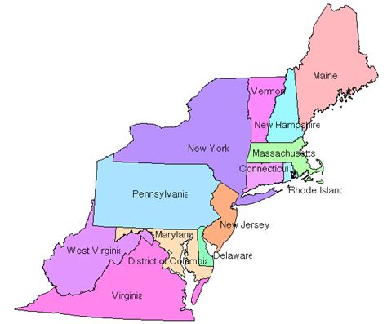


Quick recap of concepts
process
Connection 4-tuple
process
IP addr, port
IP addr, port
Application layer
socket
socket
Operating system
Operating system
Internet
Client
Server
Peer
Peer
Root
Domain Name System
TLD
TLD
TLD
Distributed database of name to IP addr mappings.
128.45.10?.??
Main domain
Subdomain

Slide 3
DNS Resource Records

Slide 4
DNS is a distributed database
DNS stores resource records (RRs)
(Incomplete) message format (headers):
Class, type, name, value, TTL
You can read all the gory details of the message format at https://www.iana.org/assignments/dns-parameters/dns-parameters.xhtml

Slide 5
DNS records
Type=A
name is hostname
value is IP address
Type=CNAME
name is alias name for some “canonical” (the real) name
e.g., www.ibm.com is really
servereast.backup2.ibm.com
value is canonical name
Type=AAAA
name is hostname
value is IPv6 address
Type=NS
name is domain (e.g. foo.com)
value is hostname of authoritative name server for this domain
Type=MX
value is name of mailserver associated with name
More complete info at https://www.iana.org/assignments/dns-parameters/dns-parameters.xhtml

Slide 6
DNS record example
NAME | Design.cs.rutgers.edu
TYPE | A
CLASS | IN
TTL | 1 day(86400)
ADDRESS | 192.26.92.30
RRs in response
to query
records for
authoritative servers
Information about nameserver
NAME | Cs.rutgers.edu
TYPE | NS
CLASS | IN
TTL | 1 day(86400)
NSDNAME | Ns-lcsr.rutgers.edu
DNS serves as a general repository of information for the Internet!

Slide 7
DNS record types
dig –t <type> <domain-name>

Slide 8
DNS caching and updating records
Once (any) name server learns a name to IP address mapping, it caches the mapping
Cache entries timeout (disappear) after some time
TLD servers typically cached in local name servers
In practice, root name servers aren’t visited often

Slide 9
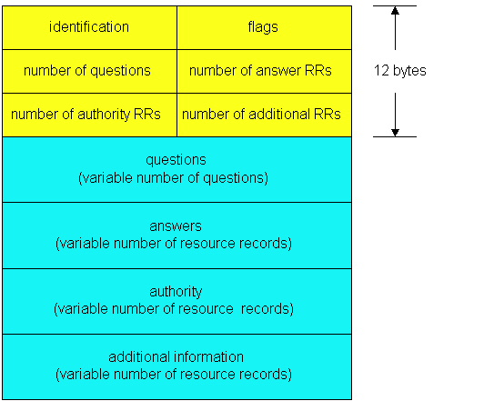
DNS protocol messages
DNS protocol : query and reply messages, both with same message format
QR
Opcode
Message header
QR = 0 for Query, 1 for response
Opcode= 0 standard
identification: 16 bit # for query, reply to query uses same #
flags:
Authoritative answer
recursion desired
recursion available
reply is authoritative

Slide 10
DNS protocol, messages
QR
OPCODE
Name, type fields
for a query
RRs in response
to query
records for
authoritative servers
Information about nameserver
additional “helpful”
info that may be used

Slide 11
Bootstrapping DNS
How does a host contact the name server if all it has is the domain name and no (name server) IP address?
IP address of at least 1 nameserver (usually, a local resolver) must be known a priori
The name server may be bootstrapped “statically”, e.g.,
File /etc/resolv.conf in unix
Start -> settings-> control panel-> network ->TCP/IP -> properties in windows
… or with another protocol!
DHCP: Dynamic Host Configuration Protocol (more on this later)

Slide 12
Summary of DNS
Hostname to IP address translation via a global network of servers
Embodies several scaling principles
Partitioning through a hierarchy
Load distribution through replication at each level of hierarchy
Caching
Once you have a reliable DB, can implement many useful things on top!
Example 1: Scaling large web services, e.g., google search, by redirecting different clients to different servers (IP addresses)
Reliability, load balancing, performance optimization
Example 2: Associating certificates, keys (security info) with domain names
https://www.rfc-editor.org/rfc/rfc8162.html
https://datatracker.ietf.org/doc/draft-ietf-dnsop-svcb-https/00/

Slide 13
Some themes and observations on DNS
Request/response nature of the protocol
How messages are structured: simple, text-based protocol
Similar in HTTP, SMTP, FTP
Load distribution through hierarchy and replication
Caching is an effective method to improve performance

Slide 15
The Web: HTTP

Slide 16
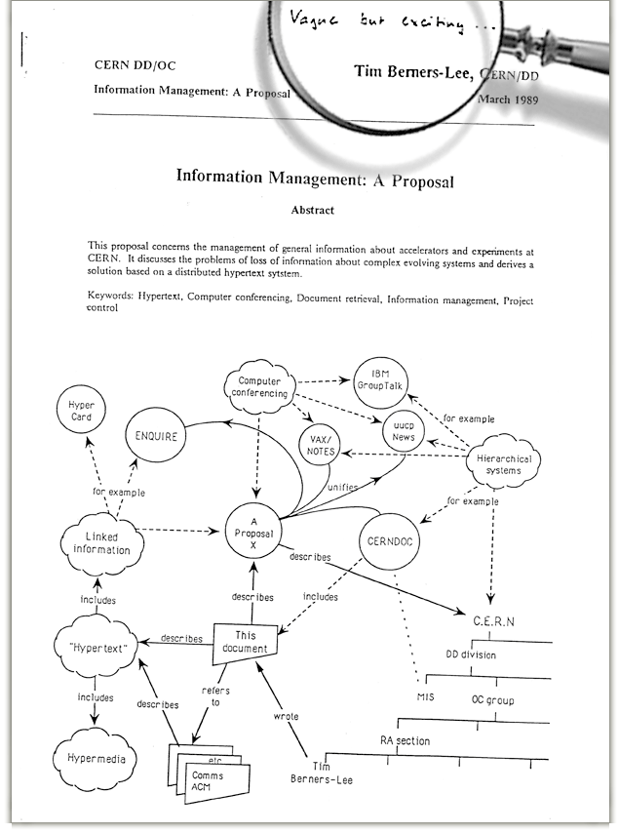
The Web: Humble origins
Tim Berners-Lee: a way to manage and access documents at CERN research lab
Info containing links to other info, accessible remotely, through a standardized mechanism.
His boss is said to have written on his proposal:
“vague, but exciting”

Slide 17
Web and HTTP: Some terms
HTTP stands for “HyperText Transfer Protocol”
A web page consists of many objects
Object can be HTML file, JPEG image, video stream chunk, audio file,…
Web page consists of base HTML-file which includes several referenced objects.
Each object is addressable by a uniform resource locator (URL)
sometimes also referred to as uniform resource identifier (URI)
Example URL:
www.cs.rutgers.edu/~sn624/index.html
host name
path name

Slide 18
HTTP Protocol Overview

Slide 19
HTTP overview
HTTP: hypertext transfer protocol
Client/server model
Client: browser that requests, receives, “displays” Web objects
Server: Web server sends objects in response to requests
HTTP 1.0: RFC 1945
HTTP 1.1: RFC 2068
HTTP request
PC running
Chrome
HTTP response
HTTP request
HTTP response
Web Server
e.g., Apache HTTP
server, nginx, etc.
Mac running
Safari

Slide 20
Client server exchanges
DNS
Hostname | IP address
Cs.Rutgers.edu | 10.0.1.2
I want to browse cs.rutgers.edu
Host name
Server IP Address
HTTP application typically associated with port 80
clientIP, clientPort, server IP Address, 80
HTTP request
HTTP response
HTTP messages

Slide 21
HTTP Messages

Slide 22
HTTP messages: request message
ASCII (human-readable format)
request line
(GET, POST,
HEAD commands)
GET /352/syllabus.html HTTP/1.1
Host: www.cs.rutgers.edu
User-agent: Mozilla/4.0
Connection: close
Accept-language:en
(extra carriage return, line feed)
Header lines
Carriage return,
line feed
indicates end
of header

Slide 23
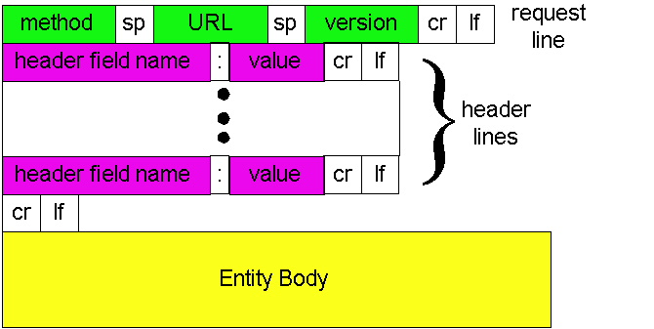
HTTP Request: General format
Sidebar: Protocol headers and formats in the exam?
In general, you don’t need to memorize protocol message formats in this course (they are easily looked up)
However, you may be asked to interpret protocol headers based on a general (conceptual) understanding of the protocol.
http://www.w3.org/Protocols/rfc2616/rfc2616-sec14.html#sec14

Slide 24
The URL
Universal Resource Locator: a way to name objects on server
But can also name an application process on the server!
Examples:
Data storage from data entered in web forms
Login pages
Web carts
Providing almost any service requires data handling by running code at the server
Not just rendering “static” resources

Slide 25
HTTP method types
GET
Get the resource specified in the requested URL (could be a process)
POST
Send entities (specified in the entity body) to a data-handling process at the requested URL
HEAD
Asks server to leave requested object out of response, but send the rest of the response
Useful for debugging
PUT
Update a resource at the requested URL with the new entity specified in the entity body
DELETE
Deletes file specified in the URL
and other methods

Slide 26
Uploading form input: GET and POST
POST method:
Web page often includes form input
Input is uploaded to server in entity body
Posted content not visible in the URL
Free form content (ex: images) can be posted since entity body interpreted as data bytes
GET method:
Entity body is empty
Input is uploaded in URL field of request line
Example:
http://site.com/form?first=jane&last=austen

Slide 27
Difference between POST and PUT
POST: the URL of the request identifies the resource that processes the entity body
PUT: the URL of the request identifies the resource that is contained in the entity body
https://tools.ietf.org/html/rfc2616

Slide 28
Difference between HEAD and GET
GET: return the requested resource in the entity body of the response along with response headers (we’ll see these shortly)
HEAD: return all the response headers in the GET response, but without the resource in the entity body
https://tools.ietf.org/html/rfc2616

Slide 29
Observing HTTP GET and POST

Slide 30
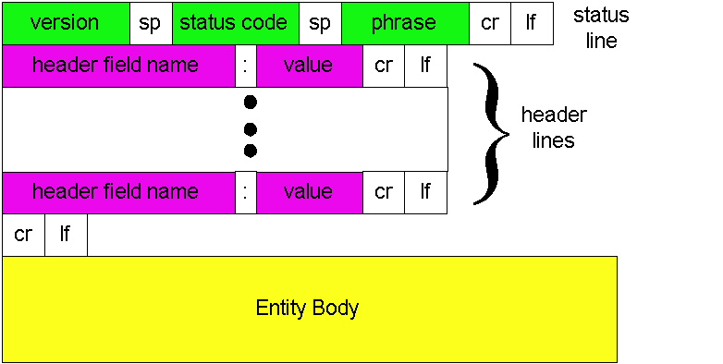
HTTP Response: General format
Unlike HTTP request, No method name

Slide 31
HTTP message: response message
status line
(protocol
status code
status phrase)
HTTP/1.1 200 OK
Connection: close
Date: Thu, 06 Aug 1998 12:00:15 GMT
Server: Apache/1.3.0 (Unix)
Last-Modified: Mon, 22 Jun 1998 …...
Content-Length: 6821
Content-Type: text/html
data data data data data ...
response
header
lines
data, e.g., requested
HTML file in entity body

Slide 32
HTTP response status codes
In first line in server->client response message.
A few sample codes:
200 OK
request succeeded, requested object later in this message
301 Moved Permanently
requested object moved, new location specified later in this message (Location:)
403 Forbidden
Insufficient permissions to access the resource
404 Not Found
requested document not found on this server
505 HTTP Version Not Supported

Slide 33
Observing response codes
wget google.com
telnet web.mit.edu 80
GET / HTTP/1.1
Host: web.mit.edu

Slide 34
Try sending a HTTP request yourself!
1. Telnet to your favorite Web server:
Opens TCP connection to port 80
(default HTTP server port).
Anything typed in sent
to port 80 at web.mit.edu
telnet web.mit.edu 80
2. Type in a GET HTTP request:
By typing this in (hit carriage
return twice), you send
this minimal (but complete)
GET request to HTTP server
GET / HTTP/1.1
Host: web.mit.edu
3. Look at response message sent by HTTP server!

