Slide 1

Crash Consistency

Slide 2
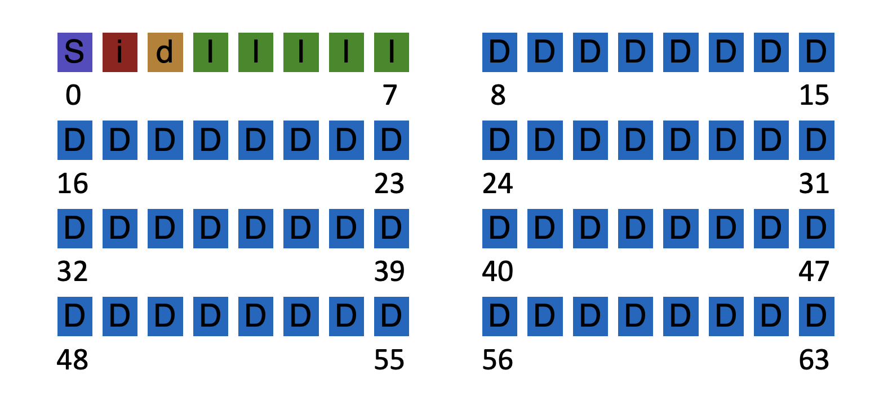
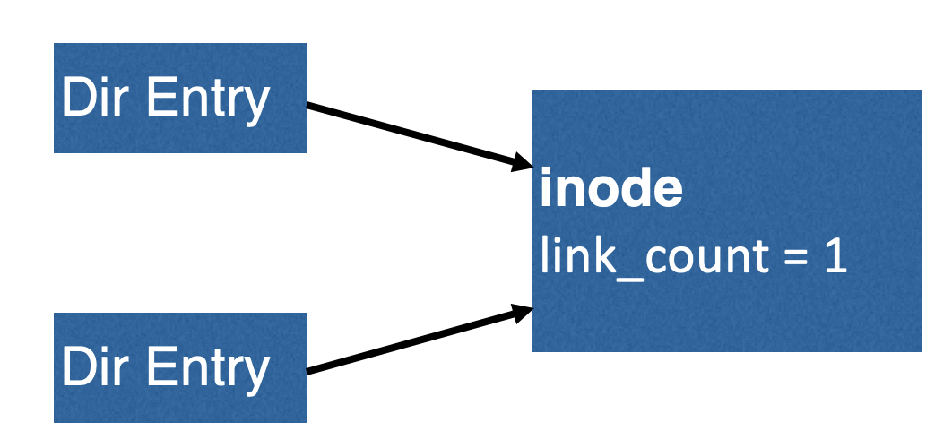
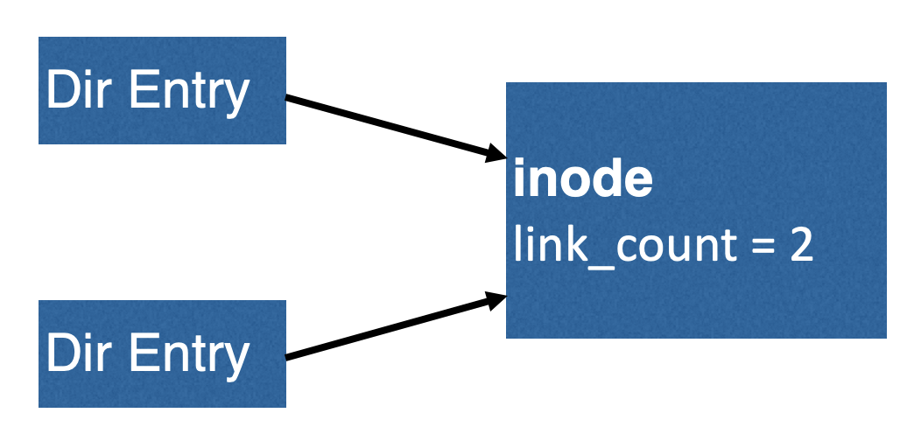
Inconsistency: a result of redundancy (non-independence)
Knowing A limits the possible values of B.
Inode pointer
Data block bitmap
Inode link count
Directory entry
Superblock total block count
Inode pointer
Filesystem checker: after a crash, look at data structures on disk, and make them consistent.
100s of checks & fixes

Slide 3

Duplicate Pointers
inode
link_count = 1
block
(number 123)
inode
link_count = 1
How to fix????

Slide 4
Duplicate Pointers
copy
inode
link_count = 1
block
(number 123)
inode
link_count = 1
block
(number 789)

Slide 5
Duplicate Pointers
inode
link_count = 1
block
(number 123)
inode
link_count = 1
block
(number 789)
Simple fix!
But is this correct?

Slide 6
Bad Pointer
inode
link_count = 1
9999
super block
tot-blocks=8000
How to fix???

Slide 7
Bad Pointer
inode
link_count = 1
Simple fix! (But is this correct?)
super block
tot-blocks=8000

Slide 8
Problems with fsck
Problem 1:
Not always obvious how to fix file system image
Don’t know “correct” state, just a consistent one
Easy way to get consistency: reformat disk!

Slide 9
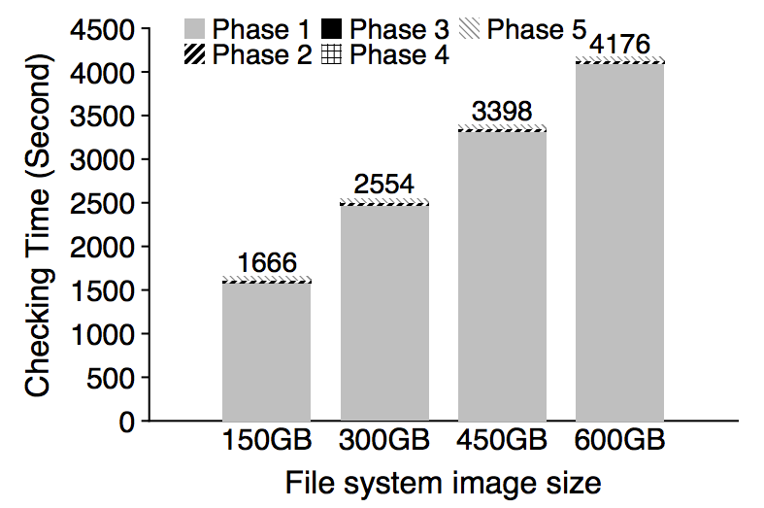
Problem 2: fsck is very slow
Checking a 600GB disk takes ~70 minutes
ffsck: The Fast File System Checker
Ao Ma, EMC Corporation and University of Wisconsin—Madison; Chris Dragga, Andrea C. Arpaci-Dusseau, and Remzi H. Arpaci-Dusseau, University of Wisconsin—Madison

Slide 10
Consistency Solution #2: Journaling
Goals
Ok to do some recovery work after crash, but not to read entire disk
Don’t move file system to just any consistent state, get correct state (in most cases)
Strategy
Atomicity
Definition of atomicity for concurrency
operations in critical sections are not interrupted by operations on related critical sections
Definition of atomicity for persistence
collections of writes are not interrupted by crashes; either (all new) or (all old) data is visible

Slide 11
Consistency vs Correctness
Say a set of writes moves the disk from state A to B
empty
all states
consistent states
A
B
fsck gives consistency
Atomicity gives A or B.

Slide 12
Journaling: General Strategy
Never delete ANY old data, until, ALL new data is safely on disk
Ironically, adding redundancy to fix the problem caused by redundancy.
Do a little extra work during regular operation, to avoid A LOT OF extra work during recovery
Also referred to as write-ahead logging

Slide 13
Fight Redundancy with Redundancy
Want to replace X with Y. Original:
DISK
X
redundant
f(X)

Slide 14
Fight Redundancy with Redundancy
Want to replace X with Y. Original:
DISK
Good time to crash?
X
f(X)
Yes, good time to crash

Slide 15
Fight Redundancy with Redundancy
Want to replace X with Y. Original:
DISK
Good time to crash?
Y
f(X)
bad time to crash

Slide 16
Fight Redundancy with Redundancy
Want to replace X with Y. Original:
DISK
DISK
Good time to crash?
Y
f(Y)
good time to crash

Slide 17
Fight Redundancy with Redundancy
Want to replace X with Y. With journal:
DISK
DISK
Good time to crash?
X
f(X)
good time to crash

Slide 18
Fight Redundancy with Redundancy
Want to replace X with Y. With journal:
DISK
DISK
X
f(X)
good time to crash
Y

Slide 19
Fight Redundancy with Redundancy
Want to replace X with Y. With journal:
DISK
DISK
X
f(X)
good time to crash
Y
f(Y)

Slide 20
Fight Redundancy with Redundancy
Want to replace X with Y. With journal:
DISK
DISK
Y
f(X)
good time to crash
Y
f(Y)

Slide 21
Fight Redundancy with Redundancy
Want to replace X with Y. With journal:
DISK
Y
f(Y)
good time to crash
Y
f(Y)

Slide 22
Fight Redundancy with Redundancy
Want to replace X with Y. With journal:
DISK
DISK
Y
f(Y)
good time to crash
f(Y)

Slide 23
Fight Redundancy with Redundancy
Want to replace X with Y. With journal:
DISK
DISK
Y
f(Y)
good time to crash

Slide 24
Fight Redundancy with Redundancy
Want to replace X with Y. With journal:
DISK
DISK
Y
f(Y)
With journaling, it’s always a good time to crash!

Slide 25
Inconsistency: how do we fix it?
Develop algorithm to atomically update two blocks: Write 10 to block 0; write 5 to block 1
Assume these are only blocks in file system.
Assume: only 1 block, not multiple, can be written in one shot
Usage Scenario: Block 0 stores Alice’s bank account;
Block 1 stores Bob’s bank account; transfer $2 from Alice to Bob
Time | Block 0 | Block 1
1 | 12 | 3
2 | 12 | 5
3 | 10 | 5
don’t crash here!
A wrong update algorithm can lead to inconsistent states (non-atomic updates)

Slide 26
Initial Solution: Journal New Data
Suppose we make updates on a copy of each block first
(note: must allocate space for these copies)
Time | Block 0 | Block 1 | J:2 | J:3 | J:valid:4
1 | 12 | 3 | 0 | 0 | 0
2 | 12 | 3 | 10 | 0 | 0
3 | 12 | 3 | 10 | 5 | 0
4 | 12 | 3 | 10 | 5 | 1
5 | 10 | 3 | 10 | 5 | 1
6 | 10 | 5 | 10 | 5 | 1
7 | 10 | 5 | 10 | 5 | 0
Crash here? → Old data
Crash here? →New data
Let’s understand behavior if crash occurs after each write
Note: every step assumes previous update committed to disk
Scenario: Block 0 stores Alice’s bank account; Block 1 stores Bob’s bank account; transfer $2 from Alice to Bob

Slide 27
void update_accounts(int cash1, int cash2) {
write(cash1 to block 2) // Alice backup
write(cash2 to block 3) // Bob backup
write(1 to block 4) // backup is safe
write(cash1 to block 0) // Alice
write(cash2 to block 1) // Bob
write(0 to block 4) // discard backup
}
void recovery() {
if(read(block 4) == 1) {
write(read(block 2) to block 0) // restore Alice
write(read(block 3) to block 1) // restore Bob
write(0 to block 4) // discard backup
} // no recovery needed if !(read(block 4) == 1)
}
Suppose the machine failed somewhere along the way…

Slide 28
Terminology
Extra blocks are called a journal
* (all blocks considered same: inode, superblock, …)
The writes to the journal are a journal transaction
The last valid bit written is a journal commit block
* journal commit relies on disk committing single-block writes fully or not at all
The writing of the actual data (in place) is called checkpoint
Approach described above: Data journaling

Slide 29
File System Integration
FS
Journal
Scheduler
Disk

Slide 30
Problems with data journaling approach
…
0
N-1
N
2N-1
2N
Disadvantages?
- slightly < half of disk space is usable
- transactions copy all the data (1/2 disk bandwidth!)
- disk commit forces hardware to seek to random locations one after another

Slide 31
Fix #1: Small Journals
Still need to first write all new data elsewhere before overwriting new data
Goal:
Reuse small area as backup for any block
How?
Store block numbers in a transaction "header” in journal

Slide 32
New Layout
journal
5,2
A
B
0
0
1
2
3
4
5
6
7
8
9
10
11
12
transaction: write A to block 5; write B to block 2

Slide 33
New Layout
journal
B
A
5,2
A
B
1
0
1
2
3
4
5
6
7
8
9
10
11
12
transaction: write A to block 5; write B to block 2
Checkpoint: Writing new data to in-place locations

Slide 34
New Layout
journal
B
A
5,2
A
B
0
0
1
2
3
4
5
6
7
8
9
10
11
12

Slide 35
New Layout
journal
journal
B
B
A
A
5,2
5,2
A
A
B
B
0
0
0
0
1
1
2
2
3
3
4
4
5
5
6
6
7
7
8
8
9
9
10
10
11
11
12
12
transaction: write C to block 4; write T to block 6

Slide 36
New Layout
journal
B
A
4,6
A
B
0
0
1
2
3
4
5
6
7
8
9
10
11
12
transaction: write C to block 4; write T to block 6

Slide 37
New Layout
journal
journal
B
A
4,6
C
B
0
0
1
2
3
4
5
6
7
8
9
10
11
12
transaction: write C to block 4; write T to block 6

Slide 38
New Layout
journal
journal
B
A
4,6
C
T
0
0
1
2
3
4
5
6
7
8
9
10
11
12
transaction: write C to block 4; write T to block 6

Slide 39
New Layout
journal
journal
B
C
A
T
4,6
C
T
1
0
0
1
1
2
2
3
3
4
4
5
5
6
6
7
7
8
8
9
9
10
10
11
11
12
12
transaction: write C to block 4; write T to block 6
Checkpoint: Writing new data to in-place locations

Slide 40
New Layout
journal
journal
B
C
A
T
4,6
C
T
0
0
0
0
1
1
1
2
2
2
3
3
3
4
4
4
5
5
5
6
6
6
7
7
7
8
8
8
9
9
9
10
10
10
11
11
11
12
12
12
transaction: write C to block 4; write T to block 6

Slide 41
Optimizations
1. Reuse small area for journal
2. Barriers - (fsync)
3. Checksums
4. Circular journal
5. Metadata journal

Slide 42
Correctness depends on Ordering
journal
journal
journal
B
B
C
C
A
A
T
T
4,6
4,6
C
C
T
T
0
0
0
0
0
0
1
1
1
1
2
2
2
2
3
3
3
3
4
4
4
4
5
5
5
5
6
6
6
6
7
7
7
7
8
8
8
8
9
9
9
9
10
10
10
10
11
11
11
11
12
12
12
12
transaction: write C to block 4; write T to block 6
write order: 9, 10, 11, 12, 4, 6, 12
Enforcing total ordering among these writes is inefficient
(random writes)
Instead: Use barriers w/ disk cache flush at key points (Q: when?)

Slide 43
Ordering
journal
journal
journal
journal
B
B
B
C
C
C
A
A
A
T
T
T
4,6
4,6
4,6
C
C
C
T
T
T
0
0
0
0
0
0
0
0
1
1
1
1
1
2
2
2
2
2
3
3
3
3
3
4
4
4
4
4
5
5
5
5
6
6
6
6
6
7
7
7
7
7
8
8
8
8
8
9
9
9
9
9
10
10
10
10
10
11
11
11
11
11
12
12
12
12
12
transaction: write C to block 4; write T to block 6
write order: 9,10,11 | 12 | 4,6 | 12
Use barriers at key points in time: 1) Before journal commit, ensure journal transaction entries complete
2) Before checkpoint, ensure journal commit complete
3) Before free journal, ensure in-place updates complete
Force disk controller to commit data through fsync()/sync()

Slide 44
Optimizations
1. Reuse small area for journal
2. Barriers
3. Checksums
4. Circular journal
5. Metadata journal

Slide 45
Checksums to avoid txn commit barrier
journal
journal
journal
journal
journal
B
B
B
B
C
C
C
C
A
A
A
A
T
T
T
T
4,6
4,6
4,6
4,6
C
C
C
C
T
T
T
T
0
0
0
0
0
0
0
0
0
0
1
1
1
1
1
1
2
2
2
2
2
2
3
3
3
3
3
3
4
4
4
4
4
4
5
5
5
5
5
5
6
6
6
6
6
6
7
7
7
7
7
7
8
8
8
8
8
8
9
9
9
9
9
9
10
10
10
10
10
10
11
11
11
11
11
11
12
12
12
12
12
12
write order: 9,10,11 | 12 | 4,6 | 12
write order: 9,10,11 | 12 | 4,6 | 12
Can we get rid of barrier between (9, 10, 11) and 12 ?

Slide 46
Checksums to avoid txn commit barrier
journal
B
C
A
T
4,6
C
T
(ck)
0
1
2
3
4
5
6
7
8
9
10
11
12
write order: 9,10,11,12 | 4,6 | 12
An easy-to-compute function f. If x != y, likely f(x) != f(y)
In last transaction block, store checksum of rest of transaction
data in 12 = checksum(9, 10, 11)
During recovery: If checksum does not match transaction, treat transaction as not committed

Slide 47
Optimizations
1. Reuse small area for journal
2. Barriers
3. Checksums
4. Circular journal
5. Metadata journal

Slide 48
Write Buffering Optimization
Note: after journal write, there is no rush to checkpoint
If system crashes, still have persistent copy of written data!
Journaling is sequential, checkpointing is random
Solution? Delay checkpointing for some time
Difficulty: need to reuse journal space
Solution: keep many transactions for un-checkpointed data

Slide 49
Circular Buffer
T1
T2
T3
T4
Journal:
0
128 MB
Keep data also in memory until checkpointed on disk

Slide 50
Circular Buffer
T2
T3
T4
Journal:
0
128 MB
checkpoint and cleanup

Slide 51
Circular Buffer
T5
T2
T3
T4
Journal:
0
128 MB
New transaction reuses cleaned-up space

Slide 52
Circular Buffer
T5
T3
T4
Journal:
0
128 MB
checkpoint and cleanup

Slide 53
Optimizations
1. Reuse small area for journal
2. Barriers
3. Checksums
4. Circular journal
5. Metadata journal

Slide 54
Data Journal
TxB
length=3
blks=4,6,1
0000000000
0000000000
0000000000
0000100000
inode
…
addr[?]=521
data block
TxE
(checksum)
Example: adding a new data block when appending to a file

Slide 55
Data Journal
TxB
length=3
blks=4,6,1
0000000000
0000000000
0000000000
0000100000
inode
…
addr[?]=521
data block
TxE
(checksum)
Actual changed data is much smaller!
Example: adding a new data block when appending to a file

Slide 56
Metadata Journal
Should “changes” include data blocks?
TxB
length=1
list of
changes
TxE
(checksum)
Metadata journals record changes to bytes, not contents of new blocks
Tradeoff: More work upon recovery! Need to read existing contents of in-place data and (re-)apply changes
Logical journaling

Slide 57
Option 1: avoid writing disk blocks twice
Observation: some blocks (e.g., user data) could be considered less important
Strategy: journal only metadata changes, including:
superblock, bitmaps, inodes, indirects, directories
For regular data, write it back whenever convenient. Problem?
Files may contain garbage if fail before writing the data.
Unordered metadata journaling

Slide 58
Unordered Metadata Journal
journal
journal
journal
B
I
?
0
0
1
2
3
4
5
6
7
8
9
10
11
12
transaction: append to inode I

Slide 59
Unordered Metadata Journal
journal
journal
journal
B
I
?
TxB
B’
I’
0
0
0
0
1
1
1
2
2
2
3
3
3
4
4
4
5
5
5
6
6
6
7
7
7
8
8
8
9
9
9
10
10
10
11
11
11
12
12
12
transaction: append to inode I

Slide 60
Unordered Metadata Journal
journal
B
I
?
TxB
B’
I’
TxE
0
0
0
0
1
1
1
1
2
2
2
2
3
3
3
3
4
4
4
4
5
5
5
5
6
6
6
6
7
7
7
7
8
8
8
8
9
9
9
9
10
10
10
10
11
11
11
11
12
12
12
12
transaction: append to inode I

Slide 61
Unordered Metadata Journal
journal
journal
journal
B
I’
?
TxB
B’
I’
TxE
0
0
0
1
1
1
2
2
2
3
3
3
4
4
4
5
5
5
6
6
6
7
7
7
8
8
8
9
9
9
10
10
10
11
11
11
12
12
12
transaction: append to inode I

Slide 62
Unordered Metadata Journal
journal
journal
journal
B’
I’
?
TxB
B’
I’
TxE
0
0
0
0
1
1
1
1
2
2
2
2
3
3
3
3
4
4
4
4
5
5
5
5
6
6
6
6
7
7
7
7
8
8
8
8
9
9
9
9
10
10
10
10
11
11
11
11
12
12
12
12
transaction: append to inode I
what if we crash now?
Point to garbage data?
Possibly leak sensitive data?
Solutions?

Slide 63
Option 2: Ordered Metadata Journaling
Still only journal metadata
But write data block before the transaction commits
No leaks of sensitive data or data loss if metadata consistent
Tip: write the “pointed-to” thing first before writing the pointer
(more generally applicable)

Slide 64
Ordered Journal
journal
journal
B
I
?
0
0
0
1
1
2
2
3
3
4
4
5
5
6
6
7
7
8
8
9
9
10
10
11
11
12
12
transaction: append to inode I

Slide 65
Ordered Journal
journal
journal
B
I
D
0
0
0
1
1
2
2
3
3
4
4
5
5
6
6
7
7
8
8
9
9
10
10
11
11
12
12
transaction: append to inode I
What happens if crash now?
B indicates D currently free, I does not point to D;
Lose D, but that might be acceptable

Slide 66
Ordered Journal
journal
journal
B
I
D
TxB
I’
B’
0
0
1
2
3
4
5
6
7
8
9
10
11
12
transaction: append to inode I

Slide 67
Ordered Journal
journal
journal
B
I
D
TxB
I’
B’
TxE
0
1
2
3
4
5
6
7
8
9
10
11
12
transaction: append to inode I

Slide 68
Ordered Journal
journal
B
I’
D
TxB
I’
B’
TxE
0
1
2
3
4
5
6
7
8
9
10
11
12
transaction: append to inode I

Slide 69
Ordered Journal
journal
B’
I’
D
TxB
I’
B’
TxE
0
1
2
3
4
5
6
7
8
9
10
11
12
transaction: append to inode I

Slide 70
Summary
Most modern file systems use journals
Ordered metadata journaling mode is popular
FSCK is still useful for weird cases: bit flips, filesystem bugs, …
Some file systems don’t use journals, but still usually write new data before deleting old (copy-on-write file systems)
Need for crash consistency makes persistent storage different from physical (main) memory

Slide 71
Operating Systems

Slide 72
Outro

Slide 73
Summary
An OS is a set of abstractions, mechanisms, policies to access your machine hardware
OS work with, rely on, and support hardware capabilities
When hardware changes, OS support must change
Virtualization: getting an app to use machine as if it’s own
Concurrency: doing things simultaneously on a machine
Persistence: accessing and storing data that remains after failure
OK, now what?

Slide 74
Go about life as usual (1/3)
But live with a deeper appreciation of how your machines work
Example: When you buy more memory, what do you expect to run faster, and what won’t?
What does your machine hardware guarantee? What doesn’t it?

Slide 75
Put your knowledge to use in tech work (2/3)
You’ve programmed significantly in this course. In future:
Become a power-user of the machine
Debug and optimize performance for your software
Why is ML inference slow? I have enough memory, so why does my program run slower when I ask for more memory?
How do you design a complex system?
What principles should you use to organize functionality? What functionality goes where?

Slide 76
Go deeper (3/3)
Use your knowledge to solve a problem you care about
Learn more about computer systems
Rutgers CS curriculum: CS 519, 552, 546, 539, 553, 545, …
Push the boundaries of the field
Talk to me about research
Thanks & all the best!

