Slide 1

CS 352 Internet Technology
Lecture 2
http://www.cs.rutgers.edu/~sn624/352-S19
Srinivas Narayana

Slide 2
Some definitions
Host: Machine running user application
Packet: a unit of data transmission (ex: 1500 bits)
Link: a physical communication channel between two or more machines
Router: A machine that processes packets moving them from one link to another towards a destination
Network: Collection of interconnected machines

Slide 3
How do machines communicate?

Slide 4


How do machines communicate?
With 1s and 0s
Computers only deal with 1s and 0s
So do networks
How do we transmit 1s and 0s in a network?

Slide 5
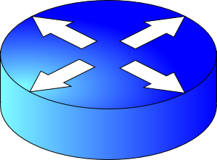

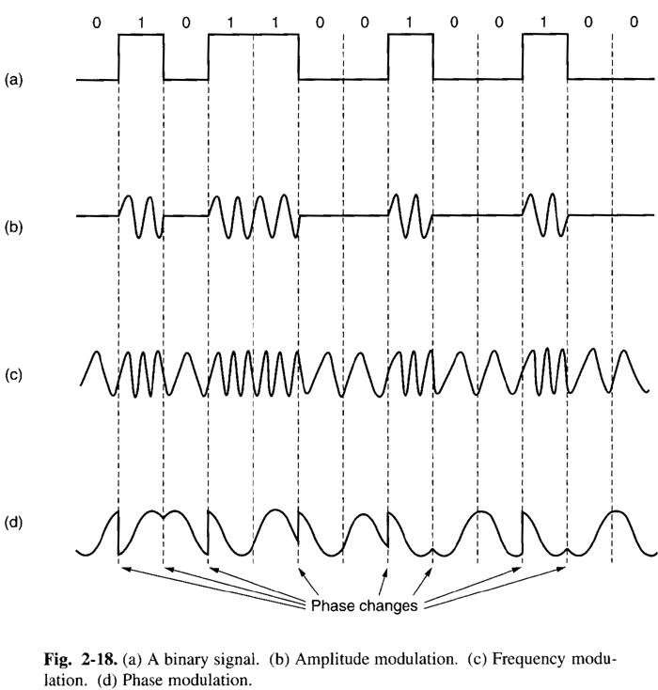
Physical transmission on a single link
How about multi-link networks?
Router
Router

Slide 6
Switching schemes
Host applications transfer data containing many messages.
(1) Circuit Switching
(2) Message Switching (Store-and-Forward)
(3) Packet Switching (Store-and-Forward)

Slide 7
Circuit switching
Provides service by setting up the total path of connected lines from the origin to the destination
Example: Telephone network

Slide 8
Circuit switching
1. Control message sets up a path from origin to destination
2. Return signal informs source that data transmission may proceed
3. Data transmission begins
4. Entire path remains allocated to the transmission (whether used or not)
5. When transmission is complete, source releases the circuit

Slide 9
Circuit switching
Call request signal
Propagation Delay
Resource reservation
delay
Time
Total transfer time
Call accept signal
Data
Transmission
Time
Data
A
B
C
D

Slide 10
Message switching
Each message is addressed to a destination
Header: metadata that denotes how to process a message
The message “hops” from node to node through a network while allocating only one link at a time
Compare to circuit switching: all links reserved at the same time, regardless of use.
Analogy: Postal service

Slide 11
Message switching
When the entire message is received at a router, the next step in its journey is selected; if this selected channel is busy, the message waits in a queue until the channel becomes free
Store and forward switching: router waits for all packet bits to arrive on incoming link before sending first bit on outgoing link
Compare to “cut–through” switching

Slide 12
Message Switching
Header
Msg
Time
Total transfer time
Msg
Queueing
Delay
Msg
A
B
C
D

Slide 13
Packet switching
Messages are split into smaller pieces called packets
Packets are numbered and addressed
Sent through the network one at a time
Pipelining: different parts of a message concurrently transmitted over different links
Provides higher utilization of link resources

Slide 14
Packet switching
Header
Pkt 1
Pkt 2
Pkt 1
Store and forward
delay
Total transfer time
Time
Pkt 3
Queueing
Delay
Pkt 2
Pkt 3
Pkt 1
Pkt 2
Pkt 3
A
B
C
D

Slide 15
The Internet uses store-and-forward packet switching.

Slide 16
Some comparisons
(1) Header Overhead (what % of bits on the wire is metadata?)
Circuit < Message < Packet
(2) Total Delay
Short Bursty Messages:
Message < Circuit
Long Continuous Messages:
Circuit < Message

Slide 17
Telephone Network
Connection-based
Admission control
Intelligence is “in the core network”
Every service provided by the telephone company
Traffic carried by relatively few, “well-known” communications companies
Internet
Packet-based
Best effort
Intelligence is “at the endpoints”
Services provided by anyone
Traffic carried by many routers, operated by many service providers

Slide 18
Some definitions
Packet length: size of a packet (bits or bytes)
Bandwidth: For a single link, amount of data it can transmit per unit time (bits/second or Bytes/second or packets/second)
Propagation delay: Time needed to move one bit across (second)
Imposed by the communication medium; depends on the effective link length
Packet transmission time: for a single link, the time required to transmit an entire packet from a sender to a receiver (seconds)
Time between the first bit and last bit at the receiver
Total transfer time: time from first bit@sender to last bit@receiver
propagation delay + transmission time for a single packet

Slide 19

Analogy: Conveyor belt
Propagation delay = time for first box to travel the length of the belt
Bandwidth = the number of boxes put on the belt per minute (“rate”)
Suppose we have N boxes in one shipment
Shipment transmission time = N / rate
The next box is put on the belt (1/rate) minutes after the last
Total transfer time = transmission time + propagation delay

Slide 20
Protocols and Layering

Slide 21
Protocols: The “rules” of networking
A protocol constitutes two things:
Message interface: messages exchanged with a peer (ex: between two communicating hosts or routers)
Actions: operations on receiving (or not receiving) messages
We use the term protocol to refer both to the specification and the implementation of these two notions.

Slide 22
The protocols of the Internet
Defined by the Internet Engineering Task Force (IETF)
… through RFCs (“Request For Comments”)
Layering and Hourglass Design
HTTPS
FTP
HTTP
SIP
RTSP
TCP
UDP
IP
X.25
…
802.11
ATM

Slide 23

Layering
Protocols at higher layers build on the ones at lower layers
Layering is a form of modularity
Example: Break laundry up into washing and drying
A washer only washes; a dryer only dries
Each picks one task and does it very well
Network communication is very complex
Layering simplifies understanding, testing, maintaining
Easy to improve or replace protocol at one layer
Without affecting other layers

Slide 24
TCP/IP Layering Architecture
Application
HTTPS
FTP
HTTP
SIP
RTSP
Transport
TCP
UDP
Network
IP
Host-to-Net
X.25
…
802.11
ATM

Slide 25
Host-to-network layer: (a) Physical Layer
The physical layer transmits the raw bit stream between two endpoints of a physical link
Functions:
Modulation of bits over physical signals
Performing bit-serial or parallel signal transmission
Half- or Full-duplex transmission
Concerns
How many pins does the network connector have?
How is physical connectivity set up or torn down?

Slide 26
Host-to-network layer: (b) Data Link Layer
The data link layer provides the network layer with what appears to be an error-free link to the other side of the link
Functions:
Provides reliable transfer of information between two adjacent nodes
Creates frames, or packets, from bits and vice versa
Provides frame-level error control

Slide 27
Network Layer
Network layer protocols move (“route”) host data towards destination
Best effort: network will try its best, but no guarantees.
Network layer implemented differently on hosts and routers
Functions:
Responsible for routing decisions
Routing may be fixed or dynamic

Slide 28
Transport Layer
Handles host to host data transmission concerns
Almost fully implemented on hosts
Hides the details of the network from the application
Example: If we replace a point-to-point link with a satellite link, it doesn’t affect the behavior of the upper layers
Functions:
Reliable delivery: Packet retransmission upon loss
Ordered delivery: Reassemble packets in order at receiver
Flow control: Ensure that the receiving host isn’t overwhelmed
Congestion control: Ensure that routers aren’t overwhelmed

Slide 29
Application Layer
Implements application-specific communication between hosts running applications of the same “type”
Ex: between your web browser and a web server (HTTP)
Functions:
Provides session support and presentation support
Session state, encryption, encoding
Examples:
FTP, HTTP, SMTP (email), SIP (Session Initiation Protocol)

Slide 30
Hourglass Design
An artifact of the history of the Internet
Addressing a need to have diverse kinds of networks cooperate
The Internet Protocol (IP) is the “glue” connecting different physical technologies, transports, and applications
HTTPS
FTP
HTTP
SIP
RTSP
TCP
UDP
IP
NET
…
NET
1
2
NET
n

Slide 31
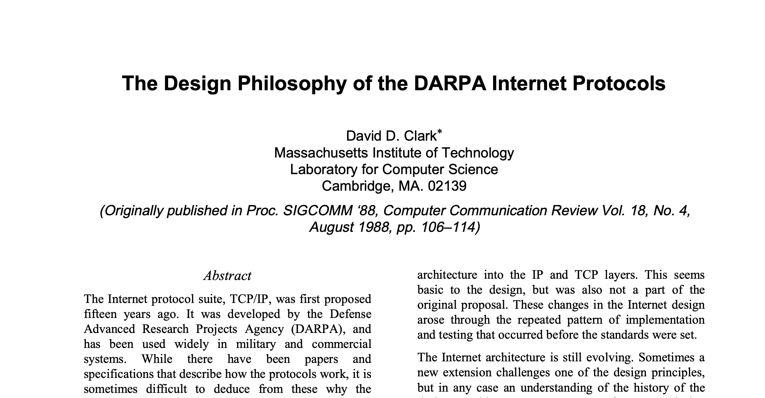
Design principles of the Internet
“multiplexed utilization of existing interconnected networks”

Slide 32
Design principles of the Internet
Accommodate heterogeneity
Interoperate with different technologies, autonomous organizations
Resilience to failure
Parts of the network must operate despite others failing
Scale
Distributed management, networks of different sizes and host types
Intelligence is at the endpoints (“the end-to-end argument”)
Much easier to engineer a network with fewer guarantees (best effort)
Hosts and applications share fate anyway

Slide 34
Backup slides

Slide 35









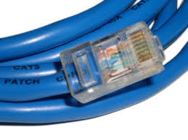


Issues at each layer
Application
Port#
Transport
End-to-end
Address
Network
Routing
Link
Access

Slide 36








functionality at each layer
Application
Port#
Transport
E-2-E
Routing
IP Address
Network
Link
Access

Slide 37
Internet Design Principles
Scale
Protocols should work in networks of all sizes and distances
Incremental deployment
New protocols need to be deployed gradually
Heterogeneity
Different technologies, autonomous organizations
End-to-end argument
Application requirements, to the extent possible should be delegated to the edges; application knows best
Encryption: Should the network provide as default or let applications or end points implement encryption on a need basis?

Slide 38
Measuring a Network’s Performance
A Brief Introduction

Slide 39
Some Definitions
Packet length: size of a packet (units = bits or bytes)
Channel speed or bandwidth: How fast the channel can transmit bits (units = bits/second or Bytes/second or packets/second)
Packet transmission time: amount of time to transmit an entire packet (units = seconds)
Propagation delay: Delay imposed by the properties of the link. Depends on the link’s distance (units = seconds)
Total transfer time =propagation delay + packet transmission time

Slide 40
Digression: Units
Bits are the units used to describe an amount of data in a network
1 kilobit (Kbit) = 1 x 10³ bits = 1,000 bits
1 megabit (Mbit) = 1 x 10⁶ bits = 1,000,000 bits
1 gigabit (Gbit) = 1 x 10⁹ bits = 1,000,000,000 bits
Seconds are the units used to measure time
1 millisecond (msec) = 1 x 10⁻³ seconds = 0.001 seconds
1 microsecond (μsec) = 1 x 10⁻⁶ seconds = 0.000001 seconds
1 nanosecond (nsec) = 1 x 10⁻⁹ seconds = 0.000000001 seconds
Bits per second are the units used to measure channel capacity/bandwidth and throughput
bit per second (bps)
kilobits per second (Kbps)
megabits per second (Mbps)
Bytes (8 bits a byte) Mega bytes, Giga bytes, Tera bytes, Peta Bytes, Exa bytes

Slide 41
Example
500 m
A
B
packet length = 1500 bytes
channel capacity = 10 Mbps
propagation delay factor = 5 μsec/km
How long does it take a single bit to travel on the link from A to B?
How long does it take A to transmit an entire packet onto the link?

Slide 42
Propagation Delay
How long does it take a single bit to travel on the link from A to B of length 500 m with a prop. delay factor = 5 μsec/km ?
Another way to ask this question:
If it takes a signal 5 μsec to travel 1 kilometer, then how long does it take a signal to travel 500 meters?
5 μsec
t
Solving for t…
t = 2.5 μsec
=
1000 m
500 m

Slide 43
Packet Transmission Time
How long does it take A to transmit an entire packet onto the link?
Relevant information: packet length = 1500 bytes
channel speed = 10 Mbps
Another way to ask this question:
If the link can transmit 10 million bits in a second, how many seconds does it take to transmit 1500 bytes (8x1500 bits)?
10 Mbits
1500 x 8 bits
Solving for t…
t = 0.0012 sec (or 1.2 msec)
=
1 sec
t

Slide 44
Message switching vs Packet switching
R1
Link speed is 1000 Bytes/sec. (ignore prop delay)
Packet size is 100 Bytes, file size is 1000 Bytes
Find total time to transfer the entire file under the two switching techniques
Msg switching
Packet switching

Slide 45
Message switching vs Packet switching
R1
Link speed is 1000 Bps. (prop delay for each link=10 msec)
Packet size is 100 bytes, file size is 1000 bytes
Find total time to transfer the entire file under the two switching techniques
Msg switching
Packet switching

Slide 46
Message switching vs Packet switching
L1
L2
L3
R1
R2
Link speed is 1000 Bytes per second . (ignore prop delay, ignore header overhead)
Packet size is 100 Bytes, file size is 1000 Bytes
Find total time to transfer the entire file under the two switching techniques

