Slide 1

The Transport Layer De/Multiplexing, Reliability
CS 352, Lecture 6
http://www.cs.rutgers.edu/~sn624/352-S19
Srinivas Narayana
(slides heavily adapted from text authors’ material)

Slide 2
This lecture: Transport
Application
HTTPS
FTP
HTTP
SMTP
DNS
Transport
TCP
UDP
Network
IP
Host-to-Net
X.25
…
802.11
ATM

Slide 3

Transport services and protocols
application
transport
network
data link
physical
Provide logical communication between app processes running on different hosts
Transport protocols run @ hosts
send side: breaks app messages into segments, passes to network layer
recv side: reassembles segments into messages, passes to app layer
More than one transport protocol available to apps
Internet: TCP and UDP
application
transport
network
data link
physical

Slide 4




Transport vs. network layer
Household analogy:
12 kids sending letters to 12 kids
processes = kids
app messages = letters in envelopes
hosts = houses
transport protocol = Alice and Bob who de/mux to in-house siblings
network-layer protocol = postal service
Network layer: logical communication between hosts
Transport layer: logical communication between processes
relies on and enhances, network layer services

Slide 5
Internet transport-layer protocols
application
transport
network
data link
physical
Reliable, in-order delivery (TCP)
congestion control
flow control
connection setup
Unreliable, unordered delivery: UDP
no-frills extension of “best-effort” IP
Services not available:
delay guarantees
bandwidth guarantees
network
data link
physical
network
data link
physical
logical end-end transport
network
data link
physical
network
data link
physical
network
data link
physical
network
data link
physical
application
transport
network
data link
physical

Slide 6
Layering: in terms of packets
send(data)
receive(data)
Other apps
Other apps
Application
port
port
Operating System
IP
Host-to-Net
Addresses (S, D)
Src, Dst
IP addr
Port #
Data

Slide 7
UDP: User Datagram Protocol [RFC 768]
“no frills,” “bare bones” Internet transport protocol
“best effort” service, UDP segments may be:
lost
delivered out of order to app
connectionless:
no handshaking between UDP sender, receiver
each UDP segment handled independently of others
Why is there a UDP?
no connection establishment (which can add delay)
simple: no connection state at sender, receiver
small segment header
no congestion control: UDP can blast away as fast as desired

Slide 8
UDP’s uses
Often used for streaming multimedia apps
loss tolerant
Delay sensitive
Other UDP uses: need “lightweight”
DNS
SNMP
If you want reliable transfer over UDP, you must add reliability at application layer
Can implement application-specific error recovery
32 bits
source port #
dest port #
length
checksum
Length, in
bytes of UDP
segment,
including
header
Application
data
(message)
UDP segment format

Slide 9
How demultiplexing works
32 bits
Host receives IP datagrams
Datagram contains a transport-level segment
each segment has source IP address, destination IP address
each segment has source, destination port number
Host uses IP addresses & port numbers to direct segment to appropriate socket
source port #
dest port #
other header fields
application
data
(message)
TCP/UDP segment format

Slide 10
Connectionless demultiplexing
Create sockets with host-local port numbers to receive data
// Example: Java UDP socket
DatagramSocket socket1 = new DatagramSocket(12534);
When creating data to send into UDP socket, you must specify
(dest IP address, dest port number)
When host receives UDP segment:
checks destination port number in segment
directs UDP segment to socket with that port number
IP datagrams with different source IP addresses and/or source port numbers directed to same socket

Slide 11
UDP client + server (Python API)
UDPsender():
try:
ssd=socket.socket(socket.AF_INET, socket.SOCK_DGRAM)
except socket.error as err:
exit()
# Define the port on which you want to send to the receiver
RPort = 50007
hisip=socket.gethostbyname(“ilab.cs.rutgers.edu”)
receiver_binding=(hisip, RPort)
MESSAGE="hello world"
msg=MESSAGE.encode('utf-8’)
ssd.sendto(msg, receiver_binding)
# no “connection” to other side needed before sending data!
# Close the sender socket
ssd.close()
exit()
UDPreceiver():
try:
rsd=socket.socket(socket.AF_INET, socket.SOCK_DGRAM)
except socket.error as err:
exit()
# Define the port on which you want to receive from the server
Rport = 50007
myip = socket.gethostbyname(socket.gethostname())
# connect to the server on local machine
server_binding=(myip, Rport)
rsd.bind(server_binding)
data, addr = rsd.recvfrom(1024)
# no need to “accept” a connection from other side before receiving data!
print(data.decode("utf-8"))
# Close the receiver socket
rsd.close()
exit()

Slide 12
UDP Checksum
Problem: detect “errors” (e.g., flipped bits) in transmitted segment
Solution principle: compute a function over data, store it along with data.
Sender:
treat segment contents as sequence of 16-bit integers
checksum: addition (1’s complement sum) of segment contents
sender puts checksum value into UDP checksum field
Receiver:
compute checksum of received segment
check if computed checksum equals checksum field value:
NO - error detected
YES - no error detected.

Slide 13
UDP checksum Example
Note: when adding numbers, a carryout from the most significant bit needs to be added to the result
Example: add two 16-bit integers
1 1 1 1 0 0 1 1 0 0 1 1 0 0 1 1 0
1 1 1 0 1 0 1 0 1 0 1 0 1 0 1 0 1
1 1 0 1 1 1 0 1 1 1 0 1 1 1 0 1 1
1 1 0 1 1 1 0 1 1 1 0 1 1 1 1 0 0
1 0 1 0 0 0 1 0 0 0 1 0 0 0 0 1 1
wraparound
sum
checksum

Slide 14
Internet Checksum Example
Complement of the sum is stored in the checksum field
At the receiver, all the byte fields are added along with the checksum
Sum + checksum must be all 1s
All 1s, No error else discard packet
UDP checksum is optional in IPv4
UPD checksum is mandatory in IPv6

Slide 15
UDP summary
A thin shim around best-effort IP
Provides basic multiplexing/demultiplexing for applications
Basic error detection (bit flips) using checksums

Slide 16
Reliable data transfer

Slide 17
Reliable Data Transfer
Problem: Reliability
Applications want an abstraction of a reliable link even though packets can be corrupted or get lost.
Where can packets be corrupted or lost?
In the network
At the receiver
Solution: keep track of packets reaching other side

Slide 18
Reliability support
Sender needs to know if a packet was corrupted or lost
How?
Acknowledgements (ACKs)
Positive ACKs and negative ACKs (NAKs)
Sender needs to retransmit on receiving a negative ACK
But what if packets are lost?
Timeouts
Remember, ACKs can also get lost!

Slide 19
Reliable delivery algorithms for transport
Consider a series of increasingly complex (and realistic) networks
“Stop and wait” protocols
An ideal network without bit errors or packet loss
Channels with bit errors
Channels with packet losses
Pipelined data transfer (“sliding window protocols”)
Go Back N
Selective Repeat

Slide 20
Transport in an ideal network
Assumptions:
Error free transmission link,
Infinite buffer at the receiver
No acknowledgement of frames necessary
Since the data link is error-free and the receiver can buffer as many frames as it likes, no frame will ever be lost

Slide 21
Stop-and-wait: normal operation
Packet Length = L; Bandwidth =R; RTT = 2*Prop Delay
sender
receiver
first packet bit transmitted, t = 0
last packet bit transmitted, t = L / R
first packet bit arrives
RTT
last packet bit arrives, send ACK
ACK arrives, send next
packet, t = RTT + L / R

Slide 22
Stop-and-wait: packet corrupted
Packet Length = L; Bandwidth =R; RTT = 2*Prop Delay
sender
receiver
first packet bit transmitted, t = 0
last packet bit transmitted, t = L / R
first packet bit arrives
RTT
last packet bit arrives, send ACK
NACK
ACK arrives, send next
packet, t = RTT + L / R

Slide 23
Stop-and-wait: packet lost
sender
receiver
first packet bit arrives
Timeout
last packet bit arrives, send ACK

Slide 24
Stop-and-wait: ACK lost!
sender
receiver
Timeout
Packet retransmission

Slide 25
Stop-and-wait: ACKs may be delayed!
sender
receiver
Timeout
Timeout too short
Duplicate Transmission

Slide 26
Stop-and-wait: Detecting duplicates
sender
receiver
0
Timeout
Timeout too short
Duplicate Transmission
Ack0
1
Ack1

Slide 27
Performance of stop and wait
example: 1 Gbps link, 1.5 ms end to end prop. delay, 1 KB packet:
T
=
L (packet length in bits)
8kb/pkt
transmit
=
= 8 microsec
R (transmission rate, bps)
10**9 b/sec
U _{sender}: utilization – fraction of time sender busy sending
1KB pkt every 3 msec -> 330kB/sec throughput over 1 Gbps link
network protocol limits use of physical resources!

Slide 28
Bandwidth-delay product
Continuously send data until first ACK
How much? BW*RTT
Known as Bandwidth delay product
Number of packets N = BW*RTT/Packet size

Slide 29
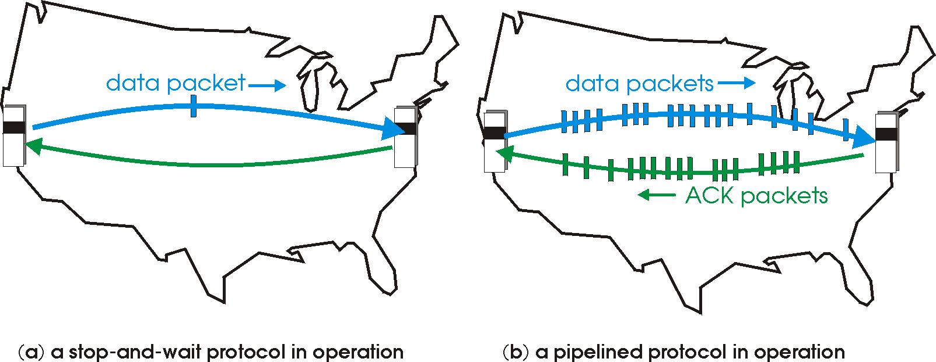
Pipelined protocols
Pipelining: sender allows multiple, “in-flight”, yet-to-be-acknowledged pkts

Slide 30
Pipelining Example: increased utilization
sender
receiver
first packet bit transmitted, t = 0
last bit transmitted, t = L / R
first packet bit arrives
RTT
last packet bit arrives, send ACK
last bit of 2nd packet arrives, send ACK
last bit of 3rd packet arrives, send ACK
ACK arrives, send next
packet, t = RTT + L / R
Increase utilization
by a factor of 3!

Slide 32
Reliable transmission & Flow Control
What to do when there is a packet loss?
On the link (in the network)
At the receiver (buffer overflow)
Need to recoup losses
What happens if the packet is lost in the network?
A random event, retransmit
What happens if the sender tries to transmit faster than the receiver can accept?
Data will be lost unless flow control is implemented

Slide 33
Flow control in an ideal network (cont’d)
Slow Joe
Fast Frank
Infinite bucket

