Slide 1

The Transport Layer Reliability
CS 352, Lecture 7
http://www.cs.rutgers.edu/~sn624/352-S19
Srinivas Narayana
(slides heavily adapted from text authors’ material)

Slide 2

Quick recap: Transport
application
transport
network
data link
physical
Provide logical communication between app processes running on different hosts
Providing reliable communication:
“Stop and wait” protocols
Concepts:
Acknowledgements (ACKs)
Timeouts
Retransmission
Sequence numbers
application
transport
network
data link
physical

Slide 3
Stop-and-wait: normal operation
Packet Length = L; Bandwidth =R; RTT = 2*Prop Delay
sender
receiver
first packet bit transmitted, t = 0
last packet bit transmitted, t = L / R
first packet bit arrives
RTT
last packet bit arrives, send ACK
ACK arrives, send next
packet, t = RTT + L / R

Slide 4
Stop-and-wait: packet corrupted
Packet Length = L; Bandwidth =R; RTT = 2*Prop Delay
sender
receiver
first packet bit transmitted, t = 0
last packet bit transmitted, t = L / R
first packet bit arrives
RTT
last packet bit arrives,
Corrupted! send NAK
NAK
ACK arrives, send next
packet, t = RTT + L / R

Slide 5
Stop-and-wait: packet lost
sender
receiver
Timeout
Packet retransmission

Slide 6
Stop-and-wait: ACK lost!
sender
receiver
Timeout
Packet retransmission
Duplicate transmission received

Slide 7
Stop-and-wait: ACKs may be delayed!
sender
receiver
Timeout
Timeout too short
Duplicate Transmission

Slide 8
Stop-and-wait: Sequence numbers
sender
receiver
0
Timeout
Ack
Sequence numbers help detect duplicate transmissions at the receiver.
1
Ack

Slide 9
Often, protocols just use ACKs (no NAKs)
sender
receiver
Instead of NAK, receiver sends ACK for last packet received OK
receiver must explicitly include seq # of pkt being ACKed
Duplicate ACK at sender results in same action as NAK: retransmit current packet
0
Timeout
Ack0
1
Ack1

Slide 10
Discussion of stop and wait protocols
sender:
seq # added to pkt
two seq. #’s (0,1) will suffice. Why?
must check if received ACK/NAK corrupted
receiver:
must check if received packet is duplicate
ACK indicates received packet, but also next packet expected
note: receiver cannot know if its last ACK/NAK received OK at sender
Problem with stop and wait: low utilization of available capacity
Reason: Transmitting one packet per round-trip time

Slide 11
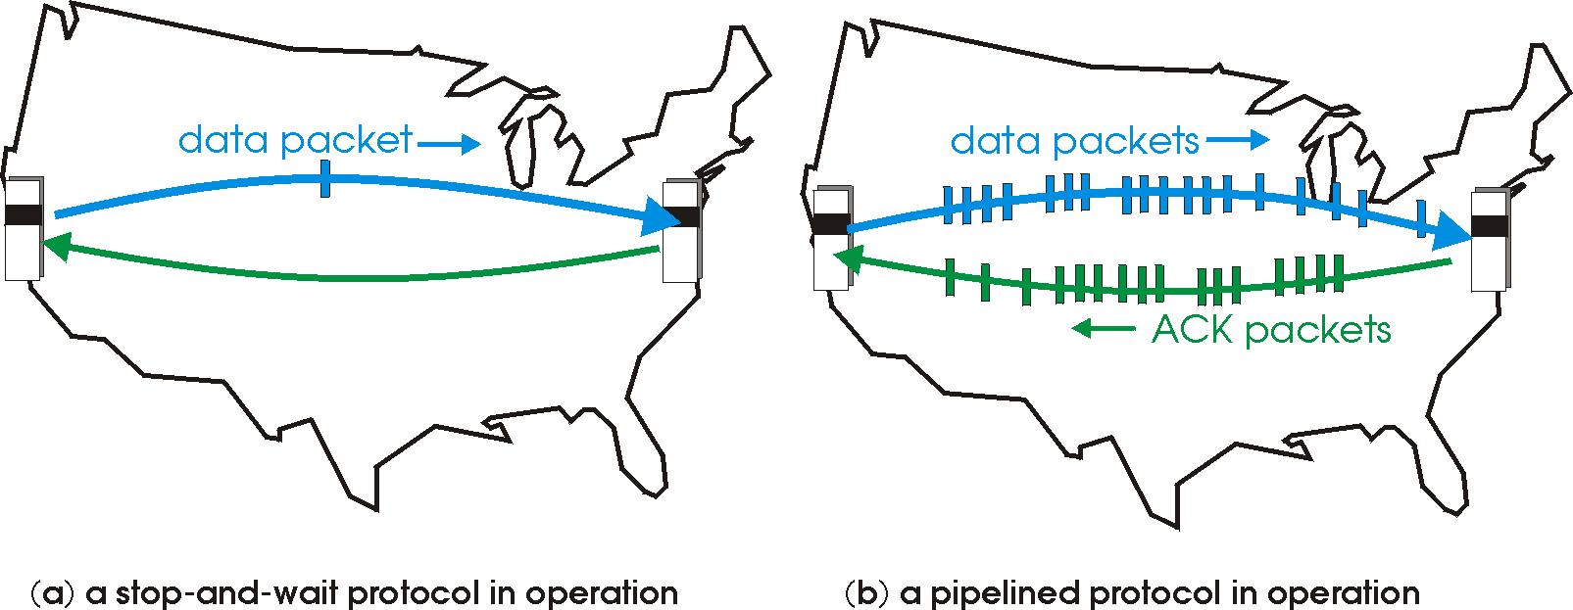
Pipelined protocols
Pipelining: sender allows multiple, “in-flight”, yet-to-be-acknowledged pkts

Slide 12
Pipelining Example: increased utilization
sender
receiver
first packet bit transmitted, t = 0
last bit transmitted, t = L / R
first packet bit arrives
RTT
last packet bit arrives, send ACK
last bit of 2nd packet arrives, send ACK
last bit of 3rd packet arrives, send ACK
ACK arrives, send next
packet, t = RTT + L / R

Slide 13
Sliding Window Protocols: Definitions
Window: informally, a subset of packets the sender or receiver consider “in flight”
Sequence Number: Each frame is assigned a sequence number that is incremented as each frame is transmitted
Sender Window: Keeps track of sequence numbers for frames that have been sent but not yet acknowledged
Sender Window size: The maximum number of frames the sender may transmit without receiving any acknowledgements
Last Frame sent: The highest sequence number frames sent
Last Ack received: sequence number of last ACK

Slide 14
Sliding Window with Maximum Sender Window Size SWS
With a maximum window size of SWS, the sender can transmit up to SWS frames before stopping and waiting for ACKs
This allows the sender to transmit several frames before waiting for an acknowledgement
Seq Number increasing
SWS
Sequence numbers wrap around! (limited number of bits in header)
0
1
2
3
4
5
6
7
0
1
LAR
LFS
LFS
- LAR <= SWS

Slide 15
Sender-Side Window with W_{S}=2
7
0
7
0
7
0
7
0
6
1
6
1
6
1
6
1
5
2
5
2
5
2
5
2
4
3
4
3
4
3
4
3
(a)
(b)
(c)
(d)
7
0
7
0
7
0
7
0
6
1
6
1
6
1
6
1
5
2
5
2
5
2
5
2
4
3
4
3
4
3
4
3
(e)
(f)
(g)
(h)
(a) Initial window state
(b) Send frame 0
(c) Send frame 1
(d) ACK for frame 0 arrives
(e) Send frame 2
(f ) ACK for frame 1 arrives
(g) ACK for frame 2 arrives, send frame 3
(h) ACK for frame 3 arrives

Slide 16
Sliding Window Protocols Receiver Definitions
Receiver Window: Keeps track of sequence numbers for frames the receiver is allowed to accept
Receiver Window size: The maximum number of frames the receiver may receive before returning an acknowledgement to the sender
Largest Frame received: The highest in-sequence numbered frame received
Largest Acceptable Frame: Highest sequence number acceptable

Slide 17
Sliding Window with Maximum Receiver Window Size RWS
With window RWS, receiver rejects pkts if SeqNum <= LFR or SeqNum > LAF
Receiver acknowledges seqnumber s.t all earlier frames have been received
Cumulative ACK
Seq Number increasing
RWS
LAF
- LFR <= RWS
LFR
LAF

Slide 18
Receiver-Side Window with W_{R}=2
7
0
7
0
7
0
7
0
6
1
6
1
6
1
6
1
5
2
5
2
5
2
5
2
4
3
4
3
4
3
4
3
(a)
(b)
(c)
(d)
7
0
7
0
7
0
7
0
6
1
6
1
6
1
6
1
5
2
5
2
5
2
5
2
4
3
4
3
4
3
4
3
(e)
(f)
(g)
(h)
(a) Initial window state
(b) Nothing happens
(c) Frame 0 arrives, ACK frame 0
(d) Nothing happens
(e) Frame 1 arrives, ACK frame 1
(f) Frame 2 arrives, ACK frame 2
(g) Nothing happens
(h) Frame 3 arrives, ACK frame 3

Slide 19
What about Errors?
What if a data or acknowledgement frame is lost when using a sliding window protocol?
Two Solutions:
Go Back N
Selective Repeat

Slide 20
Sliding Window with Go Back N
When the receiver notices a missing or erroneous frame, it simply discards all frames with greater sequence numbers and sends no ACK
The sender will eventually time out and retransmit all the frames in its sending window

Slide 21
Go Back N
Timeout interval
Sender
0
1
2
3
4
2
3
4
5
6
Maximum
window size = 8
ACK 0
ACK 1
ACK 2
ACK 3
ACK 4
ACK 5
ACK 6
Receiver
0
1
E
D
D
2
3
4
5
6
Maximum
window size = 8
Discarded by
receiver
Frame with
error
Time

Slide 22
Go Back N (cont’d)
Go Back N can recover from erroneous or missing frames
But…
It is wasteful. If there are errors, the sender will spend time retransmitting frames the receiver has already seen

Slide 23
Sliding Window with Selective Repeat
Idea: sender should only retransmit dropped/corrupted segments.
The receiver stores all the correct frames that arrive following the bad one. (Note that the receiver requires a memory buffer for each sequence number in its receiver window.)
When the receiver notices a skipped sequence number, it keeps acknowledging the last good sequence number (cumulative ACK)
When the sender times out waiting for an acknowledgement, it just retransmits the one unacknowledged frame, not all its successors.

Slide 24
Selective Repeat
Timeout interval
Sender
0
1
2
3
4
2
5
6
Maximum
window size = 8
NACK 2
NACK 2
ACK 0
ACK 1
ACK 4
ACK 5
ACK 6
Receiver
0
1
E
3
4
2
5
6
Maximum
window size = 8
Buffered by
receiver
Frame with
error
Time

Slide 25
Pipelined protocols: overview
Go-back-N:
sender can have up to N unacked packets in pipeline
receiver only sends cumulative ack
doesn’t ack packet if there’s a gap
sender has timer for oldest unacked packet
when timer expires, retransmit all unacked packets
Selective Repeat:
sender can have up to N unacked packets in pipeline
receiver sends individual ack for each packet
sender maintains timer for each unacked packet
when timer expires, retransmit only that unacked packet

Slide 26

Selective repeat in action
sender window (N=4)
sender
receiver
0 1 2 3 4 5 6 7 8
send pkt0
send pkt1
send pkt2
send pkt3
(wait)
0 1 2 3 4 5 6 7 8
receive pkt0, send ack0
receive pkt1, send ack1
receive pkt3, buffer,
send ack3
0 1 2 3 4 5 6 7 8
X
0 1 2 3 4 5 6 7 8
loss
0 1 2 3 4 5 6 7 8
rcv ack0, send pkt4
rcv ack1, send pkt5
0 1 2 3 4 5 6 7 8
receive pkt4, buffer,
send ack4
record ack3 arrived
receive pkt5, buffer,
send ack5
pkt 2 timeout
0 1 2 3 4 5 6 7 8
send pkt2
0 1 2 3 4 5 6 7 8
record ack4 arrived
0 1 2 3 4 5 6 7 8
rcv pkt2; deliver pkt2,
pkt3, pkt4, pkt5; send ack2
record ack5 arrived
0 1 2 3 4 5 6 7 8
Q: what happens when ack2 arrives?

Slide 27

Selective repeat: dilemma
sender window
(after receipt)
receiver window
(after receipt)
0 1 2 3 0 1 2
pkt0
0 1 2 3 0 1 2
pkt1
0 1 2 3 0 1 2
example:
seq #’s: 0, 1, 2, 3
window size=3
0 1 2 3 0 1 2
pkt2
0 1 2 3 0 1 2
0 1 2 3 0 1 2
0 1 2 3 0 1 2
pkt3
X
0 1 2 3 0 1 2
pkt0
will accept packet
with seq number 0
receiver sees no difference in two scenarios!
duplicate data accepted as new in (b)
Q: what relationship between seq # size and window size to avoid problem in (b)?
(a) no problem
receiver can’t see sender side.
receiver behavior identical in both cases!
something’s (very) wrong!
0 1 2 3 0 1 2
pkt0
0 1 2 3 0 1 2
pkt1
0 1 2 3 0 1 2
0 1 2 3 0 1 2
pkt2
0 1 2 3 0 1 2
X
0 1 2 3 0 1 2
X
timeout
retransmit pkt0
X
0 1 2 3 0 1 2
pkt0
will accept packet
with seq number 0
(b) oops!

Slide 28
Summary
Reliability using sliding window/pipelined protocols
Continue to use concepts from stop and wait
ACKs, sequence numbers, timeouts
Downside: More complexity, memory buffers on either side
Benefit: higher throughput and resource utilization
Sliding window protocol used extensively: TCP!

