Slide 1

Network Layer: DHCP, ICMP, NAT, IPv6
CS 352, Lecture 11
http://www.cs.rutgers.edu/~sn624/352-S19
Srinivas Narayana
(heavily adapted from slides by Prof. Badri Nath and the textbook authors)

Slide 2
IP addresses: how to get one?
Q: How does a host get IP address?
Hard-coded by system admin in a file
UNIX: /etc/network/interfaces
Windows: controlpanel -> network -> configuration -> tcp/ip -> properties
DHCP: Dynamic Host Configuration Protocol: dynamically get address from as server
“plug-and-play”

Slide 3
Similar bootstrapping problems
How does a host get its IP address?
How does a host know its local DNS server?
How does a host know its subnet mask?
How does a host know which router is its “gateway” to other networks?

Slide 4
DHCP: Dynamic Host Configuration Protocol
goal: allow host to dynamically obtain its IP address from network server when it joins network
can renew its lease on address in use
allows reuse of addresses (only hold address while connected/“on”)
support for mobile users who want to join network
DHCP overview:
host broadcasts “DHCP discover” msg [optional]
DHCP server responds with “DHCP offer” msg [optional]
host requests IP address: “DHCP request” msg
DHCP server sends address: “DHCP ack” msg

Slide 5



DHCP client-server scenario
DHCP
server
223.1.1.0/24
223.1.1.1
223.1.2.1
223.1.1.2
arriving DHCP
client needs
address in this
network
223.1.1.4
223.1.2.9
223.1.3.27
223.1.2.2
223.1.1.3
223.1.2.0/24
223.1.3.1
223.1.3.2
223.1.3.0/24

Slide 6
DHCP client-server scenario
DHCP server: 223.1.2.5
DHCP discover
arriving
client
src : 0.0.0.0, 68
dest.: 255.255.255.255,67
yiaddr: 0.0.0.0
transaction ID: 654
Broadcast: is there a DHCP server out there?
DHCP offer
src: 223.1.2.5, 67
dest: 255.255.255.255, 68
yiaddrr: 223.1.2.4
transaction ID: 654
lifetime: 3600 secs
Broadcast: I’m a DHCP server! Here’s an IP address you can use
DHCP request
src: 0.0.0.0, 68
dest:: 255.255.255.255, 67
yiaddrr: 223.1.2.4
transaction ID: 655
lifetime: 3600 secs
Broadcast: OK. I’ll take that IP address!
DHCP ACK
src: 223.1.2.5, 67
dest: 255.255.255.255, 68
yiaddrr: 223.1.2.4
transaction ID: 655
lifetime: 3600 secs
Broadcast: OK. You’ve got that IP address!

Slide 7
DHCP Protocol
Server 1
Client
Server 2
DHCPDISCOVER
DHCPDISCOVER
DHCPOFFER
DHCPOFFER
Collects replies
Selects server 2
DHCPREQUEST
DHCPREQUEST
DHCPACK

Slide 8
DHCP: more than IP addresses
DHCP can return more than just allocated IP address on subnet:
address of first-hop router for client to reach other subnets
name and IP address of the local DNS sever
subnet mask

Slide 9
DHCP Relay Agents
DHCP relay agents allow DHCP servers to handle requests from other subnets
Client
DHCP
Relay
Agent
IP
Gateway
Router
IP
Gateway
Router
DHCP
Server

Slide 10


DHCP: example
DHCP
DHCP
UDP
IP
Eth
Phy
connecting laptop needs its IP address, addr of first-hop router, addr of DNS server: use DHCP
DHCP
DHCP
DHCP
DHCP
DHCP request encapsulated in UDP, encapsulated in IP, encapsulated in 802.1 Ethernet
DHCP
DHCP
UDP
IP
Eth
Phy
168.1.1.1
DHCP
DHCP
DHCP
Ethernet frame broadcast (dest: FFFFFFFFFFFF) on LAN, received at router running DHCP server
DHCP
router with DHCP
server built into
router
Ethernet demuxed to IP demuxed, UDP demuxed to DHCP

Slide 11
DHCP: example
DHCP
UDP
IP
Eth
Phy
DCP server formulates DHCP ACK containing client’s IP address, IP address of first-hop router for client, name & IP address of DNS server
DHCP
DHCP
DHCP
DHCP
encapsulation of DHCP server, frame forwarded to client, demuxing up to DHCP at client
DHCP
DHCP
UDP
IP
Eth
Phy
DHCP
DHCP
DHCP
router with DHCP
server built into
router
client now knows its IP address, name and IP address of DNS server, IP address of its first-hop router
DHCP

Slide 12
Summary
IP addresses don’t have to be manually configured into hosts
DHCP allows “ignorant” hosts to receive IP addresses (and more) at start-up time
DHCP solves important bootstrapping problems in attaching new hosts to a network

Slide 13
Internet Control Message Protocol (ICMP)

Slide 14
ICMP
Protocol for error detection and reporting
tightly coupled with IP, unreliable
ICMP messages delivered in IP packets
ICMP functions:
Announce reachability and network errors
Announce “time exceeded” errors for IP packets
Announce network congestion
ICMP assists network troubleshooting in general

Slide 15
ICMP message
IP header
Source, Destination Address, TTL, ...
ICMP MSG
Message type, Code, Checksum,
Data

Slide 16
ICMP: Internet Control Message Protocol
Type Code description
0 0 echo reply (ping)
3 0 dest. network unreachable
3 1 dest host unreachable
3 2 dest protocol unreachable
3 3 dest port unreachable
3 6 dest network unknown
3 7 dest host unknown
4 0 source quench (congestion
control - not used)
8 0 echo request (ping)
9 0 route advertisement
10 0 router discovery
11 0 TTL expired
12 0 bad IP header
Time for an activity!

Slide 17
Specific uses of ICMP
Echo request reply
Can be used to check if a host is alive
Destination unreachable
Invalid address and/or port
TTL expired
Routing loops, or too far away

Slide 18
Ping
Uses ICMP echo request/reply
Source sends ICMP echo request message to the destination address
Destination replies with an ICMP echo reply message containing the data in the original echo request message
Source can calculate round trip time (RTT) of packets
If no echo reply comes back then the destination is unreachable

Slide 19
Ping (cont’d)
A
R1
R2
R3
B
Echo request
Time
Echo reply

Slide 20
Traceroute
Traceroute records the route that packets take
A clever use of the TTL field
When a router receives a packet, it decrements TTL
If TTL=0, it sends an ICMP time exceeded message back to the sender
To determine the route, progressively increase TTL
Every time an ICMP time exceeded message is received, record the sender’s (router’s) address
Repeat until the destination host is reached or an error message occurs
If packet reaches the destination, the dest host usually sends an ICMP port unreachable

Slide 21
Traceroute (cont’d)
Te = Time exceeded
Pu = Port unreachable
A
R1
R2
R3
B
TTL=1, Dest = B,
port = invalid
Te (R1)
TTL=2, Dest = B
Time
Te (R2)
TTL=3, Dest = B
Te (R3)
TTL=4, Dest = B
Pu (B)

Slide 22
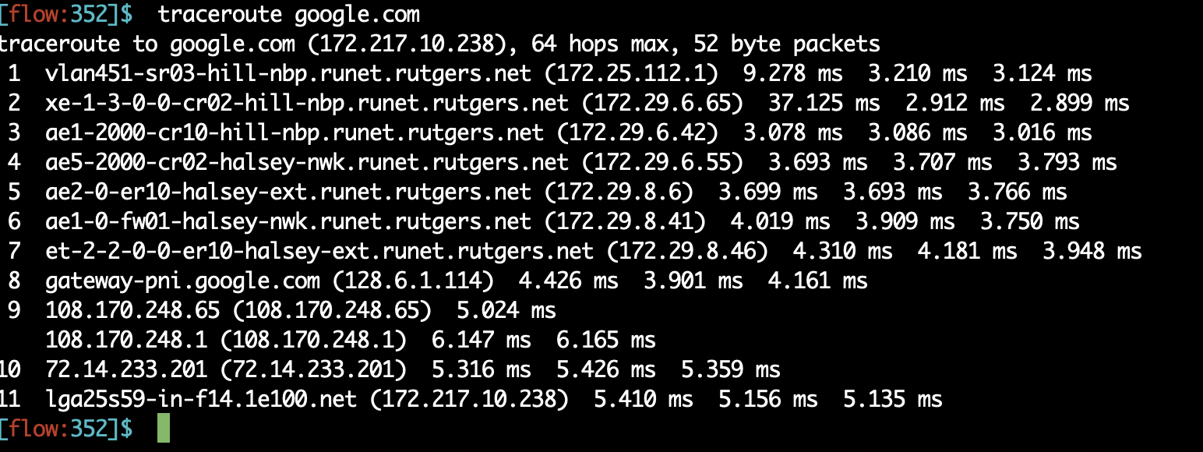
Traceroute example

Slide 23
Network Address Translation (NAT)

Slide 24
NAT: Network Address Translation
rest of
Internet
local network
(e.g., home network)
10.0.0/24
10.0.0.1
10.0.0.4
10.0.0.2
138.76.29.7
10.0.0.3
All datagrams leaving local
network have same single source NAT IP address: 138.76.29.7,
different source port numbers

Slide 25
NAT: Network Address Translation
NAT translation table
WAN side addr LAN side addr
1: host 10.0.0.1
sends datagram to
128.119.40.186, 80
2: NAT router
changes datagram
source addr from
10.0.0.1, 3345 to
138.76.29.7, 5001,
updates table
138.76.29.7, 5001 10.0.0.1, 3345
…… ……
S: 10.0.0.1, 3345
D: 128.119.40.186, 80
10.0.0.1
1
2
S: 138.76.29.7, 5001
D: 128.119.40.186, 80
10.0.0.4
10.0.0.2
138.76.29.7
S: 128.119.40.186, 80
D: 10.0.0.1, 3345
4
S: 128.119.40.186, 80
D: 138.76.29.7, 5001
3
10.0.0.3
4: NAT router
changes datagram
dest addr from
138.76.29.7, 5001 to 10.0.0.1, 3345
3: Reply arrives
dest. address:
138.76.29.7, 5001

Slide 26
NAT: Network Address Translation
Features: local network uses just one IP address as far as outside world is concerned:
range of addresses not needed from ISP: just one IP address for all devices
can change addresses of devices in local network without notifying outside world
can change ISP without changing addresses of devices in local network
devices inside local net not explicitly addressable, visible by outside world (a security plus).

Slide 27
Think about…
How do the hosts inside the home network get their IP addresses?
How does your home router get its externally visible IP address?

Slide 28
NAT: Network Address Translation
16-bit port-number field:
60,000 simultaneous connections with a single LAN-side address!
NAT is controversial:
Routers should only work upto the network layer, not transport ports!
violates “end-to-end argument”
NAT must be taken into account by app designers
e.g., P2P applications like skype
Purists: address shortage should instead be solved by IPv6

Slide 29
Internet Protocol v6 (IPv6)

Slide 30
Recent Developments: IPv6
IPv4 has limited address space (32 bits) and is running out of addresses. 32 bits are not enough!
More devices: phones, watches, your refrigerator(!), …
Real-time traffic and mobile users are also becoming more common
IP version 6

Slide 31
IPv6: Main changes from IPv4
Large address space:
128-bit addresses (16 bytes)
Allows up to 340,282,366,920,938,463,463,374,607,431,768,211,456 unique addresses (3.4 x 10 ³⁸ )
Fixed length headers (40 bytes)
Improves the speed of packet processing in routers
IPv6 “options” processing happens through a separate mechanism

Slide 32
IPv6 datagram format
priority: identify priority among datagrams in flow
flow Label: identify datagrams in same “flow”
(concept of“flow” left undefined)
next header: identify upper layer protocol for data
ver
pri
flow label
payload len
next hdr
hop limit
source address
(128 bits)
destination address
(128 bits)
data
32 bits

Slide 33
Other changes from IPv4
checksum: removed entirely to reduce processing time at each hop
options: allowed, but outside of header, indicated by “Next Header” field
ICMPv6: new version of ICMP
additional message types, e.g. “Packet Too Big”
multicast group management functions

Slide 34
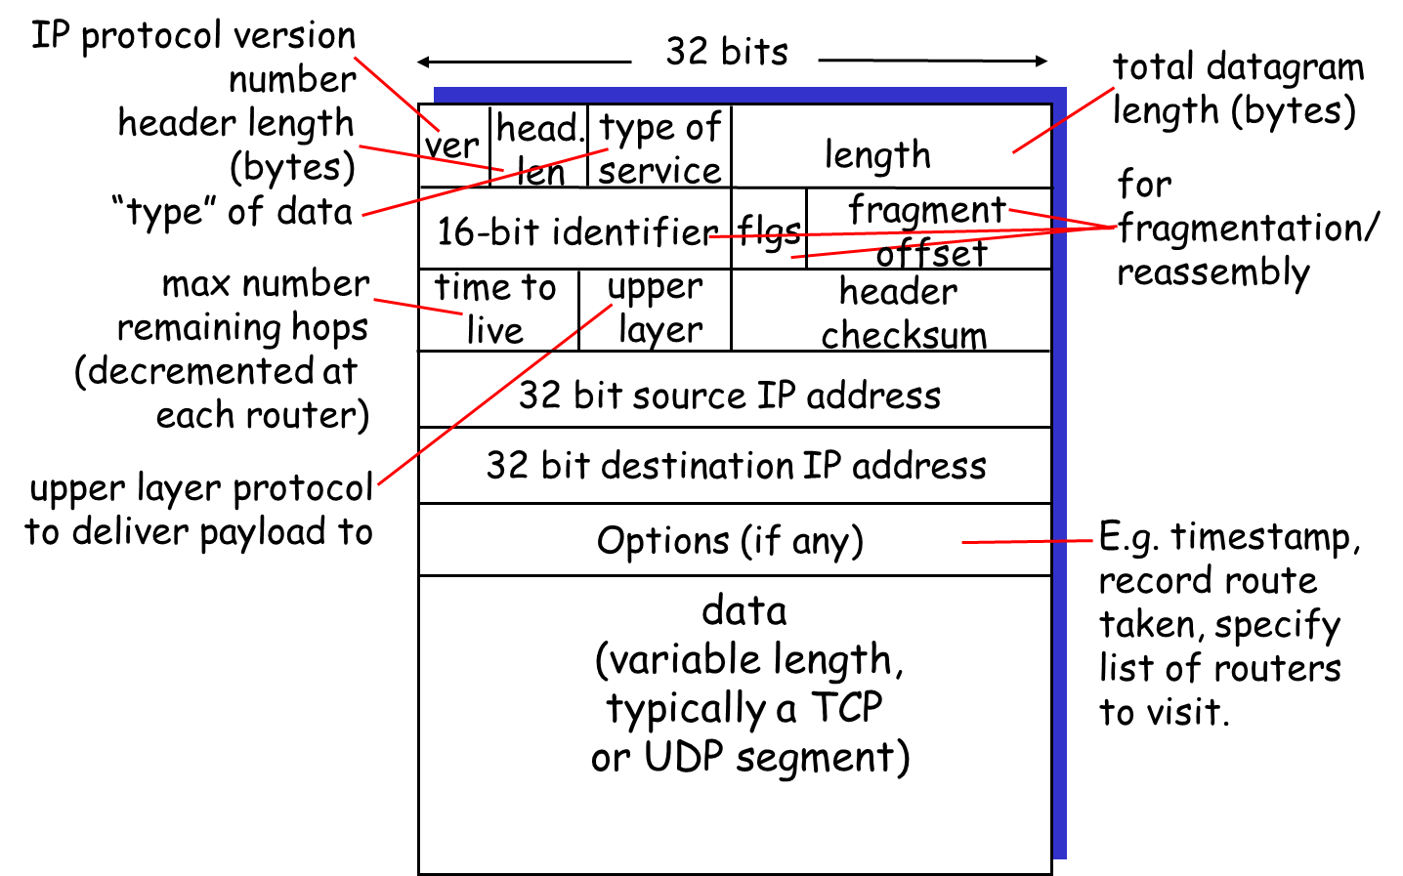
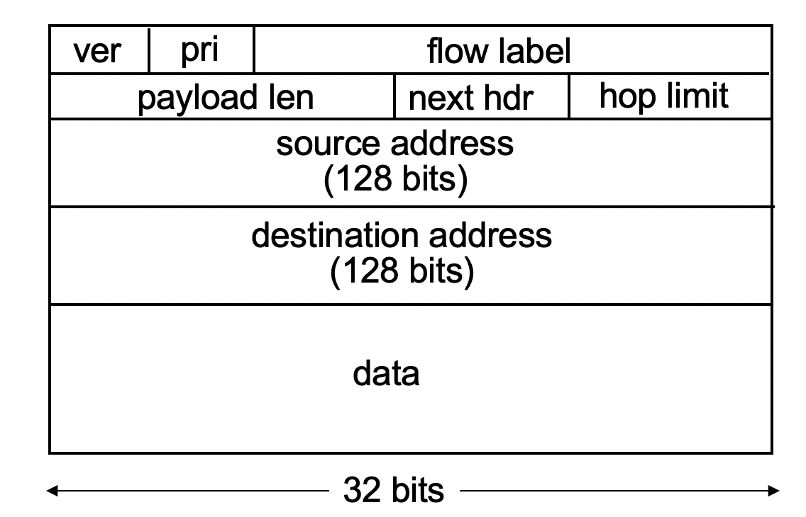
IPv4 vs IPv6: Can you tell the differences?

Slide 35
IPv6 Flows
Support for “flows”
Flows help support real-time service in the Internet
A “flow” is a number in the IPv6 header that can be used by routers to see which packets belong to the same stream
Guarantees can then be assigned to certain flows
Example:
Packets from flow 10 should receive rapid delivery
Packets from flow 12 should receive reliable delivery

Slide 36
IPv6 Addresses
Classless addressing/routing (similar to CIDR)
Notation: xx:xx:xx:xx:xx:xx:xx:xx
x = 4-bit hex number
contiguous 0s are compressed: 47CD::A456:0124
IPv6 compatible IPv4 address: ::128.64.18.87
First 96 bits are 0
Global unicast addresses start with 001….
2000::/3 prefix

Slide 37
IPv6: Adoption
Google: 8% of clients access services via IPv6
NIST: 1/3 of all US government domains are IPv6 capable
Long (long!) time for deployment, use
20 years and counting!
Think of application-level changes in last 20 years: WWW, Facebook, streaming media, Skype, …
Why?

Slide 40
Traceroute Examle
1 lcsr-gw (128.6.13.21) 1.206 ms 0.973 ms 0.782 ms
2 rucs-gw (165.230.212.129) 0.697 ms 0.569 ms 0.571 ms
3 transition2-gw (165.230.12.145) 2.786 ms 0.994 ms 0.769 ms
4 rutgers-gw.Rutgers.EDU (198.151.130.209) 1.726 ms 2.048 ms Vl1000-sr02-hil
l012-svcs.Rutgers.EDU (198.151.130.14) 1.278 ms
5 rutgers-gw.Rutgers.EDU (198.151.130.209) 1.755 ms 1.241 ms 1.828 ms
6 198.151.130.226 (198.151.130.226) 2.748 ms 3.070 ms 2.640 ms
7 clev-nycm.abilene.ucaid.edu (198.32.8.29) 15.162 ms 14.619 ms 14.663 ms
8 ipls-clev.abilene.ucaid.edu (198.32.8.25) 21.220 ms 22.497 ms 21.450 ms
9 kscy-ipls.abilene.ucaid.edu (198.32.8.5) 30.257 ms 30.604 ms 30.969 ms
10 dnvr-kscy.abilene.ucaid.edu (198.32.8.13) 40.823 ms 41.181 ms 41.076 ms
11 snva-dnvr.abilene.ucaid.edu (198.32.8.1) 65.436 ms 66.068 ms 65.569 ms
12 198.32.249.161 (198.32.249.161) 65.673 ms 65.771 ms 66.006 ms
13 BERK--SUNV.POS.calren2.net (198.32.249.13) 67.183 ms 67.131 ms 66.858 ms
14 pos1-0.inr-000-eva.Berkeley.EDU (128.32.0.89) 67.192 ms 66.749 ms 67.720
ms
15 vlan198.inr-201-eva.Berkeley.EDU (128.32.0.194) 67.373 ms 67.067 ms 67.82
1 ms
16 fast8-0-0.inr-210-cory.Berkeley.EDU (128.32.255.122) 67.634 ms 68.735 ms
68.413 ms
17 GE.cory-gw.EECS.Berkeley.EDU (169.229.1.46) 67.575 ms 68.222 ms 67.772 ms
18 gig8-1.snr1.CS.Berkeley.EDU (169.229.3.66) 67.454 ms 67.988 ms 67.177 ms
19 now.CS.Berkeley.EDU (128.32.44.96) 67.892 ms * 67.818 ms

