Slide 1

Data Link Layer: Overview; Error Detection
CS 352, Lecture 14
http://www.cs.rutgers.edu/~sn624/352-S19
Srinivas Narayana
(heavily adapted from slides by Prof. Badri Nath and the textbook authors)

Slide 2
The Link layer
Application
HTTPS
FTP
HTTP
SMTP
DNS
Transport
TCP
UDP
Network
IP
Link layer
802.3
…
802.11
ATM
Ethernet

Slide 3

















Link layer: introduction
terminology:
hosts and routers: nodes
communication channels that connect adjacent nodes along communication path: links
wired links
wireless links
LANs
layer-2 packet: frame, encapsulates datagram
data-link layer has responsibility of
transferring datagram from one node
to physically adjacent node over a link

Slide 4
Link layer: context
datagram transferred by different link protocols over different links:
e.g., Ethernet on first link, frame relay on intermediate links, 802.11 on last link
each link protocol provides different services
e.g., may or may not provide rdt over link
transportation analogy:
trip from Princeton to Lausanne
limo: Princeton to JFK
plane: JFK to Geneva
train: Geneva to Lausanne
tourist = datagram
transport segment = communication link
transportation mode = link layer protocol
travel agent = routing algorithm

Slide 5
Link layer services
Encoding
convert bits to signals and recover bits from received signals
framing, link access:
encapsulate datagram into frame, adding header, trailer
channel access if shared medium
“MAC” addresses used in frame headers to identify source, destination
different from IP address!
reliable delivery between adjacent nodes
we learned how to do this already (chapter 3)!
seldom used on low bit-error link (fiber, some twisted pair)
wireless links: high error rates
Q: why both link-level and end-end reliability?

Slide 6
Encoding
Signals propagate over a physical medium
modulate electromagnetic waves
e.g., vary voltage
Encode binary data onto signals
e.g., 0 as low signal and 1 as high signal
known as Non-Return to zero (NRZ)
Problem: consecutive 1s and 0s, noise levels
Bits
0
0
1
0
1
1
1
1
0
1
0
0
0
0
1
0
NRZ

Slide 7
Encodings (cont’d)
Bits
0
0
1
0
1
1
1
1
0
1
0
0
0
0
1
0
NRZ
Clock
Manchester
NRZI
Manchester encoding: +ve transition → 0; -ve transition → 1
XOR(bit,clock)

Slide 8
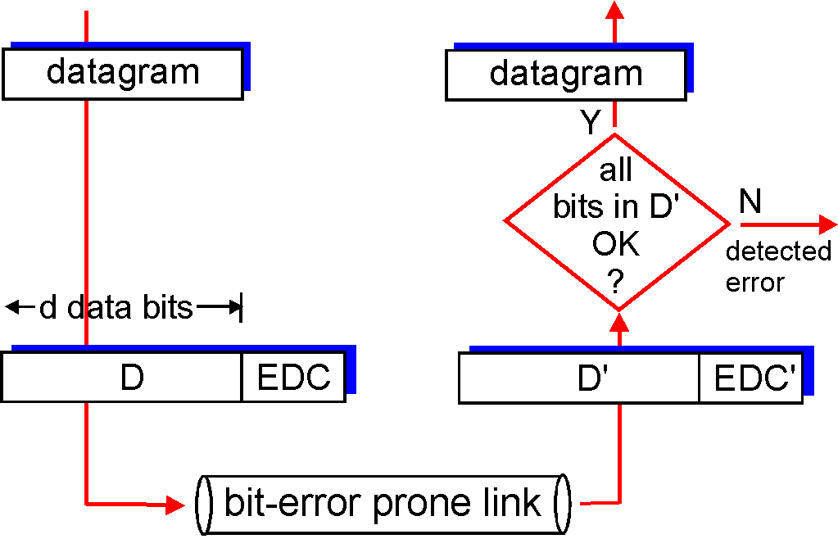
Error detection
EDC = Error Detection and Correction bits (redundancy)
D = Data protected by error checking, may include header fields
Error detection not 100% reliable!
protocol may miss some errors, but rarely
larger EDC field yields better detection and correction
otherwise

Slide 9
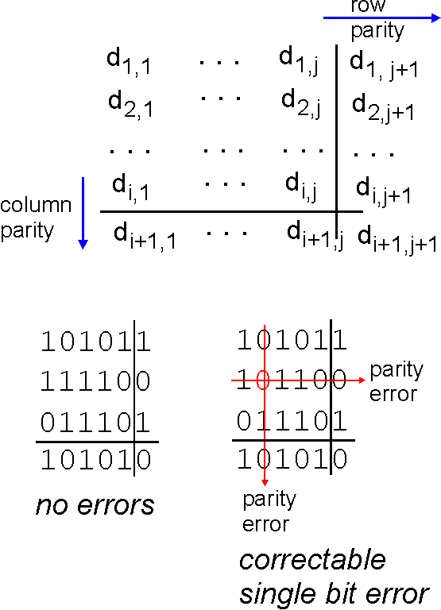
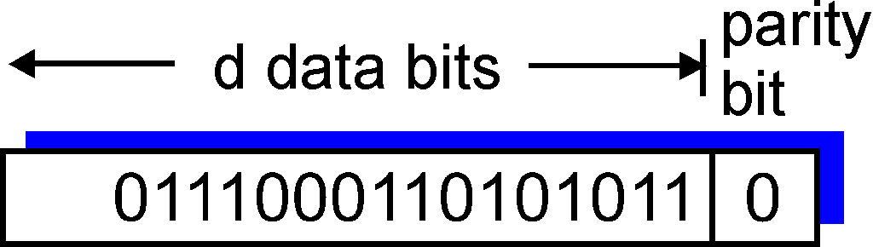
Parity checking
single bit parity:
detect single bit errors
two-dimensional bit parity:
detect and correct single bit errors
0
0

Slide 10
Internet checksum (review)
goal: detect “errors” (e.g., flipped bits) in transmitted packet (note: used at transport layer only)
sender:
treat segment contents as sequence of 16-bit integers
checksum: addition (1’s complement sum) of segment contents
sender puts checksum value into UDP checksum field
receiver:
compute checksum of received segment
check if computed checksum equals checksum field value:
NO - error detected
YES - no error detected. But maybe errors nonetheless?

Slide 11
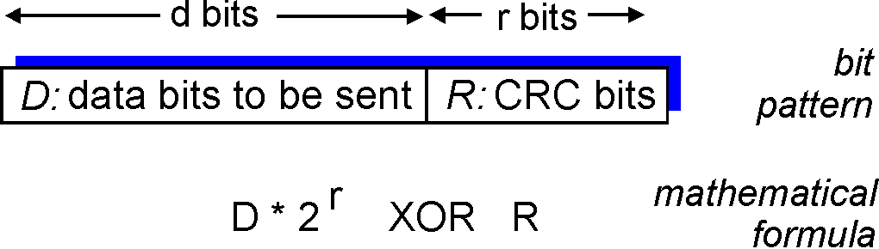
Cyclic redundancy check
more powerful error-detection coding
view data bits, D, as a binary number
choose r+1 bit pattern (generator), G
goal: choose r CRC bits, R, such that
<D,R> exactly divisible by G (modulo 2)
receiver knows G, divides <D,R> by G. If non-zero remainder: error detected!
can detect all burst errors less than r+1 bits
widely used in practice (Ethernet, 802.11 WiFi, ATM)

Slide 12
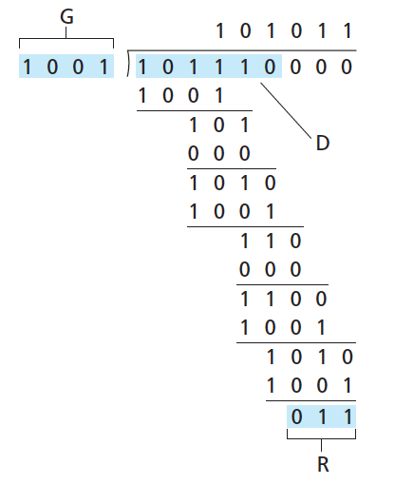
CRC example
want:
D.2^{r} XOR R = nG
equivalently:
D.2^{r} = nG XOR R
equivalently:
if we divide D.2^{r} by G, want remainder R to satisfy:
D.2^{r}
G
R = remainder[ ]

Slide 13
ARP
How to get a MAC address for an IP address?

Slide 14
ARP: Address Resolution Protocol
By default, NICs only pass on packets destined to their destination MAC address to the higher layers
In a broadcast-based LAN, each source needs to know its destination’s MAC address
After a packet reaches a router, the link layer header needs to be added to reflect the destination host on that link
ARP returns a link layer address when given an Internet address
Communication requires IP → MAC address translation

Slide 15
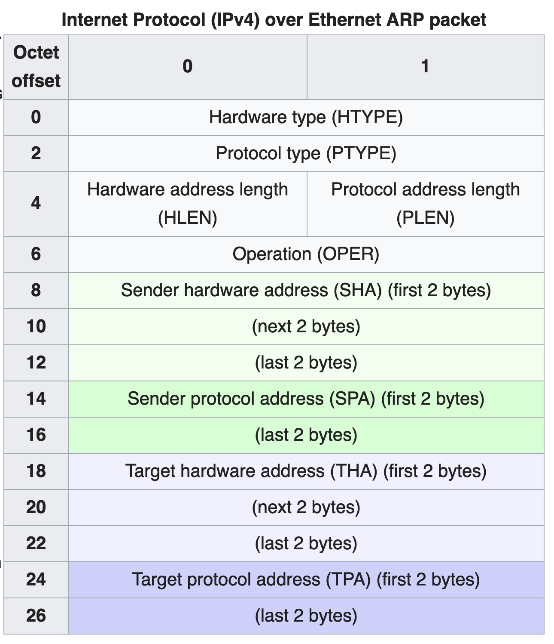
ARP packet format
Hardware type: ex: Ethernet (1)
Hardware address length: 6 octets
Protocol Type: ex: IPv4 0x0800 (requesting IPv4 addr)
Protocol address length: 4 octets
Opcode ARP request:1
Opcode ARP reply:2

Slide 16
ARP operation
Proto=IPv4
0x0800
Oper=1
Sender H/W address
Sender IP address
Target H/W address
target IP address
ARP packet
containing “128.195.1.38?”
ARP
Ethernet Address:
05:23:f4:3d:e1:04
IP Address:
128.195.1.20
Ethernet Address:
12:04:2c:6e:11:9c
IP Address:
128.195.1.122
Ethernet Address:
98:22:ee:f1:90:1a
IP Address:
128.195.1.38
Wants to transmit
to 128.195.1.38
Ignored
Answered

