Slide 1

Network
Ack: Slides heavily adapted from Jen Rexford and Michael Schapira

Slide 2



Per-router control plane
Distributed control plane: Components in every router interact with other components to produce a routing outcome.
Routing
Algorithm
control
plane
data
plane
Data plane
per-packet processing, moving packet from input port to output port
0111
1
3
2
values in arriving
packet header,
i.e, destination IP address

Slide 3


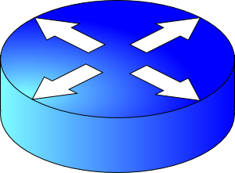

So far
5
1
v
3
w
2
5
3
5
u
2
1
z
3
2
1
2
x
y
1
4
6
7
What outcome is computed? Spanning tree, shortest paths, …
What algorithm is used?
Routing protocol
Q1. What info exchanged?
Q2. What computation?

Slide 4
Internet Routing

Slide 5



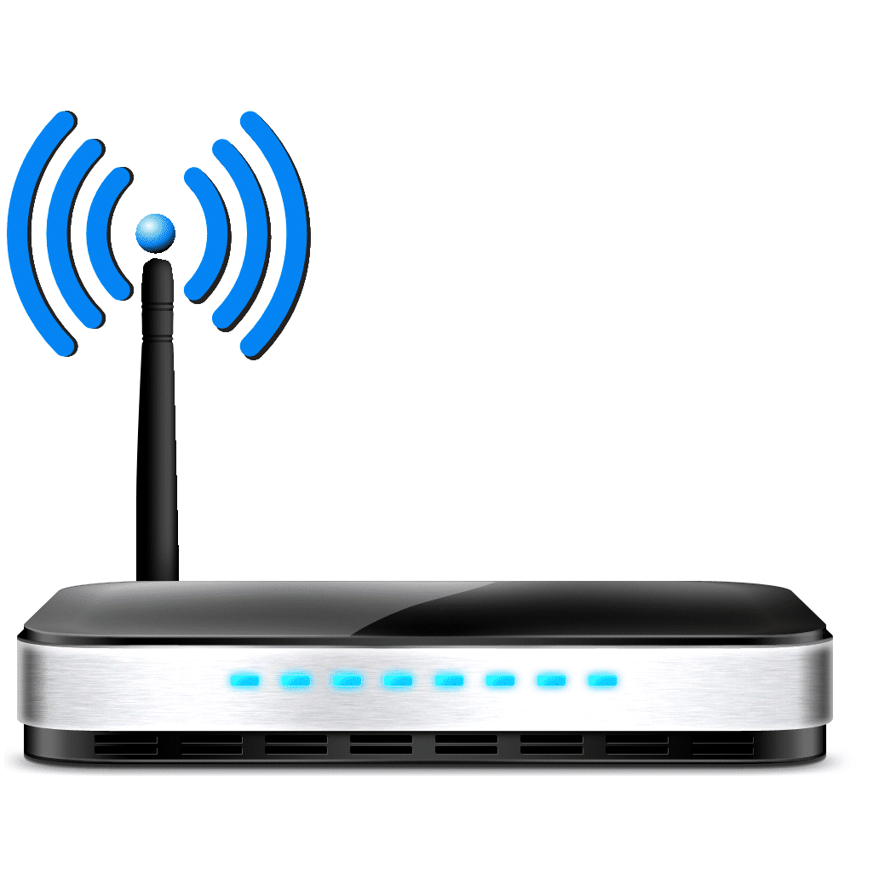

The Internet is a large federated network
AT&T
Comcast
Verizon

Slide 6
The Internet is a large federated network
Several autonomously run organizations: No one “boss”
Organizations cooperate, but also compete
AT&T
Comcast
e.g., AT&T has little commercial interest in revealing its internal network structure to Verizon.
Verizon

Slide 7
The Internet is a large federated network
Several autonomously run organizations: No one “boss”
Organizations cooperate, but also compete
AT&T
Message exchanges must
not reveal internal network details.
Comcast
Verizon
Algorithm must work with “incomplete” information about its neighbors’ internal topology.

Slide 8
The Internet is a large federated network
Internet today: > 70,000 unique autonomous networks
Internet routers: > 800,000 forwarding table entries
AT&T
Keep messages & tables as small as possible. Don’t flood
Comcast
Verizon
Algorithm must be incremental: don’t recompute the whole table on every message exchanged.

Slide 9

Local Control vs. Global Properties
The Internet is a “network of networks”
~35,000 separately administered networks
Competitive cooperation for e2e reachability
Local Control
Intradomain routing,
interdomain policies
Global Properties
Performance, security, reliability, scalability

Slide 10
Two-Tiered Routing Architecture
Goal: distributed management of resources
Internetworking of multiple networks
Networks under separate administrative control
Intradomain: inside a region of control
Routers configured to achieve a common goal
Okay for routers to share topology information
Different ASes can run different protocols
Interdomain: between regions of control
ASes have different (maybe conflicting) goals
Routers only share reachability information

Slide 11
Internet Structure

Slide 12


Autonomous Systems (ASes)
AS-level topology
Nodes are Autonomous Systems (ASes)
Destinations are prefixes (e.g., 12.0.0.0/8)
Edges are links and business relationships
4
3
5
2
7
6
1
Client
Web server

Slide 13
AS Numbers (ASNs)
ASNs are 16 bit values (or 32-bit).
64512 through 65535 are “private”
Currently > 70,000 in use.
Level 3: 1
MIT: 3
Harvard: 11
Rutgers:
Princeton: 88
AT&T: 7018, 6341, 5074, …
Verizon: 701, 702, 284, 12199, …
Sprint: 1239, 1240, 6211, 6242, …
…

Slide 14
Business Relationships Between ASes
Neighboring ASes have business contracts
How much traffic to carry
Which destinations to reach
How much money to pay
Common business relationships
Customer-provider
Peer-peer

Slide 15
Customer-Provider Relationship
Customer needs to be reachable from everyone
Provider ensures all neighbors can reach the customer
Customer “default-routes” to provider
Customer does not want to provide transit service
Customer does not let its providers send traffic through it
d
provider
provider
traffic
customer
d
customer
Traffic to the customer
Traffic from the customer

Slide 16
Peer-Peer Relationship
Peers exchange traffic between customers
AS lets its peer reach (only) its customers
AS can reach its peer’s customers
Often the relationship is settlement-free (i.e., no $$$)
Traffic to/from the peer and its customers
peer
peer
traffic
d

Slide 17
AS Structure: Tier-1 Providers
Top of the Internet hierarchy
Has no upstream provider of its own, no default routes
Typically has a large (inter)national backbone
Around 10-12 ASes: AT&T, Sprint, Level 3, …
peer-peer
peer-peer
peer-peer
peer-peer
Notes:
Fully connect to each other so they can reach each other’s customers.

Slide 18
AS Structure: Other ASes
Lower-layer providers (tier-2, …)
Provide transit service to downstream customers
But need at least one provider of their own
Typically have national or regional scope
E.g., Minnesota Regional Network
Stub ASes
Do not provide transit service
Connect to upstream provider(s)
Most ASes (e.g., 85-90%)
E.g., Princeton, Rutgers, …

Slide 19
Policy-Based Path-Vector Routing

Slide 20
Shortest-Path Routing is Restrictive
All traffic must travel on shortest paths
All nodes need common notion of link costs
Incompatible with commercial relationships
National
ISP1
National
ISP2
YES
NO
Regional
ISP3
Regional
ISP2
Regional
ISP1
Cust3
Cust2
Cust1

Slide 21
Path-Vector Routing
Extension of distance-vector routing
Support flexible routing policies
Faster convergence(avoid count-to-infinity)
Key idea: advertise the entire path
Distance vector: send distance metric per dest d
Path vector: send the entire path for each dest d
“d: path (2,1)”
“d: path (1)”
3
2
1
data traffic
data traffic
d

Slide 22
Faster Loop Detection
Node can easily detect a loop
Look for its own node identifier in the path
E.g., node 1 sees itself in the path “3, 2, 1”
Node can simply discard paths with loops
E.g., node 1 simply discards the advertisement
“d: path (2,1)”
“d: path (1)”
3
2
1
“d: path (3,2,1)”

Slide 23
Flexible Policies
Each node can apply local policies
Path selection: Which path to use?
Path export: Whether to advertise the path?
Examples
Node 2 may prefer the path “2, 3, 1” over “2, 1”
Node 1 may not let node 3 hear the path “1, 2”
2
3
2
3
1
1

Slide 24
Border Gateway Protocol

Slide 25
Border Gateway Protocol
IP-Prefix-based path-vector protocol
Policy-based routing based on AS Paths
Evolved during the past 40 years
1989 : BGP-1 [RFC 1105], replacement for EGP
1990 : BGP-2 [RFC 1163]
1991 : BGP-3 [RFC 1267]
1995 : BGP-4 [RFC 1771], support for CIDR
2006 : BGP-4 [RFC 4271], update
“BGP at 18”: http://www.youtube.com/watch?v=HAOVNYSnL7k

Slide 26
BGP Operations
Establish session on
TCP port 179
AS1
BGP session
Exchange all
active routes
AS2
While connection
is ALIVE exchange
route UPDATE messages
Exchange incremental
updates

Slide 27
Incremental Protocol
A node learns multiple paths to destination
Stores all of the routes in a routing table (RIB)
Applies policy to select a single active route (FIB)
… and may advertise the route to its neighbors
Incremental updates
Announcement
Upon selecting a new active route, add node id to path
… and (optionally) advertise to each neighbor
Withdrawal
If the active route is no longer available
… send a withdrawal message to the neighbors

Slide 28
BGP Route
Destination prefix (e.g., 128.112.0.0/16)
Route attributes, including
AS path (e.g., “7018 88”)
Next-hop IP address (e.g., 12.127.0.121)
192.0.2.1
12.127.0.121
AS 7018
128.112.0.0/16
AT&T
AS 88
AS 11
Princeton
Yale
128.112.0.0/16
AS path = 88
Next Hop = 192.0.2.1
128.112.0.0/16
AS path = 7018 88
Next Hop = 12.127.0.121

Slide 29
BGP Path Selection
AS 1129
Simplest case
Shortest AS path
Arbitrary tie break
Example
Three-hop AS path preferred over a five-hop AS path
AS 12654 prefers path through Global Crossing
But, BGP is not limited to shortest-path routing
Policy-based routing
Global Access
128.112.0.0/16
AS Path = 1129 1755 1239 7018 88
AS 12654
RIPE NCC
RIS project
128.112.0.0/16
AS Path = 3549 7018 88
AS 3549
Global Crossing

Slide 30
BGP Policy: Influencing Decisions
Open ended programming.
Constrained only by vendor configuration language
Receive
BGP
Updates
Apply Policy =
filter routes &
tweak attributes
Based on
Attribute
Values
Best
Routes
Apply Policy =
filter routes &
tweak attributes
Transmit
BGP
Updates
Apply Import
Policies
Best Route
Selection
Best Route
Table
Apply Export
Policies
Install forwarding
Entries for best
Routes.
IP Forwarding Table

Slide 31
BGP Policy: Applying Policy to Routes
Import policy
Filter unwanted routes from neighbor
E.g. prefix that your customer doesn’t own
Manipulate attributes to influence path selection
E.g., assign local preference to favored routes
Export policy
Filter routes you don’t want to tell your neighbor
E.g., don’t tell a peer a route learned from other peer
Manipulate attributes to control what they see
E.g., make a path look artificially longer than it is

Slide 32
BGP Policy Examples

Slide 33
Import Policy: Local Preference
Favor one path over another
Override the influence of AS path length
Apply local policies to prefer a path
Example: prefer customer over peer
Local-pref = 90
AT&T
Sprint
Local-pref = 100
Tier-2
Tier-3
Yale

Slide 34
Import Policy: Filtering
Discard some route announcements
Detect configuration mistakes and attacks
Examples on session to a customer
Discard route if customer doesn’t own the prefix
Discard route containing other large ISPs
Patriot
USLEC
Princeton
128.112.0.0/16

Slide 35
Export Policy: Filtering
Discard some route announcements
Limit propagation of routing information
Examples
Don’t announce routes from one peer to another
UUNET
AT&T
Sprint

Slide 36
Export Policy: Filtering
Discard some route announcements
Limit propagation of routing information
Examples
Don’t announce routes for network-management hosts or the underlying routers themselves
USLEC
network operator
Princeton

Slide 37
Export Policy: Attribute Manipulation
Modify attributes of the active route
To influence the way other ASes behave
Example: AS prepending
Artificially inflate AS path length seen by others
Convince some ASes to send traffic another way
Sprint
Patriot
USLEC
88 88
88
Princeton
128.112.0.0/16

Slide 38
BGP Policy Configuration
Policy languages are vendor-specific
Not part of the BGP protocol specification
Different languages for Cisco, Juniper, etc.
Still, all languages have some key features
Policy as a list of clauses
Each clause matches on route attributes
… and discards or modifies the matching routes
Configuration done by human operators
Implementing the policies of their AS
Biz relationships, traffic engineering, security, …

Slide 39
BGP Inside an AS

Slide 40
An AS is Not a Single Router
Multiple routers in an AS
Need to distribute BGP information within the AS
Internal BGP (iBGP) sessions between routers
AS1
eBGP
iBGP
AS2

Slide 41
Internal BGP and Local Preference
Example
Both routers prefer the path through AS 100 on the left
… even though the right router learns a different external path
AS 200
AS 100
AS 300
Local Pref = 100
Local Pref = 90
I-BGP
AS 256

Slide 42
Joining BGP and IGP Information
Border Gateway Protocol (BGP)
Announces reachability to external destinations
Maps a destination prefix to an egress point
128.112.0.0/16 reached via 192.0.2.1
Interior Gateway Protocol (IGP)
Used to compute paths within the AS
Maps an egress point to an outgoing link
192.0.2.1 reached via 10.1.1.1
10.1.1.1
192.0.2.1

Slide 43
An AS May Learn Many Routes
Multiple connections to neighboring ASes
Multiple border routers may learn good routes
… with the same local-pref and AS path length
Multiple links
4
3
5
2
7
6
1

Slide 44

Hot-Potato (Early-Exit) Routing
Hot-potato routing
Each router selects the closest egress point
… based on the path cost in intradomain protocol
BGP decision process
Highest local preference
Shortest AS path
Closest egress point
Arbitrary tie break
dst
9
B
A
B
A
D
4
3
8
10
4
3
G
F
5
8
E
C
hot potato

Slide 45
Learning the locations of the endpoints

Slide 46


Finding the endpoints
Computing the forwarding table
Still must figure out where the endpoints are
How to find the endpoints?
Learning/flooding (Ethernet)
Injecting into the routing protocol
Dissemination using a different protocol
Central directory service
Ways to curb scaling challenges
E.g., spanning tree per VLAN for endpoint flooding

Slide 47
Learning and Flooding
When the frame has an unfamiliar destination
Forward out all interfaces
… except for the one where the frame arrived
When a frame arrives
Inspect the source address
Associate address with the incoming interface
B
B
A
C
A
C
Switch learns how to reach A.
When in doubt, shout!
D
D
Used in Ethernet LANs

Slide 48
Inject into Routing Protocol
Treat the end host (or subnet) as a node
And disseminate in the routing protocol
E.g., flood information about where addresses attach
2
3
1
1
4
u
2
1
5
4
3
6
s
Used in OSPF and IS-IS, especially in enterprise networks
. . .

Slide 49

Disseminate with another protocol
One router learns the route
… and shares the information with other routers
disseminate route to other routers
learn a route to d
(e.g., via BGP)
Internal BGP (iBGP) used in backbone networks

Slide 50
Directory Service
Contact a service to learn the location
Lookup the end-host or subnet address
… and learn the label to put on the packet
… to get the traffic to the right egress point
directory
e
“Host d is at egress e”
d
i
Used in some data centers.
s
Encapsulate packet to send to egress e.

Slide 51
Conclusion
Routing is a distributed computation
With challenges in scalability and handling dynamics
Different solutions for different environments
Ethernet LAN: spanning tree, MAC learning, flooding
Enterprise: link-state routing, injecting subnet addresses
Backbone: link-state routing inside, path-vector routing with neighboring domains, and iBGP dissemination
Internet: BGP
Data centers: many different solutions, still in flux
An active research area…

