Slide 1

CS 352 Circuit & Packet Switching
Lecture 2.1
http://www.cs.rutgers.edu/~sn624/352
Srinivas Narayana

Slide 2
Review of definitions
Endpoint or Host: Machine running user application
Packet: a unit of data transmission (ex: 1500 bytes)
Link: a physical communication channel between two or more machines
Router: A machine that processes packets moving them from one link to another towards a destination
Network: Collection of interconnected machines
Address: a unique name given to a machine (more later)

Slide 3
How do machines talk?

Slide 4


How do machines communicate?
With 1s and 0s
Computers only deal with 1s and 0s
So do networks
How do we transmit 1s and 0s in a network?

Slide 5
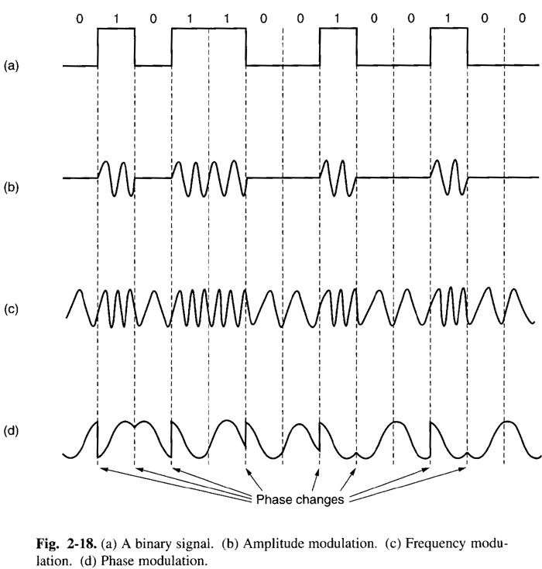
Physical transmission on a single link
Physical signaling (light, AC voltages, etc.) are often analog
Convert bits to signals through modulation of the physical characteristics of signals: encoding
Convert signals back to digital by decoding physical signals

Slide 6
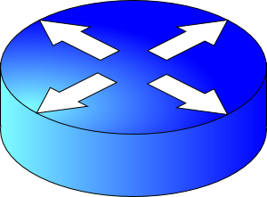

Multi-link networks
Need a way to move data across links
We use the term switching to denote physically moving data from one link to another
Router
Router

Slide 7
Switching schemes
Host applications transfer data containing many messages.
(1) Circuit Switching
(2) Message Switching
(3) Packet Switching

Slide 8
Circuit switching
Provides service by setting up the full path of connected links from the origin to the destination
Example: Telephone network

Slide 9
Circuit switching
1. Setup: Control message sets up a path from origin to destination
2. Return signal informs source that data transmission may proceed
3. Data transmission begins
4. Entire path remains allocated to the transmission (whether used or not)
5. When transmission is complete, source releases the circuit

Slide 10
Circuit switching
Call request signal
Propagation Delay
Resource reservation
delay
Time
Total transfer time
Call accept signal
Data
Transmission
Time
Data
A
B
C
D

Slide 11
Message switching
Each message is addressed to a destination
Header: metadata that denotes how to process a message
Typically includes a destination address
The message “hops” from node to node through a network while allocating only one link at a time
Compare to circuit switching: all links reserved at the same time, regardless of use.
Analogy: Postal service

Slide 12
Message switching
When the entire message is received at a router, the next step and link in its journey are selected
If this selected link is busy, the message waits in a queue until the link becomes free
Store and forward switching
Router waits for all message bits to arrive on incoming link before sending the first bit on outgoing link
Alternative: cut–through switching sends bits as they arrive

Slide 13
Message Switching
Header
Msg
Time
Total transfer time
Msg
Queueing
Delay
Msg
A
B
C
D

Slide 14
Packet switching
Messages are split into smaller pieces called packets
Packets have a maximum length
Packets are numbered and addressed
Packets are sent through the network one at a time
Pipelining: different parts of a message concurrently transmitted over different links
Provides higher utilization of link resources

Slide 15
Packet switching
Header
Pkt 1
Pkt 2
Pkt 1
Store and forward
delay
Total transfer time
Time
Pkt 3
Queueing
Delay
Pkt 2
Pkt 3
Pkt 1
Pkt 2
Pkt 3
A
B
C
D

Slide 16
The Internet uses store-and-forward packet switching.

Slide 17
Comparisons across switching tech
Circuit switching incurs an initial delay to set up the path
Packet (and message) switching can start transmitting data right away
Packet switching doesn’t reserve resources for the conversation
Circuit switching does. Needs admission control
Packet switching makes resource reservation decisions per packet
Fewer or no guarantees ➔ easier to build
Telephone networks are more reliable and harder to build

Slide 18
Comparisons across switching tech
(1) Total Delay to transfer a message
Short Bursty Messages:
Packet < Circuit
Long Continuous Messages:
Circuit < Packet
(2) Header overhead (what % of bits on the wire is metadata?)
Packet > Message
(assuming typical msgs larger than typical pkts)

Slide 20
CS 352 Measuring Networks
Lecture 2.2
http://www.cs.rutgers.edu/~sn624/352
Srinivas Narayana

Slide 21
Some definitions
Packet size: length of a packet (bits or bytes), incl. header and data
Bandwidth: For a single link, amount of data it can transmit per unit time (bits/second or Bytes/second or packets/second)
Propagation delay: Time needed to move one bit across (second)
Imposed by the communication medium; depends on the link “length”
Transmission delay: Time from first bit@sender to last bit@sender
Determined by link bandwidth and packet size
Queueing delay: Time that a packet waits for transmission
Determined by contention for the link
Total packet delay: time from first bit@sender to last bit@receiver
propagation delay + queueing delay + transmission delay for a single packet

Slide 22

An analogy: Conveyor belt
Propagation delay = time for first box to travel the length of the belt
Bandwidth = the number of boxes put on the belt per minute (“rate”)
Suppose we have N boxes in one shipment
Shipment transmission time = N / rate
The next box is put on the belt (1/rate) minutes after the last
Total transfer time = transmission time + propagation delay

Slide 23
Visualizing the delays
Transmission delay at the first link
Propagation delay of first link
Queueing at the router
Increasing time
Transmission delay at the second link
Propagation delay of second link

Slide 24
Bandwidth and delay
A small demo…

Slide 26
CS 352 Protocols and Layering
Lecture 2.3
http://www.cs.rutgers.edu/~sn624/352
Srinivas Narayana

Slide 27
Protocols: The “rules” of networking
Protocols consist of two things
Message format
structure of messages exchanged with an endpoint
Actions
operations upon receiving, or not receiving, messages
Example of a Zoom conversation:
Message format: English words and sentences
Actions: when a word is heard, say “yes”; when nothing is heard for more than 3 seconds, say “can you hear me?”

Slide 28

The protocols of the Internet
Standardized by the Internet Engineering Task Force (IETF)
through RFCs (“Request For Comments”)
Layering
HTTPS
FTP
HTTP
SIP
RTSP
TCP
UDP
IP
X.25
…
802.11
ATM

Slide 29



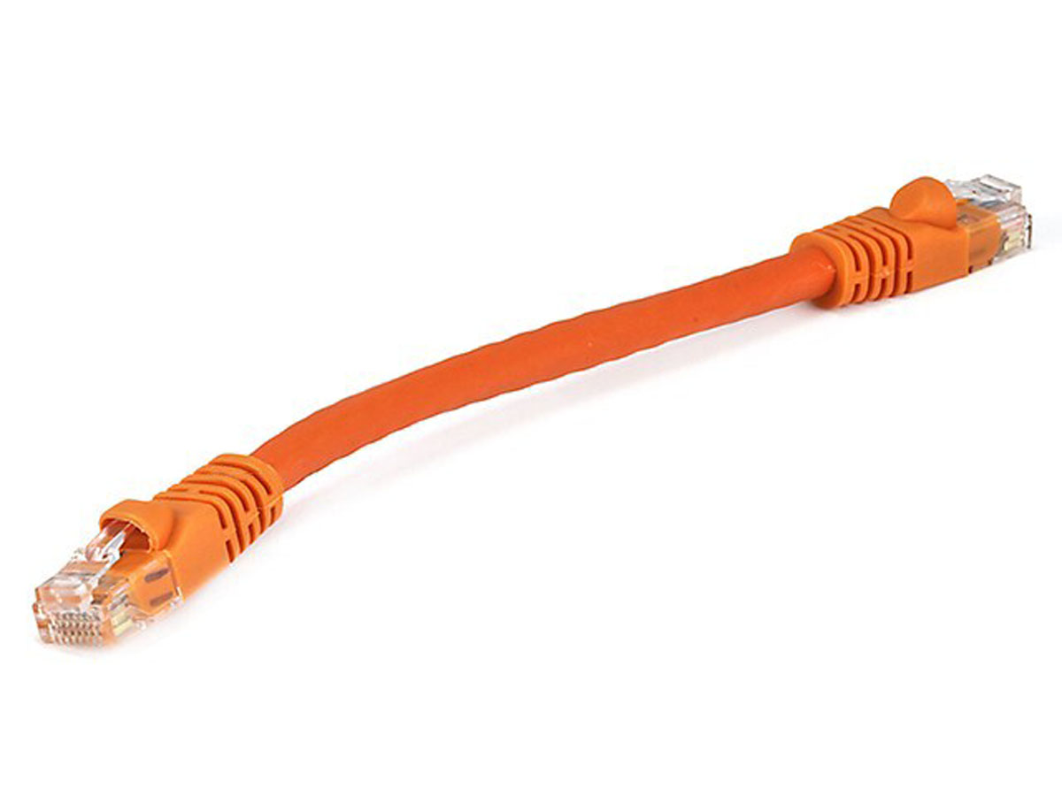
Rutgers campus network
The Internet
Transport address (port)
Ex: 64058
With which app is this conversation associated?
Network address (IP address)
Ex: 192.168.1.4
Whose network am I attached to?
Hardware address (MAC address)
Ex: 00-15-C5-49-04-A9
How do I identify my network interface (device)?

Slide 30

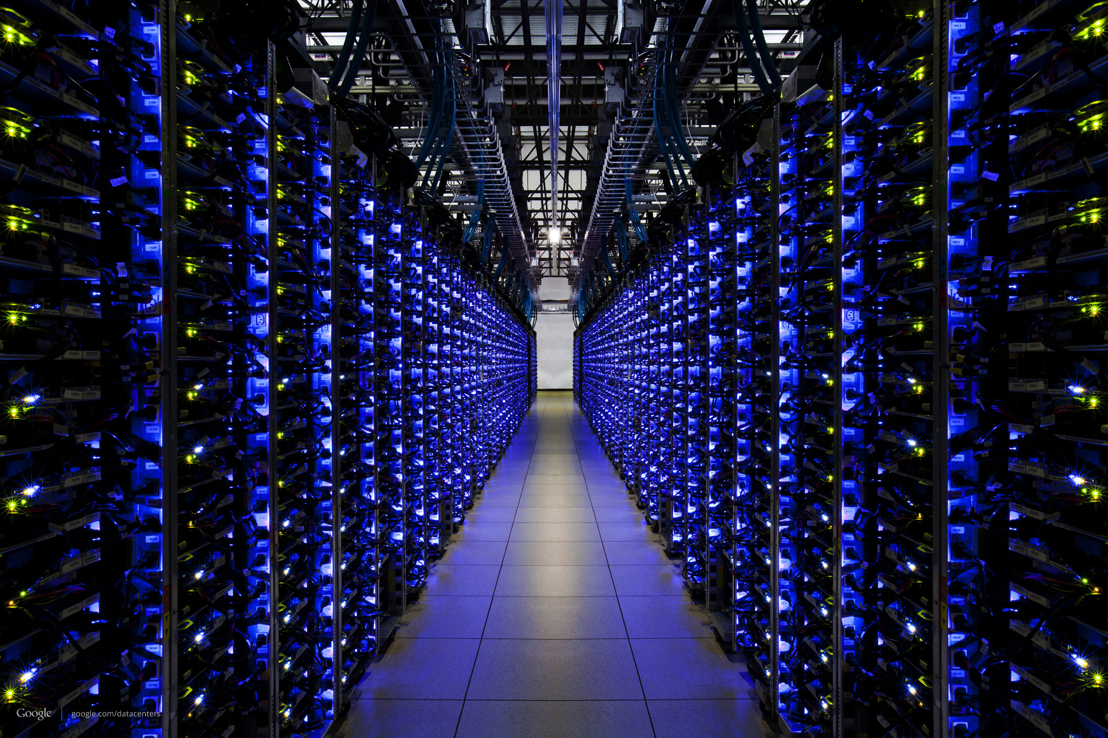
The Internet
Google’s network
Application address (URL)
Ex: mail.google.com
Transport address (port)
Ex: 4096
Network address (IP address)
Ex: 10.1.1.104
Hardware address (MAC address)
Ex: 00-15-C5-49-04-A7

Slide 31

Software and hardware for networking are arranged in layers.
Layering provides modularity
Each layer has a distinct function
& interacts with other layers through well-defined interfaces.

Slide 32
Modularity through layering
Protocols “stacked” in endpoint and router software/hardware
Apps: useful user-level functions
HTTP
FTP
NV
TFTP
Transport: provide guarantees to apps
TCP
UDP
IP
Network: best-effort global pkt delivery
Ether
ATM
…
WiFi
Link: best-effort local pkt delivery

Slide 33


The Internet
Applications
Applications
Packet starts as an
app “payload”
Transport
Packet takes on headers at each layer
Transport
Network
Network
Link layer
Link layer
The Internet

Slide 34

Applications
Applications
Transport
Transport
Network
Network
Network
Network
Link layer
Link layer
Link layer
Link layer

Slide 35
Applications
Routers do not typically have transport or app functionality
(more on this later.)
Applications
Transport
Transport
Network
Network
Network
Network
Link layer
Link layer
Link layer
Link layer

Slide 36
Layering
Network communication is very complex
Layering simplifies understanding, testing, maintaining
Easy to improve or replace protocol at one layer without affecting others

Slide 37

This course has layers
Application
HTTPS
FTP
HTTP
SIP
RTSP
Transport
TCP
UDP
Network
IP
Host-to-Net
X.25
…
802.11
ATM

