Slide 1

The Transport Layer: Congestion Control
CS 352, Lecture 10, Spring 2020
http://www.cs.rutgers.edu/~sn624/352
Srinivas Narayana

Slide 2
Course announcements
Project 2 will go online very soon
Due April 3rd at 10 PM
Mid-term grading almost finished
Project 1 should be returned sometime next week

Slide 3
Review of concepts
Permissible window size varies over time.
Receiver application’s reading speed (recv)
Communicated by the receiver to the sender through a header field
How should the receiver socket buffer be sized?
What if it’s too large?
What if it’s too small?
Want to accommodate bursty transmissions from the sender
Bandwidth-delay product

Slide 4
Feedback and Actions
The signals and knobs of congestion control

Slide 5
Feedback from network offers clues…
Signals
Packets being dropped (ex, RTO fires)
Packets being delayed
Rate of incoming ACKs
Knobs
What can you change to “probe” the sending rate?
Suppose receiver buffer is unbounded:
Let’s call the amount of in-flight data per RTT the congestion window
Increase congestion window: e.g., by x or by a factor of x
Decrease congestion window: e.g., by x or by a factor of x
“Implicit” feedback signals
(more on explicit signals later)

Slide 6
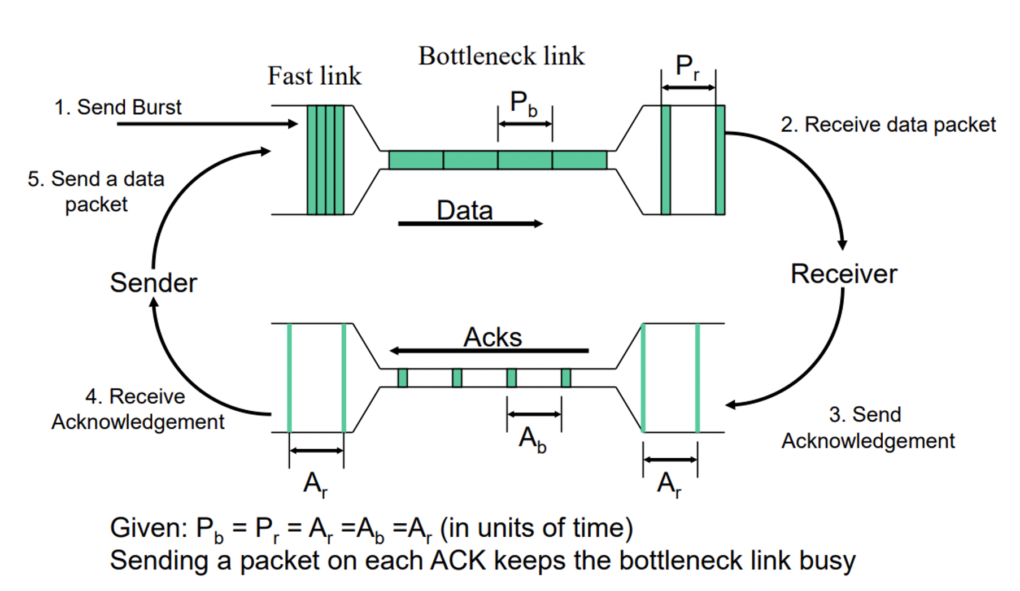
Steady state: Self clocking/ACK clocking

Slide 7
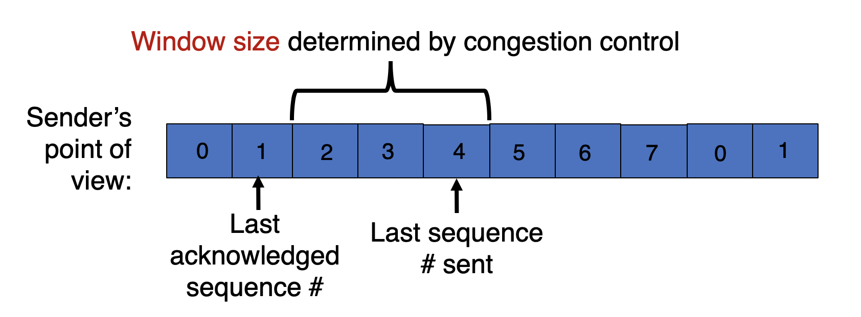
TCP congestion window
Congestion window (cwnd): an estimate of in-flight data needed to keep the pipe full and achieve self-clocking
Sending window = min(congestion window, receiver advertised window). Why min?
Overwhelm neither the receiver nor network routers
Use sliding window concept
Window size is adjusted by congestion control

Slide 8
Finding the right window

Slide 9
Time for an activity
Notes:
Make people guess a random number that you have in mind. See what strategies they come up with.

Slide 10

TCP slow start
Host A
Host B
When connection begins, increase rate exponentially until first loss event:
Initially cwnd = 1 MSS
MSS is “maximum segment size”
Double cwnd every RTT
Increment cwnd for every ACK received
Initial rate is slow but ramps up exponentially fast
On loss, restart from cwnd := 1 MSS
Is this good enough?
one segment
RTT
two segments
four segments
time

Slide 11
Problems with slow start
Congestion window increases too rapidly
Example: suppose the right window size cwnd is 17
cwnd would go from 16 to 32 and then dropping down to 1
Result: massive packet drops
Congestion window decreases too rapidly
Suppose the right cwnd is 31, and there is a loss when cwnd is 32
Slow start will resume all the way back from cwnd 1
Result: unnecessarily low throughput
Perform finer adjustments of cwnd based on signals
Want a smooth ride, not a jerky one

Slide 12
TCP additive increase
TCP does slow start until it is “close” to the correct cwnd
And grows cwnd much slower after that
(1) How does TCP know what is the correct cwnd?
Remember the recent past
The last good cwnd without packet drop is a good indicator
TCP calls this the slow start threshold (ssthresh)
What is the best way to approach the correct value?
TCP uses additive increase after cwnd hits ssthresh

Slide 13
TCP additive increase
Start with ssthresh = 64K bytes
Do slow start until ssthresh
Once the threshold is passed, do additive increase
For each ACK received, cwnd = cwnd + (MSS * MSS) / cwnd
i.e., one MSS increase for each cwnd worth data ACK’ed
Upon a TCP timeout,
cwnd = 1 MSS
Set ssthresh = max(2 * MSS, 0.5 * cwnd)
i.e., the next linear increase will start at half the current cwnd

Slide 14
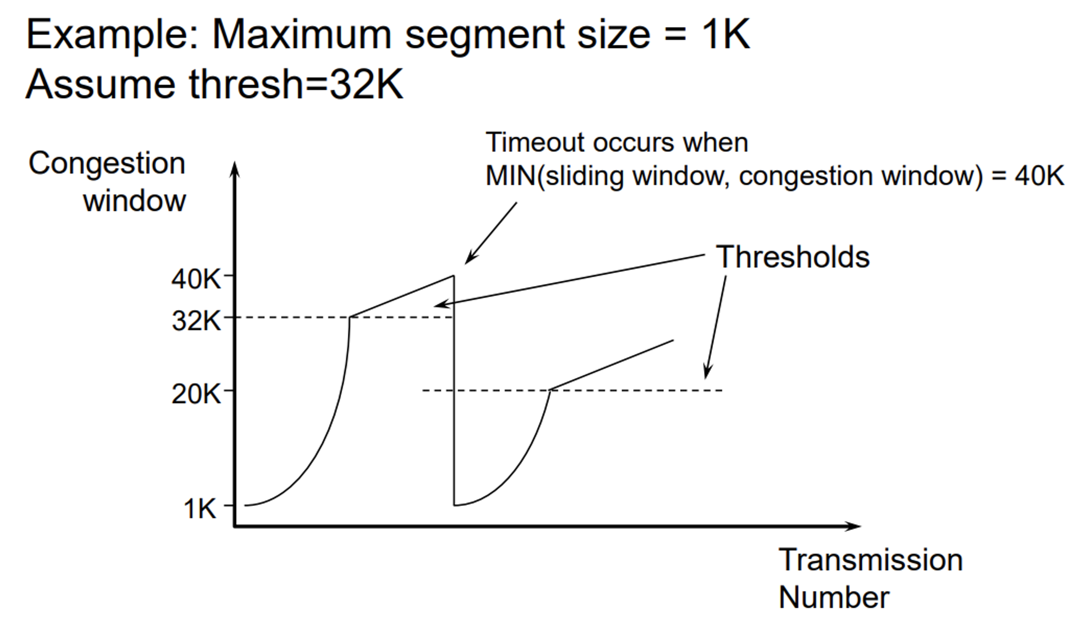
TCP additive increase

Slide 15
Problems with additive increase
Current loss detection method: RTO for a given sequence number
cwnd drops rapidly to 1 MSS when there is a timeout
When you drive, you don’t keep accelerating until you suddenly stop the car right next to a crossing pedestrian
Could we detect losses earlier (i.e., before RTO) and react proportionately?
If you see the pedestrian from afar, you want to slow down gently from a distance

Slide 16
Detecting and reacting to loss

Slide 17
Can we detect loss earlier than RTO?
Key idea: use the information in the ACKs. How?
Suppose successive cumulative ACKs contain the same ACK#
Also called duplicate ACKs
Possible because network is reordering packets
Strong indication that the requested sequence number was lost
Reduce cwnd when you see many duplicate ACKs
Default threshold: 3 dup ACKs, i.e., triple duplicate ACK
TCP sender does two things upon seeing triple dup ACKs

Slide 18
TCP fast retransmit (RFC 2581)
(1) Gently reduce the cwnd, not drop all the way down to 1
Set cwnd := cwnd / 2
Multiplicative decrease
(2) The seq# from dup ACKs is immediately retransmitted
i.e., don’t wait for RTO if you there is strong evidence packet was lost
Sender keeps reduced cwnd until a new ACK arrives
i.e., an ACK for a seq# transmitted before fast retransmit entered

Slide 19
TCP performs additive increase and multiplicative decrease of its congestion window.
This is often termed AIMD.

Slide 20
Why AIMD?
fairness
line
Converges to fairness
Converges to efficiency
Increments to rate smaller as fairness increases
(x₁,x₂)
(b_{D}x₁+a_{I}, b_{D}x₂+a_{I})
User 2: x₂
(b_{D}x₁,b_{D}x₂)
efficiency
line
User 1: x₁

