Slide 1

CPU Virtualization

Slide 2
Virtualization: The CPU
RUTGERS UNIVERSITY Computer Sciences Department
CS 416 + 518 Operating Systems Design
Sudarsun Kannan
Questions answered in this lecture:
What is a process? (Chapter 4-5)
Why is limited direct execution a good approach for virtualizing the CPU? (Chapter 6)
What execution state must be saved for a process? (Chapter 6)
What 3 modes could a process in? (Chapter 6)

Slide 3
What is a Process?
Process: An execution stream in the context of a process state
What is an execution stream?
Stream of executing instructions
Running piece of code
“thread of control”
What is process state?
Everything that the running code can affect or be affected by
Registers
General purpose, floating point, status, program counter, stack pointer
Address space
Heap, stack, and code
Open files

Slide 4
Processes vs. Programs
A process is different than a program
Program: Static code and static data
Process: Dynamic instance of code and data
Can have multiple process instances of same program
Example: many users can run “ls” at the same time

Slide 5
Process Creation
CPU
Memory
code
static data
Program

Slide 6
Process Creation
CPU
Memory
code
static data
heap
stack
Process
code
static data
Program

Slide 7
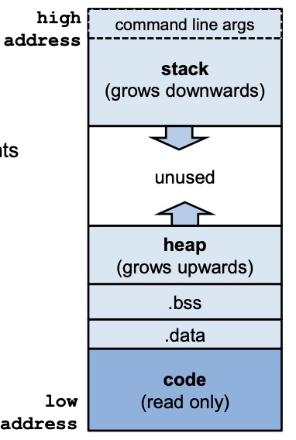
Recall: Process Memory Segments
The OS allocates memory for each process - ie. a running program – for data and code
This memory consists of different segments
Stack - for local variables – incl. command line arguments and environment variables
Heap - for dynamic memory
Data segment for – global uninitialised variables (.bss) – global initialised variables (.data)
Code segment typically read-only

Slide 8
Processes vs. Threads
A process is different than a thread
Thread: “Lightweight process” (LWP)
An execution stream that shares an address space
Multiple threads within a single process
Example:
Two processes examining same memory address 0xffe84264 see different values (I.e., different contents)
Two threads examining memory address 0xffe84264 see same value (I.e., same contents)

Slide 9
Virtualizing the CPU
Goal: Give each process the impression that it alone is actively using the CPU
Resources can be shared in time and space
Assume single uniprocessor
Time-sharing (today’s multi-processors: more nuanced)
But while sharing, processes
should not perform restricted operations
should not run forever or make the entire system slow
One possibility: let the OS inspect each process instruction before running
The problem? Performance

Slide 10
How to Provide Good CPU Performance?
Direct execution
Allow user process to run directly on hardware
OS creates process and transfers control to starting point (i.e., main())
Problems with direct execution?
Process could do something restricted
Could read/write other process data (disk or memory)
Process could run forever (slow, buggy, or malicious)
OS needs to be able to switch between processes
Process could do something slow (like I/O)
OS wants to use resources efficiently and switch CPU to other process
Solution: Limited direct execution:
OS and the hardware maintain some control

Slide 11
Problem 1: Restricted Ops
How can we ensure user process can’t unilaterally perform restricted operations?
Solution: privilege levels/separation provided by hardware (status bit on a register)
OS runs in kernel mode (not restricted)
Instructions for interacting with devices enabled
Could have many privilege levels (advanced topic)
User processes run in user mode (restricted mode)
Interacting with devices directly will trap (software interrupt)
Pre-set routines that run when privileged/restricted instructions run
How can a process legitimately access a device?
System calls (function call implemented by OS)
Change privilege level through system call (trap)

Slide 12
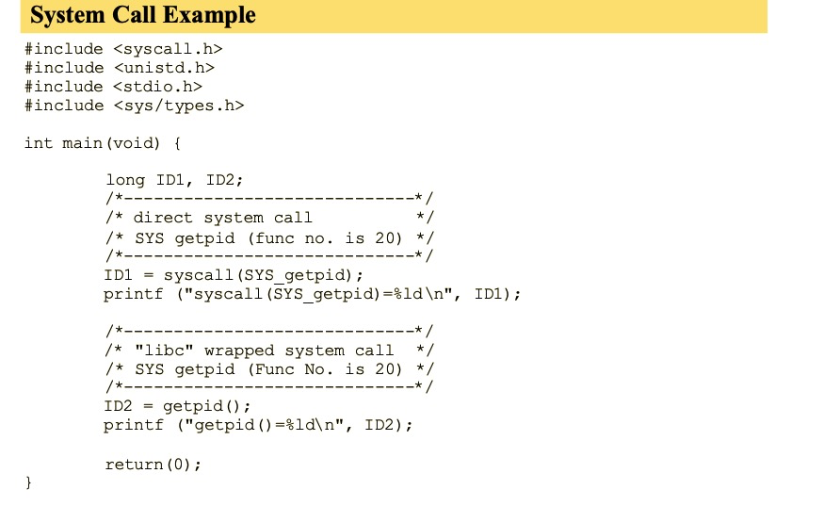
Legitimate use: System Call
syscall(SYS_call, arg1, arg2, …);

Slide 13
System Call
Process P
sys_read
RAM
P wants to call read()

Slide 14
System Call
Process P
RAM
P can only see its own memory because of user mode
(other areas, including kernel, are hidden)

Slide 15
System Call
Process P
RAM
P wants to call read() but no way to call it directly
List of Linux System Calls
http://www.cheat-sheets.org/saved-copy/Linux_Syscall_quickref.pdf

Slide 16
System Call
Process P
RAM
read():
movl $6, %eax; int $64
Assembly convention: movl %eax, …
• CPU uses contents of EAX register as source operand

Slide 17
System Call
Process P
RAM
movl $6, %eax; int $64
syscall-table index
trap-table index

Slide 18
System Call
Process P
RAM
movl $6, %eax; int $64
syscall-table index
trap-table index
Kernel mode: we can do anything!

Slide 19
System Call
Process P
syscall
sys_read
RAM
movl $6, %eax; int $64
syscall-table index
trap-table index
Follow entries to correct system call code

Slide 20
System Call
Process P
buf
syscall
sys_read
RAM
movl $6, %eax; int $64
syscall-table index
trap-table index
Kernel can access user memory to fill in user buffer
return-from-trap at end to return to Process P

Slide 21

System Call
App
System Call
movl $6, %eax; int $64
H/W-level Trap Table
$63 | illegal access
$64 | system call
$65 | Device Interrupt
Syscall() {
sysnum = %eax
sys_handle= get_fn_table(sysnum)
sys_handle ();
}
OS
Syscall table
Num | Function
6 | sys_read
7 | sys_write

Slide 22
What to limit?
User processes are not allowed to directly perform:
Arbitrary memory access
Disk I/O
Special x86 instructions like lidt
What if a process tries to do something privileged/restricted on its own?
Typical response: trap (hardware); OS kills process

Slide 23
Problem 2: How to take the CPU away?
OS requirements for multiprogramming (or multitasking)
Mechanism: To switch between processes
Policy: To decide which process to run at what time
Separation of policy and mechanism
Recurring theme in OS design
Policy: Decision-maker to optimize some workload performance metric
Which process to run when?
Process Scheduler: next lecture
Mechanism: Low-level code that implements the decision
"How”?
Process Dispatcher: Today’s lecture

Slide 24
Dispatch Mechanism
OS runs dispatch loop
while (1) {
run process A for some time-slice
stop process A and save its context
load context of another process B
}
Question 1: How does dispatcher regain control after the time slice?
Question 2: What execution context must be saved and restored?
Context-switch

Slide 25
Q1: How does Dispatcher regain control?
Option 1: Cooperative Multi-tasking
Trust process to relinquish CPU to OS through traps
Examples: System call, page fault (access page not in main memory), or error (illegal instruction or divide by zero)
Provide special yield() system call

Slide 26
Cooperative Approach
P1
yield() call

Slide 27
Cooperative Approach
yield() call
OS

Slide 28
Cooperative Approach
yield() return
OS

Slide 29
Cooperative Approach
P2
yield() return

Slide 30
Cooperative Approach
P2
yield() call

Slide 31
Q1: How Does Dispatcher regain control?
Problem with cooperative approach?
Disadvantages: Processes can misbehave
By avoiding all traps and performing no I/O, can take over entire machine
Only solution: Reboot!
Not performed in modern operating systems

Slide 32
Q1: How does Dispatcher regain control?
Option 2: Regain control without cooperation
Guarantee OS can obtain control periodically. How?
Enter OS by enabling periodic alarm clock
Hardware generates timer interrupt (CPU or separate chip)
Example: Every 10ms
User must not be able to mask timer interrupt (privileged operation)
Dispatcher counts interrupts between context switches
Example: Waiting 20 timer ticks gives 200 ms time slice
Common time slices range from 10 ms to 200 ms
Research systems today: ~5 microseconds
Use hardware mechanisms (timer, traps) to regain control

Slide 33
Q2: What Context must be Saved?
CS416
Eat & Sleep
“Now where was I…”
Context save and restore

Slide 34
Q2: What Context must be Saved?
Dispatcher must save the context of the process when it’s not running
Save it in process control block (PCB) (or process descriptor)
PCB is a structure maintained for each process in the OS
What information is stored in PCB?
PID
Process state (I.e., running, ready, or blocked)
Execution state (all registers, PC, stack pointer) -- Context
Scheduling priority
Accounting information (parent and child processes)
Credentials (which resources can be accessed, owner)
Pointers to other allocated resources (e.g., open files)
Requires special hardware support. Why?
Hardware saves process PC and PSR on interrupts

Slide 35
Q3: What’s inside a PCB?
// the information xv6 tracks about each process
// including its register context and state
struct proc {
char *mem; // Start of process memory
uint sz; // Size of process memory
char *kstack; // Bottom of kernel stack
// for this process
enum proc_state state; // Process state
int pid; // Process ID
struct proc *parent; // Parent process
int killed; // If non-zero, have been killed
struct file *ofile[NOFILE]; // Open files
struct inode *cwd; // Current directory
struct context context; // Switch here to run process
struct trapframe *tf; // Trap frame for the
// current interrupt
};
Conceptually: Separate kernel thread of execution per process

Slide 36
Operating System
Hardware
Program
Process A …

Slide 37
Operating System
Hardware
Program
timer interrupt save regs(A) to k-stack(A) move to kernel mode jump to trap handler
Process A …

Slide 38
Operating System
Hardware
Program
Handle the trap Call switch() routine save regs(A) to proc-struct(A) restore regs(B) from proc-struct(B) switch to k-stack(B) return-from-trap (into B)
timer interrupt save regs(A) to k-stack(A) move to kernel mode jump to trap handler
Process A …
Must have been saved the last time OS switched B out

Slide 39
Operating System
Hardware
Program
Handle the trap Call switch() routine save regs(A) to proc-struct(A) restore regs(B) from proc-struct(B) switch to k-stack(B) return-from-trap (into B)
timer interrupt save regs(A) to k-stack(A) move to kernel mode jump to trap handler
restore regs(B) from k-stack(B) move to user mode jump to B’s IP
Process A …

Slide 40
Operating System
Hardware
Program
Handle the trap Call switch() routine save regs(A) to proc-struct(A) restore regs(B) from proc-struct(B) switch to k-stack(B) return-from-trap (into B)
timer interrupt save regs(A) to k-stack(A) move to kernel mode jump to trap handler
restore regs(B) from k-stack(B) move to user mode jump to B’s IP
Process A …
Process B …

Slide 41
Q3: How is Context Saved?
Example:
Process A has moved from user to kernel mode, OS decides it
must switch from A to B
Save context (PC, registers, kernel stack pointer) of A on kernel stack
Switch SP to kernel stack of B
Restore context from B’s kernel stack
Who has saved registers on B’s kernel stack?
– OS/hardware did, when it switched out B in the past
Now, CPU is running B in kernel mode, return-from-trap to switch to
user mode of B

Slide 42

Q3: How Context is Saved
Proc A
Userspace
Proc B
Code
Data
User-level Stack
Heap
Code
Data
User-level Stack
Heap
Reg(A)
Reg(B)
OS
CPU
Proc B
CPU
Proc A
Process Control Block
Process Control Block
Kernel stack
Context
Kernel stack
Context
Switch()

Slide 43
Q4: What Context must be Saved?
// the registers will save and restore
// to stop and subsequently restart a process
struct context {
int eip; // Index pointer register
int esp; // Stack pointer register
int ebx; // Called the base register
int ecx; // Called the counter register
int edx; // Called the data register
int esi; // Source index register
int edi; // Destination index register
int ebp; // Stack base pointer register
};
// the different states a process can be in
enum proc_state { UNUSED, EMBRYO, SLEEPING,
RUNNABLE, RUNNING, ZOMBIE };

Slide 44
Problem 3: Slow Ops such as I/O?
When running process performs op that does not use CPU, OS switches to process that needs CPU (policy issues)
OS must track state of each process:
Running:
On the CPU (only one on a uniprocessor)
Ready:
Waiting for the CPU
Blocked
Asleep: Waiting for I/O or synchronization to complete
Running
Ready
Blocked
Transitions?

Slide 45
Problem 3: Slow Ops such as I/O?
OS must track every process in system
Each process identified by unique Process ID (PID)
OS maintains queues of all processes
Ready queue: Contains all ready processes
Event queue: One logical queue per event
e.g., disk I/O and locks
Contains all processes waiting for that event to complete
Next Lecture: Policy for determining which ready process to run

Slide 46
Summary
Virtualization: Context switching gives each process impression it has its own CPU
Direct execution makes processes fast
Limited execution at key points ensures OS retains control
Hardware is crucial for limited direct execution
Privilege separation: user vs kernel mode
Timer interrupts
Automatic register saves and restores

Slide 47
Process Creation
Two ways to create a process
Build a new empty process from scratch
Copy an existing process and change it appropriately
Option 1: New process from scratch
Steps
Load specified code and data into memory; Create empty call stack
Create and initialize PCB (make it look like context-switch)
Put process on ready list
Advantages: No wasted work (compared to option 2)
Disadvantages: Difficult to express all possible options for setup, complex
Process permissions, where to write I/O, environment variables
Example: WindowsNT has call with 10 arguments

Slide 48
Process Creation
Option 2: Clone an existing process and change it
Example: Unix fork() and exec()
Fork(): Clones the calling process
Exec(char *file): Overlays file image on calling process
Fork()
Stop current process and save its state
Make copy of code, data, stack, and PCB
Add new PCB to ready list
Any changes needed to child process? Yes!
Exec(char *file)
Replace current data and code segments with those in specified file
Advantages: Flexible, clean, simple
Disadvantages: Wasteful to perform copy and then overwrite of memory

Slide 49
Unix Process Creation
Fork/exec crucial to how the user’s shell is implemented!
While (1) {
Char *cmd = getcmd();
Int retval = fork();
If (retval == 0) {
// This is the child process
// Setup the child’s process environment here
// E.g., where is standard I/O, how to handle signals?
exec(cmd);
// exec does not return if it succeeds
printf(“ERROR: Could not execute %s\n”, cmd);
exit(1);
} else {
// This is the parent process; Wait for child to finish
int pid = retval;
wait(pid);
}
}

Slide 50
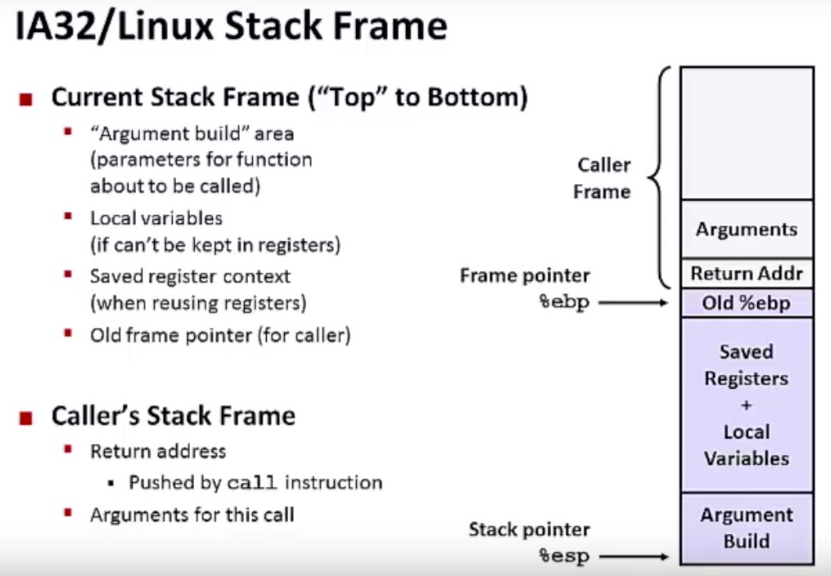
Stack Detour

Slide 51
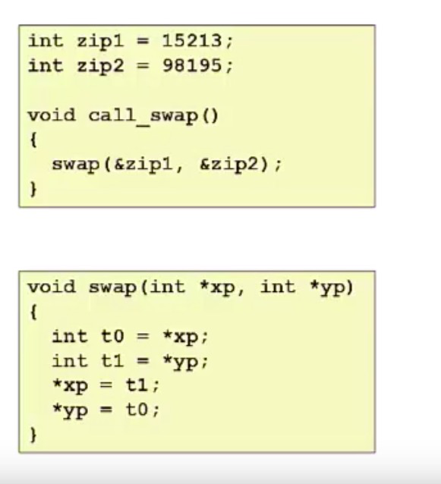
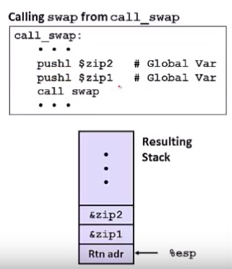
Stack Detour

Slide 52
Stack Detour

Slide 53
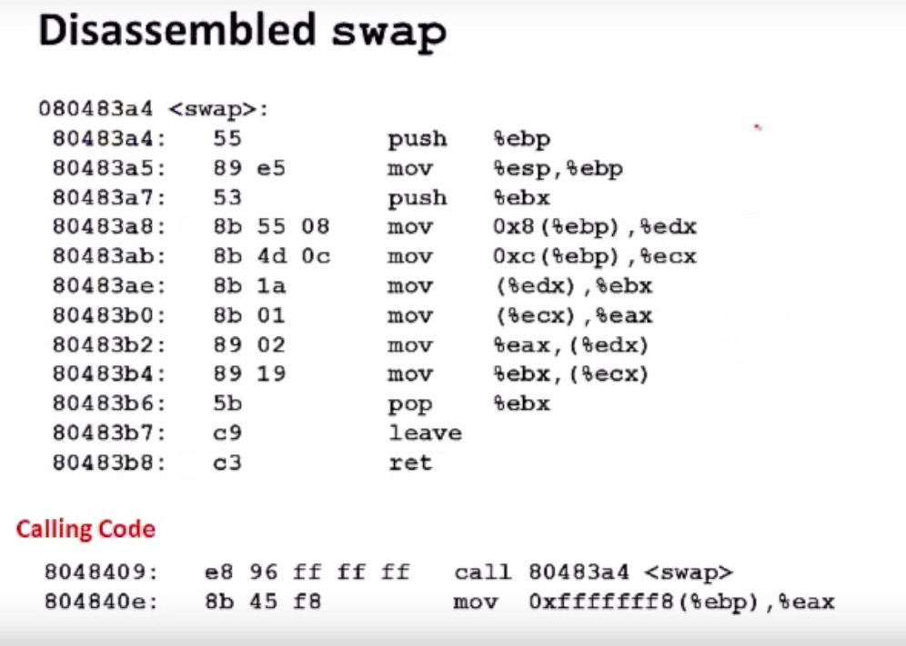
Stack Detour

Slide 54
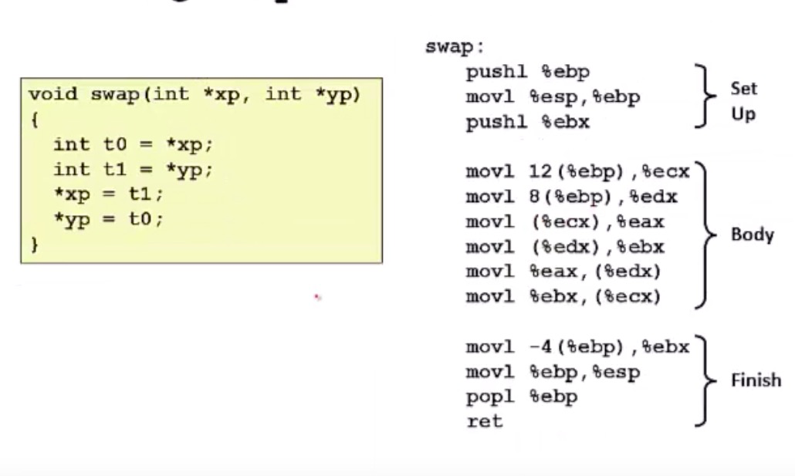
Stack Detour

Slide 55
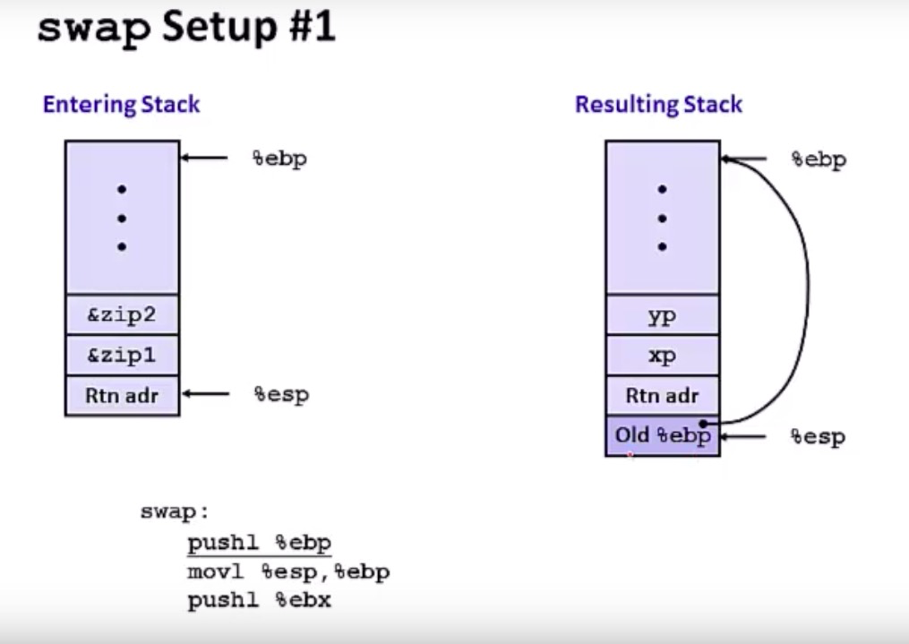
Stack Detour

Slide 56
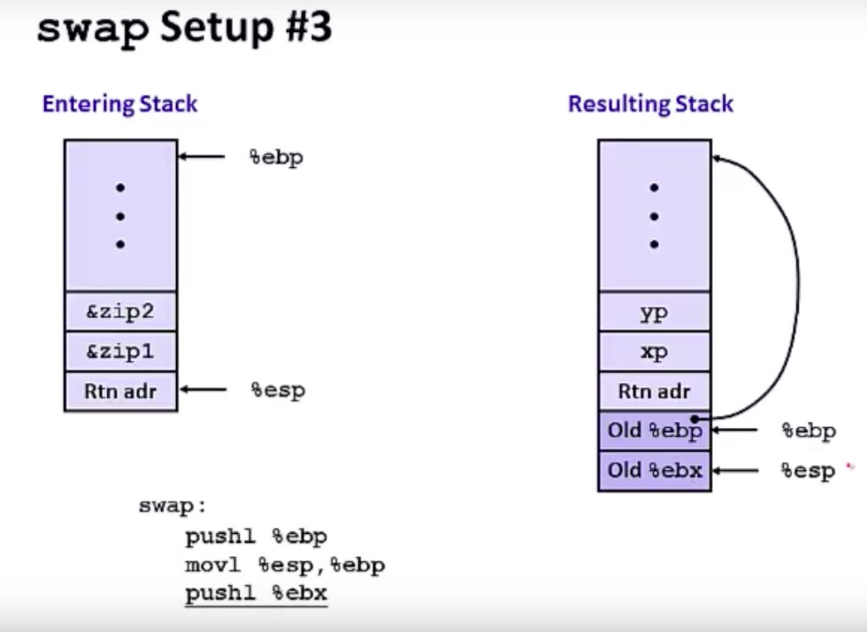
Stack Detour

Slide 57
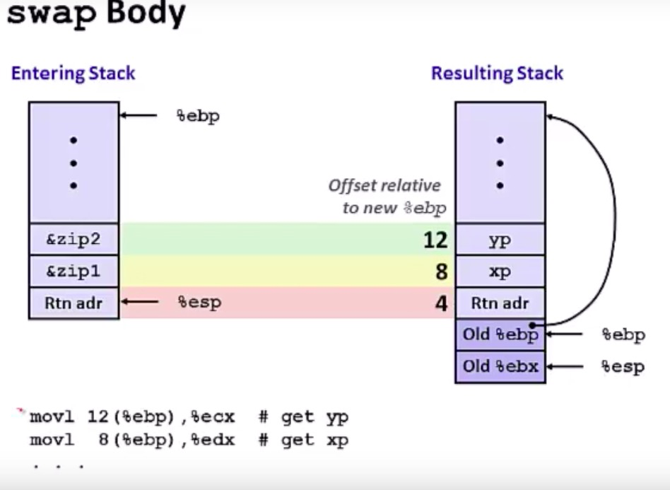
Stack Detour

Slide 58
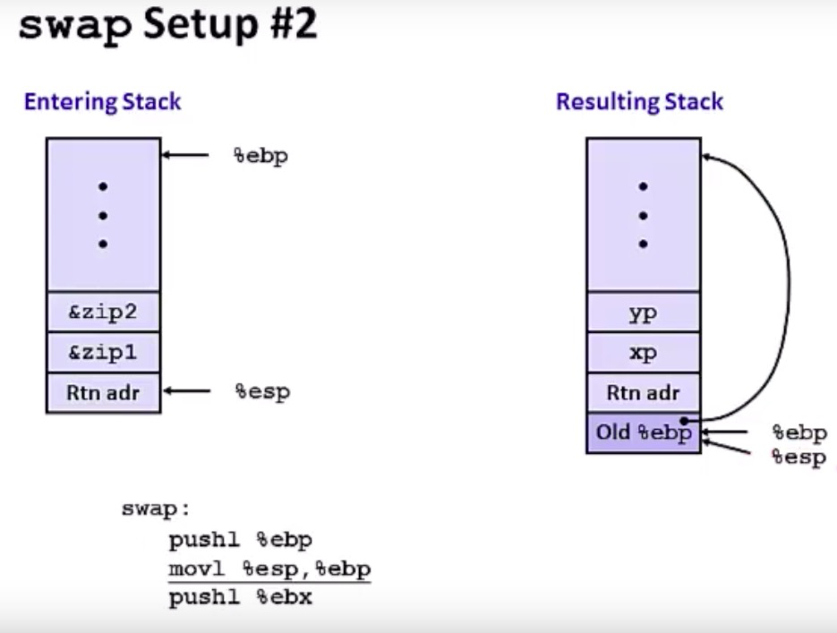
Stack Detour

Slide 59
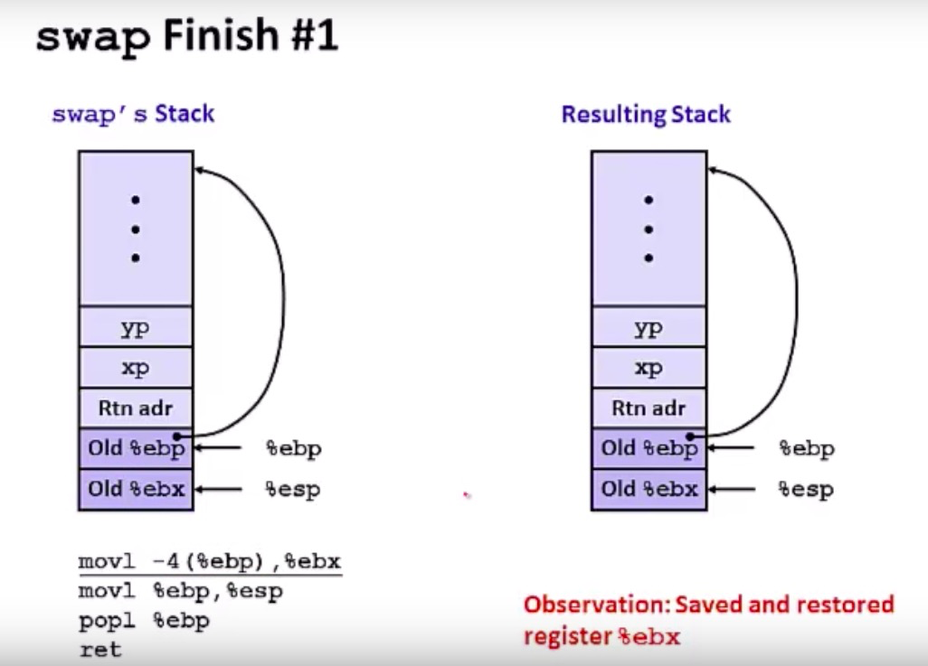
Stack Detour

Slide 60
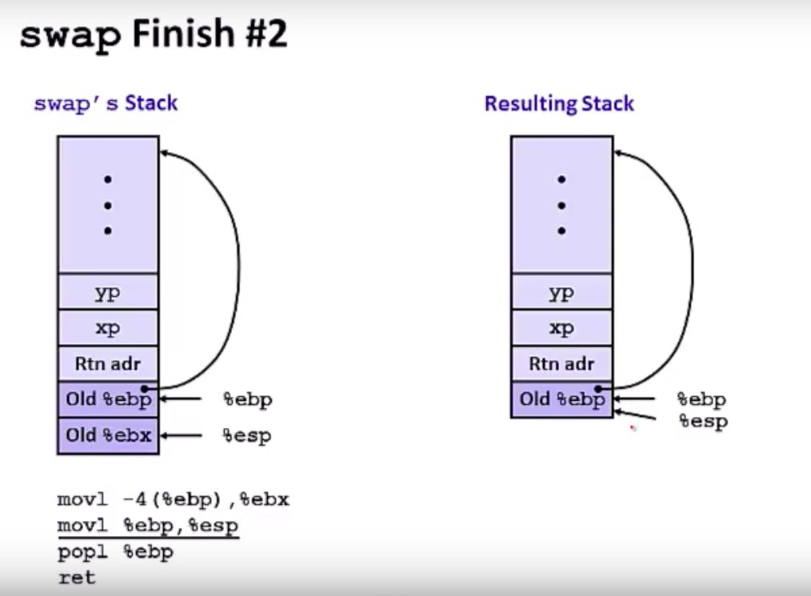
Stack Detour

Slide 61
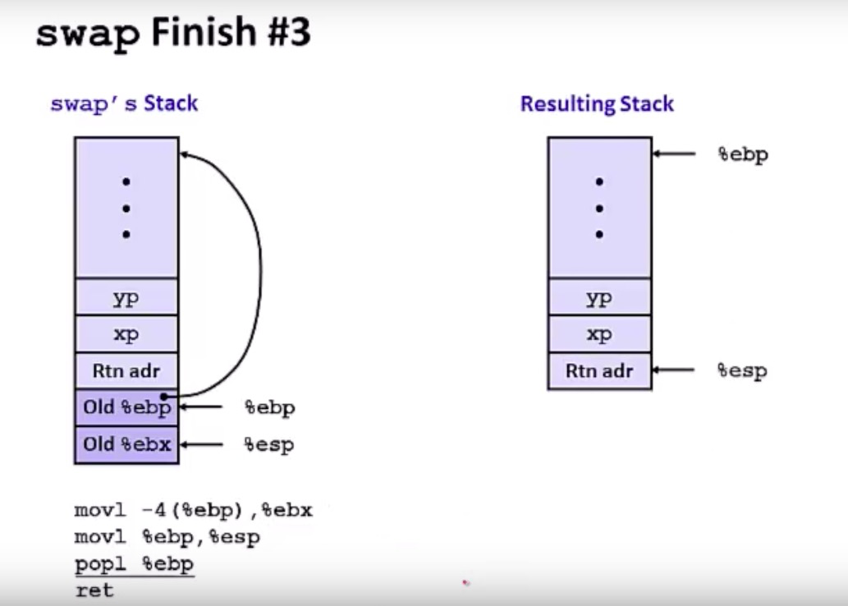
Stack Detour

Slide 62
Q4: What Context must be Saved?
// the registers will save and restore
// to stop and subsequently restart a process
struct context {
int eip; // Index pointer register
int esp; // Stack pointer register
int ebx; // Called the base register
int ecx; // Called the counter register
int edx; // Called the data register
int esi; // Source index register
int edi; // Destination index register
int ebp; // Stack base pointer register
};
// the different states a process can be in
enum proc_state { UNUSED, EMBRYO, SLEEPING,
RUNNABLE, RUNNING, ZOMBIE };

Slide 63
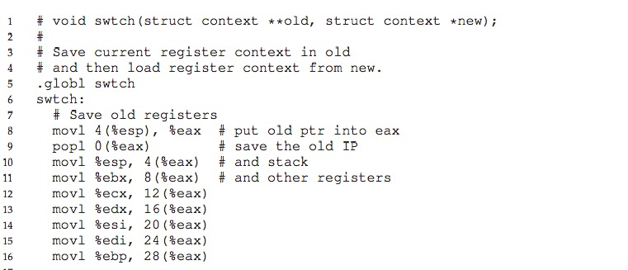
Q4: What Context must be Saved?

Slide 64
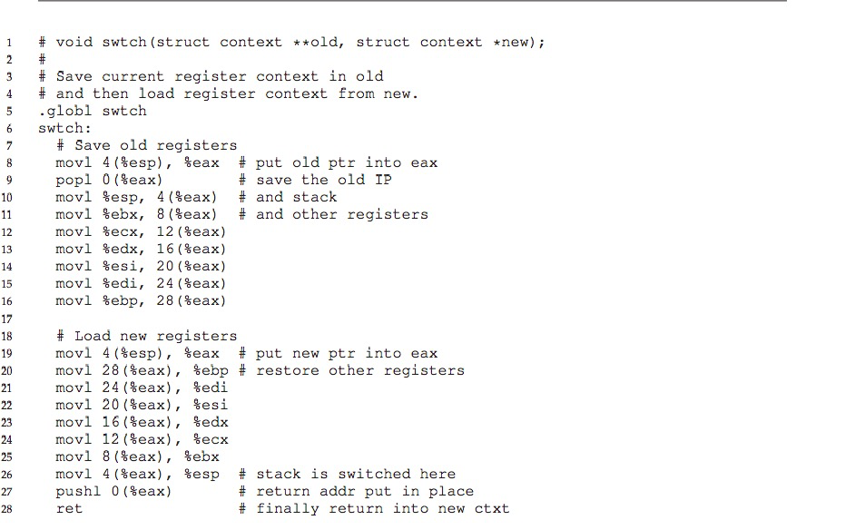
Q4: What Context must be Saved?

Slide 65
Virtualization: The CPU
RUTGERS UNIVERSITY Computer Sciences Department
CS 416 Operating Systems Design
Sudarsun Kannan
Disclaimer: Materials derived, reused, and modified from OSTEP book and lectures of Prof. Andrea and Remzi Arpaci-Dusseau and Prof. Yojip Won

