Slide 1

Network Program Synthesis
Lecture 23, Computer Networks (198:552)
Fall 2019

Slide 2

Review: Control/data plane separation
Control plane
Determine how to move packets
Routing
Algorithm
control
plane
data
plane
Data plane
Move packets
0111
1
3
2
values in arriving
packet header

Slide 3
Review: RMT router data plane
Parser Program
Header and Data Declarations
Tables and Control Flow
parser parse_ethernet { extract(ethernet); return switch(ethernet.ethertype) { 0x8100 : parse_vlan_tag; 0x0800 : parse_ipv4; 0x8847 : parse_mpls; default: ingress; }
header_type ethernet_t { … }
header_type l2_metadata_t { … }
header ethernet_t ethernet;
header vlan_tag_t vlan_tag[2];
metadata l2_metadata_t l2_meta;
table port_table { … }
control ingress { apply(port_table); if (l2_meta.vlan_tags == 0) { process_assign_vlan();
} }
Memory
ALU
Programmable Parser
Programmable Match-Action Pipeline

Slide 4
for all M, does N satisfy P?
Review: Verification
Property of interest:
Loop freedom
Blackholes
Equivalence
Many complex props…
Sequence of messages:
Packets,
Routing protocol
Link failures
Network representation:
Data plane
Control plane
Decision Procedure: An algorithm that answers yes/no

Slide 5
Review: Different guises, Similar question
Verification: for all M, does N satisfy P?
Testing: For the given M, does N satisfy P?
Synthesis: Given P, can you produce an N that satisfies it
For a given set of M? (including for all M)
Let N’ be another network representation
Equivalence checking: For all M, do N and N’ behave in the same way with respect to P?, i.e.,
i.e., either both satisfy P or both violate it

Slide 6
Stateful data plane programs
A case study in programming networks

Slide 7
Stateful processing
Action on a packet depends on previously seen packets
Example: send every 100th packet to a measurement server
Example: Track DNS TTL changes
Example: if (pkt.field > max) { counter++; max = pkt.field }
Example: Flowlet-based load balancing

Slide 8
Flowlet load balancing
Consider the time of arrival of the current packet and the last packet of the same flow
If current packet arrives threshold later than the last packet did, consider rerouting the packet to balance load
Otherwise, use the same path as before
Q: Why?
if (pkt.ts – saved_ts > threshold) {
pkt.outport = new_random(); saved_port = pkt.outport;
} else pkt.outport = saved_port;
saved_ts = pkt.ts;

Slide 9
How would you implement Flowlet LB?
Recall that pipeline is clocked at 1 GHz
i.e., a new packet admitted every 1 ns
Where is the processing? Where is the state?
How about interactions across packets?
Memory
ALU
Programmable Parser
Programmable Match-Action Pipeline

Slide 10
Abstraction: Packet transaction
A piece of code along with state that runs to completion on each packet before processing the next:
C-like domain-specific language, Domino [sigcomm’16]
Assume every packet encounters the same set of actions
i.e., the match on each stage is the same: superset of our needs
Implementation must respect abstraction
A compiler must enforce atomicity for the implementation
Challenge: transaction code may not fit in one pipeline stage!
Challenge: state updates must happen within 1 ns

Slide 11
Insight #1: Pipeline the stateless actions
if (pkt.field1 + pkt.field2 == 10) { counter ++; }
Stateless operations (whose results depend only on the current packet) can execute over multiple stages
Only the stateful operation must run atomically in one pipeline stage

Slide 12
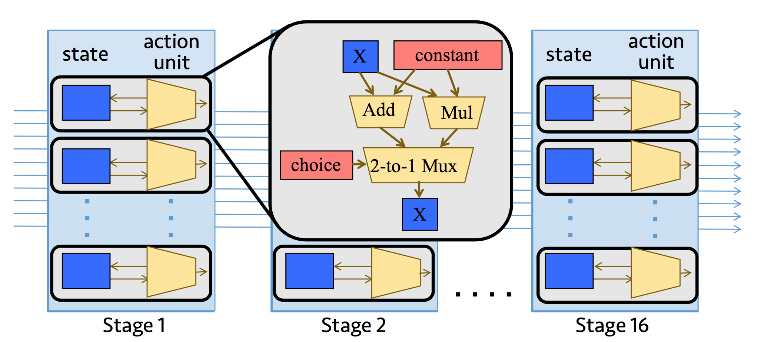
Insight #2: Fit state updates to ALUs
The atoms constitute the switch’s action instruction set. Run under 1 ns

Slide 13
All-or-nothing compilation
Problems with running stateful network programs

Slide 14
Implementing complex policies
What if you have a very large P4 or Domino program?
Example: too many logical tables
Not enough physical stages to hold tables
Example: logical table keys are too wide
Sharing memory across stages leads to paucity in physical stages
Example: Action on each packet, e.g., domino pgm, is too large
Sharing compute across stages leads to paucity in physical stages
Solution?
Re-circulation

Slide 15
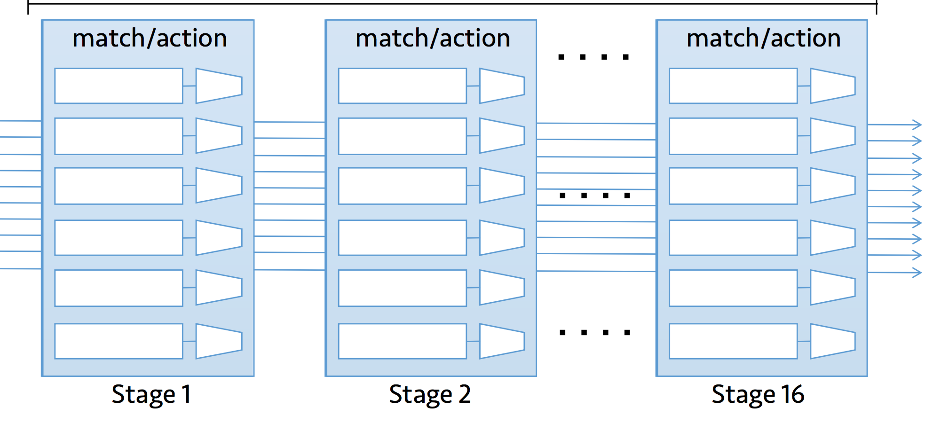
Re-circulation “extends” the pipeline
Recirculate to ingress
If you do this for every packet, packet throughput drops by 2X!

Slide 16
Synthesis of stateful data plane programs
Chipmunk

Slide 17
Program synthesis for code generation
Auto-generate a program from a specification by exhaustive search
Search space
represented by
partial program
Completed program that satisfies specification
Exhaustive
Search
Algorithm
Machine code skeletons
Return infeasible if
there is none
Specification
SKETCH
High-level language program
Program synthesis as an enabling technology for pkt-processing compilers
Notes:
So in response to the above concerns, our proposal is to use the field of program synthesis to develop code generators for packet-processing code.
#### At a really high level, program synthesis is the process of automatically generating a program that satisfies a given specification. A program synthesis engine takes two inputs: #### (1) a search space represented by one partial program？？？？ and #### (2) a specification. #### Then the program synthesis engine uses an exhaustive search algorithm #### to find the completed program that satisfies specification or #### return infeasible if none exists. #### To be specific, we can use search space of partial programs to represent the machine code skeletons and #### use specification to represent the high-level language program. #### The program synthesis tool we used is SKETCH.
#### In essence, our main idea is to use program synthesis as an enabling technology for rapidly building compilers for emerging packet-processing hardware.

Slide 18
Example: Using SKETCH to do synthesis
int sketch1(int x) implements spec {
return x * ??;
}
int sketch2(int x) implements spec {
return x + ??;
}
int spec(int x) {
return x + x + x;
}
Specification
Partial program
Infeasible partial program
no hole assignment
int sketch1(int x) implements spec {
return x * 3;
}
Hole representing
unknown constant
Completed program
Notes:
For a concrete example for SKETCH, #### the specification is a function that adds its input to itself three times. #### Here is an partial program that we can supply to SKETCH. #### ?? represents an unknown constant called a hole. #### Now, SKETCH can find a hole assignment for this partial program and complete the program by setting the hole to 3. On the other hand, #### if we consider another partial program, SKETCH cannot find a hole assignment for it and will say that it is infeasible.

Slide 19


Chipmunk: An Overview
Programmer
Compiler developer
Partial program for PISA simulator
Program as a packet transaction in Domino
State
Variable
PHV
Container
Stateless ALU
PHV
Container
Stateless ALU
PHV
Container
if (count == 10):
count = 0
pkt.sample = 1
else:
count++
pkt.sample = 0
PHV
Container
Stateless ALU
PHV
Container
Stateless ALU
PHV
Container
PHV
Stateful ALU
Output
Mux
PHV
PHV
Stateful ALU
Input
Mux
State storage
State storage
Packet
Field
Stateful ALU
Stateful ALU
State storage
State storage
Chipmunk
Machine code for PISA simulator
Notes:
Now let’s look at Chipmunk in more details.
Our specification for Chipmunk is a program that is expressed as a packet transaction #### in the Domino programming language. We picked Domino because it has a relatively high-level programming model with transactional semantics. #### What this means is that as far as the programmer is concerned, packets execute from top to the bottom in the programmer’s packet-processing code as though there were no other packets in the system. We can also use atomic construct provided by the P4-16 to express this packet transaction and plan to support this in the future. #### The programmer can use state variables like count to represent persistent switch state and #### packet fields such as pkt.sample to represent fields in packet headers.
What about our partial program for SKETCH? #### We consider a simplified version of the PISA match-action pipeline, where we do not model match units by assuming all actions execute on all packets. We abstract the effect of these actions on a packet into a 2D grid of ALUs. We have two types of ALUs, #### stateless ALUs that only manipulate packet headers and #### stateful ALUs that manipulate both persistent switch state and packet headers. #### We use PHV containers to represent storage for packet headers as they move through the switch pipeline. #### The compiler writer specifies how the ALUs use input muxes to choose PHV containers as input operands. #### She also specifies how the PHV containers use output muxes to choose from the ALU outputs. #### Each stage shares the same structure. The compiler developer will use holes to specify what operation is carried out by ALUs , the value of the immediate operands to use, and which packet headers are used for an ALU. These are converted into a SKETCH partial program.
#### Now once we have the specification and partial programs, we feed it into Chipmunk. #### We can then use the output from SKETCH to generate machine code for the PISA simulator.

Slide 20
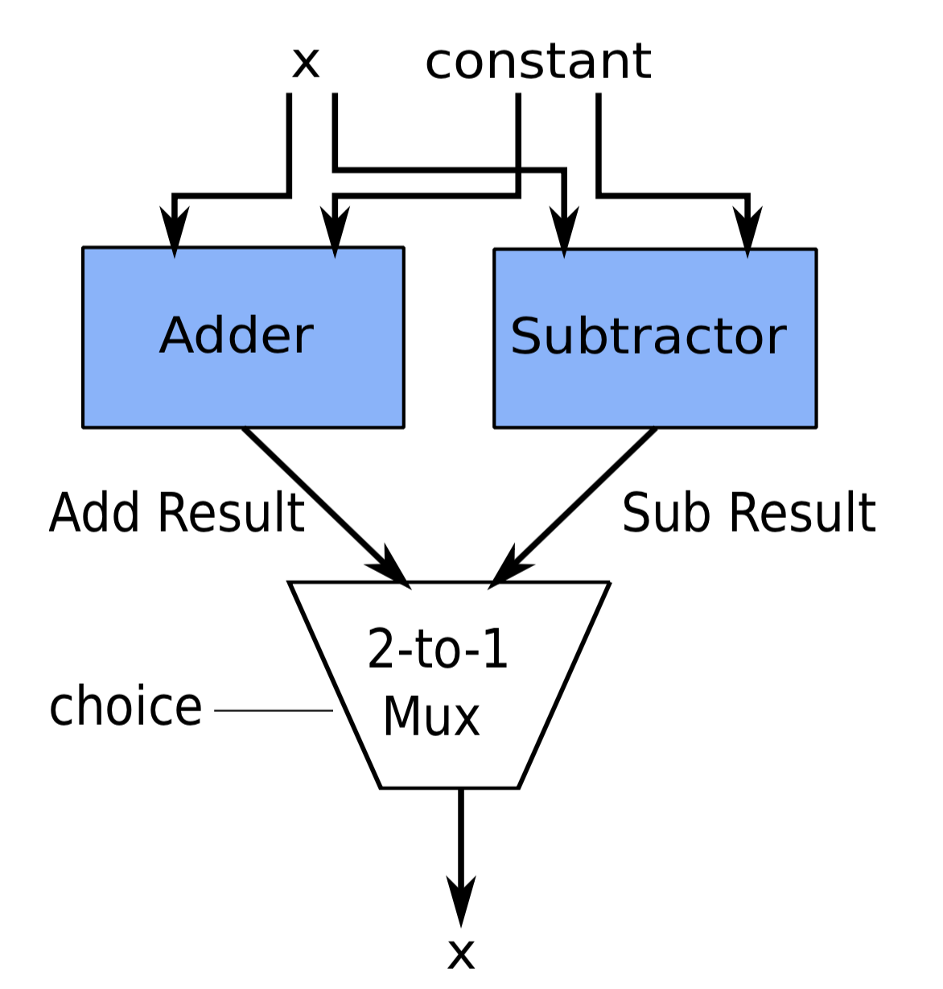
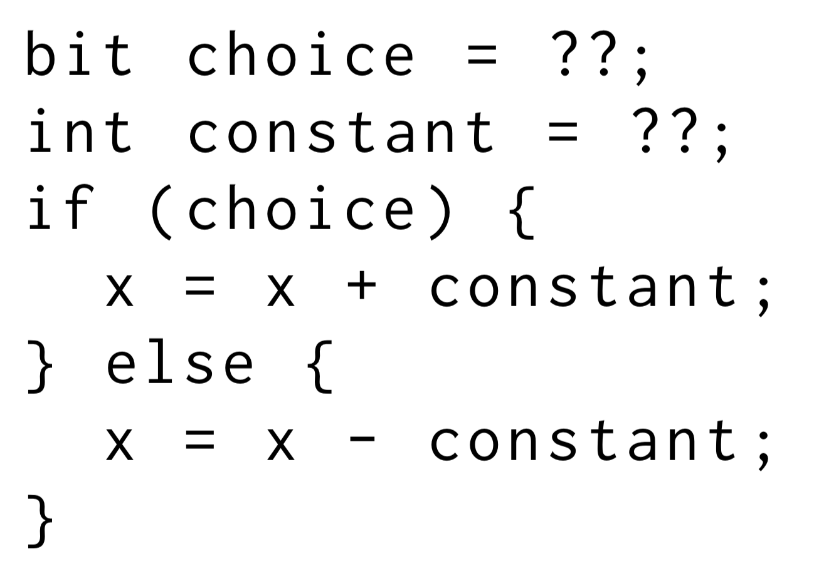
Partial program representation: Atoms

Slide 21
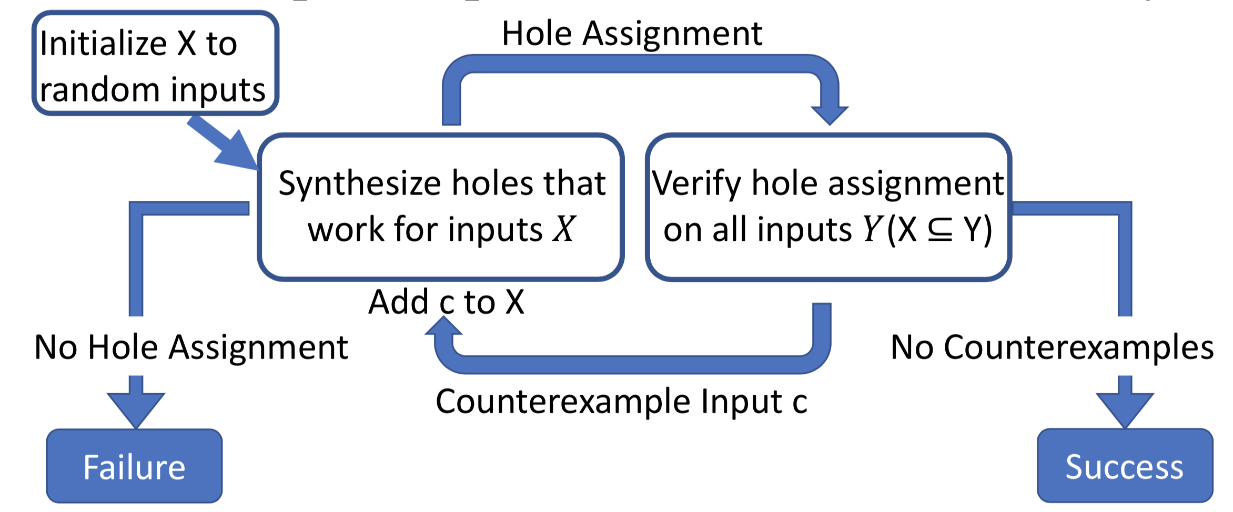
CEGIS: Finding PISA configurations (holes)
Counterexample-Guided Inductive Synthesis

Slide 22
Other apps of synthesis in networking
Generating control plane rules with desired properties
Data plane programs for other targets
e.g., Network processors (CPUs)
Program repair and troubleshooting
Approximation

