Slide 1

Persistence

Slide 2
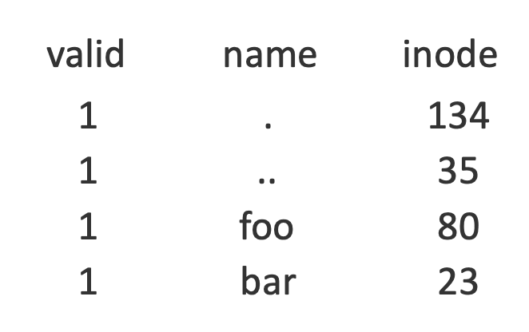
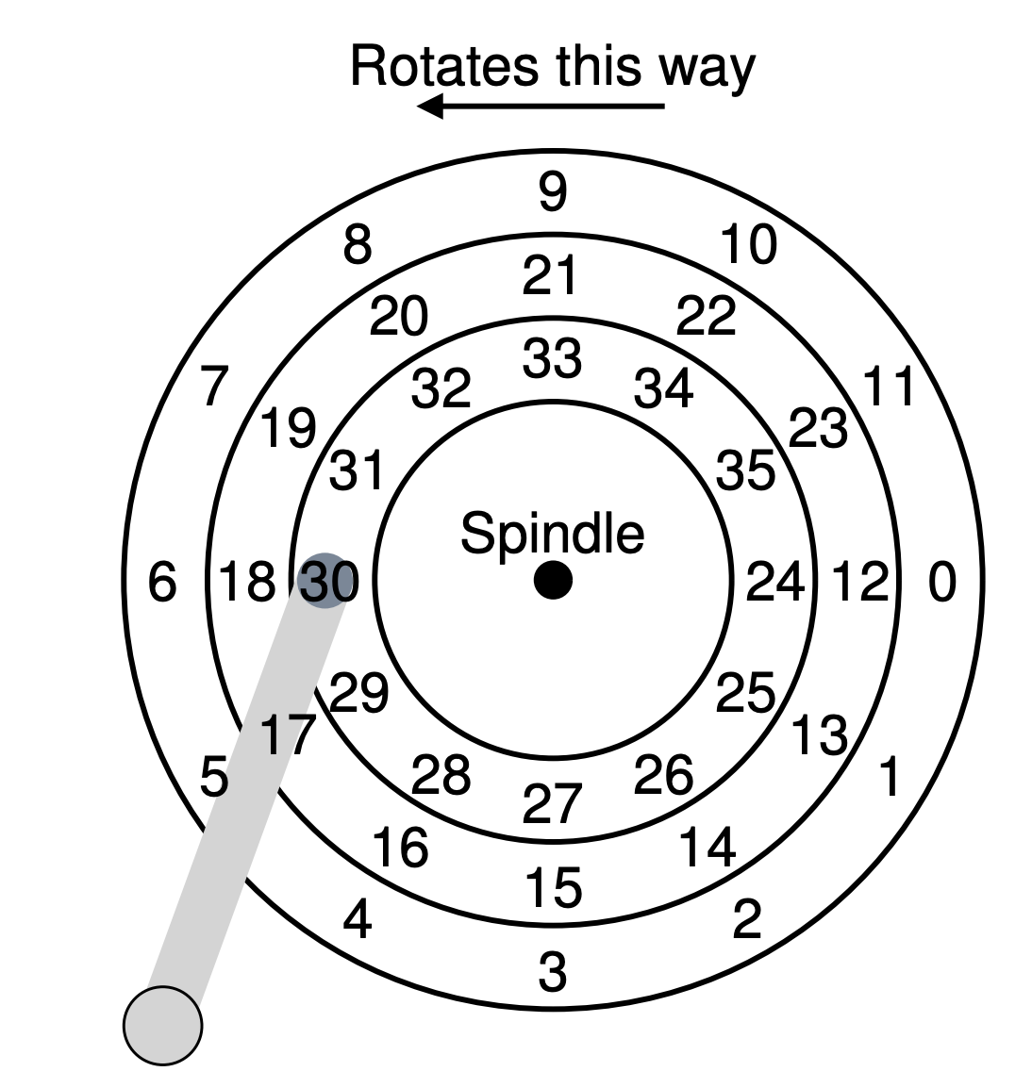
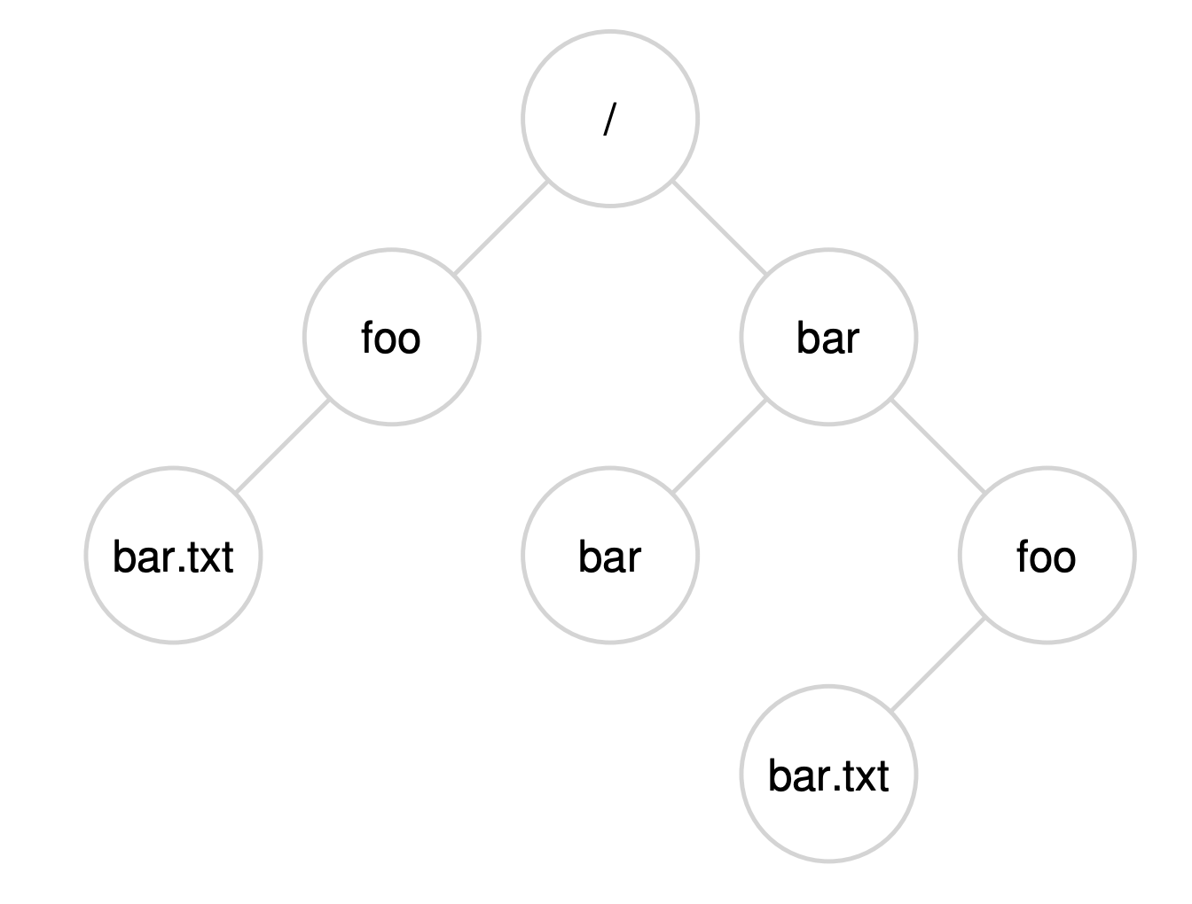
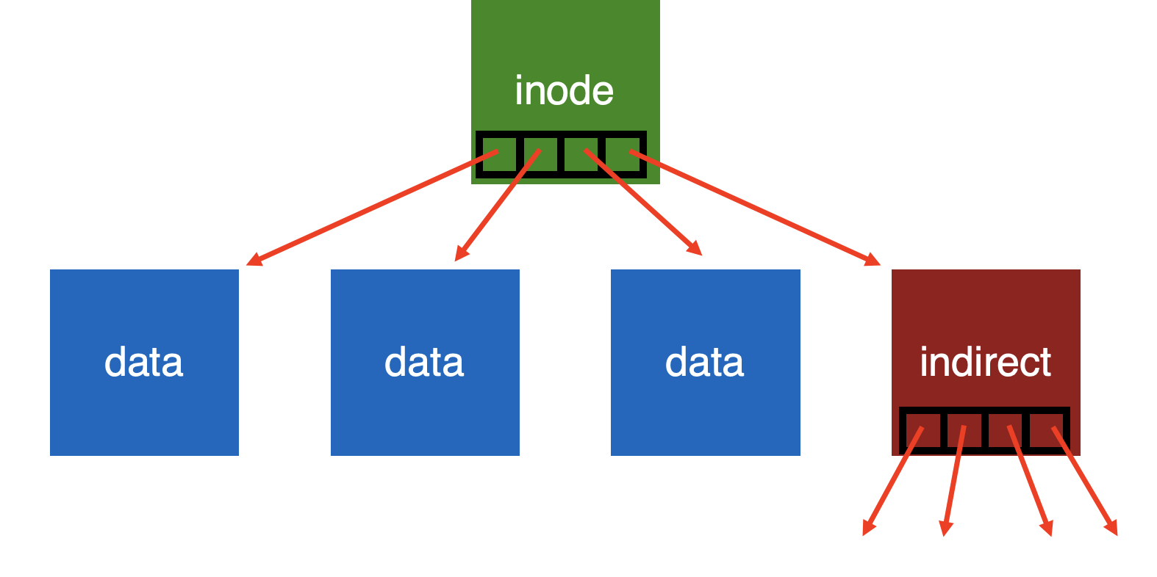
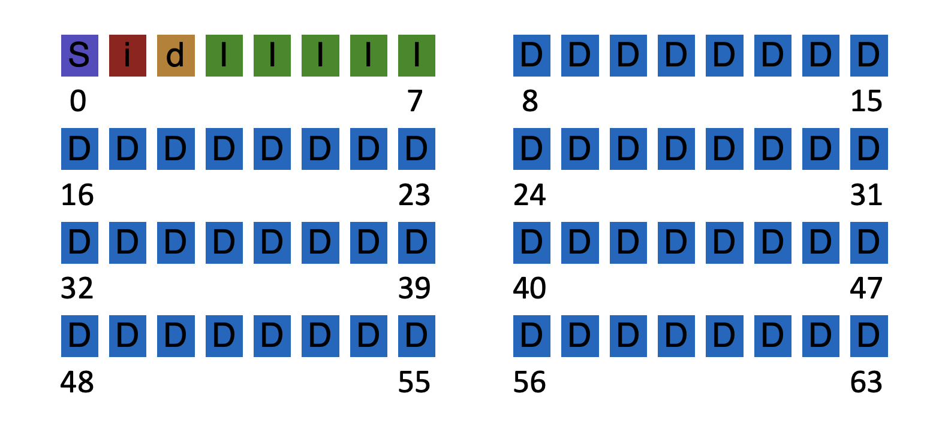
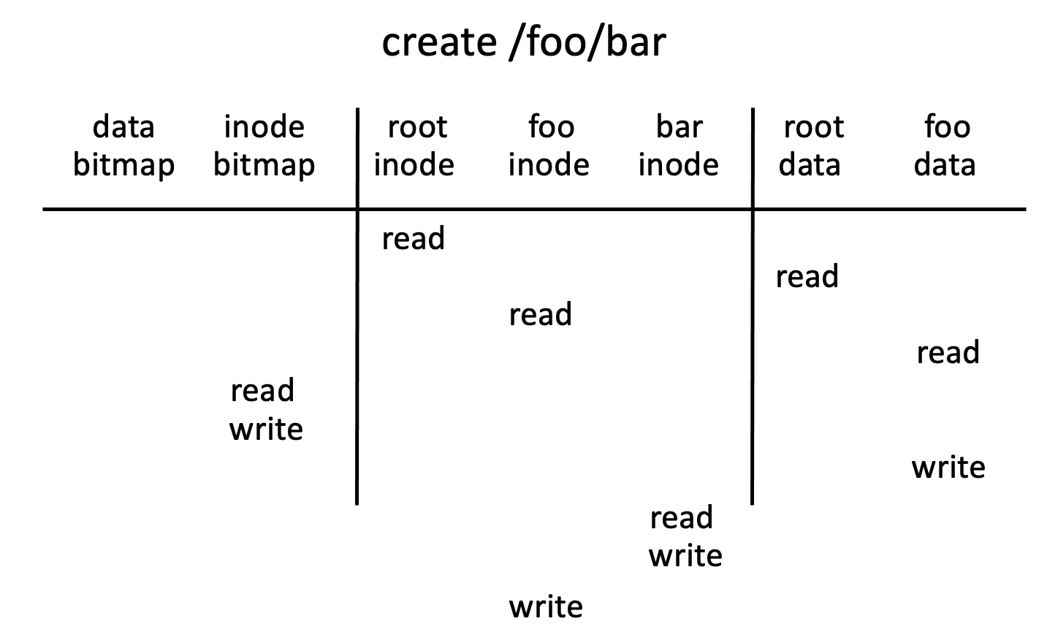

Slide 3
Efficiency
How can we avoid this excessive I/O for basic ops?
Cache for:
- reads
- write buffering

Slide 4
Write Buffering
Why does procrastination help?
Overwrites, deletes, scheduling
Shared structs (e.g., bitmaps+dirs) often overwritten.
We decide: how much to buffer, how long to buffer…
- tradeoff durability vs. performance

Slide 5
How to allocate file data to disk blocks?

Slide 6
Disk layout of data matters!
Why?
Positioning latency: disk rotation; seek
Sequential reads are faster than random reads

Slide 7
Allocation Strategies
Many different approaches
Contiguous
Extent-based
Linked
File-allocation Tables
Indexed
Multi-level Indexed
Questions
Amount of fragmentation (internal and external) – free space that can’t be used
Ability to grow file over time?
Performance of sequential accesses (contiguous layout)?
Speed to find data blocks for random accesses?
Wasted space for meta-data overhead (everything that isn’t data)?
Meta-data must be stored persistently too!

Slide 8
Contiguous Allocation
Allocate each file to contiguous sectors on disk
Meta-data:
OS allocates by finding sufficient free space
Must predict future size of file; Should space be reserved?
Example: IBM OS/360
Starting block and size of file
A
A
A
B
B
B
B
C
C
C
Fragmentation (internal and external)?
Ability to grow file over time?
Seek cost for sequential accesses?
Speed to calculate random accesses?
Wasted space for meta-data?
- Horrible external frag (needs periodic compaction)
- May not be able to without moving
+ Excellent performance
+ Simple calculation
+ Little overhead for meta-data

Slide 9
Small # of Extents
Allocate multiple contiguous regions (extents) per file
Meta-data:
Small array (2-6) designating each extent
Each entry: starting block and size
A
A
A
B
B
B
B
C
C
C
D
D
A
A
A
D
B
B
B
B
C
C
C
B
B
Fragmentation (internal and external)?
Ability to grow file over time?
Seek cost for sequential accesses?
Speed to calculate random accesses?
Wasted space for meta-data?
- Helps external fragmentation
- Can grow (until run out of extents)
+ Still good performance
+ Still simple calculation
+ Still small overhead for meta-data

Slide 10
Linked Allocation
Allocate linked-list of fixed-sized blocks (multiple sectors)
Meta-data:
Examples: TOPS-10, Alto
Location of first block of file
Each block also contains pointer to next block
D
D
A
A
A
D
B
B
B
B
C
C
C
B
B
D
B
D
Fragmentation (internal and external)?
Ability to grow file over time?
Seek cost for sequential accesses?
Speed to calculate random accesses?
Wasted space for meta-data?
+ No external frag (use any block);
+ Can grow easily
+/- Depends on data layout
- Ridiculously poor
- Waste pointer per block
Notes:
Larger --> ??
Smaller --> ??

Slide 11
File-Allocation Table (FAT)
Variation of Linked allocation
Keep linked-list information for all files in on-disk FAT table
Meta-data: Location of first block of file
And, FAT table itself
D
D
A
A
A
D
B
B
B
B
C
C
C
B
B
D
B
D
Draw corresponding FAT Table?

Slide 12
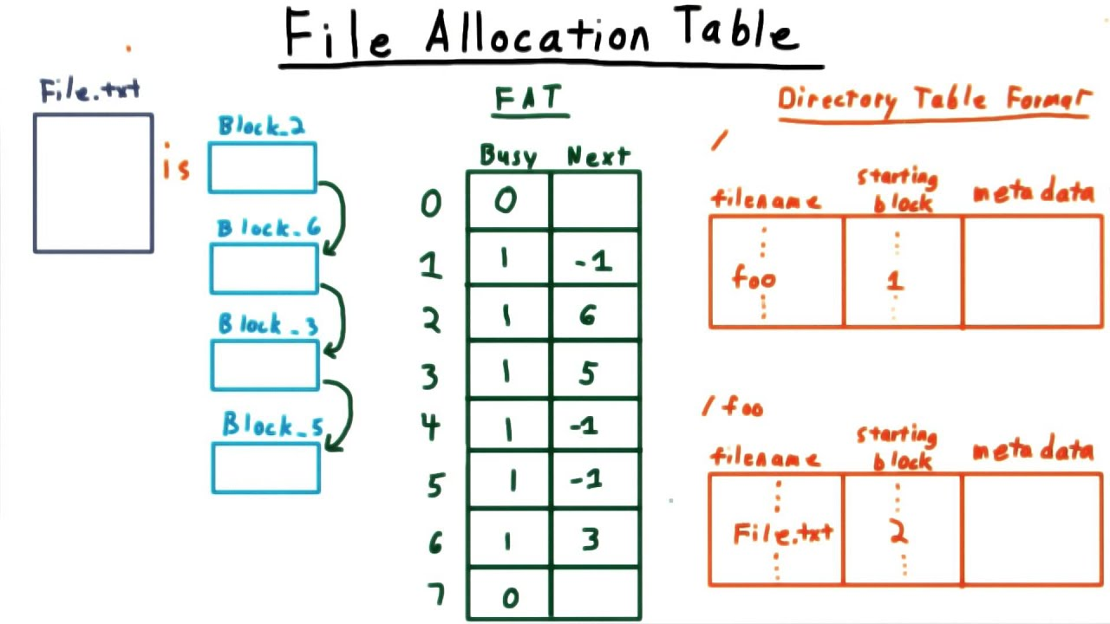
Example of a FAT
https://www.youtube.com/watch?v=mgQtlXBxH0c

Slide 13
File-Allocation Table (FAT)
Variation of Linked allocation
Keep linked-list information for all files in on-disk FAT table
Meta-data: Location of first block of file
And, FAT table itself
D
D
A
A
A
D
B
B
B
B
C
C
C
B
B
D
B
D
Draw corresponding FAT Table?
Comparison to Linked Allocation
Same basic advantages and disadvantages
Disadvantage: Read from two disk locations for every data read
Optimization: Cache FAT in main memory
Advantage: Greatly improves random accesses
What portions should be cached? Scale with larger file systems?

Slide 14
Indexed Allocation
Allocate fixed-sized blocks for each file
Meta-data:
Allocate space for pointers at file creation time
Fixed-sized array of block pointers
D
D
A
A
A
D
B
B
B
B
C
C
C
B
B
D
B
D
Advantages
No external fragmentation
Files can be easily grown up to max file size
Supports random access
Disadvantages
Large overhead for meta-data:
Wastes space for unneeded pointers (most files are small!)

Slide 15
Multi-Level Indexing
Variation of Indexed Allocation
Dynamically allocate hierarchy of pointers to blocks as needed
Meta-data: Small number of pointers allocated statically
Additional pointers to blocks of pointers
Examples: UNIX FFS-based file systems, ext2, ext3
double indirect
indirect
indirect
triple indirect
Comparison to Indexed Allocation
Advantage: Does not waste space for unneeded pointers
Still fast access for small files
Can grow to what size?
Disadvantage: Need to read indirect blocks of pointers to calculate addresses (extra disk read)
Keep indirect blocks cached in main memory

Slide 16
Flexible # of Extents
Modern file systems: Dynamic multiple contiguous regions (extents) per file
Organize extents into multi-level tree structure
Each leaf node: starting block and contiguous size
Minimizes meta-data overhead when have few extents
Allows growth beyond fixed number of extents
Fragmentation (internal and external)?
Ability to grow file over time?
Seek cost for sequential accesses?
Speed to calculate random accesses?
Wasted space for meta-data?
+ Both reasonable
+ Can grow
+ Still good performance
+/- Some calculations depending on size
+ Relatively small overhead

Slide 17
Assume Multi-Level Indexing
Simple approach
More complex file systems build from these basic data structures

Slide 18
Summary/Future
We’ve described a very simple FS.
- basic on-disk structures
- the basic ops
Future questions:
- how to handle crashes?

Slide 19
Crash Consistency
Questions answered:
What benefits and complexities exist because of data redundancy?
What can go wrong if disk blocks are not updated consistently?
How can file system be checked and fixed after crash?
How can journaling be used to obtain atomic updates?
How can the performance of journaling be improved?

Slide 20
Data Redundancy
Definition: if A and B are two pieces of data, and knowing A eliminates some or all values B could be, there is redundancy between A and B
File system examples:
Superblock: field contains total blocks in FS
Inodes: field contains pointer to data block
Is there redundancy between these two types of fields? Why or why not?

Slide 21
File System Redundancy Example
Superblock: field contains total number of blocks in FS
DATA = N
Inode: field contains pointer to data block; possible DATA?
DATA in {0, 1, 2, …, N - 1}
Pointers to block N or after are invalid!
Total-blocks field has redundancy with inode pointers

Slide 22
Pros and CONs of Redundancy
Redundancy may improve:
- reliability
Superblocks in FFS
- performance
bitmaps
But Redundancy could hurt!
- capacity
- consistency
Redundancy implies certain combinations of values are (possibly) illegal
Illegal combinations: inconsistency

Slide 23
Consistency Examples
Assumptions:
Superblock: field contains total blocks in FS.
DATA = 1024
Inode: field contains pointer to data block.
DATA in {0, 1, 2, …, 1023}
Scenario 1: Consistent or not?
Superblock: field contains total blocks in FS.
DATA = 1024
Inode: field contains pointer to data block.
DATA = 241
Consistent
Scenario 2: Consistent or not?
Superblock: field contains total blocks in FS.
DATA = 1024
node: field contains pointer to data block.
DATA = 2345
Inconsistent

Slide 24
Why is consistency challenging?
File system may perform several disk writes to redundant blocks
If file system is interrupted between writes, may leave data in inconsistent state
What can interrupt write operations?
- power loss
- kernel panic
- reboot
Bad things that can happen: inconsistency, garbage data, data loss,

Slide 25
Question for You…
File system is appending to a file and must update:
- inode
- data bitmap
- data block
What happens if crash after only updating some blocks?
a) bitmap:
b) data:
c) inode:
d) bitmap and data:
e) bitmap and inode:
f) data and inode:
lost block & data
Data loss, but otherwise OK
point to garbage (what?), another file may use
lost block & data (nothing can reach it)
point to garbage
another file may use (from bitmap)

Slide 26
How can file system fix Inconsistencies?
Solution #1:
FSCK = file system checker
Strategy:
After crash, scan whole disk for contradictions and “fix” if needed
Keep file system off-line until FSCK completes
For example, how to tell if data bitmap block is consistent?
Read every valid inode+indirect block If pointer to data block, the corresponding bit should be 1; else bit is 0

Slide 27
Fsck Checks
Hundreds of types of checks over different fields…
Do superblocks match?
Do directories contain “.” and “..”?
Do number of dir entries equal inode link counts?
Do different inodes ever point to same block?
…
How to solve problems?

Slide 28

Link Count (example 1)
Dir Entry
inode
link_count = 1
Dir Entry
How to fix to have consistent file system?

Slide 29
Link Count (example 1)
Dir Entry
inode
link_count = 2
Simple fix!
Dir Entry

Slide 30
Link Count (example 2)
inode
link_count = 1
How to fix???

Slide 31
Link Count (example 2)
Dir Entry
fix!
inode
link_count = 1
ls -l /
total 150
drwxr-xr-x 401 18432 Dec 31 1969 afs/
drwxr-xr-x. 2 4096 Nov 3 09:42 bin/
drwxr-xr-x. 5 4096 Aug 1 14:21 boot/
dr-xr-xr-x. 13 4096 Nov 3 09:41 lib/
dr-xr-xr-x. 10 12288 Nov 3 09:41 lib64/
drwx------. 2 16384 Aug 1 10:57 lost+found/
...

Slide 32
Data Bitmap
inode
link_count = 1
block
(number 123)
data bitmap
0011001100
How to fix?
for block 123

Slide 33
Data Bitmap
inode
link_count = 1
block
(number 123)
data bitmap
0011001101
Simple fix!
for block 123

