Slide 1

Programmable Scheduling
Lecture 18, Computer Networks (198:552)
Fall 2019
Notes:
Slide material heavily adapted courtesy of Albert Greenberg, Changhoon Kim, Mohammad Alizadeh.

Slide 2
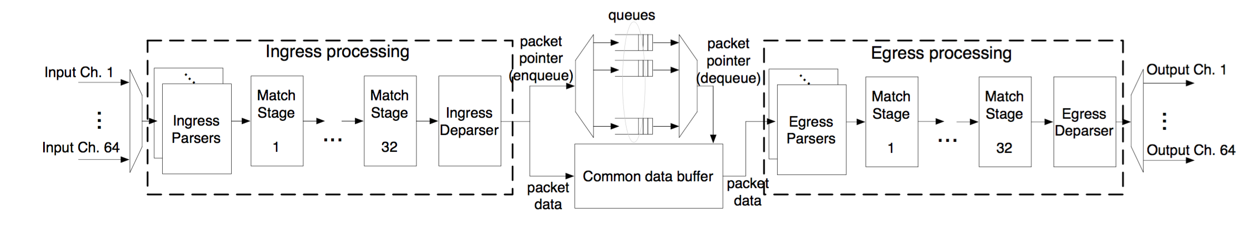
Scheduling in switch pipelines
Packets wait in buffers/queues until serviced
Two possibilities: Input-queued vs. output-queued
Suppose there are pkts on port 1 to both 2 and 3
But suppose port 2 is clogged
Port 1’s packets towards port 3 should not be delayed (HOL block)
Better to have queues represent output port contention

Slide 3
Why care about packet scheduling?
Significantly influences how packets are treated regardless of the endpoint transport
Implementations of Quality of Service (QoS) within large networks
Implications for net neutrality debates
Intellectually interesting and influential (“top 10”) question
Classic Demers et al paper (WFQ) has ~ 1500 citations
Important connections to sched literature (e.g., job scheduling)
Scheduling algorithms influence many daily life decisions ☺

Slide 4
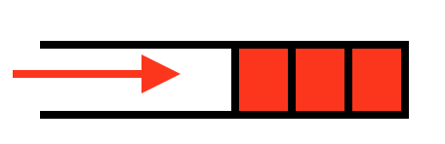
Scheduling vs. Buffer Management
How packets enter vs. how packets leave the switch buffer
Typical buffer management: Tail-drop
How should buffer memory be partitioned across ports?
Static partitioning?
Inefficient: even if port 1 has nothing to send, might drop port 2
Also want fair sharing of buffer
If output port 1 is congested, why should port 2 traffic suffer?
State of the art: dynamic buffer sharing algorithms

Slide 5
Fair Resource Allocation
Allocate how? among who?

Slide 6
Fair and efficient use of a resource
Suppose n users share a single resource
Like the bandwidth on a single link
E.g., 3 users sharing a 30 Gbit/s link
What is a fair allocation of bandwidth?
Suppose user demand is “elastic” (i.e., unlimited)
Allocate each a 1/n share (e.g., 10 Gbit/s each)
But fairness is not enough
Which allocation is best: [5, 5, 5] or [18, 6, 6]?
[5, 5, 5] is fair but [18, 6, 6] is more efficient
What about [5, 5, 5] vs. [22, 4, 4]?

Slide 7
Fair use of a single resource
What if some users have inelastic demand?
E.g., 3 users where 1 user only wants 6 Gbit/s
And the total link capacity is 30 Gbit/s
Should we still do an “equal” allocation?
E.g., [6, 6, 6]
But that leaves 12 Gbps unused
Should we allocate in proportion to demand?
E.g., 1 user wants 6 Gbps, and 2 each want 20 Gbit/s
Allocate [4, 13, 13]?
Or, give the least demanding user all she wants?
E.g., allocate [6, 12, 12]?

Slide 8
Max-min fairness
Protect the less fortunate
Any attempt to increase the allocation of one user necessarily decreases the allocation of another user with equal or lower allocation
Fully utilize a bottleneck resource
If demand exceeds capacity, the link is fully used

Slide 9
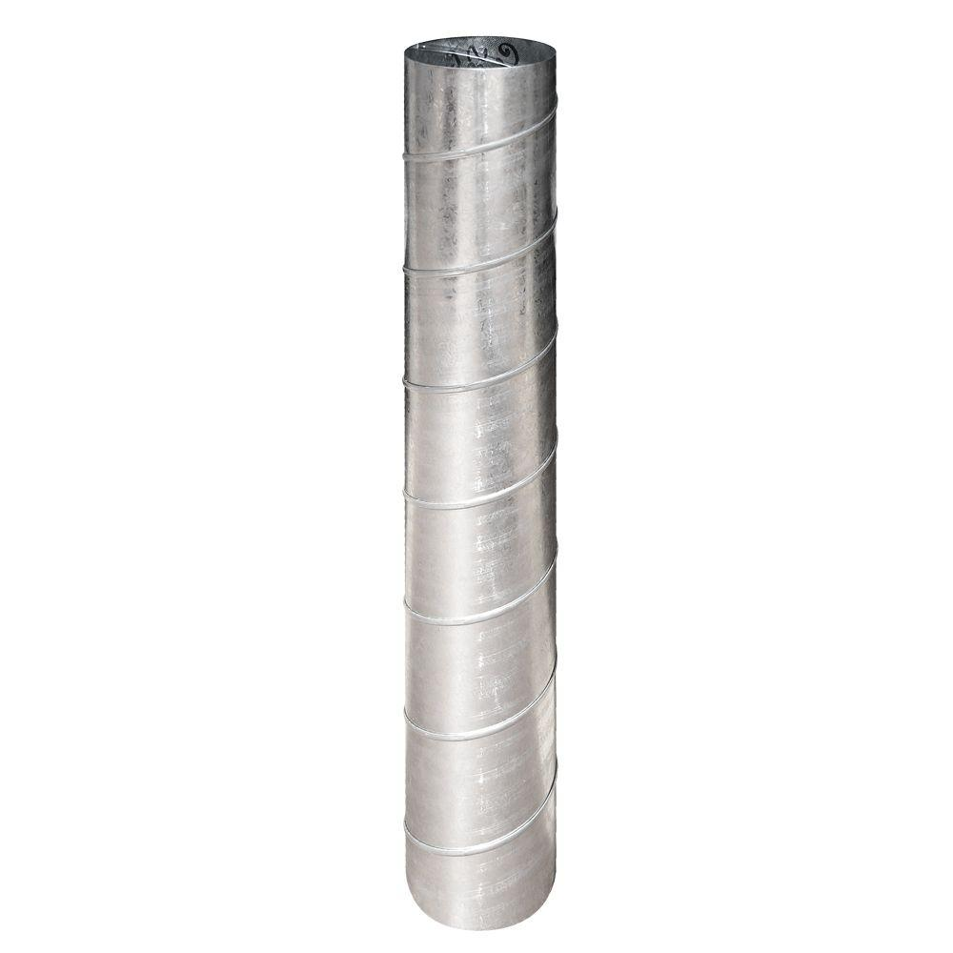
Max-min fairness for a single resource
Progressive filling algorithm (also called waterfilling)
Grow all rates until some users stop having demand
Continue increasing all remaining rates until link is fully utilized
If all users have elastic demands, single resource shared evenly
Link rate L/N
N elastic users
Link rate L/N
…
Link rate L
Link rate L/N

Slide 10
Allocation over multiple resources
A
B
Three users A, B, and C
Two 30 Gbit/s links
C
Maximum throughput: [30, 30, 0]
Unfair: total throughput of 60, but user C starves
Max-min fairness: [15, 15, 15]
Inefficient: everyone gets equal share, but throughput is just 45
Proportional fairness: [20, 20, 10]
Allocate inversely proportional to resource use per bit
C is penalized for using two busy links, as opposed to one

Slide 11
Allocate fairly among who?
Abstract entity:
a flow
Traffic sources?
Web servers, video servers, etc. need more than their fair share
Traffic destinations?
Vulnerable to malicious sources denying service to receivers
Source-destination pairs?
Can open up connections to many destinations
Application flows? (i.e., src + dst + transport ports)
Malicious app can start up many such flows
Administrative entities? (e.g., Rutgers NetID, ISP, …)
How should a router identify packets belonging to an entity?

Slide 12
Packet Scheduling Algorithms
Which packet to send next? (order)
When to send the next packet? (timing)

Slide 13
A taxonomy
12
11
10
9
8
b
7
Granularity of allocation
Per-packet vs. per-flow vs bit-by-bit
Pre-emptive vs. non-pre-emptive
Do you interrupt the current packet/flow if another shows up?
Size-aware vs. unaware
Do you consider flow or packet sizes in scheduling?
Class-based (strict priority) vs. shared
Are some flows strictly higher priority than others?
Work-conserving vs. non-work-conserving
Do you always use spare link capacity when there is demand?

Slide 14
Examples of scheduling algorithms (1/3)
FIFO over packets
Round-robin over packets of different flows
Shortest Remaining Processing Time (SRPT)
Flow-size-aware allocation which strictly prioritizes short flows
Also called shortest flow first in some contexts
Flow-size-unaware variant may predict demand using known flow size distribution

Slide 15
Examples of scheduling algorithms (2/3)
Processor sharing
Assume each flow gets a fair share of the link every unit of time
Ideal: each flow starts receiving service immediately upon arrival
Rate limiting
Non-work-conserving: flow can’t send even if more demand than limit
Class-based strict prioritization
Pre-determined flow classes with strict priorities over each other
Starve low priority flows if higher priority flows are always sending

Slide 16
Examples of scheduling algorithms (3/3)
Hierarchical policies
Arrange existing scheduling policies in a tree
Example:
Rate-limit A + B
Fair-share among A and B within limit
Fair-share among A+B and C
Complex multi-tenant isolation policies
C
A
B

Slide 17

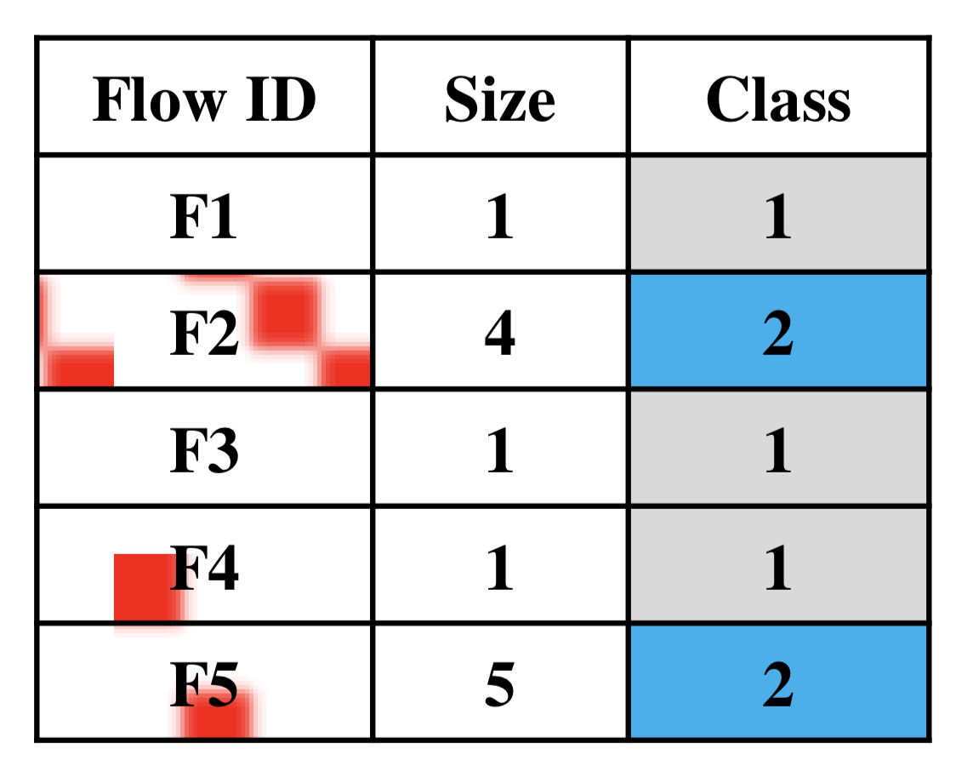
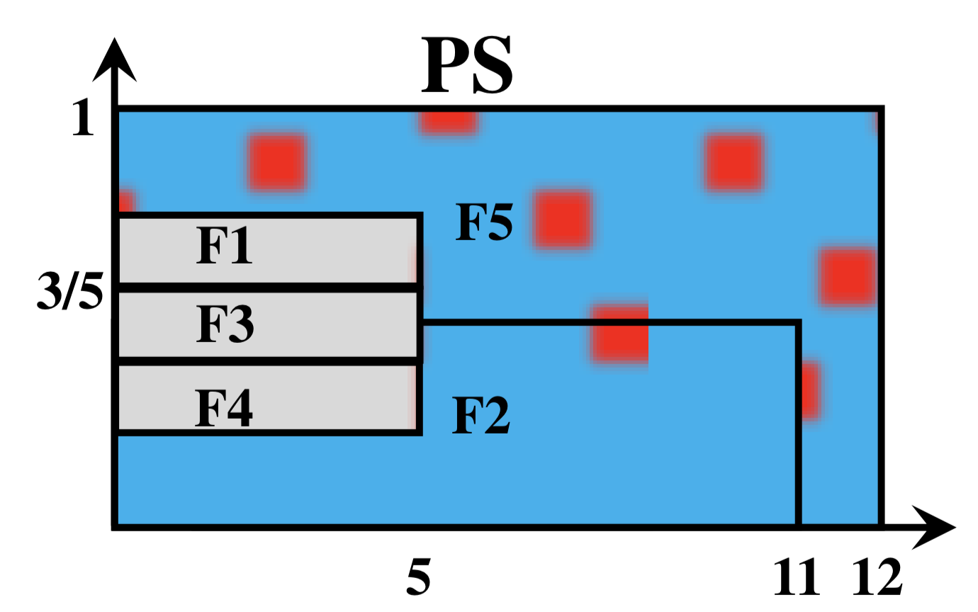
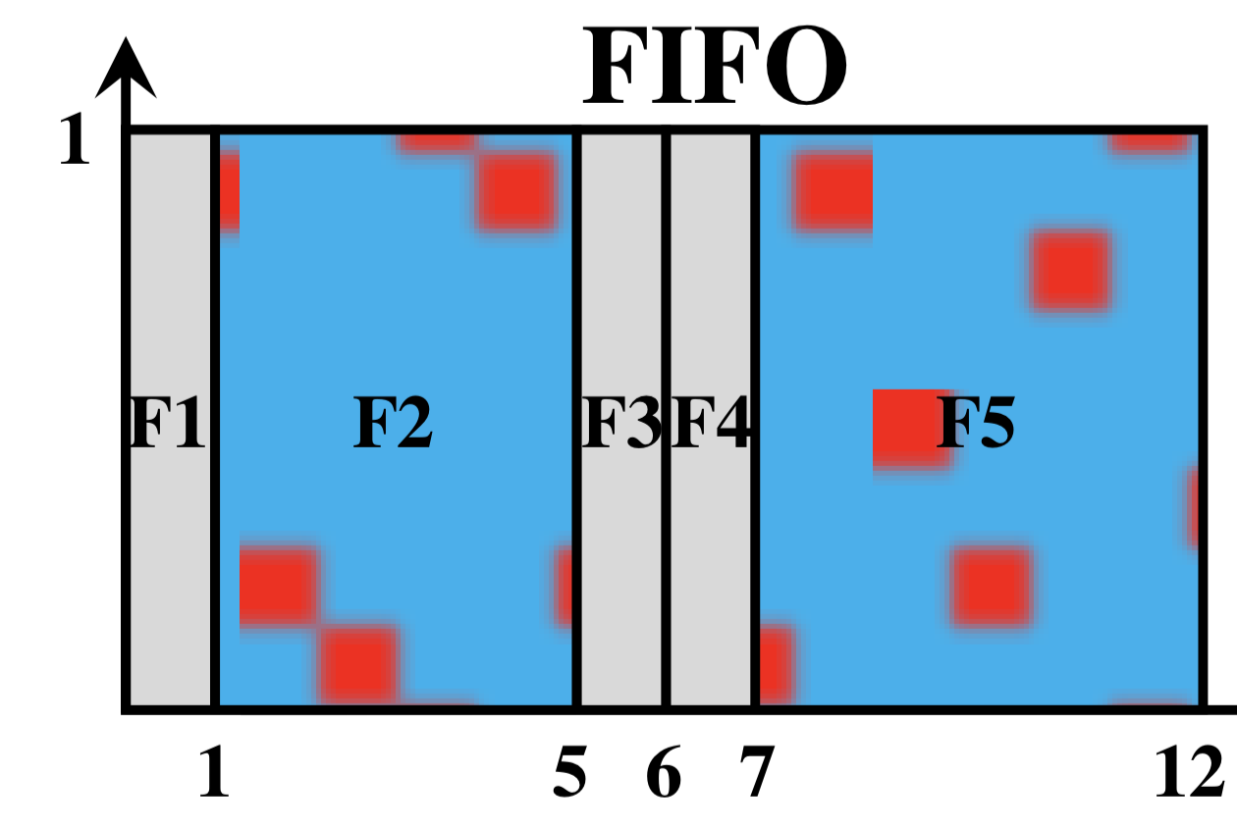
There’s not one optimal scheduling
Multiplexing
Avoids HOL blocking
Serialization
Reduces flow completion time
Source: Workload adaptive flow scheduling, by Faisal et al. CoNEXT 2018

Slide 18
Exercise: When does a flow finish?
Consider a mix of “long” and “short” flows arriving at a Q
Ex: A flow may have as few as 2 packets or as many as 10⁵
Suppose a scheduling algorithm provides each flow:
An average per-packet delay d (e.g., 50 ms)
An average link bandwidth share t (e.g., 10 Mbit/s)
Which among d & t determines
when a short flow finishes?
when a long flow finishes?

Slide 19
Push In First Out (PIFO)
A common primitive for many scheduling algorithms

Slide 20
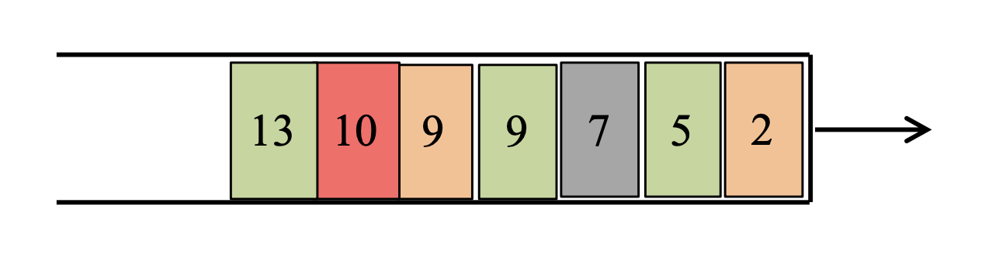
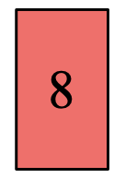
Key ideas
Scheduling algorithms determine order and timing of packet departures from a queue
Typically, relative order of buffered packets doesn’t change upon new packet arrivals
Implement scheduling through a priority-queue-based data structure (PIFO)
Push-In: pkts have arbitrary ranks; push anywhere into queue
First-Out: always dequeue from the head of the queue

Slide 21
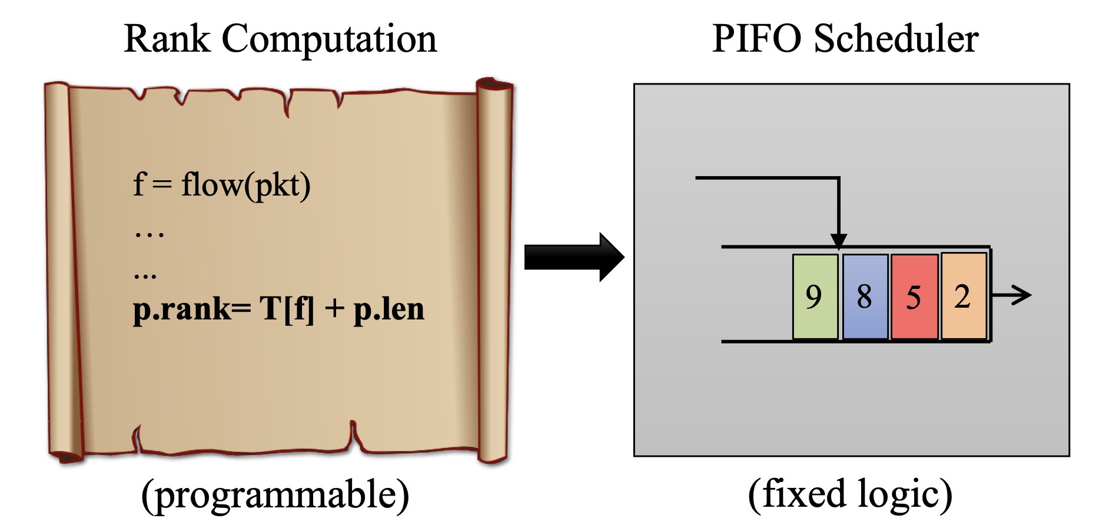
Programmable Scheduler
To program the scheduler, program the rank computation

Slide 22
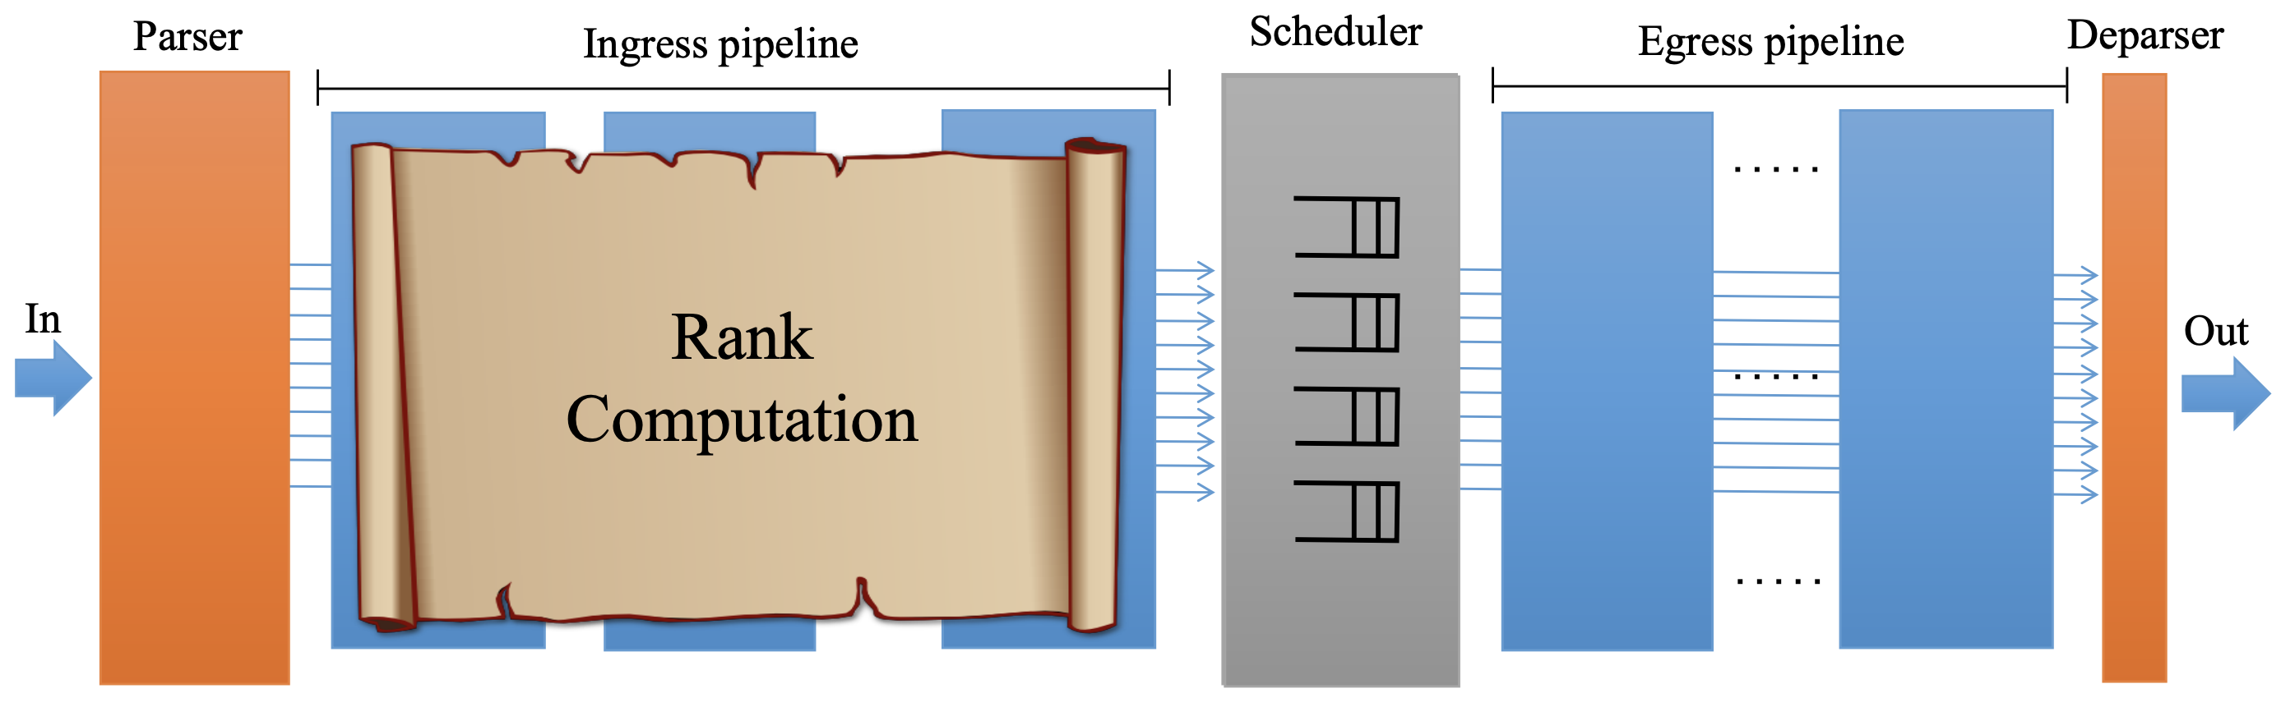
Programmable scheduling in the pipeline

Slide 23
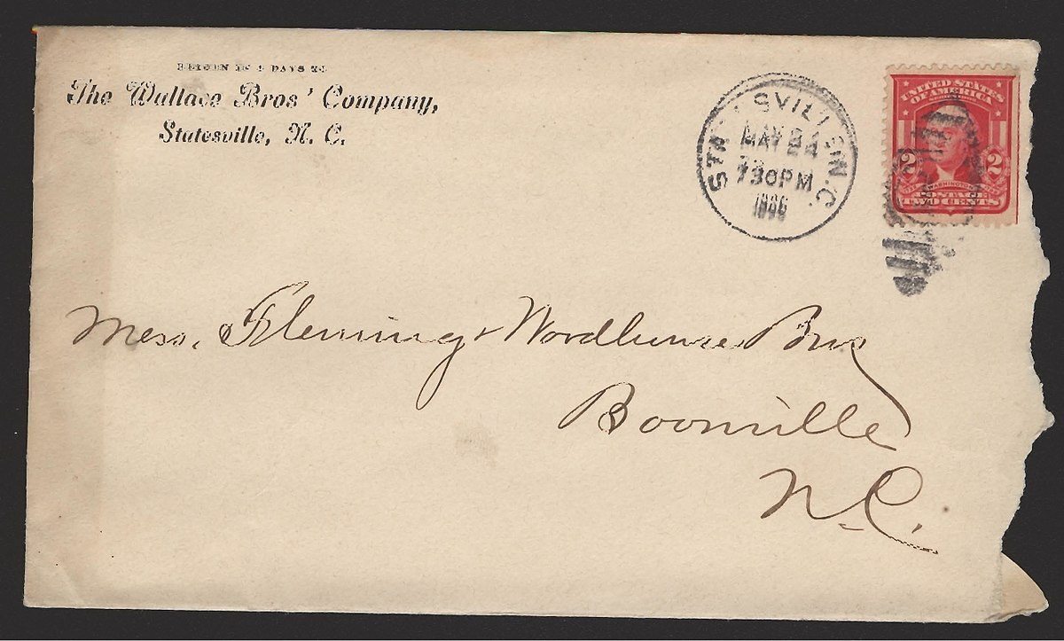
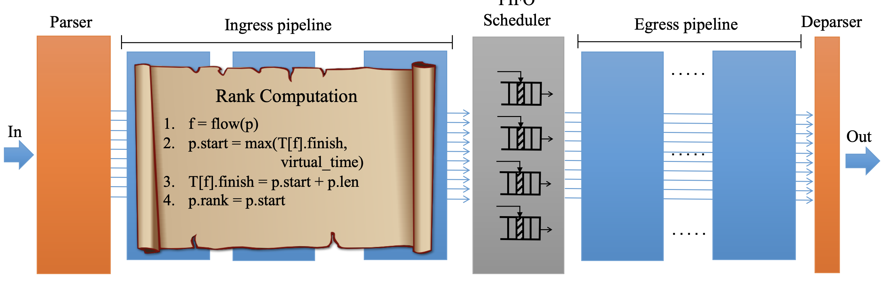
Fair queueing
…

Slide 24
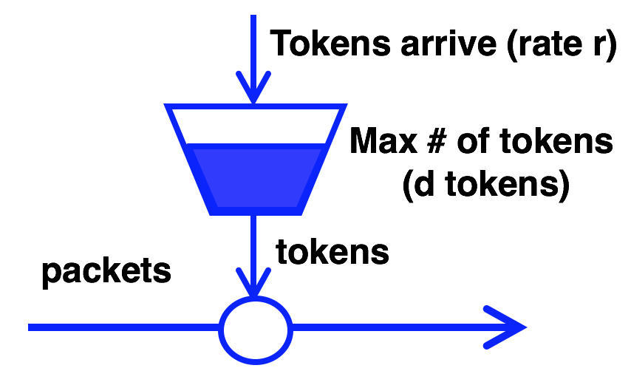
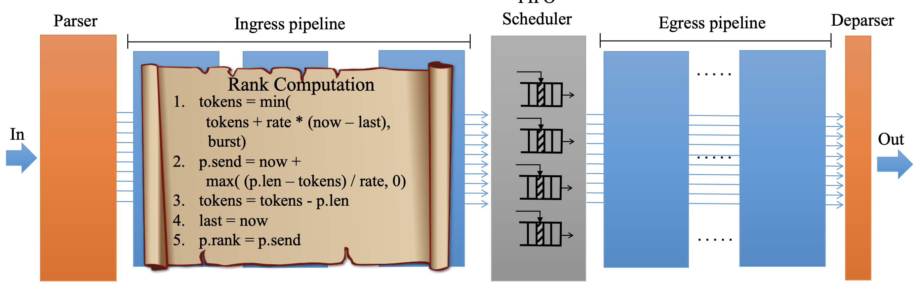
Token-bucket rate limiting

Slide 25
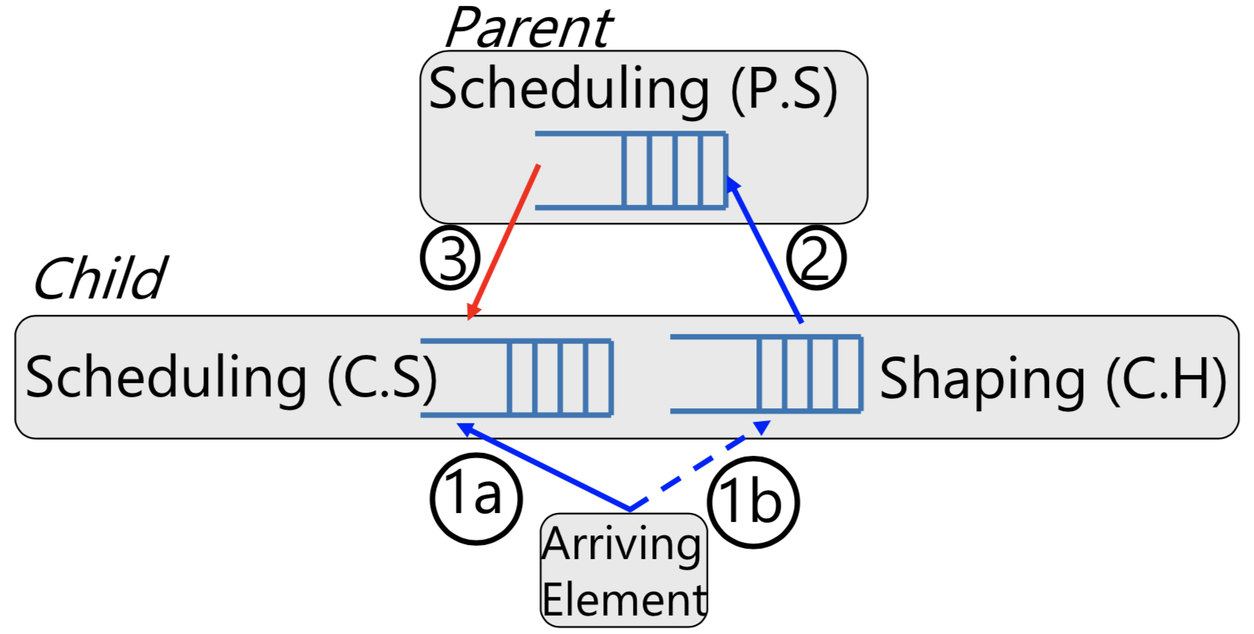
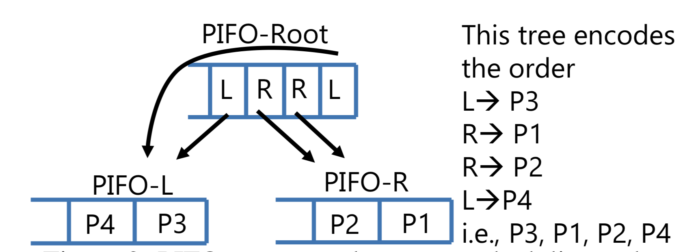
Generalizations
Use a hierarchy of PIFOs to implement hierarchical policies
Use a shaping PIFO to implement non-work-conserving scheduling policies

Slide 26
Implementation: Challenges
Packet buffer is big! Schedule among all those packets?
Maintaining a sorted list of 64K packets?
Instead, make flow-level scheduling decisions
With FIFO order among packets of a given flow
Sorting even just flows at line rate
Line-rate insertion and removal from hardware priority queue with 1000s of flow elements
Use fast flip-flops and pipelined logic

Slide 27
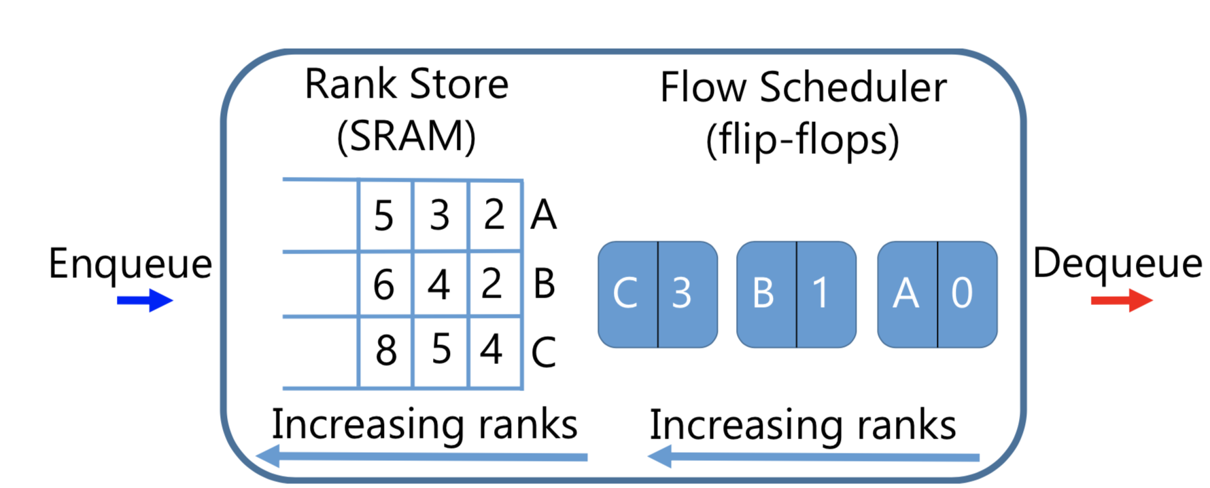
Implementation: Flow-level PIFOs

Slide 28
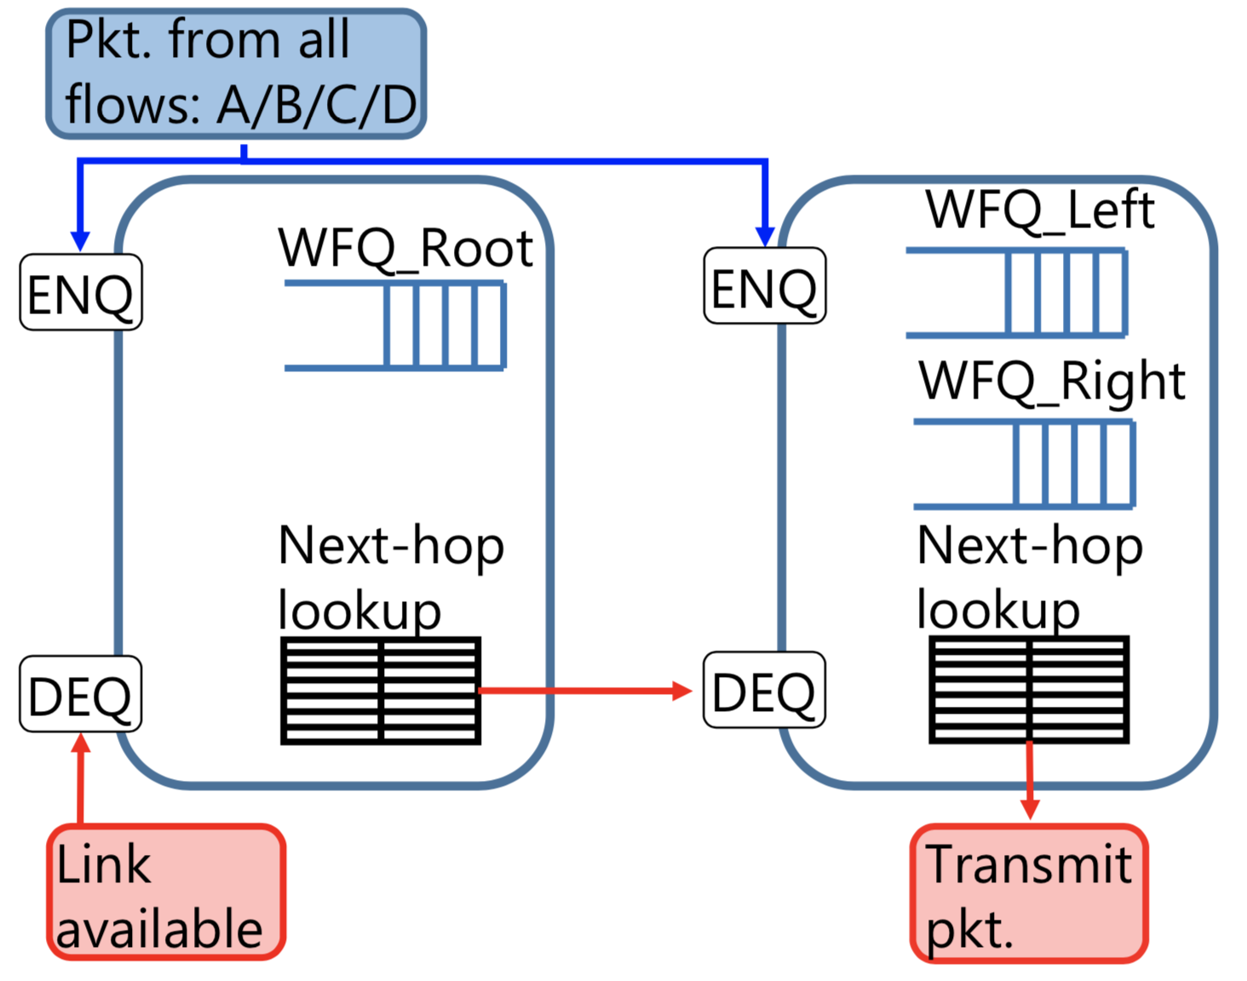
Encoding HPFQ in a PIFO mesh

Slide 30
Fair Queueing
ACM SIGCOMM ’89
Alan Demers, Srinivasan Keshav, and Scott Shenker

Slide 31
An ideal to emulate: Processor sharing
Fair-share bandwidth in the most fine-grained fashion possible
If there are N active flows, each flow gets 1/N^{th} of the link rate
“Bit by bit round robin” (BR)
Implementing BR directly on routers is unrealistic. Why?
One reason: consider the processing of the bit downstream
E.g., where to route the bit?
…

Slide 32
Emulate bit-by-bit round robin (BR)?
How about round robin over packets?
Unfair! A flow can use larger packets and gain larger bandwidth
Instead, determine when a packet would finish with BR
Depends only on packet arrival time & # of active flows
Let’s call this the “virtual finish time”
FQ: Transmit packets in the order of the virtual finish times
Buffer management: drop pkt of the flow with the largest backlog

Slide 33
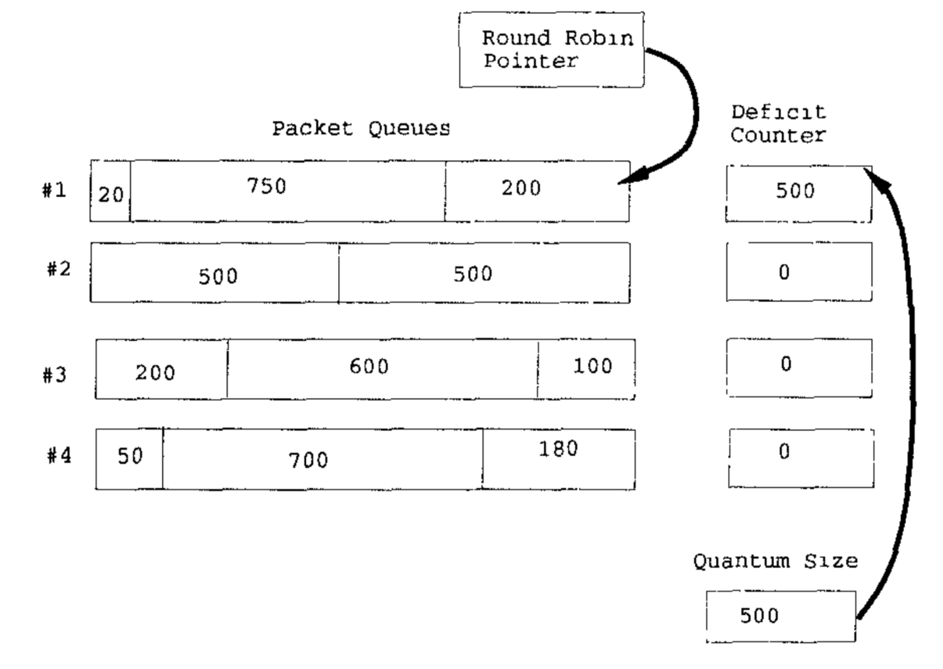
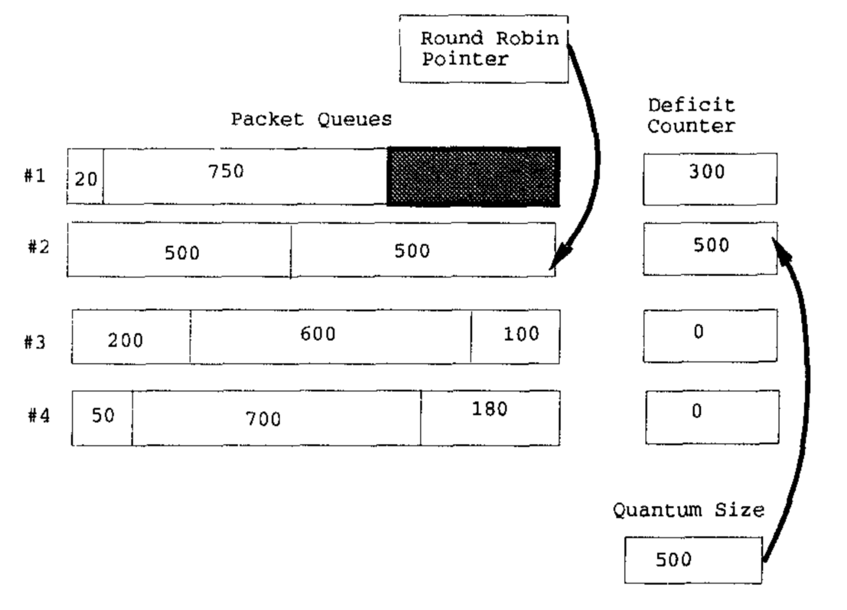
Deficit Round Robin
Router-friendly implementation of a WFQ scheme

