Slide 1

Wide-Area Congestion Control
Lecture 19, Computer Networks (198:552)
Fall 2019
Notes:
Slide material heavily adapted courtesy of Albert Greenberg, Changhoon Kim, Mohammad Alizadeh.

Slide 2
Review: TCP congestion control
Keep some in-flight (un-ACK’ed) packets: congestion window
Adjust window based on several algorithms:
Startup: slow start
Steady state: AIMD
Loss: fast retransmission, fast recovery
Window versus rate-based protocols

Slide 3
Queue Dynamics with TCP
Steady-state behavior

Slide 4


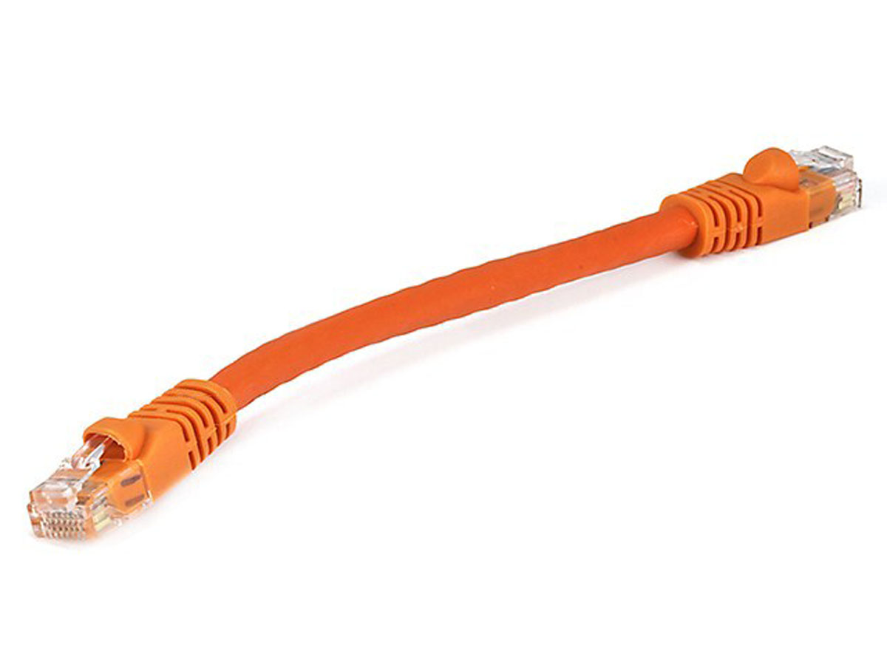

Network model
Propagation delay RT_{prop}
Queuing delay
Bottleneck queue
(max size B)
Link rate C
Single flow
Packet-switched core network

Slide 5
Sender behavior at steady state
Congestion avoidance: Additive increase, multiplicative decrease (AIMD)
Steady state isn’t static: lose pkts, grow cwnd, lose pkts, …
Loss
Congestion
Window
halved
time

Slide 6
Sender behavior at steady state
How does the queue size at the bottleneck look, over time?
Case 1: B = C * RT_{prop}
Case 2: B > C * RT_{prop}
Case 3: B < C * RT_prop
Loss
Congestion
Window
halved
time

Slide 7
Network model
Propagation delay RT_{prop}
Queuing delay
Bottleneck queue
(max size B)
Link rate C
A few flows (say 3—4)
Packet-switched core network
Q: how does queue size look now?

Slide 8
Network model
Propagation delay RT_{prop}
Queuing delay
Bottleneck queue
(max size B)
Link rate C
Many flows (say hundreds)
Packet-switched core network
Q: how does queue size look now?

Slide 9
How big should router buffers be?
Classic buffer-sizing rule: B = C * RT_{prop}
BDP buffer
Single TCP flow halving its window still gets a throughput of 100% link rate
Q: should buffers be BDP-sized?
Significant implications:
Massive pkt buffers (e.g., 40 Gbit/s with 200ms RT_{prop}): high cost
Massive pkt delays: bufferbloat

Slide 10
TCP BBR

Slide 11
Key ideas
Propagation delay RT_{prop}
Queuing delay
Bottleneck queue
(max size B)
Link rate C
Single flow
1. Estimate the bottleneck link rate C
2. Estimate the propagation delay RT_{prop}
3. Send at rate C with at most k * C * RT_{prop} packets in flight
Pros and Cons?

Slide 12
(1) Estimating the bottleneck link rate
Data can’t be delivered to a receiver faster than the bottleneck link rate
Measure the data delivery rate
And use the maximum value over the recent past
Important: measurements time out after a certain period
Occasionally send higher (PROBE_BW cycling) to see if changed
Q: how would you measure delivery rate at the receiver?
Q: how would you measure delivery rate at the sender?

Slide 13
Measuring delivery rate at the sender
Data that is unACKed at the time of transmitting packet
Packets
Normal case: All that data (and only that data) is ACKed by this point
ACKs
unACKed data at pkt transmit time
Round trip time between pkt-ACK

Slide 14
Quirk: Often, ACKs are “aggregated”
More data appears to be in flight than there actually is
Packets
Idea: use minimum of sent rate and received rate
ACKs
Q: how would you measure the rate at which data was sent?
(Note: packets of received data and sent data must be the same)

Slide 15
(2) Estimating RT_{prop}
Use the minimum of the RTT values experienced so far
If you’re sending at high rate, it is difficult to see the true RT_{prop} of the path
Q: why?
Occasionally send just a few packets in an RTT to measure RT_{prop} (PROBE_RTT cycling)
Also allows achieving fairness among BBR flows

Slide 16
Issues specific to wide-area

Slide 17
The Internet: Many things to consider…
Bufferbloat
Token-bucket policers
Cellular base station scheduling
Sometimes compete with few streams, sometimes many
Delayed and aggregated ACKs (WiFi)
Coexisting with legacy protocols (e.g., Cubic)

