Slide 1

Memory Virtualization

Slide 2
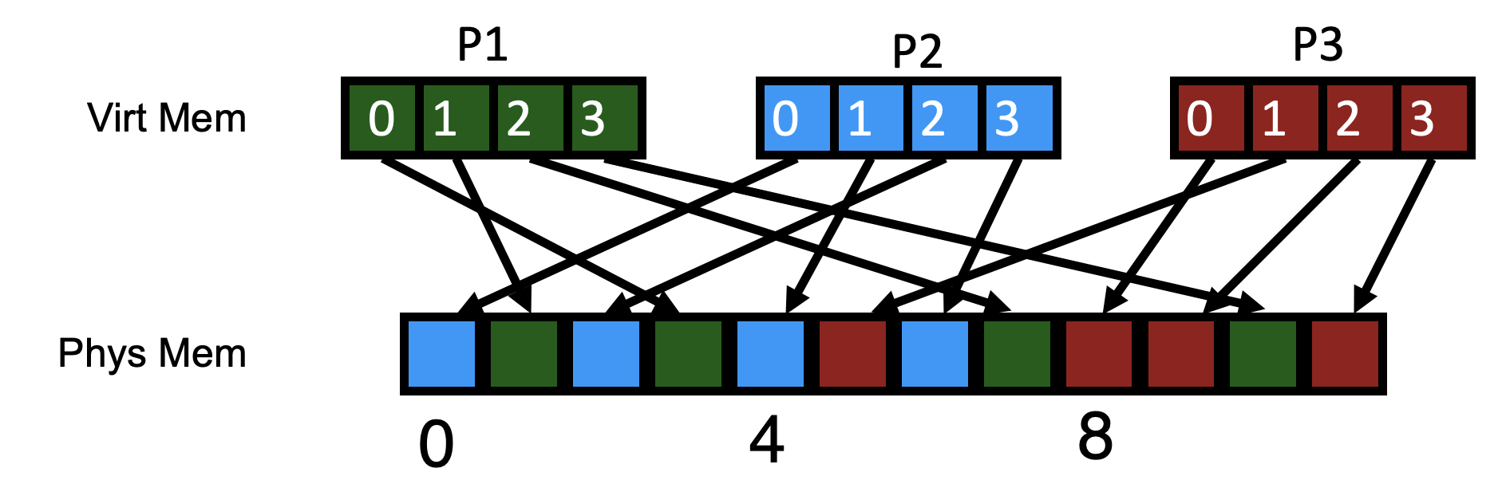
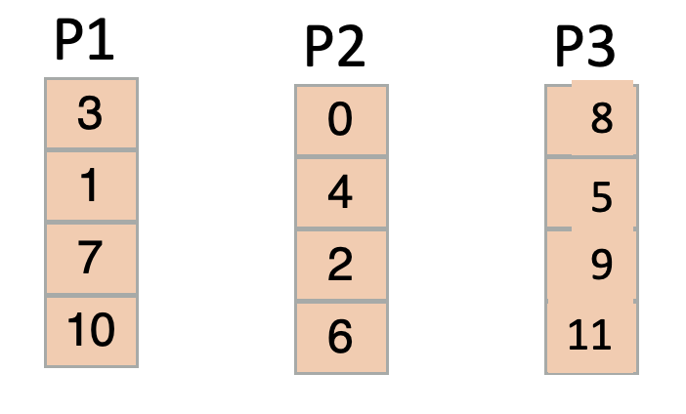
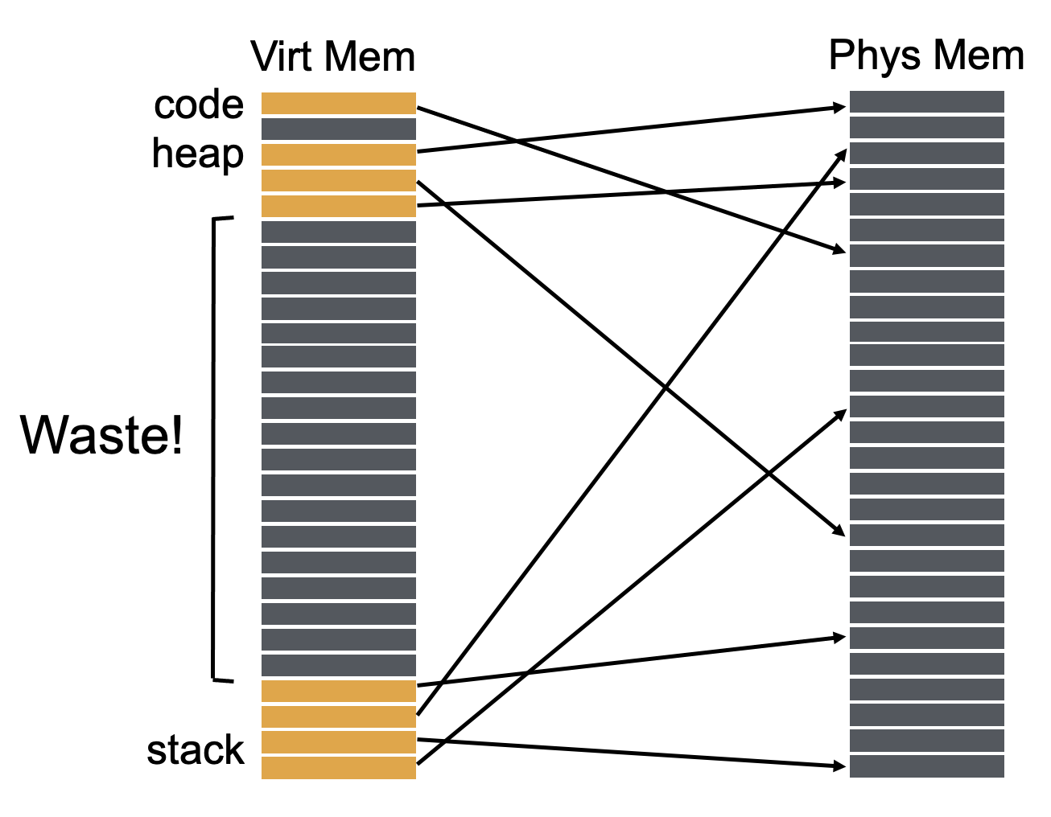
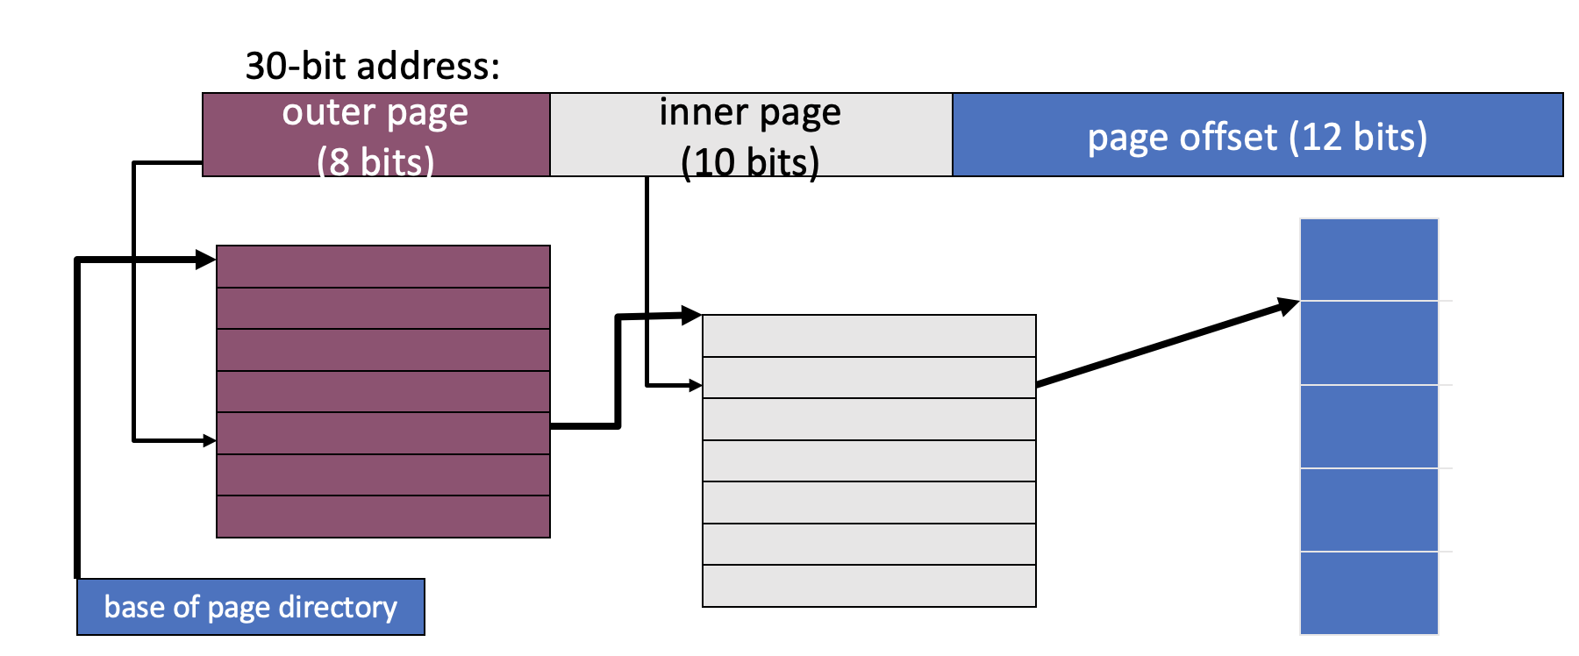
Use of a page table doubles memory references
Sparse PTEs
Valid PTEs are continuous

Slide 3
Address format for Multilevel Paging
30-bit address:
outer page
inner page
page offset (12 bits)
How should logical address be structured?
How many bits for each paging level?
Goal?
Each page table fits within a page
PTE size * number PTE = page size
Assume PTE size = 4 bytes
Page size = 2^12 bytes = 4KB
number PTE per page = (2^12 bytes per page) / (4 bytes per PTE)
→ number PTE = 2^10
→ # bits for selecting inner page = 10
Remaining bits for outer page:
30 – 10 – 12 = 8 bits

Slide 4
Problem with 2 levels?
Problem: page directory (outer level) may not fit in a page!
Solution:
Split page directories into pieces
Use another page dir to refer to the pieces of the page directory
64-bit address:
outer page? (N bits)
inner page
(10 bits)
page offset (12 bits)
VPN
PD idx 0
PD idx 1
PT idx
OFFSET
How large is virtual address space with 4 KB pages, 4 byte PTEs, each page table fits in page, given 1, 2, 3 levels?
4KB / 4 bytes → 1K entries per level
1 level: 1K * 4K = 2^22 = 4 MB
2 levels: 1K * 1K * 4K = 2^32 ≈ 4 GB
3 levels: 1K * 1K * 1K * 4K = 2^42 ≈ 4 TB

Slide 5
Review: Paging pros and cons
Advantages
No external fragmentation
don’t need to find contiguous RAM
All free pages are equivalent
Easy to manage, allocate, and free pages
Disadvantages
Page tables can get big
Must have one entry for every page of address space
Accessing page tables is too slow [address this shortly]
Doubles the number of memory references per instruction

Slide 6
Translation Steps
H/W: for each mem reference: 1. extract VPN (virt page num) from VA (virt addr) 2. calculate addr of PTE (page table entry) 3. read PTE from memory 4. extract PFN (page frame num) 5. build PA (phys addr) 6. read contents of PA from memory into register
(cheap)
(cheap)
(expensive)
(cheap)
(cheap)
(expensive)
Which steps are expensive?
Which expensive step(s) can we (not) avoid?
3) Let’s try to avoid having to read PTE from memory!

Slide 7
Translation Lookaside Buffers
How can page translations be made faster?
What is the basic idea of a TLB (Translation Lookaside Buffer)?
What types of workloads perform well with TLBs?
How do TLBs interact with context-switches?

Slide 8
Example: Array Iterator
int sum = 0;
for (i=0; i<N; i++){ sum += a[i];
}
Assume ‘a’ starts at 0x3000
Ignore instruction fetches
What virtual addresses?
What physical addresses?
load 0x3000
load 0x3004
load 0x3008
load 0x300C …
load 0x100C load 0x7000 load 0x100C load 0x7004 load 0x100C load 0x7008 load 0x100C load 0x700C
Observation: Repeatedly access same PTE because program repeatedly accesses same virtual page

Slide 9
Strategy: Cache Page Translations
We couldn’t store entire page table in MMU, but we can store a fast cache
CPU MMU
RAM
PT
Translation Cache
Some popular entries
memory interconnect
TLB: Translation Lookaside Buffer

Slide 10
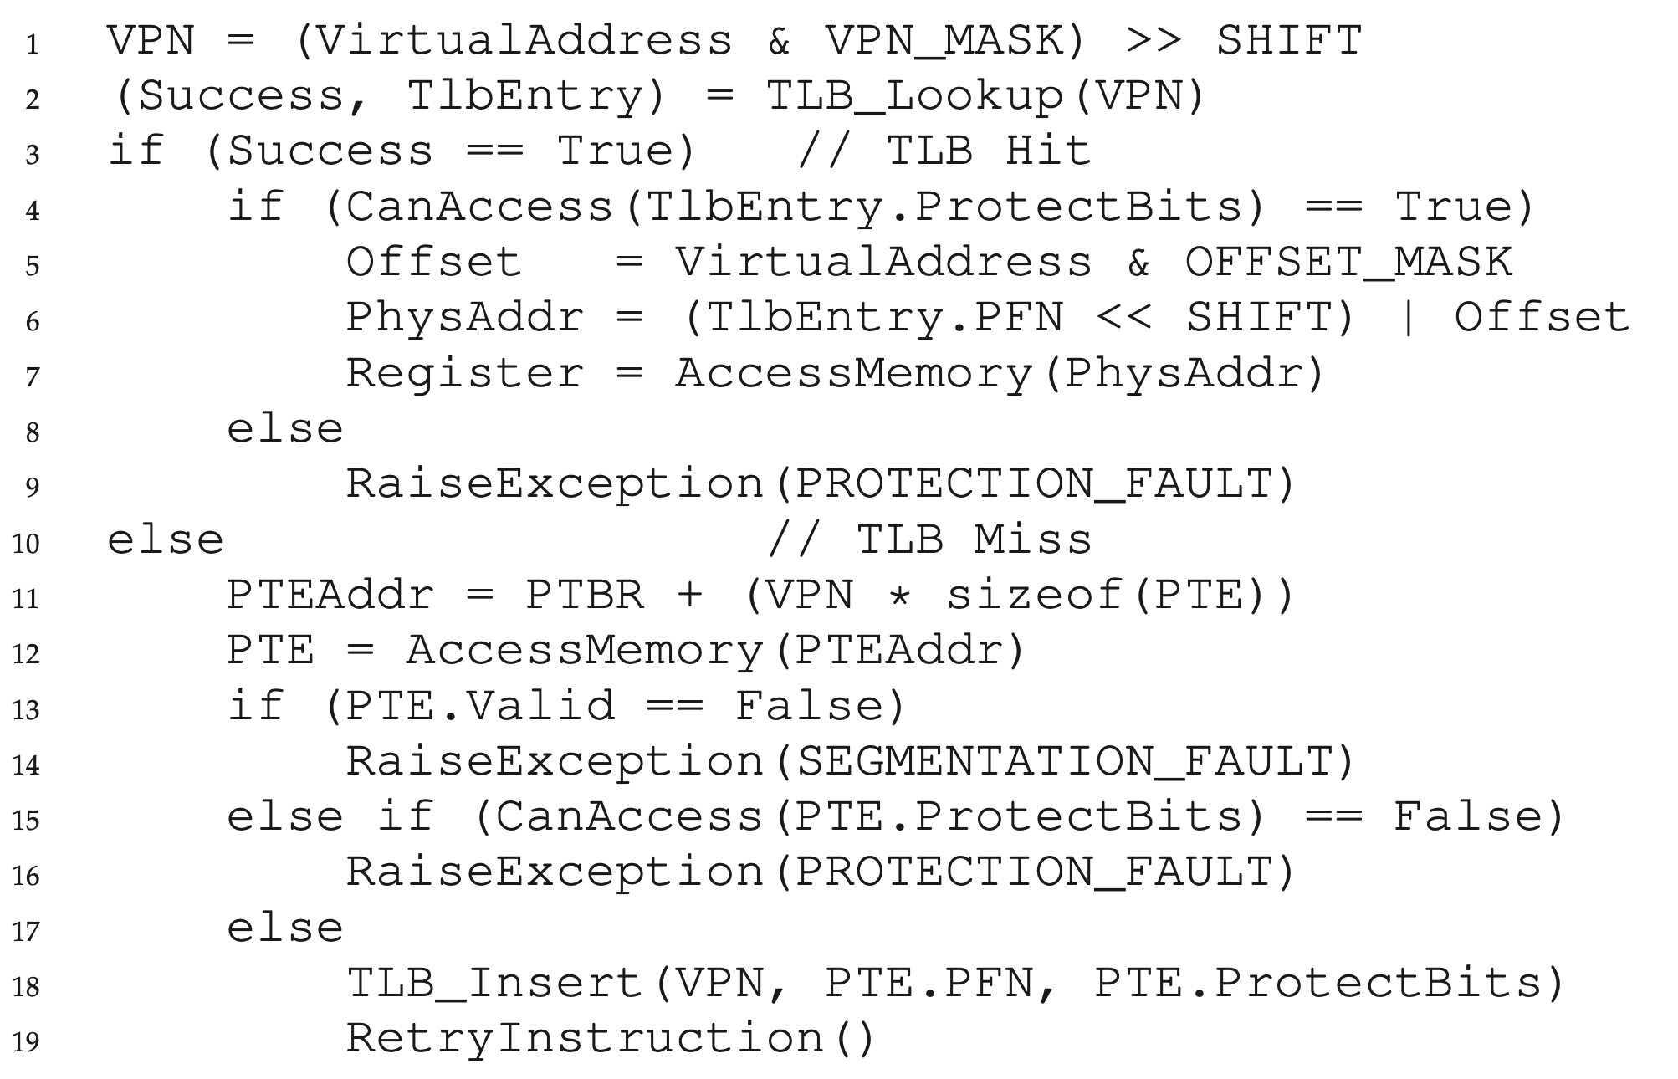
TLB Control Flow
// assume simple linear page table

Slide 11
TLB Control Flow
// assume simple linear page table

Slide 12
TLB Control Flow
// assume simple linear page table

Slide 13
TLB Control Flow
// assume simple linear page table

Slide 14
TLB Control Flow
// assume simple linear page table

Slide 15
TLB Control Flow
// assume simple linear page table

Slide 16
TLB Organization
TLB Entry
Tag (virtual page number)
Physical page number (page table entry)
A
0
1
2
3
4
5
6
7
8
9
10
11
12
13
14
15
Lookup
Calculate set (tag % num_sets)
Search for tag within resulting set
Where is VPN (tag) 18 located?
2
Direct mapped (num sets = 16)

Slide 17
TLB Organization
TLB Entry
Tag (virtual page number)
Physical page number (page table entry)
A
0
1
2
3
4
5
6
7
8
9
10
11
12
13
14
15
A
B
C
D
0
1
2
3
Index
Four-way set associative
Set
More in Computer Architecture Class
Two-way set associative
A
B
C
D
E
L
M
N
O
P
Direct mapped
Fully associative

Slide 18
TLB Associativity Trade-offs
Higher associativity
+ Better utilization, fewer collisions
Slower
More hardware
Lower associativity
+ Fast
+ Simple, less hardware
Greater chance of collisions
TLBs are usually fully associative

Slide 19
Array Iterator (with TLB)
int sum = 0;
for (i = 0; i < 2048; i++){ sum += a[i];
}
Assume following virtual address stream:
load 0x1000 load 0x1004 load 0x1008 load 0x100C …
What will TLB behavior look like?

Slide 20
TLB Accesses: Sequential Example
Virtual
Physical
0 KB
PTBR
load 0x1000
load 0x1004
load 0x1008
load 0x100c
…
load 0x2000
load 0x2004
load 0x0004
load 0x5000
(TLB hit)
load 0x5004
(TLB hit)
load 0x5008
(TLB hit)
load 0x500C …
load 0x0008
load 0x4000
(TLB hit)
load 0x4004
Page Table
4 KB
P1
P1 pagetable
8 KB
1
5
4
…
P2
0
1
2
3
12 KB
P2
CPU’s TLB
16 KB
P1
Valid | VPN | PPN
20 KB
P1
1
1
5
24 KB
1
2
4
P2
28 KB

Slide 21
Performance Of TLB?
int sum = 0; for (i=0; i<2048; i++) { sum += a[i]; }
Miss rate?
2/2048 = 0.1%
Hit rate? (1 – miss rate)
99.9%
Would hit rate get better or worse with smaller pages?
Worse
Calculate miss rate of TLB for data:
# TLB misses / # TLB lookups
# TLB lookups?
= number of accesses to a = 2048
# TLB misses?
= number of unique pages accessed
= 2048 / (elements of ‘a’ per 4K page)
= 2K / (4K / sizeof(int)) = 2K / 1K = 2

Slide 22
TLB Performance
How can system improve TLB performance (hit rate) given fixed number of TLB entries?
Increase page size
Fewer unique page translations needed to access same amount of memory
TLB “reach” in terms of physical memory size:
Number of TLB entries * Page Size
“Huge pages” used in many real systems.

Slide 23
TLB Performance with Workloads
Sequential array accesses almost always hit in TLB
Very fast!
What access pattern will be slow?
Highly random, with no repeat accesses

Slide 24
Workload Access Patterns
Workload A
Workload B
int sum = 0;
for (i=0; i<2048; i++) { sum += a[i];
}
int sum = 0; srand(1234); for (i=0; i<1000; i++) { sum += a[rand() % N]; } srand(1234); for (i=0; i<1000; i++) { sum += a[rand() % N]; }

Slide 25
Workload Access Patterns
Spatial Locality
Workload A
Sequential Accesses
int sum = 0;
for (i=0; i<2048; i++) { sum += a[i];
}
address
…
time

Slide 26
Workload Access Patterns
Temporal Locality
Workload B
Repeated Accesses (even if random locations)
int sum = 0; srand(1234); for (i=0; i<1000; i++) { sum += a[rand() % N]; } srand(1234); for (i=0; i<1000; i++) { sum += a[rand() % N]; }
address
…
time

Slide 27
Workload Locality
Spatial Locality: future access will be to nearby addresses
Temporal Locality: future access will be repeats to the same data
What TLB characteristics are best for each type?
Spatial:
Access same page repeatedly; need same VPN → PFN translation
Same TLB entry re-used
Temporal:
Access same address near in future
Same TLB entry re-used in near future
How near in future? How many TLB entries are there?

Slide 28
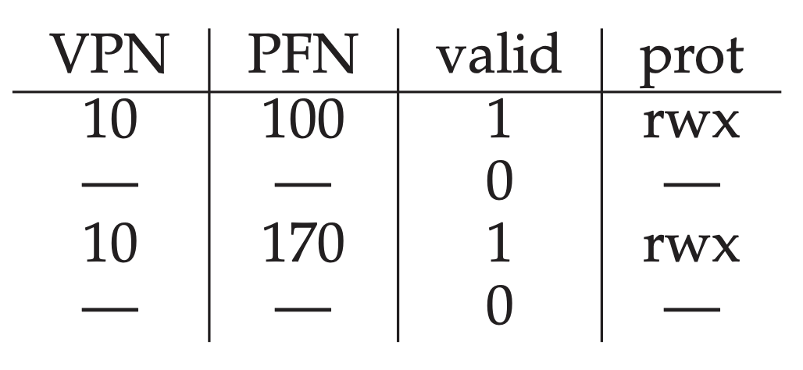
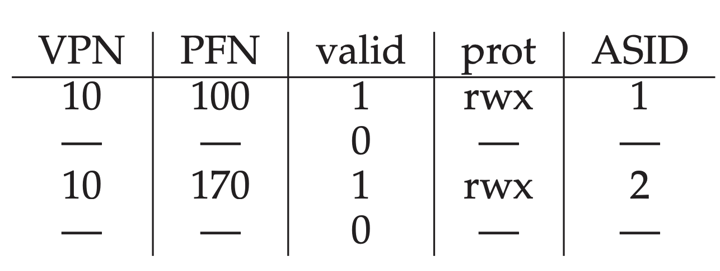
Differentiating processes
So far, we assumed VPNs are unique. They are not (across multiple processes)!
Option 1: Flush TLBs upon every context switch (valid = 0)
Problem: poor performance after each context switch
Option 2: Attach “address space identifier” to TLB entry

Slide 29
A full system with TLBs
On TLB miss: lookups with more paging levels more expensive
How much does a miss cost?
ASID | VPN | PFN | Valid
211 | 0xbb | 0x91 | 1
211 | 0xff | 0x23 | 1
122 | 0x05 | 0x91 | 1
211 | 0x05 | 0x12 | 0
Assume 3-level page table, 256-byte pages, 16-bit addresses
Assume ASID of current process is 211
How many physical accesses for each instruction?
^{(a) 0xAA10: movl 0x1111, %edi}
^{(b) 0xBB13: addl $0x3, %edi}
^{(c) 0x0519: movl %edi, 0xFF10}
0xaa: (TLB miss -> 3 for addr trans) + 1 instr fetch
Total: 8
0x11: (TLB miss -> 3 for addr trans) + 1 movl
0xbb: (TLB hit -> 0 for addr trans) + 1 instr fetch from 0x9113
Total: 1
0x05: (TLB miss -> 3 for addr trans) + 1 instr fetch
Total: 5
0xff: (TLB hit -> 0 for addr trans) + 1 movl into 0x2310

Slide 30
Summary: Better page tables
Problem: Simple linear page tables require too much contiguous memory
Many options for efficiently organizing page tables
If OS traps on TLB miss, OS can use any data structure
e.g., inverted page tables
If Hardware handles TLB miss, page tables must follow specific data structure that hardware knows how to “walk”
Multi-level page tables used in x86 architecture
Each page table must fit within a page
Next Topic: What if desired address spaces do not fit in physical memory?

Slide 31
Virtual Memory
RUTGERS UNIVERSITY Computer Sciences Department
Sudarsun Kannan
CS 416 + 518 Operating Systems Design
Questions answered:
How to run process when not enough physical memory?
When should a page be moved from disk to memory?
What page in memory should be replaced?
How can the LRU page be approximated efficiently?

Slide 32
Motivation
OS goal: Support processes when not enough physical memory
Single process with very large address space
Multiple processes with combined address spaces
User code should be independent of amount of physical memory
Correctness, if not performance
Virtual memory: OS provides illusion of more physical memory
How could we make such an illusion work?
We rely on key properties of user processes (workload) and machine architecture (hardware)

Slide 33
code
data
Program
Virtual Memory

Slide 34
Virtual Memory
code
data
Program
create
code data
heap
stack
Process 1

Slide 35
Virtual Memory
code
data
Program
create
code data
heap
stack
Process 1
what’s in code?

Slide 36
Virtual Memory
data
Program
create
LibA
LibB
LibA
LibB
data
heap
stack
Process 1
LibC
Prog
LibC
Prog
many large libraries, some
of which are rarely/never used
How to avoid wasting physical pages to back rarely used virtual pages?

Slide 37
Virtual Memory
LibA
LibB
data
heap
stack
Process 1
data
Program
Disk
LibA
LibB
LibC
Prog
LibC
Prog
Phys Memory
LibC
Prog

Slide 38
Virtual Memory
LibA
LibB
data
heap
stack
Process 1
data
Program
Disk
LibA
LibB
LibC
Prog
LibC
Prog
LibC
Prog
Phys Memory

Slide 39
Virtual Memory
LibA
LibB
data
heap
stack
Process 1
data
Program
Disk
LibA
LibB
LibC
Prog
LibC
Prog
access LibB
LibC
Prog
Phys Memory

Slide 40
Virtual Memory
LibA
LibB
data
heap
stack
Process 1
data
Program
Disk
LibA
LibB
copy (or move)
to main memory
LibC
Prog
LibC
Prog
LibC
Prog
LibB
Phys Memory

Slide 41
Virtual Memory
LibA
LibB
data
heap
stack
Process 1
data
Program
Disk
LibA
LibB
LibC
Prog
Called “paging” in
LibC
Prog
LibC
Prog
LibB
Phys Memory

Slide 42
Locality of Reference
Effectively: Using main memory as a cache of process virtual memory contents located on disk
Leverage locality of reference within processes
Spatial: reference memory addresses near previously referenced addresses
Temporal: reference memory addresses that have referenced in the past
Processes spend majority of time in small portion of code
For example: 90% of time in 10% of code
Implication:
Process only uses small amount of address space at any moment
Only small amount of address space must be resident in physical memory

Slide 43
Memory Hierarchy
Leverage memory hierarchy of machine architecture
Each layer acts as “backing store” for layer above
size
speed
cost
registers
caches
main memory
disk storage

Slide 44
Virtual Memory Intuition
Idea: OS keeps unreferenced pages on disk
Slower, cheaper backing store than memory
Process can run when not all pages are loaded into main memory
OS and hardware cooperate to provide illusion of large disk as fast as main memory
Same behavior as if all of address space in main memory
Hopefully have similar performance
Requirements:
OS must have mechanism to identify location of each page in address space either in memory or on disk
OS must have policy for determining which pages live in memory and which on disk

Slide 45
Virtual Address Space Mechanisms
Each page in virtual address space maps to one of three locations:
Physical main memory: Small, fast, expensive
Disk (backing store): Large, slow, cheap
Nothing (error): Free
Extend page tables with an extra bit: present
permissions (r/w), valid, present
Page in memory: present bit set in PTE
Page on disk: present bit cleared
PTE with cleared present bit points to block on disk
Causes trap into OS when page is referenced
Trap: page fault

Slide 46
Present Bit
Disk
PFN valid prot present
10 1 r-x 1
- 0 - -
23 1 rw- 0
- 0 - -
- 0 - -
- 0 - -
Phys Memory
- 0 - -
- 0 - -
- 0 - -
- 0 - -
- 0 - -
16 1 rw- 1
28 1 rw- 0
// VPN 0xb
4 1 rw- 1
What if access vpn 0xb?

Slide 47
Virtual Memory Mechanisms
Hardware and OS cooperate to translate addresses
First, hardware checks TLB for virtual address
if TLB hit, address translation is done; page in physical memory
If TLB miss...
Hardware or OS walk page tables
If PTE designates page is present, then page in physical memory

Slide 48
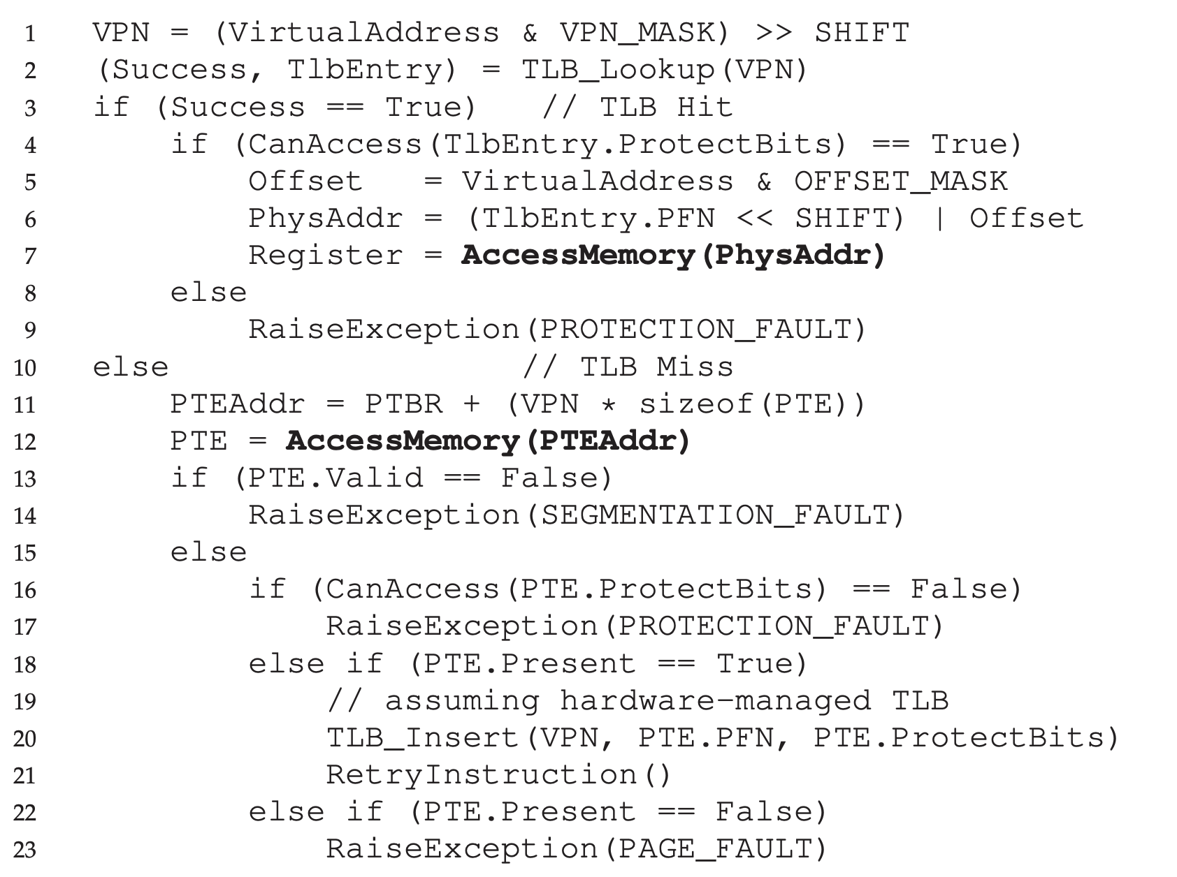
Hardware memory access: Control flow

Slide 49
Hardware memory access: Control flow

Slide 50
Hardware memory access: Control flow

Slide 51
Virtual Memory Mechanisms
If page fault (i.e., present bit is cleared)
Trap into OS (not handled by hardware. Why?)
OS selects victim page in memory to replace
Write victim page out to disk if modified. Add modified (“dirty”) bit to PTE
OS reads referenced page from disk into memory
Page table is updated, present bit is set
Process continues execution
What should scheduler do?

