Slide 1

Paging

Slide 2
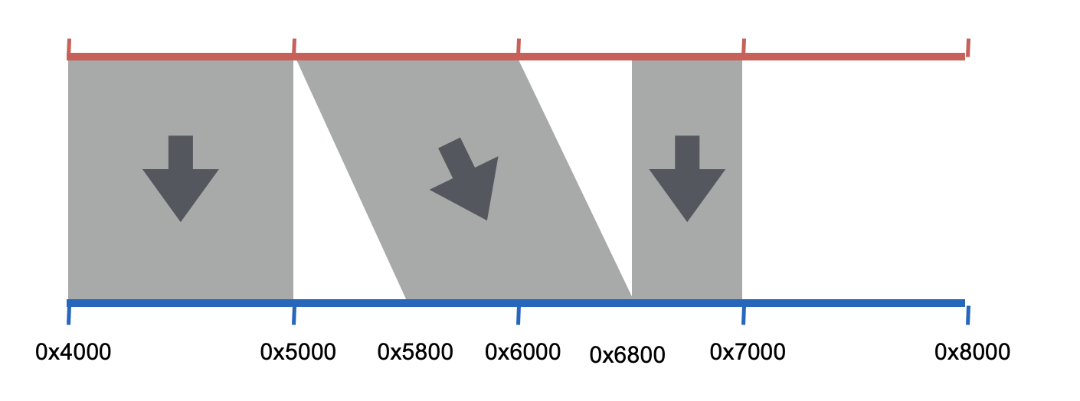
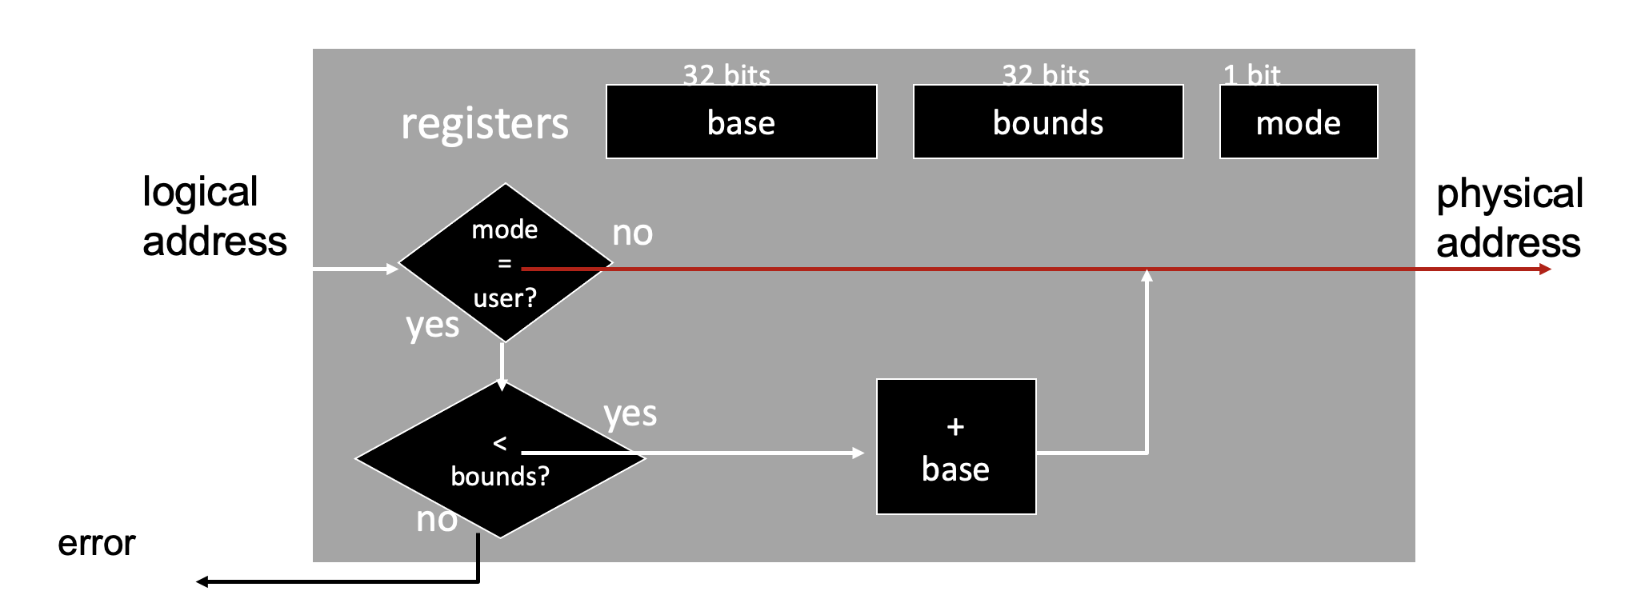
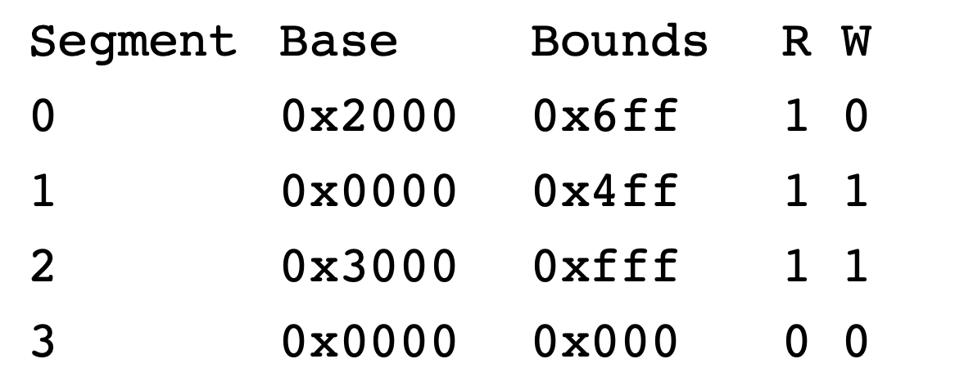
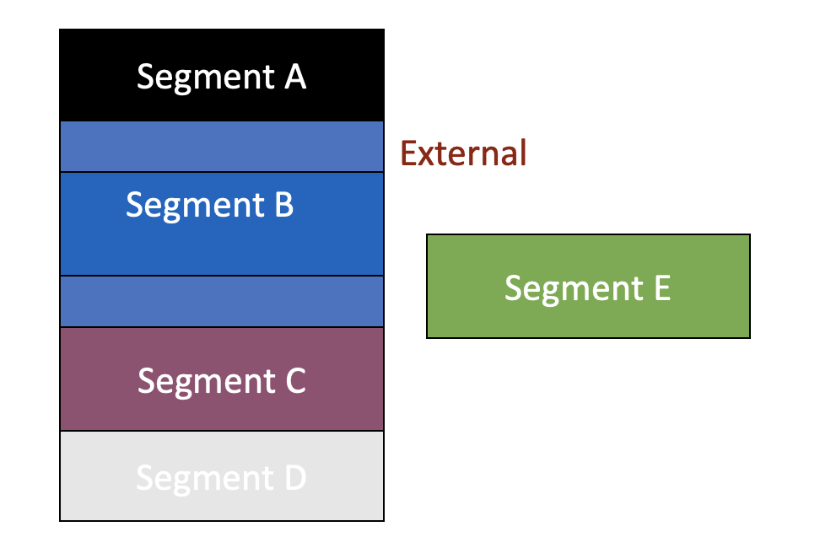
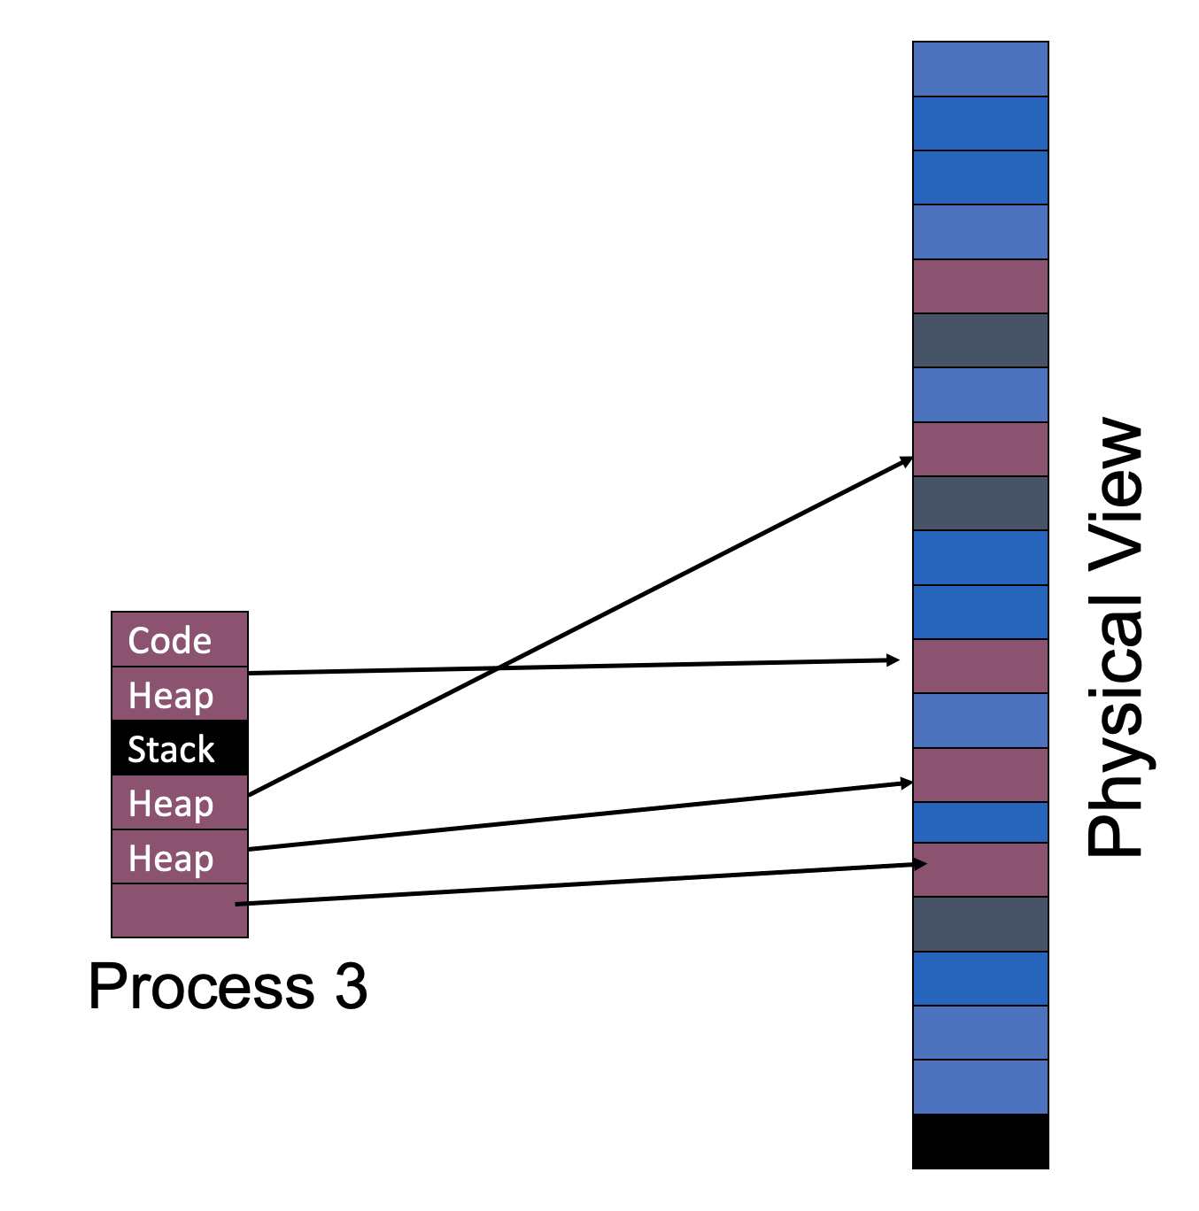
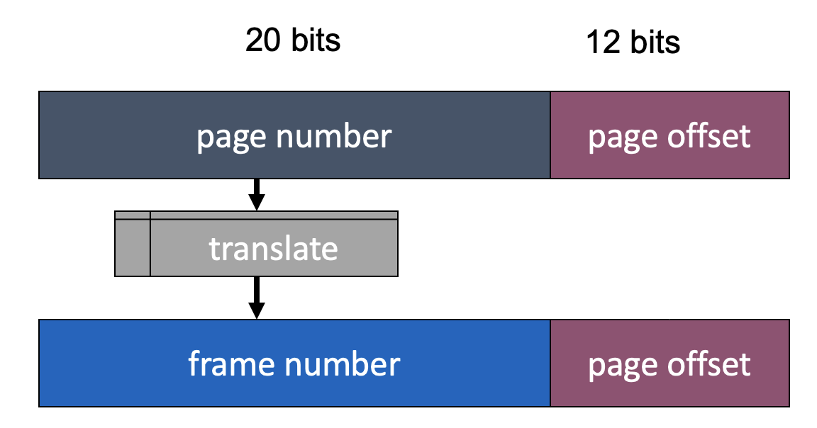
Review
Virtual addresses
Base + Bounds
Physical addresses
External Fragmentation
VPN to PFN Translation
Paging

Slide 3
Virtual => Physical PAGE Mapping
VPN
offset
Number of bits in virtual address format does not need to equal
number of bits in physical address format
0
1
0
1
0
1
Address Mapper
1
0
1
1
0
1
0
1
PPN
offset
How should OS translate VPN to PPN?
For segmentation, OS used a formula (e.g., phys addr = virt_offset + base_reg)
For paging, OS needs more general mapping mechanism
What data structure is good?
Big array: page table

Slide 4
The Mapping
P1
P2
P3
Virt Mem
Phys Mem

Slide 5
Let’s fill in the Page Table
P1
P2
P3
Virt Mem
0
1
2
3
0
1
2
3
0
1
2
3
Virt Mem
Phys Mem
Phys Mem
0
1
2
3
4
8
0
4
5
6
7
8
9
10
11
P1
P2
P3
3
0
8
Page Tables:
1
4
5
7
2
9
10
6
11

Slide 6
Where are page tables stored?
Ideally, put it in fast hardware (MMU)…
How big is a typical page table? - assume 32-bit address space - assume 4 KB pages - assume 4 byte entries
Page table size = Num entries * size of each entry
Num entries = num virtual pages = 2^(bits for vpn)
Bits for vpn = 32– number of bits for page offset
= 32 – lg(4KB) = 32 – 12 = 20
Num entries = 2^20 = 1 MB
Page table size = Num entries * 4 bytes = 4 MB per process

Slide 7
Where are page tables stored?
Implication: Store each page table in memory
Hardware finds page table base with register (e.g., CR3 on x86)
What happens on a context-switch?
Change contents of page table base register to newly scheduled process
Save old page table base register in PCB of descheduled process

Slide 8
Other PT info
What other info is in pagetable entries besides translation?
valid bit
protection bits
present bit (needed later)
reference bit (needed later)
dirty bit (needed later)
Page table entries are just bits stored in memory
Agreement between hardware and OS about interpretation

Slide 9
Memory Accesses with Pages
0x0010: movl 0x1100, %edi
0x0013: addl $0x3, %edi
0x0019: movl %edi, 0x1100
Earlier: How many mem refs with segmentation?
5 (3 instrs, 2 movl)
Physical Memory Accesses with Paging?
1) Fetch instruction at logical addr 0x0010; vpn?
Access page table to get ppn for vpn 0
Mem ref 1: 0x5000
Learn vpn 0 is at ppn 2
Fetch instruction at 0x2010 (Mem ref 2)
Exec, load from logical addr 0x1100; vpn?
Access page table to get ppn for vpn 1
Mem ref 3: 0x5004
Learn vpn 1 is at ppn 0
Movl from 0x0100 into reg (Mem ref 4)
Assume PT is at phys addr 0x5000
Assume PTE’s are 4 bytes
Assume 4KB pages
How many bits for offset?
12
Simplified view of page table
2
0
80
99
Use of a page table doubles memory references

Slide 10
Advantages of Paging
No external fragmentation
Any page can be placed in any frame in physical memory
Fast to allocate and free
Alloc: No searching for suitable free space
Free: Doesn’t have to coallesce with adjacent free space
Just use bitmap to show free/allocated page frames
Simple to swap-out portions of memory to disk (later lecture)
Page size matches disk block size
Can run process when some pages are on disk
Add “present” bit to PTE

Slide 11
Disadvantages of Paging
Internal fragmentation: Page size may not match size needed by process
Wasted memory grows with larger pages
Additional memory references → time-inefficient!
Page table must be stored in memory
MMU stores only base address of page table
Storage for page tables substantial → space-inefficient!
Simple page table: Requires PTE for all pages in address space
Naively, page table entry needed even if page not allocated
Problematic with dynamic stack and heap within address space
Page tables must be allocated contiguously in memory
Due to linear access of page table entries
Code
Heap
Stack

Slide 12
Reducing Page Table sizes

Slide 13
How big are page tables?
PTE’s are 2 bytes, and 32 possible virtual page numbers
PTE’s are 2 bytes, virtual addrs are 24 bits, pages are 16 bytes
PTE’s are 4 bytes, virtual addrs are 32 bits, and pages are 4 KB
PTE’s are 4 bytes, virtual addrs are 64 bits, and pages are 4 KB
How big is each page table?
32 * 2 bytes = 64 bytes
2 bytes * 2^(24 – lg 16) = 2^21 bytes (2 MB)
4 bytes * 2^(32 – lg 4K) = 2^22 bytes (2 MB)
4 bytes * 2^(64 – lg 4K) = 2^54 bytes

Slide 14
Why ARE Page Tables so Large?
Virt Mem
Phys Mem
code
heap
Waste!
stack

Slide 15
Many invalid page table entries
Format of linear page tables:
PFN valid prot
10 1 r-x
- 0 -
- 0 -
- 0 -
- 0 -
- 0 -
how to avoid storing these?
…many more invalid…
- 0 -
- 0 -
- 0 -
- 0 -
28 1 rw-
4 1 rw-
23 1 rw-

Slide 16
Avoid the simple linear page table
Use more efficient (but complex) data structures, instead of the simple big array
Any data structure is possible in principle*
*assuming software managed TLB

Slide 17
Some approaches
Inverted Pagetables
Segmented Pagetables
Multi-level Pagetables
Page the page tables
Page the pagetables of page tables…

Slide 18
Approach 1: Inverted Page Table
Inverted Page Tables
Only need entries for virtual pages w/ valid physical mappings
Naïve approach: Search through data structure <ppn, vpn+ASID> to find match
Too much time to search entire table
Better: Find possible matches entries by hashing vpn+ASID
Smaller number of entries to search for exact match

Slide 19
Valid PTEs are Contiguous
PFN valid prot
10 1 r-x
- 0 -
Note “hole” in addr space: valids vs. invalids are clustered
How did OS avoid allocating holes in phys memory?
- 0 -
- 0 -
- 0 -
- 0 -
how to avoid storing these?
…many more invalid…
- 0 -
- 0 -
- 0 -
- 0 -
Use ideas from segmentation!
28 1 rw-
4 1 rw-
23 1 rw-

Slide 20
Approach 2: Segmented Page Tables
Divide address space into segments (code, heap, stack)
Segments can be variable length
Divide each segment into fixed-sized pages
Logical address divided into three portions
seg # (4 bits)
page number (8 bits)
page offset (12 bits)
Ideas
Each segment has a page table
Each segment tracks the base (physical address) and bounds of the page table for that segment

Slide 21
Combining Paging and Segmentation
seg # (4 bits)
page number (8 bits)
page offset (12 bits)
Page table
...
0x01f
0x011
0x003
0x02a
0x013
...
0x00c
0x007
0x004
0x00b
0x006
...
seg | base | bounds | R W
0 | 0x002000 | 0xff (255) | 1 0
1 | 0x000000 | 0x00 | 0 0
2 | 0x001000 | 0x0f (15) | 1 1
0x001000
0x002070 read:
0x202016 read:
0x104c84 read:
0x010424 write:
0x210014 write:
0x203568 read:
0x004070
0x003016
0x002000
error
error
error
0x02a568

Slide 22
Advantages of Segments
Supports sparse address spaces
Decreases size of page tables
If segment not used, not needed for page table
Advantages of Pages
No external fragmentation
Segments can grow without any reshuffling
Can run process when some pages are swapped to disk (next lecture)
Advantages of Both
Increases flexibility of sharing
Share either single page or entire segment. How?

Slide 23
Disadvantages of Paging with Segmentation
Potentially large page tables (for each segment)
Must allocate each page table contiguously
More problematic with more address bits
Page table size?
Assume 2 bits for segment, 18 bits for page number, 12 bits for offset
Each page table is:
= Number of entries * size of each entry
= Number of pages * 4 bytes
= 2^18 * 4 bytes = 2^20 bytes = 1 MB!!!

Slide 24
Other Approaches
Inverted Pagetables
Segmented Pagetables
Multi-level Pagetables
Page the page tables
Page the pages of page tables…

Slide 25
3) Multilevel Page Tables
Goal: Allow page tables to be allocated non-contiguously
Idea: Page the page tables
Creates multiple levels of page tables; outer level page directory
Only allocate page tables for pages in use
Used in x86 architectures (hardware can walk known structure)
30-bit address:
outer page (8 bits)
inner page (10 bits)
page offset (12 bits)
base of page directory

Slide 26
Multilevel example
page directory
page of PT (@PPN:0x3)
page of PT (@PPN:0x92)
VPN 0 1 2 - - - - - - - - - - - 15
PPN 0x3 - - - - - - - - - - - - -
0x92
valid 1 0 0 0 0 0 0 0 0 0 0 0 0 0 1
PPN 0x10 0x23 - - 0x80 0x59 - - - - - - - - -
valid 1 1 0 0 1 1 0 0 0 0 0 0 0 0 0
PPN - - - - - - - - - - - - - 0x55 0x45
valid 0 0 0 0 0 0 0 0 0 0 0 0 0 1 1
translate 0x01ABC
0x23ABC
translate 0x00000
0x10000
translate 0xFEED0
0x55ED0
20-bit address:
outer page (4 bits)
inner page (4 bits)
page offset (12 bits)

Slide 27
Address format for Multilevel Paging
30-bit address:
outer page
inner page
page offset (12 bits)
How should logical address be structured?
How many bits for each paging level?
Goal?
Each page table fits within a page
PTE size * number PTE = page size
Assume PTE size = 4 bytes
Page size = 2^12 bytes = 4KB
number PTE per page = (2^12 bytes per page) / (4 bytes per PTE)
→ number PTE = 2^10
→ # bits for selecting inner page = 10
Remaining bits for outer page:
30 – 10 – 12 = 8 bits

Slide 28
Problem with 2 levels?
Problem: page directory (outer level) may not fit in a page!
Solution:
Split page directories into pieces
Use another page dir to refer to the pieces of the page directory
64-bit address:
outer page?
inner page
(10 bits)
page offset (12 bits)
VPN
PD idx 0
PD idx 1
PT idx
OFFSET
How large is virtual address space with 4 KB pages, 4 byte PTEs, each page table fits in page given 1, 2, 3 levels?
4KB / 4 bytes → 1K entries per level
1 level: 1K * 4K = 2^22 = 4 MB
2 levels: 1K * 1K * 4K = 2^32 ≈ 4 GB
3 levels: 1K * 1K * 1K * 4K = 2^42 ≈ 4 TB

Slide 29
Review: Paging pros and cons
Advantages
No external fragmentation
don’t need to find contiguous RAM
All free pages are equivalent
Easy to manage, allocate, and free pages
Disadvantages
Page tables are too big
Must have one entry for every page of address space
Accessing page tables is too slow [address this shortly]
Doubles the number of memory references per instruction

Slide 30
Translation Steps
H/W: for each mem reference: 1. extract VPN (virt page num) from VA (virt addr) 2. calculate addr of PTE (page table entry) 3. read PTE from memory 4. extract PFN (page frame num) 5. build PA (phys addr) 6. read contents of PA from memory into register
(cheap)
(cheap)
(expensive)
(cheap)
(cheap)
(expensive)
Which steps are expensive?
Which expensive step(s) can we (not) avoid?
3) Let’s try to avoid having to read PTE from memory!

Slide 31
Translation Lookaside Buffers
How can page translations be made faster?
What is the basic idea of a TLB (Translation Lookaside Buffer)?
What types of workloads perform well with TLBs?
How do TLBs interact with context-switches? (if time permits)

Slide 32
Example: Array Iterator
int sum = 0;
for (i=0; i<N; i++){ sum += a[i];
}
Assume ‘a’ starts at 0x3000
Ignore instruction fetches
What virtual addresses?
What physical addresses?
load 0x3000
load 0x3004
load 0x3008
load 0x300C …
load 0x100C load 0x7000 load 0x100C load 0x7004 load 0x100C load 0x7008 load 0x100C load 0x700C
Observation: Repeatedly access same PTE because program repeatedly accesses same virtual page

Slide 33
Strategy: Cache Page Translations
CPU MMU
RAM
PT
Translation Cache
Some popular entries
memory interconnect
TLB: Translation Lookaside Buffer

Slide 34
TLB Organization
TLB Entry
Tag (virtual page number)
Physical page number (page table entry)
A
0
1
2
3
4
5
6
7
8
9
10
11
12
13
14
15
Lookup
Calculate set (tag % num_sets)
Search for tag within resulting set
Where is VPN (tag) 18 located?
2
Direct mapped (num sets = 16)

Slide 35
TLB Organization
TLB Entry
Tag (virtual page number)
Physical page number (page table entry)
A
0
1
2
3
4
5
6
7
8
9
10
11
12
13
14
15
A
B
C
D
0
1
2
3
Index
Four-way set associative
Set
More in Computer Architecture Class
Two-way set associative
A
B
C
D
E
L
M
N
O
P
Direct mapped
Fully associative

Slide 36
TLB Associativity Trade-offs
Higher associativity
+ Better utilization, fewer collisions
Slower
More hardware
Lower associativity
+ Fast
+ Simple, less hardware
Greater chance of collisions
TLBs usually fully associative

Slide 37
Array Iterator (with TLB)
int sum = 0;
for (i = 0; i < 2048; i++){ sum += a[i];
}
Assume following virtual address stream:
load 0x1000 load 0x1004 load 0x1008 load 0x100C …
What will TLB behavior look like?

Slide 38
TLB Accesses: Sequential Example
Virtual
Physical
0 KB
PTBR
load 0x1000
load 0x1004
load 0x1008
load 0x100c
…
load 0x2000
load 0x2004
load 0x0004
load 0x5000
(TLB hit)
load 0x5004
(TLB hit)
load 0x5008
(TLB hit)
load 0x500C …
load 0x0008
load 0x4000
(TLB hit)
load 0x4004
PT
PT
4 KB
P1
P1 pagetable
8 KB
1
5
4
…
P2
0
1
2
3
12 KB
P2
CPU’s TLB
16 KB
P1
Valid | VPN | PPN
20 KB
P1
1
1
5
24 KB
1
2
4
P2
28 KB

Slide 39
Performance Of TLB?
int sum = 0; for (i=0; i<2048; i++) { sum += a[i]; }
Miss rate?
2/2048 = 0.1%
Hit rate? (1 – miss rate)
99.9%
Would hit rate get better or worse with smaller pages?
Worse
Calculate miss rate of TLB for data:
# TLB misses / # TLB lookups
# TLB lookups?
= number of accesses to a = 2048
# TLB misses?
= number of unique pages accessed
= 2048 / (elements of ‘a’ per 4K page)
= 2K / (4K / sizeof(int)) = 2K / 1K = 2

Slide 40
TLB Performance
How can system improve TLB performance (hit rate) given fixed number of TLB entries?
Increase page size
Fewer unique page translations needed to access same amount of memory
TLB “reach” in terms of physical memory size:
Number of TLB entries * Page Size
“Huge pages” used in many real systems…

Slide 41
TLB Performance with Workloads
Sequential array accesses almost always hit in TLB
Very fast!
What access pattern will be slow?
Highly random, with no repeat accesses

Slide 42
Workload Access Patterns
Workload A
Workload B
int sum = 0;
for (i=0; i<2048; i++) { sum += a[i];
}
int sum = 0; srand(1234); for (i=0; i<1000; i++) { sum += a[rand() % N]; } srand(1234); for (i=0; i<1000; i++) { sum += a[rand() % N]; }

Slide 43
Workload Access Patterns
Spatial Locality
Workload A
Sequential Accesses
int sum = 0;
for (i=0; i<2048; i++) { sum += a[i];
}
address
…
time

Slide 44
Workload Access Patterns
Temporal Locality
Workload B
Repeated Random Accesses
int sum = 0; srand(1234); for (i=0; i<1000; i++) { sum += a[rand() % N]; } srand(1234); for (i=0; i<1000; i++) { sum += a[rand() % N]; }
address
…
time

Slide 45
Workload Locality
Spatial Locality: future access will be to nearby addresses
Temporal Locality: future access will be repeats to the same data
What TLB characteristics are best for each type?
Spatial:
Access same page repeatedly; need same VPN → PFN translation
Same TLB entry re-used
Temporal:
Access same address near in future
Same TLB entry re-used in near future
How near in future? How many TLB entries are there?

Slide 46
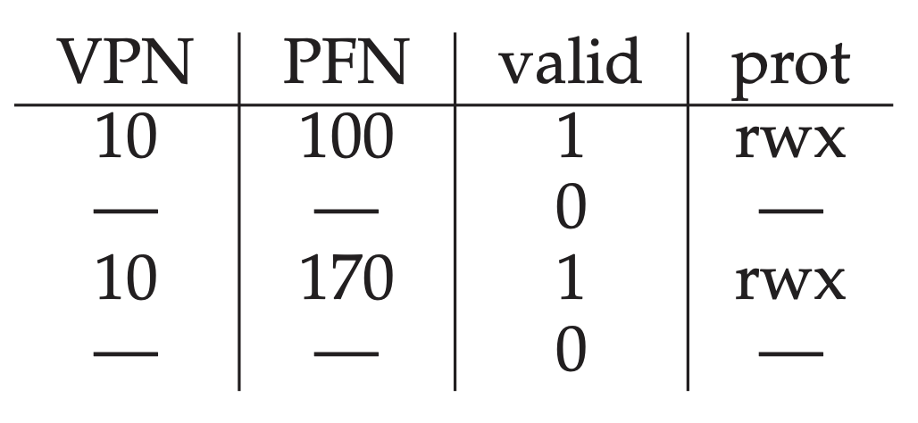
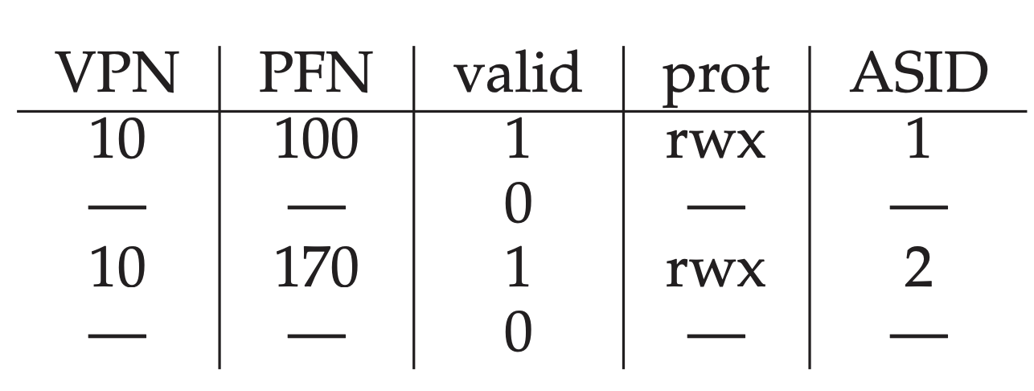
Differentiating processes
So far, we assumed VPNs are unique. They are not!
Option 1: Flush TLBs upon every context switch (valid = 0)
Problem: poor performance after each context switch
Option 2: Attach “address space identifier” to TLB entry

Slide 47
A full system with TLBs
On TLB miss: lookups with more paging levels more expensive
How much does a miss cost?
ASID | VPN | PFN | Valid
211 | 0xbb | 0x91 | 1
211 | 0xff | 0x23 | 1
122 | 0x05 | 0x91 | 1
211 | 0x05 | 0x12 | 0
Assume 3-level page table, 256-byte pages, 16-bit addresses
Assume ASID of current process is 211
How many physical accesses for each instruction?
^{(a) 0xAA10: movl 0x1111, %edi}
^{(b) 0xBB13: addl $0x3, %edi}
^{(c) 0x0519: movl %edi, 0xFF10}
0xaa: (TLB miss -> 3 for addr trans) + 1 instr fetch
Total: 8
0x11: (TLB miss -> 3 for addr trans) + 1 movl
0xbb: (TLB hit -> 0 for addr trans) + 1 instr fetch from 0x9113
Total: 1
0x05: (TLB miss -> 3 for addr trans) + 1 instr fetch
Total: 5
0xff: (TLB hit -> 0 for addr trans) + 1 movl into 0x2310

Slide 48
Summary: Better page tables
Problem: Simple linear page tables require too much contiguous memory
Many options for efficiently organizing page tables
If OS traps on TLB miss, OS can use any data structure
Inverted page tables (hashing)
If Hardware handles TLB miss, page tables must follow specific data structure that hardware knows how to “walk”
Multi-level page tables used in x86 architecture
Each page table must fit within a page
Next Topic: What if desired address spaces do not fit in physical memory?

